Slide 1


Aberdeen Python User Group
Join our Slack group to stay in touch http://bit.do/APSLACK

Slide 2
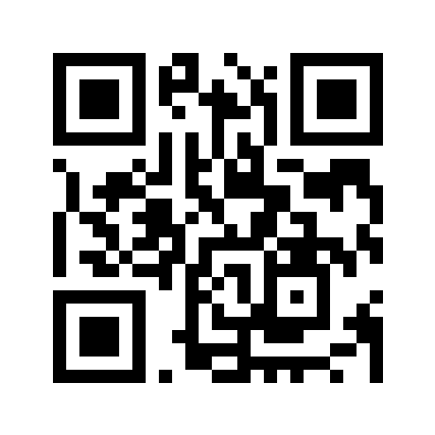
Aberdeen Python User Group Coming up …….
07 March 2023 – ADM – subject to be confirmed
08 March 2023 – APUG - subject to be confirmed
18-19 March 2023 – CTC28 Connections Hack Weekend
Details and ticket links for these on the https://codethecity.org homepage

Slide 3
“Create your own AI”
- Dr Lee Christie

Slide 4

Dr Lee A. Christie Feb 2023 APUG Workshop
@0x1ac@techhub.social

Slide 5
⚃ ⚃ ⚃ ⚃ ⚃
5-of-a-Kind
⚂ ⚃ ⚃ ⚃ ⚃
4-of-a-Kind
⚂ ⚂ ⚃ ⚃ ⚃
Full House

Slide 6
⚁ ⚂ ⚃ ⚄ ⚅
6 High Straight
⚀ ⚁ ⚂ ⚃ ⚄
5 High Straight
⚄ ⚂ ⚃ ⚃ ⚃
3-of-a-Kind

Slide 7
⚁ ⚁ ⚂ ⚂ ⚅
2 Pairs
⚀ ⚁ ⚂ ⚂ ⚄
Pair
⚀ ⚁ ⚂ ⚄ ⚅
Nothing

Slide 8
⚀ ⚁ ⚄ ⚄ ⚄
better
⚁ ⚂ ⚃ ⚃ ⚃
⚀ ⚂ ⚃ ⚃ ⚃
⚀ ⚁ ⚃ ⚃ ⚃
worse

Slide 9
5-of-a-Kind
⚃ ⚃ ⚃ ⚃ ⚃
4-of-a-Kind
⚃ ⚃ ⚃ ⚃
Full House
⚂ ⚂ ⚃ ⚃ ⚃
1. Players roll
Straight
⚁ ⚂ ⚃ ⚄ ⚅
2. Choose Dice to Reroll
3. Reroll
3-of-a-Kind
⚃ ⚃ ⚃
4. Compare hands
2 Pairs
⚁ ⚁ ⚂ ⚂
Pair
⚂ ⚂

Slide 10
Dice Poker
1. Python 3.7 ～ 3.11
2. Any Python IDE (or Jupyter Notebook)
3. github.com/leechristie/dice-poker
@0x1ac@techhub.social

Slide 11
Dice Poker
Get the code & docs:
github.com/leechristie/dice-poker
Send us your bot:
tinyurl.com/dice-poker-dropbox
@0x1ac@techhub.social

Slide 12
Join Our GitHub
github.com/PythonAberdeen/user_group
Post your work on the project here:
github.com/PythonAberdeen/user_group/tree/master/2023-02

Slide 13
Feedback
What did you learn?
Share your code
Feedback on tonight’s session
Thanks to Lee for the talk

Slide 14
Aberdeen Python User Group
For your diary …….
07 March 2023 – ADM – subject to be confirmed
08 March 2023 – APUG - subject to be confirmed
18-19 March 2023 – CTC28 Connections Hack Weekend
Details and ticket links for these on the https://codethecity.org homepage

