Slide 1

//01
FIshopee APP
Fishopee 魚皮購物
人員：
洪旭初 學號 108650018
高培恩 學號 108650031
李仲崴108360133

Slide 2
功能介紹
05
系統架構
07
流程圖、分工
09
程式介紹
11
展示結果
17
Contents
//02

Slide 3
Fishopee APP
功能介紹
//03

Slide 4
登入 | 選購 | 下訂 | 結帳
//04

Slide 5
//05
登入、註冊
選購
下訂
結帳
判斷登入帳密是否正確
註冊帳密
Presentations are communication tools that can be used as demonstrations, lectures, speeches, reports, and more. It is mostly presented before an audience. It serves a variety of purposes, making presentations powerful tools for convincing and teaching.
Presentations are communication tools that can be used as demonstrations, lectures, speeches, reports, and more. It is mostly presented before an audience. It serves a variety of purposes, making presentations powerful tools for convincing and teaching.
Presentations are communication tools that can be used as demonstrations, lectures, speeches, reports, and more. It is mostly presented before an audience. It serves a variety of purposes, making presentations powerful tools for convincing and teaching.

Slide 6
Fishopee APP
系統架構
//06

Slide 7
FIshopee APP
流程圖、分工(依據功能附上分支圖)
//07

Slide 8
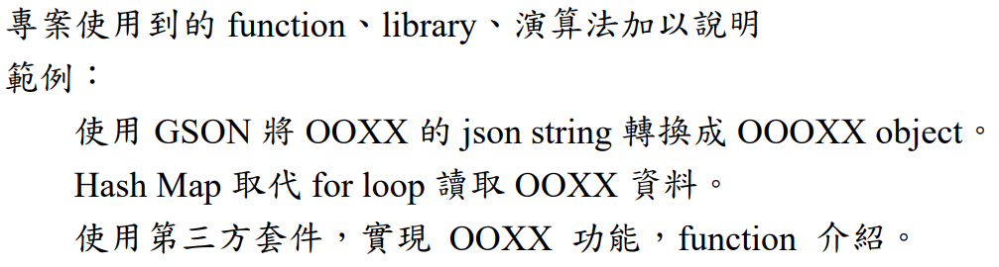
ASTRASTRONG APP
程式介紹
//08

Slide 9
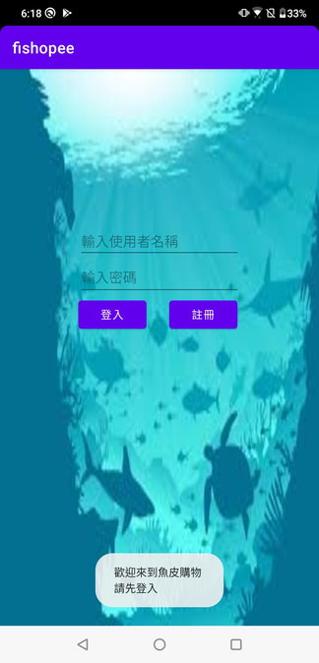
畫面
程式碼

Slide 10
畫面
程式碼

Slide 11
畫面
程式碼

Slide 12
畫面
程式碼

Slide 13
畫面
程式碼

Slide 14
畫面
程式碼

Slide 15
畫面
程式碼

Slide 16
畫面
程式碼

Slide 17
Fishopee APP
展示結果(demo)
連結：
//10

Slide 18
FIshopee APP
謝謝大家
//03

