Slide 1













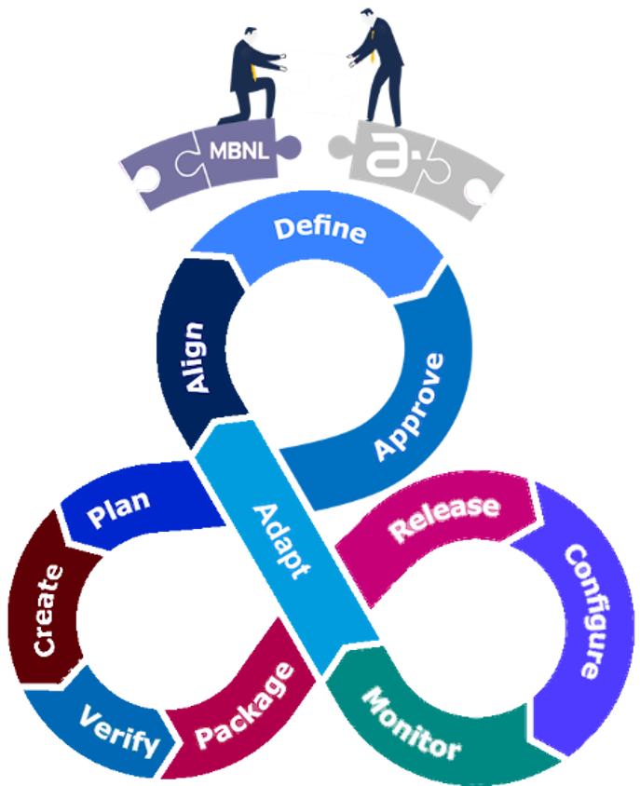

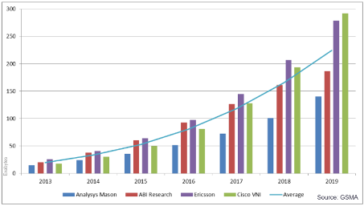









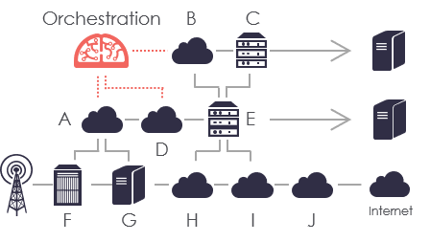





Zone A
The Lens
Scenario
Goals and Expectations
A joint venture (JV) formed in 2007 between EE and H3G to achieve CAPEX and OPEX reduction through the economies of scale of passive infrastructure sharing, resulting in the creation of a ground breaking tower company.
Transformation of both Network Operations (OPS) and Operational Support Systems (OSS) to further Shareholder vision and strategy for network planning, design, build and operation while optimising operational efficiencies and decoupling ongoing operational expenditure from network growth, enabling both MBNL and Shareholder-Unilateral processes to coexist effectively. Become a World-Class TowerCo.
2G
2.5G
3G
4G
5G
MNO rivals T-Mobile & H3G continue rollout of 2G across the UK to compete with Vodafone and O2
MBNL formed to deliver and operate 3G network
UK first 4G network launched under EE; EE & Three sign new network sharing agreement
UK 5G spectrum auction raises GBP £1,355,744,000
MBNL network integration milestone of 12,000 sites
MBNL reaches 18k RAN sites and carries 75% UK mobile data traffic
67% (£453,888,000) of UK 5G spectrum auction investment from EE and Three
Following merger with T-Mobile, Orange join MBNL as Everything Everywhere (now known as EE)
EE joins the BT group, Jan 2016
UK Government launches 5G Testbeds and Trials Programme (5GTT)
Zone B
The Experience
JV inherited monolithic, heavily customised OSS and overly complex shareholder-unilateral processes
Annual Global Mobile Data Traffic
Connected “Things” drive need for capacity & coverage
vRAN/vEPC/vIMS usage soars due to increase of NFVI
5G Readiness
2G networks expected to outlast 3G as MNOs jump to 4G
Embrace COTS
Leverage Software Defined
Consolidate & Optimise
Rules of Engagement
OSS: configuration vs. customisation (SP5)
RAN: multi-vendor / cRAN & RRH / virtualised
MBH: multi-party (OLO)
Decommissioning: remove cost & dependencies from monolithic OSS and legacy infrastructure
KPI: increased service levels availability failure
Virtualisation: Software Driven Data Centres
Orchestration: End-to-End process management with the inclusion of industry standard APIs (SP7)
Automation: driving scaling of rollouts & enhancements
Multi-tenancy: single instance serving multiple tenants
Utilisation: high asset usage CAPEX OPEX
Estate: combine legacy estates
RAN: fine-tune through drive testing, analytics, crowdsourcing data and trend forecasting
MBH: capacity & latency to be 5G ready (VoLTE & ViLTE)
OPS: business process isolation, zero technical debt
Agility: through outsourced flexibility & scalability (SP6)
UK Regulatory: 1996 / 2003 / 2006 / 2016 / 2017 / 2018
Security: SC/DV paramount, lawful interception, IDPS (SIEM)
Regulatory: Ofcom / European Commission
Data: Quality & Integrity through segregation
Spectrum: Harmonisation
Zone C
The Insights
World-Class
Certainty
Excellence
Flexibility
SD-WAN for MBH
Backed by World-Class ISV, Amdocs, with industry leading OSS and services, conforming to existing and leading industry standards: eTOM, ONAP, LSO
Work with Amdocs to introduce new global Tower-as-a-Service standards through TMF & MEF for MNOs and vendors to adopt
Enable new seamless shareholder enablement
Forecasted capacity and coverage
pre-emptively find new UK/EU tower estates (i.e. Vodafone rumoured tower sale across the EU)
Small Cell for 5G (femto, pico, micro, macro)
Profit-Centre NOT Cost-Centre ROI
Dependable Mean Time To Repair (MTTR)
On-Demand rollout and RF planning
Enter new territories: EMEA, APAC, CALA, NAM – post Brexit opportunities
Offer to global market: Tower-as-a-Service
Notes:
Automation: NFV MANO / BPEL / LSO
Standards: TMF / MEF / ETSI / GSMA / ITIL / TOGAF
Virtualisation: OpenStack / K8S / TOSCA / Cloud-Native / Open Air Interface (OAI) / M-CORD

