Slide 1
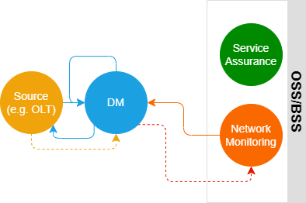
Simple
DM: Domain/Element Manager

Slide 2

Basic Telemetry Steps

Slide 3
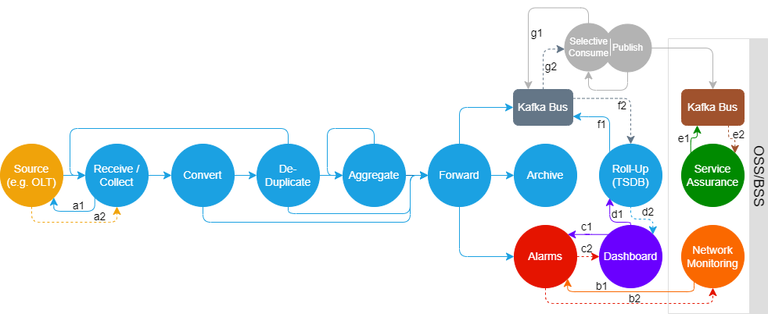
MirrorMaker (external replication)

Slide 4
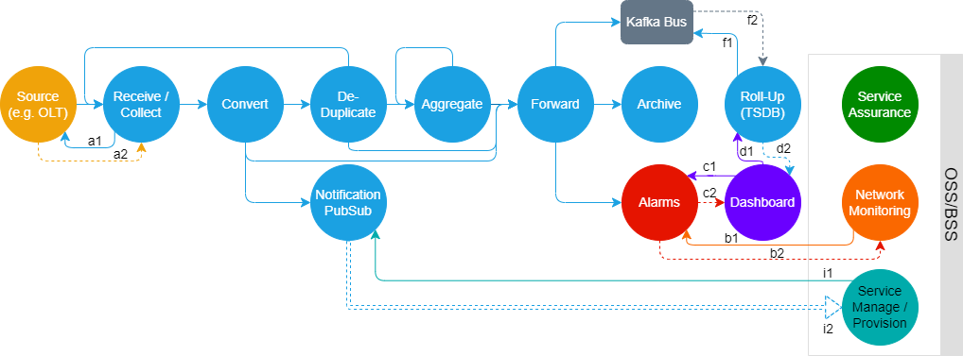
Pub/Sub (alarms/events)

Slide 5
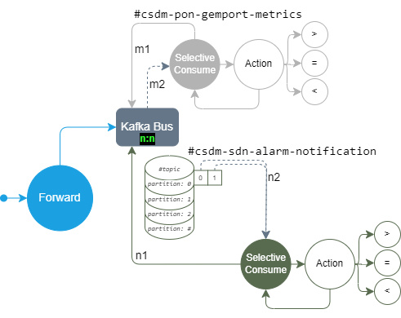
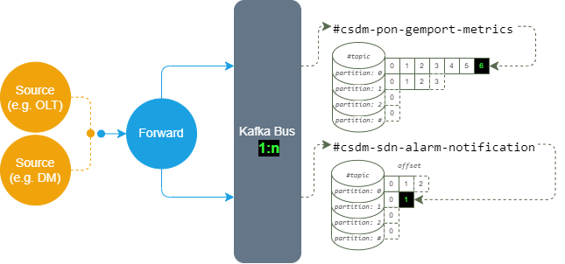
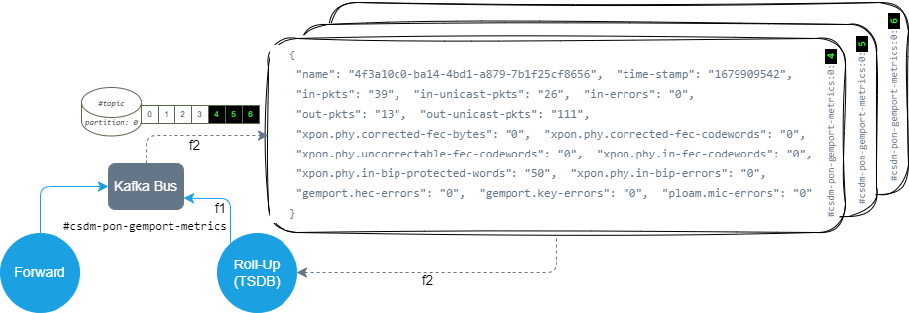
Kafka

Slide 6

UI

Slide 7
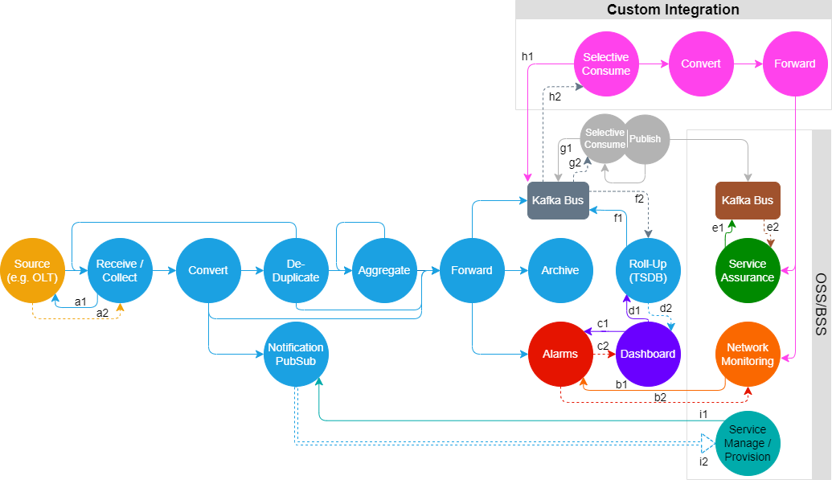
All

Slide 8
All

