Slide 1


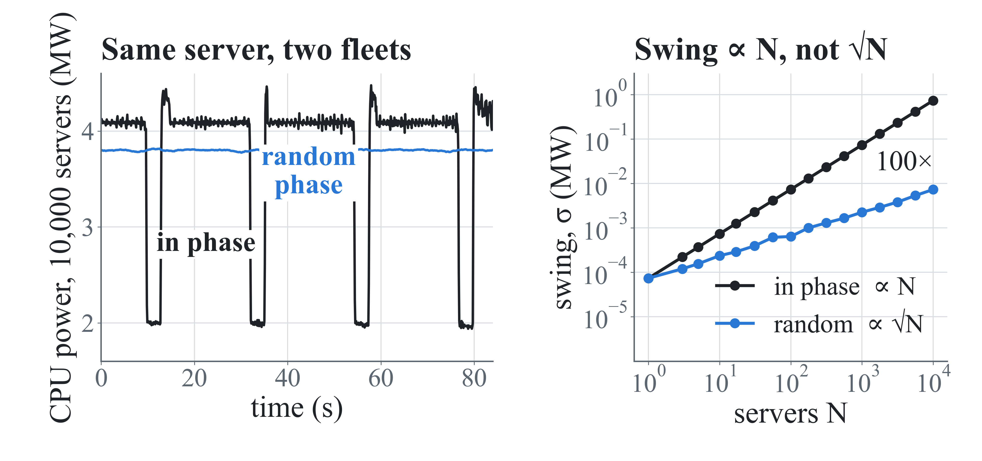
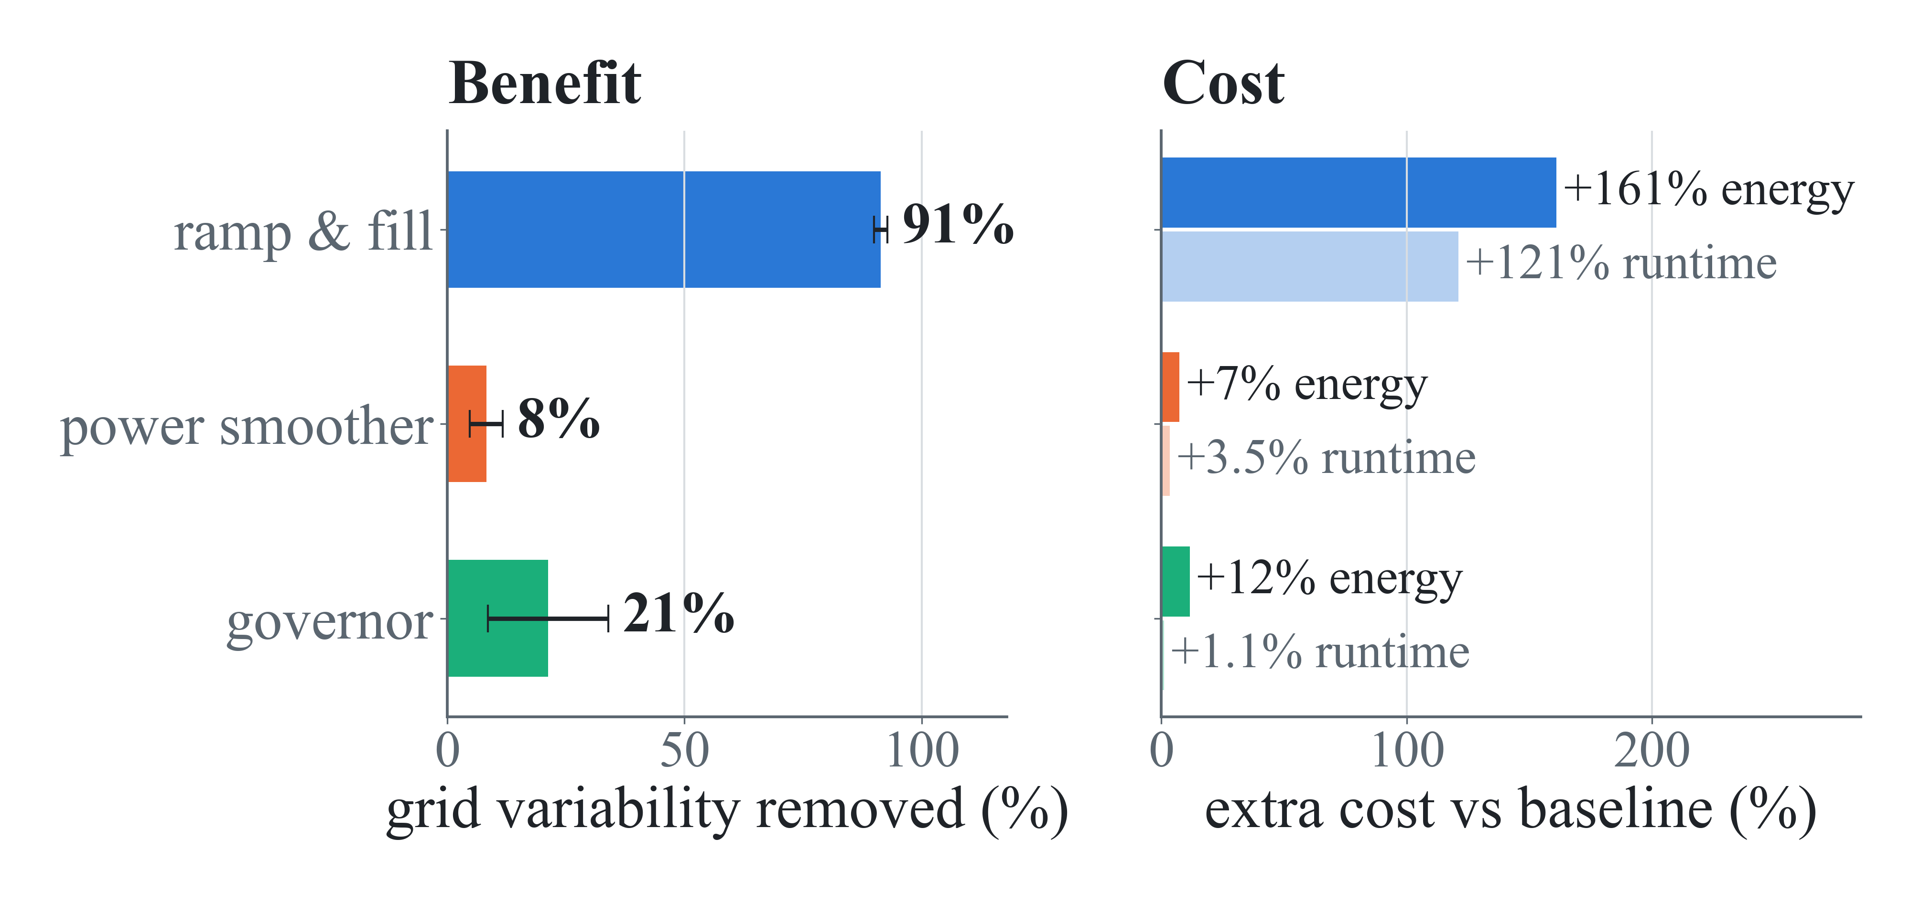
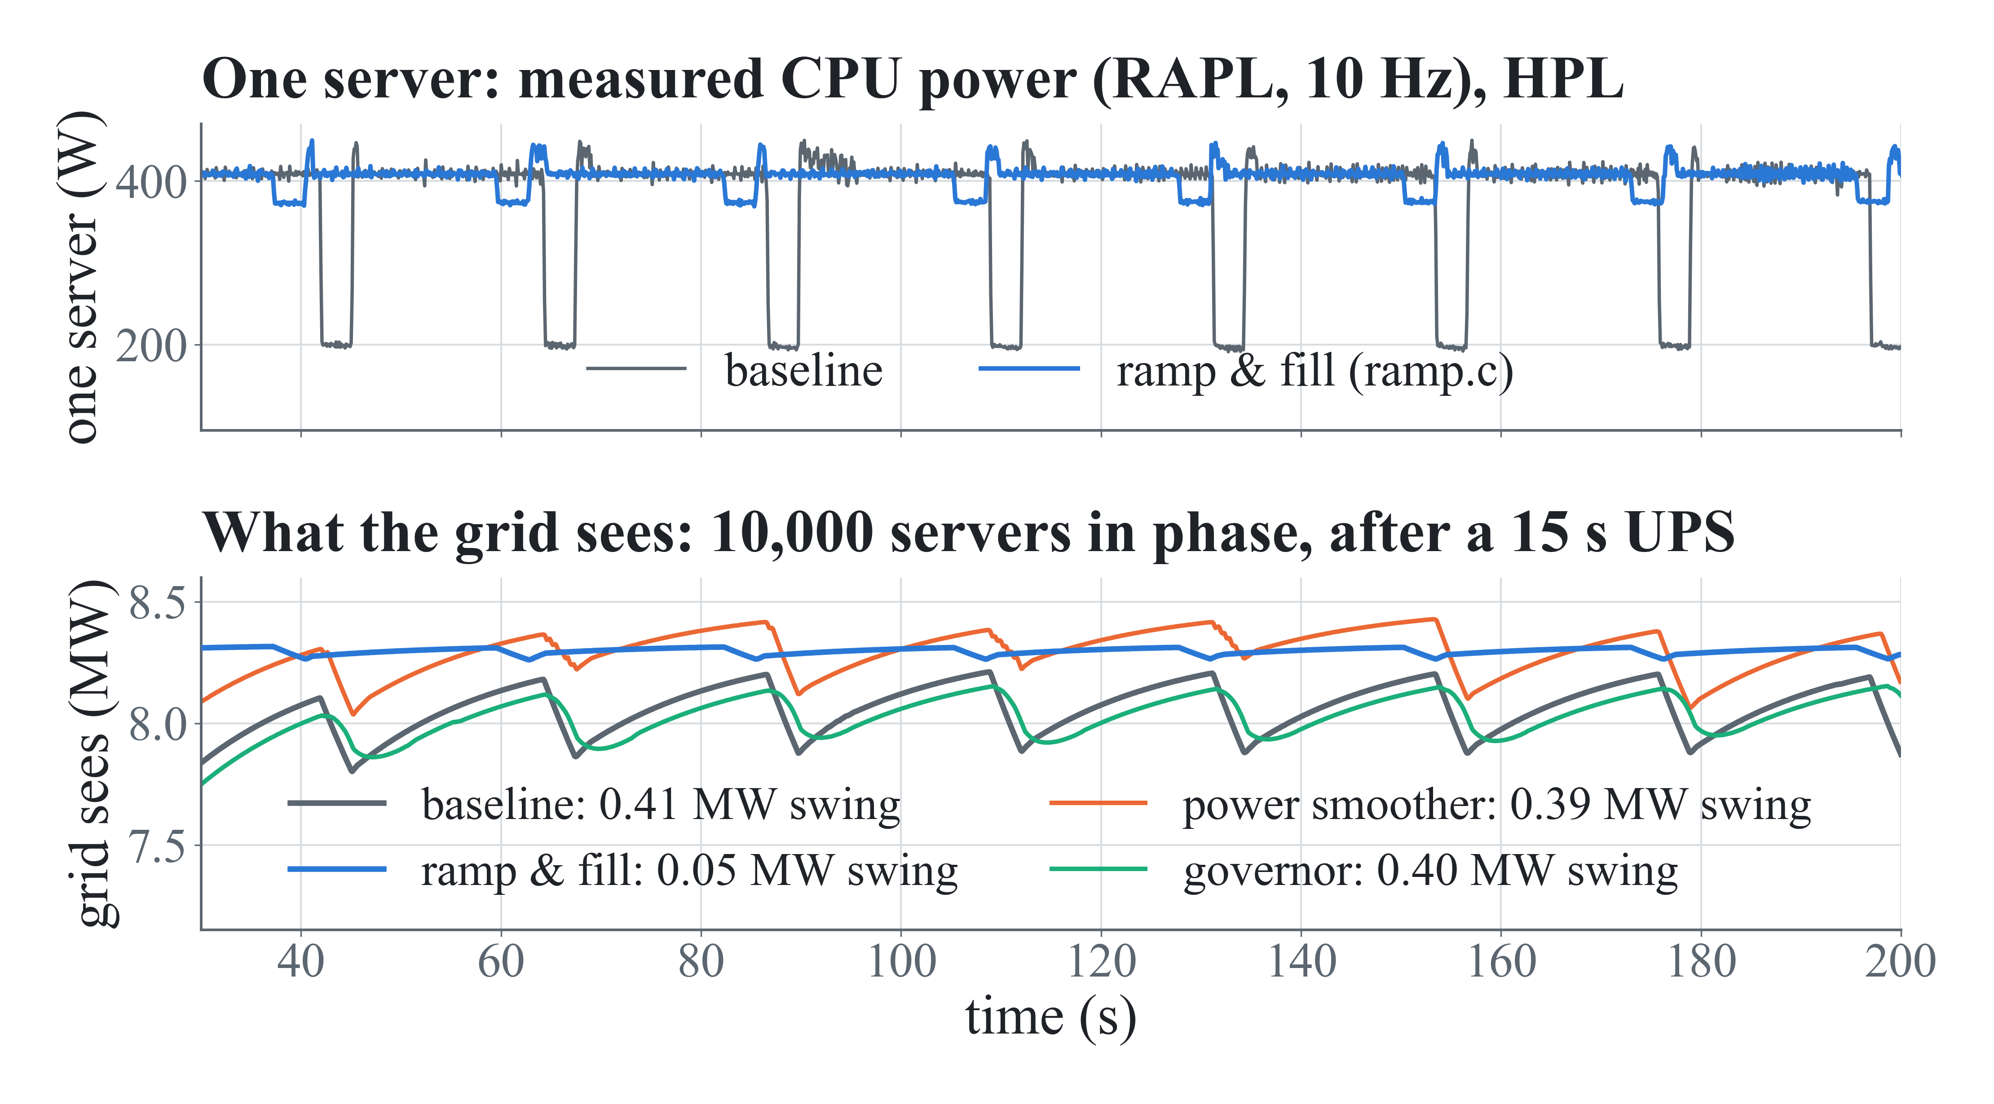
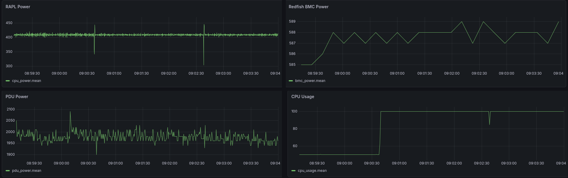
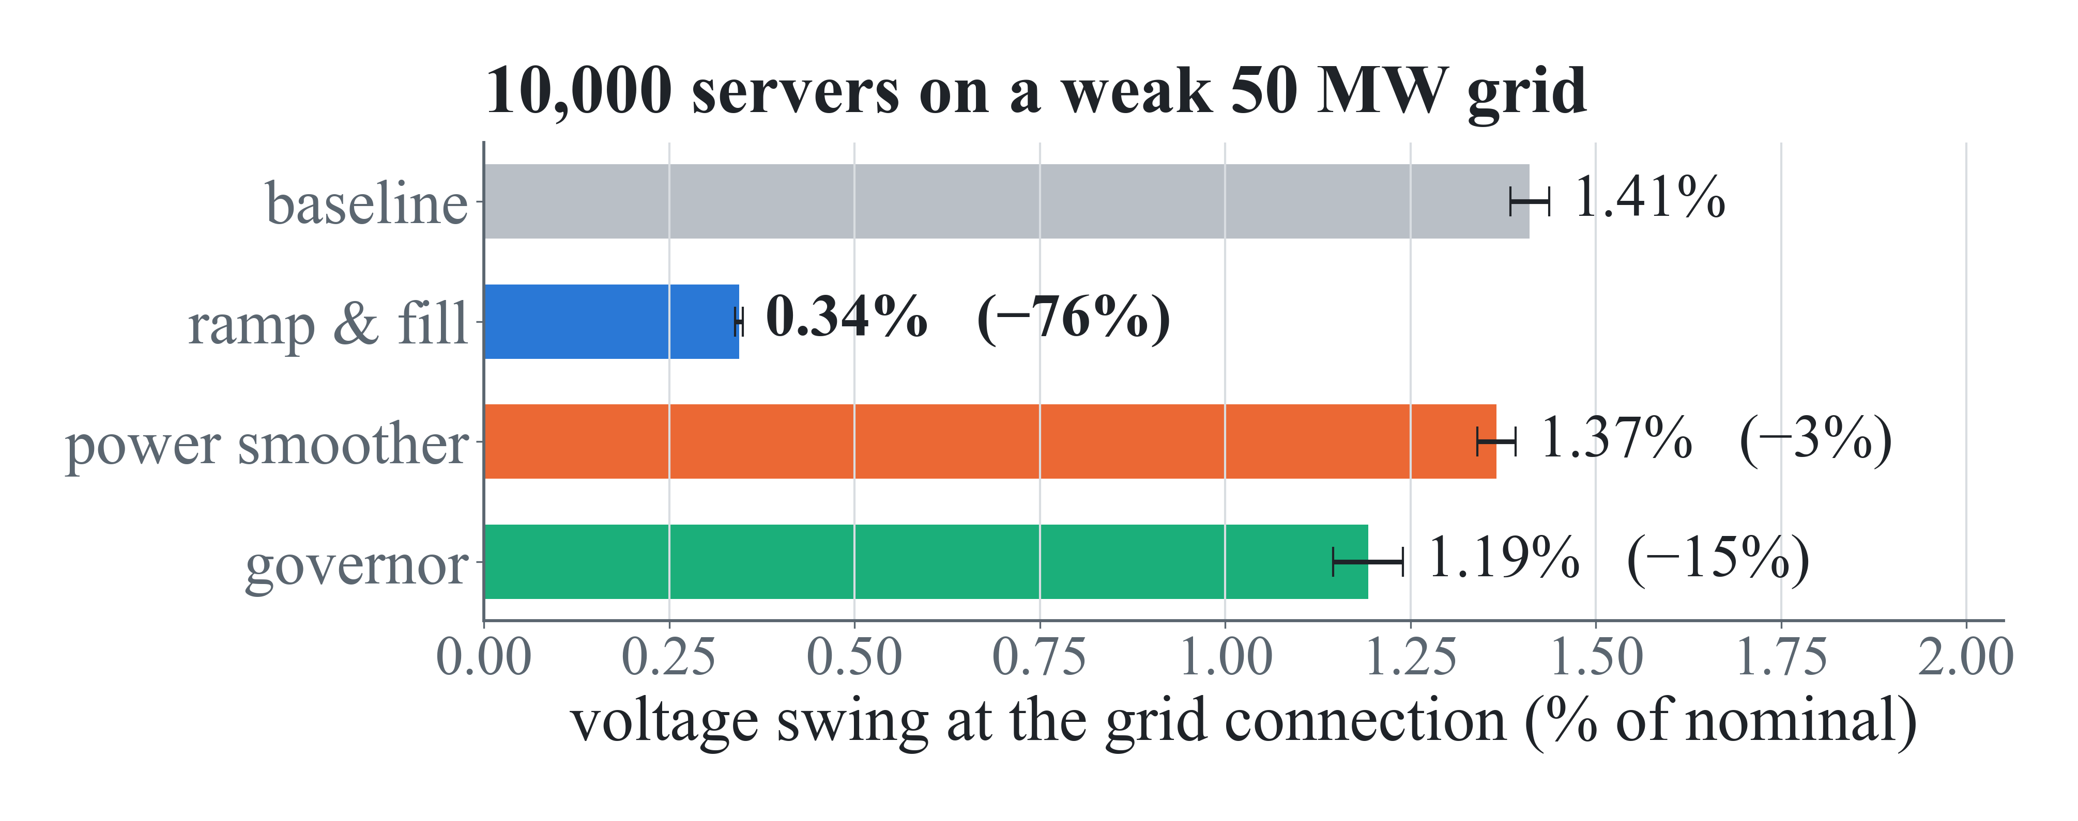

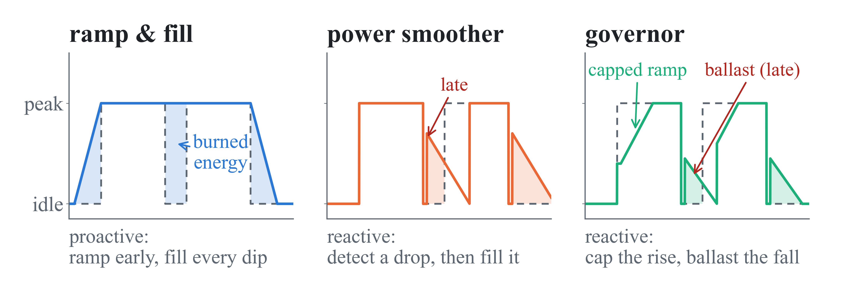


Smoothing Synchronized Power Swings in HPC Clusters
Using Software: Measurement, Prediction, and Grid Simulation
Daniel Lee¹, Emily Doyle², Alexander Johnson³
¹Grinnell College | ²Embry-Riddle Aeronautical University | ³Georgia Institute of Technology
INTRODUCTION
M3 Grid model and evaluation criteria
R3 The cost of smoothing: runtime and energy
Bulk-synchronous AI training: nodes compute, then communicate gradients to adjust weights. Thousands of servers run in lockstep, leading to huge power swings.
1 server
RAPL trace
× 10,000
in phase, +PUE
UPS
15 s low-pass
Phasor grid
50 MW, H = 2.5 s
Scorecard
metrics below
91%
8%
21%
ramp & fill
power smoother
governor
2H/ω₀ · dΔω/dt = P_{m} − P_{e} − DΔω (swing equation)
less grid variability (±1%)
less grid variability (±4%)
less grid variability (±13%)
Metric | What it captures | Limit / standard
CV, peak-to-mean | volatility; worst excursion of PCC power | lower is flatter
Voltage sag | PCC voltage dips and their depth | 0.95 pu (IEEE 1159)
Frequency nadir | lowest frequency after a load swing | 59.3 Hz relay (NERC BAL-003)
ROCOF | how fast frequency moves | Hz/s (no fixed limit)
Ramp rate (RREI, NRS) | MW/min above the limit, annualized | 20 MW/min
Runtime, energy, Gflop/s | what smoothing costs | vs. own baseline
Reduction in grid-facing variability (CV of facility power): mean of 3 workloads ± run-to-run SD, n = 4 repeats.
Experiment Design: score 13 metrics for every run against its own workload's baseline. Repeat each run four times. Simulate a grid of 10,000 identical servers synchronously running to evaluate risk of damage to the grid. All metrics were custom-made, inspired by IEEE and NERC safety standards for industrial use.
One measured server trace copied 10,000 times: random phases cancel to a √N ripple; in-phase copies swing 100× harder.
RESULTS
Benefit (left) against what it costs the server in energy and runtime (right).
METHODS
R1 Ramp & fill flattens power best
R4 Forecasting power swings: not yet possible
M1 A live power monitor for one server
Smoothing needs warning, so we tried to forecast power, then to detect it early:
RAPL CPU power 10 Hz, C sampler
InfluxDB
Data storage
Grafana
live dashboards, 5 s refresh
Approach | What happened
Regression (OLS), 5 s ahead | caught 19 of 1,735 spikes
Random forest + Kalman filter | PR-AUC 0.68, but flags 10–20 s late
Run-queue jerk, Hawkes process | real precursor (d = 1.5), branching 0.84–0.96
CPU-utilization edge detector | best: one 10 Hz sample, 5 alarms/hr
Linux /proc 1 Hz: run queue, I/O, ctx switches
Redfish BMC every 10 s: 69 fields
Rack PDU ~1.8 Hz: real power
0.23 s late
median delay of the best detector on an independent workload: it fires after the transition, not before (recall 33%, precision 19%).
CONCLUSION
Voltage is the problem: in the worst case, where all servers run in lockstep, the first damage to the grid is when voltage drops too low. Voltage sags are the bottleneck for synchronous jobs.
Proactive strategy works: ramp & fill significantly flattens power and voltage swings for a premium cost. Worth it for long jobs that maintain high power, which are relevant to the NSA.
Reacting is late but viable: power swings can’t be predicted yet, but the governor still trims ~20% of variation for minimal cost. Improved telemetry would only make this method better.
Deliverables: a live monitor that costs 0.017% of the server and a novel grid-risk evaluation framework, shared with NSA teams to continue power smoothing efforts in HPC clusters. NSA professionals shared our telemetry pipeline with AMD to inspire innovation in faster, more reliable power-reporting hardware.
Live: three independent power telemetry monitors and CPU utilization on one Grafana dashboard. Whole team can see server activity in real time.
Cost of Running: 2.19% of one core (0.017% of the server); Running sampling code as a daemon is +0.15 W.
Correct by construction: power is reported only when the RAPL counter advances, removing the kilowatt “spikes” when polling the hardware too fast.
Top: one server, measured. Bottom: the same traces after fleet aggregation and the UPS, which acts as a 15 s low-pass filter: fast fluctuations never reach the grid, but the slow duty-cycle effects do.
R2 Grid stress: voltage swings
M2 Three software mechanisms for smoothing power
Acknowledgments We thank Stewart Baker and Erin Carrick for their guidance during this project. AI tools were used to assist software testing and implementation. Supported by the Laboratory for Physical Sciences during the 2026 Future Computing Summer Internship at the National Security Agency.
github.com/leedanie2/Collecting-and-Adjusting-Server-Power
Code · data · technical reports
References [1] E. Choukse et al., Power stabilization for AI training datacenters, arXiv:2508.14318 (2025). [2] NERC, Characteristics and Risks of Emerging Large Loads (white paper). [3] NERC, Incident Review: Large Load Loss. [4] NERC, Reference Document: Balancing and Frequency Control (BAL-003). [5] IEEE Std 1159-2019, Recommended Practice for Monitoring Electric Power Quality. [6] P. Kundur, Power System Stability and Control, McGraw-Hill (1994). [7] F. Milano et al., Foundations and challenges of low-inertia systems, PSCC (2018). [8] P. Tielens and D. Van Hertem, The relevance of inertia in power systems, Renew. Sustain. Energy Rev. 55, 999 (2016). [9] Best practices for large load interconnections: data centers, arXiv:2601.12686 (2025). [10] DMTF, Redfish standard.
Experiment: 3 workloads (HPL, AI inference, step) × 4 conditions × 4 repeats = 48 traces on a quiesced dual Xeon Gold 6338.
Peak-to-trough voltage at the grid connection during steady running; mean of 3 workloads ± run-to-run SD, n = 4. For scale: unsmoothed, voltage sags below the 0.95 pu IEEE limit near 10,000 servers.

