Slide 1
Characterisation of Uber usage
relationship with weather conditions/season in New York City 2009-2015

Slide 2
Team Members
• Lee Amstrong
• Julian Ravelo
• Damian Kifuso

Slide 3
Project description
Using a dataset with information related to Uber trips in New York City from 2009 to mid-2015, we aim to characterise the usage of Uber. The main focus of the analysis is the relationship of the usage and price of the service with respect to the season, weather or time of the day/week the service is used. Because the original dataset did not include values of temperature or wind speed, we had to use the OpenWeatherAPI, adding two columns with this information. See below the first 5 rows of that merged dataframe.

Slide 4
Dataset provided in link
“Brief overview of why we felt this wouldnot provide enough data…”
“Title of dataset”

Slide 5
“DATASET’s considered…”
Attempted to source other datsets
List of sites;
“reasons why we didn’t think these datasets would work”

Slide 6
Uber App developer data APi
Consideration-
Attempt-
Limitations-
Reasons why ultimately it was not feasible to use the uber api.

Slide 7
Dataset soloutin
Using Kaggle, located a 200000 row datset spanning 2099 to mid 2015.
It did not have weather data but it did have latitude and longitude of when passenger was picked up. Using th lat and long a code was built to pull weather details from the openweatherapi.
As the csv file already had a lot of data points we decided as a team to divide our efforts.
I would focus on gathering the weather condiyon data, then use the weather data to determine if the weather condition influenced the decision to use the uber service.

Slide 8
Uber DATASET
The Uber.csv file along with a Jupyter Notebook.ipynb file was uploaded to GitHub and a project repository created with invites to collabraters ssuccesfully sent.
Branchs were created by each member of the team, allowing each member to work on the induvial goals
Lee Armstrong – Source then perform data analysis on weather.
Julian Ravelo – Clean the uber.csv file then perform data analysis on uber usage
Damian Kifuso – Investigate the relationship between cost/peak or off peak and cost/weather
Head and tail of uber.csv as a dataframe

Slide 9
Calling weather APi
Using the lat and long from the created uber_dataframe. Code was developed to request Temperature and Wind conditions for each journey.
Delete and replace = Screenshot of the code and turn this box into an explanation of what the code does??

Slide 10
Calling weather APi
As the request was for 200000 many API errors were experienced. After many alterations to code, a successful ‘else’ condition was implanted within the loop.
Delete or replace = import a screenshot of the else condition, turn this txt box into a description of what the code does.

Slide 11
Weather API answered
Head and tail of the merged dataset combining downloaded API weather data with original dataset
Delete or repurpose = import screenshot of head and tail of combined cleaned dataframe, change this to a txt box of what I will say about the image etc.

Slide 12
To Uber or not to Uber
Using the weather condition and the occurrence of rides data to determine the likelihood of weather conditions impacting the frequency of rides.
Hypothesis - Weather conditions (specifically, temperature and wind speed) are very likely to influence the usage demand of Uber trips. In other words, there should be a statistically significant difference in the frequency of Uber trips under different weather conditions.
Null hypothesis – Weather conditions (specifically, temperature and wind speed) have no influence on the usage demand of Uber trips. In other words, there is no statistically significant difference in the frequency of Uber trips under different weather conditions.
My personnel thinking was certainly with all this data we have gathered there will be a clear and significant correlation between very hot or very cold temperatures causing high demand as well as a clear visual indicator that high end wind speed would cause more frequent use.

Slide 13
DATA Analysis
The next few slides show what I did with the data, referring to code screenshots and descriptions of what the code is achieving

Slide 14
DATA Analysis
The next few slides show what I did with the data, referring to code screenshots and descriptions of what the code is achieving

Slide 15
DATA Analysis
The next few slides show what I did with the data, referring to code screenshots and descriptions of what the code is achieving

Slide 16
DATA Analysis
The next few slides show what I did with the data, referring to code screenshots and descriptions of what the code is achieving

Slide 17
DATA Analysis
The next few slides show what I did with the data, referring to code screenshots and descriptions of what the code is achieving

Slide 18
Who would have Uber believed it!
It would appear from the initial data analysis carried out that the weather conditions do not have any strong effect or even a causation correlation with the frequency of uber trips.
Discuss further?

Slide 19
ANOVA ??

Slide 20
“Outputs”
Go through my outputs and discuss what is being shown.
Import screenshots for each season and each season to each slide.
Discuss…..

Slide 21
“Outputs”
Go through my outputs and discuss what is being shown.
Import screenshots for each season and each season to each slide.
Discuss…..

Slide 22
“Outputs”
Go through my outputs and discuss what is being shown.
Import screenshots for each season and each season to each slide.
Discuss…..

Slide 23
“Outputs”
Go through my outputs and discuss what is being shown.
Import screenshots for each season and each season to each slide.
Discuss…..

Slide 24
“Outputs”
Scatter plot
Go through my outputs and discuss what is being shown.
Import screenshots.
Discuss…..

Slide 25
“Outputs”
Scatter plot
Go through my outputs and discuss what is being shown.
Import screenshots.
Discuss…..

Slide 26
The other outputs after scatter plots
Go through my outputs and discuss what is being shown.

Slide 27
The other outputs after scatter plots
Go through my outputs and discuss what is being shown.

Slide 28
Who would have Uber believed it!
Given the complexity of the question once you unwrap it and the resulting requirements to get deep into the analysis of the data and firmly tease out detailed events and separate them, it was not achievable within the time constraints to research then write the working code.
Now off course it is obvious that this is simply untrue and definitely extreme weather conditions will have an impactful effect on frequency of passengers choosing to ride in Uber rather than walk. However, to unpack the question and do it justice we would have to gather far more data in areas such as;
Whether the trip is a nesscetiy for employment.
The influence of a special event.
Alternative transport available.
We must also consider that the current data gathered was gathered under certain conditions eliminating “outliers” that may have proved impactful for our analysis.

Slide 29
Slides to break and change over presenter

Slide 30
Slides to break and change over presenter

Slide 32
Julian

Slide 33
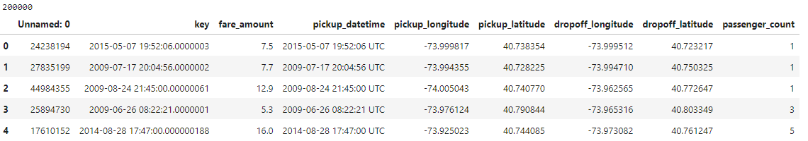
DATASET
Through summary tables and graphs, we were able to clean the data and answer the research questions. See below some general tables and graphs to show general aspects of the data and how it was cleaned and organised.
The first 5 rows of the original dataset (200k rows)

Slide 34
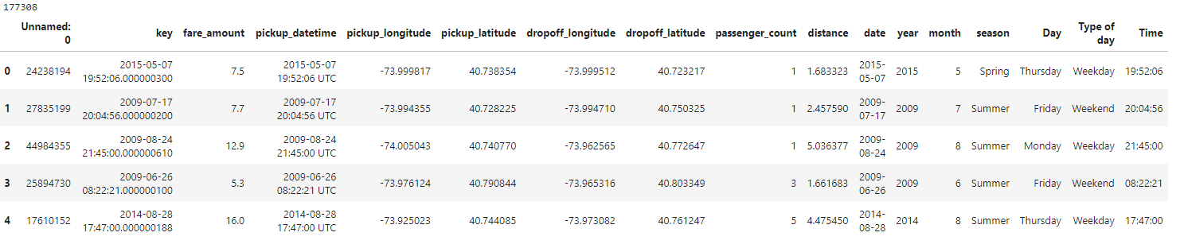
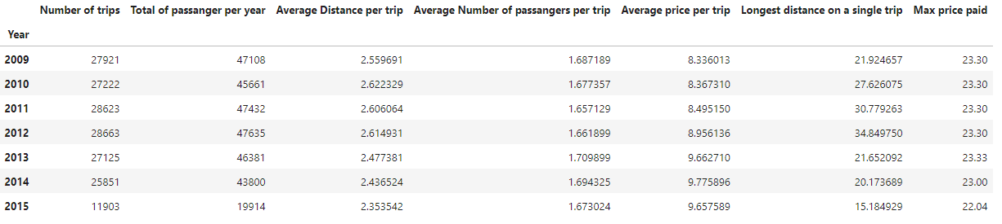
DATASET
The first 5 rows after the dataset was cleaned and some columns of interest were added (177k rows)
Summary of the main values per year

Slide 35
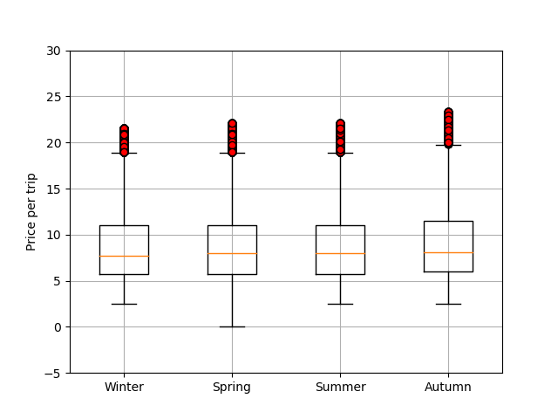
Boxplot
Showing the distribution of the data after it was cleaned

Slide 36
Findings
Is the weather conditions a variable that influences Uber usage?
For temperature there is evidence of a statistical relationship between temperature and Uber pickup times. However, the correlation is of moderate significance suggesting that while temperature does have an influence it’s practical relevance in shaping pickup times may be moderate to low.
Like temperature wind speed also exhibits a statistical relationship with Uber pickup times. However, the correlation again is of moderate significance implying that while wind speed does have an impact its practical relevance in determining pickup times may be moderate to low.
Weather, represented by temperature and wind speed can be considered a variable that influences Uber usage to some extent. However, the strength and practical significance of this influence are not exceptionally high. Many other factors not considered in this analysis, may also play a role in determining the Uber usage patterns.

Slide 37
Analysis results

Slide 38
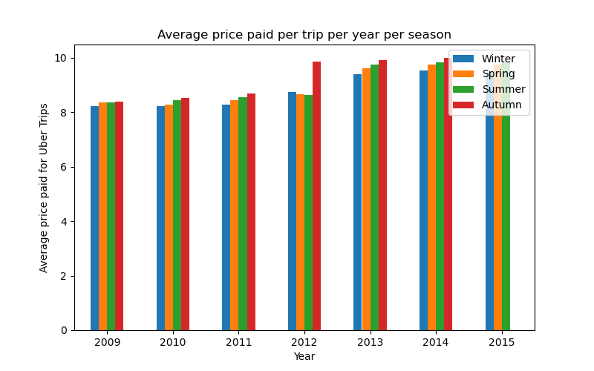
Analysis results
Is the price of an Uber trip dependent on the weather/season?
Analysing the average price per trip depending on the season as shown in the graph below. We can conclude that the average price shows a similar behavior in most of the years with Winter being the lowest average price and Autumn with the highest average price. The difference between the highest and the lowest price paid is around XXXX per year. Only 2012 shows a higher difference on the price paid in Autumn but the graph indicates that from 2012 the rates were increased.

Slide 39
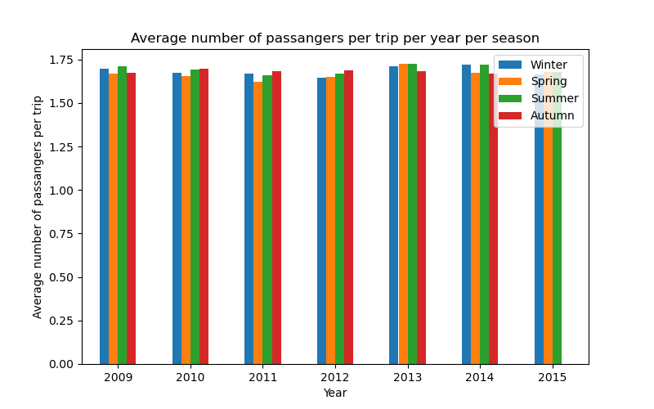
Analysis results
The relationship between the number of passengers and the weather conditions/season when using Uber
Analysing the relation between the number of passengers and the season. From the graph below, we can conclude that there is no relation between the season and the number of passengers per Uber trip. The values are quite similar independently of the season and the year.

Slide 40
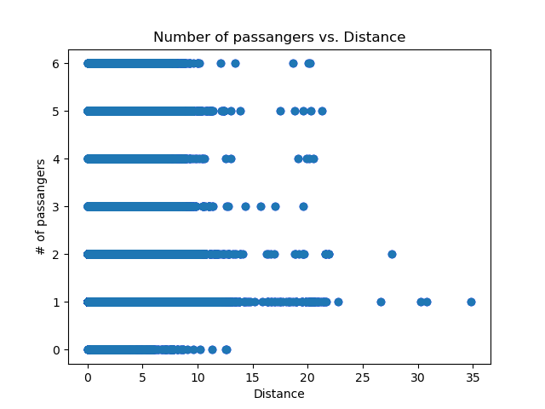
Analysis results
The relationship between the number of passengers and the distance travelled when using Uber
As shown in the image below, and by getting a 0.0 value for the correlation factor, we can conclude there is no relation between the number of passengers and the distance of the Uber trips.

Slide 41
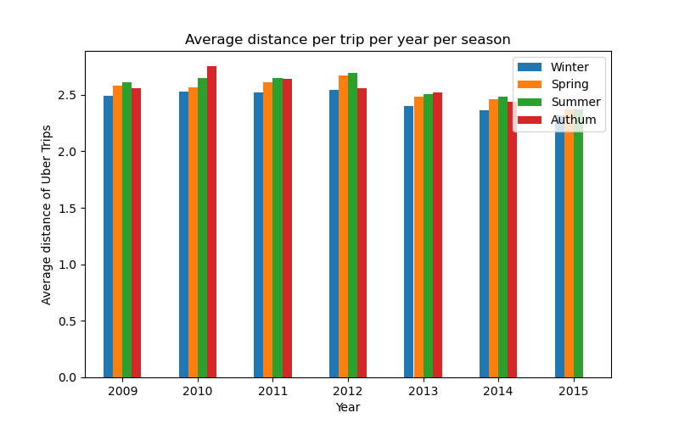
Analysis results
What is the relation between the weather conditions and the distance travelled when using Uber?
Additionally, we analysed the average distance per trip depending on the season as shown in the graph below. We can conclude that the average shows similar behavior in most of the years having Winter with the shortest average distance and Autum with the longest average distance. The difference between the longest and shortest distance is around XXXX per year.

Slide 42
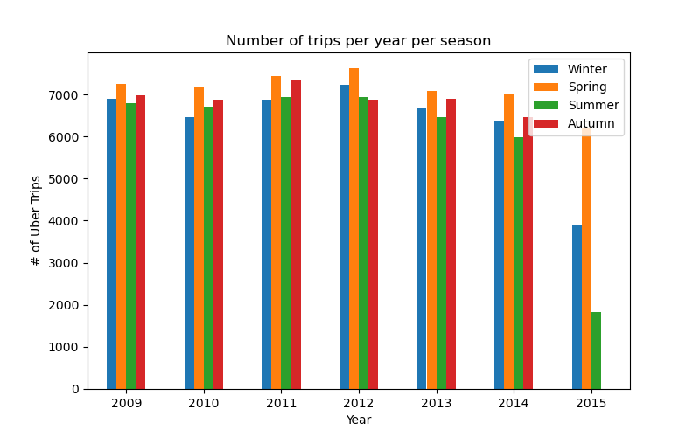
Analysis results
What is the relation between the season and the usage of Uber?
As shown in the graph below, the number of trips per season is consistent through the years. Spring and Autumn are the seasons of the year with higher usage of Uber while Winter is the season with fewer trips.

Slide 43
Analysis results
Is the usage of Uber mainly urban or rural?
When suggesting this question, we had not spent enough time working with the data and did not realise that the dataset was for trips done in New York City only. All the coordinates are points within the urban area of the city. Instead of characterising the data by rural or urban, we decided to use the Geoapify service to assign an administrative detail to each coordinate and check which specific area uses Uber the most. As it is a 200k rows dataset, we used only 2015 values. As it is shown below, we plotted the distribution of Uber trips per administrative category of New York City. 77% of the Uber trips are from Manhattan area.

Slide 44
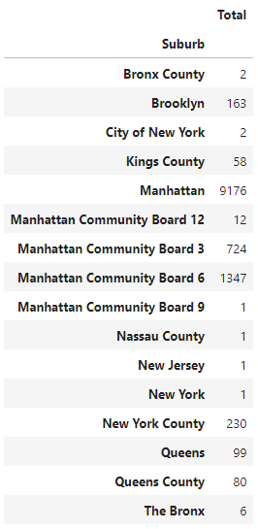
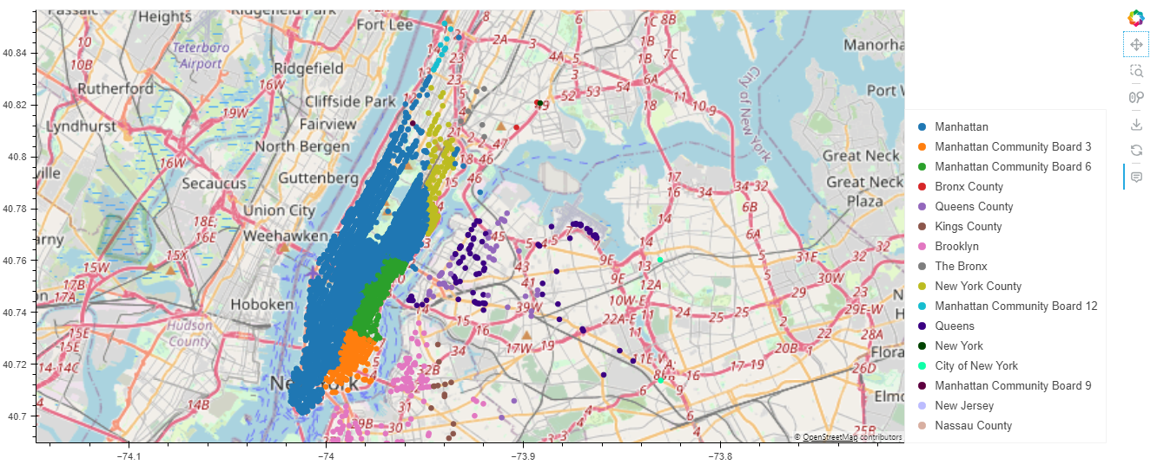

Slide 45
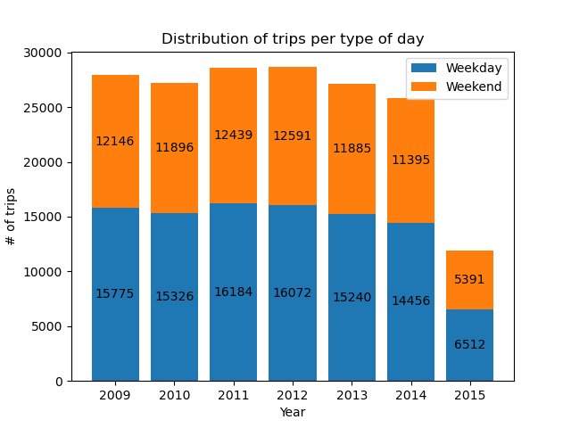
Analysis results
Does the cost/usage of Uber depend on the pick-up times? (peak hours, weekdays, weekends, etc.)
Considerations: For the purpose of this analysis, we considered weekdays as the period between Monday and Thursday. Therefore, the weekend is the period between Friday and Sunday. As it is shown in the graph below, the usage of Uber is consistently showing around 45% of usage on the weekends. Considering that it is a period of 3 days only, we might conclude that the services are mainly used during the weekends.

Slide 46
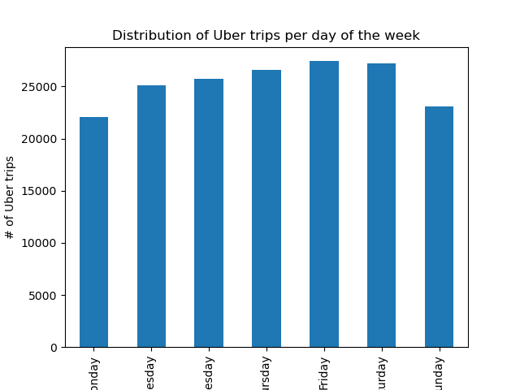
Analysis results
Does the cost/usage of Uber depend on the pick-up times? (peak hours, weekdays, weekends, etc.)
To go deeper into this analysis, the graph below shows the usage of Uber per day independently of the year. As expected, Friday is the day of the week that users use Uber the most.

Slide 47
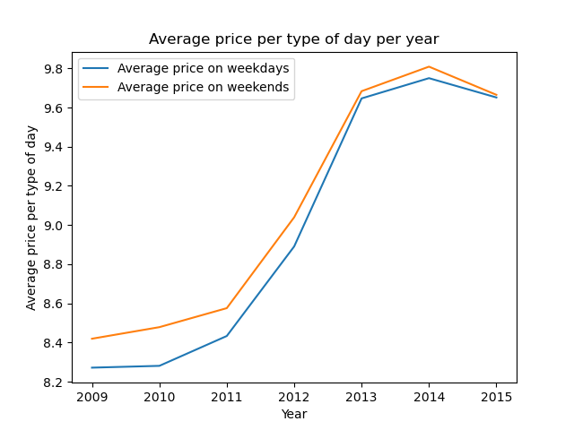
Analysis results
Does the cost/usage of Uber depend on the pick-up times? (peak hours, weekdays, weekends, etc.)
Additionally, the price paid during the weekends is consistently higher for all the years as shown on the graph below.

Slide 48
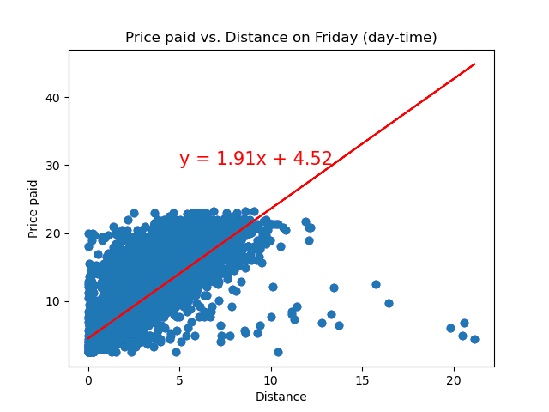
Analysis results
Does the cost/usage of Uber depend on the pick-up times? (peak hours, weekdays, weekends, etc.)
Furthermore, having Friday as the day of the week with higher Uber trips, we analyse the relation between the price and the distance on Friday. The scatter plots below, show that the price during the day is slightly higher than at night. For instance, a 10km trip will cost around $22.11 during the night while during the day it will cost $23.2, 6% more.

Slide 49
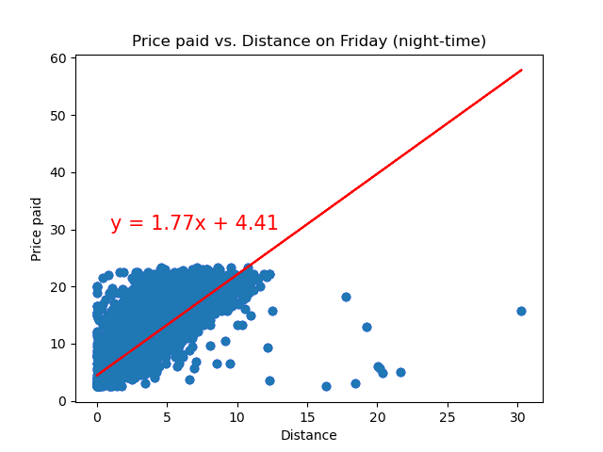
Analysis results
Does the cost/usage of Uber depend on the pick-up times? (peak hours, weekdays, weekends, etc.)
This result was quite surprising as we expected to have higher rates for Friday night trips. Therefore, we bin the data per period during the day and the result was the expected. The average price paid for an Uber trip between midnight and 6 a.m. is $9.54, 7% higher than the cheapest period of time which is between 6 a.m. and mid-day. The results on the linear regressions above might be explained by the number of trips done during the day as this value is 7% higher than the total number of trips done at night pushing the resultant slope of the regression to have a higher value.

Slide 50
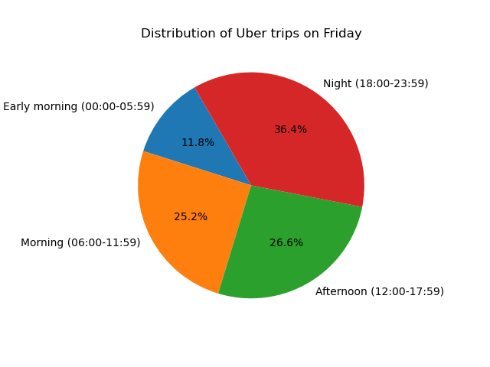
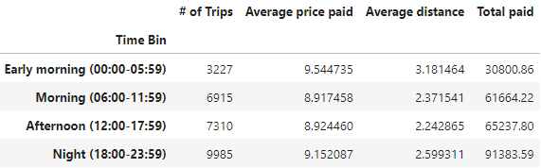
Analysis results
Does the cost/usage of Uber depend on the pick-up times? (peak hours, weekdays, weekends, etc.)
shown the distribution of the number of Uber trips on Friday per period of time.

Slide 51
Damian

Slide 52
Datasets and APIs used
• uber.csv • OpenweatherAPI • Geoapify
References
https://stackoverflow.com/questions/33151463/how-to-bin-time-in-a-pandas-dataframe https://matplotlib.org/stable/gallery/lines_bars_and_markers/bar_label_demo.html#sphx-glr-gallery-lines-bars-and-markers-bar-label-demo-py https://saturncloud.io/blog/how-to-calculate-distance-using-latitude-and-longitude-in-a-pandas-dataframe/#:~:text=Calculating%20Distance%20using%20Pandas%20Dataframe&text=We%20can%20now%20use%20the,longitude%20coordinates%20in%20our%20dataframe.

