Slide 1
Characterisation of Uber usage
relationship with weather conditions/season in New York City 2009-2015

Slide 2
Team Members
• Lee Amstrong
• Damian Kifuso
• Julian Ravelo

Slide 3
Project description
Using a dataset with information related to Uber trips in New York City from 2009 to mid-2015, we aim to characterise the usage of Uber. The main focus of the analysis is the relationship of the usage and price of the service with respect to the season, weather or time of the day/week the service is used. Because the original dataset did not include values of temperature or wind speed, we had to use the OpenWeatherAPI, adding two columns with this information. See below the first 5 rows of that merged dataframe.

Slide 4
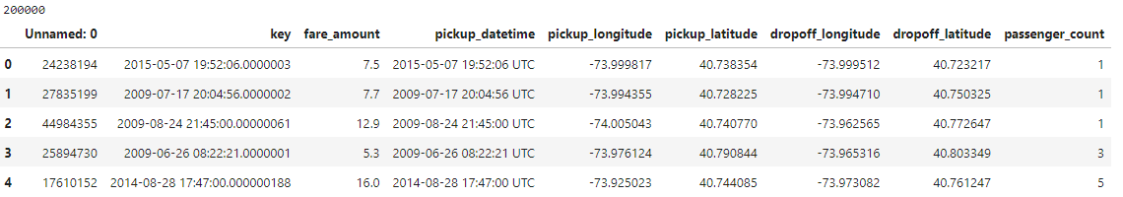
DATASET
Through summary tables and graphs, we were able to clean the data and answer the research questions. See below some general tables and graphs to show general aspects of the data and how it was cleaned and organised.
The first 5 rows of the original dataset (200k rows)

Slide 5
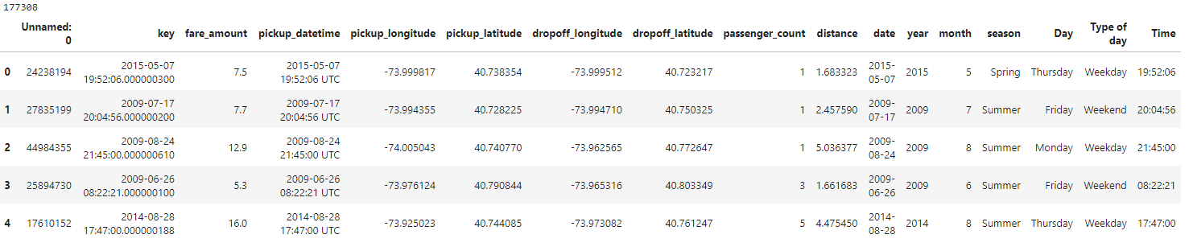
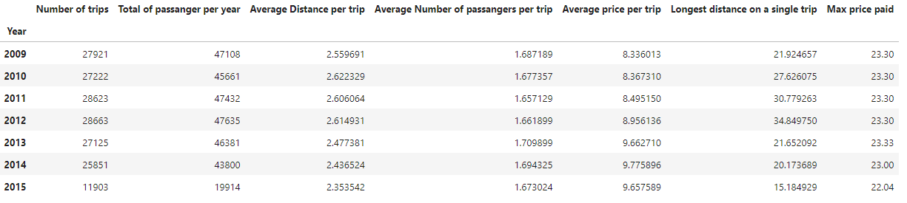
DATASET
The first 5 rows after the dataset was cleaned and some columns of interest were added (177k rows)
Summary of the main values per year

Slide 6
DATASET
Head and tail of the merged dataset combining downloaded API weather data with original dataset

Slide 7
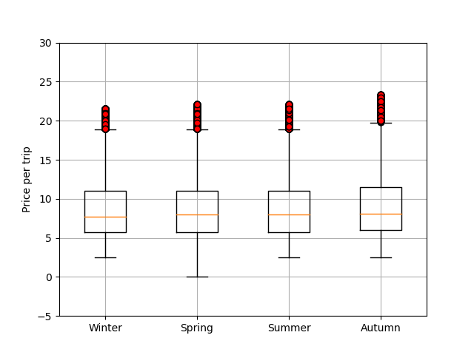
Boxplot
Showing the distribution of the data after it was cleaned

Slide 8
Findings
Is the weather conditions a variable that influences Uber usage?
For temperature there is evidence of a statistical relationship between temperature and Uber pickup times. However, the correlation is of moderate significance suggesting that while temperature does have an influence it’s practical relevance in shaping pickup times may be moderate to low.
Like temperature wind speed also exhibits a statistical relationship with Uber pickup times. However, the correlation again is of moderate significance implying that while wind speed does have an impact its practical relevance in determining pickup times may be moderate to low.
Weather, represented by temperature and wind speed can be considered a variable that influences Uber usage to some extent. However, the strength and practical significance of this influence are not exceptionally high. Many other factors not considered in this analysis, may also play a role in determining the Uber usage patterns.

Slide 9
Analysis results

Slide 10
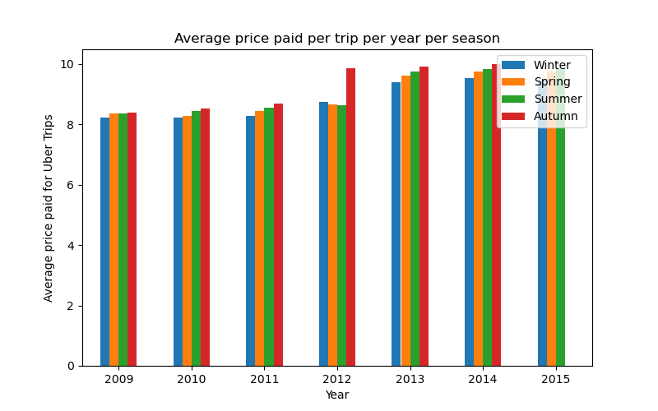
Analysis results
Is the price of an Uber trip dependent on the weather/season?
Analysing the average price per trip depending on the season as shown in the graph below. We can conclude that the average price shows a similar behavior in most of the years with Winter being the lowest average price and Autumn with the highest average price. The difference between the highest and the lowest price paid is around XXXX per year. Only 2012 shows a higher difference on the price paid in Autumn but the graph indicates that from 2012 the rates were increased.

Slide 11
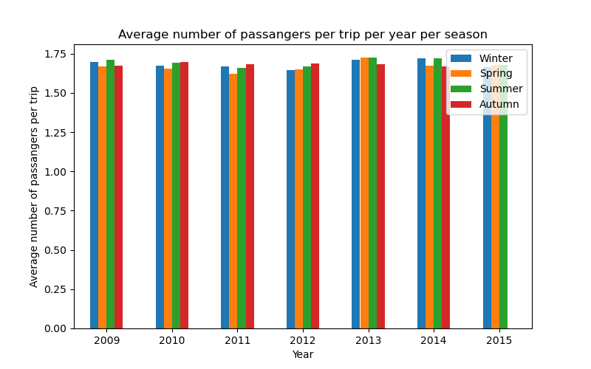
Analysis results
The relationship between the number of passengers and the weather conditions/season when using Uber
Analysing the relation between the number of passengers and the season. From the graph below, we can conclude that there is no relation between the season and the number of passengers per Uber trip. The values are quite similar independently of the season and the year.

Slide 12
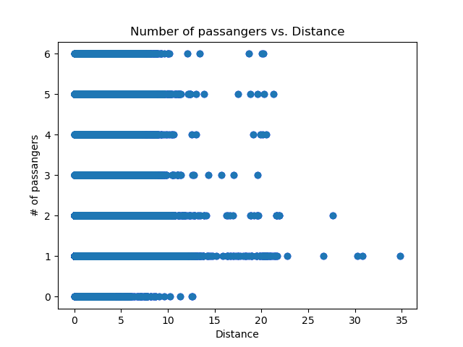
Analysis results
The relationship between the number of passengers and the distance travelled when using Uber
As shown in the image below, and by getting a 0.0 value for the correlation factor, we can conclude there is no relation between the number of passengers and the distance of the Uber trips.

Slide 13
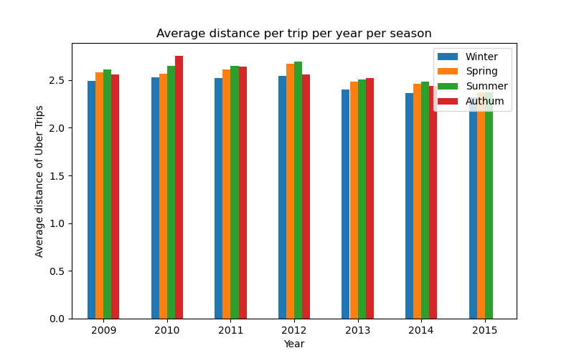
Analysis results
What is the relation between the weather conditions and the distance travelled when using Uber?
Additionally, we analysed the average distance per trip depending on the season as shown in the graph below. We can conclude that the average shows similar behavior in most of the years having Winter with the shortest average distance and Autum with the longest average distance. The difference between the longest and shortest distance is around XXXX per year.

Slide 14
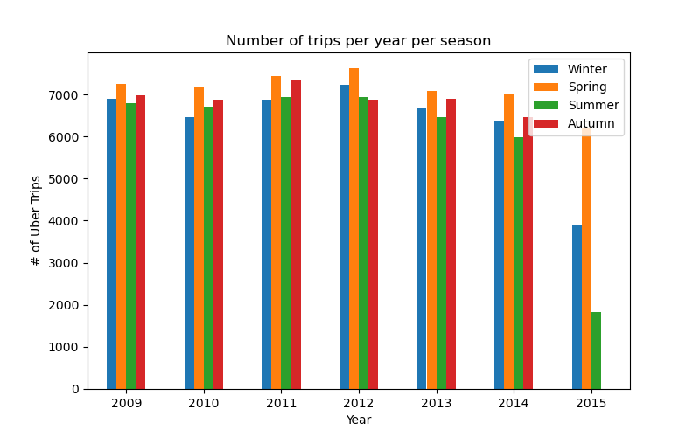
Analysis results
What is the relation between the season and the usage of Uber?
As shown in the graph below, the number of trips per season is consistent through the years. Spring and Autumn are the seasons of the year with higher usage of Uber while Winter is the season with fewer trips.

Slide 15
Analysis results
Is the usage of Uber mainly urban or rural?
When suggesting this question, we had not spent enough time working with the data and did not realise that the dataset was for trips done in New York City only. All the coordinates are points within the urban area of the city. Instead of characterising the data by rural or urban, we decided to use the Geoapify service to assign an administrative detail to each coordinate and check which specific area uses Uber the most. As it is a 200k rows dataset, we used only 2015 values. As it is shown below, we plotted the distribution of Uber trips per administrative category of New York City. 77% of the Uber trips are from Manhattan area.

Slide 16
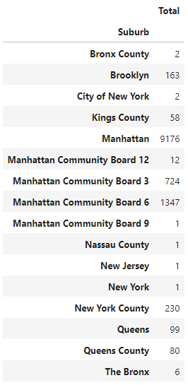
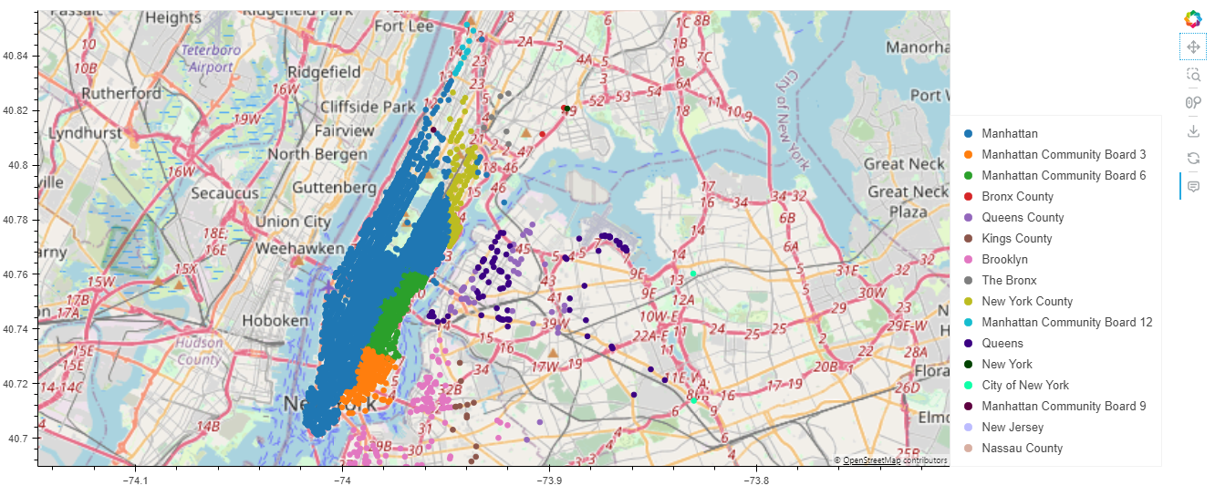

Slide 17
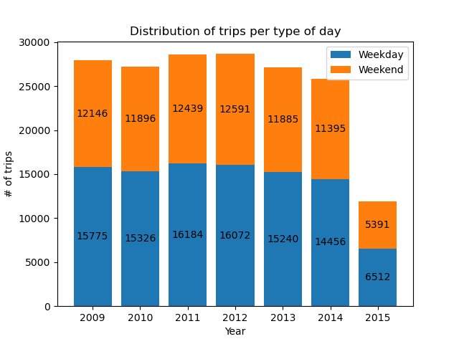
Analysis results
Does the cost/usage of Uber depend on the pick-up times? (peak hours, weekdays, weekends, etc.)
Considerations: For the purpose of this analysis, we considered weekdays as the period between Monday and Thursday. Therefore, the weekend is the period between Friday and Sunday. As it is shown in the graph below, the usage of Uber is consistently showing around 45% of usage on the weekends. Considering that it is a period of 3 days only, we might conclude that the services are mainly used during the weekends.

Slide 18
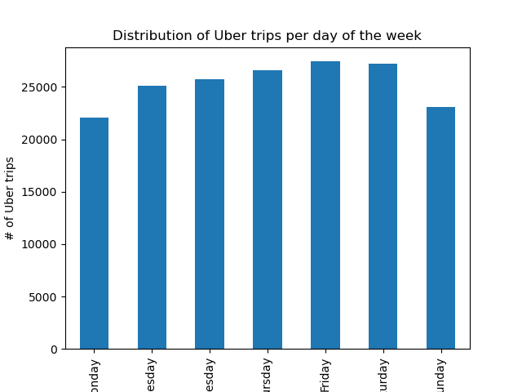
Analysis results
Does the cost/usage of Uber depend on the pick-up times? (peak hours, weekdays, weekends, etc.)
To go deeper into this analysis, the graph below shows the usage of Uber per day independently of the year. As expected, Friday is the day of the week that users use Uber the most.

Slide 19
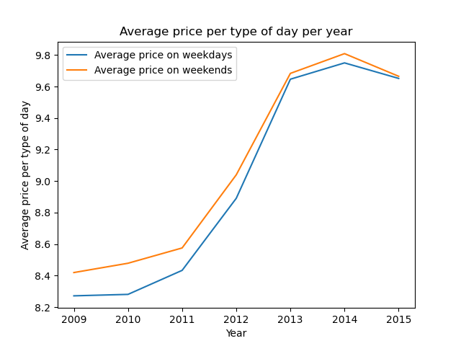
Analysis results
Does the cost/usage of Uber depend on the pick-up times? (peak hours, weekdays, weekends, etc.)
Additionally, the price paid during the weekends is consistently higher for all the years as shown on the graph below.

