Slide 1
Expectation and placebo effect
: tracking the degree of belief and its transition
전제영 이동희 신혜민
Human Brain Mapping
Notes:
Start the presentation of team ~~~
The title of our research is ~~
Basically it is about placebo effect.

Slide 2

Overview
Introduction
Background
Hypotheses
Methods
Experimental Design
Measurements
Data Analysis
Results
Behavior
fMRI
Discussion
Notes:
This is the overview of today’s presentation.
Gonna introduce some previous studies and hypotheses. Then explain the experiment and how we processed the data.
Also the analyzed result would be explained in two parts of behavior and fmri. Finally will discuss about some implications and limits.

Slide 3
Introduction

Slide 4
Introduction 1) Background
Placebo is one of the effective treatments for pain relief
It is well known that a cue information, which gives rise to expectation, modulates pain perception (Atlas et al., 2010).
However, accurate cues of experimental environment would not be enough to understand placebo effect in real life.
Dynamic probabilistic cues might help manipulate the environment to be naturalistic. The dynamic change of probability of the cues has been studied (Roy et al., 2014).
=> Study placebo effect in dynamic condition
Notes:
As most of you might agree Placebo is one of the effective treatments for pain relief
It is well known that a cue information, which elicits expectation, modulates pain perception (Atlas et al., 2010).
However, accurate cues of experimental environment would not be enough to understand placebo effect in real life. Because the real life is uncertain and noisy, so it is hard to have 100% sure belief.
Dynamic probabilistic cues might help manipulate the environment to be naturalistic. The dynamic change of probability of the cues has been studied (Roy et al., 2014).
So the aim of this research is to study placebo effect in dynamic condition

Slide 5
Introduction 2) Hypotheses
The difference of belief level would have impact on placebo effect
- Difference of brain activation in the pain related areas (S1, Insula, ACC, amygdala, thalamus etc.)
- Anticipation and belief related brain areas-medial orbitofrontal cortex(OFC) and ventral striatum(Atlas et al., 2010)-would mediate this correlation. (more placebo -> stronger mediation)
The transition of belief level would be divergent, depending on the dynamic probabilistic pain
: Represented in Periaqueductal Grey(PAG), which is known to be important for pain related learning(Roy et al., 2014).
Notes:
There are largely two hypotheses in this study,
the first one is that ~~.
- We expected that the pain related areas like s1, insula, ACC, amygdala, thalamus etc. would be different according to the belief level and the cue condition. The details are gonna be illustrated later.
- Also, Some brain areas related to Anticipation and belief, such as medial orbitofrontal cortex(OFC) and ventral striatum would mediate this correlation. (more placebo -> stronger mediation)
: we are working on mediation analysis, so it is going to be reported in the final report, not in the presentation
Second, we thought that ~
And this process would be represented in Periaqueductal grey, ~~~

Slide 6
Methods

Slide 7
Methods 1) Experimental Design
Instructed experiment
: Belief tracking task
two different cues indicating high or low pain
cue’s accuracy would be changed over a period of time
Hidden experiment
: placebo effect depending on the belief level
hidden moderate pain was given, along with high and low pain
Notes:
As this study was about placebo effect, we had some hidden part and instructed part in the experiment.
The instructed experiment was that the participants are going to do a belief tracking task, in which, two different cues indicating high or low pain are going to be presented. Also, the cue’s accuracy would be changed over a period of time. For example, although there was a high pain cue, low pain can be delievered.
The hidden experiment was that, placebo effect depending on the belief level would be observed, so some hidden moderate pain was given, along with high and low pain.

Slide 8
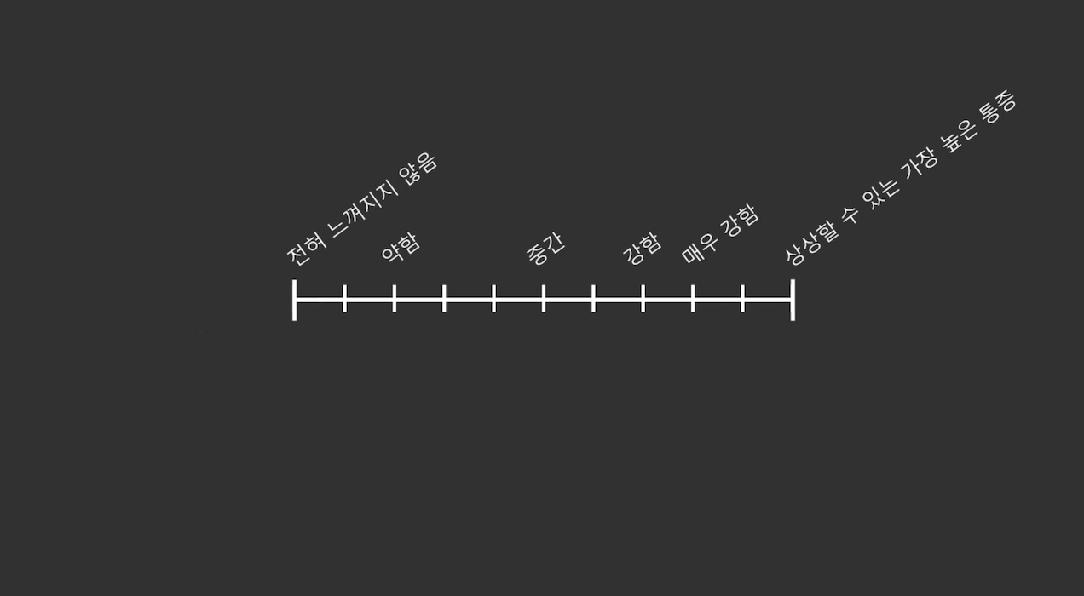
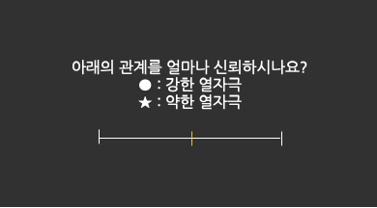
Methods 1) Experimental Design
IV: confidence condition(implicit), pain cues(explicit), thermal pain(implicit)
confidence condition: 10%, 50%, 90% match of the cue and thermal pain
pain cues: ●, ★ (high or low pain)
pain: low, middle(hidden), high
DV: pain rating, belief rating, brain activation
<Pain rating: VAS>
<Belief rating>
Notes:
There were 3 Independent variables. Those are confidence condition, pain cue, and thermal pain. Confidence condition was implicitly manipulated, and pain cues were explicit. The thermal pain was implicit, as the participants didn’t know how many, and how high temperature would be given.
There were three levels in confidence condition, 10%, 50%, 90% match of the cue and thermal pain
10% : more unmatch of the pain cue and thermal pain than match
There were two pain cues of a circle and a star, which were counterbalanced across subjects.
And three different thermal stimuli were given to a subject.
Dependent variables were pain rating, belief rating, and brain activation.
For rating the pain, VAS(visual analogue scale) was used with this labels. And for rating the belief level, this 0~100% continuous rating was used
50%: no consistency, 0%: opposite meaning

Slide 9
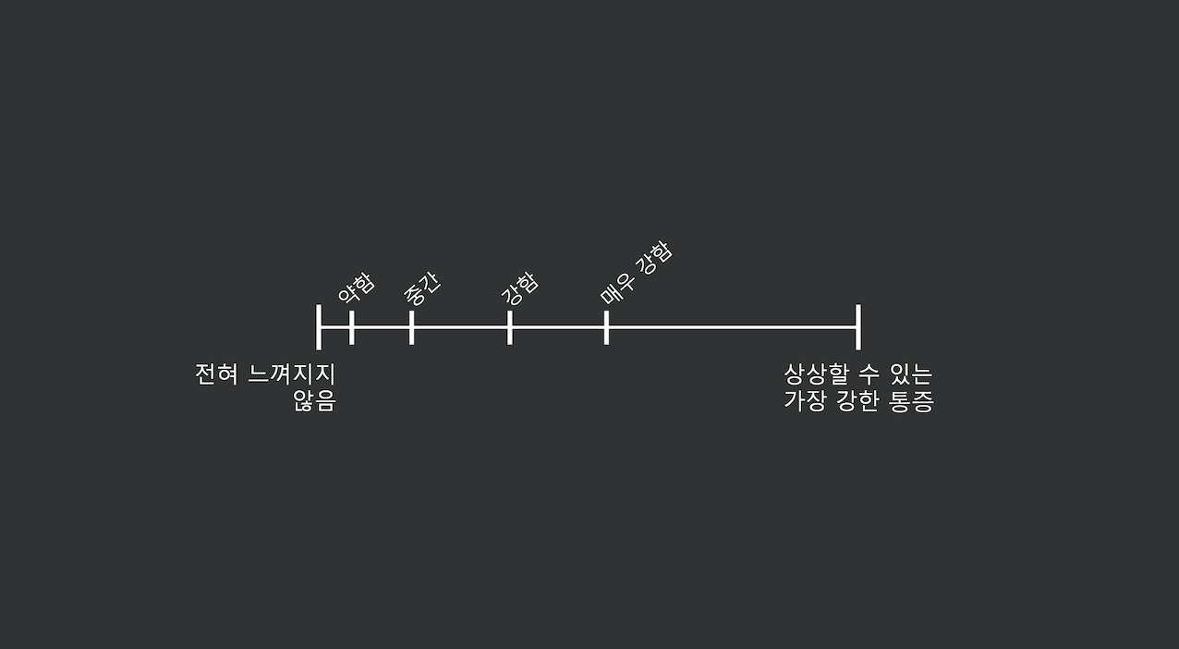
Methods 1) Experimental Design
Day1: Calibration of the heat pain
Three temperatures are chosen matched to 17(moderate), 34.7(strong), 43.6(middle of strong & very strong) in this scale
: chosen based on some behavioral experiments
1. painful but bearable
2. distanced enough
3. the middle pain to be subtly painful
‘very strong’ means ‘maximally bearable pain’
<Pain Calibration: gLMS >
Notes:
For the experiment we need three temperatures, and the temperatures were calibrated per person.
We used a scale called gLMS (general labeled magnitude scale) which is non-linear. The reason why we used different scale in calibration and fmri experiment would be illustrated later.
As a result of calibration, we can get a regression line of the score and the temperature per person, and
the three temperautres were chosen, which were mateched to 17, 34.7, 43.6 in the scale
For choosing the temperatures, we wanted the heat to be painful enough, but bearable.
Also the heat to be distanced from each other, and the hidden middle pain to be subtly painful, so that it can be felt like low pain or high pain.
+++ At the first try we tried to make the gap between each three temperature really close to make it subtle to be felt like only two temperature. However, after some behavioral experiments, we found out that people think a certain pain cue is composed of several different temperatures. Therefore, we didn’t try to make the temperatures regarded as just two of high and low at the last decision.

Slide 10
Methods 1) Experimental Design
Why the different type of scale was used
<Pain Calibration: gLMS >
<Pain rating: VAS>
1) A small range of temperatures were used in fMRI experiment
: if we use gLMS, only 1/3 of the scale would be used
2) Previous placebo study that we referred to use the VAS scale
Notes:
Here, wanna explain why the different type of scale was used.
These days this gLMS scale is more used in pain field, as it more well captures the magnitude of pain.
For instance, when the thermal pain is near ‘very strong’, small difference of temperatures makes big difference in the subjective pain.
So non-linear scale is more fit to measure the pain.
However, we used the linear scale for rating in the scanner,
we used a small range of temperatures of from 17 to 43 in gLMS, so only 1/3 of the scale would be used
Previous placebo study, which we referred to, use the VAS scale.

Slide 11
Methods 1) Experimental Design
Day2: fMRI experiment
10 trials
Confidence condition H
(90%)
Confidence condition L
(10%)
Confidence condition H
(90%)
Confidence condition H
(90%)
Confidence condition M
(50%)
Confidence condition L
(10%)
…
Run 1
Run 4
T1
Run 5
Run 8
…
…
12min
2h, 160 trials
Notes:
This is the design of our fmri experiment
There were 8 runs, and 2 confidence conditions in a run. There were diverse combination of confidence conditions, and the same confidence could be repeated.
A run was of 10 trials
Also, T1 structural imaging was in the middle of the runs for giving some rest to the participants.
A run was about 12 minutes, so around 2 hourse in total.
+++ The fMRI experiment of two different participants included all the combination of confidence condition: like HL, MM, HH etc.
As the combination numbers(9) are more than run numbers(8), each subject had some different run combinations. Also, the transition type was considered to make a scheme for each subject

Slide 12
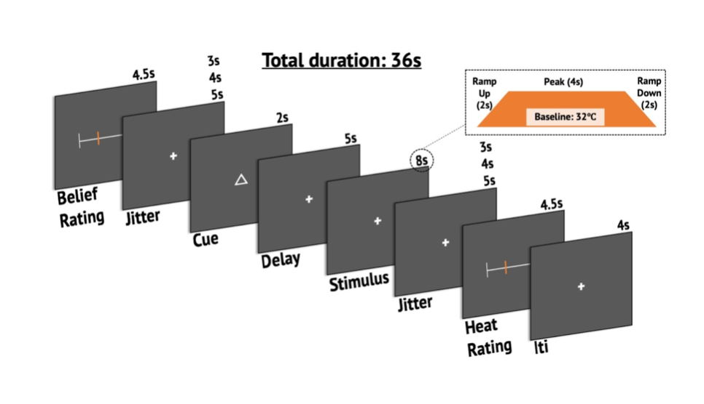
Methods 1) Experimental Design
Structure of a trial
Cue type(●, ★) is counter-balanced across subjects
Each trial has an independent probability of matching (10%,50%,90%), and the same probability is repeated for 10 times (except for 2 hidden pain trials in a random order)
Notes:
This is a structure of a trial. First of all, rated the belief level on the cues, then a cue was presented.
As mentioned before, cue type was counter-balanced across subjects. Then the thermal stimuli is delievered, and lastly rated subjective pain
Each trial had an independent probability of matching, and the same probability was repeated for 10 times except for 2 hidden pain trials in a random order.
Therefore, there were 2 hidden trials in a confidence condition, 4 trials in a run, and 32 trials in total.

Slide 13
Methods 2) Measurements
fMRI parameters
Structural T1-weighted images: magnetization-prepared rapid gradient echo sequence (0.7 ✕ 0.7 ✕ 0.7 mm³ voxel size, TR: 2,400 ms, TE: 2.34 ms, slice thickness: 0.70 mm, flip angle: 8°, FoV: 224 ✕ 224 mm²).
Functional data: gradient echo-planar imaging (EPI) sequence (2.7 ✕ 2.7 ✕ 2.7 mm³ voxel size, TR: 460 ms, TE: 27.20 ms, flip angle: 44° slice thickness: 2.7 mm, slices, FoV: 220 ✕ 220 mm², slice orientation: 15 degree off of AC-PC axis, order of slice accession: interleaved).
Notes:
Those are the fmri parameters that we used.
Any questions until here? If you don’t, 제영 will introduce the other part of methods
Placebo 논문들도 그런가..? 참고자료 넣으면 좋을 듯

Slide 14
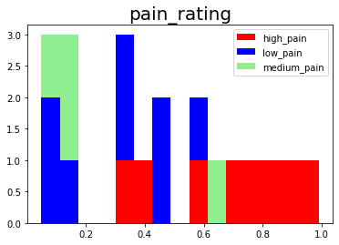
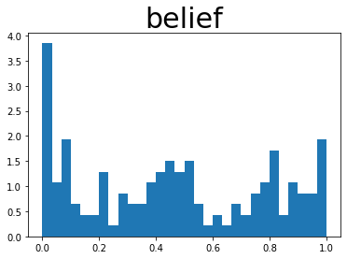
Methods 3) Data Analysis: Behavioral data
Exclusion of the data
The first run of was excluded: big variability in the
belief rating and pain rating
: would be due to the unfamiliarity to the task,
the absence of anchors to refer to,
or the delivery of inexperienced thermal pain.
2) Categorization of belief rating
Belief rating: continuous scale → discrete scale
: base on the histogram of belief rating
0~0.3: low belief
0.3~0.7: middle belief
0.7~1: high belief

Slide 15
Methods 3) Data Analysis: fMRI data
Preprocessing
Used Cocoan Lab preprocessing pipeline, which is based on SPM12 and FSL.
Structural T1-weighted images:
Co-registered to the functional image for each subject
Normalized to the MNI space.
Functional EPI images:
Motion correction (realignment)
Distortion correction using FSL’s top-up
Co-registration, spatial normalization to MNI space using structural T1-weighted images
with the interpolation to 2x2x2 voxels
Spatial smoothing with a Gaussian kernel (5 mm Full-Width Half-Maximum).

Slide 16
Results

Slide 17
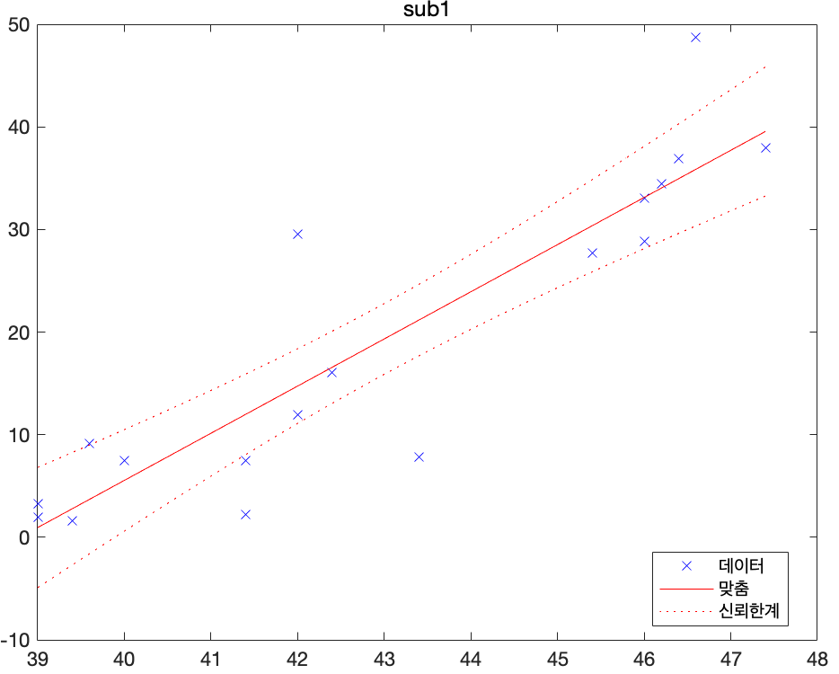
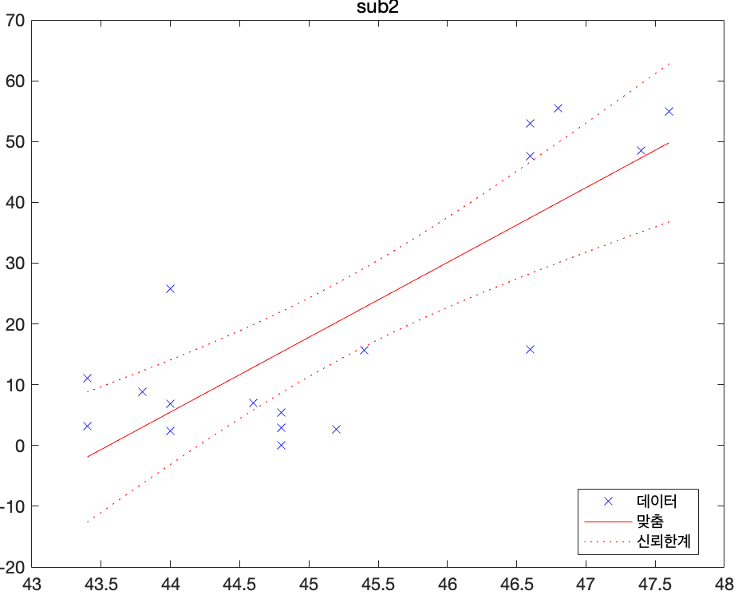
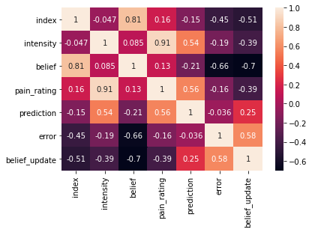
Results 1) behavior
Calibration result
42.4 / 46.2 / 48.2 44.8 / 46.2 / 47
Notes:
There was a big variability of the temperature range, and temperature itself.
Thus, the calibration procedure is thought to be helpful for the experiment.

Slide 18
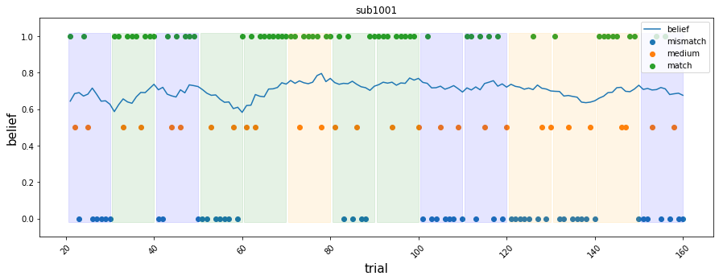
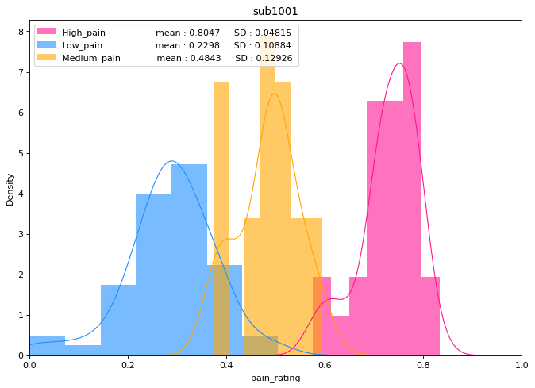
Results 1) behavior
Exclusion of sub1
mean of belief rating : 0.703
Belief rating x reflected the real belief or actual match&mismatch
Actual numbers of match& mismatch : match 51, mismatch 61
Notes:
실제와 다르다 : 절반인데, 75로 rating
Rating을 잘못

Slide 19
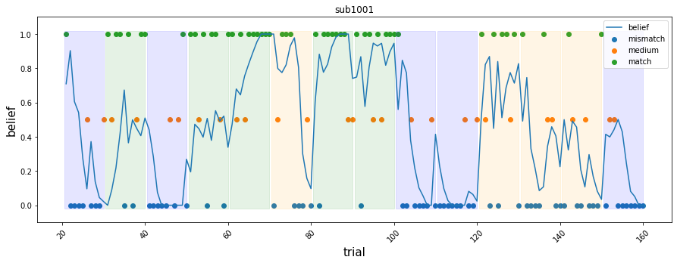
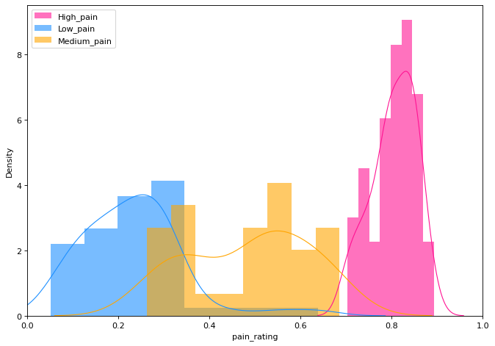
Results 1) behavior
The distribution of pain rating (sub2)
Notes:
Pain 별로 색깔을 다르게 준 figure

Slide 20
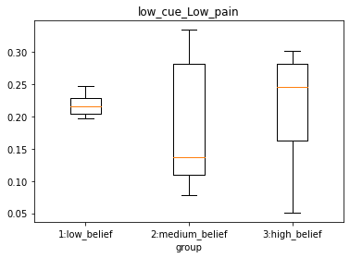
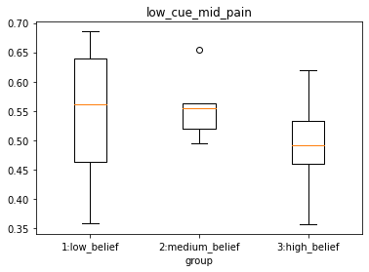
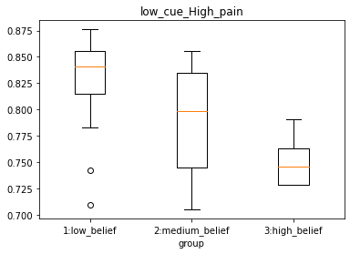
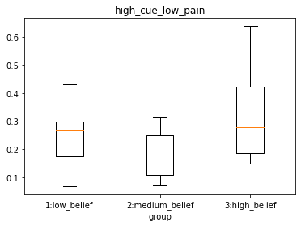
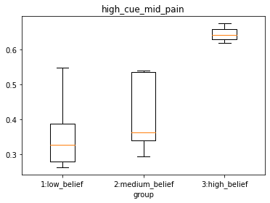
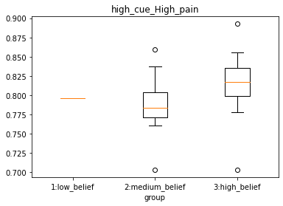
Results 1) behavior
Placebo

Slide 21
Results 1) behavior
Placebo
Pain rating of each belief group in middle pain
(F = 0.6, p = 0.59119)
(F = 8.4, p = 0.00607)

Slide 22
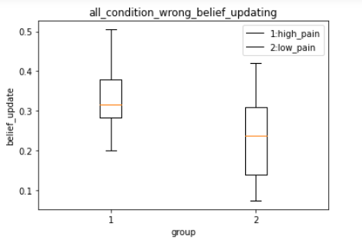
Results 1) behavior
Belief update
Belief updating conditions (combined)
Low belief, match
High belief, mismatch
=> More update in high pain
(t = -1.7701, p = 0.0970)

Slide 23
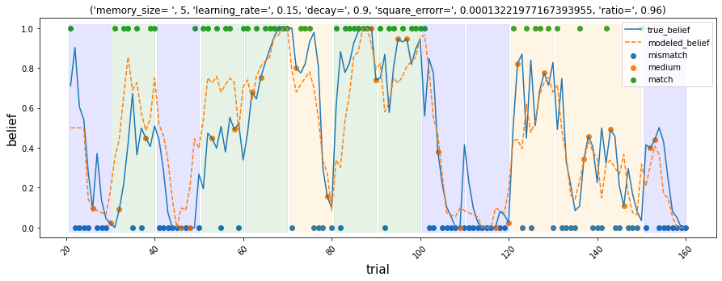
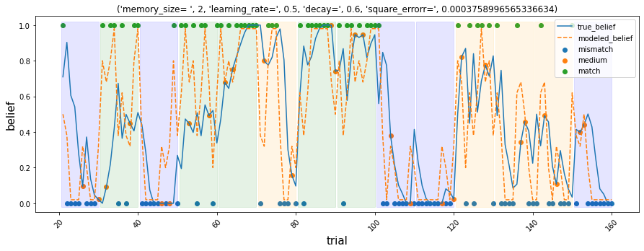
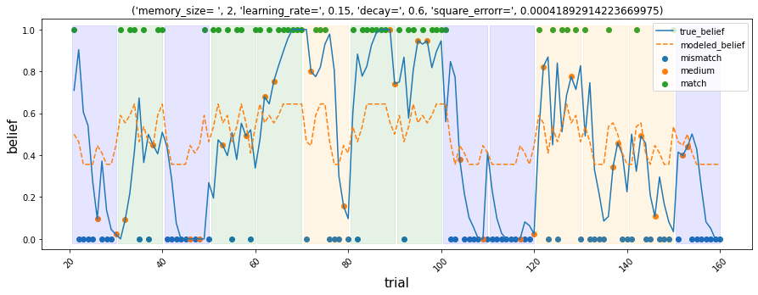
Results 1) behavior
Belief update : belief tracking model
<parameters>
Memory size
Learning rate
Discount factor
Belief ratio
Notes:
Pain 별로 색깔을 다르게 준 figure

Slide 24
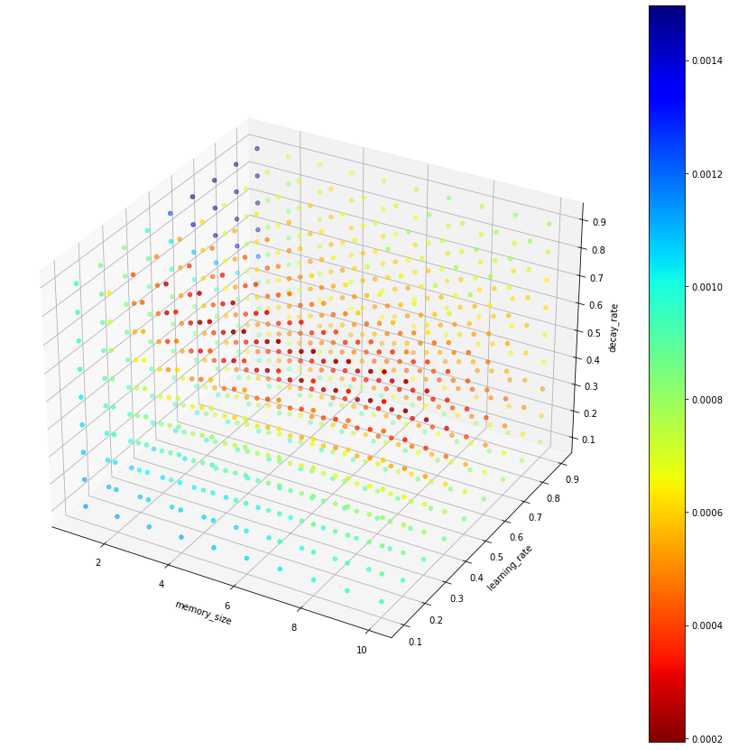
Results 1) behavior
Belief update: belief tracking model
<Parameters>
Memory size
Learning rate
Decay

Slide 25
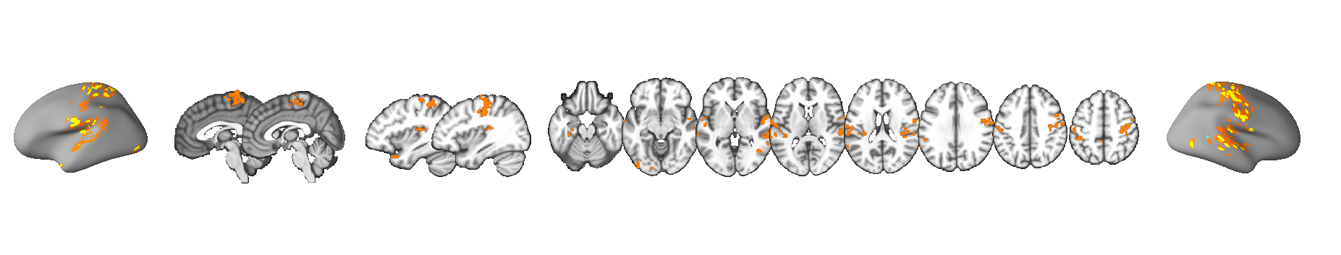
Results 2) fMRI
Placebo effect
Mid pain + High cue, high belief - low belief t test (uncorrected, p<0.005) + pruning
: Insula, S1, Amygdala, etc.

Slide 26
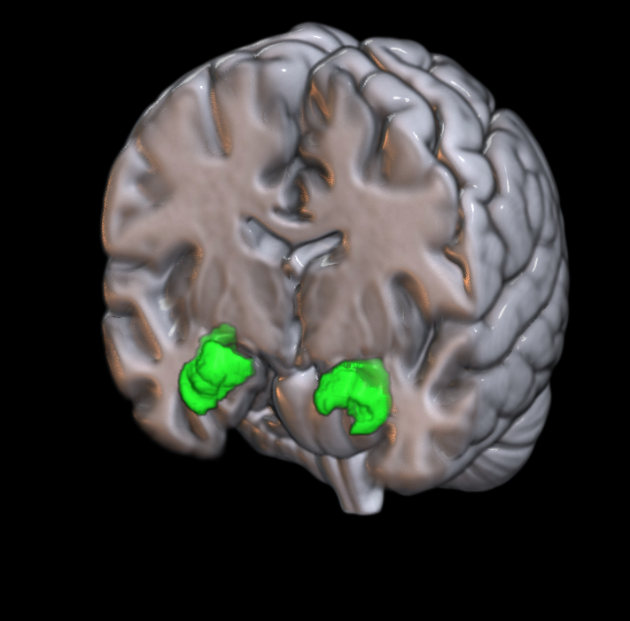
Results 2) fMRI
ㅁ
Mediation
Path a
Coeff=0.06(p=0.0092)
Amygdala
Path b
(coeff=0.14, p=0.0000)
Heat Stimulus
Levels
(Low, Medium, High)
Pain Experience
(Pain Ratings)
Path c’
Coeff=0.28 (p=0.0006)
Bootstrap : 20000

Slide 27
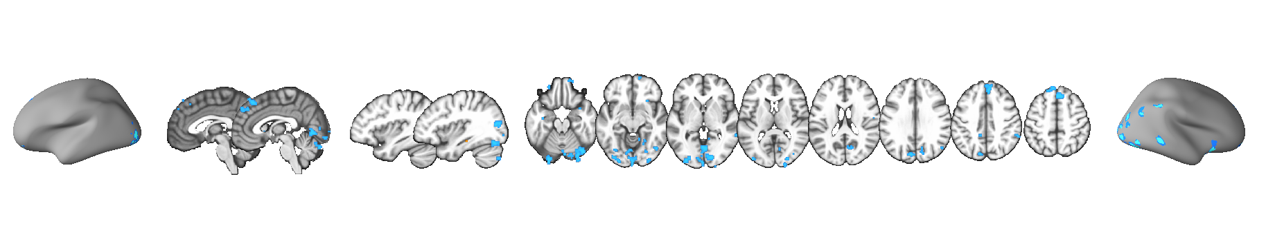
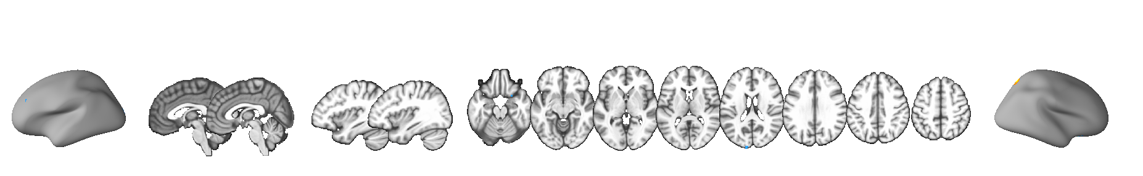
Results 2) fMRI
Belief update
High pain, high update vs. low update (uncorrected, p < 0.05) + pruning
Low pain, high update vs. low update (uncorrected, p < 0.05) + pruning
Notes:
dmPFC, visual area

Slide 28
Discussion

Slide 29
Discussion
Implications
A try to understand placebo effects in more naturalistic environment
Limitations
Participants: used different scheme for doing the task
Experimental design
Trial numbers didn’t have jitter, a run had only two confidence conditions discretely
The complexity of conditions could cause cognitive load in some conditions, which might have affected the result
Analysis: The confidence rating of stable confidence state and that of fluctuating confidence state would have different meaning, but it was not considered in this study
Notes:
The implication of this study is that is was a try to understand placebo effects in more naturalistic environment.
There were several limitations,
First of all, as the participants used different schem for doing the task, only one participant’s result was meaningful.
Second, in terms of experimental design, trial numbers were all same for the condition, and a run had only two confidence conditions discretly. So, the data point of transition was not enough.
And in analysis, the confidence rating of stable confidence state and that of fluctuating confidence state would have different meaning, but it was not considered in this study.
Run마다 이어지지 않는다는 것을 말해주거나, run마다 연결되도록 바꿔주면 좋을 것 같음

Slide 30
Reference
Atlas, L. Y., Bolger, N., Lindquist, M. A., & Wager, T. D. (2010). Brain mediators of predictive cue effects on perceived pain. Journal of Neuroscience, 30(39), 12964-12977.
Benedetti, F. (2014). Placebo Effects: From the Neurobiological Paradigm to Translational Implications. Neuron, 84(3), 623–637.
Büchel, C., Geuter, S., Sprenger, C., & Eippert, F. (2014). Placebo analgesia: a predictive coding perspective. Neuron, 81(6), 1223-1239.
Geuter, S., Boll, S., Eippert, F., & Büchel, C. (2017). Functional dissociation of stimulus intensity encoding and predictive coding of pain in the insula. Elife, 6, e24770.
Roy, M., Shohamy, D., Daw, N., Jepma, M., Wimmer, G. E., & Wager, T. D. (2014). Representation of aversive prediction errors in the human periaqueductal gray. Nature neuroscience, 17(11), 1607-1612.

Slide 31
Thank you ☺

Slide 32
10 trials
Confidence condition H
(90%)
Confidence condition L
(10%)
Confidence condition H
(90%)
Confidence condition H
(90%)
Confidence condition M
(50%)
Confidence condition L
(10%)
…
Run 1
Run 4
T1
Run 5
Run 8
…
…
12min
2h, 160 trials

Slide 33
아래의 관계를 얼마나 신뢰하시나요?
● : 강한 열자극
★ : 약한 열자극

