Slide 1

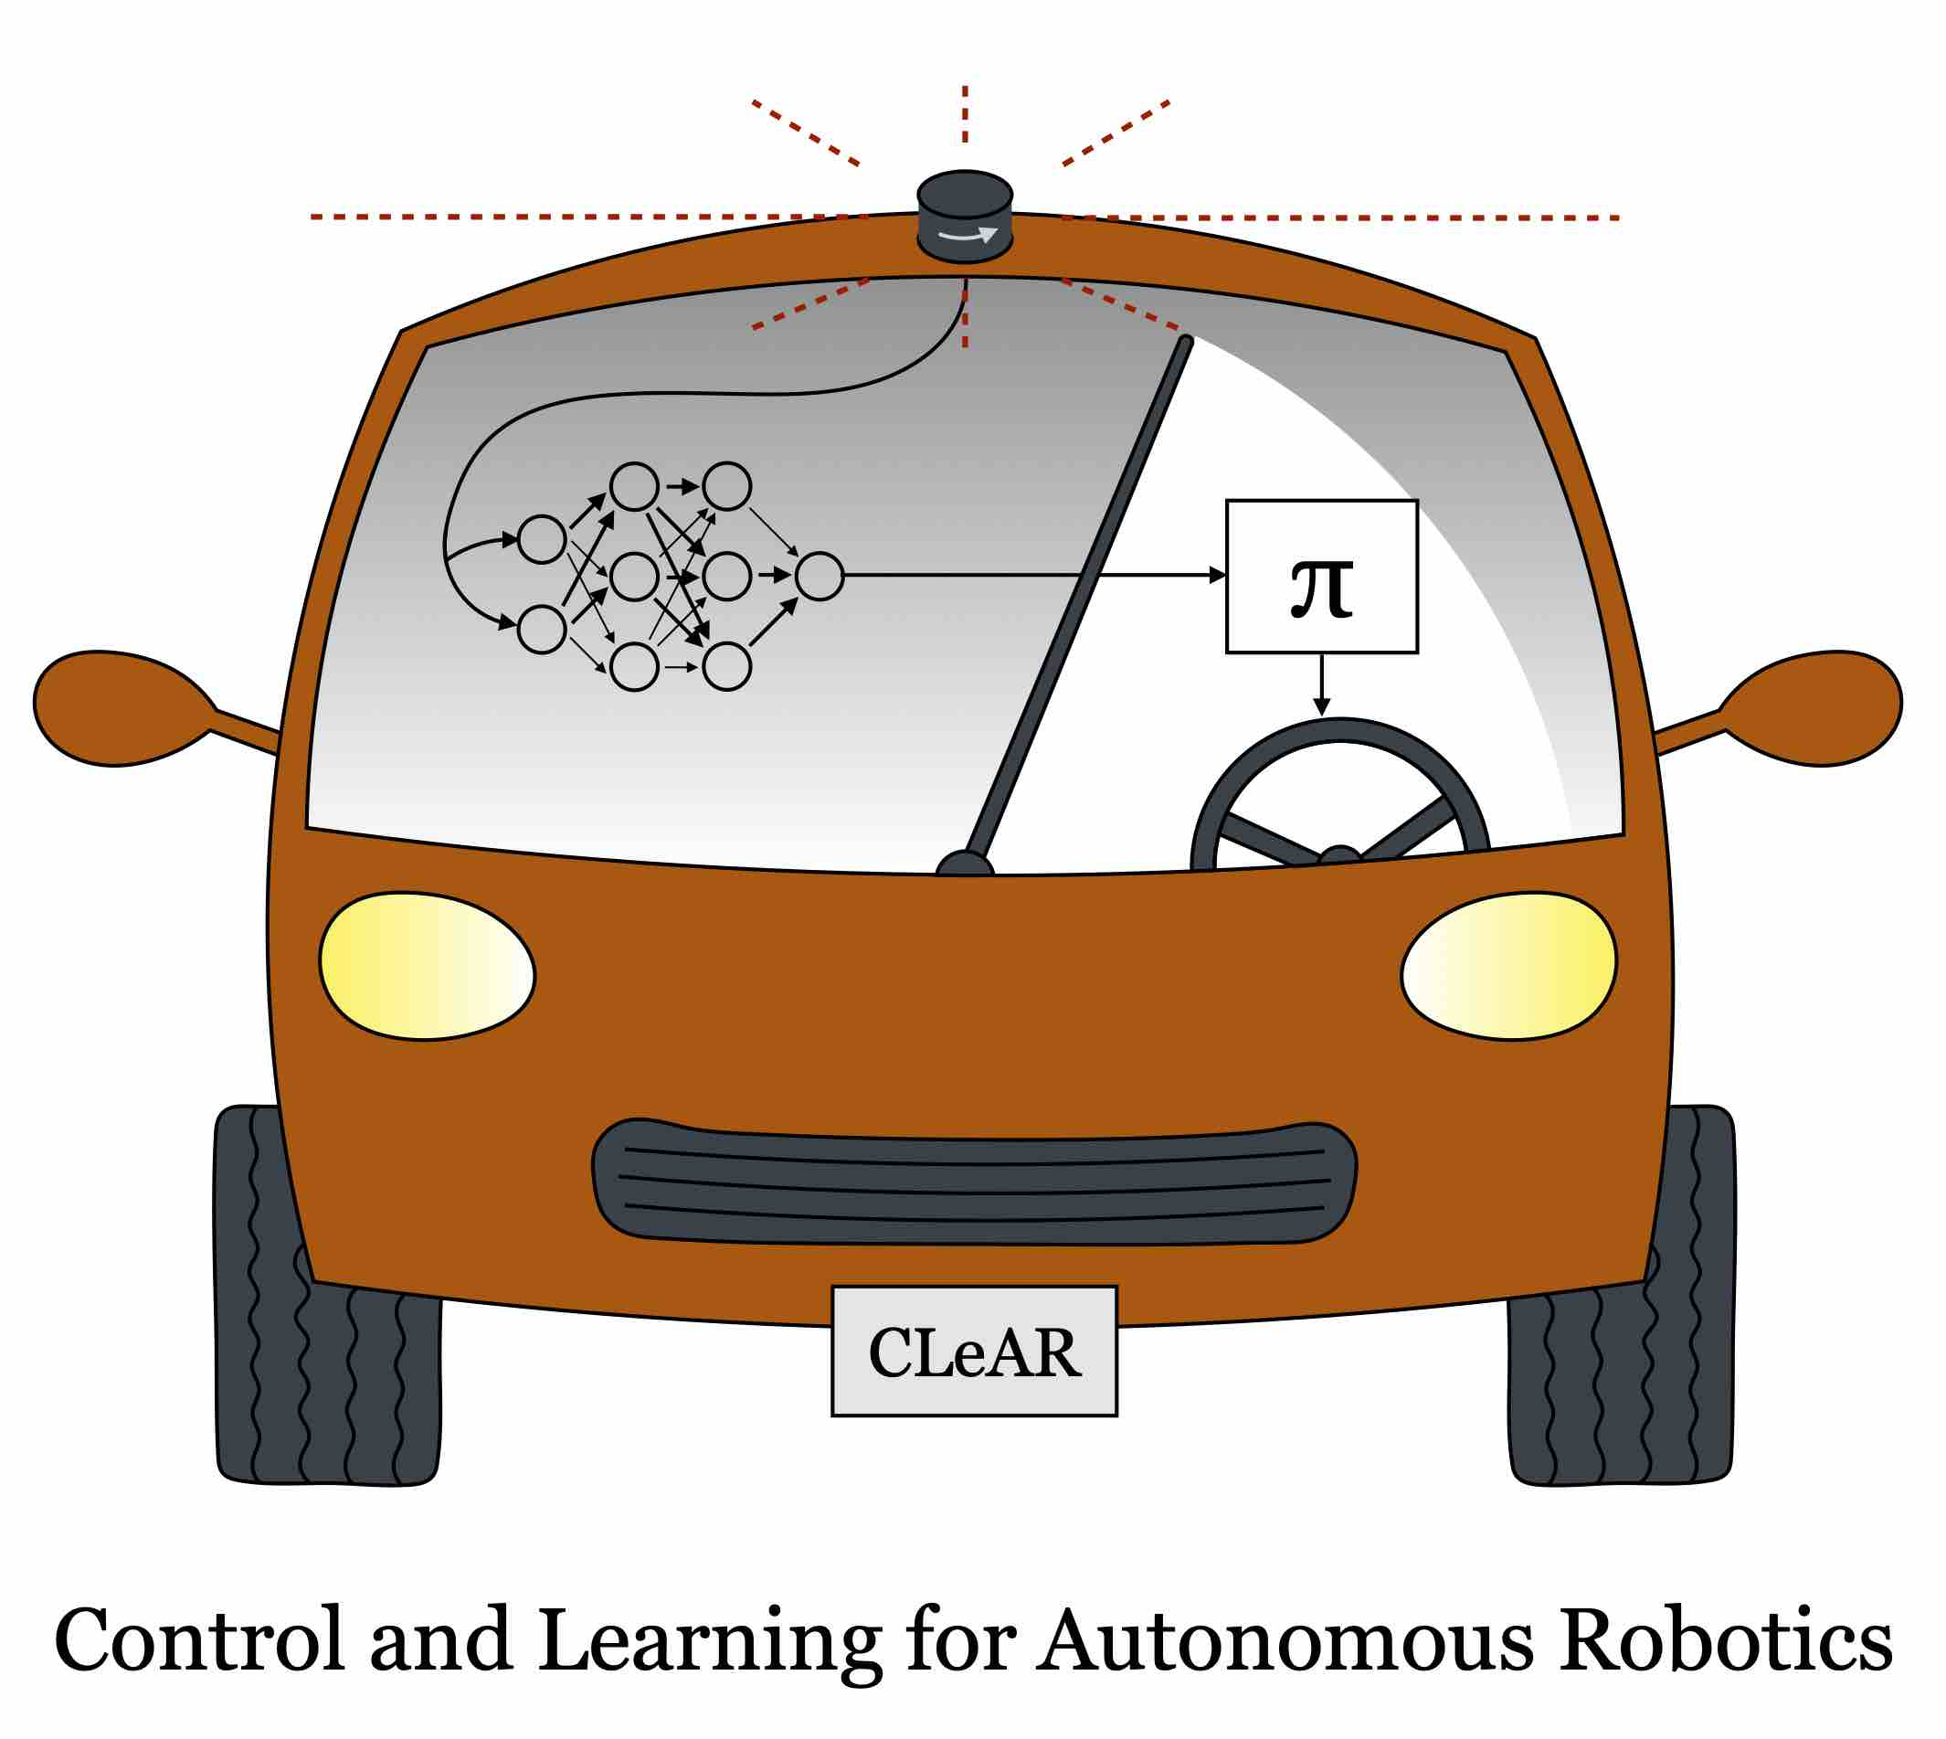

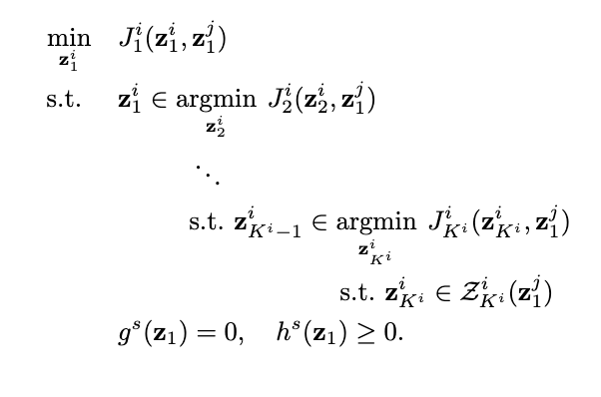
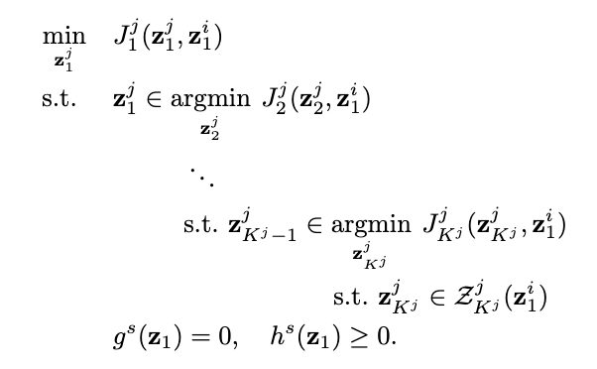
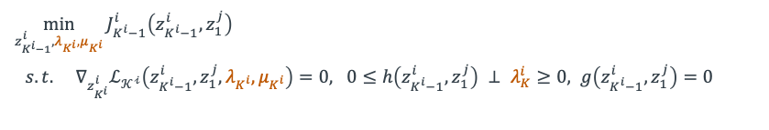
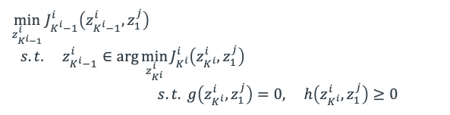

Games of Ordered Preference (GOOP)
Dong Ho Lee, Lasse Peters, David Fridovich-Keil
We propose a non-cooperative game that encodes prioritized, hierarchical objectives for each player
GOOP Formulation
Application: Intersection Scenario
Player i
Player j
Preferences
Lowest priority
Open-loop
Nash Trajectory
Intermediate priority
Vehicle 1’s goal
Vehicle 2’s goal
Highest priority
Higher
priority
KKT Reformulation: From multi-level to single-level problem
Player 1 (blue) prioritizes reaching its goal and accelerates beyond the speed limit. Player 2 (red) prioritizes obeying the speed limit and proceeds toward its goal while remaining within the limit. Both players must simultaneously ensure collision avoidance.
$\min_{z_{K^{i}−1}^{i}}{J_{K^{i}−1}^{i}\left(z_{K^{i}−1}^{i},z_{1}^{j}\right)}$
$s.t. z_{K^{i}−1}^{i}∈\arg{\min_{z_{K^{i}}^{i}}{J_{K^{i}}^{i}\left(z_{K^{i}}^{i},z_{1}^{j}\right)}}$
$$s.t. g\left(z_{K^{i}}^{i},z_{1}^{j}\right)=0, h\left(z_{K^{i}}^{i},z_{1}^{j}\right)≥0$$
Speed limit
$λ_{K^{i}},μ_{K^{i}}$: induced
primals
$$\min_{z_{K^{i}−1}^{i},λ_{K^{i}},μ_{K^{i}}}{J_{K^{i}−1}^{i}\left(z_{K^{i}−1}^{i},z_{1}^{j}\right)}$$
$s.t. ∇_{z_{K^{i}}^{i}}ℒ_{𝒦^{𝒾}}\left(z_{K^{i}−1}^{i},z_{1}^{j},λ_{K^{i}},μ_{K^{i}}\right)=0, 0≤h\left(z_{K^{i}−1}^{i},z_{1}^{j}\right) ⊥ λ_{K}^{i}≥0, g\left(z_{K^{i}−1}^{i},z_{1}^{j}\right)=0$
Notes:
Include QR code to the paper top-right
Lab logo

