Slide 1



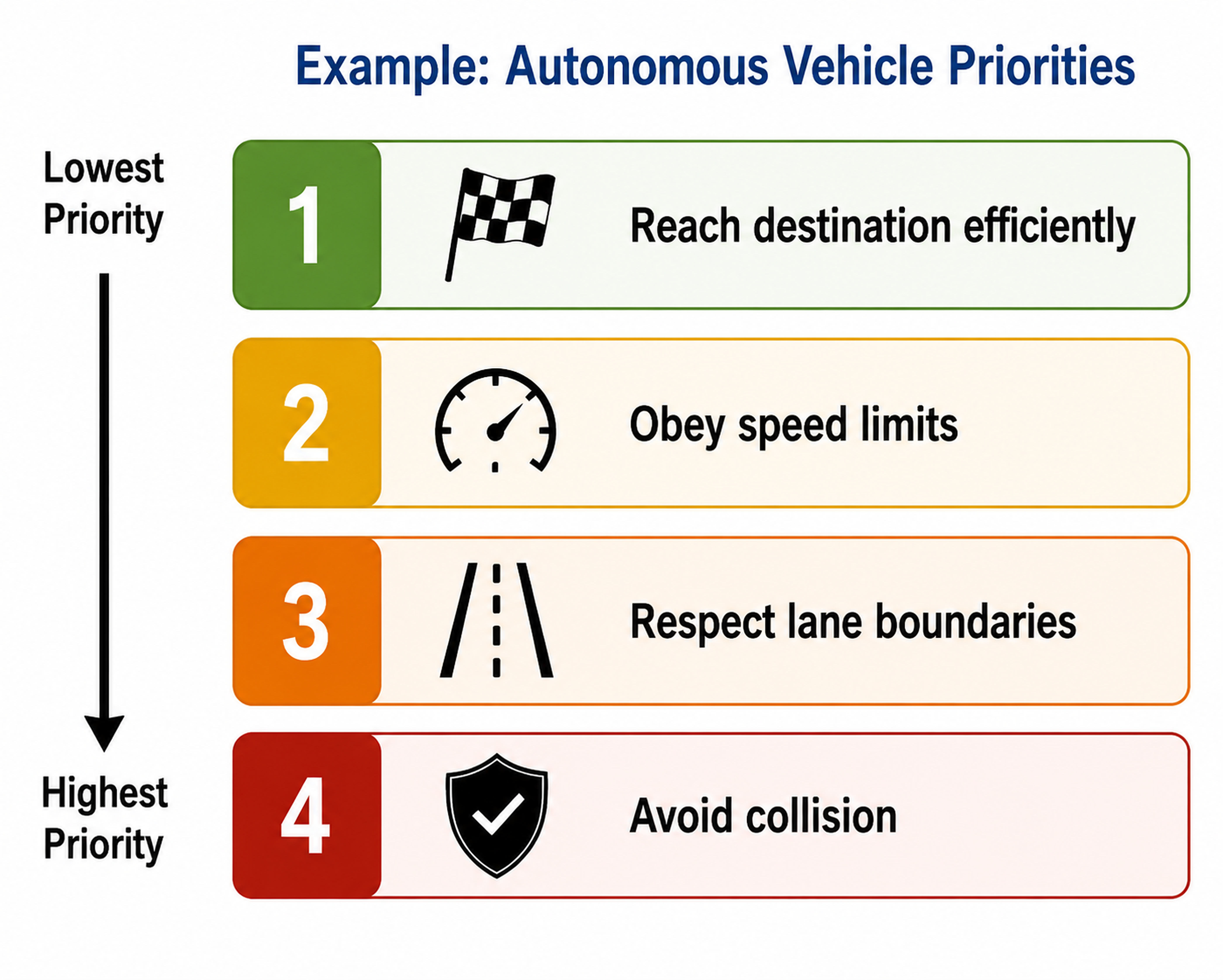

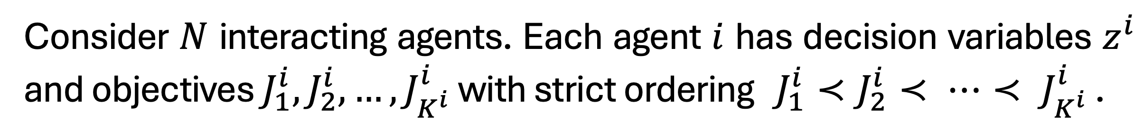
You Can’t Always Get What You Want:
Games of Ordered Preference
Dong Ho Lee, Lasse Peters, David Fridovich-Keil
1. Motivation
3. GOOP Formulation
5. Two-player Intersection
Modern autonomous systems must balance multiple competing objectives while interacting strategically with other agents.
Example applications: autonomous driving, multi-robot navigation, drone delivery, and human-robot interaction.
However, many objectives are not equally important.
Conventional multi-objective optimization often combines objectives via weighted sums:
Consider $N$ interacting agents. Each agent $i$ has decision variables $z^{i}$ and objectives $J_{1}^{i},J_{2}^{i},…,J_{K^{i}}^{i}$ with strict ordering $J_{1}^{i}≺J_{2}^{i}≺ ⋯≺ J_{K^{i}}^{i}$ .
A GOOP equilibrium is reached when (i) each player respects their own ordered preferences and (ii) no player has an incentive to unilaterally deviate from their equilibrium. This extends ideas from hierarchical/lexicographic optimization and generalized Nash equilibrium (GNE) into a unified multi-agent framework.
Limitations of weighted sums:
Requires careful tuning of weights
Difficult to encode strict priorities, i.e., allows trade-offs among prioritized objectives
Small weight changes can drastically alter behavior
Hard to interpret resulting decisions
4. Solving GOOPs
How can autonomous agents make decisions when objectives have strict priorities and should not be traded against one another?
We transcribe each agent’s hierarchical problem into a single level by successively replacing each nested problem with its corresponding KKT conditions, starting from the inner-most level (highest priority).
6. GOOP vs Weighted-sum
2. Games of Ordered Preference (GOOP)
A GOOP is a noncooperative game framework in which each agent optimizes objectives lexicographically according to a strict preference hierarchy.
Lower-level dual variables appear as primal variables in upper-level reformulations; we refer to them as induced primal variables.
Contact: Dong Ho Lee leedh0124@utexas.edu
GOOP solution (star at the top left) outperforms all baselines, achieving the smallest value of preference at the most important level. Weighted-sum baseline, on the contrary, is inconsistent and sensitive to penalty weights.
Code: https://github.com/CLeARoboticsLab/ordered-preferences
Lower-priority objectives are optimized only within the solution set of higher-priority objectives

