Slide 1
27th March 2024
William Bragg (LT 2.37)
16.00 – 18:00
Guest Speaker: None
Interactive Activity: Communicate Your Work to a Non-Technical Audience (but with AI)
2
AI

Slide 2
Time | Topic
16:05 | Intro
16:20 | Make a poster using Generative AI
16:50 | Food
17:10 | Whisper your Spiel along
17:30 | Collate and Compare
Today’s schedule

Slide 3
Show how your work is useful!

Slide 4
Overview
A lot of people are talking about impact and engaging with the wider world…
About how our models are wrong or not good enough for implementation in the real world
About how end-users don’t understand it
About academic to public engagement

Slide 5
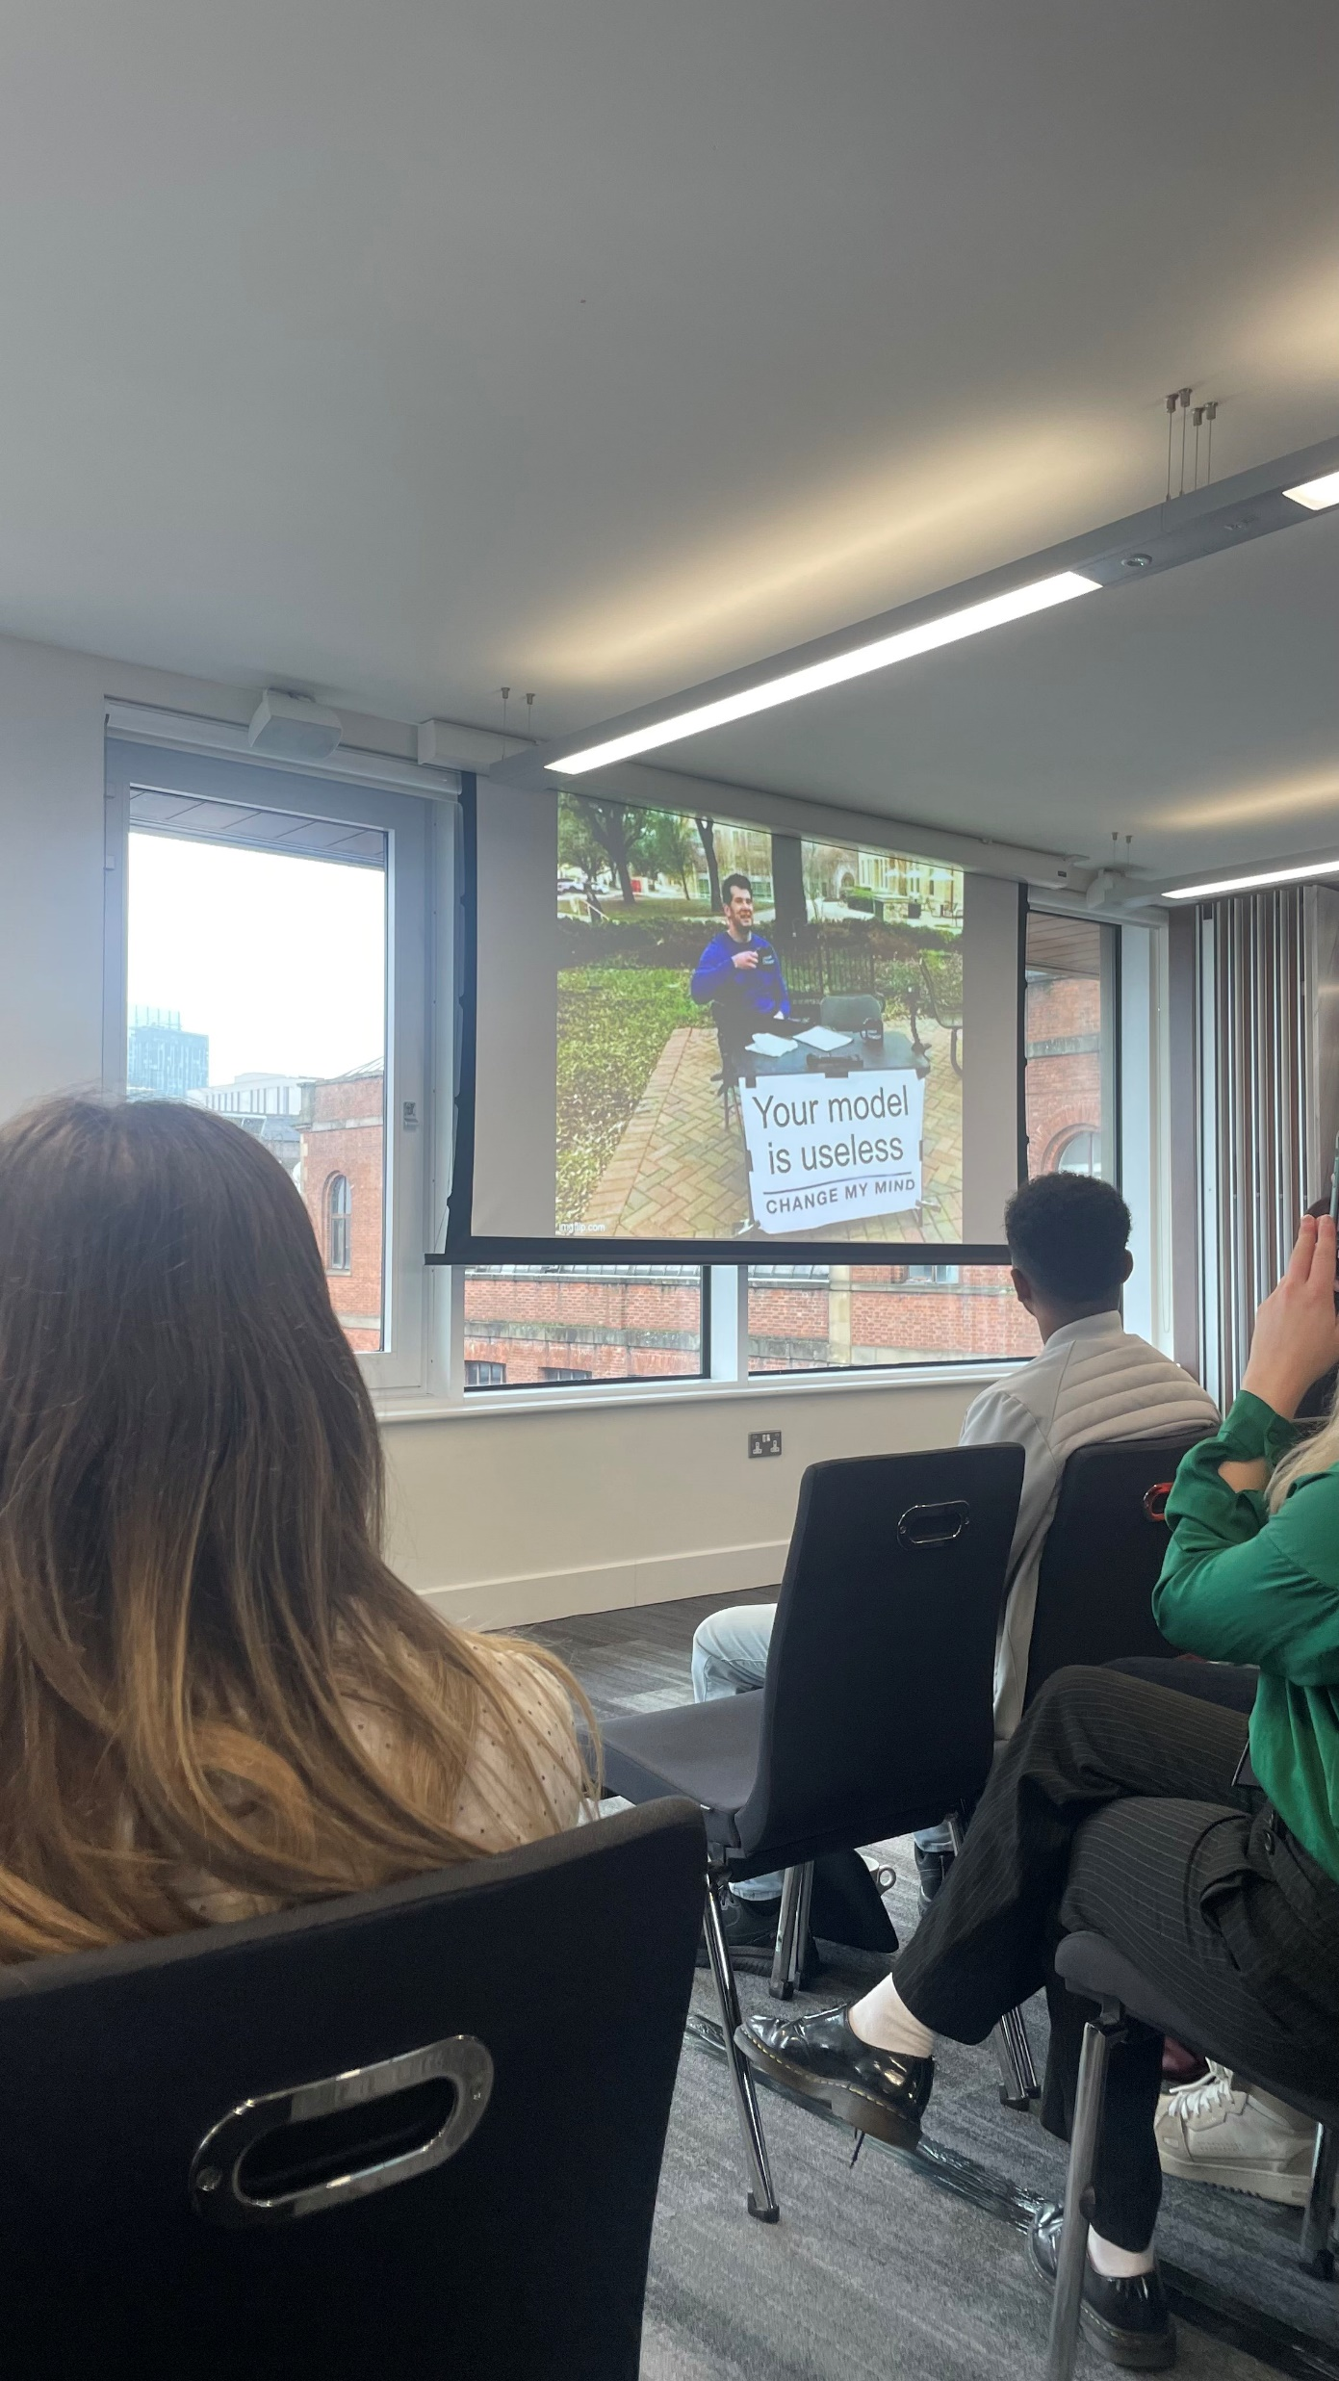
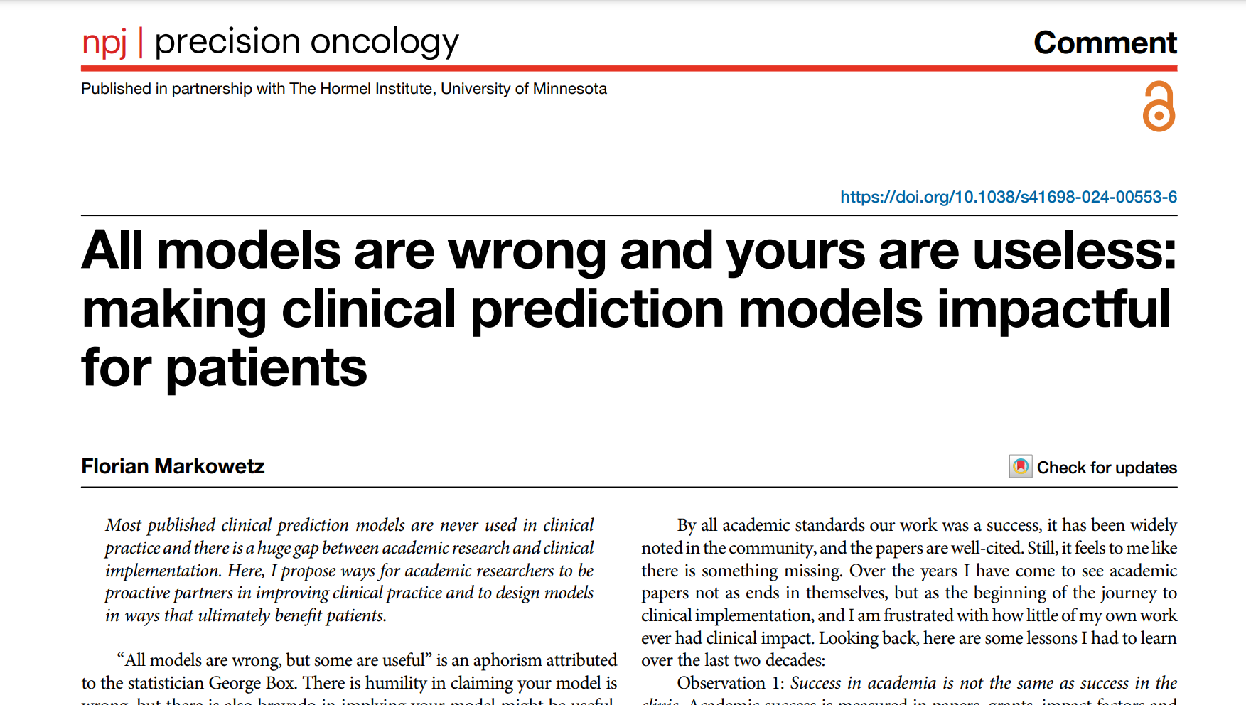
Are our models impactful?
https://www.nature.com/articles/s41698-024-00553-6

Slide 6
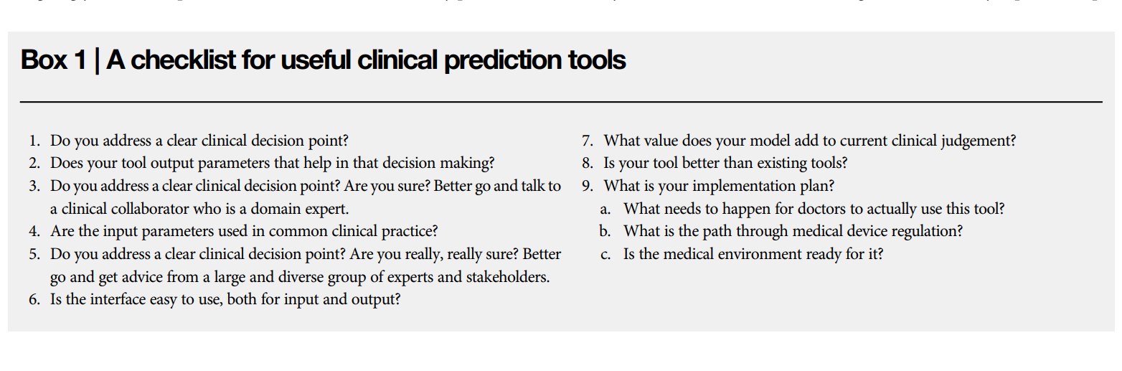
Are our models impactful?
Observation 1: Success in academia is not the same as success in the clinic.
Observation 2: Successful models use data that are available in routine practice.
Observation 3: Successful models are linked to actions.
Observation 4: Successful models are implemented outside of centres of excellence.
Observation 5: Success in the clinic is hard earned
https://www.nature.com/articles/s41698-024-00553-6

Slide 7
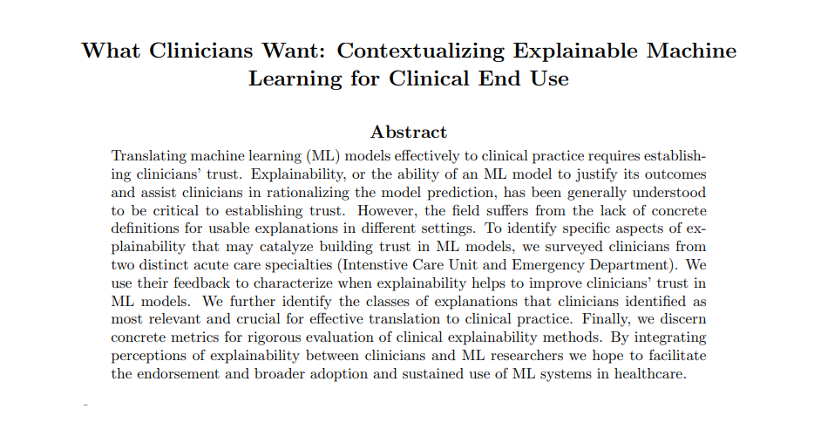
Do end users understand?
https://arxiv.org/abs/1905.05134

Slide 8
Do end users understand?
The authors say:
“Models that fall short in accuracy were deemed acceptable so long as there is clarity around why the model under-performs.”
Recalibrate clinician (stakeholder) trust of model predictions.
Provide a level of transparency that allows users to validate model outputs with domain knowledge.
Reliably disseminate model prediction using task specific representations (e.g. confidence scores).
Provide parsimonious and actionable steps clinicians can undertake. (e.g. potential interventions or data collection).
https://arxiv.org/abs/1905.05134

Slide 9
Are the public engaged?
Open question actually, I don’t have any thoughts on this one.
I haven’t put much thought into…

Slide 10
Poster
Problem / Setting the Scene
Results / Outcomes
Method / Novelty
Impact / Implementation / Hurdles

Slide 11
Poster
Problem / Setting the Scene
Results / Outcomes
2
Results / Outcomes
Problem / Setting the Scene
3
3
2
Method / Novelty
Method / Novelty
4
1
1
4
Impact / Implementation / Hurdles
Impact / Implementation / Hurdles

Slide 12
Poster
1
Problem / Setting the Scene
Hurdles to Implementation
2
Method / Novelty & Results / Outcomes
Impact of Implementation
3

Slide 13
Task
Digital Poster Phase
Using generative AI as much as possible
Pick an Audience – family, businesses/investors, end users.
Focus on Impact and Hurdles to Implementation.
Landscape orientation to fill the screen.
Spiel Phase (https://elevenlabs.io/)
Points to Hit
Context / Set the Scene
Tools / Approach
Result / Novelty / Impact
Evidence of Reliability / Trust / Use Case

Slide 14

Make the Digital Poster (with AI)

Slide 15

Time for a break!

Slide 16

Spiel Phase (pass it on)
https://elevenlabs.io/

Slide 17

Big Reveal

Slide 18
Next month:
Wednesday 24th April
William Bragg GR. 25
Topic: TBC

Slide 19

Fancy more networking?
Head over to: Old Bar or Terrace Bar
(In the Student Union)

