Slide 1
Large Language Models
building up from RNNs through Transformers
Paul Hongsuck Seo
phseo@korea.ac.kr
Korea University

Slide 2
Processing Sequential Data

Slide 3
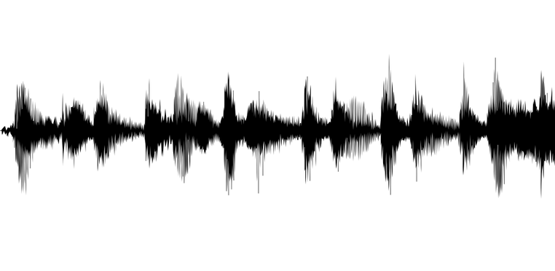

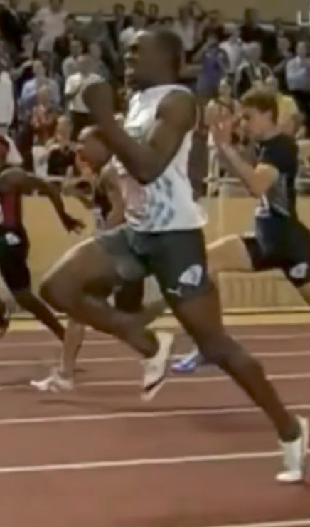
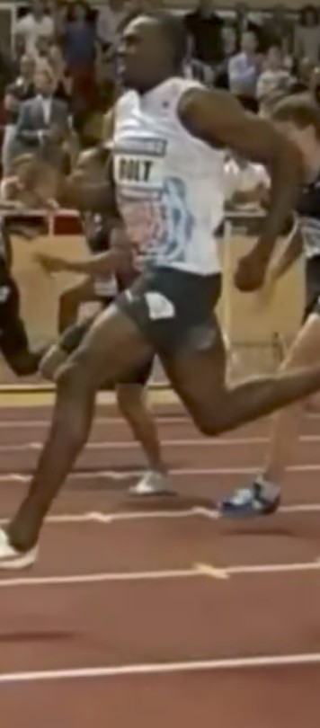
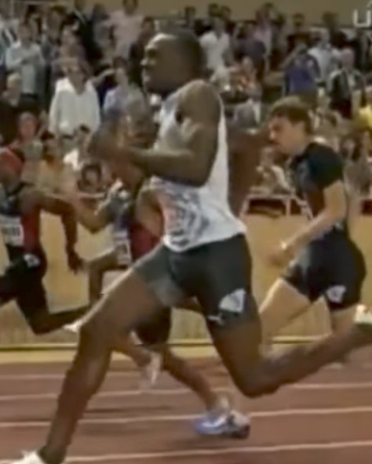
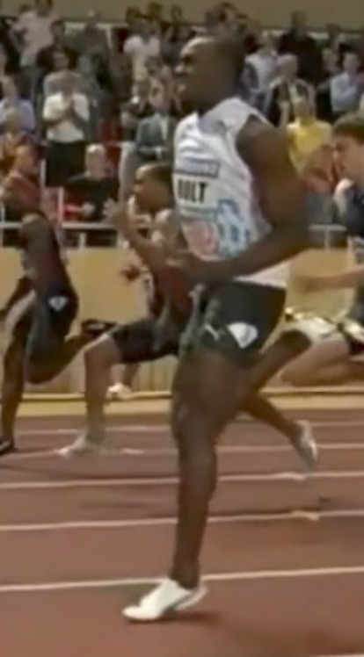
Examples of Sequence Data
Speech Recognition:
Music Generation:
Sentiment Classification:
DNA Sequence Analysis:
Machine Translation:
Video Activity Recognition:
Name Entity Recognition:
“The quick brown fox jumped over the lazy dog.”
∅
“There is nothing to like in this movie.”
AGCCCCTGTGAGGAACTAG
AGCCCCTGTGAGGAACTAG
Voulez-vous chanter avec moi?
Do you want to sing with me?
Running
Yesterday, Harry Potter met Hermione Granger.
Yesterday, Harry Potter met Hermione Granger.
[slide courtesy: Stanford, CS230]

Slide 4
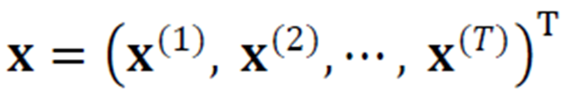
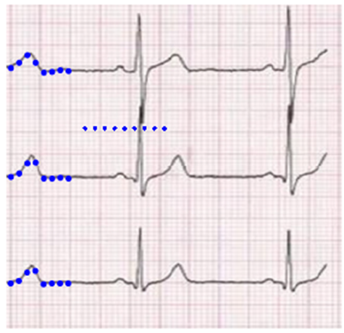
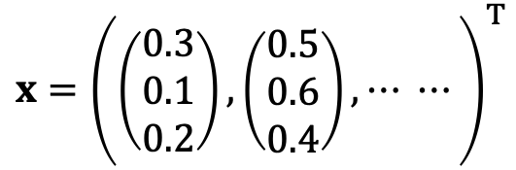
Sequential Data Representation
Input data: a set of vectors
ECG signal (3 channels)
100 samples/sec and acquire for 2 mins -> 12,000 x 3 vector (T: 12,000)
$$x={\left(\left(\begin{matrix}0.3 \\ 0.1 \\ 0.2\end{matrix}\right),\left(\begin{matrix}0.5 \\ 0.6 \\ 0.4\end{matrix}\right),⋯ ⋯\right)}^{T}$$

Slide 5
Textual Data Representation
Text sequential data representation
Text data is converted into a vector representation using a vocabulary.
Ex) The vocabulary is built with the most frequent 30,000 words in (Cho et. al., 2014).
Text representation using dictionary
Bag-of-words (BoW)
One hot code
Word embedding
Cho et. al., On the Properties of Neural Machine Translation: Encoder–Decoder Approaches, SSST-8 2014

Slide 6
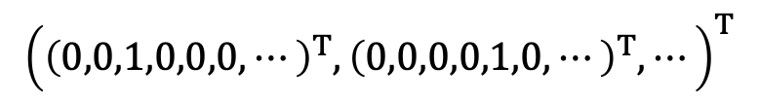
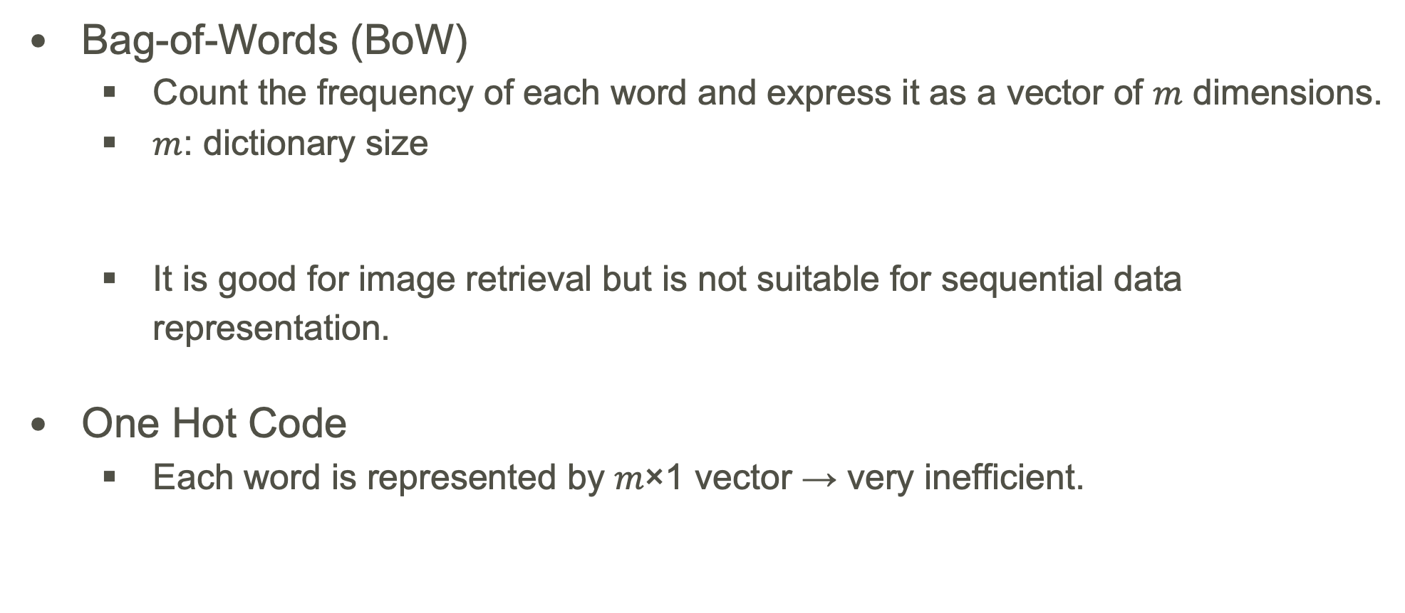
Textual Data Representation
Bag-of-Words (BoW)
Count the frequency of each word and express it as a vector of 𝑚 dimensions.
$m$: dictionary size
It is good for image retrieval but is not suitable for sequential data representation.
One Hot Code
Each word is represented by 𝑚×1 vector → very inefficient.
‘April is the cruelest month’
(0, … ,0.2, …, 0.2, …)^{T}
‘April is the cruelest month’
$${\left({\left(0,0,1,0,0,0,⋯\right)}^{T},{\left(0,0,0,0,1,0,⋯\right)}^{T},⋯\right)}^{T}$$
Cho et. al., On the Properties of Neural Machine Translation: Encoder–Decoder Approaches, SSST-8 2014

Slide 7
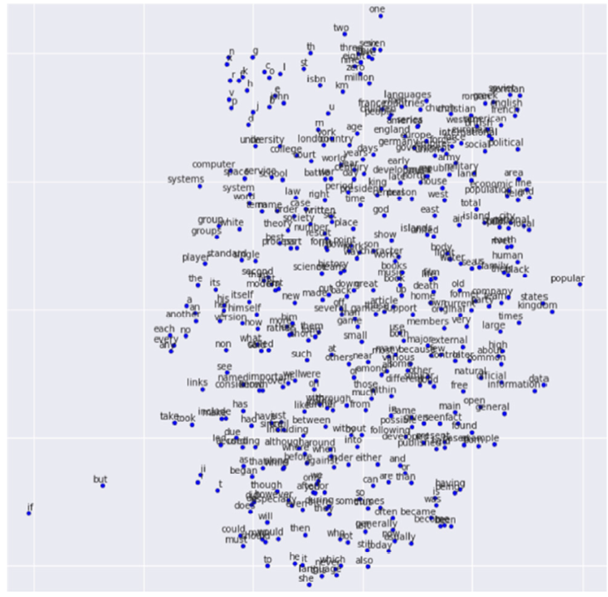
Textual Data Representation
Word Embedding
By analyzing the correlation between words in dictionary, convert the word into lower dimensional space
Ex) word in 30,000 dimensions → converted into 620 dimension
Word embedding using word2vec
Cho et. al., On the Properties of Neural Machine Translation: Encoder–Decoder Approaches, SSST-8 2014

Slide 8
Textual Data Representation
The order in which the features (words) appear is important.
Training samples may have different sizes
Context dependency
In non-sequential data, covariance matrix indicates a correlation over features.
In sequential data, context dependency is important.
She got up at lunch and ate breakfast, and he came back later.
Long-term dependency (Two distant words are correlated)
Use LSTM for handling this!

Slide 9
Recurrent Neural Networks

Slide 10
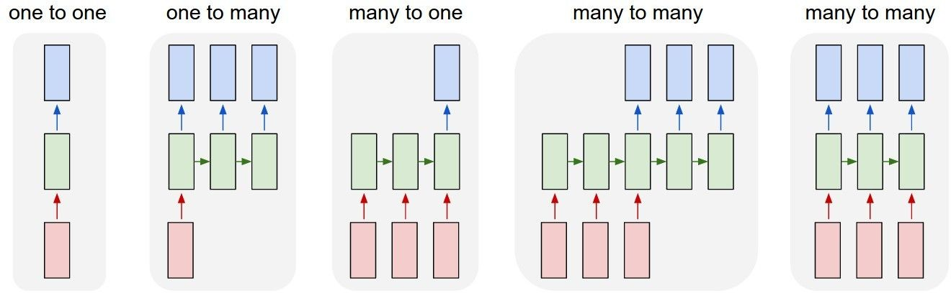
“Vanilla” Neural Networks
Vanilla Neural Networks
[slide courtesy: Stanford, CS231]

Slide 11
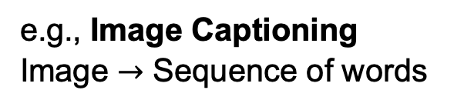
Recurrent Neural Networks (RNNs)
e.g., Image Captioning
Image $→$ Sequence of words
[slide courtesy: Stanford, CS231]

Slide 12
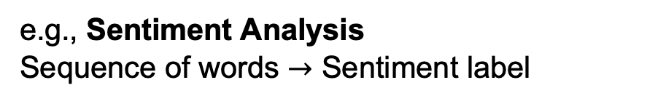
Recurrent Neural Networks (RNNs)
e.g., Sentiment Analysis
Sequence of words $→$ Sentiment label
[slide courtesy: Stanford, CS231]

Slide 13
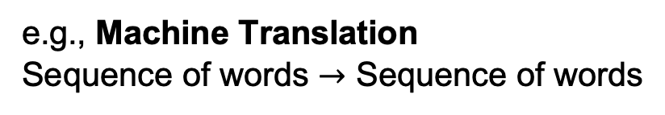
Recurrent Neural Networks (RNNs)
e.g., Machine Translation
Sequence of words $→$ Sequence of words
[slide courtesy: Stanford, CS231]

Slide 14
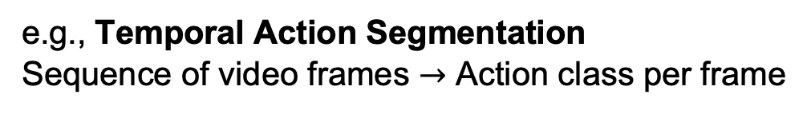
Recurrent Neural Networks (RNNs)
e.g., Temporal Action Segmentation
Sequence of video frames $→$ Action class per frame
[slide courtesy: Stanford, CS231]

Slide 15

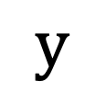
Recurrent Neural Networks (RNNs)
$$y$$
Key-idea: RNNs have an “internal state” that is updated as a sequence
is processed
RNN
$$x$$
[slide courtesy: Stanford, CS231]

Slide 16
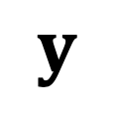
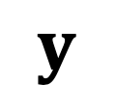


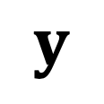

Recurrent Neural Networks (RNNs)
$$y$$
$$y$$
$$y$$
$$y$$
RNN
RNN
RNN
…
RNN
$$x$$
$$x$$
$$x$$
$$x$$
[slide courtesy: Stanford, CS231]

Slide 17
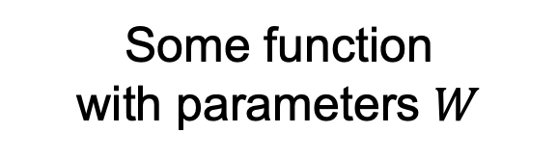
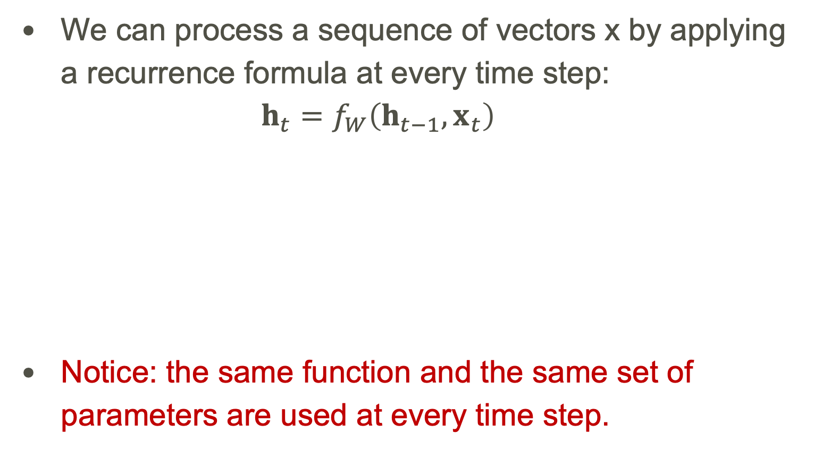
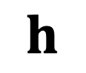
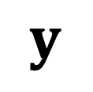

Recurrent Neural Networks (RNNs)
We can process a sequence of vectors x by applying a recurrence formula at every time step: $h_{t}=f_{W}\left(h_{t−1},x_{t}\right)$
Notice: the same function and the same set of parameters are used at every time step.
$$y$$
$$h$$
New state
Old state
Input vector at some time step
RNN
Some function with parameters $W$
$$x$$
[slide courtesy: Stanford, CS231]

Slide 18
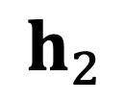

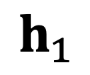

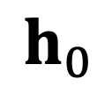
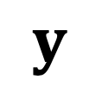

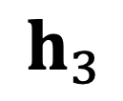
Recurrent Neural Networks (RNNs)
$$y$$
$$y$$
$$y$$
$$y$$
$$h_{0}$$
$$h_{1}$$
$$h_{2}$$
$$h_{3}$$
RNN
RNN
RNN
…
RNN
$$x$$
$$x$$
$$x$$
$$x$$
[slide courtesy: Stanford, CS231]

Slide 19



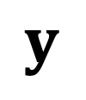
Simple Recurrent Neural Networks (RNNs)
The state consists of a single “hidden” vector $h$:
$$h_{t}=f_{W}(h_{t−1},x_{t})$$
$$↓$$
$$h_{t}=tanh\left(W_{hh}h_{t−1}+W_{xh}x_{t}\right) \\ y_{t}=W_{hy}h_{t}$$
$$y$$
$$h$$
RNN
$$x$$
[slide courtesy: Stanford, CS231]

Slide 20
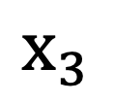
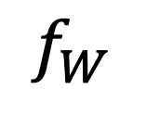
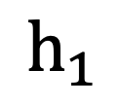
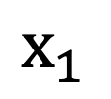
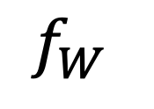
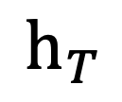
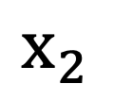
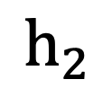
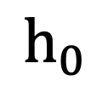
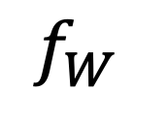
RNN: Computational Graph
$$h_{0}$$
$$f_{W}$$
$$h_{1}$$
$$f_{W}$$
$$h_{2}$$
$$f_{W}$$
…
$$h_{T}$$
$$x_{1}$$
$$x_{2}$$
$$x_{3}$$
[slide courtesy: Stanford, CS231]

Slide 21











RNN: Computational Graph
Re-use the same weight matrix at every time-step:
$$h_{0}$$
$$f_{W}$$
$$h_{1}$$
$$f_{W}$$
$$h_{2}$$
$$f_{W}$$
…
$$h_{T}$$
$$x_{1}$$
$$x_{2}$$
$$x_{3}$$
$$W$$
[slide courtesy: Stanford, CS231]

Slide 22



RNN: Computational Graph – One to Many
$$y_{1}$$
$$y_{2}$$
$$y_{T}$$
$$h_{0}$$
$$f_{W}$$
$$h_{1}$$
$$f_{W}$$
$$h_{2}$$
$$f_{W}$$
…
$$h_{T}$$
$$x_{1}$$
$$W$$
[slide courtesy: Stanford, CS231]

Slide 23

RNN: Computational Graph – Many to One
$$y$$
$$h_{0}$$
$$f_{W}$$
$$h_{1}$$
$$f_{W}$$
$$h_{2}$$
$$f_{W}$$
…
$$h_{T}$$
$$x_{1}$$
$$x_{2}$$
$$x_{3}$$
$$W$$
[slide courtesy: Stanford, CS231]

Slide 24
RNN: Computational Graph – Many to Many (1)
Aligned prediction
$$y_{1}$$
$$y_{2}$$
$$y_{T}$$
$$h_{0}$$
$$f_{W}$$
$$h_{1}$$
$$f_{W}$$
$$h_{2}$$
$$f_{W}$$
…
$$h_{T}$$
$$x_{1}$$
$$x_{2}$$
$$x_{3}$$
$$W$$
[slide courtesy: Stanford, CS231]

Slide 25







RNN: Computational Graph – Many to Many (2)
Sequence to sequence
$$y_{1}$$
$$y_{T_{o}}$$
$$h_{0}$$
$$f_{W}$$
$$h_{1}$$
…
$$f_{W}$$
$$h_{T_{i}}$$
$$f_{W}$$
…
$$h_{T}$$
$$x_{1}$$
$$x_{T_{i}}$$
$$W$$
Sutskever et al., Sequence to Sequence Learning with Neural Networks, NIPS 2014

Slide 26






Backpropagation through Time
Forward through entire sequence to compute loss, then backward through entire sequence to compute gradient:
Loss
$$y$$
$$y$$
$$y$$
$$y$$
$$y$$
$$y$$
RNN
RNN
RNN
RNN
RNN
RNN
$$x$$
$$x$$
$$x$$
$$x$$
$$x$$
$$x$$
[slide courtesy: Stanford, CS231]

Slide 27
Recurrent Neural Networks Properties
RNN Advantage:
Can process any length input.
Computation for step 𝑡 can (in theory) use information from many steps back.
Model size does not increase for longer input.
Same weights applied on every timestep, so there is symmetry in how inputs are processed.
RNN Disadvantage:
Recurrent computation is slow.
In practice, difficult to access information from many steps back.
Unidirectional sequence modeling.
[slide courtesy: Stanford, CS231]

Slide 28
Language Processing with RNNs

Slide 29
Language Processing with RNNs
A text is a sequence of characters, words or tokens.
In memory, it is represented as an array of characters.
Language as a sequence input to RNNs.

Slide 30
Language Processing with RNNs
A text is a sequence of characters, words or tokens.
In memory, it is represented as an array of characters.
Language as a sequence input to RNNs.
Vector Representation!
How should we convert the text into a vector representation?
Actually, into a sequence of vectors.

Slide 31
Text Preprocessing for Vector Representation
Text tokenization is the process of converting a sequence of text into smaller parts, known as tokens.
Vocabulary stores all possible tokens and maps each token to a unique index.
Tokens are converted into a sequence of one-hot vectors.
Note: bag-of-words representation converts the entire text into a single vector whereas the one-hot vector representation outputs a sequence of vectors.

Slide 32
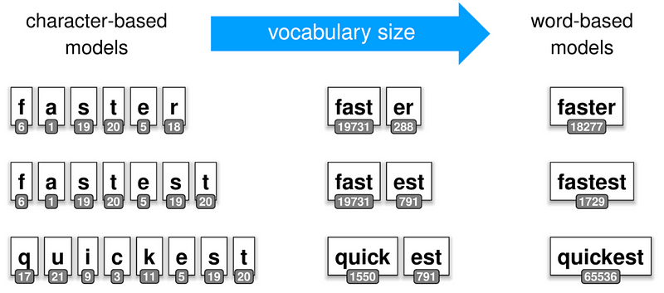
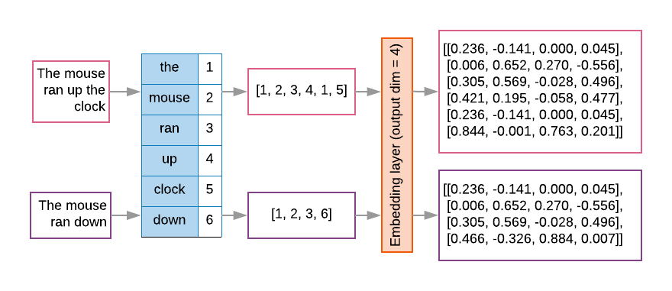
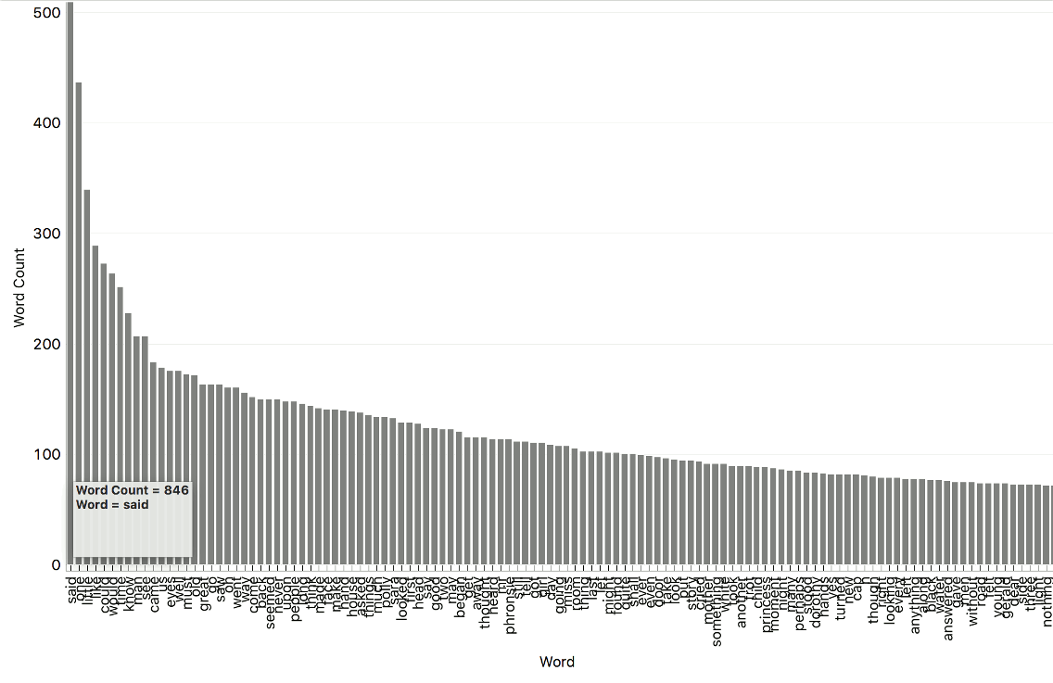
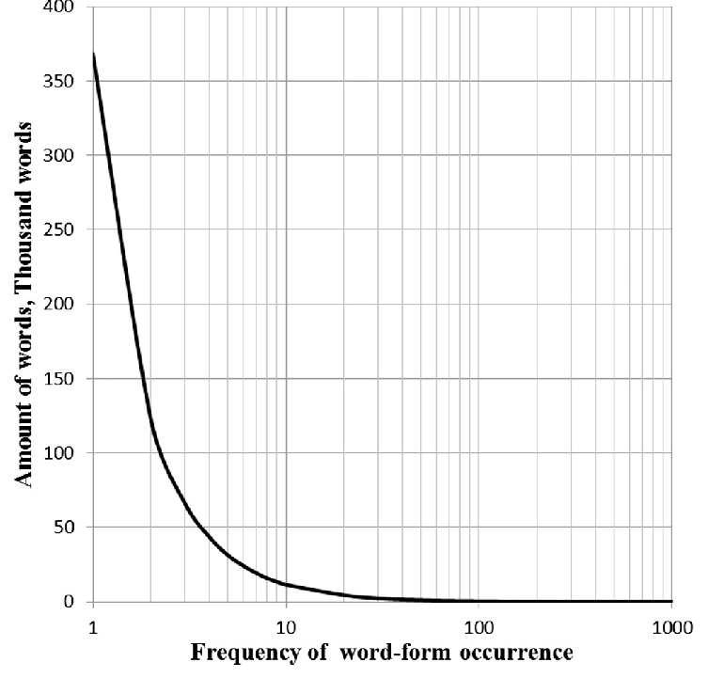
Text Tokenization
Character tokenization: each character corresponds to a single token.
Lacks semantic encoding capability.
Results in long sequences.
Word tokenization: each word is treated as a token.
Forms a big vocabulary with a long-tail distribution.
Needs a special token to deal with unknown words.
Sub-word tokenization: the vocabulary consists of frequent sub-words.
Takes advantages from the both methods.
Tokenization at different levels
Example vocabulary for tokenization
Long-tail word distribution
[source: https://www.innerdoc.com/periodic-table-of-nlp-tasks/14-tokenization/]
[source: https://orangedatamining.com/blog/observing-word-distribution/]
[source: https://www.researchgate.net/figure/Word-frequency-distribution-for-the-text-corpus_fig1_259118530]
[source: https://developers.google.com/machine-learning/guides/text-classification/step-3?hl=ko]

Slide 33
Sub-word Tokenization
Sub-word tokenization handles unknown words by merging semantics of sub-words
preschool → pre + school
longest → long + est
tokenization → token + ization
Sub-word vocabulary construction methods
WordPiece
SentencePiece
Byte Pair Encoding (BPE)
Unigram Language Model
Sennrich et. al., Neural Machine Translation of Rare Words with Subword Units, ACL 2016
Taku, Subword Regularization: Improving Neural Network Translation Models with Multiple Subword Candidates, ACL 2018
Taku et. al., SentencePiece: A simple and language independent subword tokenizer and detokenizer for Neural Text Processing, EMNLP 2018
Schuster, Japanese and Korean voice search, ICASSP 2012

Slide 34
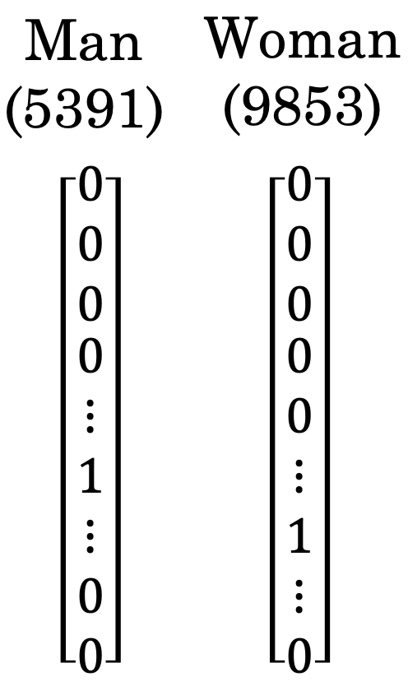
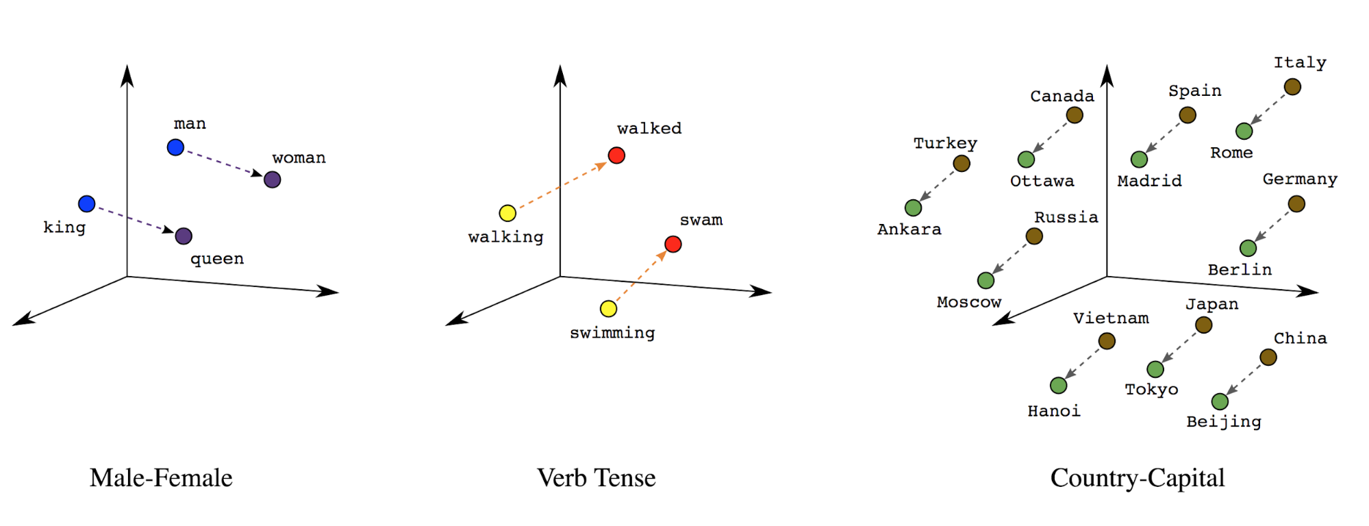
One-Hot Encoding vs. Word Embedding
One-hot encoding distinguishes different words in a vector space.
But it has some limitations
Highly sparse and inefficient use of memory with high-dimensional vectors.
The representation lacks semantic information resulting in identical pair-wise cosine similarities (0) between all words.
Word embeddings in contrast map similar words close to each other.
It allows the semantic similarity between words to be captured by their vector distances or directions.
[source: https://developers.google.com/machine-learning/guides/text-classification/step-3?hl=ko]

Slide 35
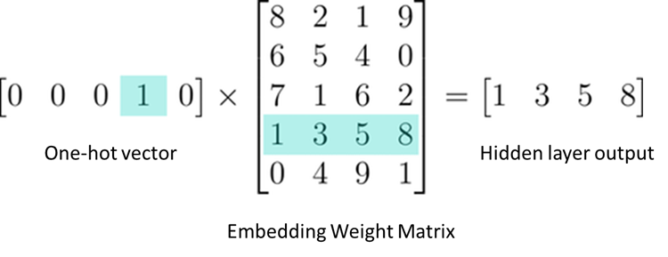
One-Hot Encoding vs. Word Embedding
Technically, one-hot encoding with an FC layer is identical to having a word embeddings
In practice, word embeddings are implemented by indexing a column (or a row) vector from a weight matrix.
[source: https://medium.com/@gautam.e/what-is-nn-embedding-really-de038baadd24]
[source: https://developers.google.com/machine-learning/guides/text-classification/step-3?hl=ko]

Slide 36
Example Task: Machine Translation

Slide 37
Machine Translation
Translating a sentence (not a document) into another language.
Input and output structures?
Both input and output are texts (sequences of tokens)
Note: there is no alignment information.
What training data?
Europarl Parallel Corpus
A benchmark with multiple parallel corpora for machine translation
Extracted from the proceedings of the European Parliament.
French to English corpus contains 2M sentence pairs with 51M French and 50M English words.

Slide 38
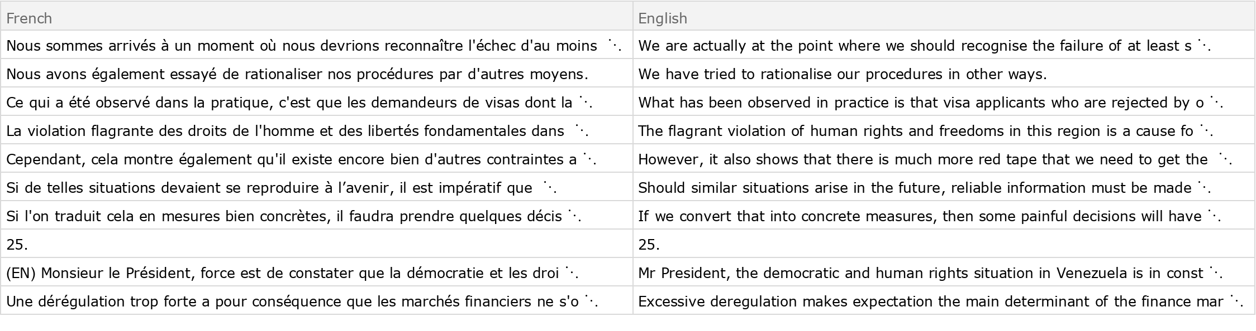
Machine Translation
Examples in a parallel corpus
[source: https://datarepository.wolframcloud.com/resources/Europarl-English-French-Machine-Translation-Dataset-V7]

Slide 39
Machine Translation
What neural architecture?
[source: https://pub.aimind.so/generating-text-with-lstm-networks-using-tensorflow-a-comprehensive-guide-79cc2eeda20a]
[source: https://www.linkedin.com/pulse/anatomy-sequence-to-sequence-machine-translation-rnn-gru-sobh-phd/]

Slide 40
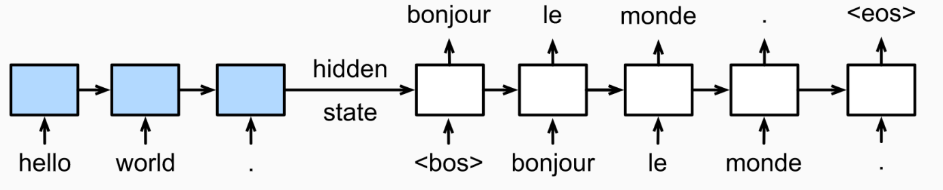
Machine Translation
What neural architecture?
Sequence to sequence model!
Encoder
Decoder
[source: https://pub.aimind.so/generating-text-with-lstm-networks-using-tensorflow-a-comprehensive-guide-79cc2eeda20a]
[source: https://www.linkedin.com/pulse/anatomy-sequence-to-sequence-machine-translation-rnn-gru-sobh-phd/]

Slide 41
Machine Translation
What neural architecture?
Sequence to sequence model!
Classifying a word (token) per timestep using softmax output function.
The alignment is never explicitly learned.
Encoder
Decoder
[source: https://pub.aimind.so/generating-text-with-lstm-networks-using-tensorflow-a-comprehensive-guide-79cc2eeda20a]
[source: https://www.linkedin.com/pulse/anatomy-sequence-to-sequence-machine-translation-rnn-gru-sobh-phd/]

Slide 42

Machine Translation
What neural architecture?
Sequence to sequence model!
Classifying a word (token) per timestep using softmax output function.
The alignment is never explicitly learned.
Autoregressive generation!
Encoder
Decoder
[source: https://pub.aimind.so/generating-text-with-lstm-networks-using-tensorflow-a-comprehensive-guide-79cc2eeda20a]
[source: https://www.linkedin.com/pulse/anatomy-sequence-to-sequence-machine-translation-rnn-gru-sobh-phd/]

Slide 43
Machine Translation
What loss function?

Slide 44

Machine Translation
What loss function?
Negative Log-Likelihood (NLL) loss
NLL loss maximizes the predicted probability of the GT label.
$$L\left(W\right)=−\frac{1}{N}\sum_{n=1}^{N}{\log{P_{W}\left(y=y_{n} | x_{n}\right)}}$$

Slide 45
Machine Translation
What loss function?
Negative Log-Likelihood (NLL) loss
NLL loss maximizes the predicted probability of the GT label.
$$L\left(W\right)=−\frac{1}{N}\sum_{n=1}^{N}{\log{P_{W}\left(y=y_{n} | x_{n}\right)}}$$
GT translated sentence

Slide 46
Machine Translation
What loss function?
Negative Log-Likelihood (NLL) loss
NLL loss maximizes the predicted probability of the GT label.
$$L\left(W\right)=−\frac{1}{N}\sum_{n=1}^{N}{\log{P_{W}\left(y=y_{n} | x_{n}\right)}}$$
GT translated sentence
Probability of GT translated sentence

Slide 47


Machine Translation
What loss function?
Negative Log-Likelihood (NLL) loss
NLL loss maximizes the predicted probability of the GT label.
$$L\left(W\right)=−\frac{1}{N}\sum_{n=1}^{N}{\log{P_{W}\left(y=y_{n} | x_{n}\right)}}$$
The probability of a generated sentence can be decomposed using the chain rule.
GT translated sentence
Probability of GT translated sentence
Chain Rule:
$$P\left(A_{1},A_{2},…,A_{n}\right)=P\left(A_{n} | A_{1},…,A_{n−1}\right)P\left(A_{1},…,A_{n−1}\right) \\ P\left(A_{1},A_{2},…,A_{n}\right)=P\left(A_{n} | A_{1},…,A_{n−1}\right)P\left(A_{n−1}|A_{1},…,A_{n−2}\right)P\left(A_{1},…,A_{n−2}\right) \\ P\left(A_{1},A_{2},…,A_{n}\right)=P\left(A_{n} | A_{1},…,A_{n−1}\right)P\left(A_{n−1}|A_{1},…,A_{n−2}\right)P\left(A_{n−2}|A_{1},…,A_{n−3}\right)P\left(A_{1},…,A_{n−3}\right) \\ P\left(A_{1},A_{2},…,A_{n}\right)=P\left(A_{n} | A_{1},…,A_{n−1}\right)P\left(A_{n−1}|A_{1},…,A_{n−2}\right)⋅…⋅P\left(A_{2}|A_{1}\right)P\left(A_{1}\right) \\ P\left(A_{1},A_{2},…,A_{n}\right)=P\left(A_{n} | A_{1:n−1}\right)P\left(A_{n−1}|A_{1:n−2}\right)⋅…⋅P\left(A_{2}|A_{1}\right)P\left(A_{1}\right) \\ P\left(A_{1},A_{2},…,A_{n}\right)=\prod_{i=1}^{n}{P\left(A_{i} | A_{1:i−1}\right)}$$

Slide 48

Machine Translation
What loss function?
Negative Log-Likelihood (NLL) loss for sentence prediction $y=(t_{1},t_{2},…,t_{L})$.
$$L\left(W\right)=−\frac{1}{N}\sum_{n=1}^{N}{\log{P_{W}\left(t_{1}=t_{1}^{\left(n\right)},t_{2}=t_{2}^{\left(n\right)},…,t_{L_{n}}=t_{L_{n}}^{\left(n\right)} | x_{n}\right)}} \\ L\left(W\right)=−\frac{1}{N}\sum_{n=1}^{N}{\log{\prod_{i=1}^{L_{n}}{P_{W}\left(t_{i}=t_{i}^{\left(n\right)} | t_{1:i−1},x_{n}\right)}}} \\ L\left(W\right)=−\frac{1}{N}\sum_{n=1}^{N}{\sum_{i=1}^{L_{n}}{\log{P_{W}\left(t_{i}=t_{i}^{\left(n\right)} | t_{1:i−1},x_{n}\right)}}}$$
Estimated probability of
GT token at each timestep.

Slide 49















Machine Translation
NLL loss computation with RNNs
+
NLL loss for the entire sequence
$$y_{1}^{∗}$$
NLL
$$y_{2}^{∗}$$
NLL
$$y_{3}^{∗}$$
NLL
$$y_{4}^{∗}$$
NLL
$$y_{n}^{∗}$$
NLL
$$y_{1}$$
$$y_{2}$$
$$y_{3}$$
$$y_{4}$$
$$y_{n}$$
RNN
RNN
RNN
RNN
…
RNN
$$y_{0}$$
$$y_{1}$$
$$y_{2}$$
$$y_{3}$$
$$y_{n−1}$$

Slide 50
Attention for Relevant Context Modeling

Slide 51









Sequence-to-Sequence with RNNs
Recall machine translation with seq2seq modeling
Input: sequence $x_{1}, …, x_{T}$
Output: sequence $y_{1}, …, y_{T^{′}}$
Encoder: $h_{t}=f_{W}(x_{t},h_{t−1})$
$$h_{1}$$
$$h_{2}$$
$$h_{3}$$
$$h_{4}$$
$$x_{1}$$
$$x_{2}$$
$$x_{3}$$
$$x_{4}$$
we
are
eating
bread
Sutskever et al, Sequence to sequence learning with neural networks, NeurIPS 2014

Slide 52



Sequence-to-Sequence with RNNs
Recall machine translation with seq2seq modeling
Input: sequence $x_{1}, …, x_{T}$
Output: sequence $y_{1}, …, y_{T^{′}}$
Encoder: $h_{t}=f_{W}(x_{t},h_{t−1})$
From final hidden state predict:
Initial decoder state $s_{0}$
Context vector $c$ (often $c=h_{T}$)
$$h_{1}$$
$$h_{2}$$
$$h_{3}$$
$$h_{4}$$
$$s_{0}$$
$$x_{1}$$
$$x_{2}$$
$$x_{3}$$
$$x_{4}$$
$$c$$
we
are
eating
bread
Sutskever et al, Sequence to sequence learning with neural networks, NeurIPS 2014

Slide 53





Sequence-to-Sequence with RNNs
Recall machine translation with seq2seq modeling
Input: sequence $x_{1}, …, x_{T}$
Output: sequence $y_{1}, …, y_{T^{′}}$
Encoder: $h_{t}=f_{W}(x_{t},h_{t−1})$
Decoder: $s_{t}=g_{U}(y_{t−1},s_{t−1},c)$
estamos
From final hidden state predict:
Initial decoder state $s_{0}$
Context vector $c$ (often $c=h_{T}$)
$$y_{1}$$
$$h_{1}$$
$$h_{2}$$
$$h_{3}$$
$$h_{4}$$
$$s_{0}$$
$$s_{1}$$
$$x_{1}$$
$$x_{2}$$
$$x_{3}$$
$$x_{4}$$
$$c$$
$$y_{0}$$
we
are
eating
bread
[START]
Sutskever et al, Sequence to sequence learning with neural networks, NeurIPS 2014

Slide 54



Sequence-to-Sequence with RNNs
Recall machine translation with seq2seq modeling
Input: sequence $x_{1}, …, x_{T}$
Output: sequence $y_{1}, …, y_{T^{′}}$
Encoder: $h_{t}=f_{W}(x_{t},h_{t−1})$
Decoder: $s_{t}=g_{U}(y_{t−1},s_{t−1},c)$
estamos
estamos comiendo
From final hidden state predict:
Initial decoder state $s_{0}$
Context vector $c$ (often $c=h_{T}$)
$$y_{1}$$
$$y_{2}$$
$$h_{1}$$
$$h_{2}$$
$$h_{3}$$
$$h_{4}$$
$$s_{0}$$
$$s_{1}$$
$$s_{2}$$
$$x_{1}$$
$$x_{2}$$
$$x_{3}$$
$$x_{4}$$
$$c$$
$$y_{0}$$
$$y_{1}$$
we
are
eating
bread
[START]
estamos
Sutskever et al, Sequence to sequence learning with neural networks, NeurIPS 2014

Slide 55






Sequence-to-Sequence with RNNs
Recall machine translation with seq2seq modeling
Input: sequence $x_{1}, …, x_{T}$
Output: sequence $y_{1}, …, y_{T^{′}}$
Encoder: $h_{t}=f_{W}(x_{t},h_{t−1})$
Decoder: $s_{t}=g_{U}(y_{t−1},s_{t−1},c)$
estamos comiendo pan [STOP]
estamos
estamos comiendo
From final hidden state predict:
Initial decoder state $s_{0}$
Context vector $c$ (often $c=h_{T}$)
$$y_{1}$$
$$y_{2}$$
$$y_{3}$$
$$y_{4}$$
$$h_{1}$$
$$h_{2}$$
$$h_{3}$$
$$h_{4}$$
$$s_{0}$$
$$s_{1}$$
$$s_{2}$$
$$s_{3}$$
$$s_{4}$$
$$x_{1}$$
$$x_{2}$$
$$x_{3}$$
$$x_{4}$$
$$c$$
$$y_{0}$$
$$y_{1}$$
$$y_{2}$$
$$y_{3}$$
we
are
eating
bread
[START]
estamos
comiendo pan
Sutskever et al, Sequence to sequence learning with neural networks, NeurIPS 2014

Slide 56
Sequence-to-Sequence with RNNs
Recall machine translation with seq2seq modeling
Input: sequence $x_{1}, …, x_{T}$
Output: sequence $y_{1}, …, y_{T^{′}}$
Encoder: $h_{t}=f_{W}(x_{t},h_{t−1})$
Decoder: $s_{t}=g_{U}(y_{t−1},s_{t−1},c)$
estamos comiendo pan [STOP]
estamos
estamos comiendo
From final hidden state predict:
Initial decoder state $s_{0}$
Context vector $c$ (often $c=h_{T}$)
$$y_{1}$$
$$y_{2}$$
$$y_{3}$$
$$y_{4}$$
$$h_{1}$$
$$h_{2}$$
$$h_{3}$$
$$h_{4}$$
$$s_{0}$$
$$s_{1}$$
$$s_{2}$$
$$s_{3}$$
$$s_{4}$$
$$x_{1}$$
$$x_{2}$$
$$x_{3}$$
$$x_{4}$$
$$c$$
$$y_{0}$$
$$y_{1}$$
$$y_{2}$$
$$y_{3}$$
Problem: Input sequence bottlenecked through fixed- sized vector. What if T=1000?
we
are
eating
bread
[START]
estamos
comiendo pan
Sutskever et al, Sequence to sequence learning with neural networks, NeurIPS 2014

Slide 57
Sequence-to-Sequence with RNNs
Recall machine translation with seq2seq modeling
Input: sequence $x_{1}, …, x_{T}$
Output: sequence $y_{1}, …, y_{T^{′}}$
Encoder: $h_{t}=f_{W}(x_{t},h_{t−1})$
Decoder: $s_{t}=g_{U}(y_{t−1},s_{t−1},c)$
estamos comiendo pan [STOP]
estamos
estamos comiendo
From final hidden state predict:
Initial decoder state $s_{0}$
Context vector $c$ (often $c=h_{T}$)
$$y_{1}$$
$$y_{2}$$
$$y_{3}$$
$$y_{4}$$
$$h_{1}$$
$$h_{2}$$
$$h_{3}$$
$$h_{4}$$
$$s_{0}$$
$$s_{1}$$
$$s_{2}$$
$$s_{3}$$
$$s_{4}$$
$$x_{1}$$
$$x_{2}$$
$$x_{3}$$
$$x_{4}$$
$$c$$
$$y_{0}$$
$$y_{1}$$
$$y_{2}$$
$$y_{3}$$
Problem: Input sequence bottlenecked through fixed- sized vector. What if T=1000?
Idea: use new context vector at each step of decoder!
we
are
eating
bread
[START]
estamos
comiendo pan
Sutskever et al, Sequence to sequence learning with neural networks, NeurIPS 2014

Slide 58

Sequence-to-Sequence with RNNs and Attention
Recall machine translation with seq2seq modeling
Input: sequence $x_{1}, …, x_{T}$
Output: sequence $y_{1}, …, y_{T^{′}}$
Encoder: $h_{t}=f_{W}(x_{t},h_{t−1})$
From final hidden state predict:
Initial decoder state $s_{0}$
$$h_{1}$$
$$h_{2}$$
$$h_{3}$$
$$h_{4}$$
$$s_{0}$$
$$x_{1}$$
$$x_{2}$$
$$x_{3}$$
$$x_{4}$$
we
are
eating
bread
Bahdanau et. al., Neural machine translation by jointly learning to align and translate, ICLR 2015

Slide 59





Sequence-to-Sequence with RNNs and Attention
Recall machine translation with seq2seq modeling
Compute (scalar) alignment scores
$$e_{ti}=f_{att}\left(s_{t−1},h_{i}\right)$$
From final hidden state predict:
Initial decoder state $s_{0}$
$$e_{11}$$
$$e_{12}$$
$$e_{13}$$
$$e_{14}$$
$$h_{1}$$
$$h_{2}$$
$$h_{3}$$
$$h_{4}$$
$$s_{0}$$
$$x_{1}$$
$$x_{2}$$
$$x_{3}$$
$$x_{4}$$
we
are
eating
bread
Bahdanau et. al., Neural machine translation by jointly learning to align and translate, ICLR 2015
Notes:
Explain f_att

Slide 60





Sequence-to-Sequence with RNNs and Attention
Recall machine translation with seq2seq modeling
Compute (scalar) alignment scores
$$e_{ti}=f_{att}\left(s_{t−1},h_{i}\right)$$
$$a_{11}$$
$$a_{12}$$
$$a_{13}$$
$$a_{14}$$
Normalize alignment scores to get attention weights
$$0≤α_{ti}≤1, \sum_{i}{α_{ti}}=1$$
softmax
From final hidden state predict:
Initial decoder state $s_{0}$
$$e_{11}$$
$$e_{12}$$
$$e_{13}$$
$$e_{14}$$
$$h_{1}$$
$$h_{2}$$
$$h_{3}$$
$$h_{4}$$
$$s_{0}$$
$$x_{1}$$
$$x_{2}$$
$$x_{3}$$
$$x_{4}$$
we
are
eating
bread
Bahdanau et. al., Neural machine translation by jointly learning to align and translate, ICLR 2015

Slide 61







Sequence-to-Sequence with RNNs and Attention
Recall machine translation with seq2seq modeling
Compute (scalar) alignment scores
$$e_{ti}=f_{att}\left(s_{t−1},h_{i}\right)$$
estamos
$$a_{11}$$
$$a_{12}$$
$$a_{13}$$
$$a_{14}$$
estamos
+
Normalize alignment scores to get attention weights
$$0≤α_{ti}≤1, \sum_{i}{α_{ti}}=1$$
softmax
From final hidden state predict:
Initial decoder state $s_{0}$
$$y_{1}$$
$$e_{11}$$
$$e_{12}$$
$$e_{13}$$
$$e_{14}$$
Compute context vector as linear combination of hidden states
$$c_{t}=\sum_{i}{α_{ti}h_{i}}$$
$$h_{1}$$
$$h_{2}$$
$$h_{3}$$
$$h_{4}$$
$$s_{0}$$
$$s_{1}$$
Use context vector in decoder
$$s_{t}=g_{U}(y_{t−1},s_{t−1},c_{t})$$
$$x_{1}$$
$$x_{2}$$
$$x_{3}$$
$$x_{4}$$
$$c_{1}$$
$$y_{0}$$
This is all differentiable! Do not supervise attention weights – backprop through everything.
we
are
eating
bread
[START]
Bahdanau et. al., Neural machine translation by jointly learning to align and translate, ICLR 2015

Slide 62

Sequence-to-Sequence with RNNs and Attention
Recall machine translation with seq2seq modeling
Compute (scalar) alignment scores
$$e_{ti}=f_{att}\left(s_{t−1},h_{i}\right)$$
estamos
$$a_{11}$$
$$a_{12}$$
$$a_{13}$$
$$a_{14}$$
estamos
+
Normalize alignment scores to get attention weights
$$0≤α_{ti}≤1, \sum_{i}{α_{ti}}=1$$
softmax
From final hidden state predict:
Initial decoder state $s_{0}$
$$y_{1}$$
$$e_{11}$$
$$e_{12}$$
$$e_{13}$$
$$e_{14}$$
Compute context vector as linear combination of hidden states
$$c_{t}=\sum_{i}{α_{ti}h_{i}}$$
$$h_{1}$$
$$h_{2}$$
$$h_{3}$$
$$h_{4}$$
$$s_{0}$$
$$s_{1}$$
Intuition: Context vector attends to the relevant part of the input sequence (alignment).
Eg., “estamos” = “we are” so maybe
$$α_{11}=α_{12}=0.45\text{, }α_{13}=α_{14}=0.05.$$
Use context vector in decoder
$$s_{t}=g_{U}(y_{t−1},s_{t−1},c_{t})$$
$$x_{1}$$
$$x_{2}$$
$$x_{3}$$
$$x_{4}$$
$$c_{1}$$
$$y_{0}$$
This is all differentiable! Do not supervise attention weights – backprop through everything.
we
are
eating
bread
[START]
Bahdanau et. al., Neural machine translation by jointly learning to align and translate, ICLR 2015

Slide 63










Sequence-to-Sequence with RNNs and Attention
Recall machine translation with seq2seq modeling
Repeat: Use $s_{1}$ to compute new context vector $c_{2}$
$$a_{21}$$
$$a_{22}$$
$$a_{23}$$
$$a_{24}$$
estamos
+
softmax
$$y_{1}$$
$$e_{21}$$
$$e_{22}$$
$$e_{23}$$
$$e_{24}$$
$$h_{1}$$
$$h_{2}$$
$$h_{3}$$
$$h_{4}$$
$$s_{0}$$
$$s_{1}$$
$$x_{1}$$
$$x_{2}$$
$$x_{3}$$
$$x_{4}$$
$$c_{1}$$
$$y_{0}$$
$$c_{2}$$
we
are
eating
bread
[START]
estamos
Bahdanau et. al., Neural machine translation by jointly learning to align and translate, ICLR 2015

Slide 64




Sequence-to-Sequence with RNNs and Attention
Recall machine translation with seq2seq modeling
Repeat: Use $s_{1}$ to compute new context vector $c_{2}$
estamos
$$a_{21}$$
$$a_{22}$$
$$a_{23}$$
$$a_{24}$$
estamos comiendo
+
Use $c_{2}$ to compute $s_{2},y_{2}$
softmax
$$y_{1}$$
$$y_{2}$$
$$e_{21}$$
$$e_{22}$$
$$e_{23}$$
$$e_{24}$$
$$h_{1}$$
$$h_{2}$$
$$h_{3}$$
$$h_{4}$$
$$s_{0}$$
$$s_{1}$$
$$s_{2}$$
$$x_{1}$$
$$x_{2}$$
$$x_{3}$$
$$x_{4}$$
$$c_{1}$$
$$y_{0}$$
$$c_{2}$$
$$y_{1}$$
we
are
eating
bread
[START]
estamos
Bahdanau et. al., Neural machine translation by jointly learning to align and translate, ICLR 2015

Slide 65








Sequence-to-Sequence with RNNs and Attention
Recall machine translation with seq2seq modeling
Use a different context vector in each timestep of decoder
estamos comiendo pan [STOP]
estamos
Input sequence not bottlenecked through a single vector
At each timestep of decoder, context vector “looks at” different parts of the input sequence
estamos comiendo
$$y_{1}$$
$$y_{2}$$
$$y_{3}$$
$$y_{4}$$
$$h_{1}$$
$$h_{2}$$
$$h_{3}$$
$$h_{4}$$
$$s_{0}$$
$$s_{1}$$
$$s_{2}$$
$$s_{3}$$
$$s_{4}$$
$$x_{1}$$
$$x_{2}$$
$$x_{3}$$
$$x_{4}$$
$$c_{1}$$
$$y_{0}$$
$$c_{2}$$
$$y_{1}$$
$$c_{3}$$
$$y_{2}$$
$$c_{4}$$
$$y_{3}$$
we
are
eating
bread
[START]
estamos
comiendo pan
Bahdanau et. al., Neural machine translation by jointly learning to align and translate, ICLR 2015

Slide 66

Sequence-to-Sequence with RNNs and Attention
Visualization of attention weights
Example:
English to French translation
Input:
“The agreement on the European Economic Area was signed in August 1992.”
Output: “L’accord sur la zone économique européenne a été signé en août 1992.”
Bahdanau et. al., Neural machine translation by jointly learning to align and translate, ICLR 2015

Slide 67
Sequence-to-Sequence with RNNs and Attention
Visualization of attention weights
Example: English to French translation
Input:
“The agreement on the European Economic Area was signed in August 1992.”
Output: “L’accord sur la zone économique européenne a été signé en août 1992.”
Diagonal attention means words correspond in order
Bahdanau et. al., Neural machine translation by jointly learning to align and translate, ICLR 2015

Slide 68
Sequence-to-Sequence with RNNs and Attention
Visualization of attention weights
Example: English to French translation
Input:
“The agreement on the European Economic Area was signed in August 1992.”
Output: “L’accord sur la zone économique européenne a été signé en août 1992.”
Diagonal attention means words correspond in order
Attention figures out different word orders
Bahdanau et. al., Neural machine translation by jointly learning to align and translate, ICLR 2015

Slide 69
Sequence-to-Sequence with RNNs and Attention
Visualization of attention weights
Example: English to French translation
Input:
“The agreement on the European Economic Area was signed in August 1992.”
Output: “L’accord sur la zone économique européenne a été signé en août 1992.”
Diagonal attention means words correspond in order
Attention figures out different word orders
Verb conjugation
Bahdanau et. al., Neural machine translation by jointly learning to align and translate, ICLR 2015

Slide 70
Transformers

Slide 71


Attention Layer
Inputs:
Query vector: $q$ (shape: $D_{Q}$)
Input vectors: $X$ (shape: $N_{X}×D_{Q}$)
Similarity function: $f_{att}$
Computation:
Similarities: $e$ (shape: $N_{X}$), $e_{i}=f_{att}\left(q,x_{i}\right)$
Attention weights: $a=softmax(e)$ (shape: $N_{X}$)
Output vector: $y=\sum_{i}{a_{i}x_{i}}$ (shape: $D_{Q}$)

Slide 72


Attention Layer
Inputs:
Query vector: $q$ (shape: $D_{Q}$)
Input vectors: $X$ (shape: $N_{X}×D_{Q}$)
Similarity function: dot product
Computation:
Similarities: $e$ (shape: $N_{X}$), $e_{i}=q⋅x_{i}$
Attention weights: $a=softmax(e)$ (shape: $N_{X}$)
Output vector: $y=\sum_{i}{a_{i}x_{i}}$ (shape: $D_{Q}$)
Changes:
- Use dot product for similarity

Slide 73


Attention Layer
Inputs:
Query vector: $q$ (shape: $D_{Q}$)
Input vectors: $X$ (shape: $N_{X}×D_{Q}$)
Similarity function: scaled dot product
Computation:
Similarities: $e$ (shape: $N_{X}$), $e_{i}=q⋅x_{i}/\sqrt{D_{Q}}$
Attention weights: $a=softmax(e)$ (shape: $N_{X}$)
Output vector: $y=\sum_{i}{a_{i}x_{i}}$ (shape: $D_{Q}$)
Changes:
- Use scaled dot product for similarity

Slide 74

Attention Layer
Inputs:
Query vector: $q$ (shape: $D_{Q}$)
Input vectors: $X$ (shape: $N_{X}×D_{Q}$)
Similarity function: scaled dot product
Large similarities will cause softmax to saturate and give vanishing gradients
Recall $a⋅b=\left|a\right|\left|b\right|\cos{(∠ab)}$ for $a,b∈D$ and thus $a⋅b$ is large when $D$ is large causing vanishing gradient.
Scaling with $1/\sqrt{D}$ will result in outputs with 0 mean and unit variance given normalized inputs.
Computation:
Similarities: $e$ (shape: $N_{X}$), $e_{i}=q⋅x_{i}/\sqrt{D_{Q}}$
Attention weights: $a=softmax(e)$ (shape: $N_{X}$)
Output vector: $y=\sum_{i}{a_{i}x_{i}}$ (shape: $D_{Q}$)
Changes:
- Use scaled dot product for similarity

Slide 75


Attention Layer
Inputs:
Query vectors: $Q$ (shape: $N_{Q}×D_{Q}$)
Input vectors: $X$ (shape: $N_{X}×D_{Q}$)
Similarity function: scaled dot product
Computation:
Similarities: $E=QX^{T}/\sqrt{D_{Q}}$ (shape: $N_{Q}×N_{X}$), $e_{ij}=q_{i}⋅x_{j}/\sqrt{D_{Q}}$
Attention weights: $A=softmax(E,dim=1)$ (shape: $N_{Q}×N_{X}$)
Output vector: $Y=AX$ (shape: $N_{Q}×D_{Q}$), $y_{i}=\sum_{j}{a_{ij}x_{j}}$
Changes:
- Use scaled dot product for similarity
- Multiple query vectors

Slide 76


Attention Layer
Inputs:
Query vectors: $Q$ (shape: $N_{Q}×D_{Q}$)
Input vectors: $X$ (shape: $N_{X}×D_{X}$)
Similarity function: scaled dot product
Key matrix: $W_{K}$ (shape: $D_{X}×D_{Q}$)
Value matrix: $W_{V}$ (shape: $D_{X}×D_{V}$)
Computation:
Key vectors: $K=XW_{K}$ (shape: $N_{X}×D_{Q}$)
Value vectors: $V=XW_{V}$ (shape: $N_{X}×D_{V}$)
Similarities: $E=QK/\sqrt{D_{Q}}$ (shape: $N_{Q}×N_{X}$), $e_{ij}=q_{i}⋅k_{j}/\sqrt{D_{Q}}$
Attention weights: $A=softmax(E,dim=1)$ (shape: $N_{Q}×N_{X}$)
Output vector: $Y=AV$ (shape: $N_{Q}×D_{V}$), $y_{i}=\sum_{j}{a_{ij}v_{j}}$
Changes:
- Use scaled dot product for similarity
- Multiple query vectors
- Separate keys and values

Slide 77






Attention Layer
Inputs:
Query vectors: $Q$ (shape: $N_{Q}×D_{Q}$)
Input vectors: $X$ (shape: $N_{X}×D_{X}$)
Similarity function: scaled dot product
Key matrix: $W_{K}$ (shape: $D_{X}×D_{Q}$)
Value matrix: $W_{V}$ (shape: $D_{X}×D_{V}$)
Computation:
Key vectors: $K=XW_{K}$ (shape: $N_{X}×D_{Q}$)
Value vectors: $V=XW_{V}$ (shape: $N_{X}×D_{V}$)
Similarities: $E=QK/\sqrt{D_{Q}}$ (shape: $N_{Q}×N_{X}$), $e_{ij}=q_{i}⋅k_{j}/\sqrt{D_{Q}}$
Attention weights: $A=softmax(E,dim=1)$ (shape: $N_{Q}×N_{X}$)
Output vector: $Y=AV$ (shape: $N_{Q}×D_{V}$), $y_{i}=\sum_{j}{a_{ij}v_{j}}$
$${ x}_{3}$$
$${ x}_{2}$$
$${ x}_{1}$$
$${ q}_{1}$$
$${ q}_{2}$$
$${ q}_{3}$$

Slide 78



Attention Layer
Inputs:
Query vectors: $Q$ (shape: $N_{Q}×D_{Q}$)
Input vectors: $X$ (shape: $N_{X}×D_{X}$)
Similarity function: scaled dot product
Key matrix: $W_{K}$ (shape: $D_{X}×D_{Q}$)
Value matrix: $W_{V}$ (shape: $D_{X}×D_{V}$)
Computation:
Key vectors: $K=XW_{K}$ (shape: $N_{X}×D_{Q}$)
Value vectors: $V=XW_{V}$ (shape: $N_{X}×D_{V}$)
Similarities: $E=QK/\sqrt{D_{Q}}$ (shape: $N_{Q}×N_{X}$), $e_{ij}=q_{i}⋅k_{j}/\sqrt{D_{Q}}$
Attention weights: $A=softmax(E,dim=1)$ (shape: $N_{Q}×N_{X}$)
Output vector: $Y=AV$ (shape: $N_{Q}×D_{V}$), $y_{i}=\sum_{j}{a_{ij}v_{j}}$
$${ x}_{3}$$
$${ k}_{3}$$
$${ x}_{2}$$
$${ k}_{2}$$
$${ x}_{1}$$
$${ k}_{1}$$
$${ q}_{1}$$
$${ q}_{2}$$
$${ q}_{3}$$

Slide 79









Attention Layer
Inputs:
Query vectors: $Q$ (shape: $N_{Q}×D_{Q}$)
Input vectors: $X$ (shape: $N_{X}×D_{X}$)
Similarity function: scaled dot product
Key matrix: $W_{K}$ (shape: $D_{X}×D_{Q}$)
Value matrix: $W_{V}$ (shape: $D_{X}×D_{V}$)
Computation:
Key vectors: $K=XW_{K}$ (shape: $N_{X}×D_{Q}$)
Value vectors: $V=XW_{V}$ (shape: $N_{X}×D_{V}$)
Similarities: $E=QK/\sqrt{D_{Q}}$ (shape: $N_{Q}×N_{X}$), $e_{ij}=q_{i}⋅k_{j}/\sqrt{D_{Q}}$
Attention weights: $A=softmax(E,dim=1)$ (shape: $N_{Q}×N_{X}$)
Output vector: $Y=AV$ (shape: $N_{Q}×D_{V}$), $y_{i}=\sum_{j}{a_{ij}v_{j}}$
$${ x}_{3}$$
$${ k}_{3}$$
$${ e}_{13}$$
$${ e}_{23}$$
$${ e}_{33}$$
$${ x}_{2}$$
$${ k}_{2}$$
$${ e}_{12}$$
$${ e}_{22}$$
$${ e}_{32}$$
$${ x}_{1}$$
$${ k}_{1}$$
$${ e}_{11}$$
$${ e}_{21}$$
$${ e}_{31}$$
$${ q}_{1}$$
$${ q}_{2}$$
$${ q}_{3}$$

Slide 80










Attention Layer
Inputs:
Query vectors: $Q$ (shape: $N_{Q}×D_{Q}$)
Input vectors: $X$ (shape: $N_{X}×D_{X}$)
Similarity function: scaled dot product
Key matrix: $W_{K}$ (shape: $D_{X}×D_{Q}$)
Value matrix: $W_{V}$ (shape: $D_{X}×D_{V}$)
$${ a}_{13}$$
$${ a}_{23}$$
$${ a}_{33}$$
$${ a}_{12}$$
$${ a}_{22}$$
$${ a}_{32}$$
$${ a}_{11}$$
$${ a}_{21}$$
$${ a}_{31}$$
$$softmax(↑)$$
Computation:
Key vectors: $K=XW_{K}$ (shape: $N_{X}×D_{Q}$)
Value vectors: $V=XW_{V}$ (shape: $N_{X}×D_{V}$)
Similarities: $E=QK/\sqrt{D_{Q}}$ (shape: $N_{Q}×N_{X}$), $e_{ij}=q_{i}⋅k_{j}/\sqrt{D_{Q}}$
Attention weights: $A=softmax(E,dim=1)$ (shape: $N_{Q}×N_{X}$)
Output vector: $Y=AV$ (shape: $N_{Q}×D_{V}$), $y_{i}=\sum_{j}{a_{ij}v_{j}}$
$${ x}_{3}$$
$${ k}_{3}$$
$${ e}_{13}$$
$${ e}_{23}$$
$${ e}_{33}$$
$${ x}_{2}$$
$${ k}_{2}$$
$${ e}_{12}$$
$${ e}_{22}$$
$${ e}_{32}$$
$${ x}_{1}$$
$${ k}_{1}$$
$${ e}_{11}$$
$${ e}_{21}$$
$${ e}_{31}$$
$${ q}_{1}$$
$${ q}_{2}$$
$${ q}_{3}$$

Slide 81



Attention Layer
Inputs:
Query vectors: $Q$ (shape: $N_{Q}×D_{Q}$)
Input vectors: $X$ (shape: $N_{X}×D_{X}$)
Similarity function: scaled dot product
Key matrix: $W_{K}$ (shape: $D_{X}×D_{Q}$)
Value matrix: $W_{V}$ (shape: $D_{X}×D_{V}$)
$${ v}_{3}$$
$${ a}_{13}$$
$${ a}_{23}$$
$${ a}_{33}$$
$${ v}_{2}$$
$${ a}_{12}$$
$${ a}_{22}$$
$${ a}_{32}$$
$${ v}_{1}$$
$${ a}_{11}$$
$${ a}_{21}$$
$${ a}_{31}$$
$$softmax(↑)$$
Computation:
Key vectors: $K=XW_{K}$ (shape: $N_{X}×D_{Q}$)
Value vectors: $V=XW_{V}$ (shape: $N_{X}×D_{V}$)
Similarities: $E=QK/\sqrt{D_{Q}}$ (shape: $N_{Q}×N_{X}$), $e_{ij}=q_{i}⋅k_{j}/\sqrt{D_{Q}}$
Attention weights: $A=softmax(E,dim=1)$ (shape: $N_{Q}×N_{X}$)
Output vector: $Y=AV$ (shape: $N_{Q}×D_{V}$), $y_{i}=\sum_{j}{a_{ij}v_{j}}$
$${ x}_{3}$$
$${ k}_{3}$$
$${ e}_{13}$$
$${ e}_{23}$$
$${ e}_{33}$$
$${ x}_{2}$$
$${ k}_{2}$$
$${ e}_{12}$$
$${ e}_{22}$$
$${ e}_{32}$$
$${ x}_{1}$$
$${ k}_{1}$$
$${ e}_{11}$$
$${ e}_{21}$$
$${ e}_{31}$$
$${ q}_{1}$$
$${ q}_{2}$$
$${ q}_{3}$$

Slide 82




Attention Layer
Inputs:
Query vectors: $Q$ (shape: $N_{Q}×D_{Q}$)
Input vectors: $X$ (shape: $N_{X}×D_{X}$)
Similarity function: scaled dot product
Key matrix: $W_{K}$ (shape: $D_{X}×D_{Q}$)
Value matrix: $W_{V}$ (shape: $D_{X}×D_{V}$)
$${ y}_{1}$$
$${ y}_{2}$$
$${ y}_{3}$$
$×(→)$, $∑(↑)$
$${ v}_{3}$$
$${ a}_{13}$$
$${ a}_{23}$$
$${ a}_{33}$$
$${ v}_{2}$$
$${ a}_{12}$$
$${ a}_{22}$$
$${ a}_{32}$$
$${ v}_{1}$$
$${ a}_{11}$$
$${ a}_{21}$$
$${ a}_{31}$$
$$softmax(↑)$$
Computation:
Key vectors: $K=XW_{K}$ (shape: $N_{X}×D_{Q}$)
Value vectors: $V=XW_{V}$ (shape: $N_{X}×D_{V}$)
Similarities: $E=QK/\sqrt{D_{Q}}$ (shape: $N_{Q}×N_{X}$), $e_{ij}=q_{i}⋅k_{j}/\sqrt{D_{Q}}$
Attention weights: $A=softmax(E,dim=1)$ (shape: $N_{Q}×N_{X}$)
Output vector: $Y=AV$ (shape: $N_{Q}×D_{V}$), $y_{i}=\sum_{j}{a_{ij}v_{j}}$
$${ x}_{3}$$
$${ k}_{3}$$
$${ e}_{13}$$
$${ e}_{23}$$
$${ e}_{33}$$
$${ x}_{2}$$
$${ k}_{2}$$
$${ e}_{12}$$
$${ e}_{22}$$
$${ e}_{32}$$
$${ x}_{1}$$
$${ k}_{1}$$
$${ e}_{11}$$
$${ e}_{21}$$
$${ e}_{31}$$
$${ q}_{1}$$
$${ q}_{2}$$
$${ q}_{3}$$

Slide 83
Attention Layer
Inputs:
Query vectors: $Q$ (shape: $N_{Q}×D_{Q}$)
Input vectors: $X$ (shape: $N_{X}×D_{X}$)
Similarity function: scaled dot product
Key matrix: $W_{K}$ (shape: $D_{X}×D_{Q}$)
Value matrix: $W_{V}$ (shape: $D_{X}×D_{V}$)
Can we use attention layer to cross-contextualize within a set of input vectors?
$${ y}_{1}$$
$${ y}_{2}$$
$${ y}_{3}$$
$×(→)$, $∑(↑)$
$${ v}_{3}$$
$${ a}_{13}$$
$${ a}_{23}$$
$${ a}_{33}$$
$${ v}_{2}$$
$${ a}_{12}$$
$${ a}_{22}$$
$${ a}_{32}$$
$${ v}_{1}$$
$${ a}_{11}$$
$${ a}_{21}$$
$${ a}_{31}$$
$$softmax(↑)$$
Computation:
Key vectors: $K=XW_{K}$ (shape: $N_{X}×D_{Q}$)
Value vectors: $V=XW_{V}$ (shape: $N_{X}×D_{V}$)
Similarities: $E=QK/\sqrt{D_{Q}}$ (shape: $N_{Q}×N_{X}$), $e_{ij}=q_{i}⋅k_{j}/\sqrt{D_{Q}}$
Attention weights: $A=softmax(E,dim=1)$ (shape: $N_{Q}×N_{X}$)
Output vector: $Y=AV$ (shape: $N_{Q}×D_{V}$), $y_{i}=\sum_{j}{a_{ij}v_{j}}$
$${ x}_{3}$$
$${ k}_{3}$$
$${ e}_{13}$$
$${ e}_{23}$$
$${ e}_{33}$$
$${ x}_{2}$$
$${ k}_{2}$$
$${ e}_{12}$$
$${ e}_{22}$$
$${ e}_{32}$$
$${ x}_{1}$$
$${ k}_{1}$$
$${ e}_{11}$$
$${ e}_{21}$$
$${ e}_{31}$$
$${ q}_{1}$$
$${ q}_{2}$$
$${ q}_{3}$$

Slide 84


Self-Attention Layer
Inputs:
Input vectors: $X$ (shape: $N_{X}×D_{X}$)
Similarity function: scaled dot product
Key matrix: $W_{K}$ (shape: $D_{X}×D_{Q}$)
Value matrix: $W_{V}$ (shape: $D_{X}×D_{V}$)
Query matrix: $W_{Q}$ (shape: $D_{X}×D_{Q}$)
Computation:
Query vectors: $Q=XW_{Q}$ (shape: $N_{X}×D_{Q}$)
Key vectors: $K=XW_{K}$ (shape: $N_{X}×D_{Q}$)
Value vectors: $V=XW_{V}$ (shape: $N_{X}×D_{V}$)
Similarities: $E=QK/\sqrt{D_{Q}}$ (shape: $N_{Q}×N_{X}$), $e_{ij}=q_{i}⋅k_{j}/\sqrt{D_{Q}}$
Attention weights: $A=softmax(E,dim=1)$ (shape: $N_{Q}×N_{X}$)
Output vector: $Y=AV$ (shape: $N_{Q}×D_{V}$), $y_{i}=\sum_{j}{a_{ij}v_{j}}$
Vaswani et. al., Attention Is All You Need, NeurIPS 2017

Slide 85



Self-Attention Layer
Inputs:
Input vectors: $X$ (shape: $N_{X}×D_{X}$)
Similarity function: scaled dot product
Key matrix: $W_{K}$ (shape: $D_{X}×D_{Q}$)
Value matrix: $W_{V}$ (shape: $D_{X}×D_{V}$)
Query matrix: $W_{Q}$ (shape: $D_{X}×D_{Q}$)
Computation:
Query vectors: $Q=XW_{Q}$ (shape: $N_{X}×D_{Q}$)
Key vectors: $K=XW_{K}$ (shape: $N_{X}×D_{Q}$)
Value vectors: $V=XW_{V}$ (shape: $N_{X}×D_{V}$)
Similarities: $E=QK/\sqrt{D_{Q}}$ (shape: $N_{Q}×N_{X}$), $e_{ij}=q_{i}⋅k_{j}/\sqrt{D_{Q}}$
Attention weights: $A=softmax(E,dim=1)$ (shape: $N_{Q}×N_{X}$)
Output vector: $Y=AV$ (shape: $N_{Q}×D_{V}$), $y_{i}=\sum_{j}{a_{ij}v_{j}}$
$${ x}_{1}$$
$${ x}_{2}$$
$${ x}_{3}$$
Vaswani et. al., Attention Is All You Need, NeurIPS 2017

Slide 86



Self-Attention Layer
Inputs:
Input vectors: $X$ (shape: $N_{X}×D_{X}$)
Similarity function: scaled dot product
Key matrix: $W_{K}$ (shape: $D_{X}×D_{Q}$)
Value matrix: $W_{V}$ (shape: $D_{X}×D_{V}$)
Query matrix: $W_{Q}$ (shape: $D_{X}×D_{Q}$)
Computation:
Query vectors: $Q=XW_{Q}$ (shape: $N_{X}×D_{Q}$)
Key vectors: $K=XW_{K}$ (shape: $N_{X}×D_{Q}$)
Value vectors: $V=XW_{V}$ (shape: $N_{X}×D_{V}$)
Similarities: $E=QK/\sqrt{D_{Q}}$ (shape: $N_{Q}×N_{X}$), $e_{ij}=q_{i}⋅k_{j}/\sqrt{D_{Q}}$
Attention weights: $A=softmax(E,dim=1)$ (shape: $N_{Q}×N_{X}$)
Output vector: $Y=AV$ (shape: $N_{Q}×D_{V}$), $y_{i}=\sum_{j}{a_{ij}v_{j}}$
$${ q}_{1}$$
$${ q}_{2}$$
$${ q}_{3}$$
$${ x}_{1}$$
$${ x}_{2}$$
$${ x}_{3}$$
Vaswani et. al., Attention Is All You Need, NeurIPS 2017

Slide 87



Self-Attention Layer
Inputs:
Input vectors: $X$ (shape: $N_{X}×D_{X}$)
Similarity function: scaled dot product
Key matrix: $W_{K}$ (shape: $D_{X}×D_{Q}$)
Value matrix: $W_{V}$ (shape: $D_{X}×D_{V}$)
Query matrix: $W_{Q}$ (shape: $D_{X}×D_{Q}$)
Computation:
Query vectors: $Q=XW_{Q}$ (shape: $N_{X}×D_{Q}$)
Key vectors: $K=XW_{K}$ (shape: $N_{X}×D_{Q}$)
Value vectors: $V=XW_{V}$ (shape: $N_{X}×D_{V}$)
Similarities: $E=QK/\sqrt{D_{Q}}$ (shape: $N_{Q}×N_{X}$), $e_{ij}=q_{i}⋅k_{j}/\sqrt{D_{Q}}$
Attention weights: $A=softmax(E,dim=1)$ (shape: $N_{Q}×N_{X}$)
Output vector: $Y=AV$ (shape: $N_{Q}×D_{V}$), $y_{i}=\sum_{j}{a_{ij}v_{j}}$
$${ k}_{3}$$
$${ k}_{2}$$
$${ k}_{1}$$
$${ q}_{1}$$
$${ q}_{2}$$
$${ q}_{3}$$
$${ x}_{1}$$
$${ x}_{2}$$
$${ x}_{3}$$
Vaswani et. al., Attention Is All You Need, NeurIPS 2017

Slide 88









Self-Attention Layer
Inputs:
Input vectors: $X$ (shape: $N_{X}×D_{X}$)
Similarity function: scaled dot product
Key matrix: $W_{K}$ (shape: $D_{X}×D_{Q}$)
Value matrix: $W_{V}$ (shape: $D_{X}×D_{V}$)
Query matrix: $W_{Q}$ (shape: $D_{X}×D_{Q}$)
Computation:
Query vectors: $Q=XW_{Q}$ (shape: $N_{X}×D_{Q}$)
Key vectors: $K=XW_{K}$ (shape: $N_{X}×D_{Q}$)
Value vectors: $V=XW_{V}$ (shape: $N_{X}×D_{V}$)
Similarities: $E=QK/\sqrt{D_{Q}}$ (shape: $N_{Q}×N_{X}$), $e_{ij}=q_{i}⋅k_{j}/\sqrt{D_{Q}}$
Attention weights: $A=softmax(E,dim=1)$ (shape: $N_{Q}×N_{X}$)
Output vector: $Y=AV$ (shape: $N_{Q}×D_{V}$), $y_{i}=\sum_{j}{a_{ij}v_{j}}$
$${ k}_{3}$$
$${ e}_{13}$$
$${ e}_{23}$$
$${ e}_{33}$$
$${ k}_{2}$$
$${ e}_{12}$$
$${ e}_{22}$$
$${ e}_{32}$$
$${ k}_{1}$$
$${ e}_{11}$$
$${ e}_{21}$$
$${ e}_{31}$$
$${ q}_{1}$$
$${ q}_{2}$$
$${ q}_{3}$$
$${ x}_{1}$$
$${ x}_{2}$$
$${ x}_{3}$$
Vaswani et. al., Attention Is All You Need, NeurIPS 2017

Slide 89










Self-Attention Layer
Inputs:
Input vectors: $X$ (shape: $N_{X}×D_{X}$)
Similarity function: scaled dot product
Key matrix: $W_{K}$ (shape: $D_{X}×D_{Q}$)
Value matrix: $W_{V}$ (shape: $D_{X}×D_{V}$)
Query matrix: $W_{Q}$ (shape: $D_{X}×D_{Q}$)
$${ a}_{13}$$
$${ a}_{23}$$
$${ a}_{33}$$
$${ a}_{12}$$
$${ a}_{22}$$
$${ a}_{32}$$
$${ a}_{11}$$
$${ a}_{21}$$
$${ a}_{31}$$
$$softmax(↑)$$
Computation:
Query vectors: $Q=XW_{Q}$ (shape: $N_{X}×D_{Q}$)
Key vectors: $K=XW_{K}$ (shape: $N_{X}×D_{Q}$)
Value vectors: $V=XW_{V}$ (shape: $N_{X}×D_{V}$)
Similarities: $E=QK/\sqrt{D_{Q}}$ (shape: $N_{Q}×N_{X}$), $e_{ij}=q_{i}⋅k_{j}/\sqrt{D_{Q}}$
Attention weights: $A=softmax(E,dim=1)$ (shape: $N_{Q}×N_{X}$)
Output vector: $Y=AV$ (shape: $N_{Q}×D_{V}$), $y_{i}=\sum_{j}{a_{ij}v_{j}}$
$${ k}_{3}$$
$${ e}_{13}$$
$${ e}_{23}$$
$${ e}_{33}$$
$${ k}_{2}$$
$${ e}_{12}$$
$${ e}_{22}$$
$${ e}_{32}$$
$${ k}_{1}$$
$${ e}_{11}$$
$${ e}_{21}$$
$${ e}_{31}$$
$${ q}_{1}$$
$${ q}_{2}$$
$${ q}_{3}$$
$${ x}_{1}$$
$${ x}_{2}$$
$${ x}_{3}$$
Vaswani et. al., Attention Is All You Need, NeurIPS 2017

Slide 90



Self-Attention Layer
Inputs:
Input vectors: $X$ (shape: $N_{X}×D_{X}$)
Similarity function: scaled dot product
Key matrix: $W_{K}$ (shape: $D_{X}×D_{Q}$)
Value matrix: $W_{V}$ (shape: $D_{X}×D_{V}$)
Query matrix: $W_{Q}$ (shape: $D_{X}×D_{Q}$)
$${ v}_{3}$$
$${ a}_{13}$$
$${ a}_{23}$$
$${ a}_{33}$$
$${ v}_{2}$$
$${ a}_{12}$$
$${ a}_{22}$$
$${ a}_{32}$$
$${ v}_{1}$$
$${ a}_{11}$$
$${ a}_{21}$$
$${ a}_{31}$$
$$softmax(↑)$$
Computation:
Query vectors: $Q=XW_{Q}$ (shape: $N_{X}×D_{Q}$)
Key vectors: $K=XW_{K}$ (shape: $N_{X}×D_{Q}$)
Value vectors: $V=XW_{V}$ (shape: $N_{X}×D_{V}$)
Similarities: $E=QK/\sqrt{D_{Q}}$ (shape: $N_{Q}×N_{X}$), $e_{ij}=q_{i}⋅k_{j}/\sqrt{D_{Q}}$
Attention weights: $A=softmax(E,dim=1)$ (shape: $N_{Q}×N_{X}$)
Output vector: $Y=AV$ (shape: $N_{Q}×D_{V}$), $y_{i}=\sum_{j}{a_{ij}v_{j}}$
$${ k}_{3}$$
$${ e}_{13}$$
$${ e}_{23}$$
$${ e}_{33}$$
$${ k}_{2}$$
$${ e}_{12}$$
$${ e}_{22}$$
$${ e}_{32}$$
$${ k}_{1}$$
$${ e}_{11}$$
$${ e}_{21}$$
$${ e}_{31}$$
$${ q}_{1}$$
$${ q}_{2}$$
$${ q}_{3}$$
$${ x}_{1}$$
$${ x}_{2}$$
$${ x}_{3}$$
Vaswani et. al., Attention Is All You Need, NeurIPS 2017

Slide 91




Self-Attention Layer
Inputs:
Input vectors: $X$ (shape: $N_{X}×D_{X}$)
Similarity function: scaled dot product
Key matrix: $W_{K}$ (shape: $D_{X}×D_{Q}$)
Value matrix: $W_{V}$ (shape: $D_{X}×D_{V}$)
Query matrix: $W_{Q}$ (shape: $D_{X}×D_{Q}$)
$${ y}_{1}$$
$${ y}_{2}$$
$${ y}_{3}$$
$×(→)$, $∑(↑)$
$${ v}_{3}$$
$${ a}_{13}$$
$${ a}_{23}$$
$${ a}_{33}$$
$${ v}_{2}$$
$${ a}_{12}$$
$${ a}_{22}$$
$${ a}_{32}$$
$${ v}_{1}$$
$${ a}_{11}$$
$${ a}_{21}$$
$${ a}_{31}$$
$$softmax(↑)$$
Computation:
Query vectors: $Q=XW_{Q}$ (shape: $N_{X}×D_{Q}$)
Key vectors: $K=XW_{K}$ (shape: $N_{X}×D_{Q}$)
Value vectors: $V=XW_{V}$ (shape: $N_{X}×D_{V}$)
Similarities: $E=QK/\sqrt{D_{Q}}$ (shape: $N_{Q}×N_{X}$), $e_{ij}=q_{i}⋅k_{j}/\sqrt{D_{Q}}$
Attention weights: $A=softmax(E,dim=1)$ (shape: $N_{Q}×N_{X}$)
Output vector: $Y=AV$ (shape: $N_{Q}×D_{V}$), $y_{i}=\sum_{j}{a_{ij}v_{j}}$
$${ k}_{3}$$
$${ e}_{13}$$
$${ e}_{23}$$
$${ e}_{33}$$
$${ k}_{2}$$
$${ e}_{12}$$
$${ e}_{22}$$
$${ e}_{32}$$
$${ k}_{1}$$
$${ e}_{11}$$
$${ e}_{21}$$
$${ e}_{31}$$
$${ q}_{1}$$
$${ q}_{2}$$
$${ q}_{3}$$
$${ x}_{1}$$
$${ x}_{2}$$
$${ x}_{3}$$
Vaswani et. al., Attention Is All You Need, NeurIPS 2017

Slide 92



Self-Attention Layer
Inputs:
Input vectors: $X$ (shape: $N_{X}×D_{X}$)
Similarity function: scaled dot product
Key matrix: $W_{K}$ (shape: $D_{X}×D_{Q}$)
Value matrix: $W_{V}$ (shape: $D_{X}×D_{V}$)
Query matrix: $W_{Q}$ (shape: $D_{X}×D_{Q}$)
Consider permuting the input vectors.
$×(→)$, $∑(↑)$
$$softmax(↑)$$
Computation:
Query vectors: $Q=XW_{Q}$ (shape: $N_{X}×D_{Q}$)
Key vectors: $K=XW_{K}$ (shape: $N_{X}×D_{Q}$)
Value vectors: $V=XW_{V}$ (shape: $N_{X}×D_{V}$)
Similarities: $E=QK/\sqrt{D_{Q}}$ (shape: $N_{Q}×N_{X}$), $e_{ij}=q_{i}⋅k_{j}/\sqrt{D_{Q}}$
Attention weights: $A=softmax(E,dim=1)$ (shape: $N_{Q}×N_{X}$)
Output vector: $Y=AV$ (shape: $N_{Q}×D_{V}$), $y_{i}=\sum_{j}{a_{ij}v_{j}}$
$${ x}_{3}$$
$${ x}_{1}$$
$${ x}_{2}$$
Vaswani et. al., Attention Is All You Need, NeurIPS 2017

Slide 93





Self-Attention Layer
Inputs:
Input vectors: $X$ (shape: $N_{X}×D_{X}$)
Similarity function: scaled dot product
Key matrix: $W_{K}$ (shape: $D_{X}×D_{Q}$)
Value matrix: $W_{V}$ (shape: $D_{X}×D_{V}$)
Query matrix: $W_{Q}$ (shape: $D_{X}×D_{Q}$)
Consider permuting the input vectors.
$×(→)$, $∑(↑)$
Queries and keys will be the same but permuted.
$$softmax(↑)$$
Computation:
Query vectors: $Q=XW_{Q}$ (shape: $N_{X}×D_{Q}$)
Key vectors: $K=XW_{K}$ (shape: $N_{X}×D_{Q}$)
Value vectors: $V=XW_{V}$ (shape: $N_{X}×D_{V}$)
Similarities: $E=QK/\sqrt{D_{Q}}$ (shape: $N_{Q}×N_{X}$), $e_{ij}=q_{i}⋅k_{j}/\sqrt{D_{Q}}$
Attention weights: $A=softmax(E,dim=1)$ (shape: $N_{Q}×N_{X}$)
Output vector: $Y=AV$ (shape: $N_{Q}×D_{V}$), $y_{i}=\sum_{j}{a_{ij}v_{j}}$
$${ k}_{2}$$
$${ k}_{1}$$
$${ k}_{3}$$
$${ q}_{3}$$
$${ q}_{1}$$
$${ q}_{2}$$
$${ x}_{3}$$
$${ x}_{1}$$
$${ x}_{2}$$
Vaswani et. al., Attention Is All You Need, NeurIPS 2017

Slide 94









Self-Attention Layer
Inputs:
Input vectors: $X$ (shape: $N_{X}×D_{X}$)
Similarity function: scaled dot product
Key matrix: $W_{K}$ (shape: $D_{X}×D_{Q}$)
Value matrix: $W_{V}$ (shape: $D_{X}×D_{V}$)
Query matrix: $W_{Q}$ (shape: $D_{X}×D_{Q}$)
Consider permuting the input vectors.
$×(→)$, $∑(↑)$
Queries and keys will be the same but permuted.
Similarities will be the same but permuted.
$$softmax(↑)$$
Computation:
Query vectors: $Q=XW_{Q}$ (shape: $N_{X}×D_{Q}$)
Key vectors: $K=XW_{K}$ (shape: $N_{X}×D_{Q}$)
Value vectors: $V=XW_{V}$ (shape: $N_{X}×D_{V}$)
Similarities: $E=QK/\sqrt{D_{Q}}$ (shape: $N_{Q}×N_{X}$), $e_{ij}=q_{i}⋅k_{j}/\sqrt{D_{Q}}$
Attention weights: $A=softmax(E,dim=1)$ (shape: $N_{Q}×N_{X}$)
Output vector: $Y=AV$ (shape: $N_{Q}×D_{V}$), $y_{i}=\sum_{j}{a_{ij}v_{j}}$
$${ k}_{2}$$
$${ e}_{32}$$
$${ e}_{12}$$
$${ e}_{22}$$
$${ k}_{1}$$
$${ e}_{31}$$
$${ e}_{11}$$
$${ e}_{21}$$
$${ k}_{3}$$
$${ e}_{33}$$
$${ e}_{13}$$
$${ e}_{23}$$
$${ q}_{3}$$
$${ q}_{1}$$
$${ q}_{2}$$
$${ x}_{3}$$
$${ x}_{1}$$
$${ x}_{2}$$
Vaswani et. al., Attention Is All You Need, NeurIPS 2017

Slide 95









Self-Attention Layer
Inputs:
Input vectors: $X$ (shape: $N_{X}×D_{X}$)
Similarity function: scaled dot product
Key matrix: $W_{K}$ (shape: $D_{X}×D_{Q}$)
Value matrix: $W_{V}$ (shape: $D_{X}×D_{V}$)
Query matrix: $W_{Q}$ (shape: $D_{X}×D_{Q}$)
Consider permuting the input vectors.
$×(→)$, $∑(↑)$
Queries and keys will be the same but permuted.
$${ a}_{32}$$
$${ a}_{12}$$
$${ a}_{22}$$
Similarities will be the same but permuted.
$${ a}_{31}$$
$${ a}_{11}$$
$${ a}_{21}$$
$${ a}_{33}$$
$${ a}_{13}$$
$${ a}_{23}$$
Attention weights will be the same but permuted.
$$softmax(↑)$$
Computation:
Query vectors: $Q=XW_{Q}$ (shape: $N_{X}×D_{Q}$)
Key vectors: $K=XW_{K}$ (shape: $N_{X}×D_{Q}$)
Value vectors: $V=XW_{V}$ (shape: $N_{X}×D_{V}$)
Similarities: $E=QK/\sqrt{D_{Q}}$ (shape: $N_{Q}×N_{X}$), $e_{ij}=q_{i}⋅k_{j}/\sqrt{D_{Q}}$
Attention weights: $A=softmax(E,dim=1)$ (shape: $N_{Q}×N_{X}$)
Output vector: $Y=AV$ (shape: $N_{Q}×D_{V}$), $y_{i}=\sum_{j}{a_{ij}v_{j}}$
$${ k}_{2}$$
$${ e}_{32}$$
$${ e}_{12}$$
$${ e}_{22}$$
$${ k}_{1}$$
$${ e}_{31}$$
$${ e}_{11}$$
$${ e}_{21}$$
$${ k}_{3}$$
$${ e}_{33}$$
$${ e}_{13}$$
$${ e}_{23}$$
$${ q}_{3}$$
$${ q}_{1}$$
$${ q}_{2}$$
$${ x}_{3}$$
$${ x}_{1}$$
$${ x}_{2}$$
Vaswani et. al., Attention Is All You Need, NeurIPS 2017

Slide 96

Self-Attention Layer
Inputs:
Input vectors: $X$ (shape: $N_{X}×D_{X}$)
Similarity function: scaled dot product
Key matrix: $W_{K}$ (shape: $D_{X}×D_{Q}$)
Value matrix: $W_{V}$ (shape: $D_{X}×D_{V}$)
Query matrix: $W_{Q}$ (shape: $D_{X}×D_{Q}$)
Consider permuting the input vectors.
$×(→)$, $∑(↑)$
Queries and keys will be the same but permuted.
$${ v}_{2}$$
$${ a}_{32}$$
$${ a}_{12}$$
$${ a}_{22}$$
Similarities will be the same but permuted.
$${ v}_{1}$$
$${ a}_{31}$$
$${ a}_{11}$$
$${ a}_{21}$$
$${ v}_{3}$$
$${ a}_{33}$$
$${ a}_{13}$$
$${ a}_{23}$$
Attention weights will be the same but permuted.
$$softmax(↑)$$
Values will be the same but permuted.
Computation:
Query vectors: $Q=XW_{Q}$ (shape: $N_{X}×D_{Q}$)
Key vectors: $K=XW_{K}$ (shape: $N_{X}×D_{Q}$)
Value vectors: $V=XW_{V}$ (shape: $N_{X}×D_{V}$)
Similarities: $E=QK/\sqrt{D_{Q}}$ (shape: $N_{Q}×N_{X}$), $e_{ij}=q_{i}⋅k_{j}/\sqrt{D_{Q}}$
Attention weights: $A=softmax(E,dim=1)$ (shape: $N_{Q}×N_{X}$)
Output vector: $Y=AV$ (shape: $N_{Q}×D_{V}$), $y_{i}=\sum_{j}{a_{ij}v_{j}}$
$${ k}_{2}$$
$${ e}_{32}$$
$${ e}_{12}$$
$${ e}_{22}$$
$${ k}_{1}$$
$${ e}_{31}$$
$${ e}_{11}$$
$${ e}_{21}$$
$${ k}_{3}$$
$${ e}_{33}$$
$${ e}_{13}$$
$${ e}_{23}$$
$${ q}_{3}$$
$${ q}_{1}$$
$${ q}_{2}$$
$${ x}_{3}$$
$${ x}_{1}$$
$${ x}_{2}$$
Vaswani et. al., Attention Is All You Need, NeurIPS 2017

Slide 97



Self-Attention Layer
Inputs:
Input vectors: $X$ (shape: $N_{X}×D_{X}$)
Similarity function: scaled dot product
Key matrix: $W_{K}$ (shape: $D_{X}×D_{Q}$)
Value matrix: $W_{V}$ (shape: $D_{X}×D_{V}$)
Query matrix: $W_{Q}$ (shape: $D_{X}×D_{Q}$)
Consider permuting the input vectors.
$${ y}_{3}$$
$${ y}_{1}$$
$${ y}_{2}$$
$×(→)$, $∑(↑)$
Queries and keys will be the same but permuted.
$${ v}_{2}$$
$${ a}_{32}$$
$${ a}_{12}$$
$${ a}_{22}$$
Similarities will be the same but permuted.
$${ v}_{1}$$
$${ a}_{31}$$
$${ a}_{11}$$
$${ a}_{21}$$
$${ v}_{3}$$
$${ a}_{33}$$
$${ a}_{13}$$
$${ a}_{23}$$
Attention weights will be the same but permuted.
$$softmax(↑)$$
Values will be the same but permuted.
Computation:
Query vectors: $Q=XW_{Q}$ (shape: $N_{X}×D_{Q}$)
Key vectors: $K=XW_{K}$ (shape: $N_{X}×D_{Q}$)
Value vectors: $V=XW_{V}$ (shape: $N_{X}×D_{V}$)
Similarities: $E=QK/\sqrt{D_{Q}}$ (shape: $N_{Q}×N_{X}$), $e_{ij}=q_{i}⋅k_{j}/\sqrt{D_{Q}}$
Attention weights: $A=softmax(E,dim=1)$ (shape: $N_{Q}×N_{X}$)
Output vector: $Y=AV$ (shape: $N_{Q}×D_{V}$), $y_{i}=\sum_{j}{a_{ij}v_{j}}$
$${ k}_{2}$$
$${ e}_{32}$$
$${ e}_{12}$$
$${ e}_{22}$$
Outputs will be the same but permuted.
$${ k}_{1}$$
$${ e}_{31}$$
$${ e}_{11}$$
$${ e}_{21}$$
$${ k}_{3}$$
$${ e}_{33}$$
$${ e}_{13}$$
$${ e}_{23}$$
$${ q}_{3}$$
$${ q}_{1}$$
$${ q}_{2}$$
$${ x}_{3}$$
$${ x}_{1}$$
$${ x}_{2}$$
Vaswani et. al., Attention Is All You Need, NeurIPS 2017

Slide 98

Self-Attention Layer
Inputs:
Input vectors: $X$ (shape: $N_{X}×D_{X}$)
Similarity function: scaled dot product
Key matrix: $W_{K}$ (shape: $D_{X}×D_{Q}$)
Value matrix: $W_{V}$ (shape: $D_{X}×D_{V}$)
Query matrix: $W_{Q}$ (shape: $D_{X}×D_{Q}$)
Self-attention layer is permutation equivariant!
$$f\left(permute\left(x\right)\right)=permute(f\left(x\right))$$
$${ y}_{3}$$
$${ y}_{1}$$
$${ y}_{2}$$
$×(→)$, $∑(↑)$
Self-attention works on sets of vectors.
$${ v}_{2}$$
$${ a}_{32}$$
$${ a}_{12}$$
$${ a}_{22}$$
$${ v}_{1}$$
$${ a}_{31}$$
$${ a}_{11}$$
$${ a}_{21}$$
Self-attention does not know the order of vectors it is processing.
$${ v}_{3}$$
$${ a}_{33}$$
$${ a}_{13}$$
$${ a}_{23}$$
$$softmax(↑)$$
Computation:
Query vectors: $Q=XW_{Q}$ (shape: $N_{X}×D_{Q}$)
Key vectors: $K=XW_{K}$ (shape: $N_{X}×D_{Q}$)
Value vectors: $V=XW_{V}$ (shape: $N_{X}×D_{V}$)
Similarities: $E=QK/\sqrt{D_{Q}}$ (shape: $N_{Q}×N_{X}$), $e_{ij}=q_{i}⋅k_{j}/\sqrt{D_{Q}}$
Attention weights: $A=softmax(E,dim=1)$ (shape: $N_{Q}×N_{X}$)
Output vector: $Y=AV$ (shape: $N_{Q}×D_{V}$), $y_{i}=\sum_{j}{a_{ij}v_{j}}$
$${ k}_{2}$$
$${ e}_{32}$$
$${ e}_{12}$$
$${ e}_{22}$$
$${ k}_{1}$$
$${ e}_{31}$$
$${ e}_{11}$$
$${ e}_{21}$$
$${ k}_{3}$$
$${ e}_{33}$$
$${ e}_{13}$$
$${ e}_{23}$$
$${ q}_{3}$$
$${ q}_{1}$$
$${ q}_{2}$$
$${ x}_{3}$$
$${ x}_{1}$$
$${ x}_{2}$$
Vaswani et. al., Attention Is All You Need, NeurIPS 2017

Slide 99



Self-Attention Layer
Inputs:
Input vectors: $X$ (shape: $N_{X}×D_{X}$)
Similarity function: scaled dot product
Key matrix: $W_{K}$ (shape: $D_{X}×D_{Q}$)
Value matrix: $W_{V}$ (shape: $D_{X}×D_{V}$)
Query matrix: $W_{Q}$ (shape: $D_{X}×D_{Q}$)
Self-attention layer is permutation equivariant!
$$f\left(permute\left(x\right)\right)=permute(f\left(x\right))$$
$${ y}_{1}$$
$${ y}_{2}$$
$${ y}_{3}$$
$×(→)$, $∑(↑)$
Self-attention works on sets of vectors.
$${ v}_{3}$$
$${ a}_{13}$$
$${ a}_{23}$$
$${ a}_{33}$$
$${ v}_{2}$$
$${ a}_{12}$$
$${ a}_{22}$$
$${ a}_{32}$$
Self-attention does not know the order of vectors it is processing.
$${ v}_{1}$$
$${ a}_{11}$$
$${ a}_{21}$$
$${ a}_{31}$$
$$softmax(↑)$$
Add or concatenate positional encoding to make the model position-aware
Computation:
Query vectors: $Q=XW_{Q}$ (shape: $N_{X}×D_{Q}$)
Key vectors: $K=XW_{K}$ (shape: $N_{X}×D_{Q}$)
Value vectors: $V=XW_{V}$ (shape: $N_{X}×D_{V}$)
Similarities: $E=QK/\sqrt{D_{Q}}$ (shape: $N_{Q}×N_{X}$), $e_{ij}=q_{i}⋅k_{j}/\sqrt{D_{Q}}$
Attention weights: $A=softmax(E,dim=1)$ (shape: $N_{Q}×N_{X}$)
Output vector: $Y=AV$ (shape: $N_{Q}×D_{V}$), $y_{i}=\sum_{j}{a_{ij}v_{j}}$
$${ k}_{3}$$
$${ e}_{13}$$
$${ e}_{23}$$
$${ e}_{33}$$
$${ k}_{2}$$
$${ e}_{12}$$
$${ e}_{22}$$
$${ e}_{32}$$
$${ k}_{1}$$
$${ e}_{11}$$
$${ e}_{21}$$
$${ e}_{31}$$
$${ q}_{1}$$
$${ q}_{2}$$
$${ q}_{3}$$
$${ x}_{1}$$
$${ x}_{2}$$
$${ x}_{3}$$
$${ p}_{1}$$
$${ p}_{2}$$
$${ p}_{3}$$
Vaswani et. al., Attention Is All You Need, NeurIPS 2017

Slide 100






Masked Self-Attention Layer
Inputs:
Input vectors: $X$ (shape: $N_{X}×D_{X}$)
Similarity function: scaled dot product
Key matrix: $W_{K}$ (shape: $D_{X}×D_{Q}$)
Value matrix: $W_{V}$ (shape: $D_{X}×D_{V}$)
Query matrix: $W_{Q}$ (shape: $D_{X}×D_{Q}$)
Don’t let vectors “look ahead” in a sequence.
$${ y}_{1}$$
$${ y}_{2}$$
$${ y}_{3}$$
$×(→)$, $∑(↑)$
Used for language generation (predict next word)
$${ v}_{3}$$
$$0$$
$$0$$
$${ a}_{33}$$
$${ v}_{2}$$
$$0$$
$${ a}_{22}$$
$${ a}_{32}$$
$${ v}_{1}$$
$${ a}_{11}$$
$${ a}_{21}$$
$${ a}_{31}$$
$$softmax(↑)$$
Computation:
Query vectors: $Q=XW_{Q}$ (shape: $N_{X}×D_{Q}$)
Key vectors: $K=XW_{K}$ (shape: $N_{X}×D_{Q}$)
Value vectors: $V=XW_{V}$ (shape: $N_{X}×D_{V}$)
Similarities: $E=QK/\sqrt{D_{Q}}$ (shape: $N_{Q}×N_{X}$), $e_{ij}=q_{i}⋅k_{j}/\sqrt{D_{Q}}$
Attention weights: $A=softmax(E,dim=1)$ (shape: $N_{Q}×N_{X}$)
Output vector: $Y=AV$ (shape: $N_{Q}×D_{V}$), $y_{i}=\sum_{j}{a_{ij}v_{j}}$
$${ k}_{3}$$
$$−∞$$
$$−∞$$
$${ e}_{33}$$
$${ k}_{2}$$
$$−∞$$
$${ e}_{22}$$
$${ e}_{32}$$
$${ k}_{1}$$
$${ e}_{11}$$
$${ e}_{21}$$
$${ e}_{31}$$
$${ q}_{1}$$
$${ q}_{2}$$
$${ q}_{3}$$
$${ x}_{1}$$
$${ x}_{2}$$
$${ x}_{3}$$
Vaswani et. al., Attention Is All You Need, NeurIPS 2017

Slide 101




Multi-head Self-Attention Layer
Inputs:
Input vectors: $X$ (shape: $N_{X}×D_{X}$)
Similarity function: scaled dot product
Key matrix: $W_{K}$ (shape: $D_{X}×D_{Q}$)
Value matrix: $W_{V}$ (shape: $D_{X}×D_{V}$)
Query matrix: $W_{Q}$ (shape: $D_{X}×D_{Q}$)
Use $H$ independent attention heads in parallel.
Computation:
Query vectors: $Q=XW_{Q}$ (shape: $N_{X}×D_{Q}$)
Key vectors: $K=XW_{K}$ (shape: $N_{X}×D_{Q}$)
Value vectors: $V=XW_{V}$ (shape: $N_{X}×D_{V}$)
Similarities: $E=QK/\sqrt{D_{Q}}$ (shape: $N_{Q}×N_{X}$), $e_{ij}=q_{i}⋅k_{j}/\sqrt{D_{Q}}$
Attention weights: $A=softmax(E,dim=1)$ (shape: $N_{Q}×N_{X}$)
Output vector: $Y=AV$ (shape: $N_{Q}×D_{V}$), $y_{i}=\sum_{j}{a_{ij}v_{j}}$
$${ x}_{1}$$
$${ x}_{2}$$
$${ x}_{3}$$
Vaswani et. al., Attention Is All You Need, NeurIPS 2017

Slide 102









Multi-head Self-Attention Layer
Inputs:
Input vectors: $X$ (shape: $N_{X}×D_{X}$)
Similarity function: scaled dot product
Key matrix: $W_{K}$ (shape: $D_{X}×D_{Q}$)
Value matrix: $W_{V}$ (shape: $D_{X}×D_{V}$)
Query matrix: $W_{Q}$ (shape: $D_{X}×D_{Q}$)
Use $H$ independent attention heads in parallel.
Computation:
Query vectors: $Q=XW_{Q}$ (shape: $N_{X}×D_{Q}$)
Key vectors: $K=XW_{K}$ (shape: $N_{X}×D_{Q}$)
Value vectors: $V=XW_{V}$ (shape: $N_{X}×D_{V}$)
Similarities: $E=QK/\sqrt{D_{Q}}$ (shape: $N_{Q}×N_{X}$), $e_{ij}=q_{i}⋅k_{j}/\sqrt{D_{Q}}$
Attention weights: $A=softmax(E,dim=1)$ (shape: $N_{Q}×N_{X}$)
Output vector: $Y=AV$ (shape: $N_{Q}×D_{V}$), $y_{i}=\sum_{j}{a_{ij}v_{j}}$
$${ x}_{1,1}$$
$${ x}_{2,1}$$
$${ x}_{3,1}$$
Vaswani et. al., Attention Is All You Need, NeurIPS 2017
$${ x}_{1,2}$$
$${ x}_{2,2}$$
$${ x}_{3,2}$$
$${ x}_{1,3}$$
$${ x}_{2,3}$$
$${ x}_{3,3}$$

Slide 103



Multi-head Self-Attention Layer
Inputs:
Input vectors: $X$ (shape: $N_{X}×D_{X}$)
Similarity function: scaled dot product
Key matrix: $W_{K}$ (shape: $D_{X}×D_{Q}$)
Value matrix: $W_{V}$ (shape: $D_{X}×D_{V}$)
Query matrix: $W_{Q}$ (shape: $D_{X}×D_{Q}$)
Use $H$ independent attention heads in parallel.
Computation:
Query vectors: $Q=XW_{Q}$ (shape: $N_{X}×D_{Q}$)
Key vectors: $K=XW_{K}$ (shape: $N_{X}×D_{Q}$)
Value vectors: $V=XW_{V}$ (shape: $N_{X}×D_{V}$)
Similarities: $E=QK/\sqrt{D_{Q}}$ (shape: $N_{Q}×N_{X}$), $e_{ij}=q_{i}⋅k_{j}/\sqrt{D_{Q}}$
Attention weights: $A=softmax(E,dim=1)$ (shape: $N_{Q}×N_{X}$)
Output vector: $Y=AV$ (shape: $N_{Q}×D_{V}$), $y_{i}=\sum_{j}{a_{ij}v_{j}}$
$${ x}_{1,1}$$
$${ x}_{1,2}$$
$${ x}_{1,3}$$
split
$${ x}_{1,1}$$
$${ x}_{2,1}$$
$${ x}_{3,1}$$
Vaswani et. al., Attention Is All You Need, NeurIPS 2017
$${ x}_{1,2}$$
$${ x}_{2,2}$$
$${ x}_{3,2}$$
$${ x}_{1,3}$$
$${ x}_{2,3}$$
$${ x}_{3,3}$$

Slide 104



Multi-head Self-Attention Layer
Inputs:
Input vectors: $X$ (shape: $N_{X}×D_{X}$)
Similarity function: scaled dot product
Key matrix: $W_{K}$ (shape: $D_{X}×D_{Q}$)
Value matrix: $W_{V}$ (shape: $D_{X}×D_{V}$)
Query matrix: $W_{Q}$ (shape: $D_{X}×D_{Q}$)
Use $H$ independent attention heads in parallel.
Computation:
Query vectors: $Q=XW_{Q}$ (shape: $N_{X}×D_{Q}$)
Key vectors: $K=XW_{K}$ (shape: $N_{X}×D_{Q}$)
Value vectors: $V=XW_{V}$ (shape: $N_{X}×D_{V}$)
Similarities: $E=QK/\sqrt{D_{Q}}$ (shape: $N_{Q}×N_{X}$), $e_{ij}=q_{i}⋅k_{j}/\sqrt{D_{Q}}$
Attention weights: $A=softmax(E,dim=1)$ (shape: $N_{Q}×N_{X}$)
Output vector: $Y=AV$ (shape: $N_{Q}×D_{V}$), $y_{i}=\sum_{j}{a_{ij}v_{j}}$
$${ x}_{1,1}$$
$${ x}_{2,1}$$
$${ x}_{1,2}$$
$${ x}_{2,2}$$
$${ x}_{1,3}$$
$${ x}_{2,3}$$
split
$${ x}_{1,1}$$
$${ x}_{2,1}$$
$${ x}_{3,1}$$
Vaswani et. al., Attention Is All You Need, NeurIPS 2017
$${ x}_{1,2}$$
$${ x}_{2,2}$$
$${ x}_{3,2}$$
$${ x}_{1,3}$$
$${ x}_{2,3}$$
$${ x}_{3,3}$$

Slide 105



Multi-head Self-Attention Layer
Inputs:
Input vectors: $X$ (shape: $N_{X}×D_{X}$)
Similarity function: scaled dot product
Key matrix: $W_{K}$ (shape: $D_{X}×D_{Q}$)
Value matrix: $W_{V}$ (shape: $D_{X}×D_{V}$)
Query matrix: $W_{Q}$ (shape: $D_{X}×D_{Q}$)
Use $H$ independent attention heads in parallel.
Computation:
Query vectors: $Q=XW_{Q}$ (shape: $N_{X}×D_{Q}$)
Key vectors: $K=XW_{K}$ (shape: $N_{X}×D_{Q}$)
Value vectors: $V=XW_{V}$ (shape: $N_{X}×D_{V}$)
Similarities: $E=QK/\sqrt{D_{Q}}$ (shape: $N_{Q}×N_{X}$), $e_{ij}=q_{i}⋅k_{j}/\sqrt{D_{Q}}$
Attention weights: $A=softmax(E,dim=1)$ (shape: $N_{Q}×N_{X}$)
Output vector: $Y=AV$ (shape: $N_{Q}×D_{V}$), $y_{i}=\sum_{j}{a_{ij}v_{j}}$
$${ x}_{1,1}$$
$${ x}_{2,1}$$
$${ x}_{3,1}$$
$${ x}_{1,2}$$
$${ x}_{2,2}$$
$${ x}_{3,2}$$
$${ x}_{1,3}$$
$${ x}_{2,3}$$
$${ x}_{3,3}$$
split
$${ x}_{1,1}$$
$${ x}_{2,1}$$
$${ x}_{3,1}$$
Vaswani et. al., Attention Is All You Need, NeurIPS 2017
$${ x}_{1,2}$$
$${ x}_{2,2}$$
$${ x}_{3,2}$$
$${ x}_{1,3}$$
$${ x}_{2,3}$$
$${ x}_{3,3}$$

Slide 106









Multi-head Self-Attention Layer
Inputs:
Input vectors: $X$ (shape: $N_{X}×D_{X}$)
Similarity function: scaled dot product
Key matrix: $W_{K}$ (shape: $D_{X}×D_{Q}$)
Value matrix: $W_{V}$ (shape: $D_{X}×D_{V}$)
Query matrix: $W_{Q}$ (shape: $D_{X}×D_{Q}$)
Use $H$ independent attention heads in parallel.
Run self-attention in parallel on each set of input vectors with different weights per head.
$${ y}_{1,1}$$
$${ y}_{2,1}$$
$${ y}_{3,1}$$
$${ y}_{1,2}$$
$${ y}_{2,2}$$
$${ y}_{3,2}$$
$${ y}_{1,3}$$
$${ y}_{2,3}$$
$${ y}_{3,3}$$
Computation:
Query vectors: $Q=XW_{Q}$ (shape: $N_{X}×D_{Q}$)
Key vectors: $K=XW_{K}$ (shape: $N_{X}×D_{Q}$)
Value vectors: $V=XW_{V}$ (shape: $N_{X}×D_{V}$)
Similarities: $E=QK/\sqrt{D_{Q}}$ (shape: $N_{Q}×N_{X}$), $e_{ij}=q_{i}⋅k_{j}/\sqrt{D_{Q}}$
Attention weights: $A=softmax(E,dim=1)$ (shape: $N_{Q}×N_{X}$)
Output vector: $Y=AV$ (shape: $N_{Q}×D_{V}$), $y_{i}=\sum_{j}{a_{ij}v_{j}}$
$${ x}_{1,1}$$
$${ x}_{2,1}$$
$${ x}_{3,1}$$
$${ x}_{1,2}$$
$${ x}_{2,2}$$
$${ x}_{3,2}$$
$${ x}_{1,3}$$
$${ x}_{2,3}$$
$${ x}_{3,3}$$
split
$${ x}_{1,1}$$
$${ x}_{2,1}$$
$${ x}_{3,1}$$
Vaswani et. al., Attention Is All You Need, NeurIPS 2017
$${ x}_{1,2}$$
$${ x}_{2,2}$$
$${ x}_{3,2}$$
$${ x}_{1,3}$$
$${ x}_{2,3}$$
$${ x}_{3,3}$$

Slide 107









Multi-head Self-Attention Layer
Inputs:
Input vectors: $X$ (shape: $N_{X}×D_{X}$)
Similarity function: scaled dot product
Key matrix: $W_{K}$ (shape: $D_{X}×D_{Q}$)
Value matrix: $W_{V}$ (shape: $D_{X}×D_{V}$)
Query matrix: $W_{Q}$ (shape: $D_{X}×D_{Q}$)
Use $H$ independent attention heads in parallel.
$${ y}_{1,1}$$
$${ y}_{2,1}$$
$${ y}_{3,1}$$
$${ y}_{1,2}$$
$${ y}_{2,2}$$
$${ y}_{3,2}$$
$${ y}_{1,3}$$
$${ y}_{2,3}$$
$${ y}_{3,3}$$
concat
$${ y}_{1,1}$$
$${ y}_{2,1}$$
$${ y}_{3,1}$$
$${ y}_{1,2}$$
$${ y}_{2,2}$$
$${ y}_{3,2}$$
$${ y}_{1,3}$$
$${ y}_{2,3}$$
$${ y}_{3,3}$$
Computation:
Query vectors: $Q=XW_{Q}$ (shape: $N_{X}×D_{Q}$)
Key vectors: $K=XW_{K}$ (shape: $N_{X}×D_{Q}$)
Value vectors: $V=XW_{V}$ (shape: $N_{X}×D_{V}$)
Similarities: $E=QK/\sqrt{D_{Q}}$ (shape: $N_{Q}×N_{X}$), $e_{ij}=q_{i}⋅k_{j}/\sqrt{D_{Q}}$
Attention weights: $A=softmax(E,dim=1)$ (shape: $N_{Q}×N_{X}$)
Output vector: $Y=AV$ (shape: $N_{Q}×D_{V}$), $y_{i}=\sum_{j}{a_{ij}v_{j}}$
$${ x}_{1,1}$$
$${ x}_{2,1}$$
$${ x}_{3,1}$$
$${ x}_{1,2}$$
$${ x}_{2,2}$$
$${ x}_{3,2}$$
$${ x}_{1,3}$$
$${ x}_{2,3}$$
$${ x}_{3,3}$$
split
$${ x}_{1,1}$$
$${ x}_{2,1}$$
$${ x}_{3,1}$$
Vaswani et. al., Attention Is All You Need, NeurIPS 2017
$${ x}_{1,2}$$
$${ x}_{2,2}$$
$${ x}_{3,2}$$
$${ x}_{1,3}$$
$${ x}_{2,3}$$
$${ x}_{3,3}$$

Slide 108



Multi-head Self-Attention Layer
Inputs:
Input vectors: $X$ (shape: $N_{X}×D_{X}$)
Similarity function: scaled dot product
Key matrix: $W_{K}$ (shape: $D_{X}×D_{Q}$)
Value matrix: $W_{V}$ (shape: $D_{X}×D_{V}$)
Query matrix: $W_{Q}$ (shape: $D_{X}×D_{Q}$)
Use $H$ independent attention heads in parallel.
$${ y}_{1}$$
$${ y}_{2}$$
$${ y}_{3}$$
linear projection
$${ y}_{1,1}$$
$${ y}_{2,1}$$
$${ y}_{3,1}$$
$${ y}_{1,2}$$
$${ y}_{2,2}$$
$${ y}_{3,2}$$
$${ y}_{1,3}$$
$${ y}_{2,3}$$
$${ y}_{3,3}$$
concat
$${ y}_{1,1}$$
$${ y}_{2,1}$$
$${ y}_{3,1}$$
$${ y}_{1,2}$$
$${ y}_{2,2}$$
$${ y}_{3,2}$$
$${ y}_{1,3}$$
$${ y}_{2,3}$$
$${ y}_{3,3}$$
Computation:
Query vectors: $Q=XW_{Q}$ (shape: $N_{X}×D_{Q}$)
Key vectors: $K=XW_{K}$ (shape: $N_{X}×D_{Q}$)
Value vectors: $V=XW_{V}$ (shape: $N_{X}×D_{V}$)
Similarities: $E=QK/\sqrt{D_{Q}}$ (shape: $N_{Q}×N_{X}$), $e_{ij}=q_{i}⋅k_{j}/\sqrt{D_{Q}}$
Attention weights: $A=softmax(E,dim=1)$ (shape: $N_{Q}×N_{X}$)
Output vector: $Y=AV$ (shape: $N_{Q}×D_{V}$), $y_{i}=\sum_{j}{a_{ij}v_{j}}$
$${ x}_{1,1}$$
$${ x}_{2,1}$$
$${ x}_{3,1}$$
$${ x}_{1,2}$$
$${ x}_{2,2}$$
$${ x}_{3,2}$$
$${ x}_{1,3}$$
$${ x}_{2,3}$$
$${ x}_{3,3}$$
split
$${ x}_{1,1}$$
$${ x}_{2,1}$$
$${ x}_{3,1}$$
Vaswani et. al., Attention Is All You Need, NeurIPS 2017
$${ x}_{1,2}$$
$${ x}_{2,2}$$
$${ x}_{3,2}$$
$${ x}_{1,3}$$
$${ x}_{2,3}$$
$${ x}_{3,3}$$

Slide 109
Transformers
$${ x}_{1}$$
$${ x}_{2}$$
$${ x}_{3}$$
Vaswani et. al., Attention Is All You Need, NeurIPS 2017

Slide 110
Transformers
All vectors interact with each other
Self-Attention
$${ x}_{1}$$
$${ x}_{2}$$
$${ x}_{3}$$
Vaswani et. al., Attention Is All You Need, NeurIPS 2017

Slide 111
Transformers
Residual connection
+
All vectors interact with each other
Self-Attention
$${ x}_{1}$$
$${ x}_{2}$$
$${ x}_{3}$$
Vaswani et. al., Attention Is All You Need, NeurIPS 2017

Slide 112


Transformers
Layer normalization:
Given $h_{1},…,h_{N}$
Scale: $γ$
Shift: $β$
$μ_{i}=\frac{\sum_{j}{h_{i,j}}}{D}$
$σ_{i}=\sqrt{\frac{\sum_{j}{{\left(h_{i,j}−μ_{i}\right)}^{2}}}{D}}$
$z_{i}=\frac{h_{i}−μ_{i}}{σ_{i}}$
$y_{i}=γz_{i}+β$
(Shape: D)
(Shape: D)
(Shape: D)
(Scalar) $μ_{i}=\frac{\sum_{j}{h_{i,j}}}{D}$
(Scalar) $σ_{i}=\sqrt{\frac{\sum_{j}{{\left(h_{i,j}−μ_{i}\right)}^{2}}}{D}}$
Layer Norm
Residual connection
+
All vectors interact with each other
Self-Attention
$${ x}_{1}$$
$${ x}_{2}$$
$${ x}_{3}$$
Vaswani et. al., Attention Is All You Need, NeurIPS 2017

Slide 113
Transformers
Layer normalization:
Given $h_{1},…,h_{N}$
Scale: $γ$
Shift: $β$
$μ_{i}=\frac{\sum_{j}{h_{i,j}}}{D}$
$σ_{i}=\sqrt{\frac{\sum_{j}{{\left(h_{i,j}−μ_{i}\right)}^{2}}}{D}}$
$z_{i}=\frac{h_{i}−μ_{i}}{σ_{i}}$
$y_{i}=γz_{i}+β$
(Shape: D)
(Shape: D)
(Shape: D)
(Scalar) $μ_{i}=\frac{\sum_{j}{h_{i,j}}}{D}$
(Scalar) $σ_{i}=\sqrt{\frac{\sum_{j}{{\left(h_{i,j}−μ_{i}\right)}^{2}}}{D}}$
MLP independently on each vector
MLP
MLP
MLP
Layer Norm
Residual connection
+
All vectors interact with each other
Self-Attention
$${ x}_{1}$$
$${ x}_{2}$$
$${ x}_{3}$$
Vaswani et. al., Attention Is All You Need, NeurIPS 2017

Slide 114
Transformers
Layer normalization:
Given $h_{1},…,h_{N}$
Scale: $γ$
Shift: $β$
$μ_{i}=\frac{\sum_{j}{h_{i,j}}}{D}$
$σ_{i}=\sqrt{\frac{\sum_{j}{{\left(h_{i,j}−μ_{i}\right)}^{2}}}{D}}$
$z_{i}=\frac{h_{i}−μ_{i}}{σ_{i}}$
$y_{i}=γz_{i}+β$
(Shape: D)
(Shape: D)
(Shape: D)
(Scalar) $μ_{i}=\frac{\sum_{j}{h_{i,j}}}{D}$
(Scalar) $σ_{i}=\sqrt{\frac{\sum_{j}{{\left(h_{i,j}−μ_{i}\right)}^{2}}}{D}}$
Residual connection
+
MLP independently on each vector
MLP
MLP
MLP
Layer Norm
Residual connection
+
All vectors interact with each other
Self-Attention
$${ x}_{1}$$
$${ x}_{2}$$
$${ x}_{3}$$
Vaswani et. al., Attention Is All You Need, NeurIPS 2017

Slide 115
Transformers
Layer normalization:
Given $h_{1},…,h_{N}$
Scale: $γ$
Shift: $β$
$μ_{i}=\frac{\sum_{j}{h_{i,j}}}{D}$
$σ_{i}=\sqrt{\frac{\sum_{j}{{\left(h_{i,j}−μ_{i}\right)}^{2}}}{D}}$
$z_{i}=\frac{h_{i}−μ_{i}}{σ_{i}}$
$y_{i}=γz_{i}+β$
(Shape: D)
(Shape: D)
(Shape: D)
(Scalar) $μ_{i}=\frac{\sum_{j}{h_{i,j}}}{D}$
(Scalar) $σ_{i}=\sqrt{\frac{\sum_{j}{{\left(h_{i,j}−μ_{i}\right)}^{2}}}{D}}$
$${ y}_{1}$$
$${ y}_{2}$$
$${ y}_{3}$$
Layer Norm
Residual connection
+
MLP independently on each vector
MLP
MLP
MLP
Layer Norm
Residual connection
+
All vectors interact with each other
Self-Attention
$${ x}_{1}$$
$${ x}_{2}$$
$${ x}_{3}$$
Vaswani et. al., Attention Is All You Need, NeurIPS 2017

Slide 116

Transformers
$${ y}_{1}$$
$${ y}_{2}$$
$${ y}_{3}$$
Transformer Block:
Input: a set of vectors $x_{1},…,x_{N}$
Output: a set of vectors $y_{1},…,y_{N}$
Attention is the only interaction between vectors!
Layer norm and MLP work independently per vector.
Highly scalable, highly parallelizable.
Layer Norm
+
MLP
MLP
MLP
Layer Norm
+
Self-Attention
$${ x}_{1}$$
$${ x}_{2}$$
$${ x}_{3}$$
Vaswani et. al., Attention Is All You Need, NeurIPS 2017

Slide 117
Transformers
$${ y}_{1}$$
$${ y}_{2}$$
$${ y}_{3}$$
Layer Norm
Post-Norm Transformer:
Layer normalization is after residual connection
+
MLP
MLP
MLP
Layer Norm
+
Self-Attention
$${ x}_{1}$$
$${ x}_{2}$$
$${ x}_{3}$$
Vaswani et. al., Attention Is All You Need, NeurIPS 2017

Slide 118
Transformers
$${ y}_{1}$$
$${ y}_{2}$$
$${ y}_{3}$$
Pre-Norm Transformer:
Layer normalization is inside residual connection
Gives more stable training,
commonly used in practice!
+
MLP
MLP
MLP
Layer Norm
+
Layer Norm
Self-Attention
$${ x}_{1}$$
$${ x}_{2}$$
$${ x}_{3}$$
Baevski et. al., Adaptive Input Representations for Neural Language Modeling, arXiv 2018

Slide 119
Transformers
Transformer Block:
Input: a set of vectors $x_{1},…,x_{N}$
Output: a set of vectors $y_{1},…,y_{N}$
Attention is the only interaction between vectors!
Layer norm and MLP work independently per vector.
Highly scalable, highly parallelizable.
A transformer is a stack of transformer blocks.
Vaswani et. al.:
12 blocks, DQ=512, 6 heads
Vaswani et. al., Attention Is All You Need, NeurIPS 2017

Slide 120
Large Language Models

Slide 121


Language Modeling
The task of predicting the next word in a document.
This technique can be used to train language models.
Language models can be applied to a wide range of tasks:
Text generation, text completion, question answering.
$$P\left(x_{1},x_{2},…,x_{T}\right)=P\left(x_{1}\right)P\left(x_{2} | x_{1}\right)⋯P\left(x_{T} | x_{1},…,x_{T−1}\right)=\prod_{t=1}^{T}{P\left(x_{t} | x_{<t}\right)}$$
https://lena-voita.github.io/nlp_course/language_modeling.html

Slide 122



Language Models are Unsupervised Multitask Learners
GPT-2
Language models can perform multiple downstream tasks without task-specific finetuning.
As the model size gets bigger, the zero-shot capability also improves.
Radford et. al., Language Models are Unsupervised Multitask Learners, OpenAI Blog 2019

Slide 123


Language Models are Few-Shot Learners
GPT-3
In-context learning: few shot examples given within the context improves the downstream predictions.
Brown et. al., Language Models are Few-Shot Learners, 2020

Slide 124



Language Models are Few-Shot Learners
GPT-3
Model sizes matter.
New abilities are emergent as the model size becomes bigger.
Brown et. al., Language Models are Few-Shot Learners, NeurIPS 2020
Wei et. al., Emergent Abilities of Large Language Models, TMLR 2022

Slide 125

Transferring Knowledge of FMs
Data: unannotated data, web-scale, multimodal
CLIP, Flamingo, SAM use (almost) annotated datasets.
Pretext objectives: self-supervised learning
CLIP directly uses a retrieval objective.
Adaptation: finetuning, prompt-engineering (zero/few-shot)

Slide 126
LLMs as Generalist AI Systems
The Generalist Paradigm
A single LLM performs diverse tasks without task-specific training.
Emergent Versatility: Capability to perform coding, creative writing, and logical reasoning without retraining.
Zero-Shot Learning: The ability to solve novel problems purely through natural language instructions (prompting).
Measuring Broad Intelligence
Evaluation Shift: From single-metric accuracy to Massive Multi-Task Benchmarking.

Slide 127

The Evolutionary Tree of Modern LLMs
Yang et. al., Harnessing the Power of LLMs in Practice: A Survey on ChatGPT and Beyond, Trans. on KDD 2024

Slide 128
Two Ways of Using LLMs
Commercial APIs
On-Prem / Self-Hosted
GPT-4o, Claude, Gemini — via cloud API
Pros
No infrastructure to build or maintain
Best-in-class quality, always updated
Fast to integrate; scales on demand
Cons
Data leaves your environment
Ongoing per-token / usage costs
Vendor lock-in, rate limits, downtime risk
Llama, Mistral, Qwen — on your own GPUs
Pros
Full data privacy and control
Fixed cost; no per-call fees
Customizable, fine-tunable, offline-capable
Cons
Requires GPU hardware and MLOps
Quality below frontier models
You own maintenance and scaling

Slide 129


