Slide 1
LEEDS DEVOPS
A hub for everyone who lives, breathes and occasionally sleeps
DevOps in Leeds and the surrounding area
WELCOME

Slide 2
today
Tickets/venue
New Faces
GROUP NEWS
Robin Harvey - Devops ExPerience
INTERMISSION
Andrew Taylor - Past, Present, Future. DevOps from inside a billion pound company
probably a beer

Slide 3
DevOps is...
Culture
Skills
Tools

Slide 4


DevOps is...
VS

Slide 5
NEWS
SINCE LATE NOVEMBER…
Talking to EMPLOYERS
Talking With Yrkshiretech AND DEVOPS MANCHESTER
present at Agile Yorkshire, Drupal YorkshiRe, Leeds PHP & LEEDS TESTER GATHERING
Google Group/MAILING LIST - https://groups.google.com/d/forum/leedsdevops
https://github.com/leedsdevops
Next Meetup - TUESDAY 18/02/2014

Slide 6
HELP WANTED
Speakers
sponsors
promotion
“INS”
IDEAS
BIGGER VENUE

Slide 7
SPONSORS
This LEEDSDEVOPS MEET UP IS BROUGHT TO YOU BY...

Slide 8


Slide 9


Slide 10
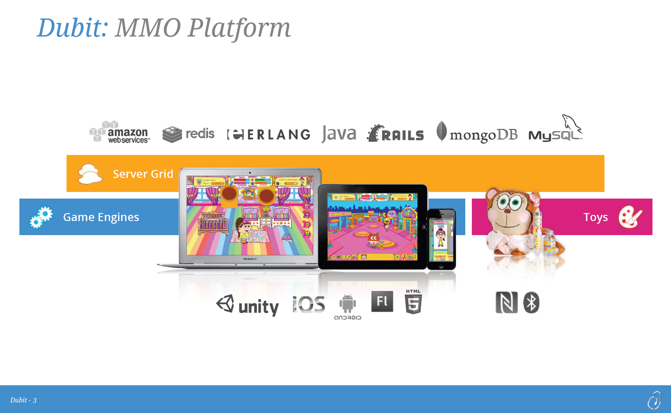

Slide 11
SPONSORS
Dubit have kindly offered to sponsor the bar
You’ll need “TAB xxx”
Dubit are recruiting digital profesionals, including DEVOPS and sysAdmins - Speak to MIKE AND DANNY

Slide 12
QUESTIONS
OWT ?
ANNOUNCEMENTS ?
leedsdevops.org.uk
info@leedsdevops.org.uk
@leedsdevops
https://groups.google.com/d/forum/leedsdevops

