Slide 1
LEEDS DEVOPS
A hub for everyone who lives, breathes
and occasionally sleeps DevOps in Leeds
and the surrounding area
WELCOME

Slide 2
today
7:00 - 7:20 : BEER & CHIP BUTTIES
7:20 - 7:30 : WELCOME
7:30 - 8:00 : Wes Mason “Where Goombas Dare - Build pipelines, Release Engineering, and You!”
8:00 - 8:15 : Intermission
8:15 - 9:00 : Ian Massingham “Amazon EC2 MasterClass”

Slide 3
Speakers
Wes Mason
a polyglot developer with over 15 years of experience programming large scale networked applications.
Ian Massingham
Technical Evangelist for Amazon Web Services.

Slide 4


Why are we here...
VS

Slide 5
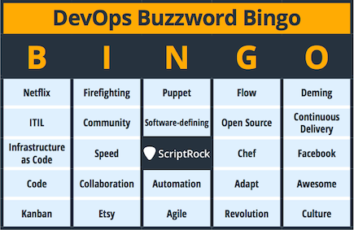
Why are we here...

Slide 6
NEWS
Presented at DRUPAL yorkshire
drupal camp yorkshire
Devops weekly mention
Chef AND Puppet are sending goodies
WE'll talk to you

Slide 7
NEXT TIME
TUES 20th MAY 2014
NEW Venue – ODI NODE LEEDS
Sponsor - tuleap
Speaker needed – apply within

Slide 8
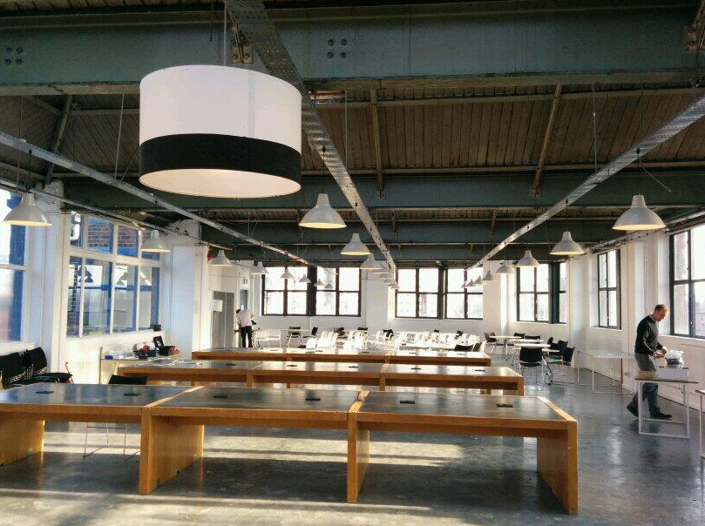
NEWS

Slide 9
WARNING
Blatant act of self promotion...

Slide 10
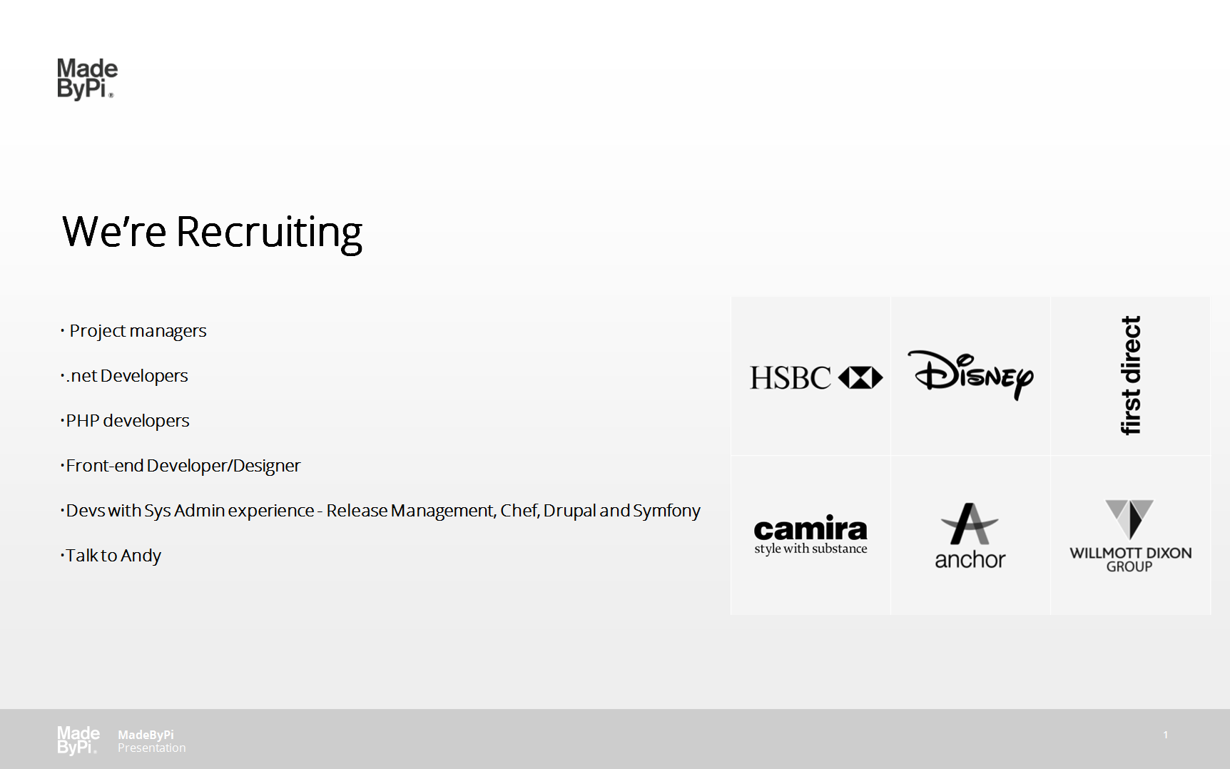

Slide 11
SPONSORS
Keep it free
Bigger venue
food and drink
This LEEDSDEVOPS MEET UP IS BROUGHT TO YOU BY...

Slide 12

SPONSORS

Slide 13
Help required
Speakers, Sponsors, ideas
Meetfinch.com - docker
Thoughts, ideas etc

Slide 14
QUESTIONS
OWT ?
ANNOUNCEMENTS ?
leedsdevops.org.uk
info@leedsdevops.org.uk
@leedsdevops
https://groups.google.com/d/forum/leedsdevops

