Slide 1
LEEDS DEVOPS
A hub for everyone who lives, breathes
and occasionally sleeps DevOps in Leeds
and the surrounding area
WELCOME

Slide 2
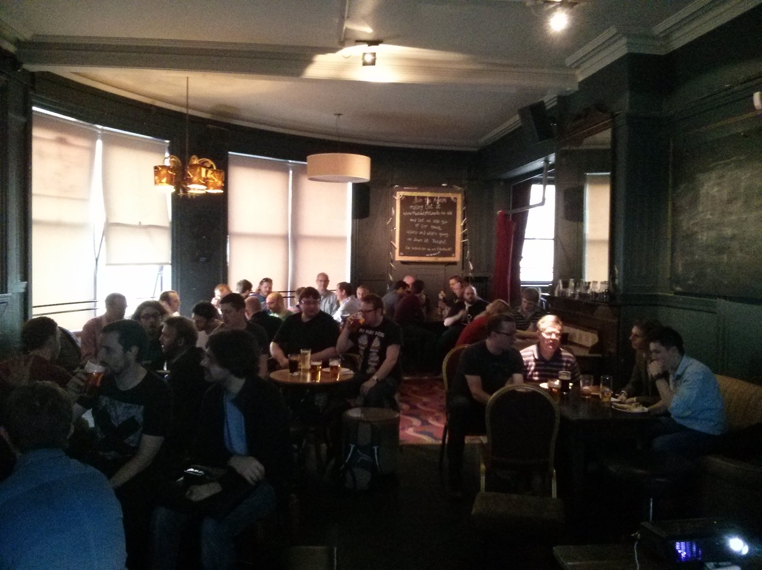
today

Slide 3
today
7:00 - 7:20 : Grab a beer, have a natter.
7:20 - 7:30 : Group news/announcements
7:30 - 8:00 : Steve Melrose - “The Last Mile”
8:00 - 8:15 : Intermission
8:15 - 8:20 : About ODI LEEDS
8:20 - 9:00 : Chris Reid - “DevOps, SDN and the Virtual world”
9:00 - late : Decamp to the Wardrobe

Slide 4
Speakers
Steve Melrose
Developer at Sky Bet, works with PHP MVC, Javascript and NodeJS, soon to be freelance.
Chris Reid
Cloud orchestration and networking, Cloudstack 2014 comittee member, speaker at Network Virtualisation/SDN World summit.

Slide 5


Why are we here...
VS

Slide 6


Getting Started
THE PHOeNIX PROJECT
ARRESTED DEVOPS PODCAST

Slide 7
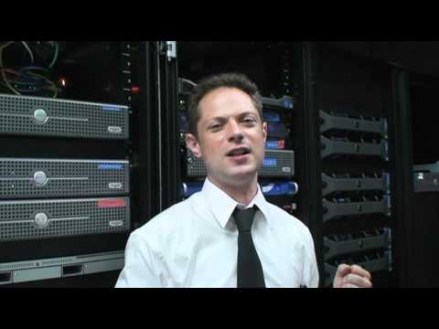
Getting Started

Slide 8
SPONSORS
Keep it free
Bigger venue
food and drink
This LEEDSDEVOPS MEET UP IS BROUGHT TO YOU BY...

Slide 9

SPONSORS

Slide 10

SPONSORS
Please Deploy Responsibly

Slide 11
Help required
Speakers, Sponsors, ideas
Crisp Thinking
Meetfinch.com - docker
Thoughts, Feedback etc

Slide 12
QUESTIONS
OWT ?
ANNOUNCEMENTS ?
leedsdevops.org.uk
info@leedsdevops.org.uk
@leedsdevops
https://groups.google.com/d/forum/leedsdevops

