Slide 1




LEEDS DEVOPS
A hub for everyone who lives, breathes
and occasionally sleeps DevOps in Leeds
and the surrounding area

Slide 2
today
7:00 - 7:20 : Welcome
7:20 - 7:30 : Group updates/news/announcements
7:30 - 8:00 : Stephen Myers - The twentysix toolchain
8:00 - 8:15 : Intermission
8:15 - 9:00 : Peter Maude - Crisp Thinking Platform
9:00 - late : Decamp to the Adelphi

Slide 3
DevOps is...
“Devops means giving a s#!t about your job enough to not pass the buck. Devops means giving a s#!t about your job enough to want to learn all the parts and not just your little world...”
Notes:
Improving how teams work together and
valuing the contributions the team makes

Slide 4
DevOps is...
“…developers need to understand infrastructure. Operations people need to understand code.
People need to f#*&ing work with each other and not just occupy space next to each other.”
John E VINCENT (@LuSis)
Notes:
Improving how teams work together and valuing
the contributions the team makes

Slide 5
NEWS
New venue, 40+ here tonight
NEW GROUPS In Town
  Leeds Code Dojo - 09/07/14
  AWS Leeds - opsworks 30/07/14
  DDD NORTH - 18/10/14

Slide 6
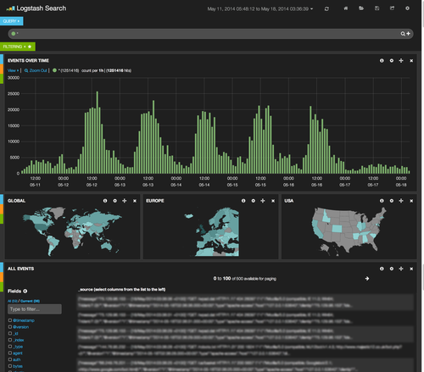
NEWS
Data.andyburgin.co.uk

Slide 7
HELP WANTED
Speakers
sponsors
promotion
“INS”
IDEAs

Slide 8
Coming Soon
NEXT EVENT 12th August 2014 - venue TBC
  JUSTIN ARBUCKLE - VP EMEA & Chief Enterprise Architect CHEF (FORMELY OPSCODE)
  Jon Milsom - Co-founder & CTO Pitchero

Slide 9
Coming Soon
Not DOCKER
PUPPET LABS
rackspace
plusnet
brightbox
dom hodgeson
ruby gems
manchester devops - Tues 22nd july 2014

Slide 10

TONIGHT

Slide 11
Speakers
Stephen Myers - Head of .NET dev at twentysix, 15+ years of web dev and delivery, talking about the tools they use and the .NET devops ecosystem.
Peter Maude - CTO of Crisp Thinking, service Moderates and manages User Generated Content.

Slide 12
SPONSORS
Keep it free
Bigger venue
buy us beer - the essential devops tool

Slide 13


SKYBET
&
SKY SPORTS
Are Recruiting!
DevOps, PlatOps, Developers
For details; please contact
victoria.howling@bskyb.com

Slide 14
QUESTIONS
OWT ?
ANNOUNCEMENTS ?
leedsdevops.org.uk
info@leedsdevops.org.uk
@leedsdevops
linked in group

