Slide 1
LEEDS DEVOPS
A hub for everyone who lives, breathes
and occasionally sleeps DevOps in Leeds
and the surrounding area
WELCOME

Slide 2
today
Welcome
new venue, new faces, group news
sponsors
mark barrett - Leeds Data Mill
intermission
Simon Davy - Canonical
beer (the ultimate devops tool)

Slide 3


Why are we here...
VS

Slide 4
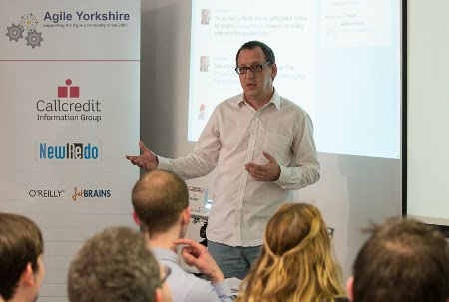
NEWS
New venue, 40+ here tonight
Presented at agile yorkshire
..they were lovely
Definitions - history, roots, lean, CAMS, what devops isnt

Slide 5
NEWS
Presenting at Drupal yorkshire
Speakers
sponsors
promotion - “INS”
IDEAs

Slide 6
Speakers
Mark Barrett
from Leeds Data Mill - how Leeds is about to become an Open Data city and you can get involved.
Simon Davy
how Canonical use Juju to develop and deploy complex environments in production that provide services for Ubuntu users.

Slide 7
SPONSORS
Keep it free
Bigger venue
food and drink
This LEEDSDEVOPS MEET UP IS BROUGHT TO YOU BY...

Slide 8


SKYBET
&
SKY SPORTS
Are Recruiting!
DevOps, PlatOps, Developers
For details; please contact
victoria.howling@bskyb.com

Slide 9
QUESTIONS
OWT ?
ANNOUNCEMENTS ?
leedsdevops.org.uk
info@leedsdevops.org.uk
@leedsdevops
https://groups.google.com/d/forum/leedsdevops

