Slide 1



LEEDS DEVOPS
In a DevOps environment, developers and
sysadmins build relationships, processes,
and tools that allow them to better interact
and ultimately better service the customer.
This is what we talk about here.

Slide 2
today
6:45 - 7:20 : Welcome
7:20 - 7:30 : Group updates/news/announcements
7:30 - 8:00 : Gemma Cammeron & james jefferies
8:00 - 8:15 : Intermission
8:15 - 9:00 : sriram rajan
9:00 - late : Decamp to the Adelphi

Slide 3
News
Presented at LeeDS PHP
AWS GROUP 2nd MeetUP 08/10/14
Leeds code DOJO - 01/10/14
DDD NORTH 18/10/14 - waiting list
Notes:
Improving how teams work together and
valuing the contributions the team makes

Slide 4

Devopsdays North
up ere

Slide 5


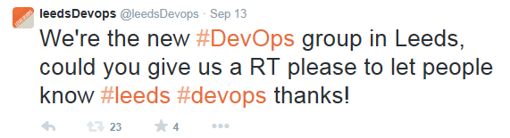
OCTOBER 14th 2014
Notes:
Improving how teams work together and
valuing the contributions the team makes

Slide 6
OCTOBER 14th 2014
Steve Elliott - LATEROOMS - ELK WRESTLING
Aanand prasad - CTO of Orchard Labs - FIG
IN THE Adelphi, LIMITED AVAILABILITY.
Notes:
Improving how teams work together and
valuing the contributions the team makes

Slide 7
November 11th 2014
Mark Crossfield - AUTOTRADER - GRAPHITE and FRIENDS
SteveN Johnson - ex puppetlabs
At the adelphi, LIMITED AVAILABILITY.
Notes:
Improving how teams work together and
valuing the contributions the team makes

Slide 8
Speakers
Gemma Cameron and james Jefferies - Whats Next For DevOps
SRIRAM Ranjan - principal engineer and devops specialist at rackspace

Slide 9
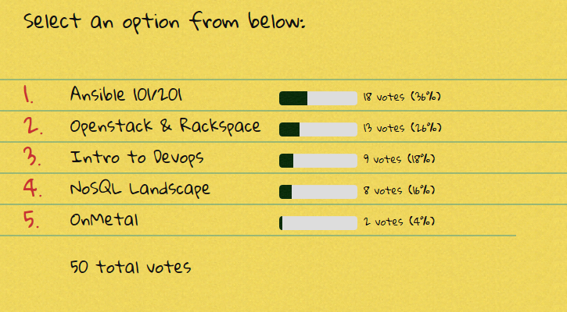
Speakers

Slide 10
SPONSORS
“Beer is the most powerful tool in the DevOps environment. Take everyone down to the bar and just let them talk.”
Ben Rockwood, Joyent

Slide 11
SPONSORS

Slide 12
Sponsors
Jon MILSOM - PITCHERO
LOOKING FOR JUNIOR PHP DEV
Work alongside their senior devs
4 million monthly visitors
12000 sports websites

Slide 13
HELP WANTED
Speakers
sponsors
promotion
“INS”
IDEAs

Slide 14
QUESTIONS
OWT ?
ANNOUNCEMENTS ?
leedsdevops.org.uk
info@leedsdevops.org.uk
@leedsdevops
linked in group <- 26 members!

