Slide 1



LEEDS DEVOPS
In a DevOps environment, developers and
sysadmins build relationships, processes,
and tools that allow them to better interact
and ultimately better service the customer.
This is what we talk about here.

Slide 2
today
6:45 - 7:20 : Welcome
7:20 - 7:30 : Group updates/news/announcements
7:30 - 8:15: ANNAND PRASAD
8:15 - 8:30 : Intermission
8:30 - 9:00 : STEVE ELLIOT
9:00 - late : TALK

Slide 3


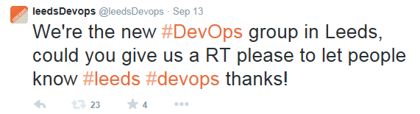
OCTOBER 14th 2014
Notes:
Improving how teams work together and
valuing the contributions the team makes

Slide 4

News
Notes:
Improving how teams work together and
valuing the contributions the team makes

Slide 5

Devopsdays derby
SAT 07/02/15
SUN 08/02/15
http://devopsdays.wp.derby.ac.uk/

Slide 6
November 11th 2014
Mark Crossfield - AUTOTRADER - GRAPHITE and FRIENDS
SteveN Johnson - ex puppetlabs
At the adelphi, LIMITED AVAILABILITY.
Notes:
Improving how teams work together and
valuing the contributions the team makes

Slide 7
OCTOBER 14th 2014
Steve Elliott - LATEROOMS - ELK WRESTLING
Aanand prasad - CTO of Orchard Labs - FIG
Notes:
Improving how teams work together and
valuing the contributions the team makes

Slide 8
SPONSORS
“Beer is the most powerful tool in the DevOps environment. Take everyone down to the bar and just let them talk.”
Ben Rockwood, Joyent

Slide 9
SPONSORS

Slide 10
HELP WANTED
Speakers
sponsors
promotion
“INS”
IDEAs

Slide 11
QUESTIONS
OWT ?
ANNOUNCEMENTS ?
leedsdevops.org.uk
info@leedsdevops.org.uk
@leedsdevops
linked in group <- 29 members!

