Slide 1
CSC 143
Stacks and Queues:
Concepts and Implementations

Slide 2
Overview
Topics
  Stacks
  Queues
  Simulations
Readings
  Textbook sec. 25.2 & 25.3

Slide 3
Typing and Correcting Chars
What data structure would you use for this problem?
  User types characters on the command line
  Until she hits enter, the backspace key (<) can be used to "erase the previous character"

Slide 4
Sample
Action
type h
type e
type l
type o
type <
type l
type w
type <
type <
type <
type <
type i
Result
h
he
hel
helo
hel
hell
hellw
hell
hel
he
h
hi

Slide 5
Analysis
We need to store a sequence of characters
The order of the characters in the sequence is significant
Characters are added at the end of the sequence
We only can remove the most recently entered character
We need a data structure that is Last in, first out, or LIFO –
a stack
  Many examples in real life: stuff on top of your desk, trays in the cafeteria, discard pile in a card game, …

Slide 6

Stack Terminology
Top: Uppermost element of stack,
  first to be removed
Bottom: Lowest element of stack,
  last to be removed
Elements are always inserted and
removed from the top (LIFO)
top
...
bottom
aStack:

Slide 7
Stack Operations
push(Object): Adds an element to top of stack, increasing stack height by one
Object pop( ): Removes topmost element from stack and returns it, decreasing stack height by one
Object top( ): Returns a copy of topmost element of stack, leaving stack unchanged
No “direct access”
  cannot index to a particular data item
No convenient way to traverse the collection
  Try it at home!

Slide 8
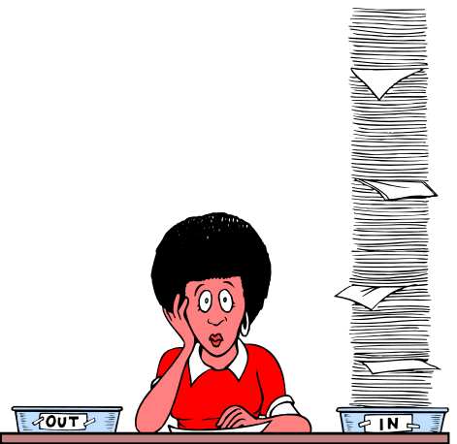
Picturing a Stack
Stack pictures are usually somewhat abstract
Not necessary to show "official" style of names, references, etc.
  Unless asked to do so, or course!
"Top" of stack can be up, down, left, right – just label it.

Slide 9
What is the result of...
    Stack s;
    Object v1,v2,v3,v4,v5,v6;
    s.push(“Yawn”);
    s.push(“Burp”);
    v1 = s.pop( );
    s.push(“Wave”);
    s.push(“Hop”);
    v2 = s.pop( );
    s.push(“Jump”);
    v3 = s.pop( );
    v4 = s.pop( );
    v5 = s.pop( );
    v6 = s.pop( );
s
v1
v2
v3
v4
v5
v6

Slide 10
Stack Practice
Show the changes to the stack in the following example:
    Stack s;
    Object obj;
    s.push(“abc”);
    s.push(“xyzzy”);
    s.push(“secret”);
    obj = s.pop( );
    obj = s.top( );
    s.push(“swordfish”);
    s.push(“terces”);

Slide 11
Stack Implementations
Several possible ways to implement
  An array
  A linked list
    Useful thought problem: How would you do these?
Java library does not have a Stack class
Easiest way in Java: implement with some sort of List
  push(Object) :: add(Object)
  top( ) :: get(size( ) –1)
  pop( ) :: remove(size( ) -1)
  Precondition for top( ) and pop( ): stack not empty

Slide 12

What is the Appropriate Model?
waiting line at the movie theater...
job flow on an assembly line...
traffic flow at the airport....
"Your call is important to us. Please stay on the line. Your call will be answered in the order received. Your call is important to us...
  …
Characteristics
  Objects enter the line at one end (rear)
  Objects leave the line at the other end (front)
This is a “first in, first out” (FIFO) data structure.

Slide 13

Queue Definition
Queue: Ordered collection, accessed only at the front (remove) and rear (insert)
  Front: First element in queue
  Rear: Last element of queue
FIFO: First In, First Out
Footnote: picture can be drawn in any direction
...
aQueue:
front
rear

Slide 14
Abstract Queue Operations
insert(Object) : Adds an element to rear of queue
  succeeds unless the queue is full (if implementation is bounded)
  often called “enqueue”
Object front( ) : Return a copy of the front element of queue
  precondition: queue is not empty
Object remove( ) : Remove and return the front element of queue
  precondition: queue is not empty
  often called “dequeue”

Slide 15
Queue Example
Draw a picture and show the changes to the queue in the following example:
    Queue q; Object v1, v2;
    q.insert(“chore”);
    q.insert(“work”);
    q.insert(“play”);
    v1 = q.remove();
    v2 = q.front();
    q.insert(“job”);
    q.insert(“fun”);

Slide 16
What is the result of:
    Queue q; Object v1,v2,v3,v4,v5,v6
    q.insert(“Sue”);
    q.insert(“Sam”);
    q.insert(“Sarah”);
    v1 = q.remove( );
    v2 = q. front( );
    q.insert(“Seymour”);
    v3 = q.remove( );
    v4 = q.front( );
    q.insert(“Sally”);
    v5 = q.remove( );
    v6 = q. front( );

Slide 17
Queue Implementations
Similar to stack
  Array – trick here is what do you do when you run off the end
  Linked list – ideal, if you have both a first and a last pointer.
No standard Queue class in Java library
Easiest way in Java: use LinkedList class
  insert(Object):: addLast(Object) [or add(Object)]
  getFront( ):: getFirst( )
  remove( ):: removeFirst( )
    Interesting "coincidence" that a Java LinkedList supports exactly the operations you want to implement queues.

Slide 18
Bounded vs Unbounded
In the abstract, queues and stacks are generally thought of as "unbounded": no limit to the number of items that can be inserted.
In most practical applications, only a finite size can be accommodated: "bounded".
Assume "unbounded" unless you hear otherwise.
  Makes analysis and problem solution easier
  Well-behaved applications rarely reach the physical limit
When the boundedness of a queue is an issue, it is sometimes called a "buffer"
  People speak of bounded buffers and unbounded buffers
  Frequent applications in systems programming
  E.g. incoming packets, outgoing packets

Slide 19
Summary
Stacks and Queues
  Specialized list data structures for particular applications
Stack
  LIFO (Last in, first out)
  Operations: push(Object), top( ), and pop( )
Queue
  FIFO (First in, first out)
  Operations: insert(Object), getFront( ), and remove( )
Implementations: arrays or lists are possibilities for each
Next up: applications of stacks and queues

