Slide 1
CEIS150 Module 4
Inheritance
Summary Report
Professor: Dr. Omar Haddad
Student: . B. Lee Ecke

Slide 2
Rubric
Activity | Requirement(s) | Points
Inherited classes | Screen shot of classes | 15
Unit Tests | Screen Shot of unit tests working | 15
Main program | Screenshot of classes in main | 10
2

Slide 3
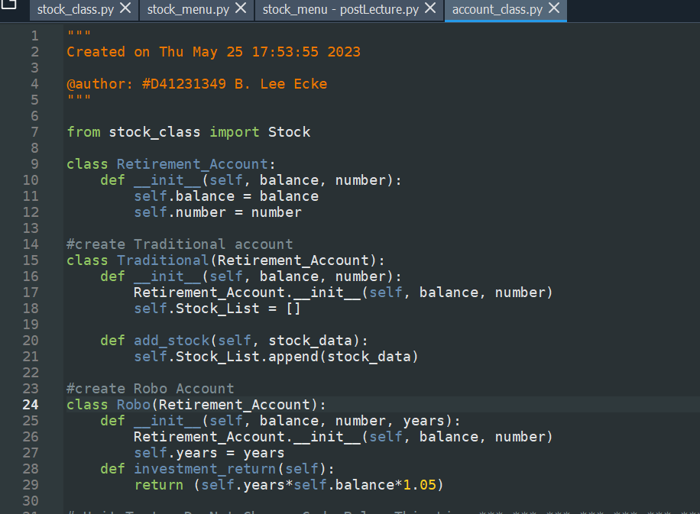
Inherited classes
3

Slide 4
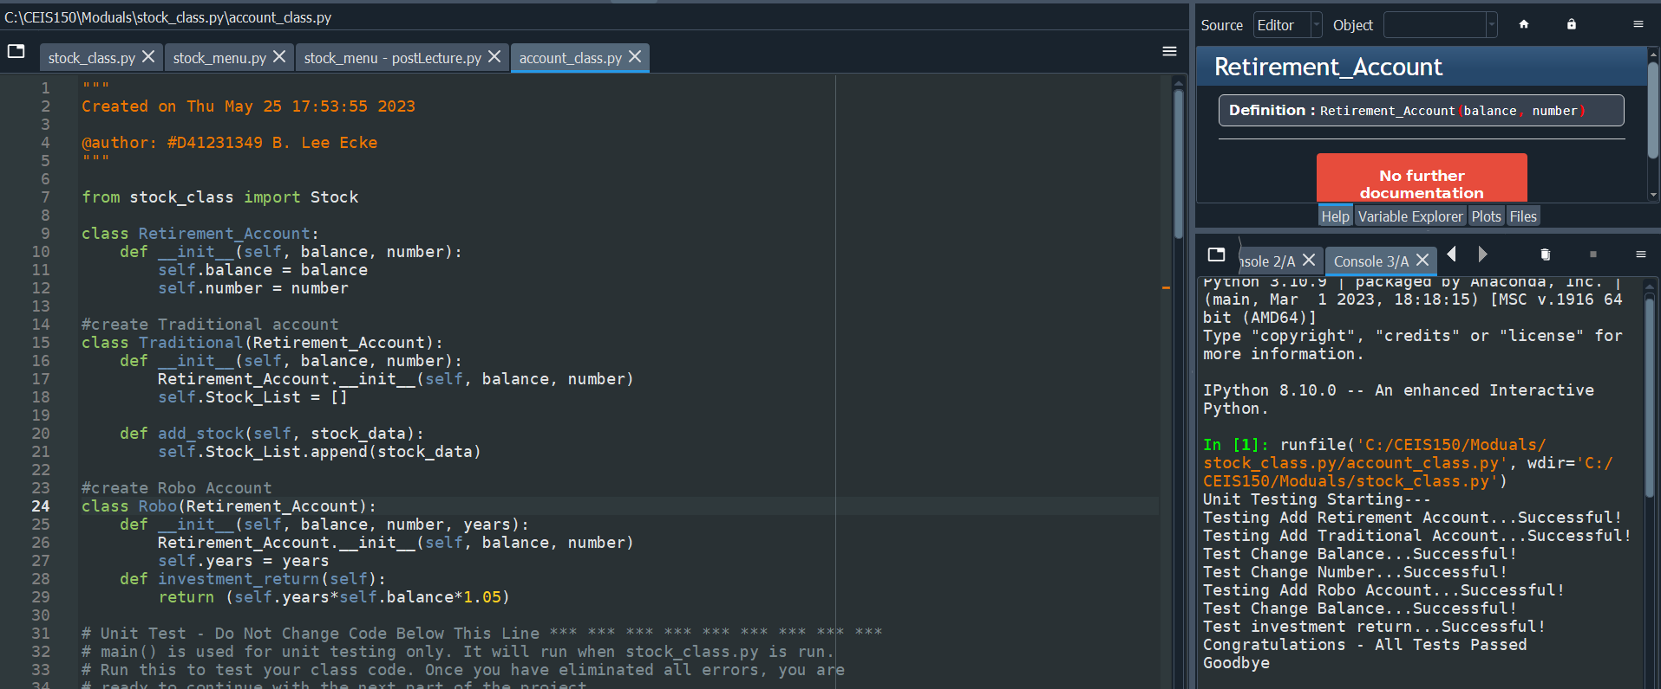
Unit Tests
4

Slide 5
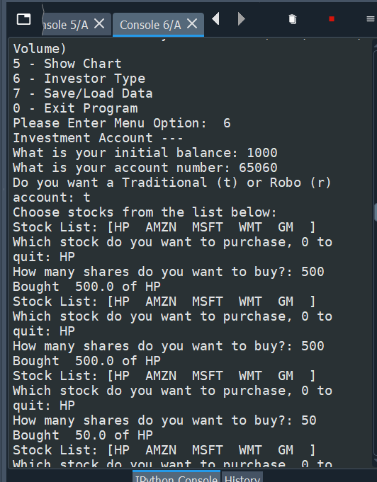
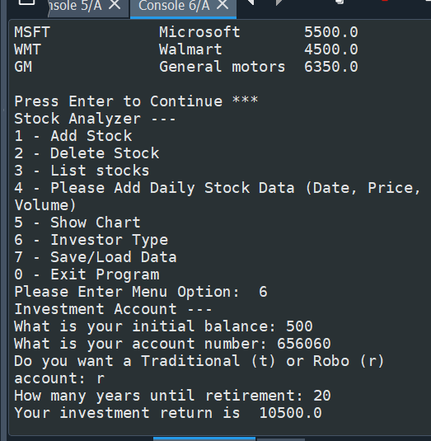
Stock menu program
5

