Slide 1
LINUX project II
Mai Beitnoba
Leen Ahmad
Sec 6

Slide 2
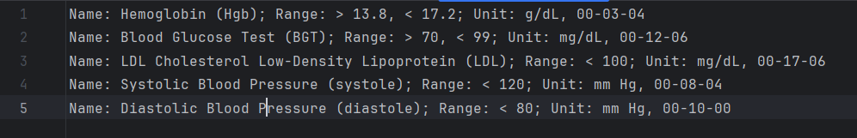
Medical Tests file:

Slide 3
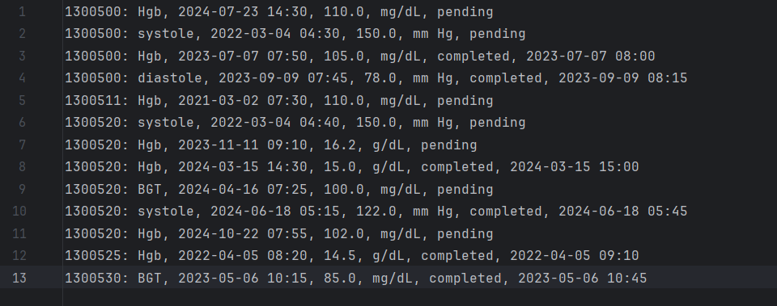
Medical Record file:

Slide 4
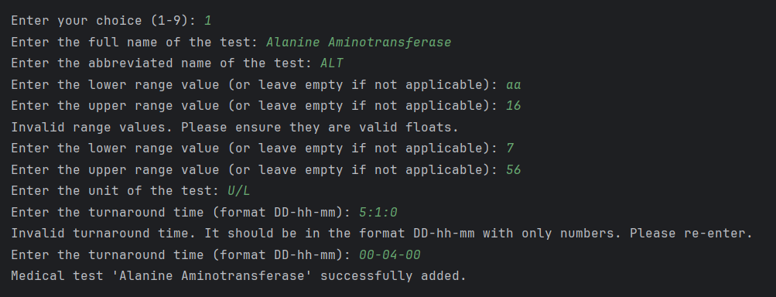
Add New Medical Test

Slide 5
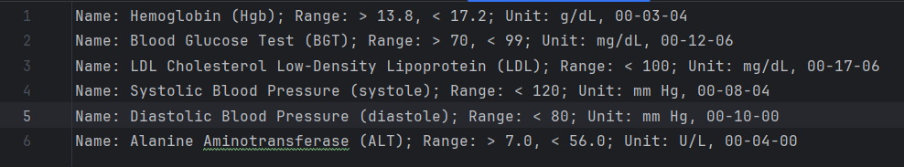
Medical test file after adding new test

Slide 6
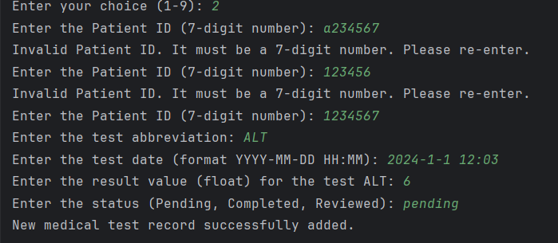
Adding new medical record:

Slide 7
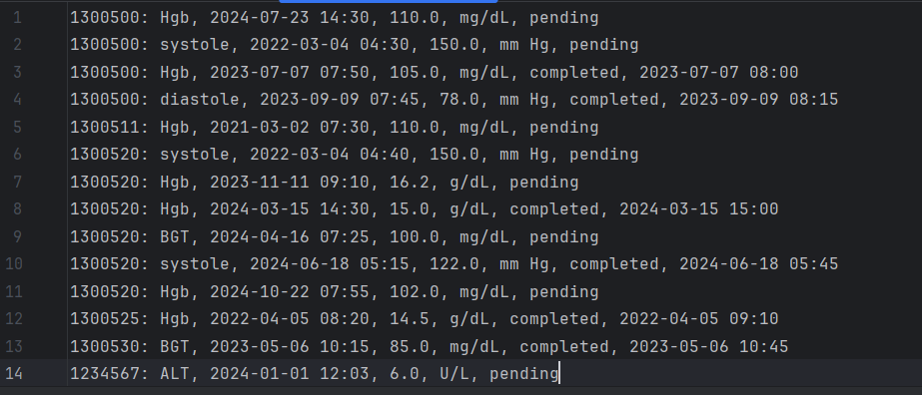
The medical record file after adding the new record

Slide 8
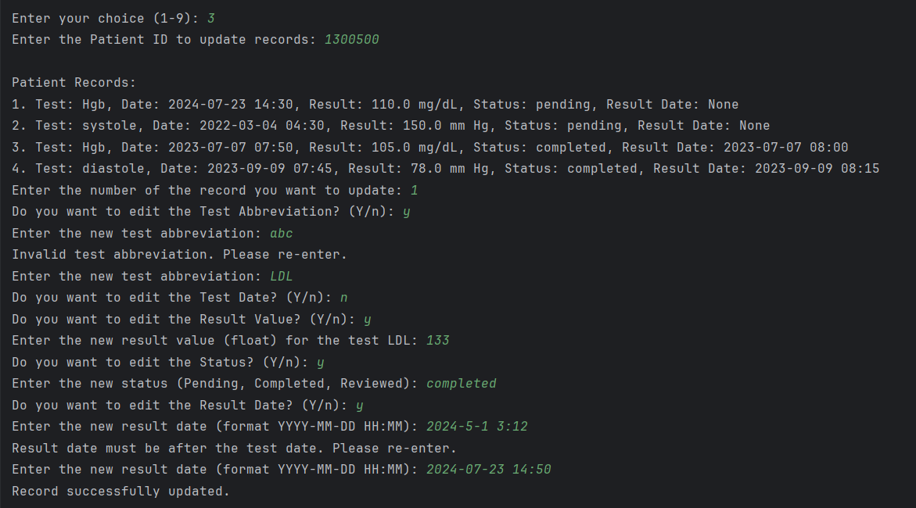
Update Patient Records

Slide 9
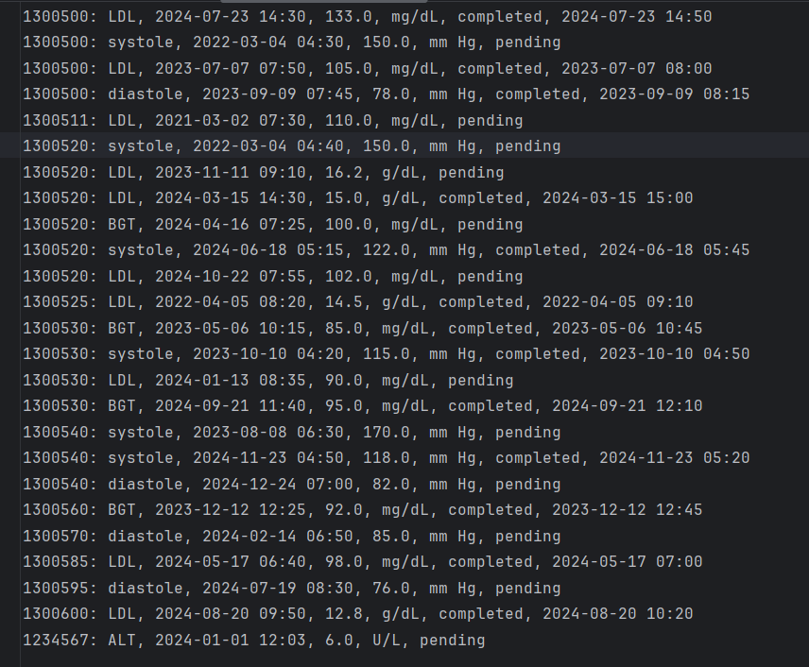
The file after updating:
Mars

Slide 10
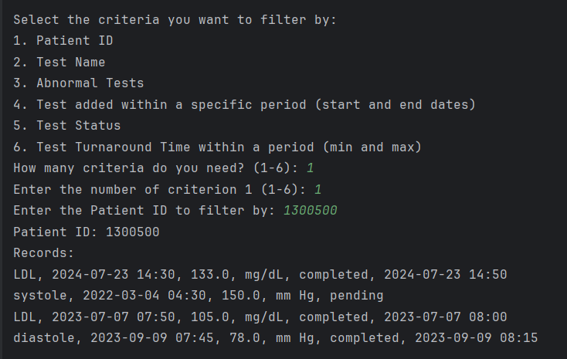
Filter based on one criteria patient ID

Slide 11
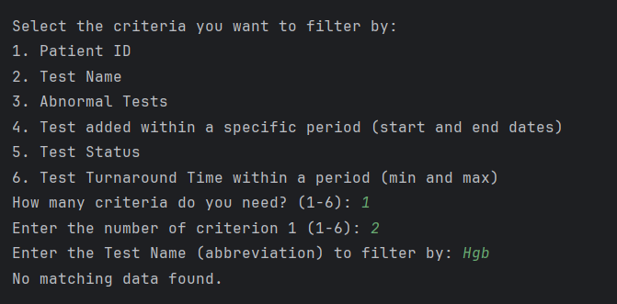
Filter based on one criteria Test name

Slide 12
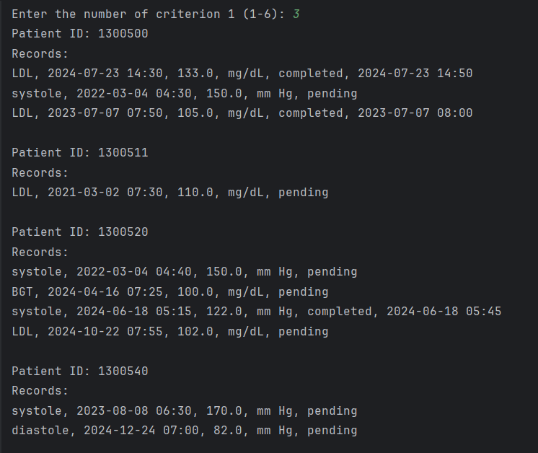
Filter based on one criteria Abnormal tests

Slide 13
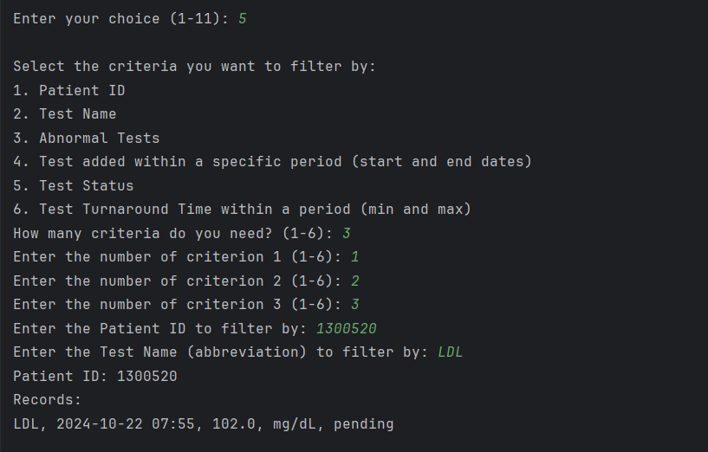
Filter based on more than 1 criteria

Slide 14
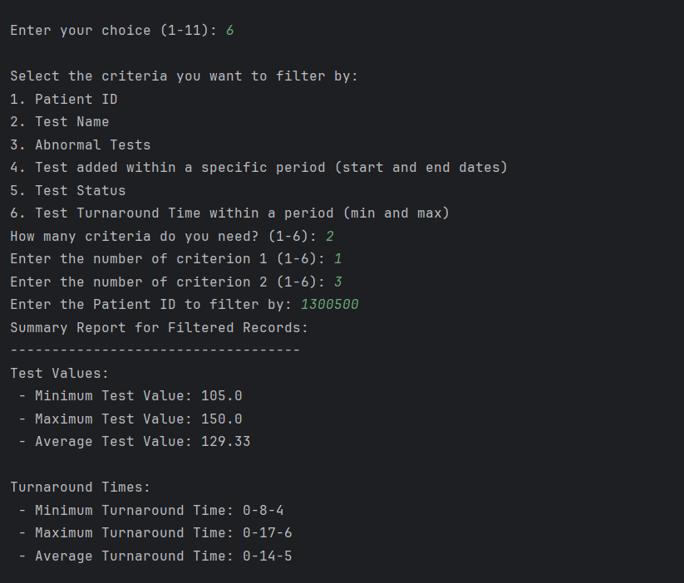
Generate Summary Reports

Slide 15
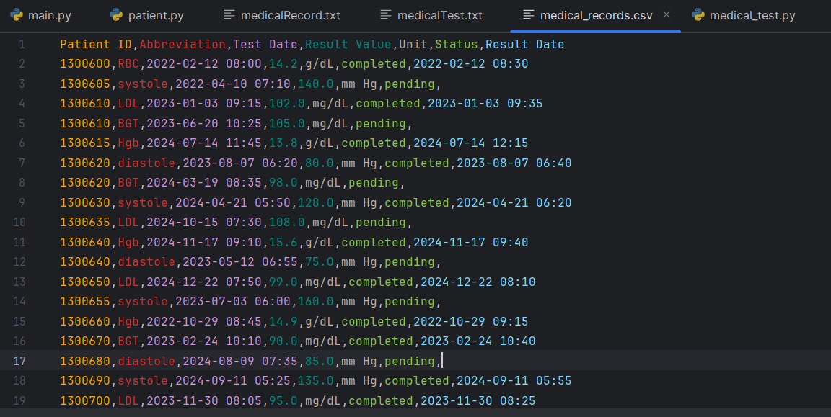
Import data from CSV

Slide 16
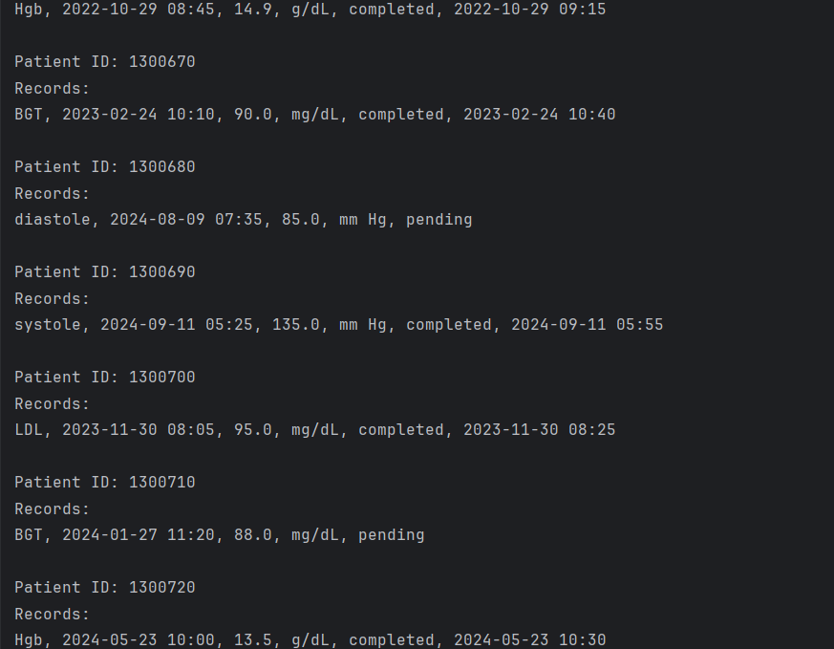
Import data from CSV

Slide 17
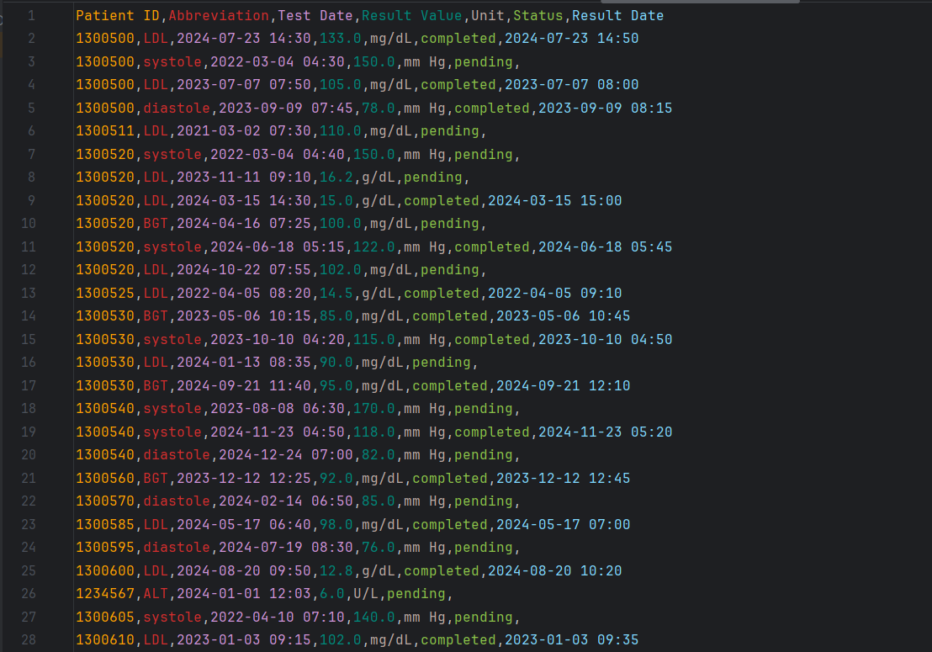
export data to CSV

Slide 18
Awesome penguins

