Slide 1
HANDS-ON TEACHING DEMO
K-means Clustering
with Python
Iris dataset • Step-by-step code • Google Colab
Dr. Jiahui Mo
Information Technology & Business Analytics

Slide 2
OVERVIEW
What will we do?
1
Load
Read the Iris CSV into a pandas DataFrame
2
Prepare
Select four measurements and scale them
3
Cluster
Fit K-means with K = 3
4
Interpret
Review cluster size, means, and WSSE
5
Evaluate
Use the elbow plot, visualization, and species labels
Hands-on K-means Clustering with Python
2

Slide 3
STEP 1 · FRAME THE PROBLEM
Business problem and data
Goal
Column | Role | Meaning
RowNames | ID | Observation ID
SPECIES | Known label | Flower species
SEPAL.L | Input | Sepal length
SEPAL.W | Input | Sepal width
PETAL.L | Input | Petal length
PETAL.W | Input | Petal width
Identify groups of iris flowers from their sepal and petal measurements.
K-means is unsupervised: SPECIES is not used to create the clusters.
Hands-on K-means Clustering with Python
3

Slide 4
STEP 2 · SET UP PYTHON
Import the libraries
1 import io
2 import matplotlib.pyplot as plt
3 import pandas as pd
4 from sklearn.cluster import KMeans
5 from sklearn.preprocessing import MinMaxScaler
1 Reads an uploaded file stored as bytes.
2 Creates charts.
3 Loads and summarizes tabular data.
4 Imports the K-means algorithm.
5 Imports 0–1 feature scaling.
Hands-on K-means Clustering with Python
4

Slide 5
STEP 3 · LOAD DATA
Choose how to load the CSV
1 raw_url = "https://raw.githubusercontent.com/.../iris_csv.csv"
2 UPLOAD_FILE = False
1 Stores the direct GitHub address of the CSV.
2 False loads from GitHub. Change to True to upload a file in Colab.
Hands-on K-means Clustering with Python
5

Slide 6
STEP 3 · LOAD DATA
Load from GitHub or upload a file
1 if UPLOAD_FILE:
2 from google.colab import files
3 uploaded = files.upload()
4 df = pd.read_csv(
5 io.BytesIO(next(iter(uploaded.values())))
6 )
7 else:
8 df = pd.read_csv(raw_url)
1–3 When True, Colab displays a Choose Files button.
4–6 Selects the uploaded bytes and converts them into a DataFrame named df.
7–8 Otherwise, pandas reads the CSV from GitHub.
Hands-on K-means Clustering with Python
6

Slide 7
STEP 3 · LOAD DATA
Check the loaded data
1 print(f"Dataset shape: {df.shape[0]} rows × {df.shape[1]} columns")
2 df.head()
3 df.describe(include="all").round(2)
1 Shows the number of rows and columns: 150 × 6.
2 Displays the first five observations.
3 Summarizes numerical and categorical columns; values are rounded to two decimals.
Hands-on K-means Clustering with Python
7

Slide 8
STEP 4 · SELECT VARIABLES
Select the clustering variables
1 feature_columns = ["SEPAL.L", "SEPAL.W",
2 "PETAL.L", "PETAL.W"]
3 X = df[feature_columns]
4 X.head()
1–2 Lists the four measurements used to compare flowers.
3 Creates X, the feature table used by K-means.
4 Checks the first five rows of X.
Hands-on K-means Clustering with Python
8

Slide 9
STEP 5 · PREPARE DATA
Check and scale the features
1 print(X.isna().sum())
2 scaler = MinMaxScaler()
3 X_scaled = scaler.fit_transform(X)
1 Counts missing values in each feature. K-means needs complete numerical data.
2 Creates a scaler that maps every feature to the range 0–1.
3 Learns each feature's minimum and maximum, then scales X.
Hands-on K-means Clustering with Python
9

Slide 10
STEP 6 · RUN K-MEANS
Fit K-means with K = 3
1 kmeans = KMeans(
2 n_clusters=3,
3 random_state=10,
4 n_init=10
5 )
6 df["Cluster"] = kmeans.fit_predict(X_scaled)
1 Creates the K-means model.
2 Requests three clusters.
3 Makes the result reproducible.
4 Tries ten starting solutions and keeps the best.
6 Fits the model and saves each flower's cluster number.
Hands-on K-means Clustering with Python
10

Slide 11
STEP 7 · INTERPRET CLUSTERS
Summarize each cluster
1 cluster_summary = df.groupby("Cluster")[feature_columns].mean().round(2)
2 cluster_summary.insert(0, "Count", df.groupby("Cluster").size())
3 display(cluster_summary)
4 print(f"WSSE: {kmeans.inertia_:.4f}")
1 Groups rows by cluster and calculates each measurement's mean.
2 Adds the number of flowers in each cluster.
3 Displays the completed summary table.
4 Reports within-cluster sum of squared errors.
Hands-on K-means Clustering with Python
11

Slide 12
STEP 7 · INTERPRET CLUSTERS
Cluster output
 | Count | SEPAL.L | SEPAL.W | PETAL.L | PETAL.W
Cluster 0 | 39.0 | 6.85 | 3.08 | 5.7 | 2.08
Cluster 1 | 50.0 | 5.01 | 3.43 | 1.46 | 0.25
Cluster 2 | 61.0 | 5.89 | 2.74 | 4.4 | 1.42
WSSE
6.9822
Lower WSSE means observations are closer to their assigned centers. Compare WSSE only when using the same scaled features.
Interpretation question: Which measurements most clearly distinguish the clusters?
Hands-on K-means Clustering with Python
12

Slide 13
STEP 8 · CHOOSE K
Calculate WSSE for several values of K
1 k_values = range(2, 9)
2 wsse_values = [
3 KMeans(n_clusters=k, random_state=10, n_init=10)
4 .fit(X_scaled).inertia_
5 for k in k_values
6 ]
1 Tests K values from 2 through 8.
2–6 Fits one K-means model for each K and stores its WSSE.
3 Uses the same seed and ten starts for fair comparison.
4 Extracts inertia_, scikit-learn's WSSE measure.
Hands-on K-means Clustering with Python
13

Slide 14
STEP 8 · CHOOSE K
Draw the elbow plot
1 plt.figure(figsize=(7, 4))
2 plt.plot(k_values, wsse_values, marker="o")
3 plt.xlabel("Number of clusters (K)")
4 plt.ylabel("WSSE")
5 plt.title("Elbow Plot for K-means")
6 plt.xticks(list(k_values))
7 plt.show()
1 Creates the plotting area.
2 Plots K against WSSE and marks each tested value.
3–5 Adds clear axis labels and a title.
6 Shows every tested K on the horizontal axis.
7 Displays the completed chart.
Hands-on K-means Clustering with Python
14

Slide 15
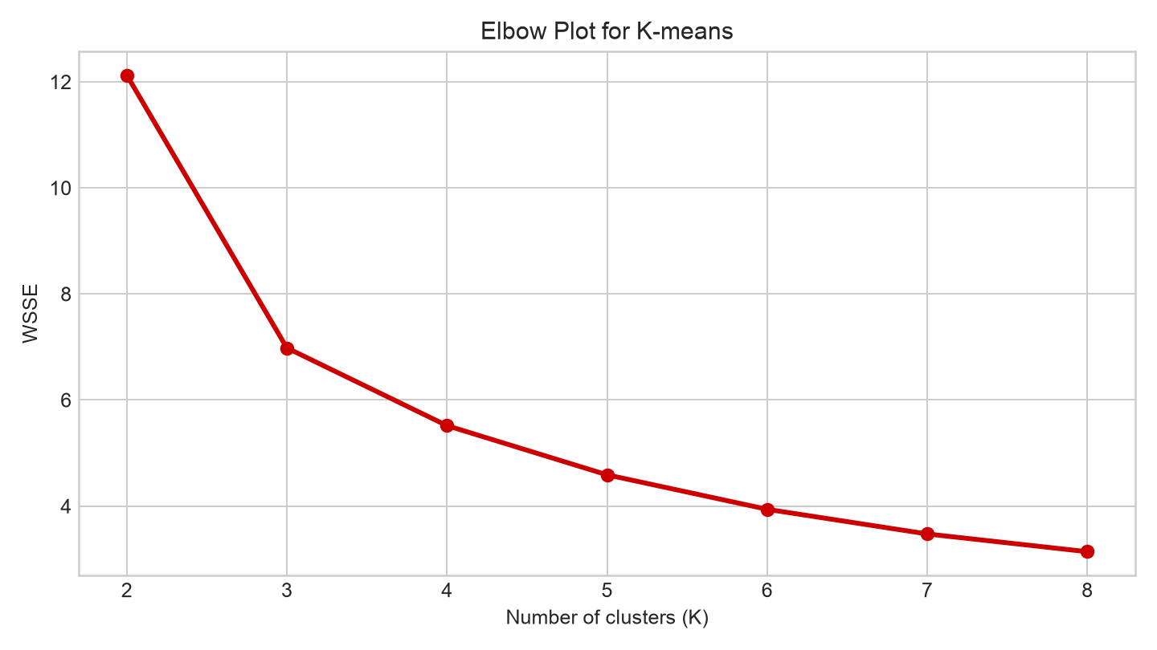
STEP 8 · CHOOSE K
Interpret the elbow
Look for the bend
• WSSE always decreases as K increases.
• The improvement becomes much smaller after K = 3.
• K = 3 is a reasonable balance between fit and simplicity.
The elbow method is a judgment tool—not an automatic rule.
Hands-on K-means Clustering with Python
15

Slide 16
STEP 9 · VISUALIZE CLUSTERS
Prepare the cluster centers for plotting
1 centers = scaler.inverse_transform(
2 kmeans.cluster_centers_
3 )
1 Creates centers in the original measurement units.
2 cluster_centers_ contains the model's centers in scaled units.
1–3 inverse_transform converts 0–1 values back to centimeters.
Hands-on K-means Clustering with Python
16

Slide 17
STEP 9 · VISUALIZE CLUSTERS
Plot observations and cluster centers
1 plt.figure(figsize=(8, 5))
2 plt.scatter(df["PETAL.L"], df["PETAL.W"],
3 c=df["Cluster"], cmap="viridis")
4 plt.scatter(centers[:, 2], centers[:, 3],
5 color="red", marker="X", s=200)
6 plt.xlabel("Petal length (cm)")
7 plt.ylabel("Petal width (cm)")
8 plt.title("K-means Clusters of Iris Flowers")
9 plt.colorbar(label="Cluster")
10 plt.show()
1 Creates the plotting area.
2–3 Plots each flower; color represents its assigned cluster.
4–5 Adds a large red X at each cluster center.
6–8 Adds labels and a descriptive title.
9 Explains the cluster colors.
10 Displays the plot.
Hands-on K-means Clustering with Python
17

Slide 18
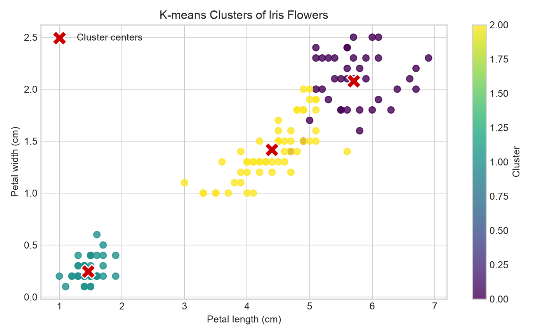
STEP 9 · VISUALIZE CLUSTERS
Interpret the cluster plot
• One group has very short, narrow petals.
• The other two groups overlap more closely.
• Red X symbols represent the cluster centers.
• This plot shows only two of the four model inputs.
Do not judge a four-feature model from one two-dimensional view alone.
Hands-on K-means Clustering with Python
18

Slide 19
STEP 10 · EVALUATE
Compare clusters with known species
1 pd.crosstab(df["Cluster"],
2 df["SPECIES"],
3 margins=True)
1 Places the discovered cluster numbers in rows.
2 Places the known species labels in columns.
3 Adds row and column totals.
Note SPECIES evaluates the result; it was not used to fit K-means.
Hands-on K-means Clustering with Python
19

Slide 20
STEP 10 · EVALUATE
Cluster-to-species comparison
 | Setosa | Versicolor | Virginica | All
Cluster 0 | 0 | 3 | 36 | 39
Cluster 1 | 50 | 0 | 0 | 50
Cluster 2 | 0 | 47 | 14 | 61
All | 50 | 50 | 50 | 150
• Setosa is separated cleanly.
• Versicolor and Virginica overlap.
• Cluster numbers are arbitrary labels—not rankings.
Good clustering supports interpretation; it does not guarantee perfect class prediction.
Hands-on K-means Clustering with Python
20

Slide 21
GENERAL PROCESS
A repeatable clustering workflow
01
Choose variables
04
Fit and explain
Use variables that address the business question.
Describe cluster size, centers, and characteristics.
02
Prepare data
05
Validate usefulness
Handle missing values, outliers, text, skew, and scale.
Connect the groups back to the original question.
03
Choose K
Compare WSSE and use domain knowledge.
Clustering is valuable when the groups lead to meaningful decisions.

Slide 22
TEACHING HANDOFF
Run the demo in Google Colab
• Open the notebook using the Colab link below.
• Keep UPLOAD_FILE = False to read from GitHub, or change it to True to upload a CSV.
• Select Runtime → Run all.
• Use File → Save a copy in Drive before editing or sharing with students.
OPEN THE COLAB NOTEBOOK
https://colab.research.google.com/github/leeexiaoming/web/blob/master/teaching/kmeans_clustering_iris_demo.ipynb
Teaching tip: pause before each output and ask students to predict what they expect to see.
Hands-on K-means Clustering with Python
22

