Slide 1
27G Mentor-mentee
Final Presentation
Date: oct 23, 2020
Mentor: phu nguyen
Mentee: Phat le
ss1/rcais/rcarenv

Slide 2
Agenda
Project Introduction Page 03
Current Status Page 04
Achievement Page 08
Difficulties and Solutions Page 09
Q&A Page 14

Slide 3
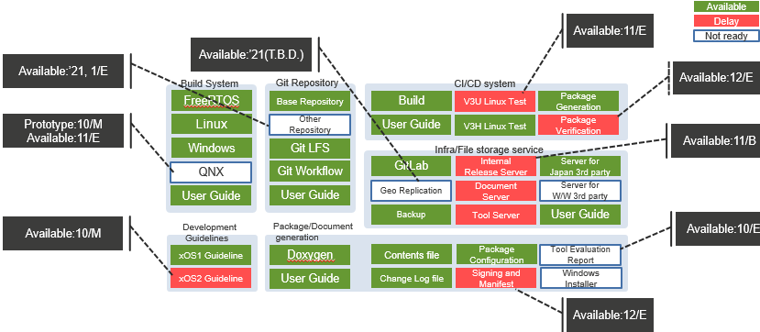
Project introduction
Notes:
Currently, we are develop build system for rcar xos platform and ci/cd system for it
About build system, already supported freertos, linux, windows and recently, we have just added prototype support for qnx
about build system, we supported build, test and package generation for it, next we will add automation test support for v3u linux and package vefication to the CI

Slide 4
Training ProGress
LV1
LV2
LV3
Item
Time
06/2018-12/2018 | 01/2019-06/2019
Write script for verify, run test on Fuego. | Maintain, create test script for Fuego SI
Learn about Linux environment, Docker, Kubernetes | Use Kubenertes, Docker knowledge to deploy CI infrastructure Learn about Gerrit
Follow coding rule Maintain, update test script from colleague
No activities
No activities
6/2019-12/2019 | 01/2020-06/2020
Investigate about CMake Use it to do investigate/ feasibility checking for RCar Env build system | Use CMake to develop build system and package generation feature follow the design Update feature based on feedback from system team and users Review/give solution for colleague source code
Deploy and manage Gerrit server Use Gerrit to maintain and review source code Maintain CI infrastructure | Learn about Git, Gitlab CI Use JIRA/Confluence to manage task/document Follow defined Gitlab workflow for development Support member to design/implement Automation test on CI
Follow CMake Coding internal rule Modularize each build system feature and manage it in different files/ functions Review source codes of colleagues
No activities | Create architure design for RCar Env build system
Create Build system draft detailed design based on system requirement | Update design based on feedback/latest implementation
Software Coding
Development environment
Readability
Software architecture design
Software detailed design
First Presentation
Midterm Presentation
Final Presentation
Notes:
Next is my trainning process during the last 2 years, you can check it later

Slide 5
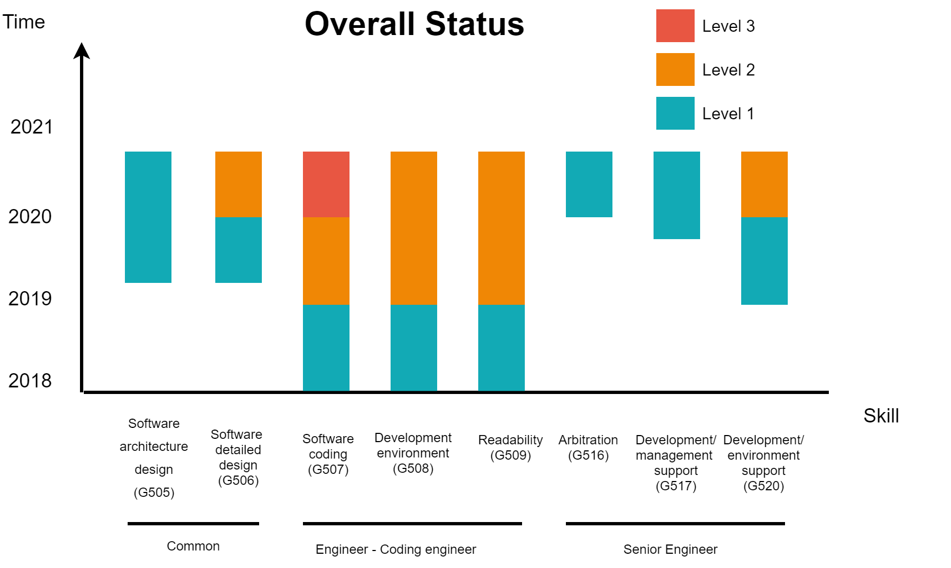
Current status Overall
Refer to: Role_Skill_Definition_(SW_Division)_SS1_v2.xlsx
Level 1: Need other engineer to support step by step
Level 2: Can perform the task and need other engineer to confirm
Level 3: Can perform the task without support for other engineer with good quality (no issue, bug in output code)
Notes:
Overall of current Status.
Common skill and coding skill. These skill achieve level as expectation
Have some improvement for some skill required for senior engineer

Slide 6
current status Common
Skill | Old Status (5/2019) | Current Status (10/2020)
Software architecture design | No experience | Able to understand system requirement from REE to create architecture design for RCar Environment Be familiar with Diagram Tool (draw.io) to create the design Be familiar with Confluence page to manage the desigin
Software detailed design | No experience | Be able create concept page (detail design) for each feature of RCAR Env Be familiar with Confluence page to manage the design Be familiar with Diagram Tool (draw.io) to create the design Can review/give feedback for the design of colleague
Notes:
Let’s go into detail about my current status
Sw arch design: im familiar with diagram tool (draw.io) and confluence page to use it in design activity
Detailed design: for each feature of rcar env, we will create detail design for each, and I also review/give feedback for design of my colleage

Slide 7
current status coding engineer
Skill | Old Status (5/2019) | Current Status (10/2020)
Software coding | Familiar with Bash scripts, Python, Makeup language (yaml) Coding without creating design No experience about CMake | Master of CMake => use it to develop RCarEnv build system Have review for each source code updating (using Gitlab MR feature) Detect limitation for each release and give solution to improve it in next release Review colleague output and give solution for them
Development environment | Familiar with Linux environment Expert in using Docker, Kubernetes Familiar with Fuego, LAVA | Develop following Gitlab workflow Understand development environment/build system of FreeRTOS, QNX, Linux, Windows SIL OS to intergrate it into RCar Env build system Understand Gitlab CI to apply automation feature for RCar Env
Readability | Can understand, maintain, improve source code of colleague | Review source code of colleague and propose solution to fix (if any) Follow Coding rule Modularize each build system feature and manage it in different files/ functions Create CMake template/guideline for developer to use RCarEnv
Notes:
About coding skill
Currenly, im confident to say that
Review colleague source code and give them to solution to improve or fix issue
Development environemnt:
im familar with gilab workflow and use it in daily development activity
To develop build system for multiple os,
Readability
/ˈmɑː.dʒə.lə.raɪz/
Create CMake template/guideline for developer to use RCarEnv so they can use it to write cmake file for their module

Slide 8
current status senior engineer skill
Skill | Old Status (5/2019) | Current Status (10/2020)
Arbitration | No experience | Able to hold a meeting to share RCar Env Knowledge to other teams. Trainer of Fuego topic in 30G Training activities
Management support | No experience | Able to create Project Plan and related documents. (e.g: Project WBS when has COVID19) Able to assign task to member (define clearly input/output and breakdown) and give an approach/solution when they has issues. Create training plan for new members
Development environment support | No experience | Build up infrastructure by using Kubernetes (Fuego/ Gerrit/ Drawio/ Mediawiki/…) Maintain/update infrastructure based on the feedback from user
Notes:
About senior eng skill
Able to hold a meeting to share RCar Env Knowledge to other teams.
Create training plan for new members and support them
Buildup and maintain infrastructure by using Kubernetes, and it work stably for more than 1 year, no major issue occur

Slide 9
current status softskill
Skill | Old Status (5/2019) | Current Status (10/2020)
Management | Can self-estimate and create plan for assigned task | Can estimate and create plan for project
Communication | Familiar to use Redmine, Email Take a little time to write report Can report to REL when PL absent TOEIC 665 | Discuss with REL/REE via Scrum meeting/ MS Chat daily Able to hold meeting with REE to discuss about RCar Env Able to review REE/REL output and give them solution if they have any issue TOEIC 765
Notes:
Can estimate and create plan for project, currently, we use Agile /ˈædʒaɪl/ model, plan will be reviewed and update every 2 weeks b

Slide 10
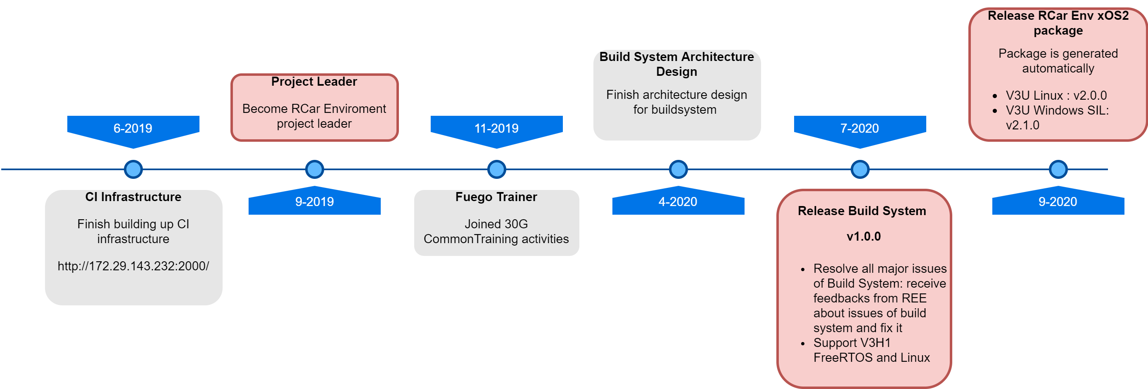
Achievement
Notes:
This is summary of my achivement after 2 years working
The significant achievements are
Become rcar env project leader
Release build system v1.0.0
Recently, add automated package generation feature to generate v3u and v3u windows sil package
And of course. These achivement comes from much efforts and supports from my colleague

Slide 11
Difficulties and Solutions Lookback Difficulties in midterm
5-2019
Now
Difficulties
Status
Almost the tasks are investigating and making document
Boring
RESOLVED
Tasks are diversity now (design, code, documentation, review …)

Slide 12
Difficulties and Solutions Lookback Difficulties in midterm
5-2019
Now
Difficulties
Status
Tasks which related to kubernetes are new field in RVC
=> Hard to get support from colleague
RESOLVED
Solution
Self investigate from internet

Slide 13
Difficulties and Solutions new difficulties after midterm (5-2019)
Difficulties
Sometimes misunderstand system requirement from REE because requirement is transfer from REE -> REL -> RVC
Solution
Can directly discuss with REE about the requirement to clarify them
Create feedback page to handle feedback from REE
Hold a meeting to discuss with REE (if needed)

Slide 14
Difficulties and Solutions new difficulties after midterm (5-2019)
Difficulties
Don’t have chance to improve C language as well as knowledge about module component functionality
Solution
Have a chance to approach all component source codes and documents
=> Read them to enhance knowleage when having time.

Slide 15
Q&A

Slide 16
Thank you for listening

Slide 17
Renesas.com

