Slide 1

CS M117 Computer Networks: Physical Layer
Project Presentation
Spring 2016
MyPoll
Shijun Huang 904302829
Zhengxu Xia 104250792
Zhanxi Gao 504282654
Jiahui Li 004356402
Yu Wang 704409906

Slide 2
Motivation
Struggling to make a decision with your teammates?
Want to take a anonymous vote at the instant?
MyPoll is designed for you!
-- a handy app which provides you an effective way to vote for a proposal and get instant response.

Slide 3
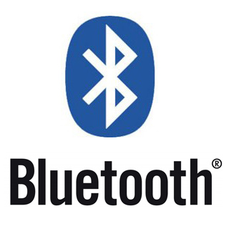
Features
Wireless
anytime and anywhere
without requirement of WIFI, Data
Interaction
voting within multiple members
Instantaneity
simply vote and display the result immediately
Anonymousness
secret ballot

Slide 4
Communication Network
Wireless communication among smartphones via Bluetooth.
Hardware Requirement
Samsung Android smartphones
Programming Technique
Java in Android SDK

Slide 5
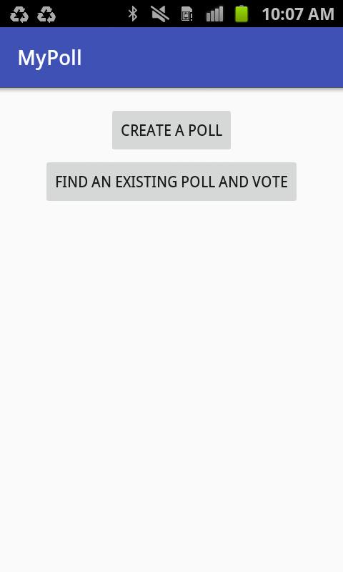
Interface
Main interface:
initiate a poll
search a poll and vote

Slide 6
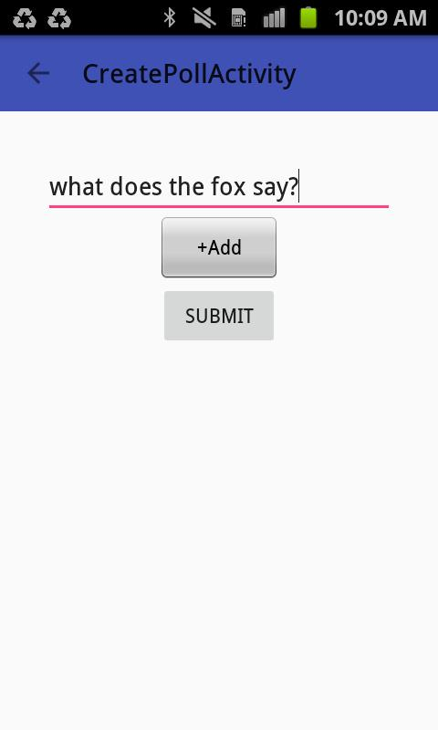
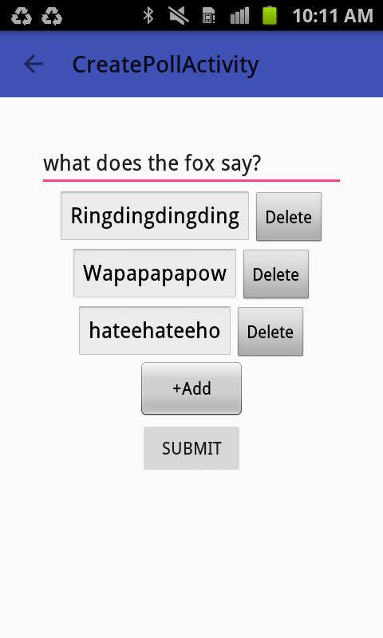
If you decide to create a poll:
Just type in the question you’d like to ask
Click “+Add” for adding options(as many as you want)
Click “SUBMIT” and post!

Slide 7
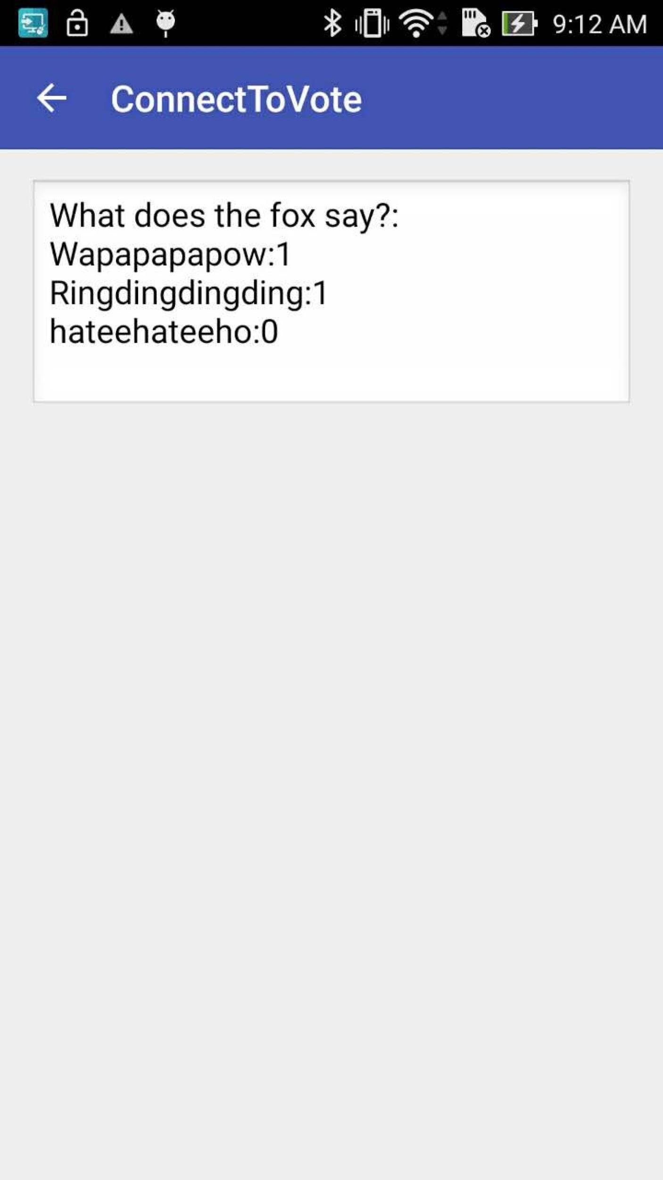
Result Display:

Slide 8
High-level Design
Q&A Interface:
A user can create a survey by editing a question and multiple choices. This user acts as a server and is able to broadcast the survey via Bluetooth.
Others users, acting as clients, are able to enable their bluetooth module to search the server device to make a connection. Because the server device contains up to seven unique UUIDs (each for a different client), it thus supports multiple Bluetooth connections.
Each client device will receive the survey and make a choice so that it can send back the result back to the server. After the server device collects all the results, it can make the final summary and send back each client.

Slide 9
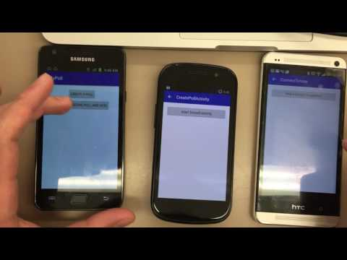
Demo

Slide 10
Discussion
Major problems encountered:
to familiarize java programming and Android SDK
to build up multiple-device-connection network over Bluetooth
code debugging
Limitations:
Short range communication.
Sometimes, the connection is not stable.
Number of devices is limited by UUID we built in.
Notes:
No mature example founded on line
A layer called Bluetooth service that hold on accept thread, connect thread, connected thread
But it turned out the server always failed to connect the second device. After a long time struggling, we realized we needed to hold multiple bluetooth service layer.
So each service maintains one connection between a pair of client and server.

Slide 11
Future Possible Improvement
1. Improve the design of user interface
2. Support file sharing like image, text files.
3. Support multiple piconets.
Now it only supports one master device so this limits the number of devices connected to the network.
Next step is to add interaction between different master devices (servers) so that the results from different survey can be summarized.
The detailed network structure is in next slide.

Slide 12
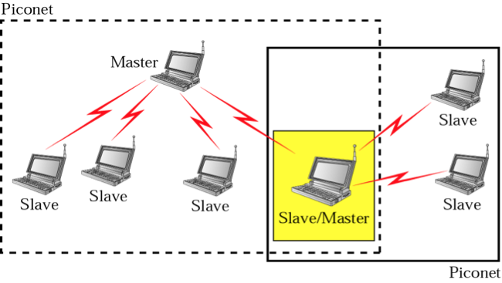
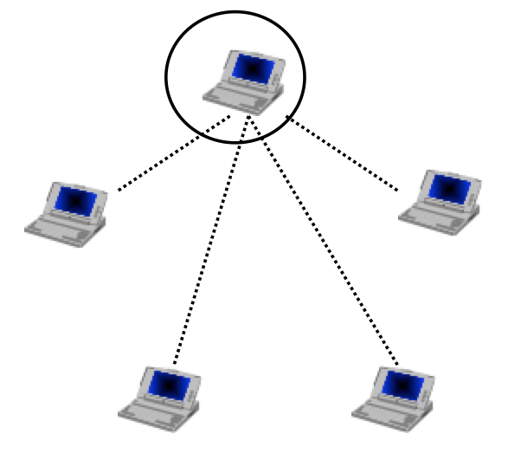
Improve from left to right

Slide 13


