Slide 1
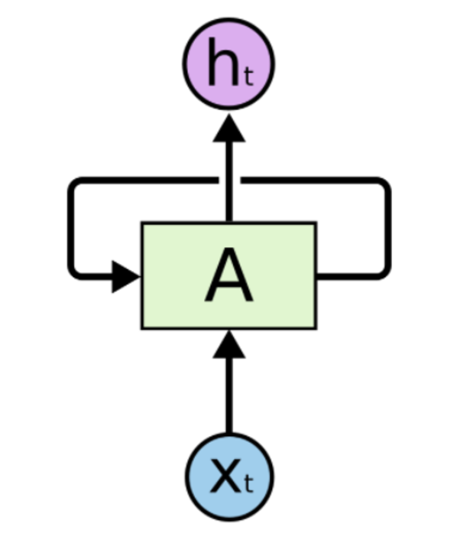
RNN in TensorFlow
cell = tf.contrib.rnn.BasicRNNCell(num_units=hidden_size)
... outputs, _states = tf.nn.dynamic_rnn(cell, x_data, dtype=tf.float32)

Slide 2
RNN in TensorFlow
cell = tf.contrib.rnn.BasicRNNCell(num_units=hidden_size)
cell = tf.contrib.rnn.BasicLSTMCell(num_units=hidden_size) ... outputs, _states = tf.nn.dynamic_rnn(cell, x_data, dtype=tf.float32)

Slide 3
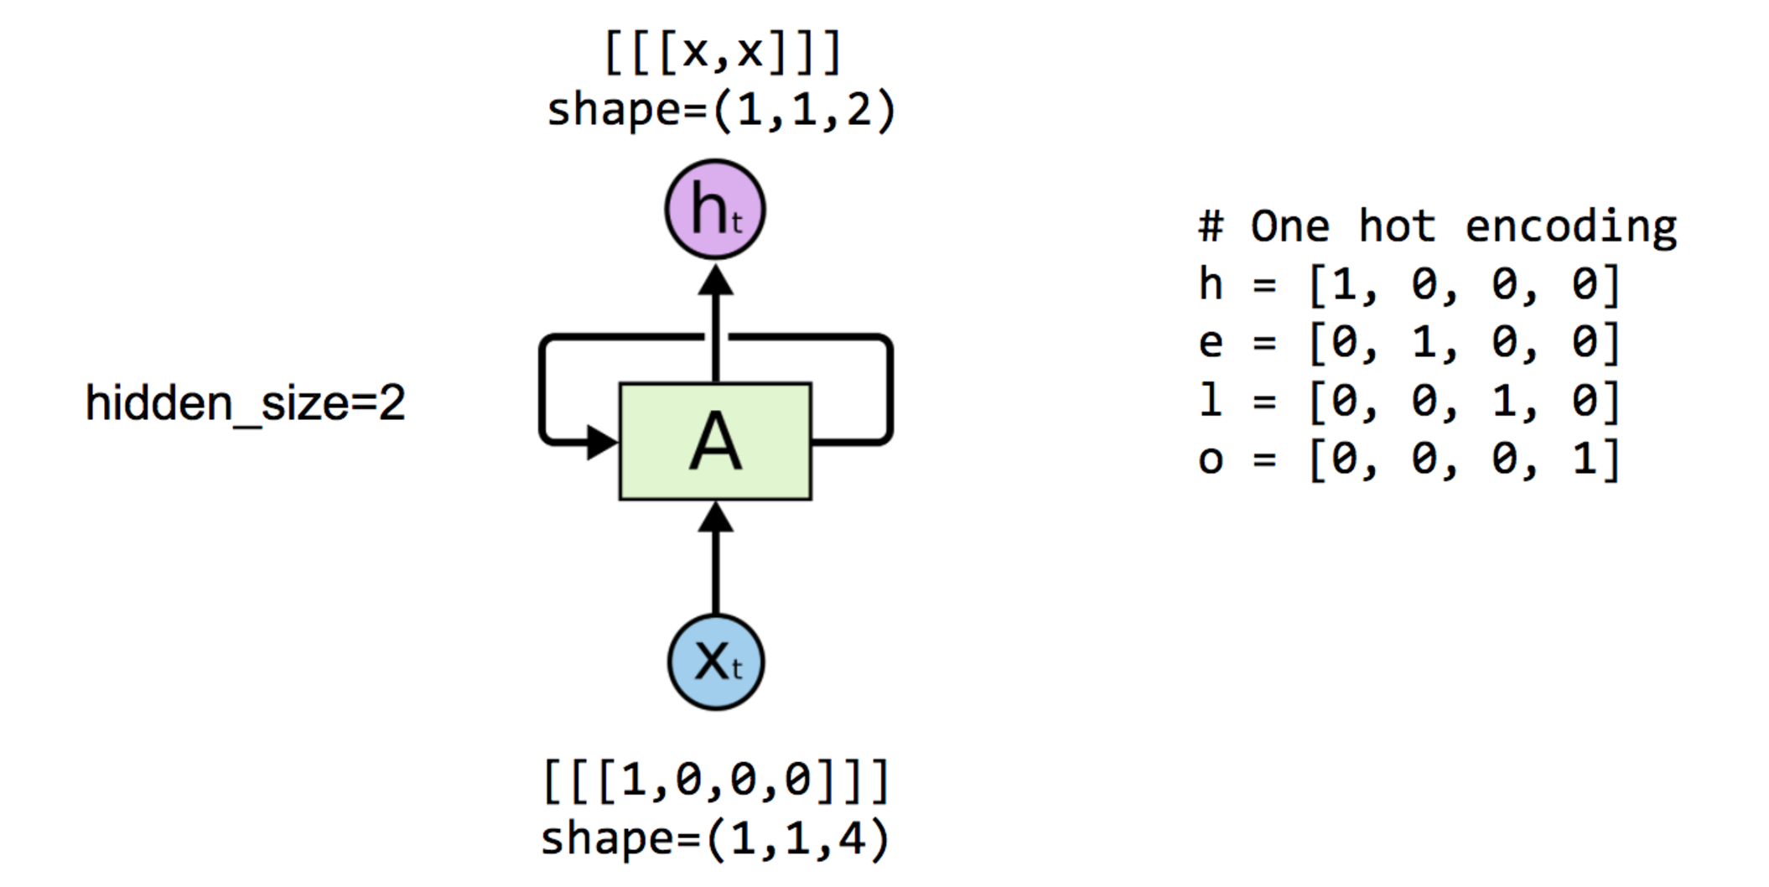
One node: 4 (input-dim) in 2 (hidden_size)

Slide 4
One node: 4 (input-dim) in 2 (hidden_size)

Slide 5
One node: 4 (input-dim) in 2 (hidden_size)
# One cell RNN input_dim (4) -> output_dim (2) hidden_size = 2 cell = tf.contrib.rnn.BasicLSTMCell(num_units=hidden_size) x_data = np.array([[[1,0,0,0]]], dtype=np.float32)
outputs, _states = tf.nn.dynamic_rnn(cell, x_data, dtype=tf.float32) sess.run(tf.global_variables_initializer()) pp.pprint(outputs.eval())
array([[[-0.42409304, 0.64651132]]])

Slide 6
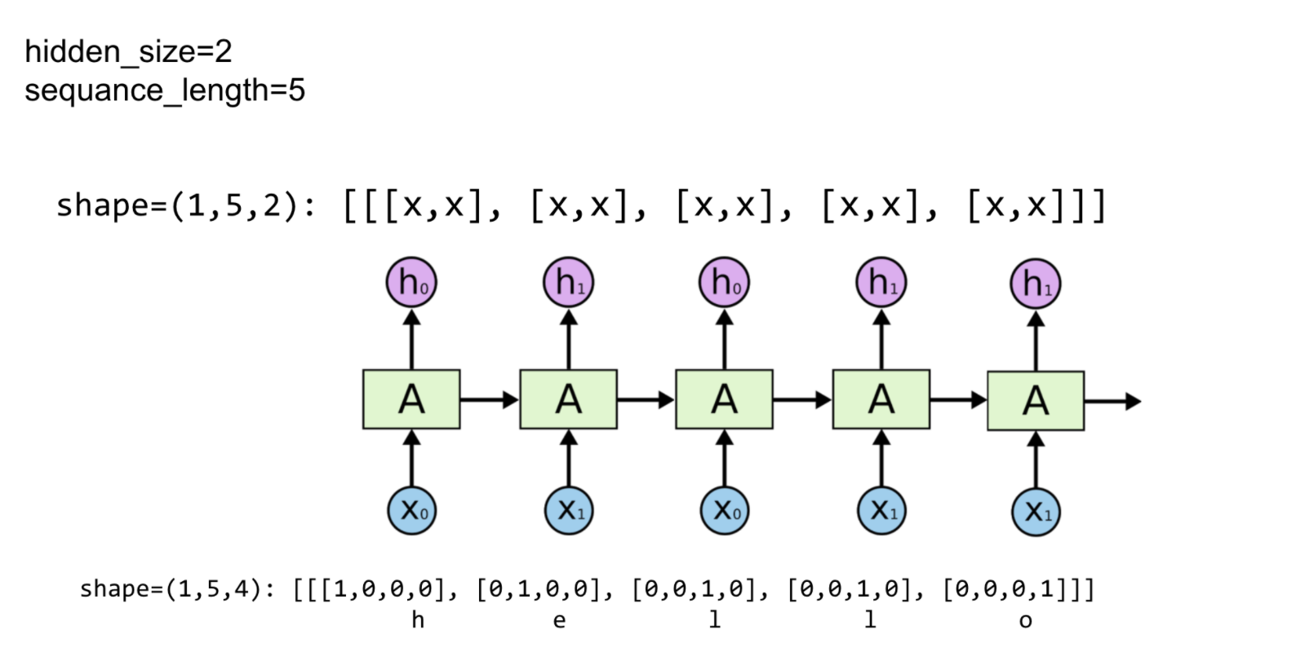
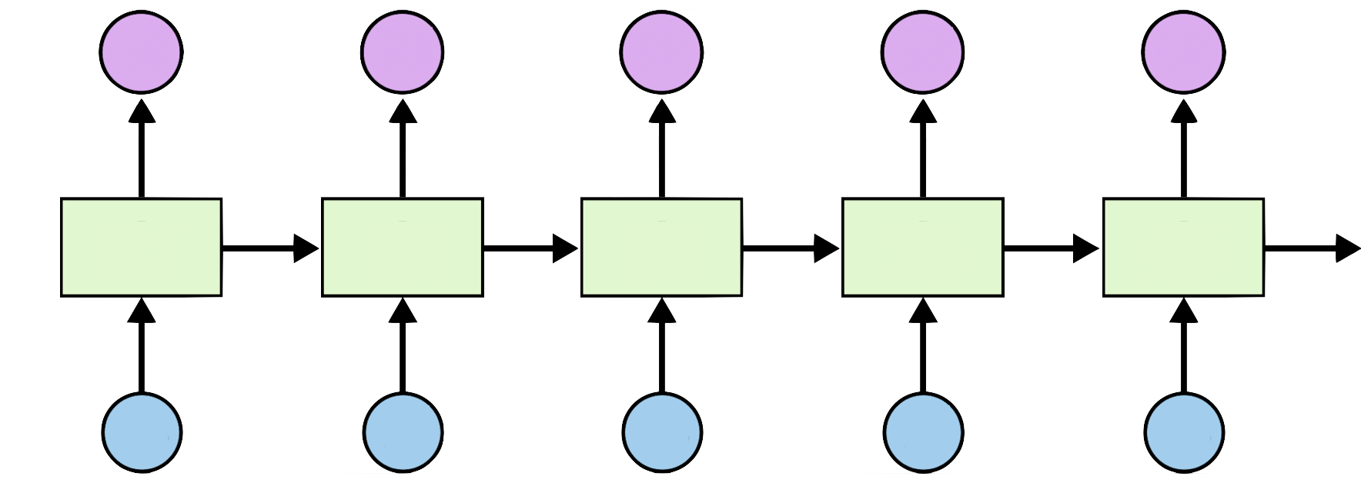

Unfolding to n sequences
Hidden_size=2
sequence_length=5

Slide 7
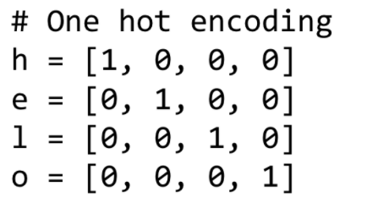
Unfolding to n sequences
# One cell RNN input_dim (4) -> output_dim (2). sequence: 5 hidden_size = 2 cell = tf.contrib.rnn.BasicLSTMCell(num_units=hidden_size) x_data = np.array([[h, e, l, l, o]], dtype=np.float32) print(x_data.shape) pp.pprint(x_data) outputs, states = tf.nn.dynamic_rnn(cell, x_data, dtype=tf.float32) sess.run(tf.global_variables_initializer()) pp.pprint(outputs.eval())
X_data = array
([[[ 1., 0., 0., 0.], [ 0., 1., 0., 0.], [ 0., 0., 1., 0.], [ 0., 0., 1., 0.], [ 0., 0., 0., 1.]]], dtype=float32) Outputs = array
([[[ 0.19709368, 0.24918222], [-0.11721198, 0.1784237 ], [-0.35297349, -0.66278851], [-0.70915914, -0.58334434], [-0.38886023, 0.47304463]]], dtype=float32)
Hidden_size=2
sequence_length=5

Slide 8
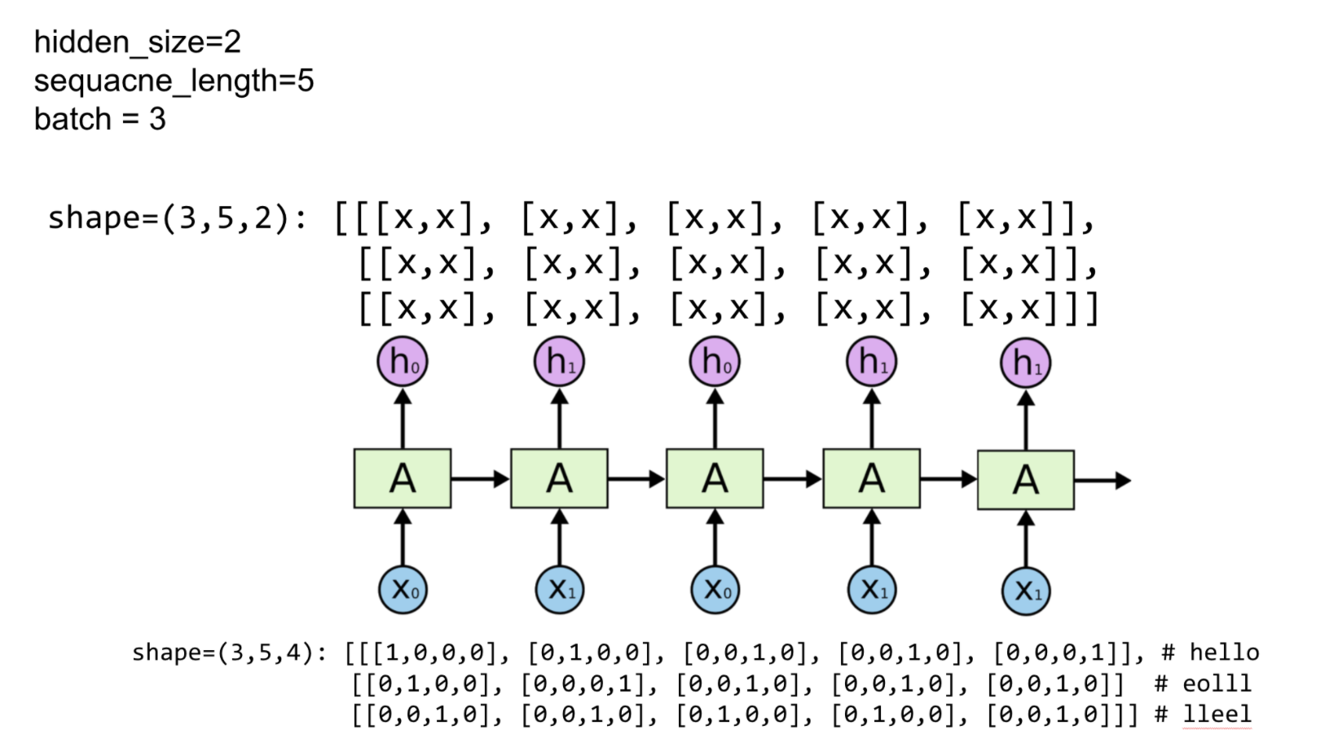
Batching input
Hidden_size=2
sequence_length=5
batch_size=3

Slide 9
Batching input
# One cell RNN input_dim (4) -> output_dim (2). sequence: 5, batch 3 # 3 batches 'hello', 'eolll', 'lleel' x_data = np.array([[h, e, l, l, o], [e, o, l, l, l], [l, l, e, e, l]], dtype=np.float32) pp.pprint(x_data) cell = rnn.BasicLSTMCell(num_units=2, state_is_tuple=True) outputs, _states = tf.nn.dynamic_rnn(cell, x_data,
dtype=tf.float32) sess.run(tf.global_variables_initializer()) pp.pprint(outputs.eval())
array([[[ 1., 0., 0., 0.], [ 0., 1., 0., 0.], [ 0., 0., 1., 0.], [ 0., 0., 1., 0.], [ 0., 0., 0., 1.]], [[ 0., 1., 0., 0.], [ 0., 0., 0., 1.], [ 0., 0., 1., 0.], [ 0., 0., 1., 0.], [ 0., 0., 1., 0.]], [[ 0., 0., 1., 0.], [ 0., 0., 1., 0.], [ 0., 1., 0., 0.], [ 0., 1., 0., 0.], [ 0., 0., 1., 0.]]],
Hidden_size=2
sequence_length=5
batch_size=3

Slide 10
Batching input
# One cell RNN input_dim (4) -> output_dim (2). sequence: 5, batch 3 # 3 batches 'hello', 'eolll', 'lleel' x_data = np.array([[h, e, l, l, o], [e, o, l, l, l], [l, l, e, e, l]], dtype=np.float32) pp.pprint(x_data) cell = rnn.BasicLSTMCell(num_units=2, state_is_tuple=True) outputs, _states = tf.nn.dynamic_rnn(cell, x_data,
dtype=tf.float32) sess.run(tf.global_variables_initializer()) pp.pprint(outputs.eval())
array([[[ 1., 0., 0., 0.], [ 0., 1., 0., 0.], [ 0., 0., 1., 0.], [ 0., 0., 1., 0.], [ 0., 0., 0., 1.]], [[ 0., 1., 0., 0.], [ 0., 0., 0., 1.], [ 0., 0., 1., 0.], [ 0., 0., 1., 0.], [ 0., 0., 1., 0.]], [[ 0., 0., 1., 0.], [ 0., 0., 1., 0.], [ 0., 1., 0., 0.], [ 0., 1., 0., 0.], [ 0., 0., 1., 0.]]],
array([[[-0.0173022 , -0.12929453], [-0.14995177, -0.23189341], [ 0.03294011, 0.01962204], [ 0.12852104, 0.12375218], [ 0.13597946, 0.31746736]], [[-0.15243632, -0.14177315], [ 0.04586344, 0.12249056], [ 0.14292534, 0.15872268], [ 0.18998367, 0.21004884], [ 0.21788891, 0.24151592]], [[ 0.10713603, 0.11001928], [ 0.17076059, 0.1799853 ], [-0.03531617, 0.08993293], [-0.1881337 , -0.08296411], [-0.00404597, 0.07156041]]],
Hidden_size=2
sequence_length=5
batch_size=3

Slide 11
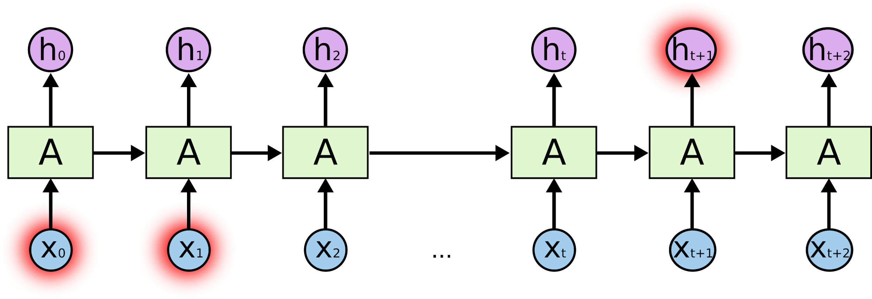

Lab 12-2
Hi Hello RNN
With TF 1.0!

Slide 12
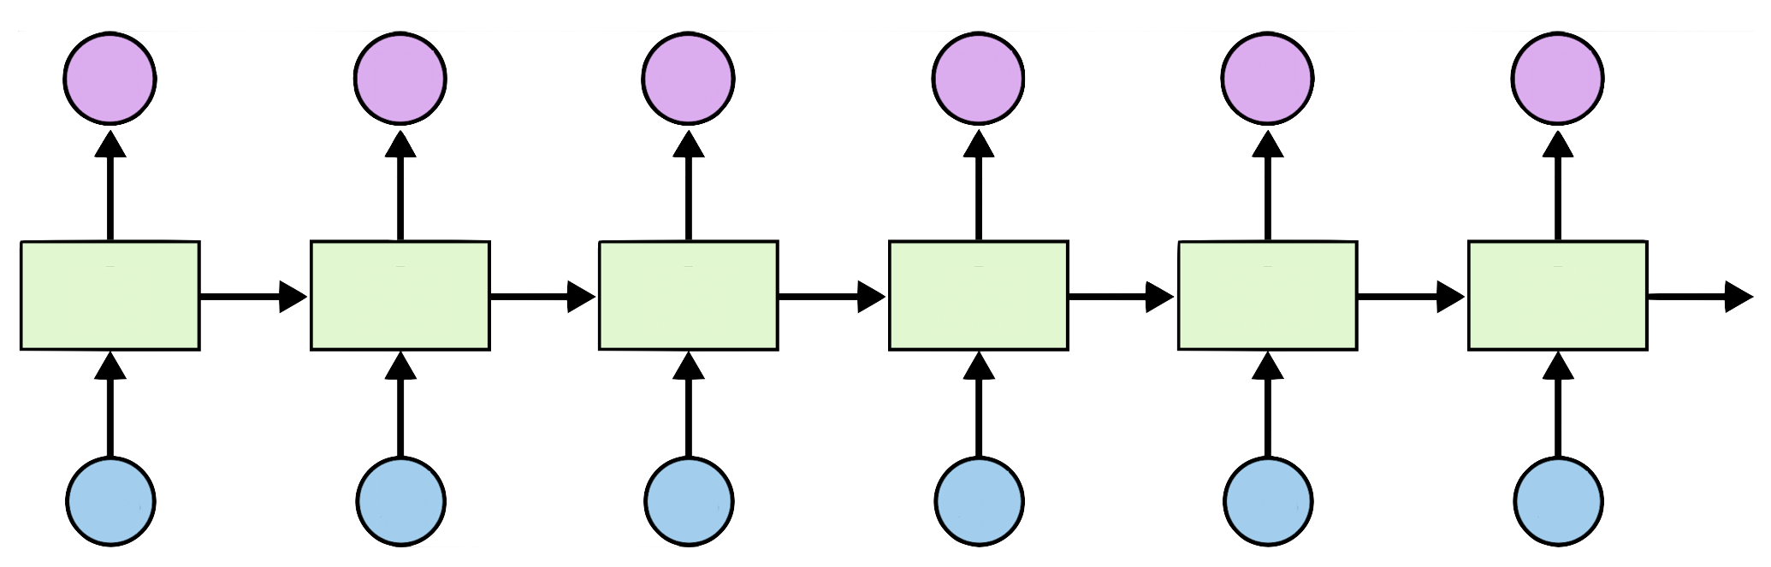
Teach RNN ‘hihello’
i
h
e
l
l
o
h
i
h
e
l
l

Slide 13
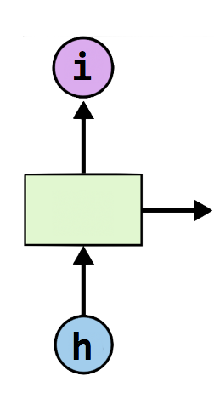
One-hot encoding
text: ‘hihello’
unique chars (vocabulary, voc):
h, i, e, l, o
voc index:
h:0, i:1, e:2, l:3, o:4
[1, 0, 0, 0, 0], # h 0
[0, 1, 0, 0, 0], # i 1
[0, 0, 1, 0, 0], # e 2
[0, 0, 0, 1, 0], # l 3
[0, 0, 0, 0, 1], # o 4

Slide 14
Teach RNN ‘hihello’
[1, 0, 0, 0, 0], # h 0
[0, 1, 0, 0, 0], # i 1
[0, 0, 1, 0, 0], # e 2
[0, 0, 0, 1, 0], # l 3
[0, 0, 0, 0, 1], # o 4
[0, 1, 0, 0, 0]
[1, 0, 0, 0, 0]
[0, 1, 0, 0, 0]
[0, 1, 0, 0, 0]
[0, 1, 0, 0, 0]
[0, 0, 0, 0, 1]
i
h
e
l
l
o
h
i
h
e
l
l
[1, 0, 0, 0, 0]
[0, 1, 0, 0, 0]
[1, 0, 0, 0, 0]
[0, 1, 0, 0, 0]
[0, 1, 0, 0, 0]
[0, 1, 0, 0, 0]

Slide 15
Teach RNN ‘hihello’
[1, 0, 0, 0, 0], # h 0
[0, 1, 0, 0, 0], # i 1
[0, 0, 1, 0, 0], # e 2
[0, 0, 0, 1, 0], # l 3
[0, 0, 0, 0, 1], # o 4

Slide 16
Creating rnn cell
# RNN model
rnn_cell = rnn_cell.BasicRNNCell(rnn_size)
rnn_cell = rnn_cell. BasicLSTMCell(rnn_size)
rnn_cell = rnn_cell. GRUCell(rnn_size)

Slide 17
Creating rnn cell
# RNN model
rnn_cell = rnn_cell.BasicRNNCell(rnn_size)
rnn_cell = rnn_cell. BasicLSTMCell(rnn_size)
rnn_cell = rnn_cell. GRUCell(rnn_size)

Slide 18


Execute RNN
hidden_rnn_size
# RNN model
rnn_cell = rnn_cell.BasicRNNCell(rnn_size)
outputs, _states = tf.nn.dynamic_rnn(
rnn_cell,
X,
initial_state=initial_state,
dtype=tf.float32)

Slide 19
RNN parameters
hidden_size = 5 # output from the LSTM
input_dim = 5 # one-hot size
batch_size = 1 # one sentence
sequence_length = 6 # |ihello| == 6

Slide 20
Data creation
idx2char = ['h', 'i', 'e', 'l', 'o'] # h=0, i=1, e=2, l=3, o=4
x_data = [[0, 1, 0, 2, 3, 3]] # hihell
x_one_hot = [[[1, 0, 0, 0, 0], # h 0
[0, 1, 0, 0, 0], # i 1
[1, 0, 0, 0, 0], # h 0
[0, 0, 1, 0, 0], # e 2
[0, 0, 0, 1, 0], # l 3
[0, 0, 0, 1, 0]]] # l 3
y_data = [[1, 0, 2, 3, 3, 4]] # ihello
X = tf.placeholder(tf.float32,
[None, sequence_length, input_dim]) # X one-hot
Y = tf.placeholder(tf.int32, [None, sequence_length]) # Y label

Slide 21
Feed to RNN
x_one_hot = [[[1, 0, 0, 0, 0], # h 0
[0, 1, 0, 0, 0], # i 1
[1, 0, 0, 0, 0], # h 0
[0, 0, 1, 0, 0], # e 2
[0, 0, 0, 1, 0], # l 3
[0, 0, 0, 1, 0]]] # l 3
y_data = [[1, 0, 2, 3, 3, 4]] # ihello
X = tf.placeholder(
tf.float32, [None, sequence_length, hidden_size]) # X one-hot
Y = tf.placeholder(tf.int32, [None, sequence_length]) # Y label
cell = tf.contrib.rnn.BasicLSTMCell(num_units=hidden_size, state_is_tuple=True)
initial_state = cell.zero_state(batch_size, tf.float32)
outputs, _states = tf.nn.dynamic_rnn(
cell, X, initial_state=initial_state, dtype=tf.float32)

Slide 22
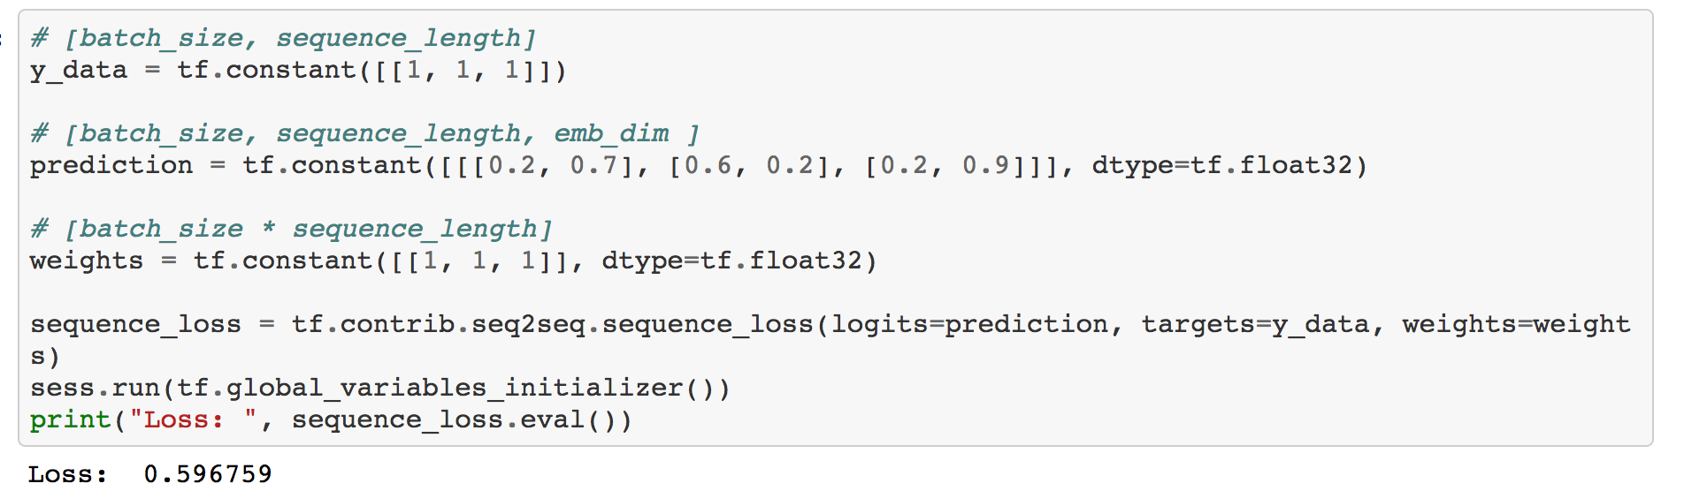
Cost: sequence_loss

Slide 23
Cost: sequence_loss
# [batch_size, sequence_length] y_data = tf.constant([[1, 1, 1]]) # [batch_size, sequence_length, emb_dim ] prediction1 = tf.constant([[[0.3, 0.7], [0.3, 0.7], [0.3, 0.7]]], dtype=tf.float32) prediction2 = tf.constant([[[0.1, 0.9], [0.1, 0.9], [0.1, 0.9]]], dtype=tf.float32) # [batch_size * sequence_length] weights = tf.constant([[1, 1, 1]], dtype=tf.float32) sequence_loss1 = tf.contrib.seq2seq.sequence_loss(prediction1, y_data, weights) sequence_loss2 = tf.contrib.seq2seq.sequence_loss(prediction2, y_data, weights) sess.run(tf.global_variables_initializer()) print("Loss1: ", sequence_loss1.eval(), "Loss2: ", sequence_loss2.eval())
Loss1: 0.513015
Loss2: 0.371101

Slide 24
Cost: sequence_loss
outputs, _states = tf.nn.dynamic_rnn(
cell, X, initial_state=initial_state, dtype=tf.float32)
weights = tf.ones([batch_size, sequence_length])
sequence_loss = tf.contrib.seq2seq.sequence_loss(
logits=outputs, targets=Y, weights=weights)
loss = tf.reduce_mean(sequence_loss)
train = tf.train.AdamOptimizer(learning_rate=0.1).minimize(loss)

Slide 25
Training
prediction = tf.argmax(outputs, axis=2)
with tf.Session() as sess:
sess.run(tf.global_variables_initializer())
for i in range(2000):
l, _ = sess.run([loss, train], feed_dict={X: x_one_hot, Y: y_data})
result = sess.run(prediction, feed_dict={X: x_one_hot})
print(i, "loss:", l, "prediction: ", result, "true Y: ", y_data)
# print char using dic
result_str = [idx2char[c] for c in np.squeeze(result)]
print("\tPrediction str: ", ''.join(result_str))

Slide 26
Results
prediction = tf.argmax(outputs, axis=2)
with tf.Session() as sess:
sess.run(tf.global_variables_initializer())
for i in range(2000):
l, _ = sess.run([loss, train], feed_dict={X: x_one_hot, Y: y_data})
result = sess.run(prediction, feed_dict={X: x_one_hot})
print(i, "loss:", l, "prediction: ", result, "true Y: ", y_data)
# print char using dic
result_str = [idx2char[c] for c in np.squeeze(result)]
print("\tPrediction str: ", ''.join(result_str))
0 loss: 1.55474 prediction: [[3 3 3 3 4 4]] true Y: [[1, 0, 2, 3, 3, 4]] Prediction str: lllloo
1 loss: 1.55081 prediction: [[3 3 3 3 4 4]] true Y: [[1, 0, 2, 3, 3, 4]] Prediction str: lllloo
2 loss: 1.54704 prediction: [[3 3 3 3 4 4]] true Y: [[1, 0, 2, 3, 3, 4]] Prediction str: lllloo
3 loss: 1.54342 prediction: [[3 3 3 3 4 4]] true Y: [[1, 0, 2, 3, 3, 4]] Prediction str: lllloo
...
1998 loss: 0.75305 prediction: [[1 0 2 3 3 4]] true Y: [[1, 0, 2, 3, 3, 4]] Prediction str: ihello
1999 loss: 0.752973 prediction: [[1 0 2 3 3 4]] true Y: [[1, 0, 2, 3, 3, 4]] Prediction str: ihello

