Slide 1
Assignment 4-B
Read Chapter15 Appendix about the syntax of scheme functional programming, then answer the questions in the next slides
Extra YouTube videos
Introduction to Scheme
Lambdas functions and Conditionals
Abstraction

Slide 2
Q1. What does the following Scheme function do?
(define (y s lis)
(cond
((null? lis) ‘() )
((equal? s (car lis)) lis)
(else (y s (cdr lis)))
))

Slide 3
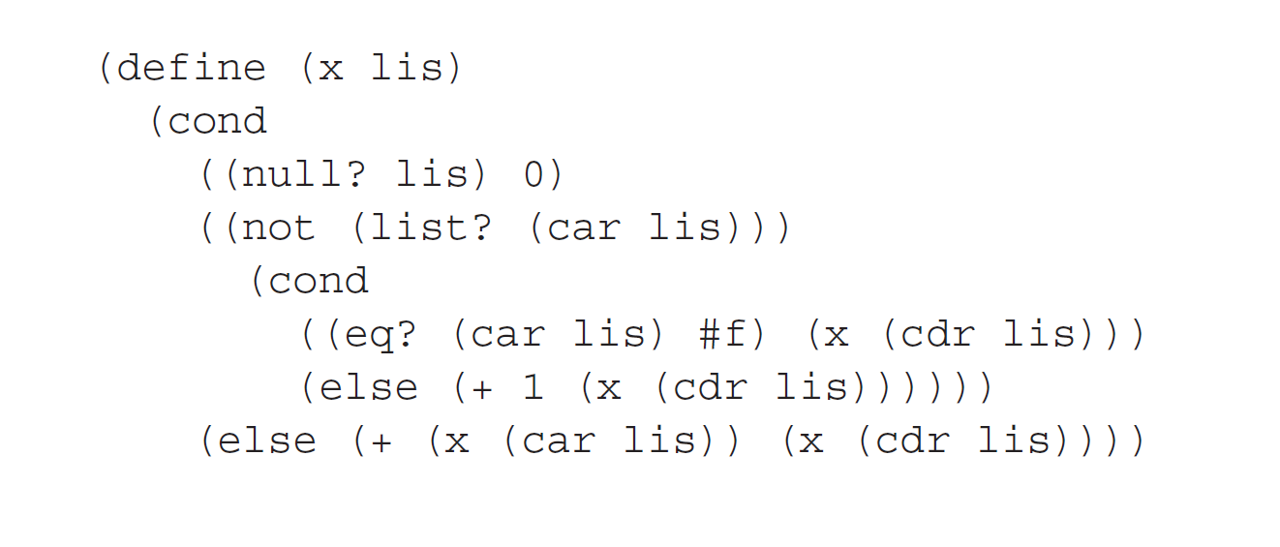
Q2. What does the following Scheme function do?

Slide 4
Q3. Change the following function
The following function returns the number of zeros in a given simple list of numbers
(define (countZero aList)
;; assume that aList is a list of numbers
(cond ( (null? aList) 0 )
( (eq? (car aList) 0) (+ 1 (countZero (cdr aList))))
( #t (countZero (cdr aList)))
) )
Change this function to make it return the number of element x in simple list.
For example: number of 1 in the list ‘(1 2 5 4 1 3 1) is 3
For example: number of 4 in the list ‘(4 2 4 4 4 3 4 6 7) is 5

Slide 5
Q4. Write the following function
Write a Scheme function that takes a simple list of numbers as a parameter and returns a list with the largest and smallest numbers in the input list.
For example: the list ‘(1 2 5 4 1 3 1) returns
  ‘(5 1)

Slide 6
Q5. Write the following function
Write a Scheme function that takes a list and an atom as parameters and returns a list identical to its parameter list except with all instances of the given atom deleted.
Assume the function name is deleteatom, then, you can use the function as follows:
> (deleteatom '2 '(2 3 1 4 5 6 -1 2 7))
'(3 1 4 5 6 -1 7)
> (deleteall 'a '(a r f t a r c d a e))
'(r f t r c d e)

