Slide 1

How I do backend?

Slide 2

Introduce
이규락
-backend developer
-4th first employed
-Python, Django

Slide 3

What I speech?

Slide 4



What is backend?
Backend

Slide 5
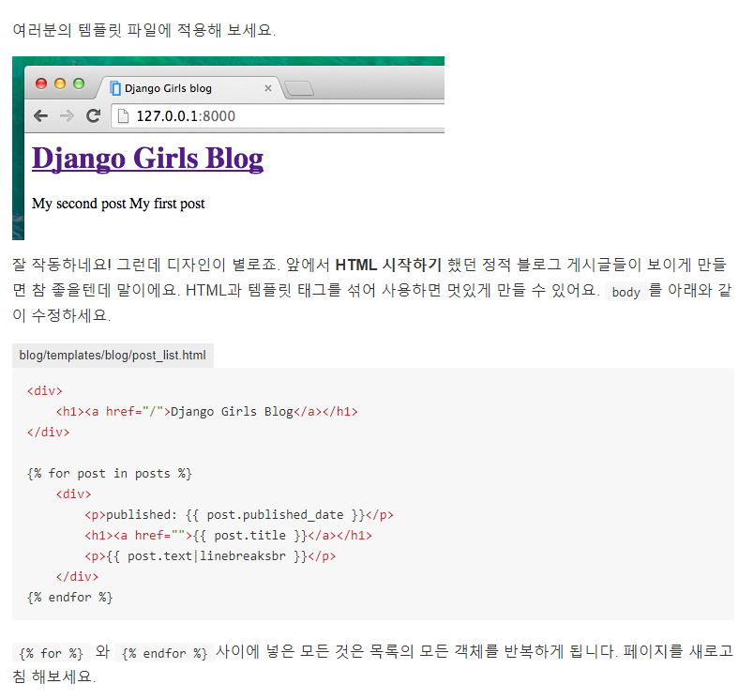
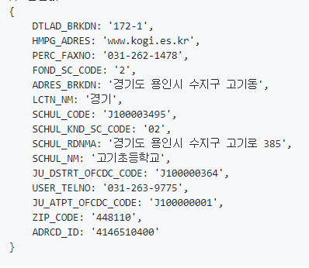
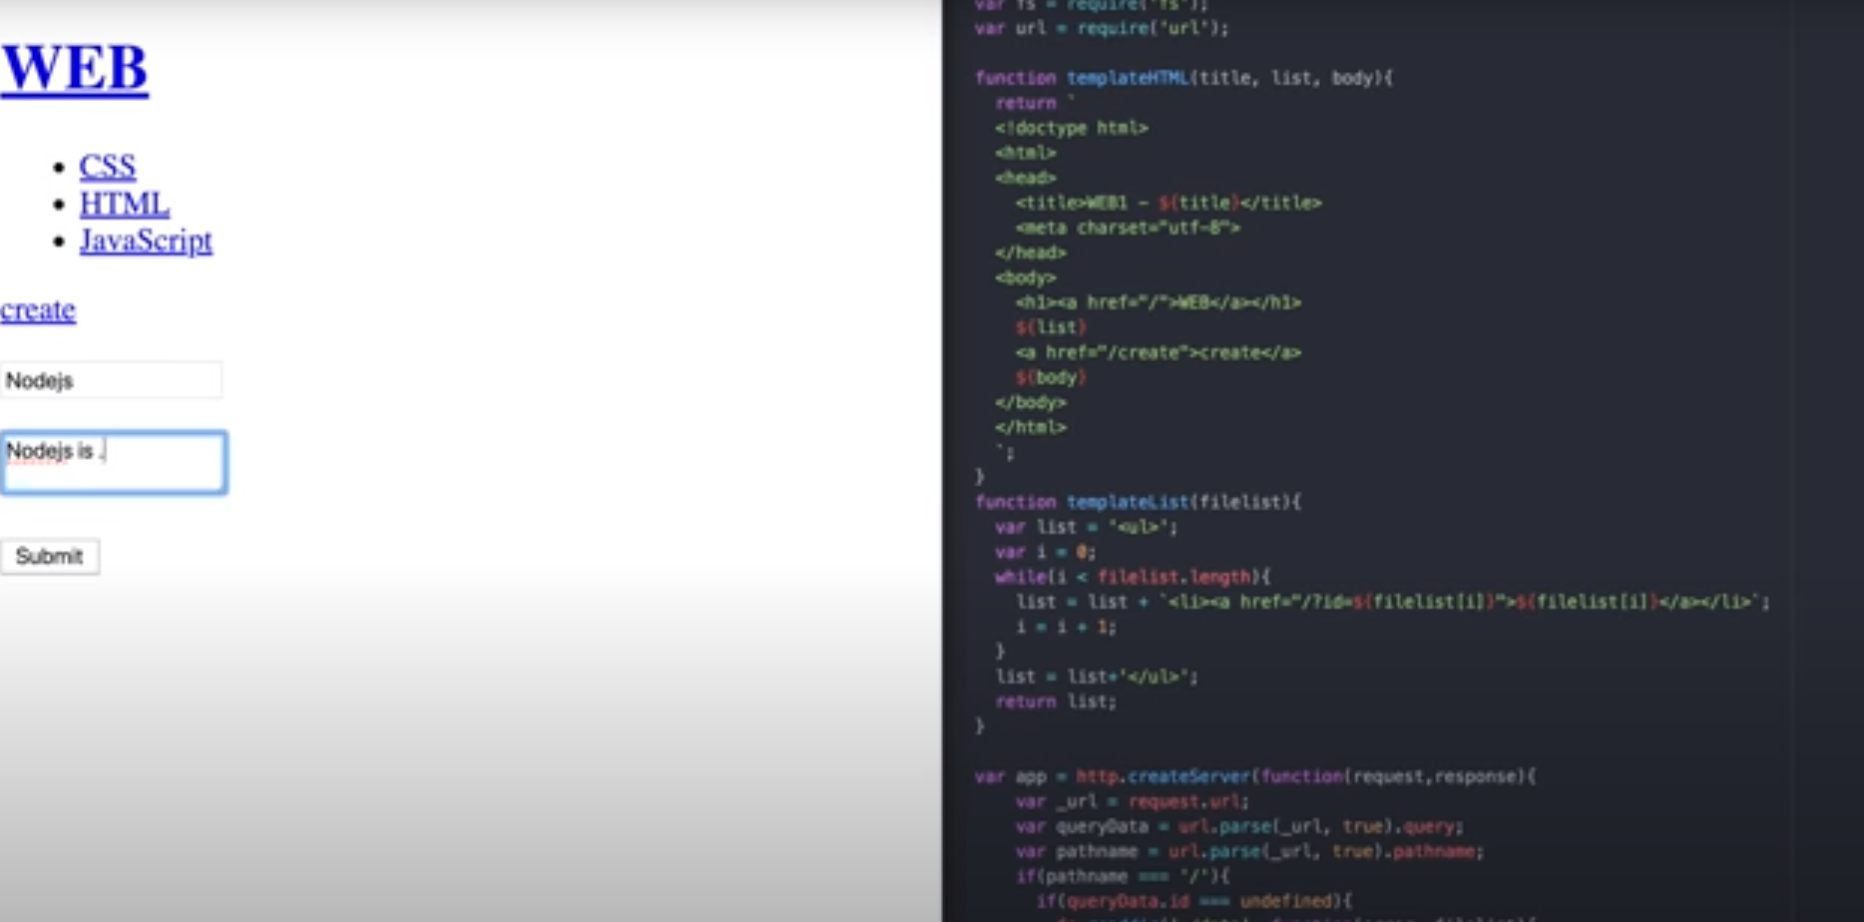
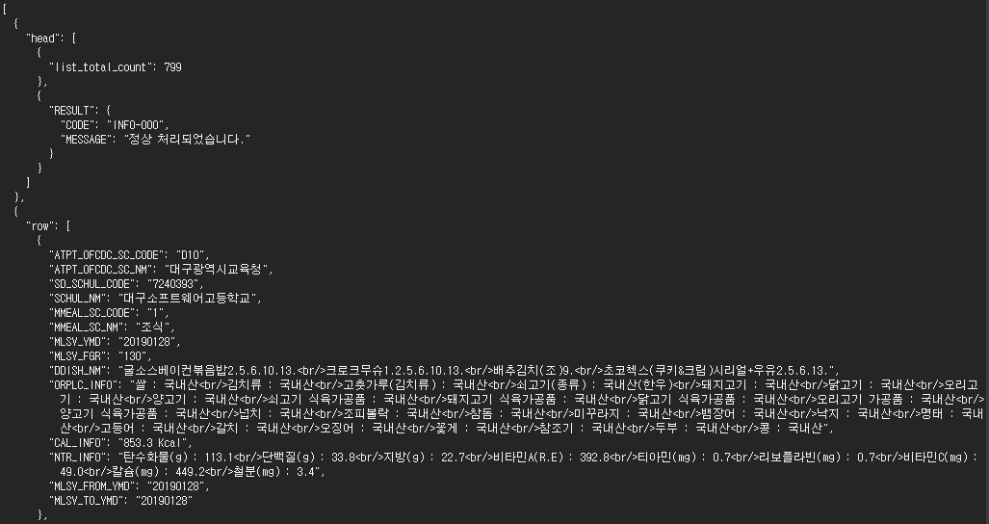
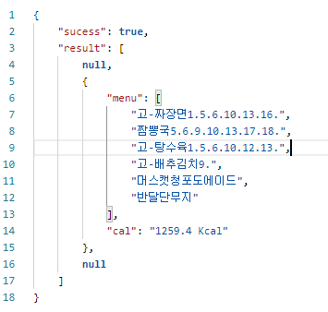

POST
GET
PUT, PATCH
DELETE
How I study?
authentication
HTTP method
REST API
CRUD
JSON
DB

Slide 6
- HTTP METHOD
- request
- JSON
- Understanding REST API
- response
- DB
- CRUD
- authentication

Slide 7
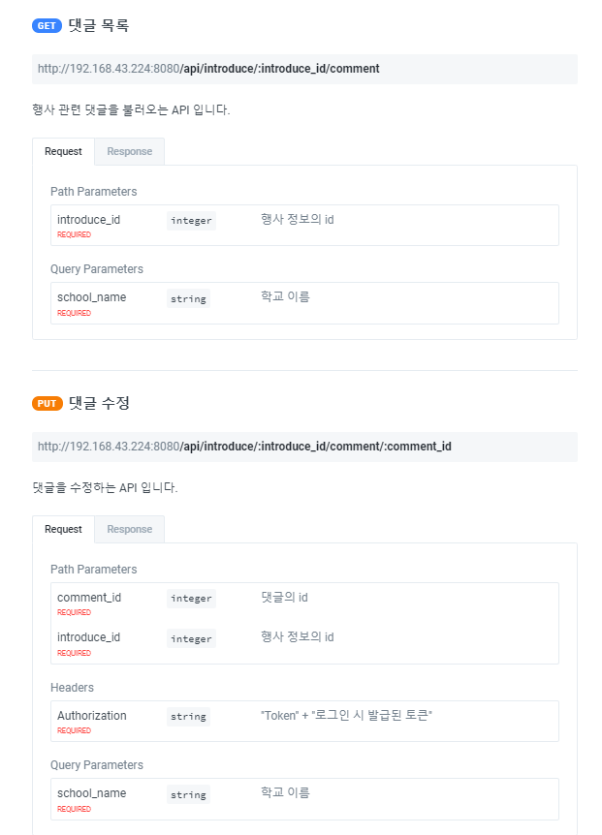
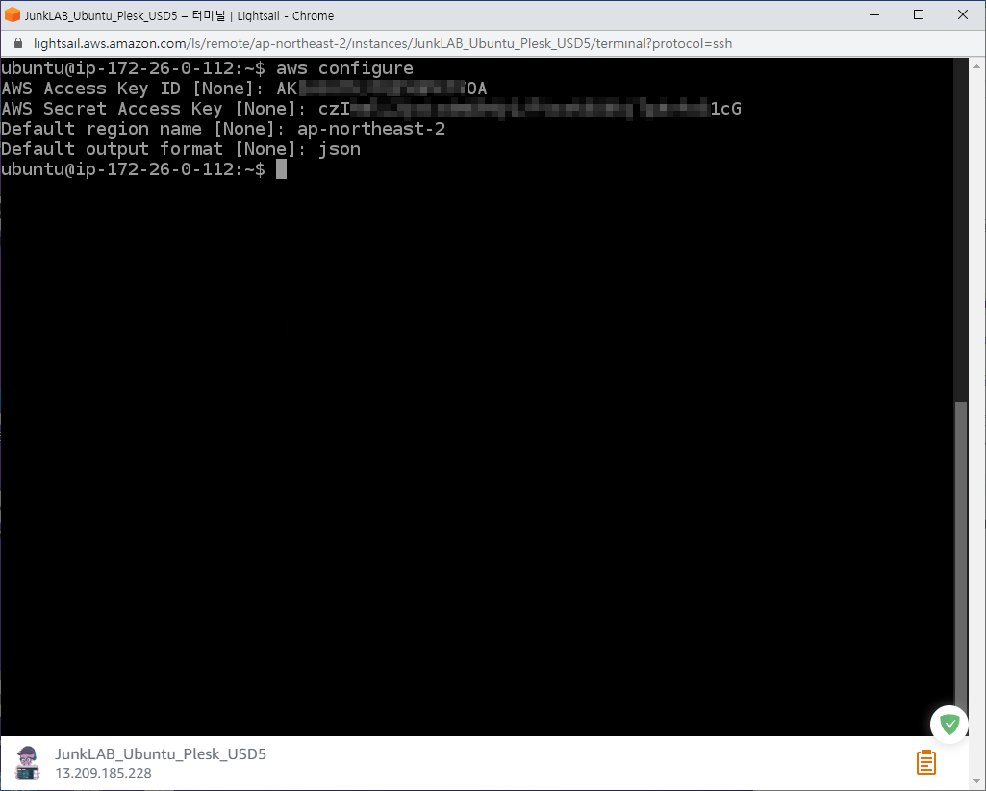

Should do this
AWS, Linux
SQL, ORM
REST API
docs

Slide 8

Question

Slide 9

Thanks

