Slide 1
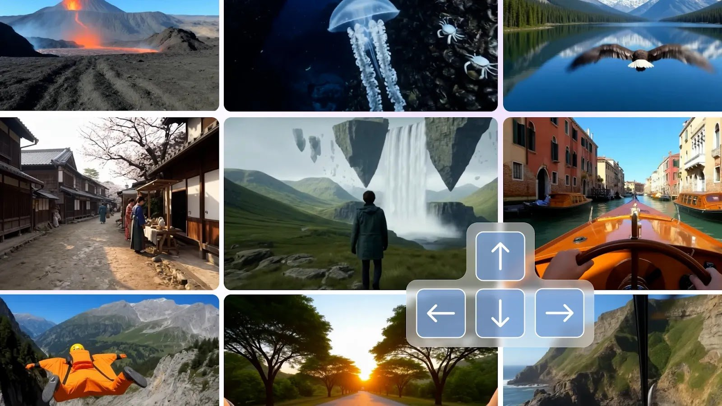
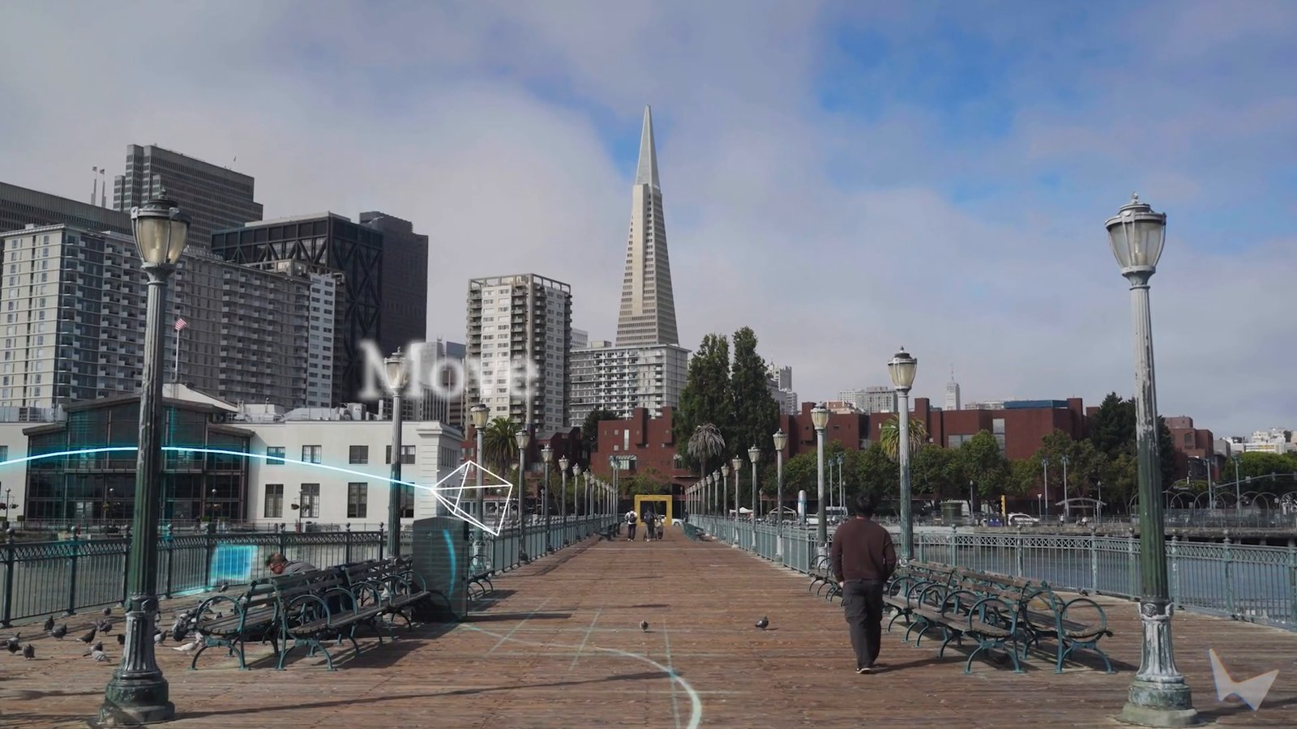
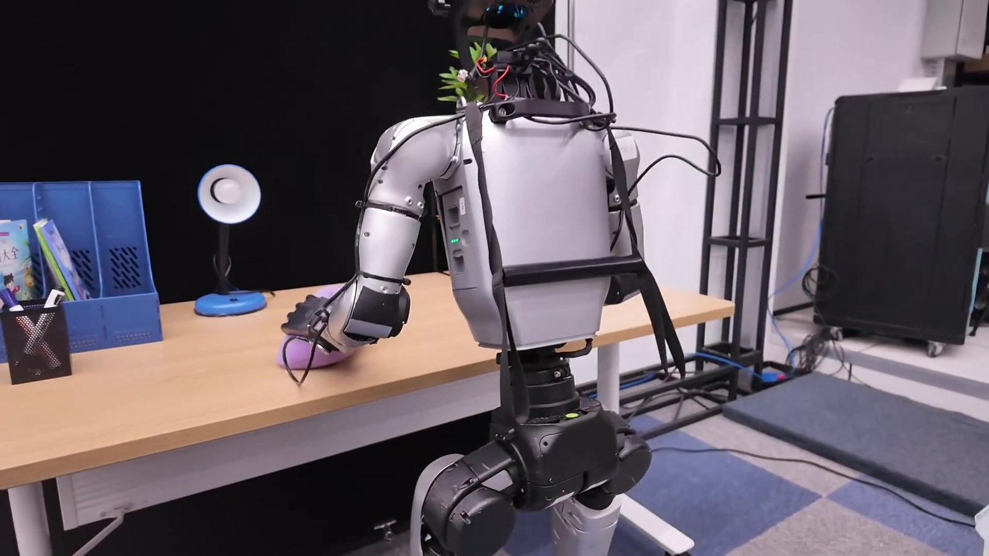
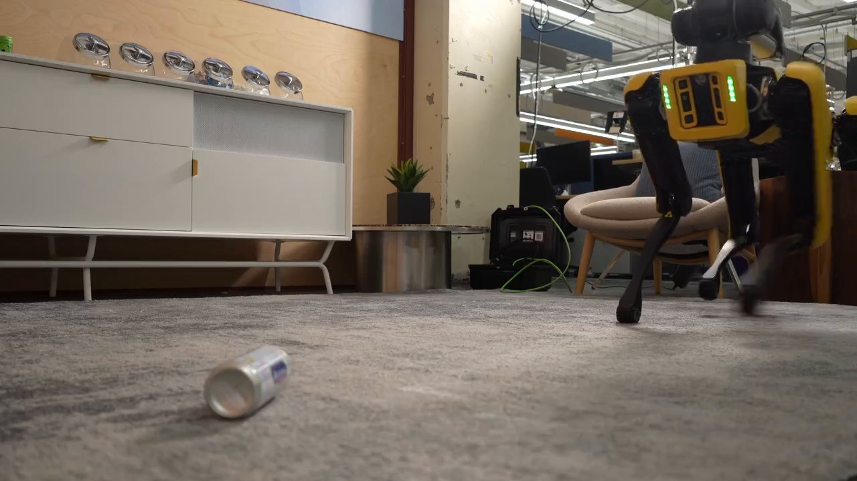
AMCC 5160 · LECTURE 09 · 27 OCTOBER 2026
Worlds You Can Walk Into,
Robots That Learn by Watching
World models, 3D, and robotics · Fall 2026
Harry Yang · Division of Arts and Machine Creativity, HKUST · MIL13002
Notes:
Good evening, everyone, and welcome to Week 9. For eight weeks we have been making pictures that move: images, motion, long takes, and last week, video that talks. Tonight the picture stops being a picture. It becomes a world you can walk into, a 3D place you can export to Blender, and finally a body: a robot that learned what to do by watching people. Three words for tonight: worlds, splats and bodies.

Slide 2
WARM-UP · 1 MINUTE
“I push this cup off the edge of the table. What happens next?”
Say it out loud: where does it land, what sound does it make?
Now: what if the floor is carpet? What if I push gently?
You just ran a world model in your head, conditioned on an action
AMCC 5160 · Week 9 · Worlds, Splats and Bodies
2
Notes:
Let's start with a tiny game. [Hold a cup near the edge of the desk.] If I push this cup off the edge, what happens next? Shout it out. Where does it land, what sound, does it break? Now, what if the floor were carpet? What if I pushed it gently? Notice what you just did. You predicted the future of a scene, and you changed your prediction when I changed the action. That is exactly what tonight's models try to learn: what happens next, given what I do.

Slide 3
Four stories from this year
01
From video to playable worlds
02
3D is back: worlds as splats
Genie 3, Project Genie and the Waymo World Model: video you can steer, one frame at a time
Marble, Atlas and the open HY-World 2.0: generated worlds you can export, and an $8.2B bet on them
Genie 3 (2025) → Gemini Omni (May 2026)
Atlas, 1 Sept 2026 · AMD × World Labs, 28 Sept
03
Robots that learn by watching
04
Does a world model need pixels?
λ0 learns from 500 hours of first-person human video; Gemini 4 Argon turns a video into a simulator
NVIDIA Cosmos 3 generates the world; LeCun’s AMI Labs predicts it in latent space. Debate
Gemini 4 Argon, 13 Oct · λ0, 26 Oct 2026
Cosmos 3 (June) vs. JEPA
AMCC 5160 · Week 9 · Worlds, Splats and Bodies
3
Notes:
Four stories tonight, same format as the last two weeks. One: video that you can steer, frame by frame, which is what people now call an interactive world model. Two: 3D comes back, and generated worlds become Gaussian splats you can export, with one of the biggest deals of the year behind it. Three: robots that learn by watching people, including a model released yesterday. Four: a real disagreement in the field. Does a world model need to draw pixels at all? We'll finish with a debate.

Slide 4
Where we’ve been: the pieces you already have
03
Lecture 03
07
Lecture 07
08
Lecture 08
World models: “what is being predicted?” The Astra round trip. VLA: see, read, act.
Helios: a minute of video in real time. KV cache and distillation. A humanoid learns K-pop from phone video.
Real-time characters: the latency budget, streaming distillation, avatars that listen.
→
Tonight: worlds
→
Tonight: 3D
→
Tonight: bodies
Put an action into the loop: real-time video becomes a world
Keep the geometry: the world becomes a file you can open
Close the loop with a real robot: the world becomes training data
AMCC 5160 · Week 9 · Worlds, Splats and Bodies
4
Notes:
You already own most of the pieces. In Lecture 03 we asked what a world model predicts, we did the round-trip test with Astra, and we saw a vision-language-action model for the first time. In Lecture 07, Helios generated a minute of video in real time using a KV cache and distillation, and a humanoid learned a K-pop dance from phone video. Last week, real-time avatars that listen. Tonight we add one thing to each: an action in the loop, explicit geometry, and a real body.

Slide 5
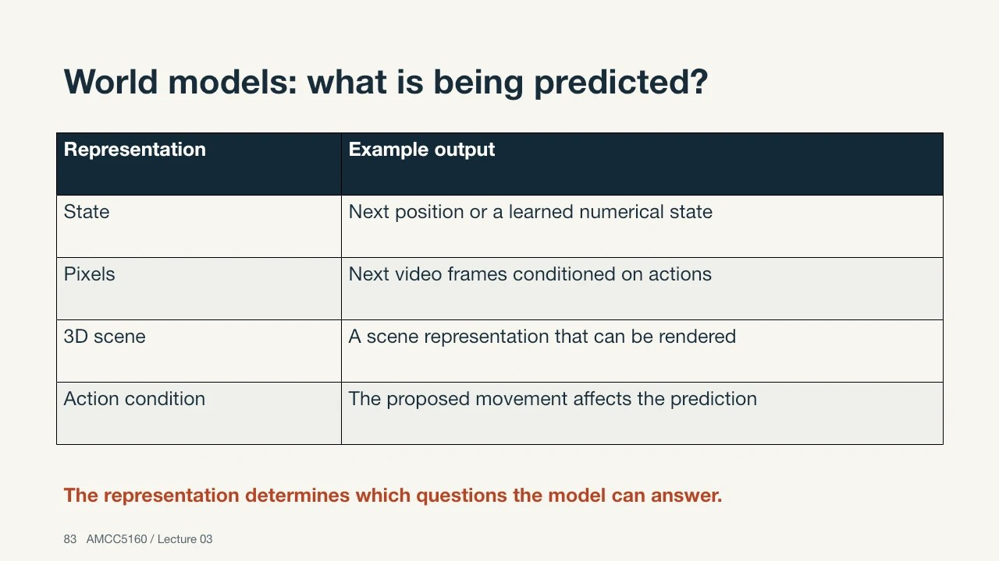
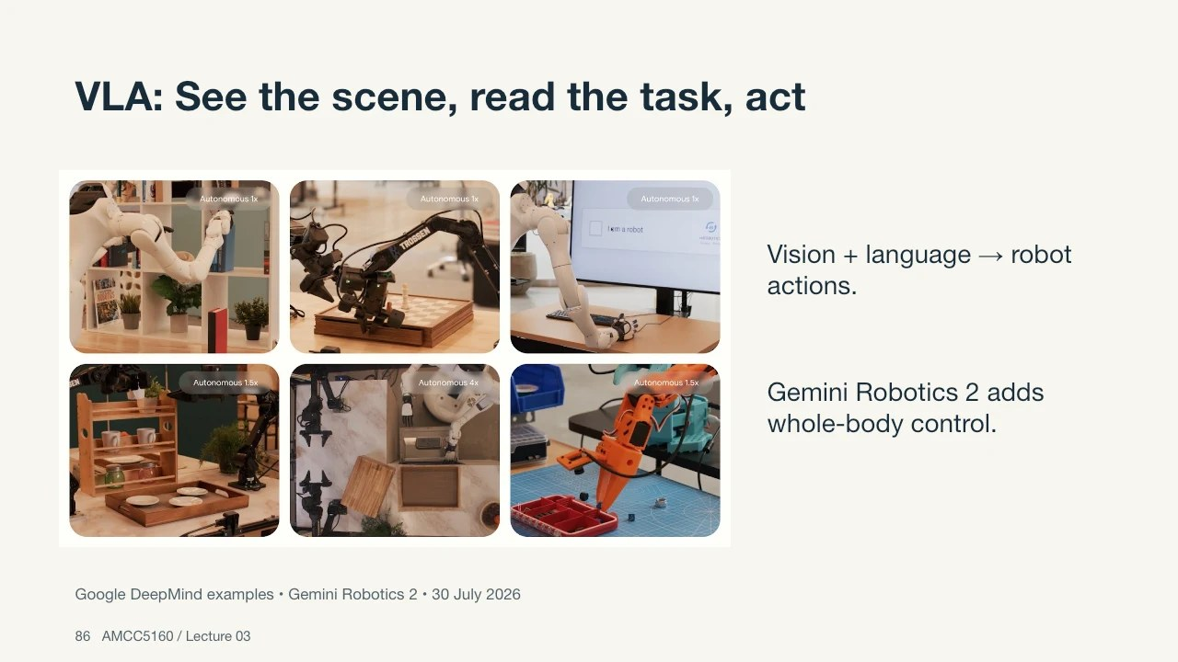
You have seen two slides of tonight already
Lecture 03, slide 83: World models, what is being predicted?
Lecture 03, slide 86: VLA, see the scene, read the task, act
Tonight opens both boxes: how the prediction is made, and how a robot learns the action.
AMCC 5160 · Week 9 · Worlds, Splats and Bodies
5
Notes:
Here are two slides from Lecture 03. On the left, the question 'what is being predicted?': a pixel, a compact state, or an action's result. On the right, the VLA: the robot sees the scene, reads the task and acts. In September these were one slide each, near the end of a hundred-slide lecture. Tonight each of them becomes a whole story. If you have your Lecture 03 notes, keep them open.

Slide 6
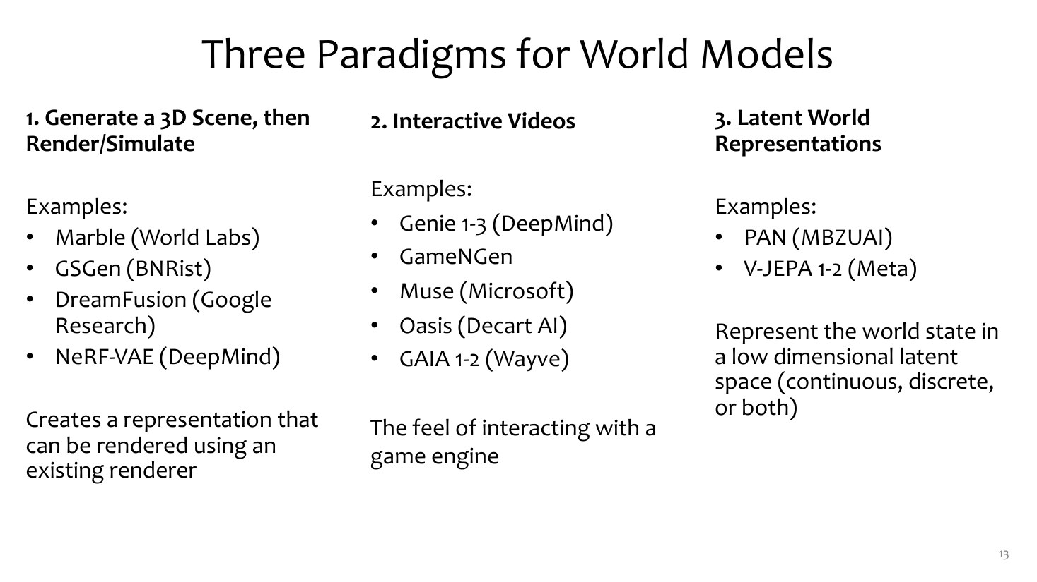
How a top course maps the field: three paradigms
THE TAKEAWAY
1 · Generate a 3D scene, then render it (Marble, GSGen) → our Story 2
2 · Interactive video (Genie, GameNGen) → Story 1
3 · Latent world representations (V-JEPA) → Story 4
Robots (Story 3) borrow from all three
Adapted from CMU 10-423/623/723 Generative AI, Lecture 26 "Interactive World Models" (Matt Gormley & Aran Nayebi). cs.cmu.edu/~mgormley/courses/10423
AMCC 5160 · Week 9 · Worlds, Splats and Bodies
6
Notes:
This is how Matt Gormley and Aran Nayebi at CMU organise their world-models lecture, which we also borrowed from in Lecture 03. Three paradigms. First, generate a 3D scene, then render it, like World Labs' Marble. Second, interactive video, like DeepMind's Genie: you press a key and the next frame appears. Third, a latent world representation, where you predict an abstract state instead of pixels, like Meta's V-JEPA. Our four stories follow this map, and robots borrow from all three.

Slide 7
STORY 1 OF 4
01
From video to playable worlds
Press a key, and the model draws the next moment
Genie 3 · Google DeepMind
Notes:
Story one. A video model gives you a clip. A world model gives you a place: you press a key, or type an event, and it draws the next moment for you, live.

Slide 8
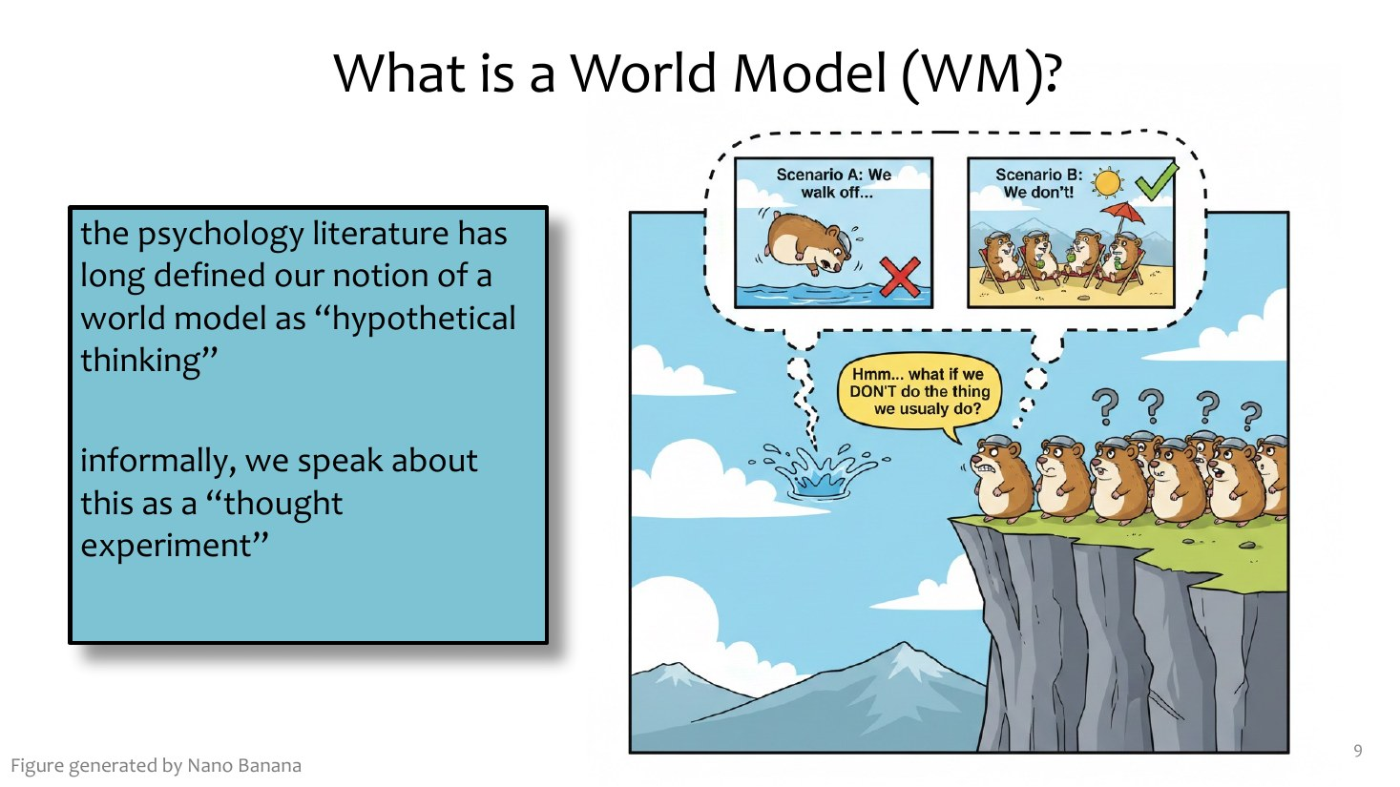
What is a world model?
DEFINITION
A model that takes the previous world state and an action, and predicts the next state
p(s′ | s, a)
The “state” can be pixels, 3D, or an abstract vector
Video model: what happens next. World model: what happens next if I do this
Adapted from CMU 10-423/623/723 Generative AI, Lecture 26 "Interactive World Models" (Matt Gormley & Aran Nayebi). cs.cmu.edu/~mgormley/courses/10423
AMCC 5160 · Week 9 · Worlds, Splats and Bodies
8
Notes:
CMU's definition is simple: a world model takes the previous state of the world and an action, and predicts the next state, or a distribution over next states. The state might be a picture, a 3D scene or an abstract vector. The important word is action. A video model answers 'what happens next?' A world model answers 'what happens next if I do this?' That one extra input changes the medium from film to game.

Slide 9
Eight years, from a dream of a car race to a playable world
①
2018 · Ha & Schmidhuber
②
2024 · GameNGen
③
Feb 2024 · Genie
“World Models”: an agent learns to drive inside its own dream of a racing game
A diffusion model runs DOOM at about 20 fps, with no game engine
Learns playable 2D platformers from unlabelled internet video, ~1 fps
④
Dec 2024 · Genie 2
⑤
Aug 2025 · Genie 3
⑥
2026 · Project Genie, Gemini Omni
3D worlds from one image, 10–20 seconds, 360p
Real time: 720p, 24 fps, a few minutes of consistency
A public prototype (60-second sessions) and a “world model” as a consumer product
Ha & Schmidhuber 2018 (worldmodels.github.io); Valevski et al. 2024 (GameNGen); Bruce et al. 2024 (Genie); Google DeepMind Genie 2 and Genie 3 posts; Google I/O, 19 May 2026 (Gemini Omni).
AMCC 5160 · Week 9 · Worlds, Splats and Bodies
9
Notes:
A quick history. In 2018, David Ha and Jürgen Schmidhuber trained an agent to drive inside its own dream of a car-racing game, and called the paper World Models. In 2024 a Google team ran DOOM entirely inside a diffusion model, GameNGen, at about twenty frames per second. The same year, DeepMind's first Genie learned playable 2D platform games from internet video, at about one frame per second. Genie 2 went 3D. Genie 3, August 2025, reached real time: 720p at 24 frames per second, consistent for a few minutes. And in 2026, the public could try it, and Google started calling a product a world model.

Slide 10
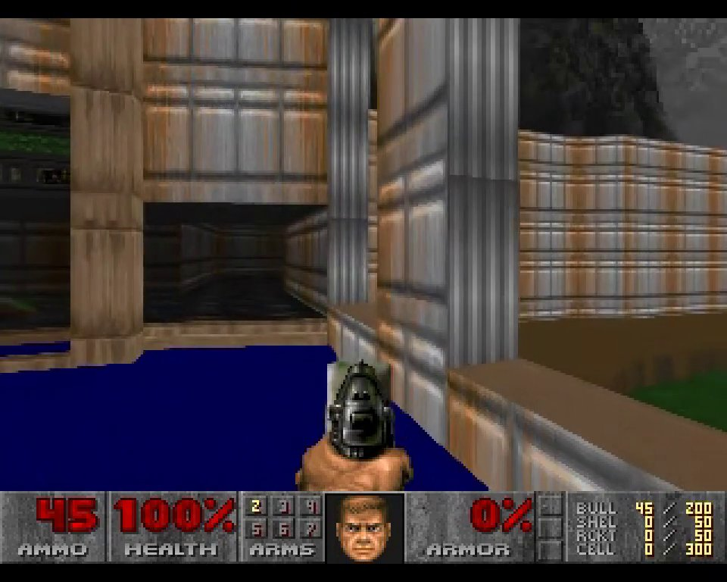
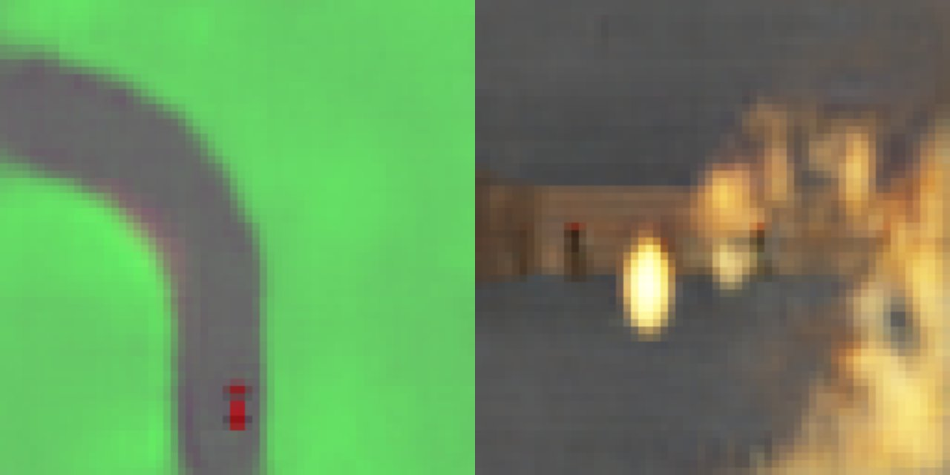
Two ancestors: a dream of a race, and DOOM without an engine
Ha & Schmidhuber (2018): the real frame vs. the agent’s compressed “dream”
GameNGen (2024): every DOOM frame is generated, live, by a diffusion model
Left: learn a small world and practise inside it. Right: make the world itself out of a generator. Genie joins the two.
Ha & Schmidhuber, “World Models”, 2018 (worldmodels.github.io); Valevski et al., “Diffusion Models Are Real-Time Game Engines”, 2024 (gamengen.github.io).
AMCC 5160 · Week 9 · Worlds, Splats and Bodies
10
Notes:
Two ancestors worth seeing. On the left, Ha and Schmidhuber's car racer. One half is a real frame from the game; the other is the same frame as the agent's compressed model remembers it. The agent learned to drive partly inside this blurry dream. On the right, GameNGen. There is no game engine here at all: every frame of DOOM is generated by a diffusion model reacting to the player's keys. The left idea is 'practise inside a model'; the right idea is 'the model is the game'. Genie joins the two.

Slide 11

Genie 3: a world that waits for you
• Text prompt → explorable world
• 720p, 24 fps, real time
• Remembers what it drew for about a minute
• “Promptable world events”: type “a storm starts” mid-walk
▶ Genie 3 demos
Google DeepMind, “Genie 3: A new frontier for world models”, August 2025.
AMCC 5160 · Week 9 · Worlds, Splats and Bodies
11
Notes:
Genie 3. [Play.] You type a prompt, a world appears, and you walk around in it with the keyboard. It runs at 720p and 24 frames per second, in real time. If you look away and come back, the wall you painted is still there, for about a minute. And there is a new kind of control DeepMind calls promptable world events: while you are walking, you type 'a storm starts', or 'a deer runs across', and the world changes. For a director, that is a new verb.

Slide 12
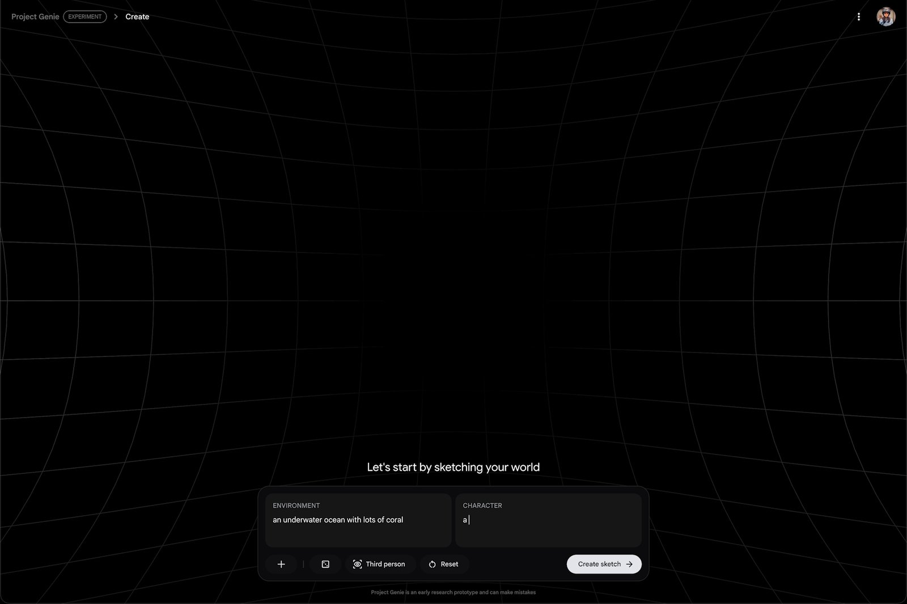
Project Genie: anyone (with a subscription) can try it
• A prototype combining Genie 3, Nano Banana Pro and Gemini
• For Google AI Ultra subscribers in the US
• Sessions capped at 60 seconds: compute is the limit
• Google says it is also collecting feedback and data
▶ Project Genie
Google, “Introducing Project Genie”, 29 January 2026.
AMCC 5160 · Week 9 · Worlds, Splats and Bodies
12
Notes:
In 2026 Google turned Genie 3 into a public prototype called Project Genie. It combines Genie 3 with the Nano Banana Pro image model and Gemini. Notice the limits: US Ultra subscribers only, and each world lasts sixty seconds. That cap tells you what these things cost to run: every frame is generated, live, for one person. People immediately made imitations of famous Nintendo games, and video-game company stocks dipped. Hold that thought for the debate.

Slide 13
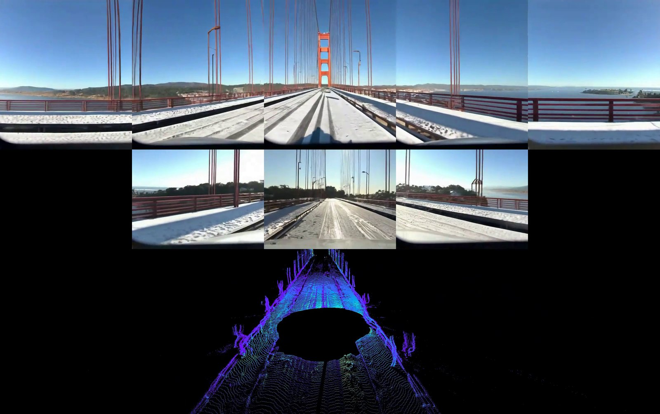
Waymo World Model: Genie 3 learns to drive
• A Genie 3 variant built for self-driving
• Generates camera views and lidar
• Controls: the car’s actions, scene layout, other drivers, weather
• Used to rehearse rare, dangerous edge cases
▶ Waymo World Model
Waymo, “The Waymo World Model: a new frontier for autonomous driving simulation”, February 2026.
AMCC 5160 · Week 9 · Worlds, Splats and Bodies
13
Notes:
Here is the same model doing serious work. Waymo built a variant of Genie 3 for self-driving. It generates not only camera views but lidar, the laser depth sensor on the car's roof. Engineers can control the car's actions, the layout of the street, what other drivers do, and the weather. Why? Because the dangerous situations you most need to train on, a child running out between parked cars, are the ones you can never film on purpose. A world model is a place to rehearse the rare.

Slide 14
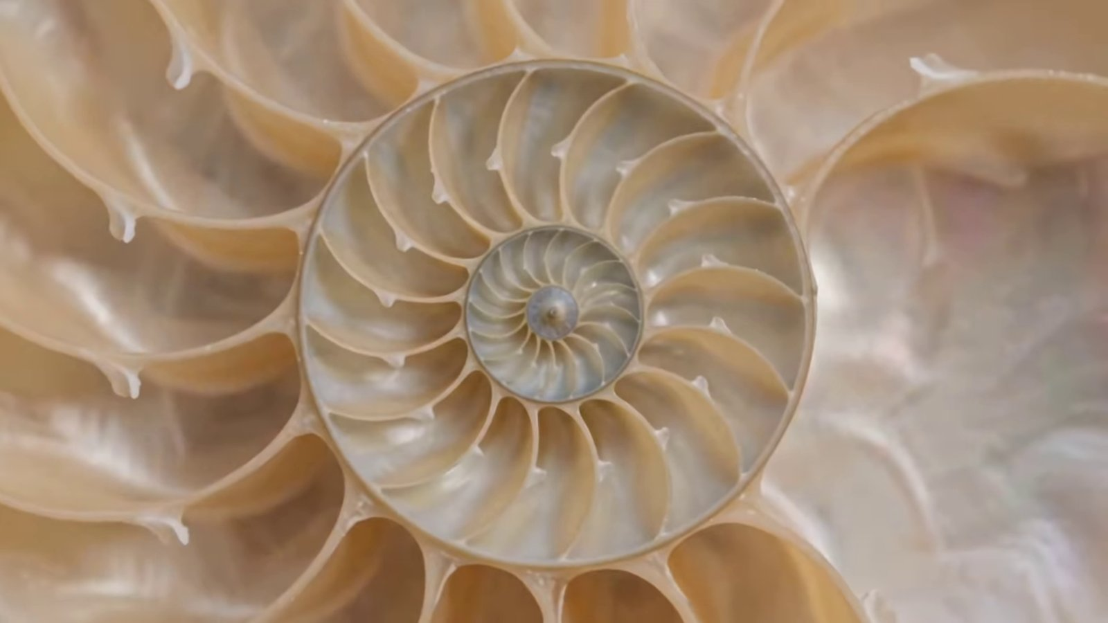
Gemini Omni: “world model” becomes a product name
• Announced at Google I/O, 19 May 2026
• Any input (text, audio, image, video) → video
• Edit by conversation: camera, background, style
• Every output carries a SynthID watermark
▶ Gemini Omni
Google I/O 2026; Yahoo Tech, “Gemini Omni is Google’s new world model”, May 2026.
AMCC 5160 · Week 9 · Worlds, Splats and Bodies
14
Notes:
In May, Google launched Gemini Omni and called it a world model in the keynote. In practice, most people meet it as a video generator and editor: you give it text, audio, images or video, and you change the camera, background or style by talking to it. Every output carries a SynthID watermark. I show this to make a point about words: 'world model' is now also marketing. Part of tonight is learning to ask, which kind?

Slide 15
Under the hood: one extra input
past frames
text prompt
next frame
Video model
→
→
past frames
your action (key, joystick, “a storm starts”)
next frame
World model
→
→
video: p(xₜ₊₁ | x≤ₜ , text) world model: p(xₜ₊₁ | x≤ₜ , aₜ)
The architecture can be almost the same autoregressive video model from Lecture 07. The difference: an action enters at every step, so the model must generate fast enough to wait for you.
AMCC 5160 · Week 9 · Worlds, Splats and Bodies
15
Notes:
Under the hood, the difference is one input. A video model predicts the next frame from the past frames and a text prompt. A world model also takes your action at every step: a key press, a joystick, or a typed event. The network can be almost the same autoregressive video model we met with Helios in Lecture 07. But because the action arrives every step, the model can't generate the whole clip in advance; it must wait for you and answer quickly.

Slide 16
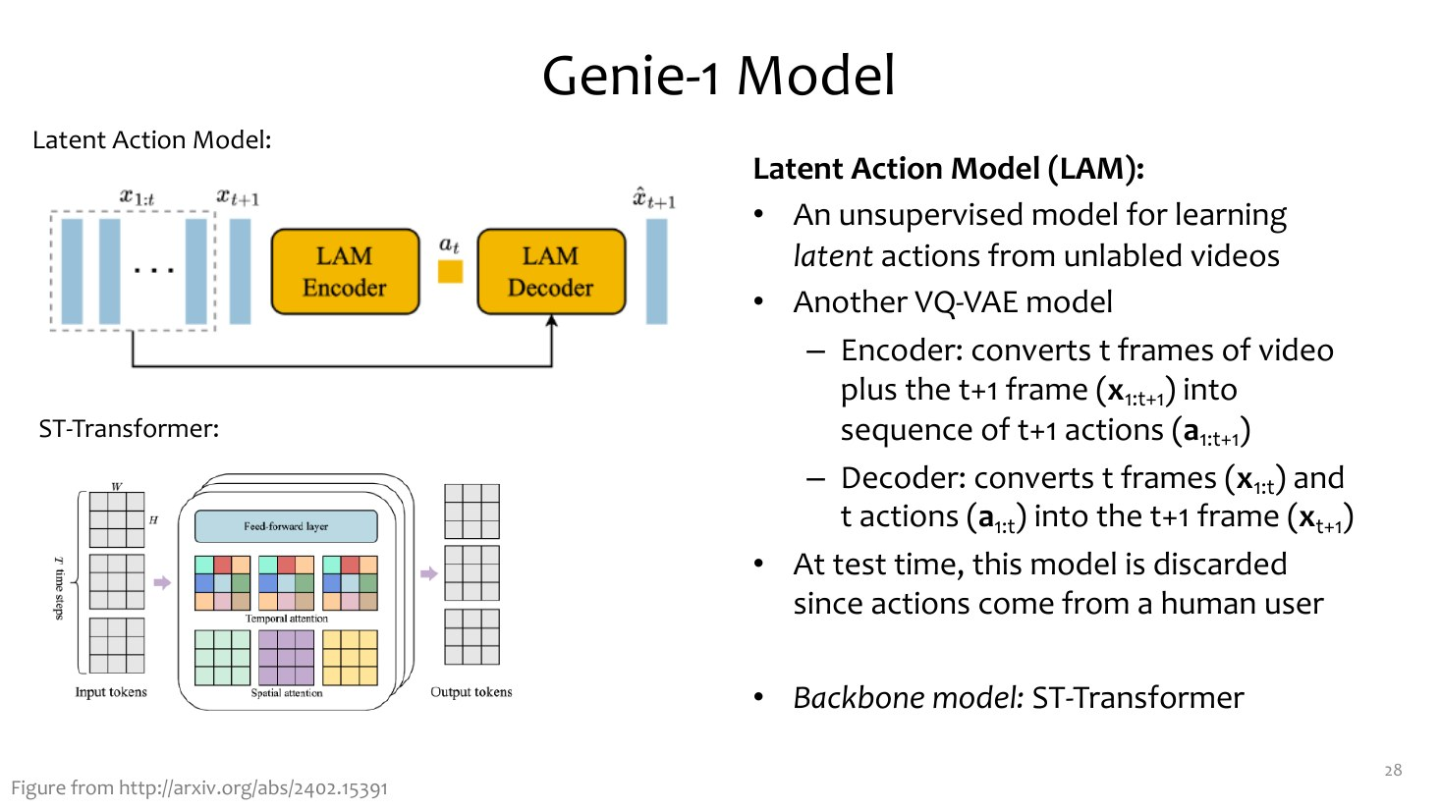
Under the hood: where do the actions come from?
GENIE’S TRICK
Internet video has no key presses
Genie learns a “latent action” between two frames: one of 8 discrete codes
Trained without any labels
At play time, your key press picks a code
Adapted from CMU 10-423/623/723 Generative AI, Lecture 26 "Interactive World Models" (Matt Gormley & Aran Nayebi). cs.cmu.edu/~mgormley/courses/10423
AMCC 5160 · Week 9 · Worlds, Splats and Bodies
16
Notes:
Here's a real problem. To learn what happens if I press left, you need video labelled with key presses, and the internet doesn't have that. Genie's trick, shown in this CMU slide: a latent action model looks at two consecutive frames and asks, what small action could explain the change? It must squeeze the answer into one of only eight codes. Nobody labels anything. After training, the codes turn out to mean things like left, right, jump. At play time, your key press simply chooses a code.

Slide 17
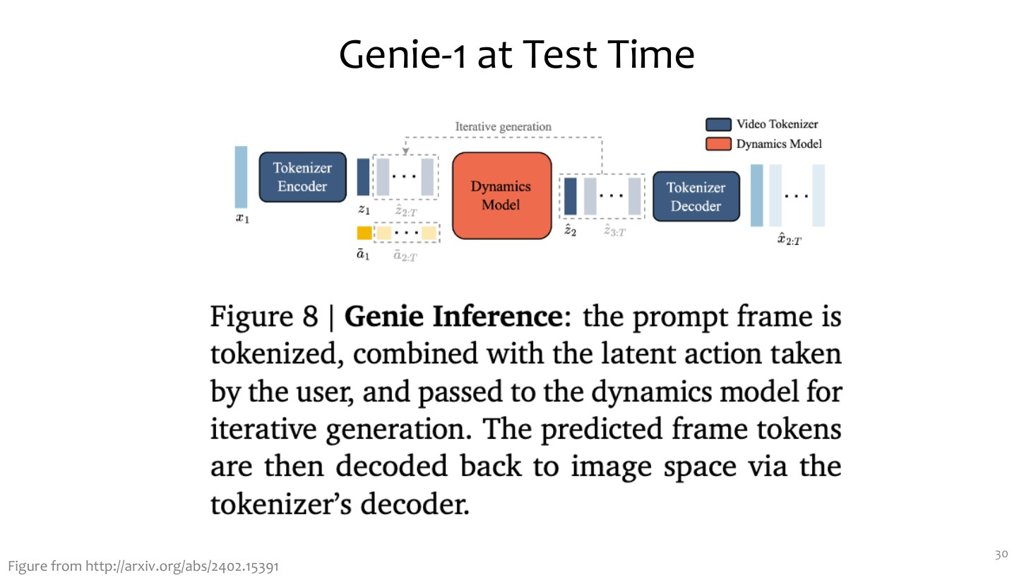
Genie at play time: three parts in a loop
THE LOOP
1 · Tokenizer: frame → tokens
2 · Your action → a latent action code
3 · Dynamics model predicts the next frame’s tokens
Decode → show → repeat, every frame
Adapted from CMU 10-423/623/723 Generative AI, Lecture 26 "Interactive World Models" (Matt Gormley & Aran Nayebi). cs.cmu.edu/~mgormley/courses/10423
AMCC 5160 · Week 9 · Worlds, Splats and Bodies
17
Notes:
At play time, Genie is a loop of three parts. A video tokenizer turns the frame into tokens, like the compressed representation in Lecture 03. Your key press becomes a latent action. A dynamics model, a transformer, predicts the next frame's tokens from the past tokens and the action. Decode, show it to you, repeat. Twenty-four times a second, in Genie 3's case.

Slide 18
GAME · 3 MINUTES
Be the latent action model
I show two frames from a game you have never played
You have only 8 hand signals. Agree as a row: which one explains the change?
Then: did every row invent the same 8 “actions”?
AMCC 5160 · Week 9 · Worlds, Splats and Bodies
18
Notes:
Let's be the latent action model. I'll show two frames from a game you've never seen. Each row has only eight hand signals to explain the change between them. Agree quickly as a row. [Show frames from the Genie qualitative results slide, or any two frames from a platform game.] Now compare rows. Did you all invent the same actions? Probably left, right and jump appear in every row, but the rest differ. That's exactly what happens in the model: the codes are discovered, not given, so they are useful but not always tidy.

Slide 19
Under the hood: why the world must come back the same
see a red door
turn left 10 s
turn back
Walk away
→
→
the red door is still there
same place, same paint
“object permanence”
Pass
→
→
the door is blue, or gone
the room has re-arranged
drift (Lecture 07)
Fail
→
→
Lecture 03’s round-trip test, now in real time. Genie 3 keeps visual memory for about a minute; long-take video in Lecture 07 drifted for the same reason.
AMCC 5160 · Week 9 · Worlds, Splats and Bodies
19
Notes:
Remember the round-trip test from Lecture 03? See a red door, turn away for ten seconds, turn back. A good world model shows the same red door. A weak one shows a blue door, or no door, because it only remembers what is in its context window. It's the same drift problem we saw in Lecture 07's long takes. Genie 3 holds visual memory for about a minute. That's the main thing to test when you try any world model: walk away, and come back.

Slide 20
Under the hood: the real-time budget
24 fps
~40 ms
KV cache
Few steps
the target: one new frame every 41.7 ms
→
to read your key, run the model, decode and display
→
reuse the past instead of recomputing it (Lecture 07)
→
distil 50 denoising steps into a handful (Lecture 07, 08)
The same three tricks made Helios real-time in Lecture 07 and talking avatars real-time in Lecture 08. A world model is the same budget, with your hand on the controls.
AMCC 5160 · Week 9 · Worlds, Splats and Bodies
20
Notes:
The budget. At 24 frames per second you have 41.7 milliseconds per frame to read the action, run the model, decode and display. You already know the tricks: a KV cache so you don't recompute the past, and distillation from fifty denoising steps to a few. Those made Helios real-time in Lecture 07 and the avatars real-time last week. A world model is the same budget, except now your hand is on the controls.

Slide 21
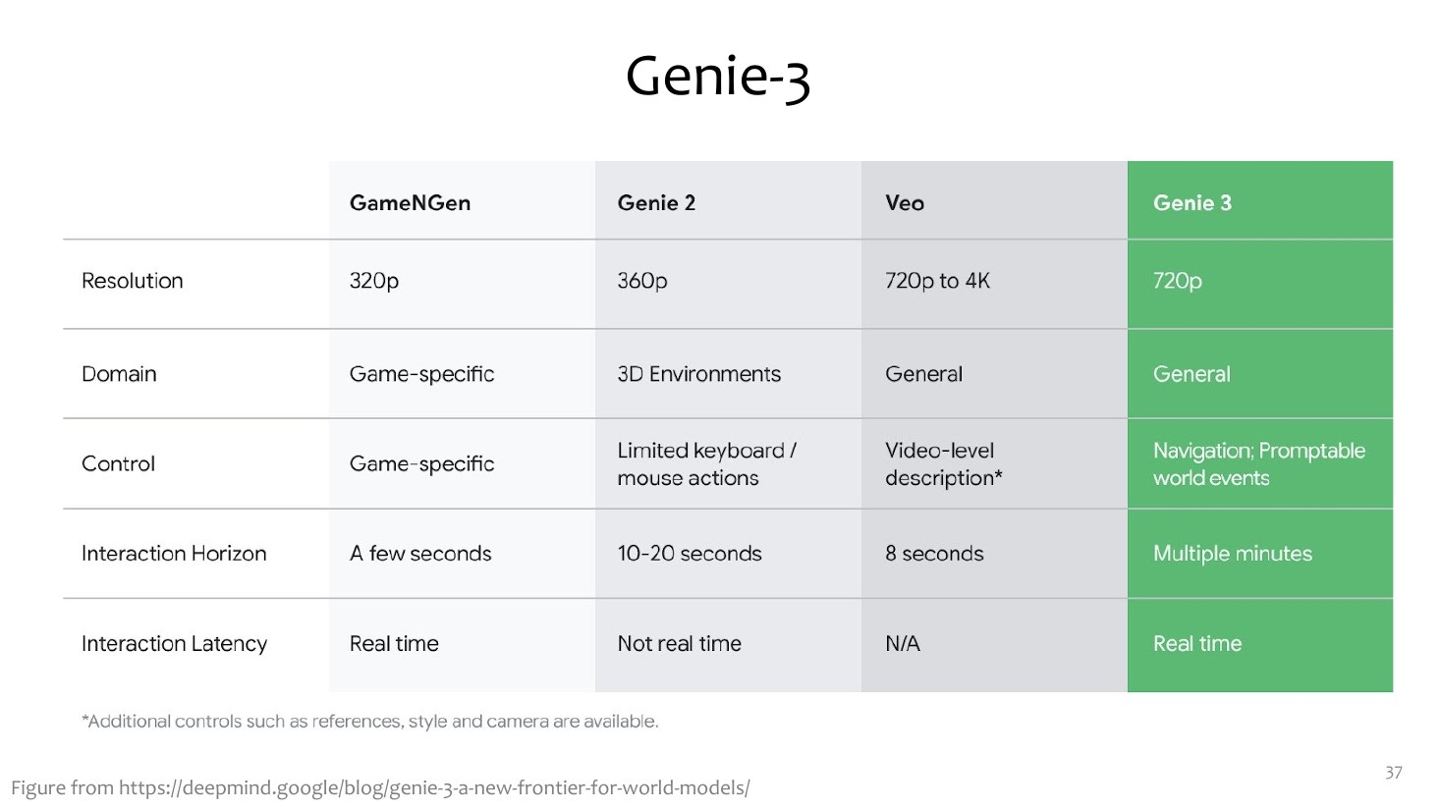
Genie 3 vs. Genie 2 vs. GameNGen
READ THE TABLE
Resolution: 360p → 720p
Domain: one game → any 3D world
Interaction horizon: seconds → minutes
Latency: real time, at 24 fps
Adapted from CMU 10-423/623/723 Generative AI, Lecture 26 "Interactive World Models" (Matt Gormley & Aran Nayebi). cs.cmu.edu/~mgormley/courses/10423
AMCC 5160 · Week 9 · Worlds, Splats and Bodies
21
Notes:
CMU's comparison table. Read it left to right. GameNGen: one game, DOOM. Genie 2: general 3D worlds, but short and not real time. Genie 3: 720p, general, minutes long, real time. The biggest jump isn't image quality; it's the interaction horizon, from seconds to minutes. That's what turns a demo into a place you can spend time in.

Slide 22
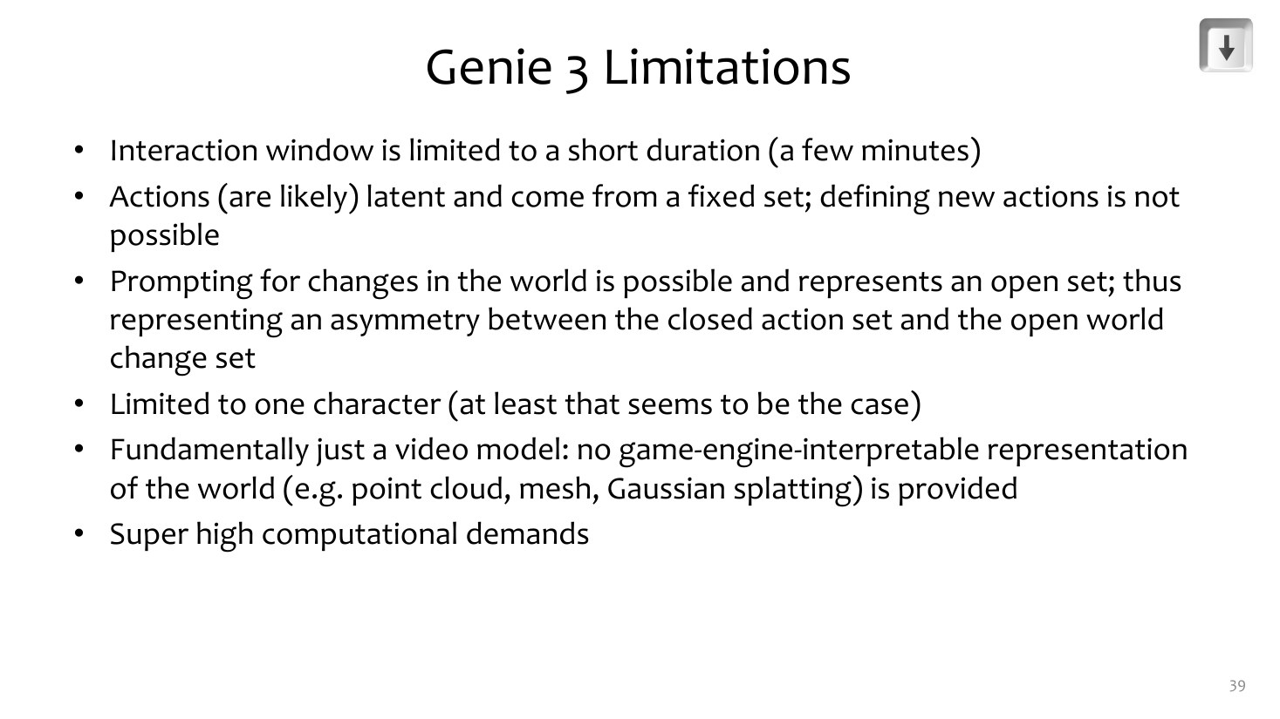
What world models still get wrong
LIMITS (CMU)
Interaction lasts minutes, not hours
Action space is limited and fixed
Several characters interacting: hard
Text in the world is unreliable
It is video: no mesh, no 3D file to export
Adapted from CMU 10-423/623/723 Generative AI, Lecture 26 "Interactive World Models" (Matt Gormley & Aran Nayebi). cs.cmu.edu/~mgormley/courses/10423
AMCC 5160 · Week 9 · Worlds, Splats and Bodies
22
Notes:
And the limits, from the same lecture. Minutes, not hours. A limited, fixed set of actions. Multiple characters interacting is hard. Text and signs in the world are unreliable. And the last point leads to Story 2: it's video. There's no mesh, no 3D file. When the session ends, the world is gone. If you want to keep the world, open it in Blender, or walk a robot through it, you need geometry.

Slide 23
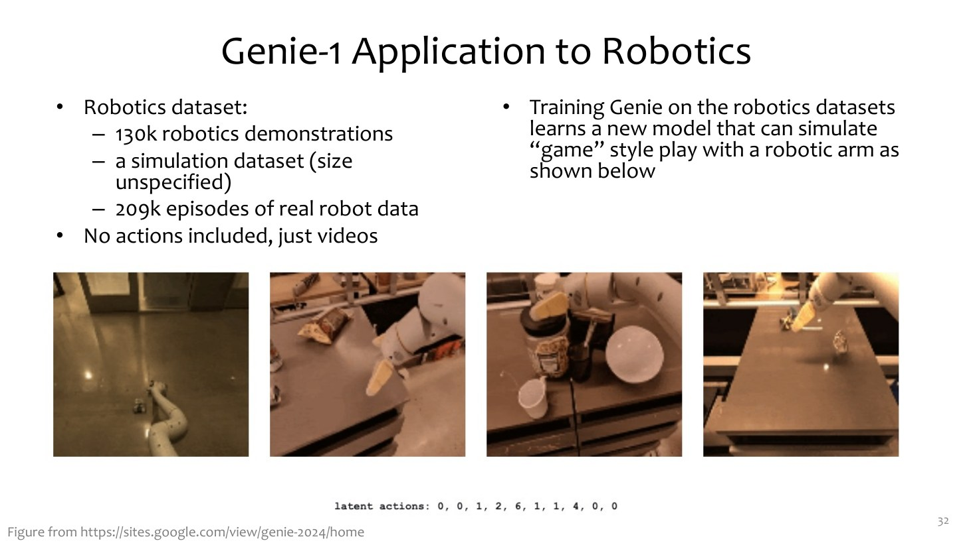
A bridge to robots: Genie dreams of a robot arm
ALREADY IN 2024
Same recipe on ~130k robot videos, no action labels
The latent actions became robot-arm moves
A world model is a place a robot can practise
→ Story 3
Adapted from CMU 10-423/623/723 Generative AI, Lecture 26 "Interactive World Models" (Matt Gormley & Aran Nayebi). cs.cmu.edu/~mgormley/courses/10423
AMCC 5160 · Week 9 · Worlds, Splats and Bodies
23
Notes:
One more slide from CMU, as a bridge. Already in 2024 the Genie team trained the same recipe on robot videos with no action labels, and the latent actions became arm movements. Keep that in mind: if a model can imagine what happens when an arm moves, a robot can practise inside that imagination. That's Story 3.

Slide 24
Useful: directing a world, not a clip
1
World
2
Body
3
Events
4
Test
Place, era, weather, lighting. “A flooded night market in Mong Kok, neon reflections”
Who are you? Height, speed, camera: first person, drone, a cat
What can happen while you walk: “a tram passes”, “the rain stops”
Walk away and come back; try to break it; note where it drifts
Your Assignment 3 game: use a world model as a level sketch, then rebuild what works.
AMCC 5160 · Week 9 · Worlds, Splats and Bodies
24
Notes:
Something useful for your projects. When you direct a world instead of a clip, think in four parts. The world: place, era, weather, light. The body: who you are, how tall, how fast, which camera. The events you can trigger while you walk. And the test: walk away and come back, and try to break it. For Assignment 3, your game, a world model is a fast way to sketch a level and feel it, before you build the parts that work in Unity or the browser.

Slide 25
DISCUSSION · 3 MINUTES
If a world only exists while someone is playing it, what is the artwork: the world, the play, or the recording?
AMCC 5160 · Week 9 · Worlds, Splats and Bodies
25
Notes:
Turn to your neighbour for three minutes. If a world only exists while someone is playing it, and disappears when the session ends, what is the artwork? The model? The prompt? Your sixty seconds of play? Or the screen recording you post afterwards?

Slide 26
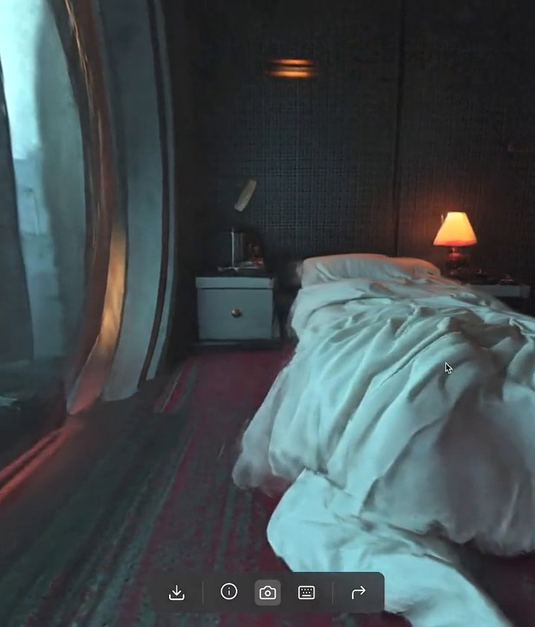
STORY 2 OF 4
02
3D is back: worlds as Gaussian splats
Generated worlds you can keep, export and walk a robot through
Marble · World Labs
Notes:
Story two. If video worlds disappear, the other answer is: generate the world in 3D, so you can keep it.

Slide 27
Pixels or geometry? Two ways to make a world
A
Draw the next frame (Story 1)
B
Build the scene, then render (Story 2)
Genie 3, Gemini Omni
+ Anything can happen: water, crowds, storms
+ Feels alive
− Forgets after about a minute
− Nothing to export; every frame costs a GPU
Marble, Atlas, HY-World 2.0
+ Consistent forever: it is a file
+ Open it in Blender, Unity, a headset, a robot simulator
− Mostly static: things don’t move by themselves
− Rendering is cheap, generation is not
AMCC 5160 · Week 9 · Worlds, Splats and Bodies
27
Notes:
Two ways to make a world. Draw the next frame, like Genie: anything can happen, water, crowds, storms, and it feels alive, but it forgets, and there's nothing to export. Or build the scene first and render it, like Marble, Atlas or HY-World: it's a file, consistent forever, you can open it in Blender, Unity, a VR headset or a robot simulator. But it's mostly static. Both camps are moving towards each other, and Atlas, which we'll see in a minute, is an attempt to have both.

Slide 28
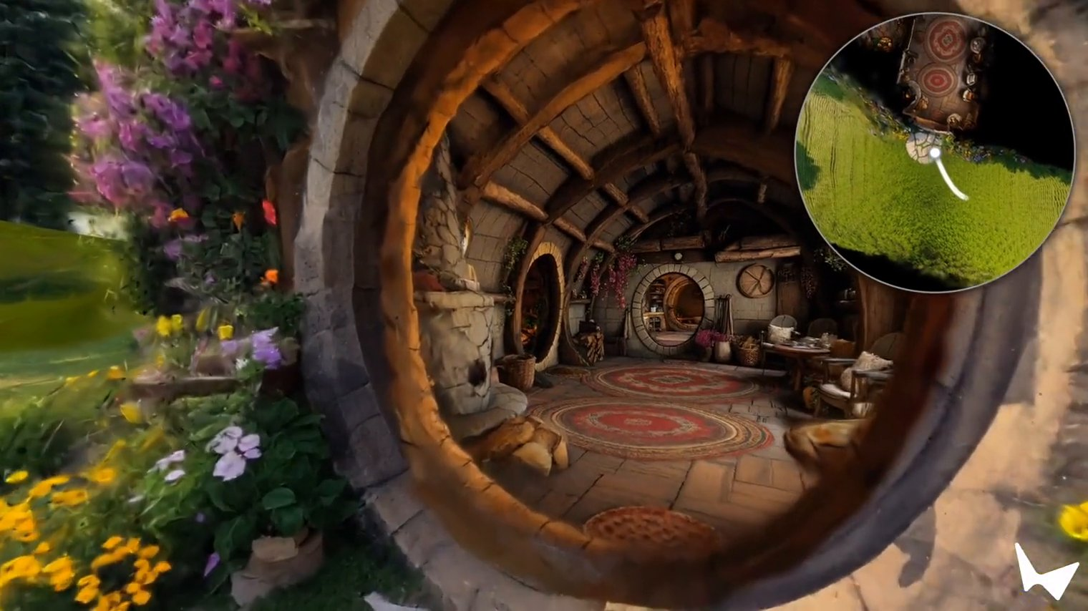
Marble: one picture in, a world you can walk around
• Input: text, one image, several images, a 360° panorama, or video
• Output: a Gaussian-splat world (.spz / .ply)
• Marble 1.1 (April 2026): better light, auto-expanding worlds
• View on desktop, phone or VR with the open Spark renderer
▶ Marble 1.1
World Labs, Marble 1.1 release notes and “Generating bigger and better worlds”, April 2026.
AMCC 5160 · Week 9 · Worlds, Splats and Bodies
28
Notes:
Marble, from Fei-Fei Li's company World Labs. You give it text, a photo, several photos, a 360 panorama, or a video, and it gives you a world you can walk around. The output isn't video; it's a Gaussian splat file, .spz or .ply, which you can download. Version 1.1 in April improved lighting and added worlds that expand automatically. You can view it on a laptop, a phone or a VR headset with their open-source renderer, Spark.

Slide 29
Atlas (1 Sept 2026): one model for pictures, video and 3D
• Everything goes into one “spatial context”: each image placed at a camera pose in 3D
• Outputs: new views, minute-long 1440p video, depth, point clouds, splats
• Two or three phone photos → a faithful 3D scene
• Early access only; will power future Marble versions
▶ Atlas demos
World Labs, “Atlas”, 1 September 2026. worldlabs.ai/blog/atlas
AMCC 5160 · Week 9 · Worlds, Splats and Bodies
29
Notes:
In September World Labs announced Atlas, the model behind future versions of Marble. The idea: every input, text, photos, depth, video, goes into one shared spatial context, and each image is pinned to a camera position in 3D. From that context it can generate new views, up to a minute of 1440p camera-controlled video, depth maps, point clouds or splats. With only two or three ordinary phone photos it can rebuild a scene faithfully. It's in early access only.

Slide 30
Atlas, by World Labs’ own numbers
75–94%
2–3
24
25.3
of raters preferred Atlas for camera-controlled video, vs. five video models incl. Seedance 2.5 and Gemini Omni Flash
photos are usually enough for a faithful reconstruction; it can hold 100+
phone-video frames per room to simulate a robot driving through it
average 3D error (×10⁻³), vs. 28.7–47.7 for the best open reconstruction models
Company numbers, no paper yet. Treat them as claims, and test them: walk away and come back.
AMCC 5160 · Week 9 · Worlds, Splats and Bodies
30
Notes:
World Labs' own numbers. Three quarters or more of raters preferred Atlas for camera-controlled video, against five video models including Seedance 2.5, which we saw in Lecture 07. Two or three photos for a faithful reconstruction. Twenty-four phone-video frames per room to simulate a robot driving through it, which links to Story 3. And a lower 3D reconstruction error than specialised open models. But these are company numbers, with no paper. Treat them as claims to test.

Slide 31
The money: a chip company buys a world-model company
$1B
~$8.2B
Fei-Fei Li
End 2026
World Labs’ funding round, February 2026, with AMD, NVIDIA and Autodesk
→
AMD’s all-stock deal to acquire World Labs, announced late September 2026
→
to become AMD executive VP and chief scientist
→
expected closing, subject to regulators
Why would a chip maker buy a world-model lab? Every frame of a world, and every robot practising in it, is compute. Not yet closed: what happens to Marble and Spark is not announced.
AMCC 5160 · Week 9 · Worlds, Splats and Bodies
31
Notes:
Now the money. In February, World Labs raised a billion dollars, from AMD, NVIDIA and Autodesk among others. At the end of September, AMD announced it would buy World Labs in an all-stock deal worth about 8.2 billion dollars, with Fei-Fei Li becoming AMD's chief scientist. Why would a chip maker buy a world-model company? Because worlds are compute: every generated frame, and every robot practising inside a simulated world, runs on chips. The deal hasn't closed, and nobody has said what happens to Marble or Spark.

Slide 32
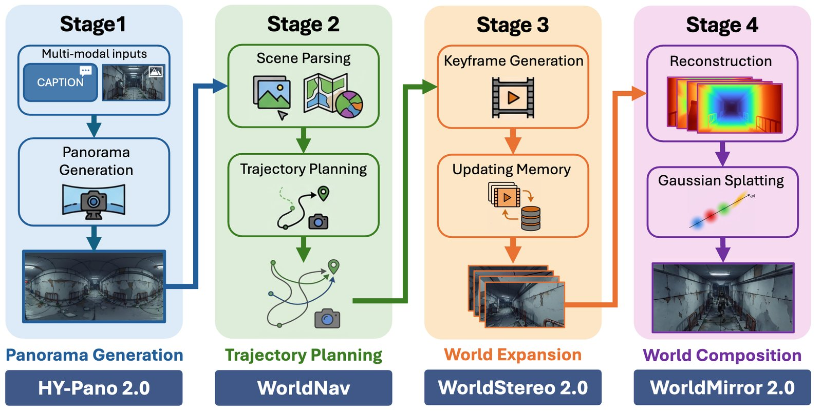
The open alternative: Tencent HY-World 2.0
• Text or one image → a navigable 3D world; photos or video → a reconstruction
• Pipeline: panorama → camera path → expand views → 3D in one pass (WorldMirror 2.0)
• Exports mesh, 3D Gaussian splats, point clouds → Blender, Unity, Unreal, Isaac Sim
• Open code and weights released April–May 2026
▶ HY-World 2.0 project page
Tencent Hunyuan, HY-World 2.0 technical report (arXiv 2604.14268) and GitHub, April 2026.
AMCC 5160 · Week 9 · Worlds, Splats and Bodies
32
Notes:
If you want something open, Tencent's HY-World 2.0. From text or one image it builds a navigable 3D world, and from photos or video it reconstructs one. The pipeline is easy to read: make a 360 panorama, plan a camera path, expand the views, and then one network, WorldMirror 2.0, predicts depth, normals, cameras and Gaussian splats in one pass. It exports to Blender, Unity, Unreal, and NVIDIA's Isaac Sim for robots. Code and weights came out in April and May.

Slide 33
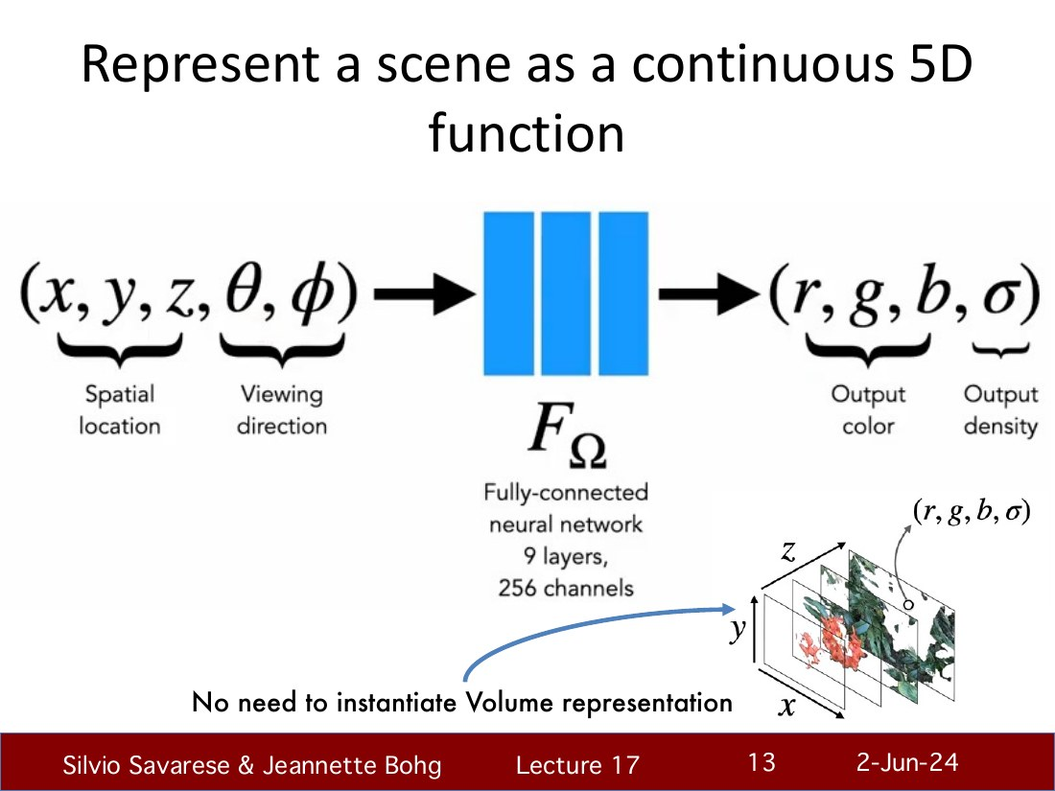
Under the hood: from a scene to a function (NeRF)
NERF, 2020
A network answers: at point (x, y, z), seen from direction (θ, φ), what colour and how dense?
Render by marching along each camera ray
Train by matching your photos
Beautiful, but slow: ask the network millions of times per image
Adapted from Stanford CS231A Lecture 17 "Gaussian Splatting for Novel View Synthesis" (Silvio Savarese & Jeannette Bohg; slides adapted from MIT 6.S980, Vincent Sitzmann).
AMCC 5160 · Week 9 · Worlds, Splats and Bodies
33
Notes:
How does a pile of photos become a 3D world? Stanford's CS231A tells the story in two steps. Step one, NeRF, 2020: a neural network that answers a question. At this point in space, seen from this direction, what colour is it and how dense? To render a pixel, you march along the camera ray and ask the network many times. You train it until its renders match your photos. Beautiful results, but slow, because you ask the network millions of times per image.

Slide 34
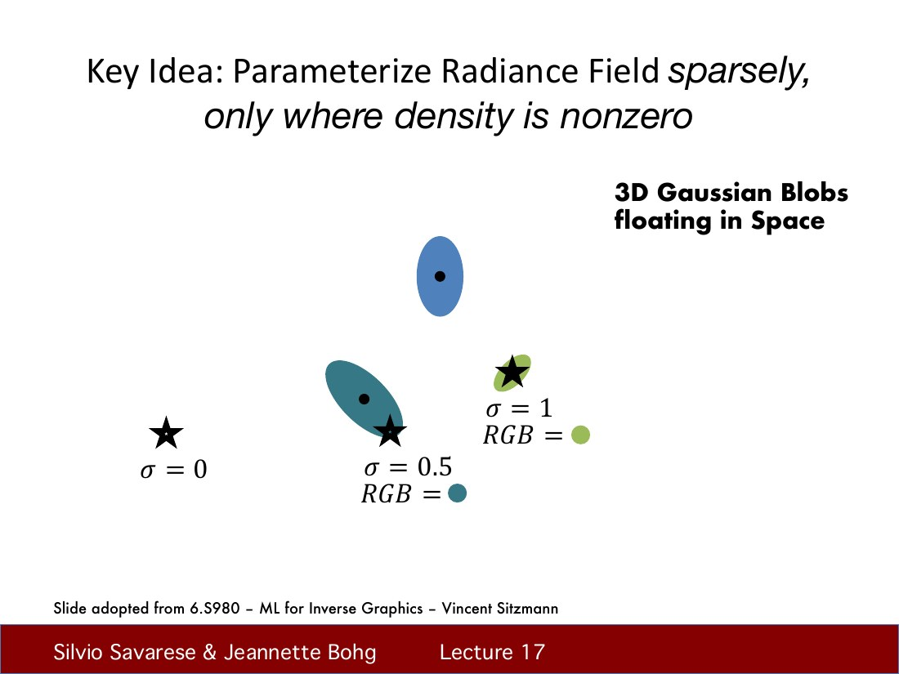
Under the hood: only put stuff where stuff is
3D GAUSSIAN SPLATTING, 2023
Most of space is empty air
So: millions of small 3D blobs (Gaussians), only where there is something
Each blob: position, shape, opacity, colour
“Splatting”: throw each blob onto the screen like a paint splat
Adapted from Stanford CS231A Lecture 17 "Gaussian Splatting for Novel View Synthesis" (Silvio Savarese & Jeannette Bohg; slides adapted from MIT 6.S980, Vincent Sitzmann).
AMCC 5160 · Week 9 · Worlds, Splats and Bodies
34
Notes:
Step two, 3D Gaussian Splatting, 2023. The key idea on this slide: most of space is empty air, so why ask a network about it? Instead, put millions of small, soft, coloured blobs, 3D Gaussians, only where something exists. Each blob has a position, a shape, an opacity and a colour. To render, you throw each blob onto the screen, like a splat of paint. That's the name.

Slide 35
Worked example: what is inside one splat?
3
3 + 4
1
48
= 59
position: x, y, z
→
shape: scale on 3 axes + a rotation (quaternion)
→
opacity
→
colour that changes with viewing angle (spherical harmonics, 16 × RGB)
→
numbers per splat ≈ 236 bytes. 1 million splats ≈ 236 MB raw
So a room of 1–3 million splats is a few hundred MB as .ply. Compressed formats like .spz (used by Marble) are roughly 10× smaller, which is why splats now stream to phones.
AMCC 5160 · Week 9 · Worlds, Splats and Bodies
35
Notes:
Let's count. One splat has three numbers for position, seven for shape, three scales and a four-number rotation, one for opacity, and forty-eight for colour, because the colour changes with viewing angle and is stored as spherical harmonics, sixteen coefficients for each of red, green and blue. Fifty-nine numbers, about 236 bytes. A million splats is about 236 megabytes raw. A room has one to three million. Compressed formats like .spz, which Marble uses, are roughly ten times smaller. That's why splats now stream to a phone.

Slide 36
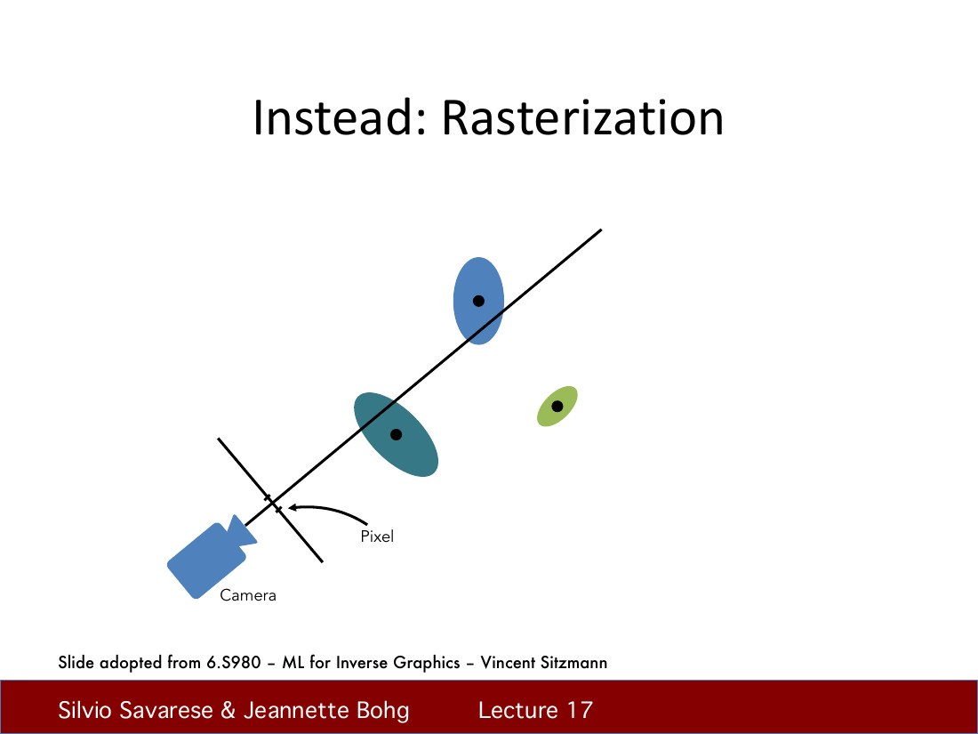
Under the hood: rasterize, don’t ray-march
WHY IT IS FAST
Project every blob onto the screen as a 2D ellipse
Sort by depth, blend front to back
This is what GPUs were built for (like games)
No neural network at render time
Adapted from Stanford CS231A Lecture 17 "Gaussian Splatting for Novel View Synthesis" (Silvio Savarese & Jeannette Bohg; slides adapted from MIT 6.S980, Vincent Sitzmann).
AMCC 5160 · Week 9 · Worlds, Splats and Bodies
36
Notes:
Why is it fast? Instead of marching along rays and asking a network, you project every blob onto the screen as a flat ellipse, sort them by depth, and blend them front to back. That's rasterization, the same thing graphics cards do for video games. At render time there is no neural network at all, just millions of coloured ellipses.

Slide 37
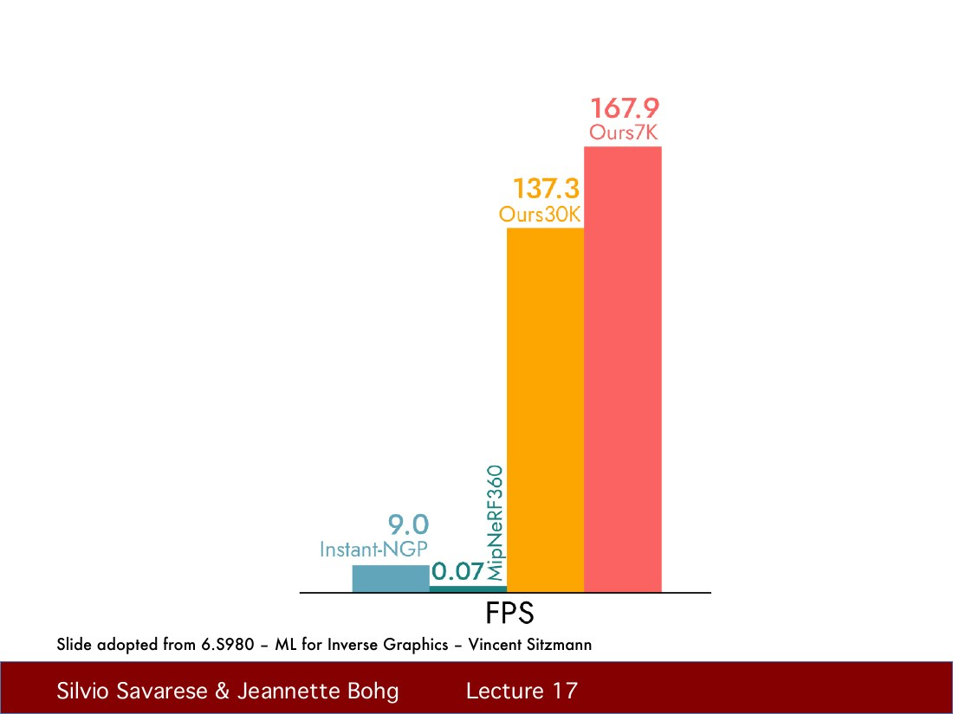
The result: from 0.07 to 100+ frames per second
SPEED
NeRF-quality views at 0.07 fps (Mip-NeRF 360)
Instant-NGP: ~9 fps
3D Gaussian Splatting: 100+ fps
Real time is what made splats a medium, not just a paper
Adapted from Stanford CS231A Lecture 17 "Gaussian Splatting for Novel View Synthesis" (Silvio Savarese & Jeannette Bohg; slides adapted from MIT 6.S980, Vincent Sitzmann).
AMCC 5160 · Week 9 · Worlds, Splats and Bodies
37
Notes:
And here is the payoff. High-quality NeRF rendered at about 0.07 frames per second. Instant-NGP got to about nine. Gaussian splatting: over a hundred. Real time is what turned splats from a paper into a medium you can walk around in VR. Same lesson as Lecture 07: speed changes what something is.

Slide 38
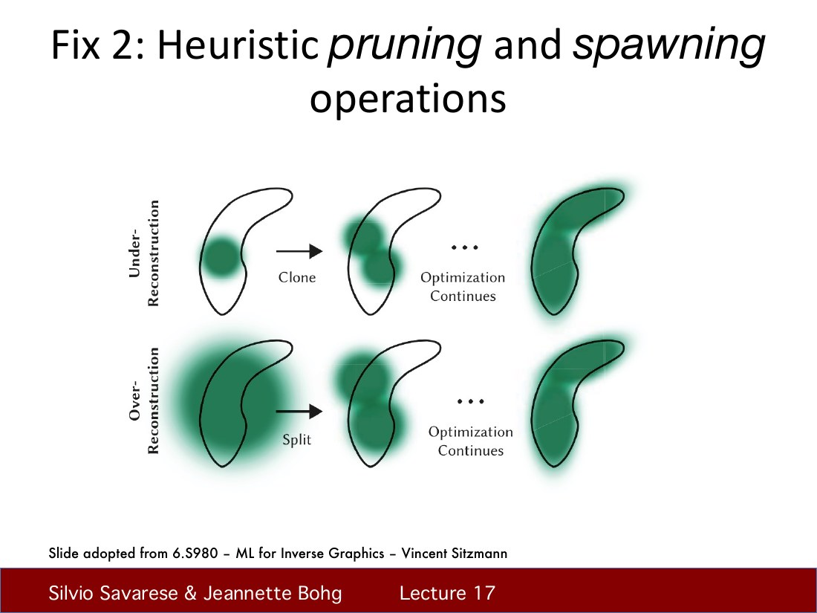
Under the hood: how splats are trained
TRAINING
Start from the 3D points that photo-matching (SfM) already found
Render, compare to your photos, nudge every blob
Split blobs that are too big, clone where detail is missing, prune invisible ones
~20–40 minutes on one GPU for a room
Adapted from Stanford CS231A Lecture 17 "Gaussian Splatting for Novel View Synthesis" (Silvio Savarese & Jeannette Bohg; slides adapted from MIT 6.S980, Vincent Sitzmann).
AMCC 5160 · Week 9 · Worlds, Splats and Bodies
38
Notes:
Training. You start from the rough 3D points that photo-matching software, structure from motion, finds in your photos. Then repeat: render, compare with the photos, nudge every blob's position, shape and colour. Every so often, split blobs that are too big, clone blobs where detail is missing, and delete ones that don't contribute. On one GPU, a room takes roughly twenty to forty minutes. Generated worlds like Marble and Atlas skip the photos: a model imagines the views first, then lifts them to splats.

Slide 39
Capture or generate: two roads to the same file
60–150 phone photos or a video
match photos → camera poses (SfM)
optimise splats (≈30 min)
.ply / .spz world
Capture
→
→
→
text, one image, or 2–3 photos
imagine new views (Marble, Atlas, HY-World)
lift views to 3D in one pass
.ply / .spz world
Generate
→
→
→
Capture is faithful but needs the place. Generation needs only a prompt but invents what it cannot see. Atlas blurs the line: more photos means less invention.
AMCC 5160 · Week 9 · Worlds, Splats and Bodies
39
Notes:
So there are two roads to the same file. Capture: take sixty to a hundred and fifty photos or a video, match them to find camera positions, optimise splats for half an hour. Faithful, but you need to be there. Generate: give text, one image or a few photos; a model imagines the missing views and lifts them to 3D. You need nothing but a prompt, but it invents what it can't see. Atlas blurs the line: the more photos you give it, the less it invents.

Slide 40
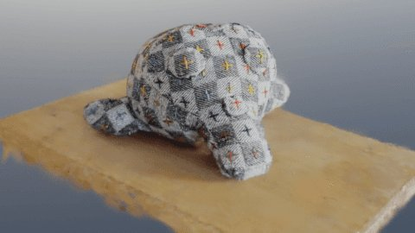
This autumn, splats became a normal file format
• Blender 5.3 (alpha): native PLY / SPZ splat import and render in EEVEE and Cycles
• three.js r186: a built-in splat renderer for the web
• Khronos: a glTF Gaussian-splatting extension
• SuperSplat 3.0 editor; 4D splats streamed for live sport
▶ Radiance Fields: Sept 2026 round-up
Radiance Fields, “Gaussian Splatting in September 2026”; Khronos Group glTF press release.
AMCC 5160 · Week 9 · Worlds, Splats and Bodies
40
Notes:
Here's why I think 3D is really back. This autumn, splats stopped being a research format. The Blender 5.3 alpha imports and renders splats natively, in EEVEE and Cycles. three.js, which many of you use for browser games, now has a built-in splat renderer. Khronos, the group behind glTF, has a splat extension. PlayCanvas shipped SuperSplat 3.0 for editing. Companies are streaming 4D splats of live sport. For your projects, that means a splat world can go straight into your normal tools.

Slide 41
Useful: phone → splat → Blender, in one evening
1
Capture
2
Train
3
Clean
4
Use
Orbit slowly, 60–150 photos or a 1-minute video. Even light, no moving people, lots of overlap
Free/desktop: Postshot, Brush, or nerfstudio’s gsplat. Or an app (Polycam, Scaniverse)
SuperSplat in the browser: crop floaters and sky, set the floor level
Blender 5.3 or three.js / Spark; or skip 1–2 and ask Marble or HY-World to generate
Tip: a splat is lit by the light you captured. Shoot at the hour you want the scene to feel like.
AMCC 5160 · Week 9 · Worlds, Splats and Bodies
41
Notes:
If you want to try this tonight. Capture: walk slowly around the subject, sixty to a hundred and fifty photos or a one-minute video, even light, no people walking through. Train with a desktop tool like Postshot or Brush, nerfstudio's gsplat if you like code, or just a phone app like Polycam or Scaniverse. Clean it up in SuperSplat in the browser: delete the floating blobs and the sky. Then use it in Blender 5.3 or the browser. One tip: a splat keeps the light you captured, so shoot at the time of day you want the scene to feel like.

Slide 42
Three art prompts for a splat
I
A place that is about to disappear
II
An impossible join
III
A level for your game
Give Atlas or Marble two unrelated photos and let it invent the corridor between them. What does the model think connects them?
Scan a real corner of campus, then break it: change the light, remove the floor, add one impossible door (Assignment 3)
Scan a shop, a room, a street before it changes. A splat freezes a place the way a photo freezes a moment
AMCC 5160 · Week 9 · Worlds, Splats and Bodies
42
Notes:
Three art prompts. First, a place about to disappear: a shop, your grandparents' flat, a street before redevelopment. A splat freezes a place the way a photo freezes a moment. Second, an impossible join: give Atlas or Marble two unrelated photos and let it invent what connects them, and look at what the model thinks belongs in between. Third, a level for your Assignment 3 game: scan a real corner of campus, then break it on purpose.

Slide 43
DISCUSSION · 3 MINUTES
A photo freezes a moment. A splat freezes a place. What should you be allowed to scan, and who owns the copy?
Your own room?
A shop, a temple, a museum gallery?
A stranger’s home, from photos they posted online?
AMCC 5160 · Week 9 · Worlds, Splats and Bodies
43
Notes:
Three minutes. A photo freezes a moment; a splat freezes a place, walkable, from any angle. What should you be allowed to scan? Your room, fine. A shop? A temple? A museum gallery full of other people's art? And what about a stranger's home, reconstructed from photos they posted online, which Atlas says needs only two or three? Who owns the copy?

Slide 44
STORY 3 OF 4
03
Robots that learn by watching
First-person video, a simulator built from a video, and a model released yesterday
λ0 · Alibaba Amap
Notes:
Story three. In Lecture 07 a robot learned one dance from one phone video. Tonight: robots learning many everyday tasks from watching people, and from simulators built out of video.

Slide 45
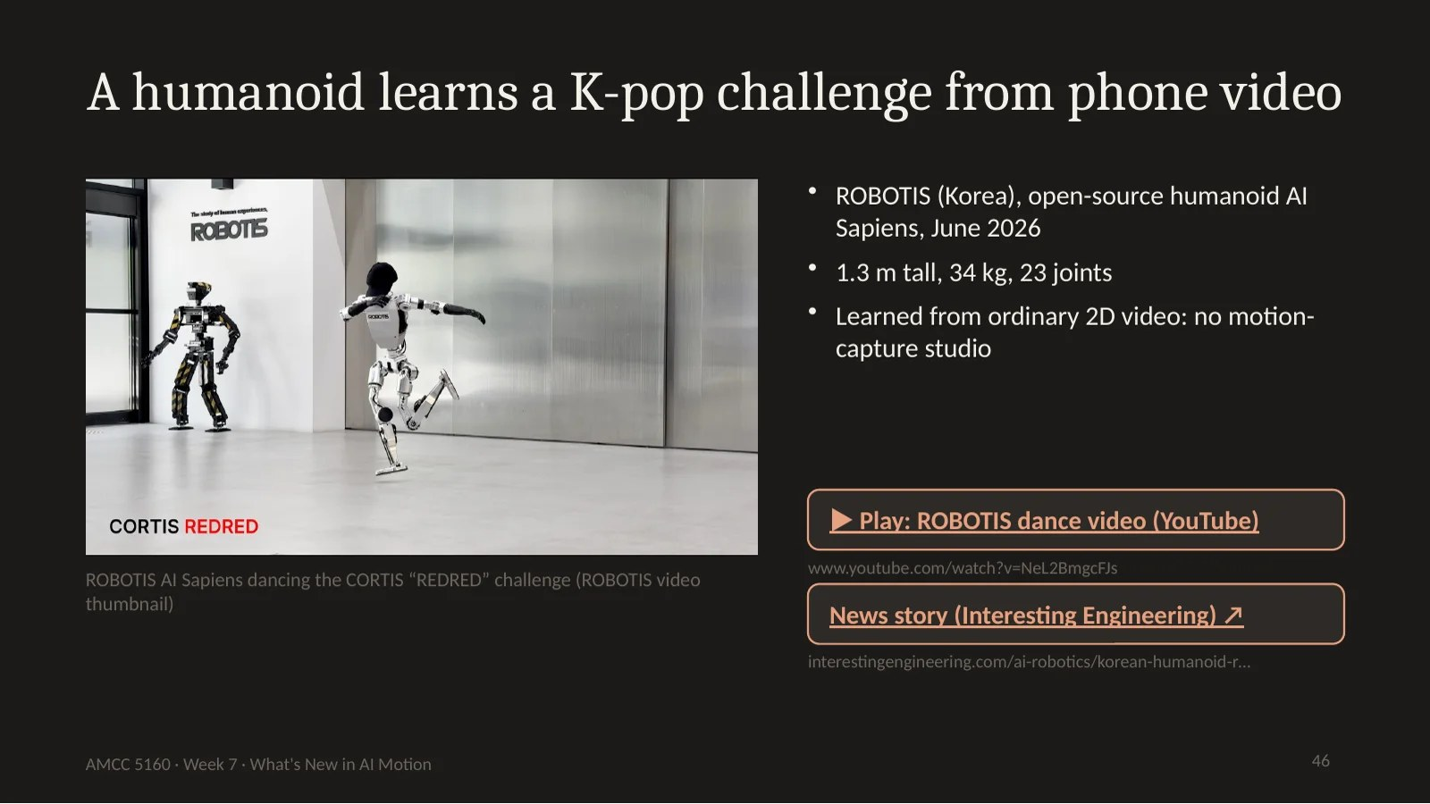
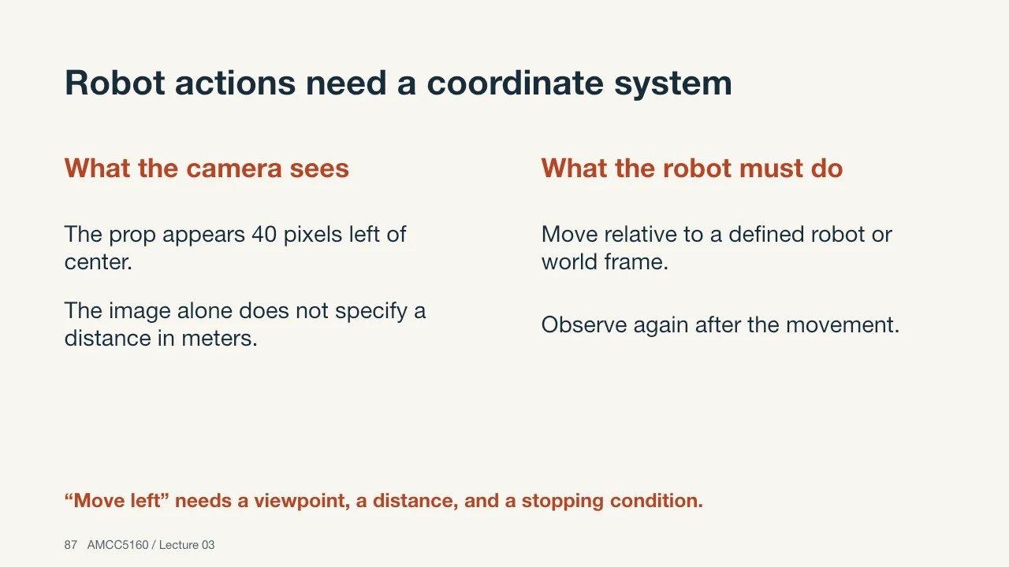
Where we left robots: Lecture 07 and Lecture 03
Lecture 07: a humanoid learns a K-pop challenge from phone video
Lecture 03: robot actions need a coordinate system
Copying one dance is retargeting. Tonight: learning many tasks, with objects, from people’s video.
AMCC 5160 · Week 9 · Worlds, Splats and Bodies
45
Notes:
Where we left robots. In Lecture 07, the K-pop humanoid: estimate the 3D pose from a phone video, retarget it onto the robot's body, and train a controller in simulation. In Lecture 03: an image location and a robot movement use different coordinate systems. Copying a dance is retargeting one motion. Tonight is harder: picking things up, opening fridges, wiping tables, from video of people.

Slide 46
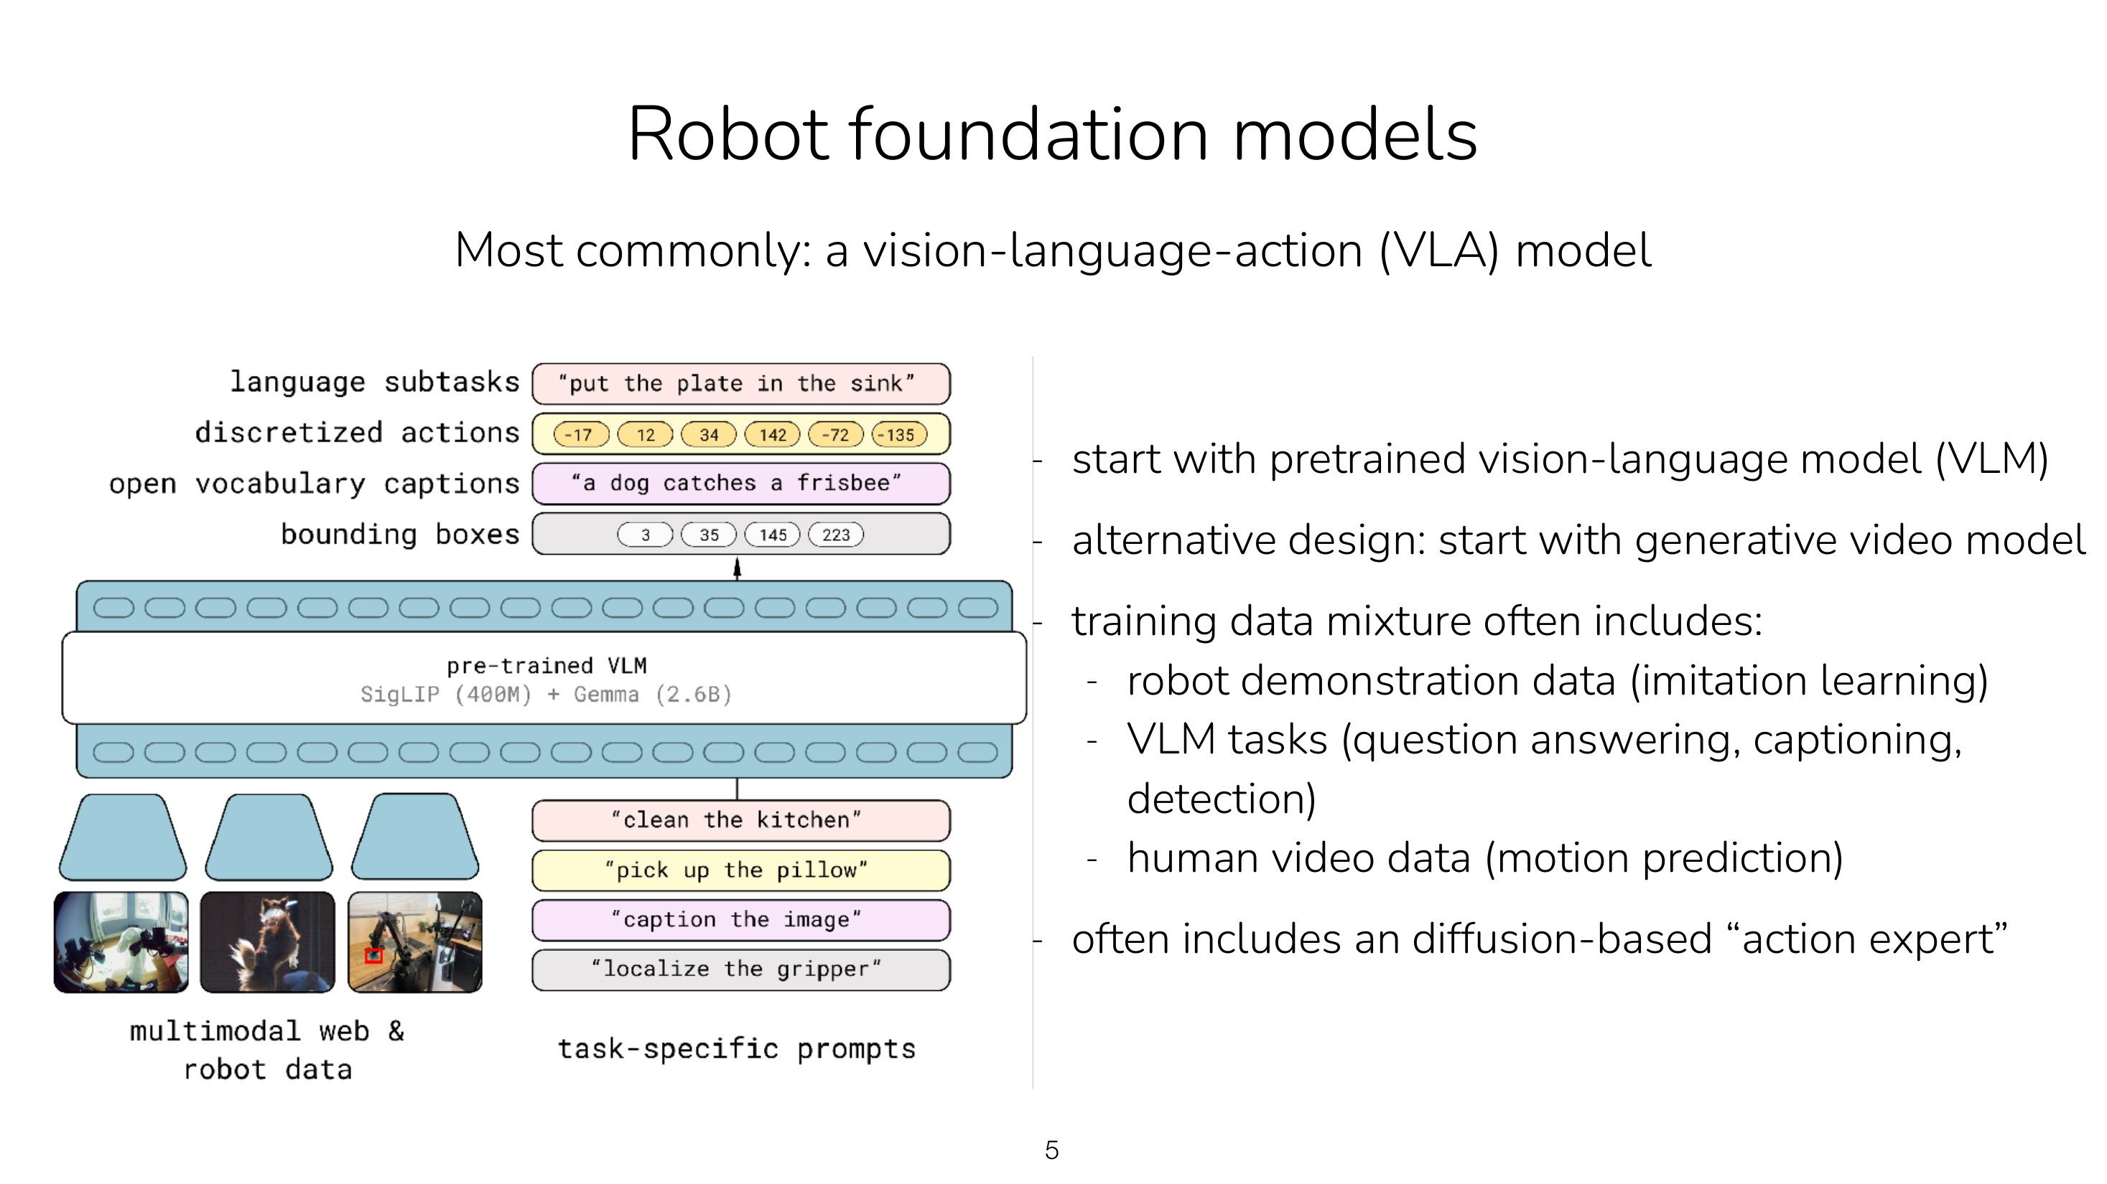
Under the hood: what is inside a VLA?
VLA = VISION-LANGUAGE-ACTION
Start from a vision-language model (it already knows objects and words)
Add an “action expert”: diffusion or flow matching (Lecture 03) outputs continuous joint commands
Train on robot demos + web tasks + human video
Output: a short chunk of actions, ~50 at a time
Adapted from Stanford CS 224R Deep RL, Lecture 17 "RL for Robot Foundation Models" (Chelsea Finn, Spring 2026). cs224r.stanford.edu
AMCC 5160 · Week 9 · Worlds, Splats and Bodies
46
Notes:
Under the hood, what is a VLA? Chelsea Finn's Stanford course shows the common recipe. Start from a vision-language model, which already knows objects and words from the internet. Attach an action expert, a small network that uses diffusion or flow matching, the same generation method from Lecture 03, to output continuous joint commands instead of pixels. Train on robot demonstrations, plus web tasks so it doesn't forget language, plus human video. It outputs a short chunk of actions at a time.

Slide 47
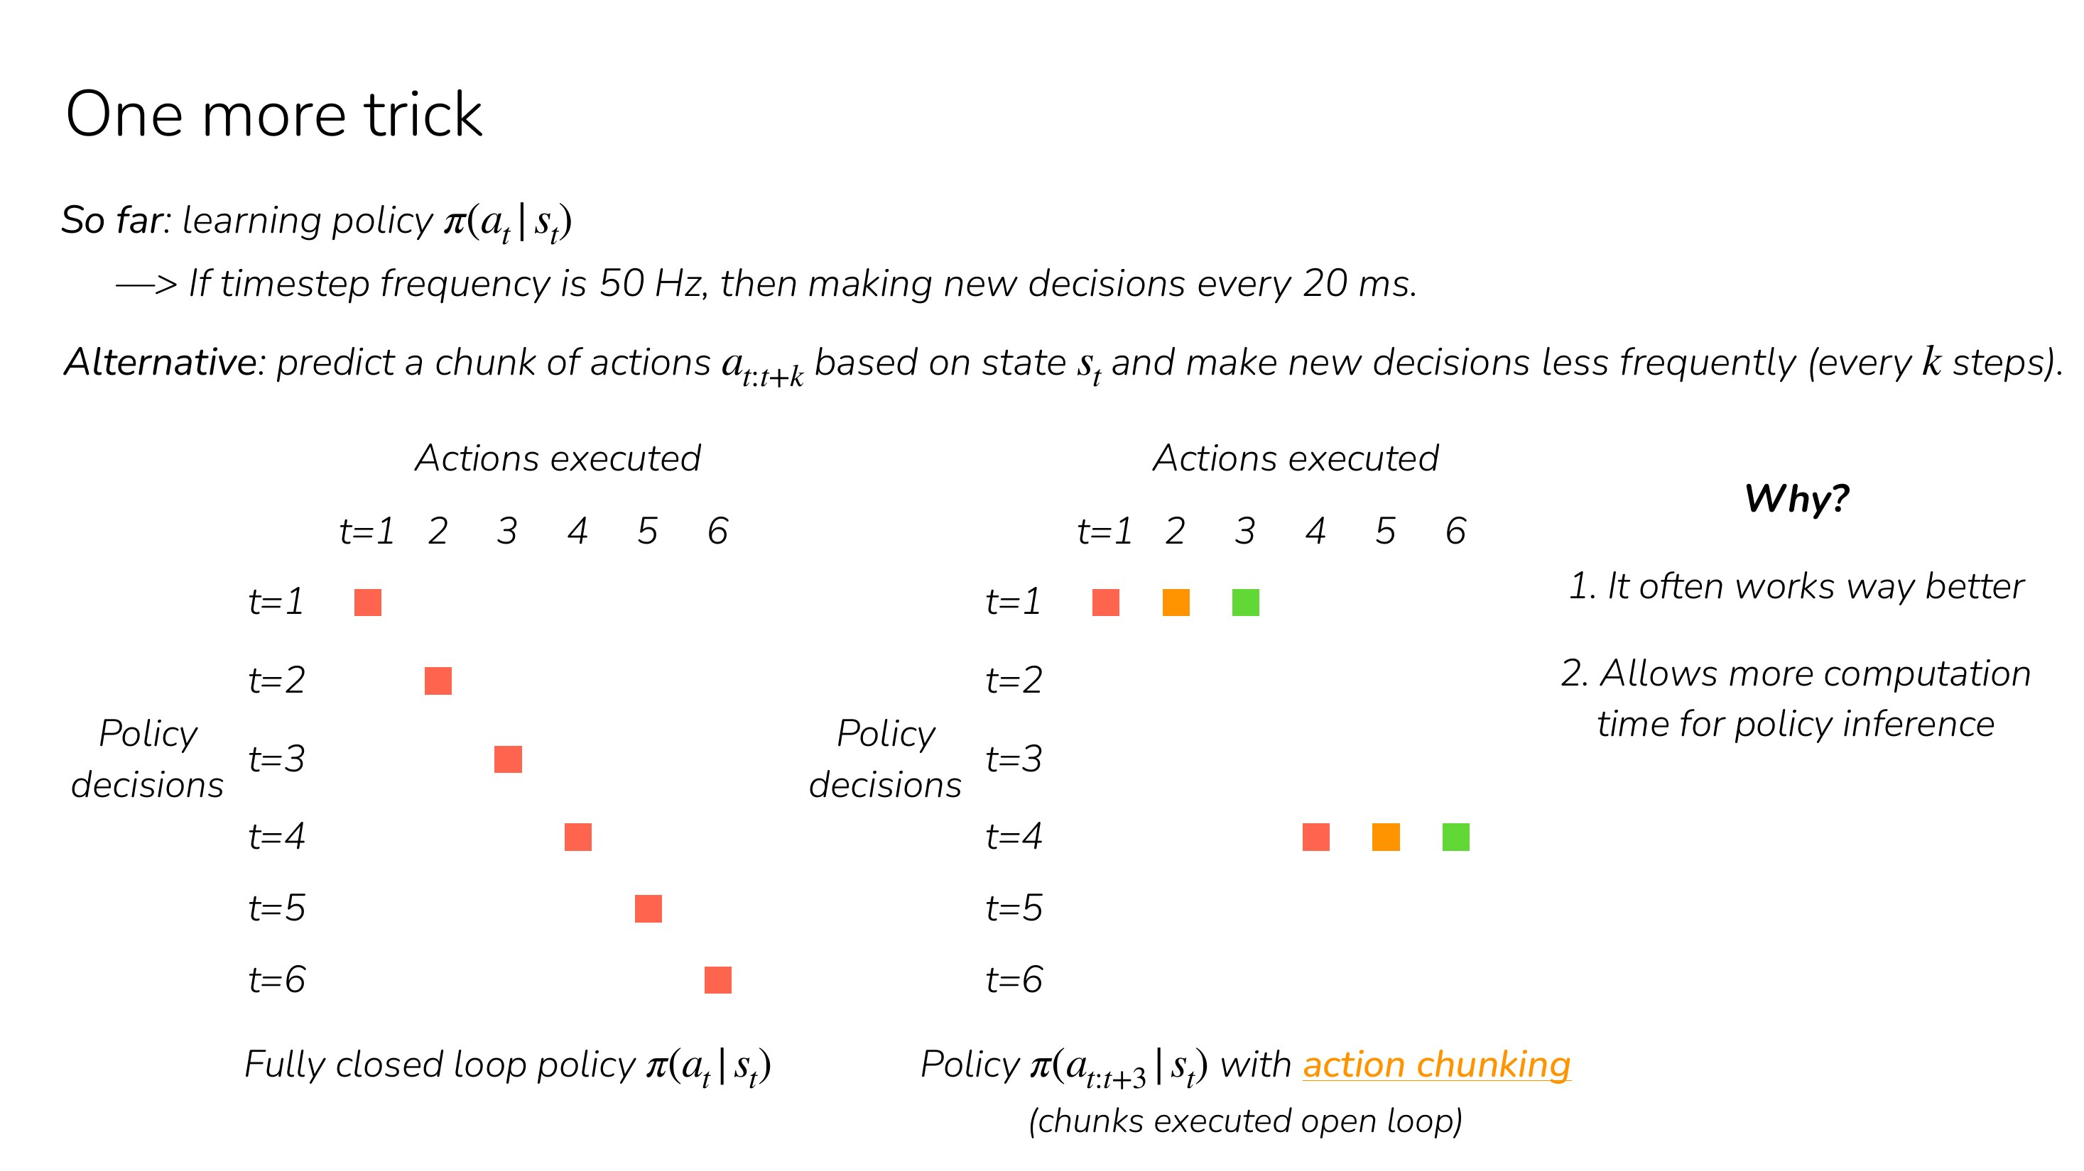
Under the hood: why predict a chunk of actions?
ACTION CHUNKING
A 50 Hz robot must decide every 20 ms
Predict the next ~1 second of actions at once
Smoother motion, fewer chances to hesitate
Same idea as generating a video clip, not a single frame
Adapted from Stanford CS 224R Deep RL, Lecture 2 "Imitation Learning" (Chelsea Finn, Spring 2026). cs224r.stanford.edu
AMCC 5160 · Week 9 · Worlds, Splats and Bodies
47
Notes:
Why chunks? A robot arm running at fifty hertz has to decide every twenty milliseconds. If it decides one tiny step at a time, it hesitates and jitters, especially when the demonstrations disagree. So modern policies predict about a second of actions at once, execute part of it, then re-plan. It's the same idea as generating a whole clip rather than one frame: you get smoother, more coherent motion.

Slide 48
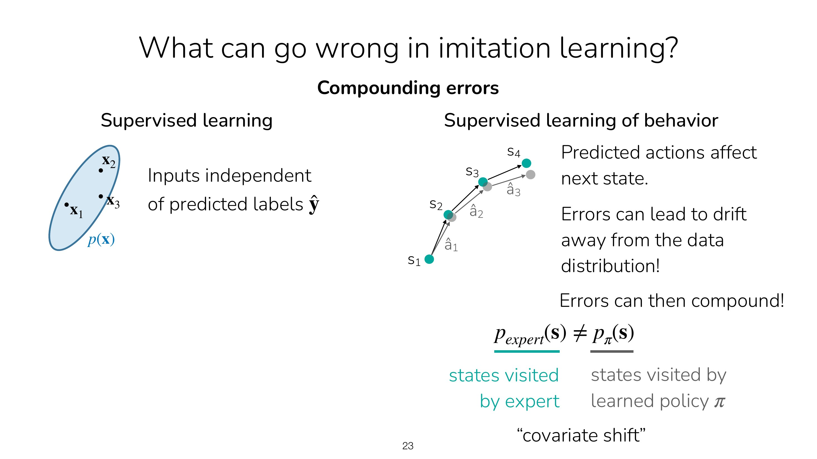
Under the hood: small mistakes compound
COVARIATE SHIFT
The robot copies the expert, but never perfectly
One small error → a state the expert never showed
There it makes a bigger error → drift
Same shape as long-video drift (Lecture 07)
Adapted from Stanford CS 224R Deep RL, Lecture 2 "Imitation Learning" (Chelsea Finn, Spring 2026). cs224r.stanford.edu
AMCC 5160 · Week 9 · Worlds, Splats and Bodies
48
Notes:
The classic problem with learning by copying. The robot imitates the expert, but never perfectly. One small error takes it to a situation the expert never demonstrated, so it has no idea what to do there, and makes a bigger error. Errors compound. It's exactly the shape of drift in long video from Lecture 07: train on clean data, then at test time you feed on your own mistakes.

Slide 49
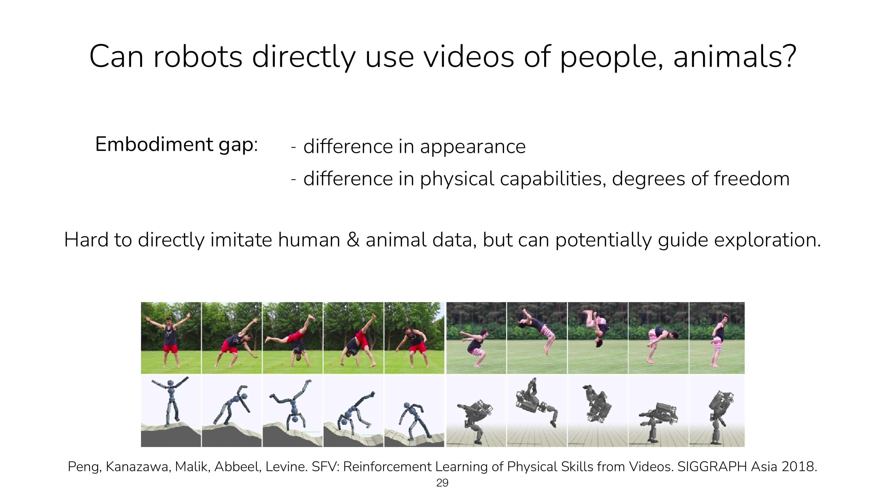
The data problem: can robots learn from videos of people?
THE EMBODIMENT GAP
Robots have no internet of their own
Teleoperation is precise but slow and costly
Human video is everywhere, but people look and move differently
Bridging this gap is tonight’s main news
Adapted from Stanford CS 224R Deep RL, Lecture 2 "Imitation Learning" (Chelsea Finn, Spring 2026). cs224r.stanford.edu
AMCC 5160 · Week 9 · Worlds, Splats and Bodies
49
Notes:
And the big one: data. Language models had the whole internet. Robots don't. Teleoperation, a person steering the robot, gives precise data but slowly and expensively. Videos of people are everywhere, but a human hand isn't a robot gripper, and our bodies move differently. Finn's slide calls it the embodiment gap. Both of tonight's robot stories are about bridging it.

Slide 50
λ0 (26 Oct 2026): a humanoid that learned from people
• From Alibaba’s Amap and Token Hub, released yesterday
• Whole-body tasks: walk, bend, carry, use both hands
• Robot: Unitree G1 with five-fingered hands
• Trained mostly on HumanVerse: 500 hours of people doing everyday things
▶ λ0 project page
Alibaba Amap, λ0 project page (lambdahumanoid.github.io); TechNode, 26 October 2026.
AMCC 5160 · Week 9 · Worlds, Splats and Bodies
50
Notes:
λ0, released yesterday by Alibaba's mapping company Amap. It's a VLA for a humanoid's whole body: walking, bending, carrying, using both hands. The robot is a Unitree G1 with five-fingered hands. What's new is the data: most of what it learned came from a dataset called HumanVerse, five hundred hours of people doing everyday things, with no robot present.

Slide 51
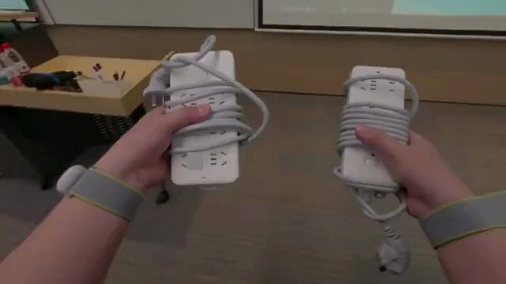
HumanVerse: wear the robot’s eyes
• A GoPro on the neck, at the robot’s camera height
• Body tracking: 24 joints; hands: 21 joints each
• Recorded in real places, not a lab
• About 3.4× faster to collect than teleoperation
▶ Watch the demo
λ0 project page: HumanVerse capture setup.
AMCC 5160 · Week 9 · Worlds, Splats and Bodies
51
Notes:
How do you make human video useful for a robot? You wear the robot's eyes. In HumanVerse, people wear a GoPro on the neck at the same height as the robot's head camera, a body tracker recording twenty-four joints, and hand tracking with twenty-one joints per hand. Then they just live: tidy, carry boxes, water plants. The team estimates it's about 3.4 times faster than collecting the same data by teleoperating a robot.

Slide 52
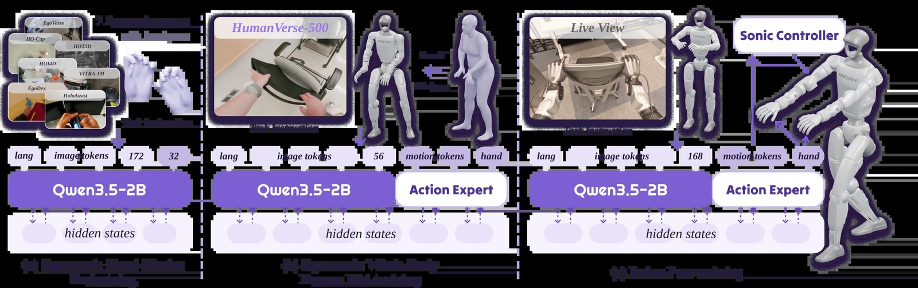
λ0: three stages, from human hands to a robot body
• I · Learn hands and objects from 7 first-person human datasets
• II · Translate HumanVerse into the robot’s view and joints (“alignment”)
• III · Finish on 600 real robot demos (150 per task)
• At run time: camera + instruction + body sense → whole-body motion
▶ Watch the demo
λ0 project page: training recipe.
AMCC 5160 · Week 9 · Worlds, Splats and Bodies
52
Notes:
Training happens in three stages. One: learn how hands interact with objects from seven existing first-person human datasets. Two: the key step, translate HumanVerse into the robot's point of view and the robot's joints, so a person's reach becomes a robot's reach. Three: finish with a small amount of real robot data, six hundred demos, a hundred and fifty per task. At run time, the robot gets its camera image, an instruction and its body sense, and outputs whole-body motion.

Slide 53
λ0, by the numbers
40.0%
62.5%
22.5%
15.0%
success of the strongest baseline (π0.5) on 4 real tasks
λ0: 25 of 40 real trials
λ0 without stage II (no human-to-robot translation)
λ0 without any human-data pretraining
The ablation is the lesson: remove the human video and success falls from 62.5% to 15%. Human video is not decoration; it is most of the skill.
AMCC 5160 · Week 9 · Worlds, Splats and Bodies
53
Notes:
The numbers. On four real tasks, the strongest baseline, Physical Intelligence's π0.5, succeeded 40 percent of the time. λ0: 62.5 percent, twenty-five out of forty. The most interesting part is the ablation. Remove stage two, the human-to-robot translation, and it falls to 22.5. Remove all human data, 15 percent. So the human video isn't decoration; it's most of the skill. Also note that 62.5 is far from good enough for a home. Keep that in mind.

Slide 54
Gemini 4 Argon (13 Oct): watch a video, write a simulator
• A general Gemini model with strong physical reasoning
• Turns robot camera feeds, human video, even a sketch into a MuJoCo simulation
• Writes control code; practises in sim; improves real success (56% → 75% in one demo)
• Available in the Gemini API and AI Studio
▶ Argon robotics demos
Google for Developers, “Gemini 4 Argon for robotics”, 13 October 2026.
AMCC 5160 · Week 9 · Worlds, Splats and Bodies
54
Notes:
A completely different route, from Google two weeks ago. Gemini 4 Argon isn't a robot policy; it's a general model that's very good at physical reasoning and code. You give it a robot camera feed, a video of a person, or even a hand-drawn sketch, and it writes a MuJoCo physics simulation of that scene. Then it writes control code, practises in the simulator and transfers the result. In one of their demos, simulation-generated data raised real-world success from 56 to 75 percent.

Slide 55
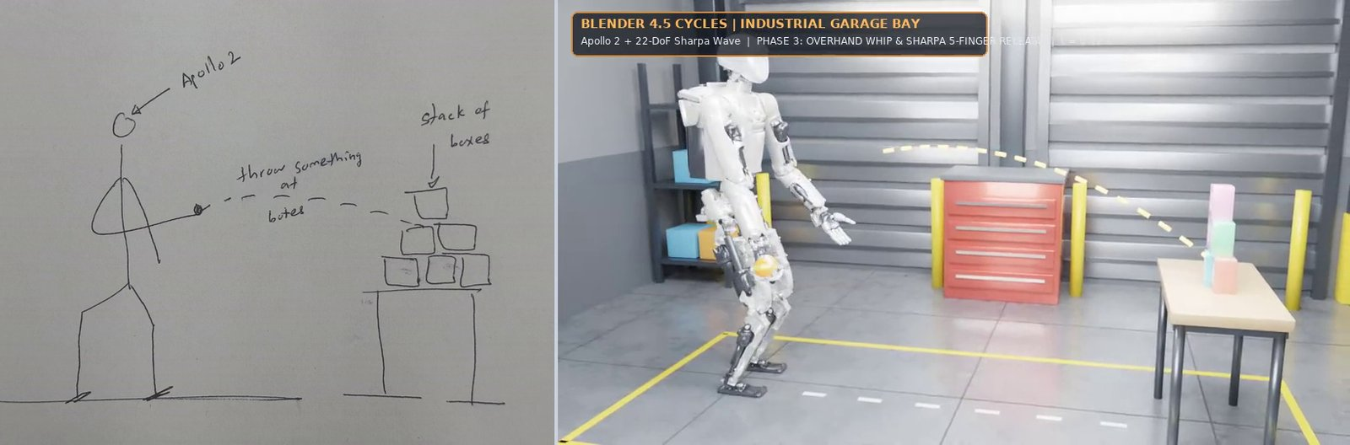
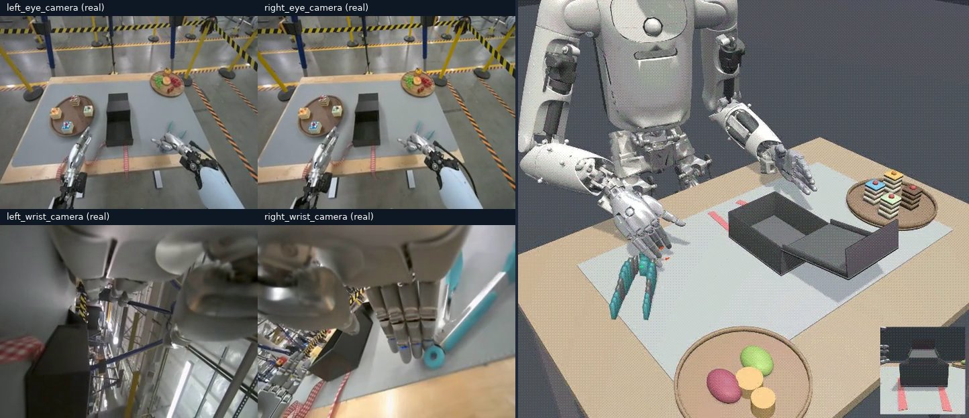
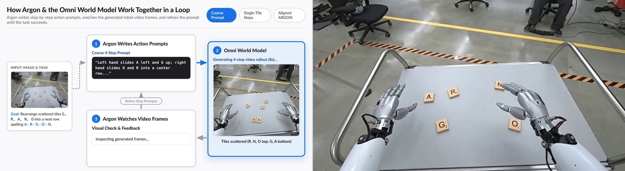
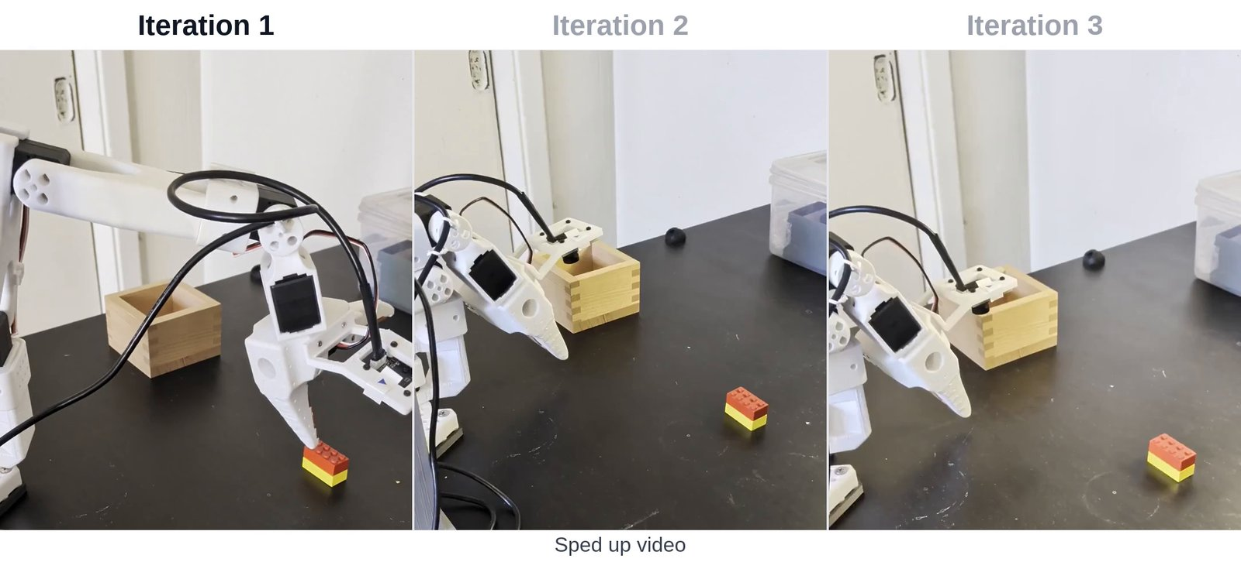
Argon demos: video → simulation → robot
Sketch → simulation of a humanoid throwing a ball
Robot camera feeds → a calibrated simulated twin
Steering a world model to spell A-R-G-O-N
SO-101 arm improves itself: 58.9 s → 22.9 s → 17.4 s
Google for Developers, “Gemini 4 Argon for robotics”, 13 October 2026 (demo videos).
AMCC 5160 · Week 9 · Worlds, Splats and Bodies
55
Notes:
Four of their demos. [Click through.] A sketch of a humanoid throwing a ball becomes a simulation. A person's first-person video becomes a simulated twin of their kitchen. Argon steers a video world model, Gemini Omni, to spell its own name with Scrabble tiles, which is Story 1 and Story 3 meeting. And a cheap SO-101 arm, the kind you can buy for a few hundred dollars, gets faster at a pick-and-place task by practising: 59 seconds, then 23, then 17.

Slide 56
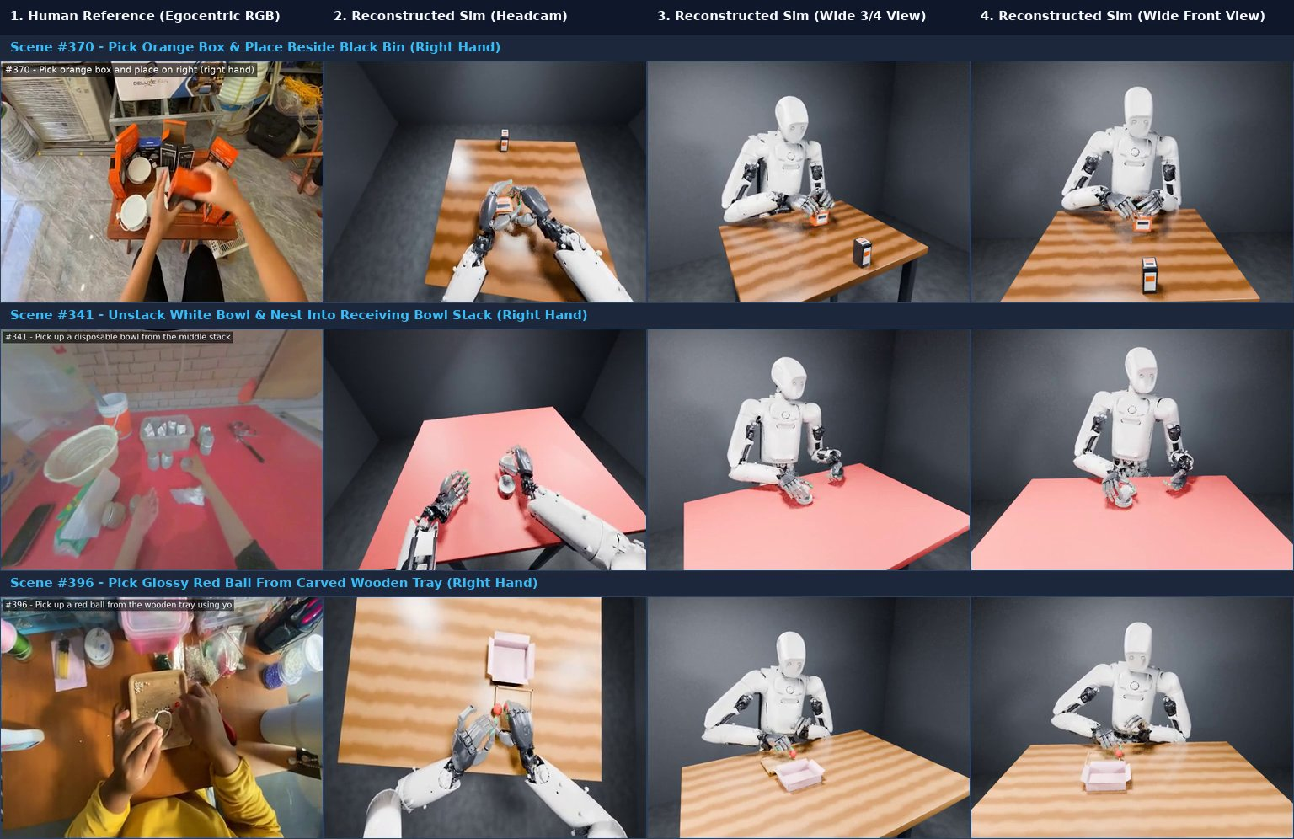
Watch one person play cornhole, then do it
• Argon watches a raw video of a person playing cornhole
• Maps the space and works out whole-body joint motion
• Writes the simulation itself → trains → Apptronik Apollo
• Real trial: seven throws in a row on target
▶ Apollo cornhole (Oct 22)
Robotics & Automation News, 22 October 2026, on Google DeepMind and Apptronik.
AMCC 5160 · Week 9 · Worlds, Splats and Bodies
56
Notes:
And last week, the demo that made the headlines. Argon watched an ordinary video of a person playing cornhole, the American bean-bag throwing game. It mapped the space, worked out the whole-body joint motion, wrote the simulation itself, trained the skill in simulation, and transferred it to Apptronik's Apollo humanoid. In a real trial, Apollo landed seven throws in a row. Google says this 'video-to-sim-to-real' pipeline turns weeks of manual simulation work into hours.

Slide 57
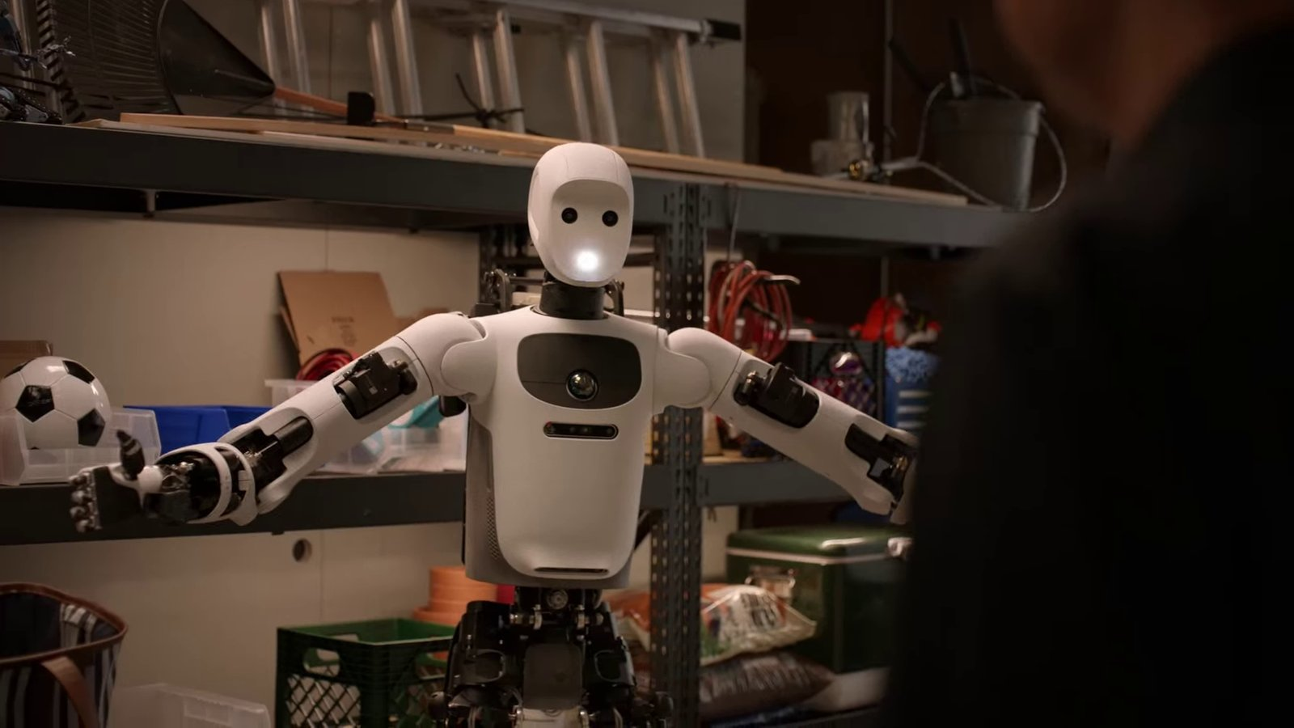
Gemini Robotics 2 (July): one model for the whole body
• VLA that walks and manipulates: “put the watering can in the green bin on the bottom shelf”
• ER 2 plans and checks progress; the VLA acts
• Adapts to a new robot body with fewer than ~200 examples
• Lecture 03, slide 86, in motion
▶ Gemini Robotics 2
Google DeepMind, Gemini Robotics 2, 30 July 2026; The Robot Report, 2 August 2026.
AMCC 5160 · Week 9 · Worlds, Splats and Bodies
57
Notes:
For context, the model we met in Lecture 03, now in motion. Gemini Robotics 2, from July, controls a humanoid's whole body, not just the arms over a table. An instruction like 'put the watering can in the green bin on the bottom shelf' means walking, picking, walking, placing. A separate reasoning model, ER 2, plans the steps and checks progress, and the VLA moves. It can adapt to a new robot body with typically fewer than two hundred examples.

Slide 58
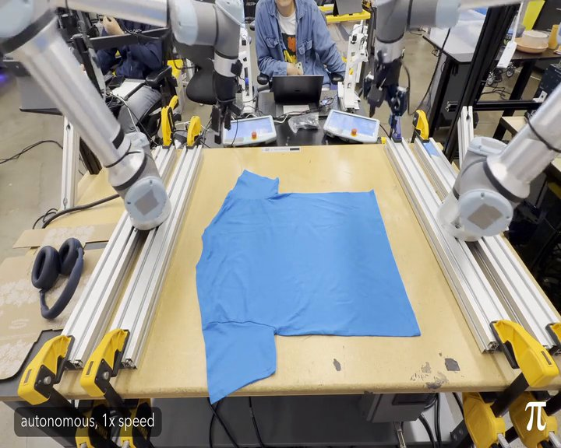
π0.7 and the Pi API: robot brains as a service
• π0.7 (April): steer with more than words: speed, quality, subgoal images
• Folded laundry on a robot with no laundry training data
• Pi API beta (13 Oct): upload demos → fine-tune → hosted inference
• Older π0 / π0.5 weights are open (openpi, Apache-2.0)
▶ Physical Intelligence
Physical Intelligence, π0.7 (16 April 2026) and Pi API beta (13 October 2026); openpi on GitHub.
AMCC 5160 · Week 9 · Worlds, Splats and Bodies
58
Notes:
Physical Intelligence, the startup behind the π models. π0.7 in April could be steered with more than words: you can say faster, or higher quality, or show a subgoal image. It folded laundry on a robot that had no laundry training data. And on the 13th of October they opened a beta Pi API: upload your robot's demonstrations, they fine-tune and host the model. Robot brains become a cloud service. Their older π0 and π0.5 weights are open, and that's what λ0 was compared against.

Slide 59
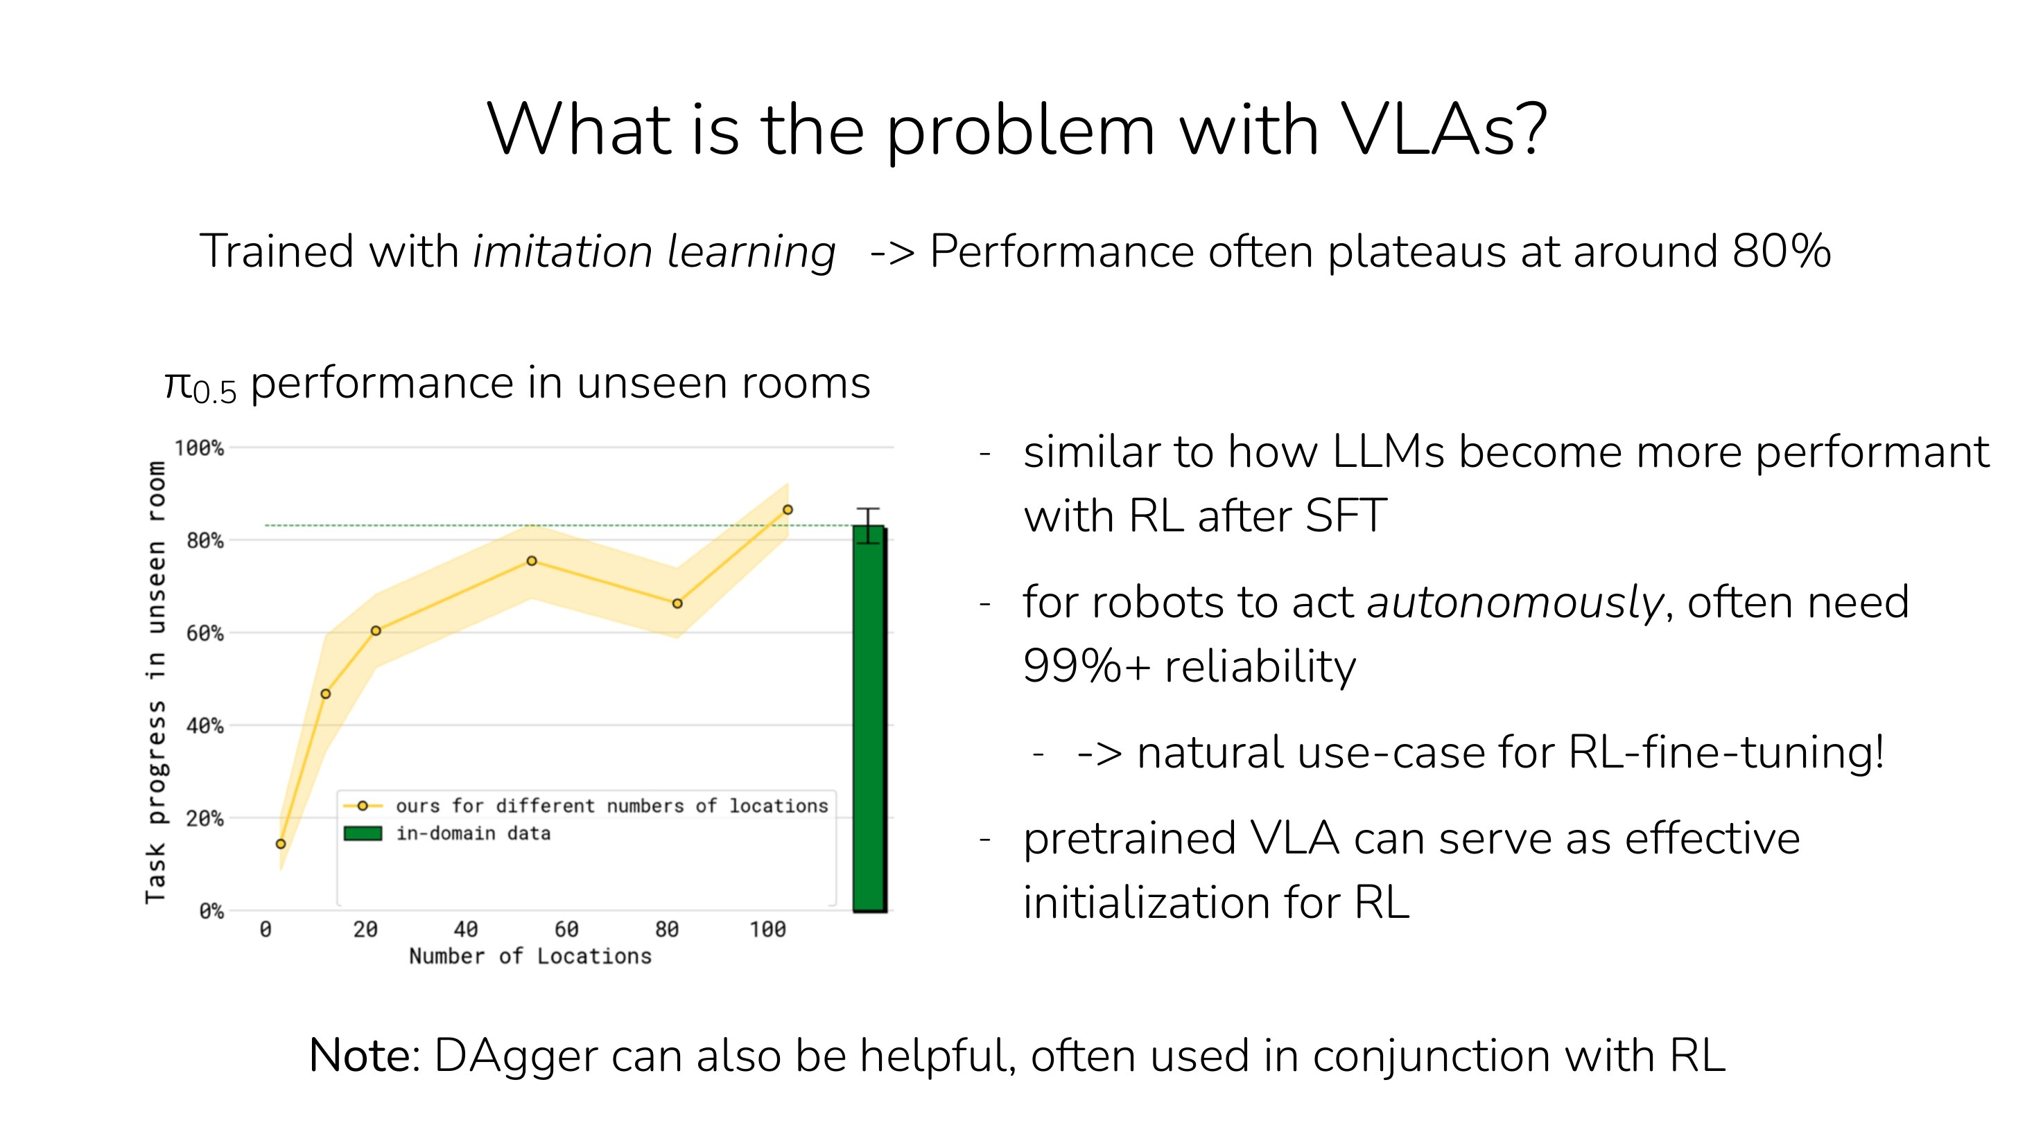
Under the hood: why copying plateaus around 80%
THE LAST 20%
Imitation-trained VLAs often plateau around 80% reliability
A home or factory needs 99%+
Copying can’t be better than the demos
So: let the robot practise and learn from its own attempts (RL)
Adapted from Stanford CS 224R Deep RL, Lecture 17 "RL for Robot Foundation Models" (Chelsea Finn, Spring 2026). cs224r.stanford.edu
AMCC 5160 · Week 9 · Worlds, Splats and Bodies
59
Notes:
Under the hood, why isn't λ0's 62 percent, or anyone's 80, good enough? Finn's lecture makes the point clearly: VLAs trained only by imitation tend to plateau around 80 percent. A robot in a home needs 99 percent or more, because a robot that drops one cup in five is not a product. And copying can't make you better than your teachers. So the frontier is letting robots practise and learn from their own attempts, which is reinforcement learning.

Slide 60
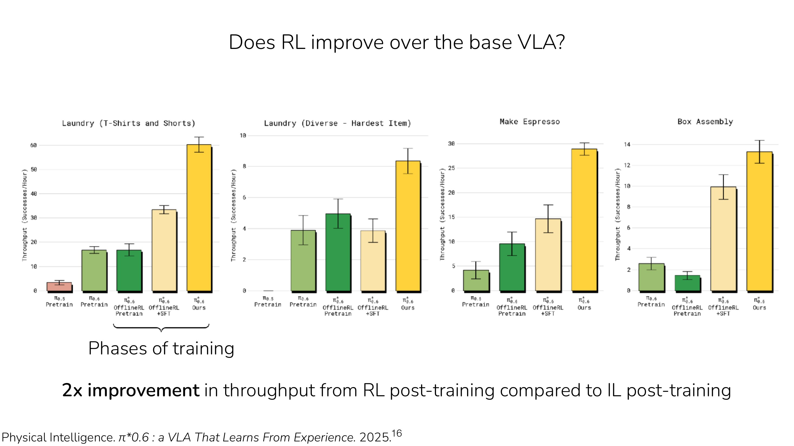
Practice beats copying: RL roughly doubles throughput
π*0.6 RESULT
Fit a value function: “is this going well?”
Fine-tune on what worked
About 2× throughput vs. imitation alone, on real tasks
Where world models help: practise in imagination, not on real dishes
Adapted from Stanford CS 224R Deep RL, Lecture 17 "RL for Robot Foundation Models" (Chelsea Finn, Spring 2026). cs224r.stanford.edu
AMCC 5160 · Week 9 · Worlds, Splats and Bodies
60
Notes:
Here is the evidence from the same lecture. Physical Intelligence's π-star-0.6 learned a value function, roughly a sense of 'is this going well?', and fine-tuned on what worked. Throughput roughly doubled compared with imitation alone, on real tasks like making espresso. And this is where world models come back. Practising on real dishes is slow and expensive. Practising inside a world model or a simulator built from video, like Argon's, is cheap.

Slide 61
Three ways to teach a robot, 2026
1
Steer it (teleoperation)
2
Show it (human video)
3
Imagine it (simulation, world models)
+ precise, the robot’s own body
− slow, costly, needs a person per robot
π models: 10,000+ hours
+ cheap, everywhere, real homes
− different body, different eyes
λ0: 500 hours of HumanVerse
+ unlimited practice, rare events
− the sim-to-real gap (Lecture 07)
Argon, Cosmos, Atlas, Genie
Every serious system in 2026 mixes all three.
AMCC 5160 · Week 9 · Worlds, Splats and Bodies
61
Notes:
So in 2026 there are three ways to teach a robot. Steer it: teleoperation, precise but slow, and Physical Intelligence's open models were pretrained on more than ten thousand hours of it. Show it: human video, cheap and everywhere, but a different body, as with λ0. Imagine it: simulation and world models, unlimited practice, but the sim-to-real gap from Lecture 07. Every serious system now mixes all three.

Slide 62
GAME · 4 MINUTES
Be the VLA
One student is the robot: eyes closed, moves only on instructions
A partner gives one-sentence commands: “move your right hand 20 cm left”
Goal: put a pen into a cup. Count the commands. Now try with eyes open
AMCC 5160 · Week 9 · Worlds, Splats and Bodies
62
Notes:
A game. One volunteer per pair is the robot: eyes closed, moves only when told. The partner gives one-sentence commands, like 'move your right hand twenty centimetres to the left', and the goal is to put a pen into a cup. Count the commands. Then let the robot open its eyes and try again with one instruction: 'put the pen in the cup'. What changed? Vision plus language is what lets one sentence replace twenty low-level commands. That's the V and the L in VLA.

Slide 63
DISCUSSION · 3 MINUTES
If robots learn from first-person video of people’s daily lives, whose bodies and homes become the training data?
Who should be paid or credited?
What should never be recorded?
Would you wear the camera for a week? For how much?
AMCC 5160 · Week 9 · Worlds, Splats and Bodies
63
Notes:
Three minutes. If robots learn from first-person video of people's daily lives, whose bodies and whose homes become training data? HumanVerse paid people to record. But there are millions of hours of first-person video online already. Who should be paid or credited? What should never be recorded? And personally, would you wear the camera for a week? For how much?

Slide 64
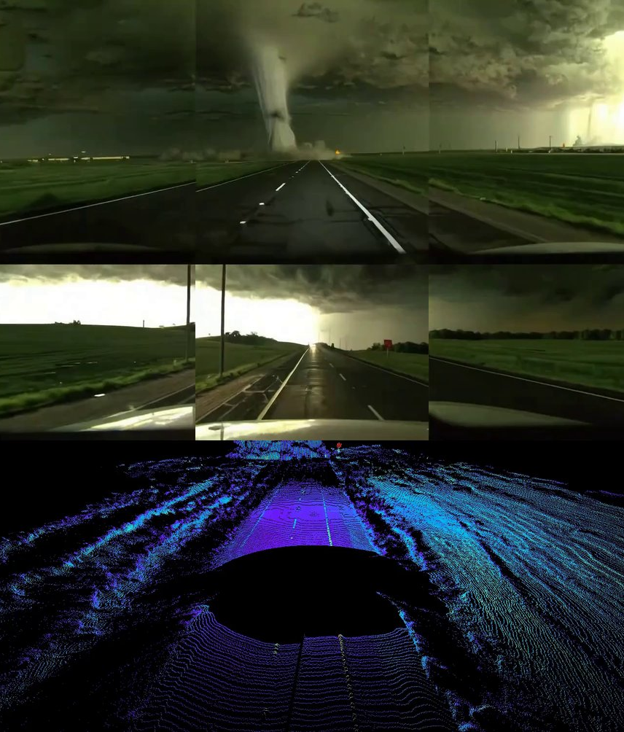
STORY 4 OF 4
04
Does a world model need to draw pixels?
Generate the world, or predict it in a space you never see
Waymo World Model · generated camera and lidar
Notes:
Story four, a real disagreement. Everything so far draws pixels or splats. Some people think that's the wrong goal entirely.

Slide 65
Two camps
A
Generate the world
B
Predict in latent space
Predict the next frame in pixels (or splats). You can watch the prediction, train robots inside it, and sell it as video.
Genie 3 · Gemini Omni · Cosmos 3 · Atlas
Predict an abstract summary of the next moment, never the pixels. Ignore leaves and reflections; keep what matters for acting.
Yann LeCun · JEPA · V-JEPA 2 · AMI Labs
AMCC 5160 · Week 9 · Worlds, Splats and Bodies
65
Notes:
Two camps. One generates the world: predict the next frame in pixels or splats. The advantage is you can watch the prediction, train robots inside it, and also sell it as video. Genie, Omni, Cosmos, Atlas. The other predicts in latent space: predict an abstract summary of what happens next, never the pixels. Why waste effort drawing every leaf and reflection, if what matters for acting is where the cup goes? That's Yann LeCun's position, with JEPA.

Slide 66
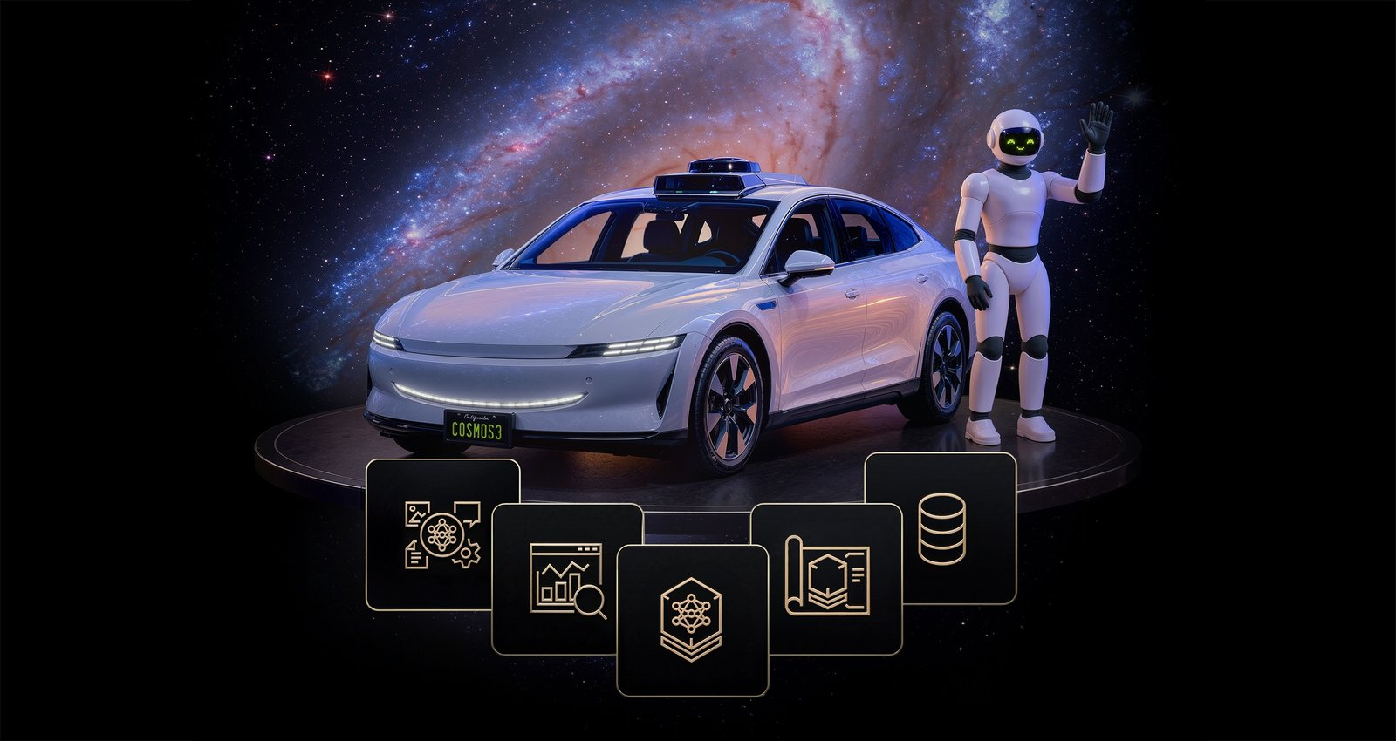
NVIDIA Cosmos 3: one open model to reason, simulate and act
• Announced 31 May 2026 at GTC Taipei; fully open weights, data and training code
• Two towers: a Reasoner (VLM) + a Generator (video and actions)
• Super 32B for data centres; Nano 8B for a workstation
• Use: synthetic training data and testing robot policies
▶ NVIDIA Cosmos
NVIDIA, Cosmos 3 announcement, GTC Taipei, 31 May 2026; DataNorth summary, June 2026.
AMCC 5160 · Week 9 · Worlds, Splats and Bodies
66
Notes:
The strongest open version of the first camp is NVIDIA's Cosmos 3, from the end of May. It's one model with two towers: a reasoner, which is a vision-language model, and a generator that outputs video and robot actions. There's a 32-billion-parameter version for data centres and an 8-billion one for a workstation. NVIDIA released the weights, training code and datasets under a licence that allows commercial use. What is it for? Mostly making synthetic training data and testing robot policies before they touch real hardware.

Slide 67
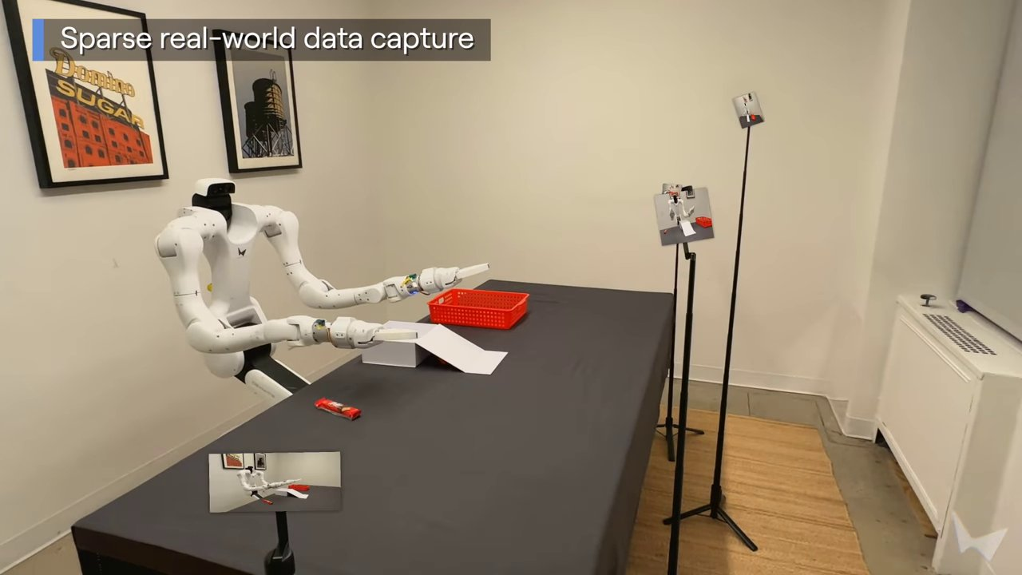
Why generate pixels? Because cameras are what robots see
• A robot’s sensors see pixels and depth, so a simulator must produce them
• Atlas: 24 phone frames per room → RGB + depth for any robot path
• Waymo: rehearse crashes that can’t be filmed
• Pixels are checkable: you can watch what the model believes
▶ Atlas robotics demo
World Labs, “Atlas” (robotics section), September 2026; Waymo World Model.
AMCC 5160 · Week 9 · Worlds, Splats and Bodies
67
Notes:
The argument for pixels. A robot's camera sees pixels and depth, so to train or test it in imagination, someone must produce pixels and depth. Atlas does exactly that: from twenty-four frames of phone video per room, it generates what any robot would see along any path. Waymo uses the same idea for crashes it can't film. And pixels are checkable: you can watch what the model believes and catch it when it's wrong.

Slide 68
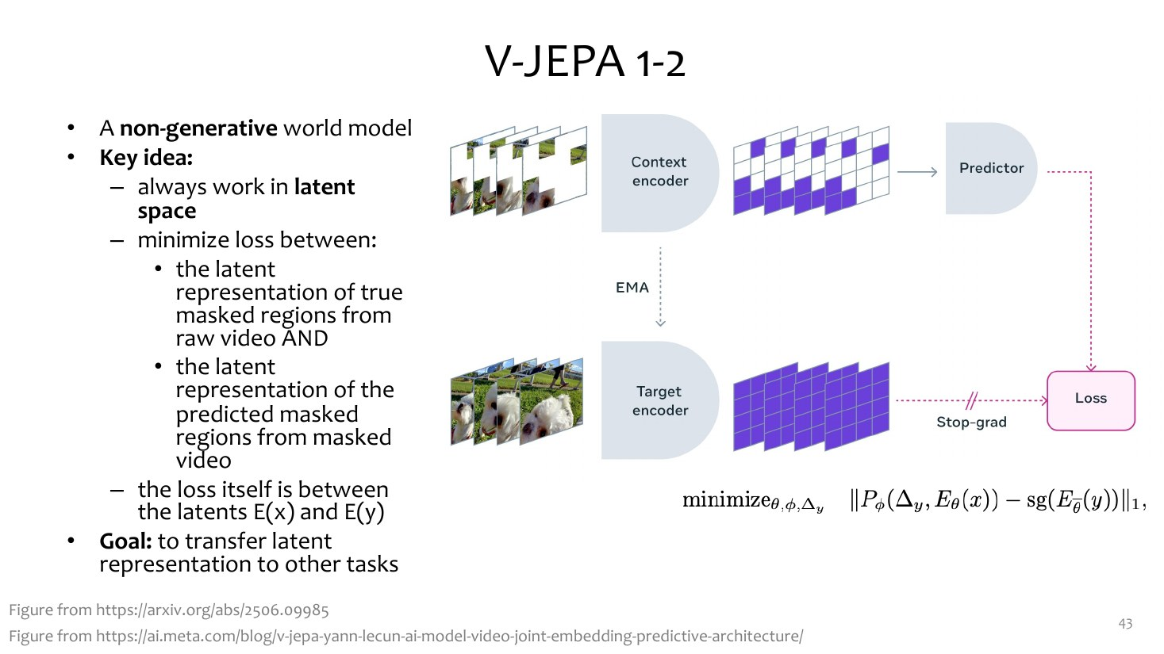
Why not pixels? JEPA predicts the meaning, not the picture
V-JEPA (META)
Mask part of a video; predict the representation of the missing part, not its pixels
V-JEPA 2: pretrained on 1M+ hours of video
+ under 62 hours of robot video → an action-conditioned model that can plan
LeCun’s AMI Labs: $1.03B seed (March 2026) to build this
Adapted from CMU 10-423/623/723 Generative AI, Lecture 26 "Interactive World Models" (Matt Gormley & Aran Nayebi). cs.cmu.edu/~mgormley/courses/10423 Facts: Meta V-JEPA 2 (2025); TorontoStarts on AMI Labs, Sept 2026.
AMCC 5160 · Week 9 · Worlds, Splats and Bodies
68
Notes:
The argument against. In JEPA, you hide part of a video and predict the representation of the missing part, an abstract summary, not its pixels. Meta's V-JEPA 2 was pretrained on more than a million hours of video, then adapted with under 62 hours of unlabelled robot video into a model that can plan robot actions. LeCun left Meta and founded AMI Labs in Paris, which raised a 1.03-billion-dollar seed round in March to build this. His argument: a model that must draw every pixel wastes its capacity on details that don't matter for acting.

Slide 69
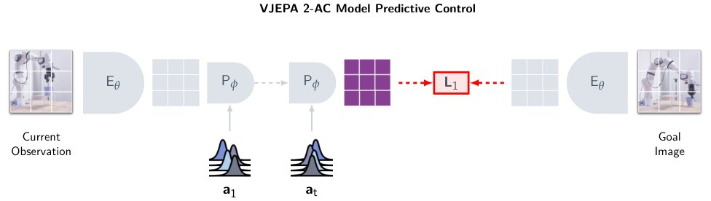
V-JEPA 2-AC: plan a robot move without drawing the future
• Give a goal image: “the cup should end up here”
• Imagine many action sequences, in embedding space only
• Pick the one whose predicted embedding is closest to the goal
• Execute a step, look again, re-plan
▶ V-JEPA 2 paper
Assran et al., “V-JEPA 2: Self-Supervised Video Models Enable Understanding, Prediction and Planning”, Meta, 2025 (arXiv 2506.09985).
AMCC 5160 · Week 9 · Worlds, Splats and Bodies
69
Notes:
Here is what that looks like in practice, from Meta's V-JEPA 2 paper. You show the robot a goal image: the cup should end up here. The model imagines many possible action sequences, but only in embedding space; it never draws a single frame. It picks the sequence whose predicted embedding is closest to the goal's, executes one step, looks again and re-plans. That's model-predictive control, with a world model that never makes a picture.

Slide 70
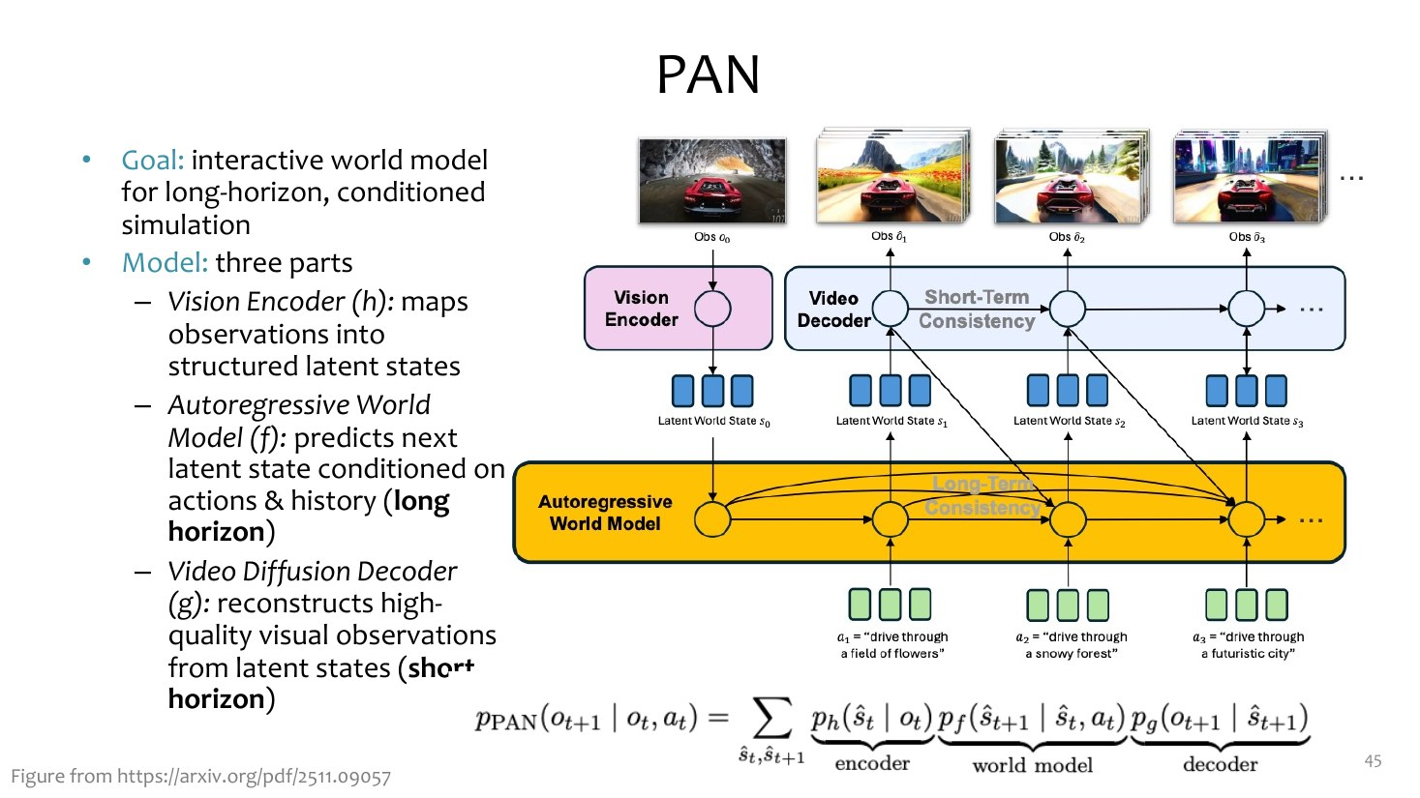
Under the hood: the two losses, side by side
READ THE TWO LINES
Generative: make the predicted next observation look like the real one (pixels)
JEPA: make the predicted embedding match the real embedding
Same structure: state + action → next
The fight is about what to compare: pictures or meanings
Adapted from CMU 10-423/623/723 Generative AI, Lecture 26 "Interactive World Models" (Matt Gormley & Aran Nayebi). cs.cmu.edu/~mgormley/courses/10423
AMCC 5160 · Week 9 · Worlds, Splats and Bodies
70
Notes:
CMU's slide puts the two losses side by side. The generative loss compares the predicted next observation with the real one, in pixel space. The JEPA loss compares the predicted embedding with the real embedding, in a learned space. The structure is the same, state plus action gives next state. The whole fight is about what you compare: pictures or meanings.

Slide 71
How would you know a world model really “understands”?
1
Round trip
2
Counterfactual
3
Long horizon
4
Real action
Walk away and come back: is it the same? (Lecture 03)
Push the cup instead of lifting it: does the result change correctly?
Still consistent after 10 minutes? An hour?
Does a robot that planned inside it succeed in the real room?
Only the last test is the same for both camps. That is why robots have become the referee.
AMCC 5160 · Week 9 · Worlds, Splats and Bodies
71
Notes:
How would you know a world model really understands the world? Four tests. The round trip from Lecture 03. A counterfactual: push the cup instead of lifting it, does the outcome change in the right way? Long horizon: still consistent after ten minutes, an hour? And real action: does a robot that planned inside the model succeed in the real room? Only the last test works for both camps, which is why robotics has become the referee of this debate.

Slide 72
DEBATE · 10 MINUTES
“A video generator is a world model.”
Left side of the room argues for; right side against
Two speakers per side, one minute each
Then the whole room votes by show of hands
AMCC 5160 · Week 9 · Worlds, Splats and Bodies
72
Notes:
Debate. The motion: a video generator is a world model. Left side for, right side against. Two speakers per side, one minute each. Use tonight's examples: Genie, Omni, Atlas, Cosmos, JEPA, the robot results. Then we vote.

Slide 73
Arguments to start from
+
For
−
Against
• Genie 3 already takes actions and keeps a minute of memory
• Waymo trains real cars with it
• Argon steers Omni to move Scrabble tiles: it predicts consequences
• To draw the future correctly, you must model the world
• Most video models take no actions: they predict, they don’t respond
• They forget, drift and break physics (Lecture 07)
• Pretty ≠ correct: a beautiful wrong future
• JEPA: the world is not its pixels
AMCC 5160 · Week 9 · Worlds, Splats and Bodies
73
Notes:
Some arguments to start from, if your side is stuck. For: Genie 3 already takes actions and keeps memory; Waymo uses it for real cars; Argon steers Omni to move objects, which means the model predicts consequences; and to draw the future correctly at all, you need some model of the world. Against: most video generators take no actions, they predict but don't respond; they forget and drift, as we saw in Lecture 07; a beautiful future can be wrong; and LeCun's point, the world is not its pixels.

Slide 74
Four stories, one line each
01
Playable worlds
02
Splats
Add an action to a video model and it becomes a place; the hard part is memory
Keep the geometry and the world becomes a file you can open, edit and sell
03
Bodies
04
Pixels?
Robots now learn mostly from people and from imagined worlds, but still fail 1 time in 3
Whether a world model must draw the world is still open, and robots will decide
AMCC 5160 · Week 9 · Worlds, Splats and Bodies
74
Notes:
Four stories, one line each. Add an action to a video model and it becomes a place, and the hard part is memory. Keep the geometry and the world becomes a file you can open, edit and sell. Robots now learn mostly from people and from imagined worlds, but still fail about one time in three. And whether a world model must draw the world at all is still open; robots will decide.

Slide 75
Tonight → your assignments (both due Nov 30)
A3
Assignment 3: your game
A2
Assignment 2
→
Final project ideas
Sketch a level in a world model or Marble; or scan a real place as a splat and load it in three.js. Use the “directing a world” checklist
A splat or a world-model clip can be a set; disclose which tools made which parts
An explorable memory · a world you can only enter once · a robot that learns your gesture
AMCC 5160 · Week 9 · Worlds, Splats and Bodies
75
Notes:
How tonight connects to your assignments, both due November 30th. For Assignment 3, your game: sketch a level with a world model or Marble, or scan a real place as a splat and load it into three.js or Unity. For Assignment 2, a splat or a world-model clip can be your set, just say clearly which tool made which part. And some final-project ideas: an explorable memory, a world you can only enter once, a robot that learns your gesture.

Slide 76
Three readings for this week
1
Atlas
2
λ0
3
Genie 3 and the AGI question
World Labs (Sept 2026). One model for images, video and 3D; read the “spatial context” and robotics sections
Alibaba Amap (Oct 2026). Read the HumanVerse and three-stage training sections, and look at the ablation
TechCrunch (Aug 2025). How DeepMind frames world models as a step towards general AI
Technique · worldlabs.ai/blog/atlas
Robotics · lambdahumanoid.github.io
Culture · techcrunch.com
AMCC 5160 · Week 9 · Worlds, Splats and Bodies
76
Notes:
Three readings. One, World Labs' Atlas post: read the spatial-context part and the robotics part. Two, the λ0 project page: focus on HumanVerse, the three training stages and the ablation. Three, a TechCrunch piece on Genie 3 and why DeepMind thinks world models matter for general AI; read it critically, with tonight's debate in mind. Optional for the technical students: Google's Gemini 4 Argon robotics post.

Slide 77
Quiz 09 · five short questions
1
Q1 · Technique
2
Q2 · Technique
3
Q3 · Art
What one input turns a video model into a world model?
Why do Gaussian splats render so much faster than NeRF?
Choose a place you would scan as a splat. What would the copy keep and lose?
4
Q4 · Art
5
Q5 · Reading
Whose daily life should (not) become robot training data?
One claim from a reading you would want to test, and how
AMCC 5160 · Week 9 · Worlds, Splats and Bodies
77
Notes:
Quiz 09, five short questions, same format as before: two technique, two art, one reading reflection. Due by the end of the semester, on the course site.

Slide 78
Every demo from tonight, in one place
▶ Genie 3 (Google DeepMind)
▶ Splats in Sept 2026 (Radiance Fields)
▶ Project Genie
▶ λ0 (Alibaba Amap)
▶ Waymo World Model
▶ Gemini 4 Argon for robotics
▶ Gemini Omni
▶ Apollo plays cornhole
▶ GameNGen: DOOM in a diffusion model
▶ Gemini Robotics 2
▶ World Models (Ha & Schmidhuber, 2018)
▶ Physical Intelligence π0.7 / Pi API
▶ Marble 1.1 (World Labs)
▶ NVIDIA Cosmos 3
▶ Atlas (World Labs)
▶ Meta V-JEPA 2
▶ AMD to acquire World Labs
▶ CMU 10-423 Lecture 26 (World Models)
▶ HY-World 2.0 (Tencent)
▶ Stanford CS231A Lecture 17 (Splatting)
▶ 3D Gaussian Splatting (Inria)
▶ Stanford CS 224R (VLAs, imitation)
AMCC 5160 · Week 9 · Worlds, Splats and Bodies
78
Notes:
Every demo and source from tonight is on this slide and on the course page, so you can go back to them.

Slide 79
NEXT WEEK
Critique, evaluation, provenance, and responsible release
Now that we can make worlds, voices and bodies: how do we judge them, label them, and decide what to release?
AMCC 5160 · Week 9 · Worlds, Splats and Bodies
79
Notes:
Next week we step back. Now that we can make worlds, voices and bodies, how do we judge them, how do we label them, and how do we decide what to release? Bring one piece you've made this term.

Slide 80

AMCC 5160 · LECTURE 09 · 27 OCTOBER 2026
Worlds, Splats,
and Bodies
Thank you · Questions?
Harry Yang · Division of Arts and Machine Creativity, HKUST · MIL13002
Notes:
Worlds, splats and bodies. Thank you. Questions?

Slide 81

APPENDIX
DIY
Do it yourself
Tools, a one-evening workflow, and a checklist
3D Gaussian Splatting · Inria
Notes:
An appendix for your projects: tools, a workflow, and a review checklist.

Slide 82
Toolkit: what to use for each job
Job
Tool
Runs on
Open?
World from text or one image
Marble 1.1 (World Labs) · HY-World 2.0 (Tencent)
Web, credits · 1 large GPU
No · Yes
Try a playable world
Project Genie (Google, US Ultra) · Gemini Omni Flash
Web / app
No
Scan a real place
Postshot · Brush · nerfstudio gsplat · Polycam, Scaniverse
Laptop GPU or phone
Mixed
Edit and clean splats
SuperSplat 3.0 (PlayCanvas)
Browser
Yes
Use splats in a scene
Blender 5.3 (alpha) · three.js r186 · Spark
Laptop / browser
Yes
Robot policy
openpi (π0, π0.5) · LeRobot + SO-101 arm
>8 GB GPU for inference
Yes
Simulate
MuJoCo · NVIDIA Isaac Sim · Cosmos 3 Nano (8B)
Laptop · workstation GPU
Yes
Check each licence before commercial use. Sources: vendor pages and release notes, Sept–Oct 2026.
AMCC 5160 · Week 9 · Worlds, Splats and Bodies
82
Notes:
A toolkit, one row per job. For a world from a prompt: Marble online, or HY-World 2.0 if you have a big GPU. To try a playable world: Project Genie or Gemini Omni. To scan a place: Postshot, Brush, gsplat, or a phone app. Edit in SuperSplat. Use the result in Blender 5.3 or three.js. If you want to touch robots: openpi and LeRobot with an SO-101 arm, and MuJoCo for simulation. Check licences before commercial use.

Slide 83
Workflow: a walk-in level for your game, in one evening
1 · Pick a place (real or prompted)
2 · Scan 60–150 photos, or generate in Marble / HY-World
3 · Clean in SuperSplat; set scale and floor
→
→
4 · Load in three.js / Spark or Blender
5 · Add a collider and one interaction
6 · Playtest: walk away, come back, break it
→
→
Budget: ~30 min capture, ~40 min training, ~30 min cleaning, ~1 h in the engine. Keep the original photos and the export settings (Lecture 07: keep your sources).
AMCC 5160 · Week 9 · Worlds, Splats and Bodies
83
Notes:
A one-evening workflow for a walk-in level. Pick a place. Scan it or generate it. Clean it in SuperSplat and set the scale and floor. Load it into three.js with Spark, or Blender. Add a simple collider so you don't walk through walls, and one interaction. Then playtest: walk away, come back, try to break it. Roughly three hours in total. And as in Lecture 07, keep your source photos and export settings.

Slide 84
Review checklist for a generated world
1
Consistency
2
Scale and physics
3
Invented parts
Round trip passes? Objects keep colour, size, place?
Doors at human height? Things fall the right way?
Which parts did the model make up? Are they labelled?
4
Rights
5
Export
6
Disclosure
Did you have permission to scan? Whose photos?
Format, splat count, file size, licence of the tool
Credits: which model made which part (Week 10)
AMCC 5160 · Week 9 · Worlds, Splats and Bodies
84
Notes:
And a checklist before you submit a generated world. Consistency. Scale and physics. Which parts were invented by the model, and are they labelled? Rights: did you have permission to scan, and whose photos? Export details. And disclosure, which leads into next week.

