Slide 1
KBO statistic analysis
Focuses on the correlation
between team performance and attendance
Hyunjae Lee / Hosoo Lee / Duyoung Choi

Slide 2
contents
Introduction
- defining theme
- reason for select
Body
- explaining our data
- proposal of analysis means
- core features
- limitations
- plot for each factors
- null hypothesis
- supplementation and modification
Conclusion
- our speculation

Slide 3
Defining theme
The correlation between
teams performance
and the number of spectators

Slide 4
Reason for selection
Korean professional baseball welcomes
the 34th anniversary this year
It has drawn the largest audiences among the whole professional sports

Slide 5
Explaining our data
Attendance
Rank - team ranking
AVG - batting average
ERA - earned run average

Slide 6
proposal of analysis means
Regression analysis (plot)
Correlation analysis (cor, cor.test)

Slide 7
core features
Core feature - attendance
Sub data - Rank, AVG,ERA
(showing attack/defense ability)

Slide 8
Limitations
International contest grade
- relative evaluation is impossible
- Impact the contest has to spectators
Social event
- group cheering events are restricted

Slide 9
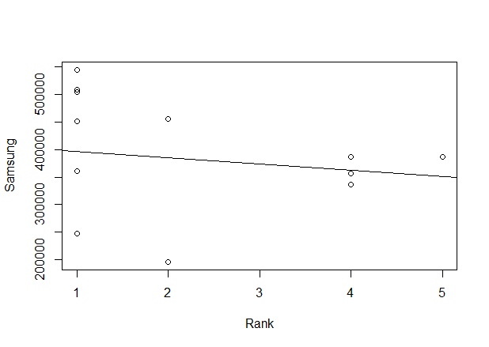
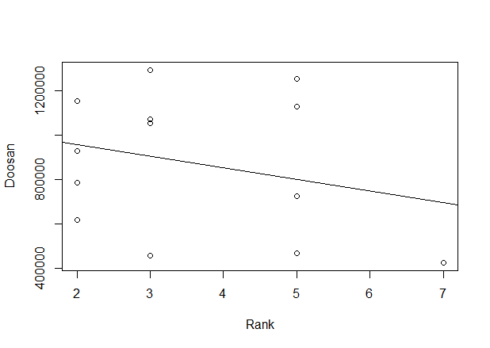
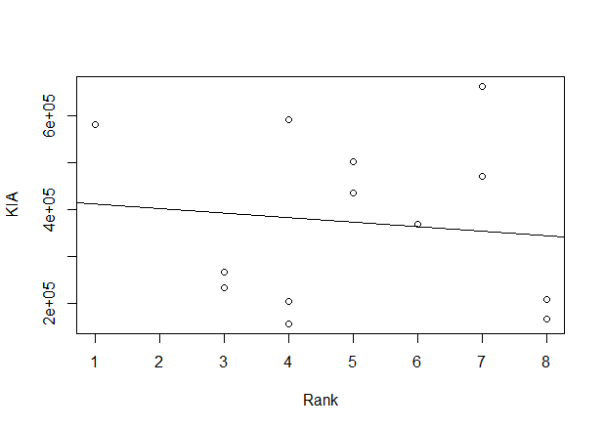
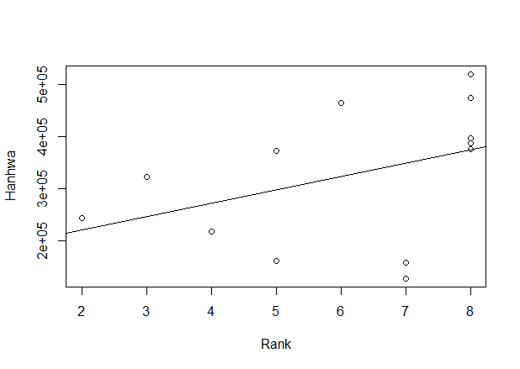
attendance with Rank

Slide 10
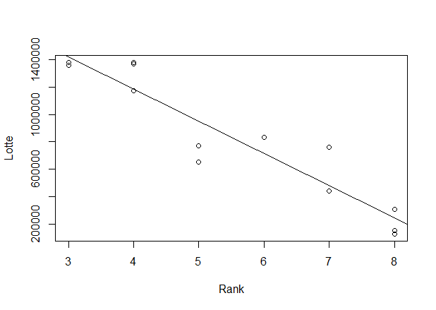
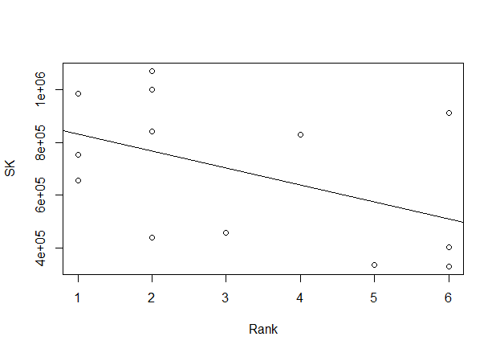
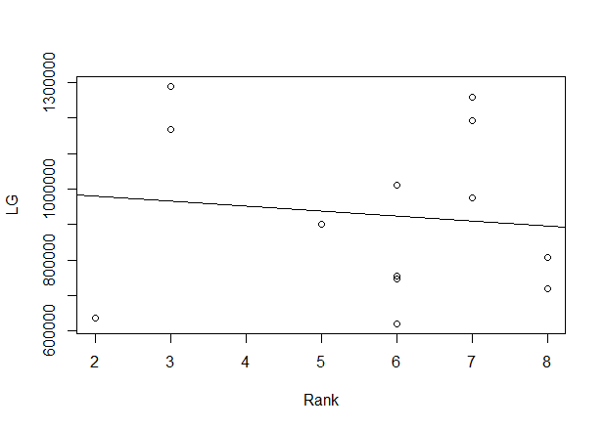
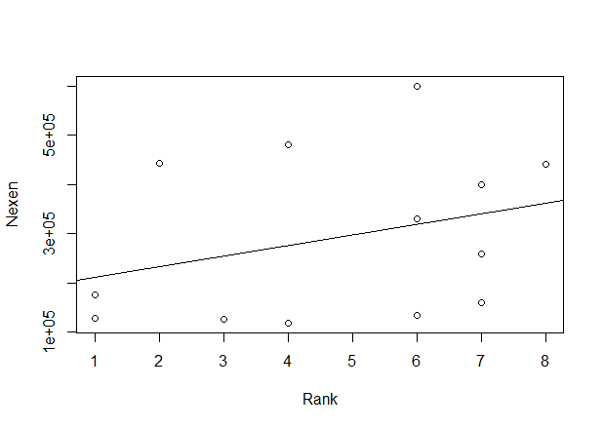
attendance with Rank

Slide 11
Null hypothesis
each team’s attendance and Rank, there is no correlation
Team | Cor | P-Value
Samsung | -0.1559318 | 0.611
Kia | -0.1144 | 0.7097
Lotte | -0.9396 | 1.869e-06
LG | -0.1142 | 0.7103
Doosan | -0.2684 | 0.3752
Hanhwa | 0.4112 | 0.0993
SK | -0.4770 | 0.0993
Nexen | -0.0181 | 0.9532
The correlation is not exist except Lotte

Slide 12
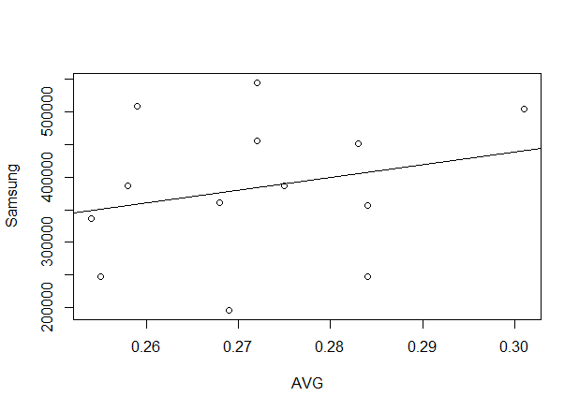
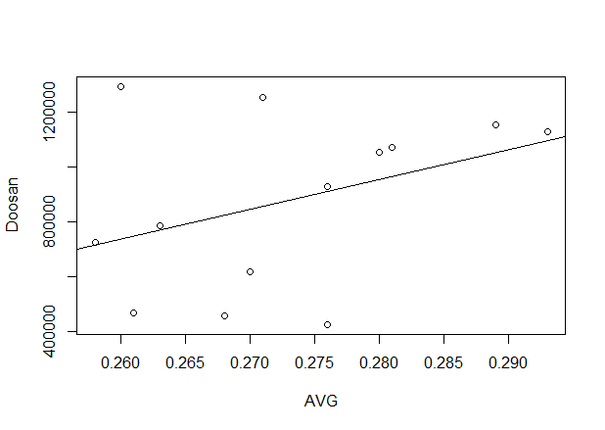
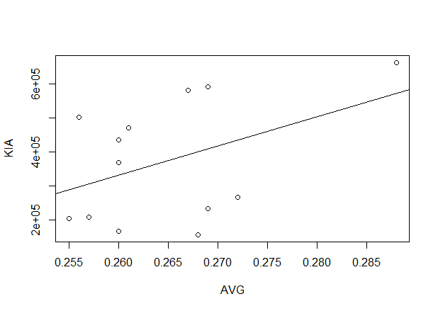
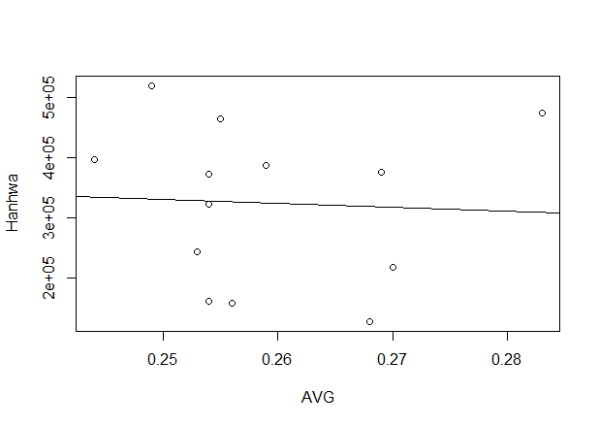
attendance with AVG

Slide 13
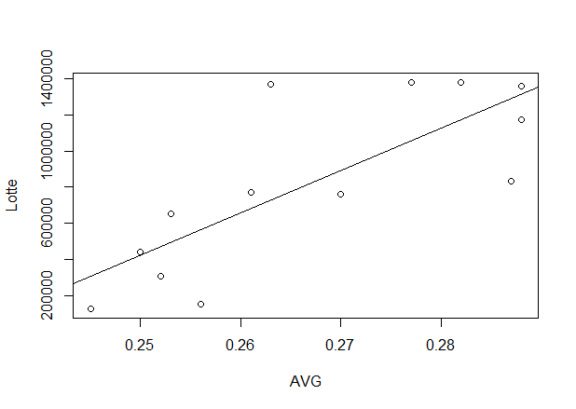
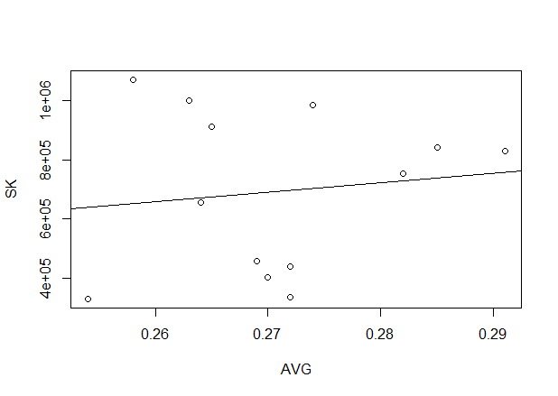
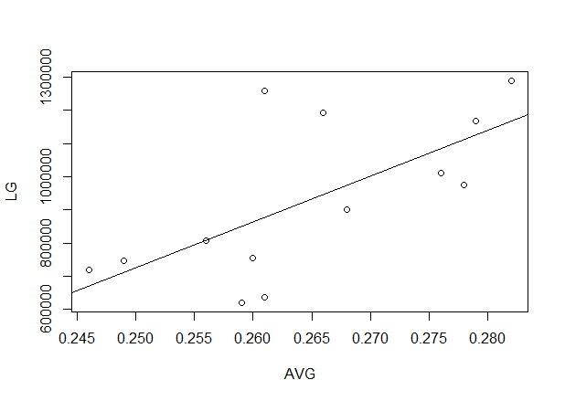
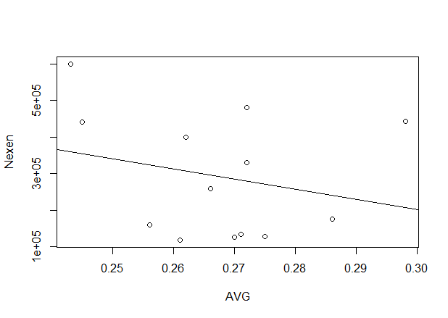
attendance with AVG

Slide 14
Null hypothesis
each team’s attendance and AVG, there is no correlation
Team | Cor | P-Value
Samsung | 0.2488 | 0.4124
Kia | 0.4286 | 0.1439
Lotte | 0.7779 | 0.0017
LG | 0.6650 | 0.0131
Doosan | 0.3825 | 0.1971
Hanhwa | -0.0521 | 0.866
SK | 0.1244 | 0.6855
Nexen | 0.5747 | 0.04
The correlation is not exist except Lotte,LG,Nexen

Slide 15
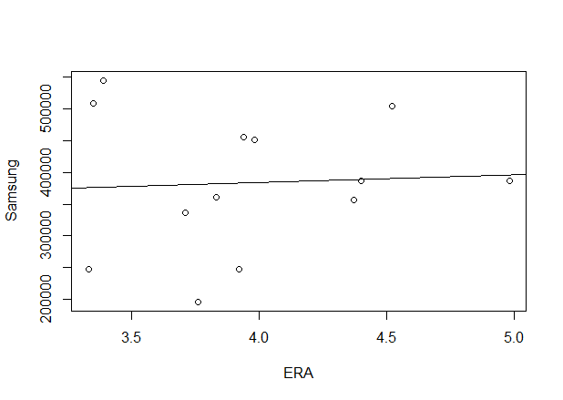
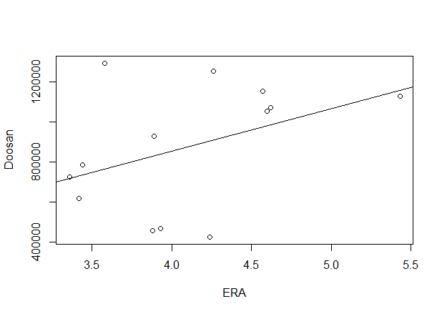
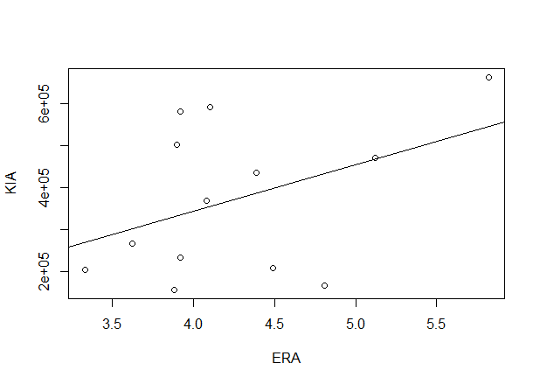
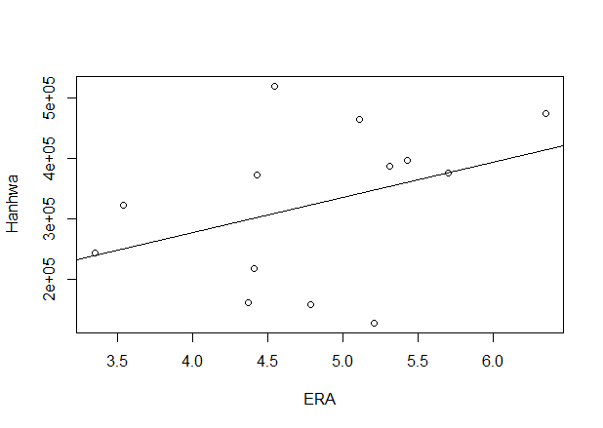
attendance with ERA

Slide 16
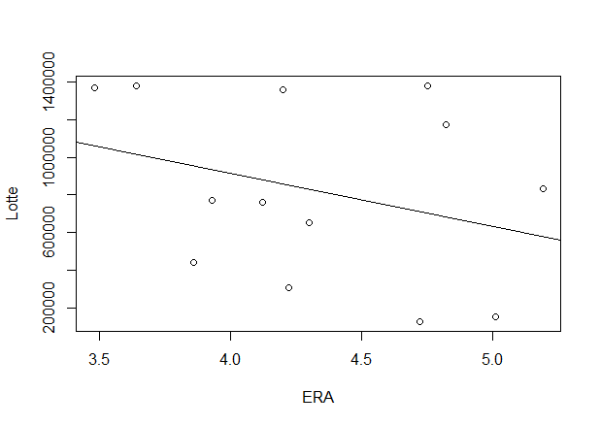
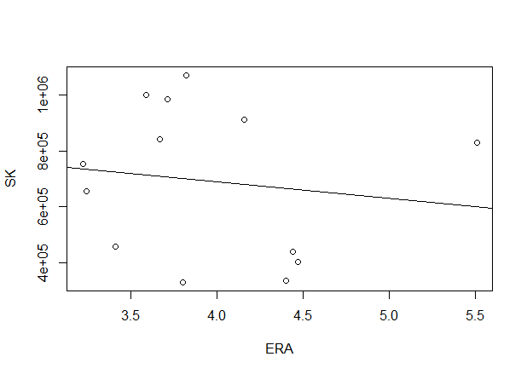
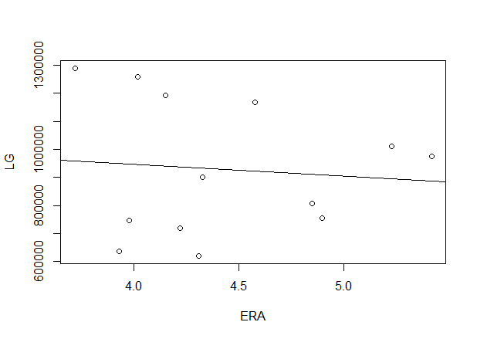
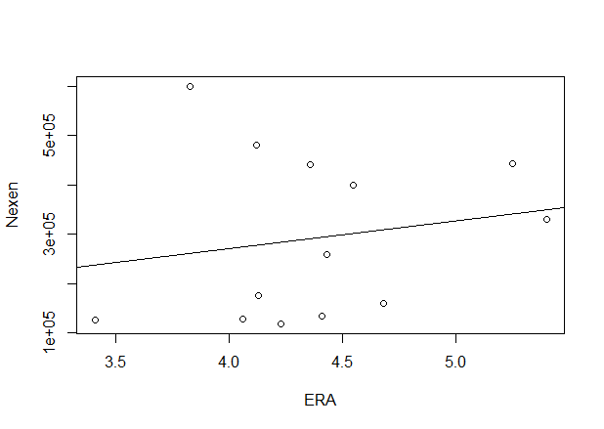
attendance with ERA

Slide 17
Null hypothesis
each team’s attendance and ERA, there is no correlation
Team | Cor | P-Value
Samsung | 0.058 | 0.8506
Kia | 0.4157 | 0.157
Lotte | -0.3141 | 0.296
LG | -0.0936 | 0.761
Doosan | 0.4118 | 0.1621
Hanhwa | 0.3704 | 0.2128
SK | -0.1382 | 0.6526
Nexen | -0.0207 | 0.9466
The correlation is not exist in all team

Slide 18
supplementation and modification
We need to increase the quantity of data
Reflection of hometown loyalty
ex) Hanhwa

Slide 19
Conclusion
The reason spectators come to baseball stadium is very complex and various
Team performance can affect to the attendance
It will show clearer correlation after the materials are stacked as time goes by

Slide 20
THANK YOU

