Slide 1
"flow": "http://127.0.0.1:28000/api/flow/",
"flow_dtl": "http://127.0.0.1:28000/api/flow_dtl/",
"api": "http://127.0.0.1:28000/api/api/",
"flow_job": "http://127.0.0.1:28000/api/flow_job/",
"check_job": "http://127.0.0.1:28000/api/check_job/",
"user": "http://127.0.0.1:28000/api/user/"
Local Test Environment
Flowmanager
( /api )
PORT:28000
Flask-Sample
Flow_initiator
( / )
API-Sample
/
PORT:17000
Sync
/
Service Dispatcher
( / )
/
/info
/tasks
Sync
/callback
/tasks/<task_id>
API.api_type
/callback_post
Async
/sync_tasks/<api_id>
PORT:19000
PORT:18081
Async
GET
Service async_receiver
( / )
/callback_tasks
POST
/callback_tasks/<api_id>
PORT:18082
PUT
DELETE
PORT:17000

Slide 2
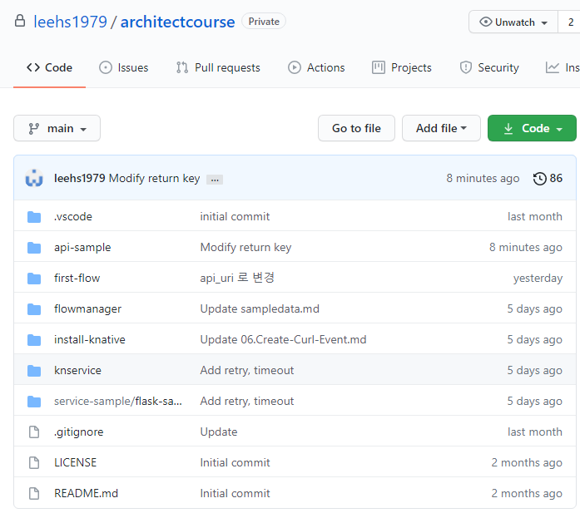
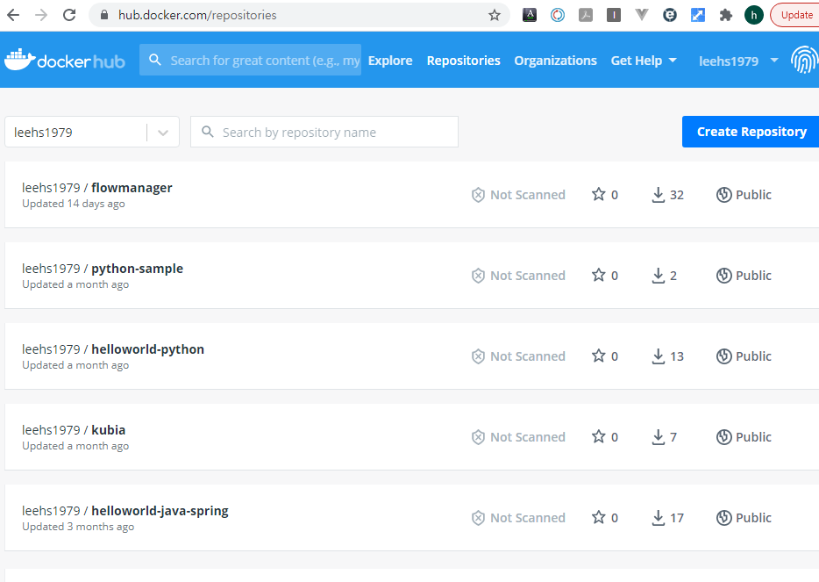
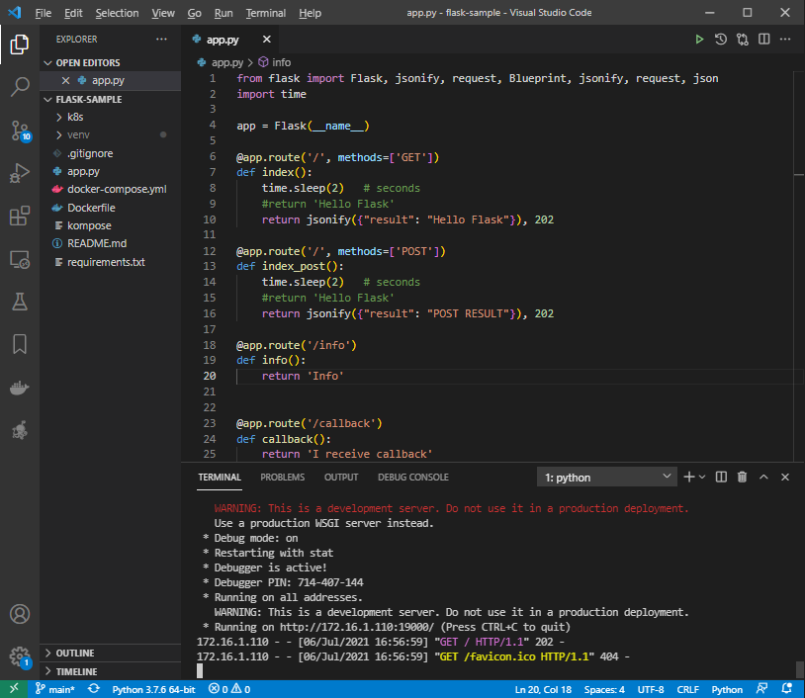
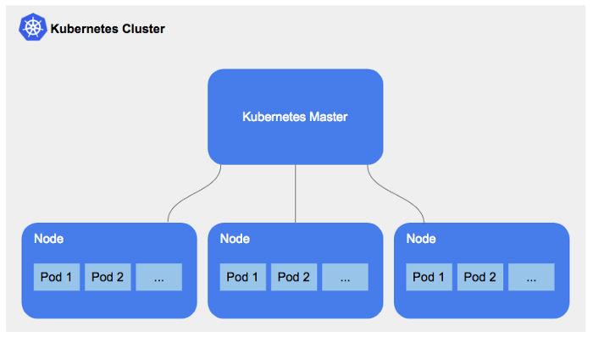
https://hub.docker.com/repository/docker/leehs1979/flowmanager
Run run.sh in deployment

Slide 3
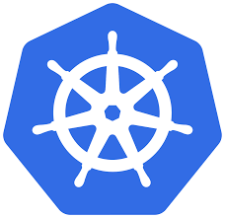

"flow": "http://34.64.115.117:28000/api/flow/",
"flow_dtl": "http://34.64.115.117:28000/api/flow_dtl/",
"api": "http://34.64.115.117:28000/api/api/",
"flow_job": "http://34.64.115.117:28000/api/flow_job/",
"check_job": "http://34.64.115.117:28000/api/check_job/",
"user": "http://34.64.115.117:28000/api/user/"
K8S Test Environment
Flowmanager
( /api )
PORT:28000
http://34.64.115.117:28000
http://34.64.134.132:19000/
http://34.64.68.166:17000
Flask-Sample
Flow_initiator
( / )
API-Sample
/
PORT:17000
Sync
/
Service Dispatcher
( / )
/
/info
/tasks
Sync
/callback
/tasks/<task_id>
API.api_type
/callback_post
Async
/sync_tasks/<api_id>
PORT:19000
PORT:18081
Async
GET
/callback_tasks
Service async_receiver
( / )
POST
/callback_tasks/<api_id>
PUT
PORT:18082
DELETE
PORT:5104
http://34.64.238.174:5104/

Slide 4
* GKE Resources

Slide 5
* Docker image build and push to repository using vscode extension

Slide 6
* Code-server (https://github.com/cdr/code-server)

