Slide 1

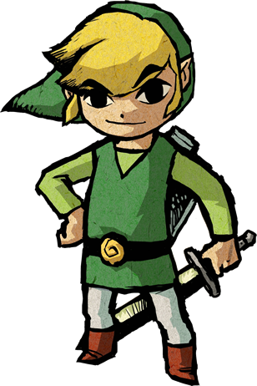

Mastering the Tri-force
Understanding the Exposure Triangle
Hain-Lee Hsueh

Slide 2

I saved you, and found this triangle thing.

Slide 3
Man, I got lost in these gnarly places and saw gnarly creatures! Should’ve seen them!

Slide 4
Pics or it didn’t happen. *giggle*

Slide 5
The Exposure Triangle
Shutter Speed
ISO
Aperture

Slide 6

Objective
Understand how each part of the triangle and combinations of settings affect the outcome of a photo.
How do I use this thing?
Shutter Speed
ISO
Aperture

Slide 7
Teaching Part
Create a concept map that organizes how to tweak settings
Adjustments for each desired effect
Adjustments satisfying each constraint
Each setting can be increased, decreased, or fixed
Multiple tweaks can be AND-ed or OR-ed

Slide 8
Example Partial Concept Map
Reduce noise
Decrease ISO
Maintain DOF
Fix aperture
Soft Waterfall Effect
Decrease shutter speed
Maintain sharpness
OR
Fix ISO
Increase exposure
AND
OR
Increase ISO
Decrease shutter speed
Increase shutter speed
Decrease ISO
Increase aperture

Slide 9
Assessment
Problem
Show given photo with suboptimal settings
List desired effects
List constraints needed to be satisfied
Answer
A list of actions (increase, decrease, fix) for relevant settings

Slide 10

Example Problem
I want to retake the photo so that
Background is less blurry (higher DOF)
Subject is brighter
But…
I don’t want to introduce additional noise
Answer:
Decrease aperture, decrease shutter speed, fix ISO

