Slide 1

Kinexpressions!
Learning Emotions through the Kinect
Prototyping Interactive Systems
CS 377i | March 14, 2012
Hain-Lee Hsueh, Anna Ly, Andrea Miller

Slide 2
Design Problem
Children with autism/ASD have difficulty understanding how other people feel and read non-verbal cues.
Our system endeavors to teach kids with autism about one particular form of non-verbal communication: Expressions!
overview
Notes:
Children with autism and other autism spectrum disorders have difficulty understanding how other people feel (empathy). One reason for this is an inability to read and interpret non verbal cues, which most people learn naturally and unconsciously / social situations. Our system is an endeavor to help kids with autism about one particular form of non verbal communication – facial expressions

Slide 3
Users
Young children (5-12 years) with mild to moderate ASD
Janie with mild autism
Has poor social skills; doesn’t like to be in groups
High functioning, excels in one talent
Normal motor functions
Therapists (occupational, speech)
Works with elementary students in a special needs school
Therapeutic center on weekend
SPED for 10 years
Familiar with assistive technology / Not fan of iPad
Prefers hands-on, pair activities
define
Notes:
Mild to moderate implies that the children who use our system must be able to function at a minimum level. They may have severe language delays or lack of refined motor skills but will need to have manageable control over his/her body. Common manifestations in children with autism include periods of time when they’re in their own little world as well as emphasis on fixed behaviors and routines, which sometimes translates to ritualistic behaviors
Originally we wanted to design something for interaction between multiple kids, perhaps more than 1 on the spectrum, but from interviews we decided to focus more on therapists and the work/activities they do with children on the spectrum. A couple also mentioned how difficult and complex it would be to have activities involving multiple children on the spectrum (e.g. most integrated play groups only have 1 child on the spectrum interacting with typically developing peers)

Slide 4
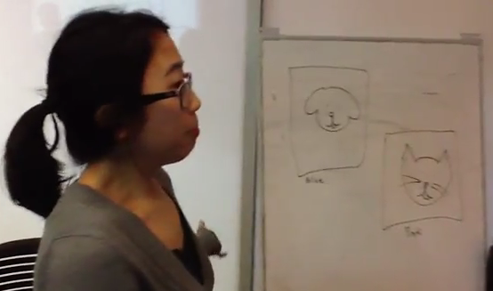
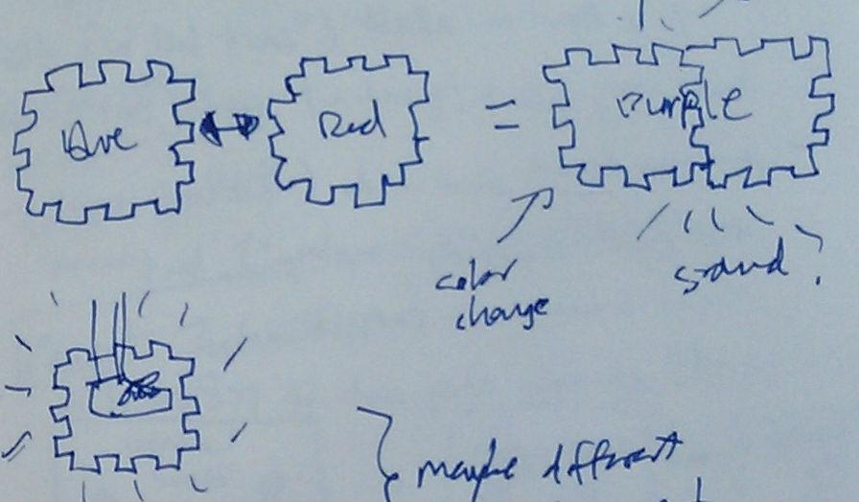
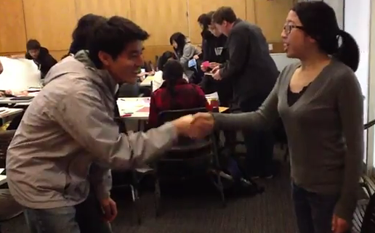
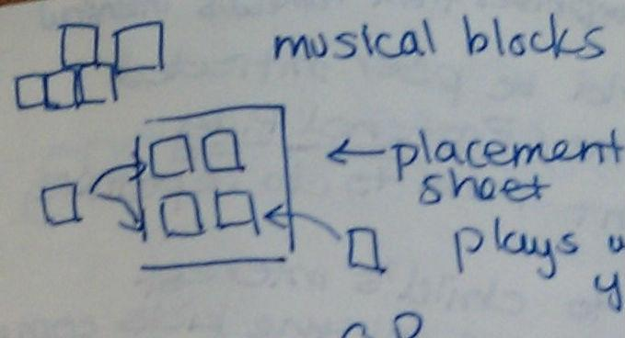
Ideation: Initial Design Concepts
Facilitated Group Story Creation
(video)
Color-changing Tiles
Interactive Social Story Quest
Music Generation with Blocks (video)
Initial brainstorming
Notes:
Facilitated Group Story Creation
A screen displays various objects to kickstart brainstorming and facilitate turn-taking. (video)
Music Generation with Blocks
Blocks that generate a sequence of sounds based on how they are positioned relative to each other. (video)
Color-changing Tiles
Interactive blocks or tiles that can change color depending on what tiles are connected to it.
Interactive Social Story Quest
Navigate through a virtual quest by performing appropriate social interactions with characters in the game.
Reasons why we chose to go with what we’re doing
Interviews geared towards emotion
Most of these ideas exist already (music blocks, facilitated story creation, computerized blocks)
We wanted to explore an area that was new and we were not as aware of it
Kinect at Lakeside – research that it is proven to help autism

Slide 5
Interviews
“One kid once came up really close to me and said, ‘It’s nice to meet you!’ and I had to back away to let him know that he was standing too close.”
re-define
Notes:
Hope Technology School ATL staff / Sandra, Erlinda, Jen, Maisa & Associated Language and Learning Specialists / Michelle Fong
Proximity
Hula hoops – one kid stood right up against the edge instead of staying in the center.

Slide 6
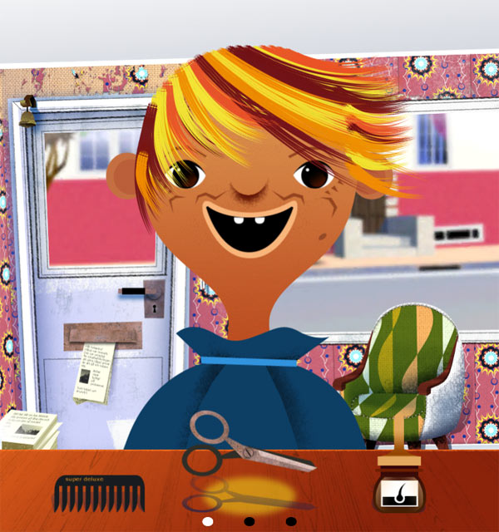
Interviews
“Let him get his hair cut, not me.”
re-define
Notes:
Identification and connection
Example with Toca Boca salon
On child did not want to get his haircut – tried to use the app to get him familiar with what happens at a barber shop, hopefully to make him less anxious about it
But at the end of it, he still did not want to go.

Slide 7
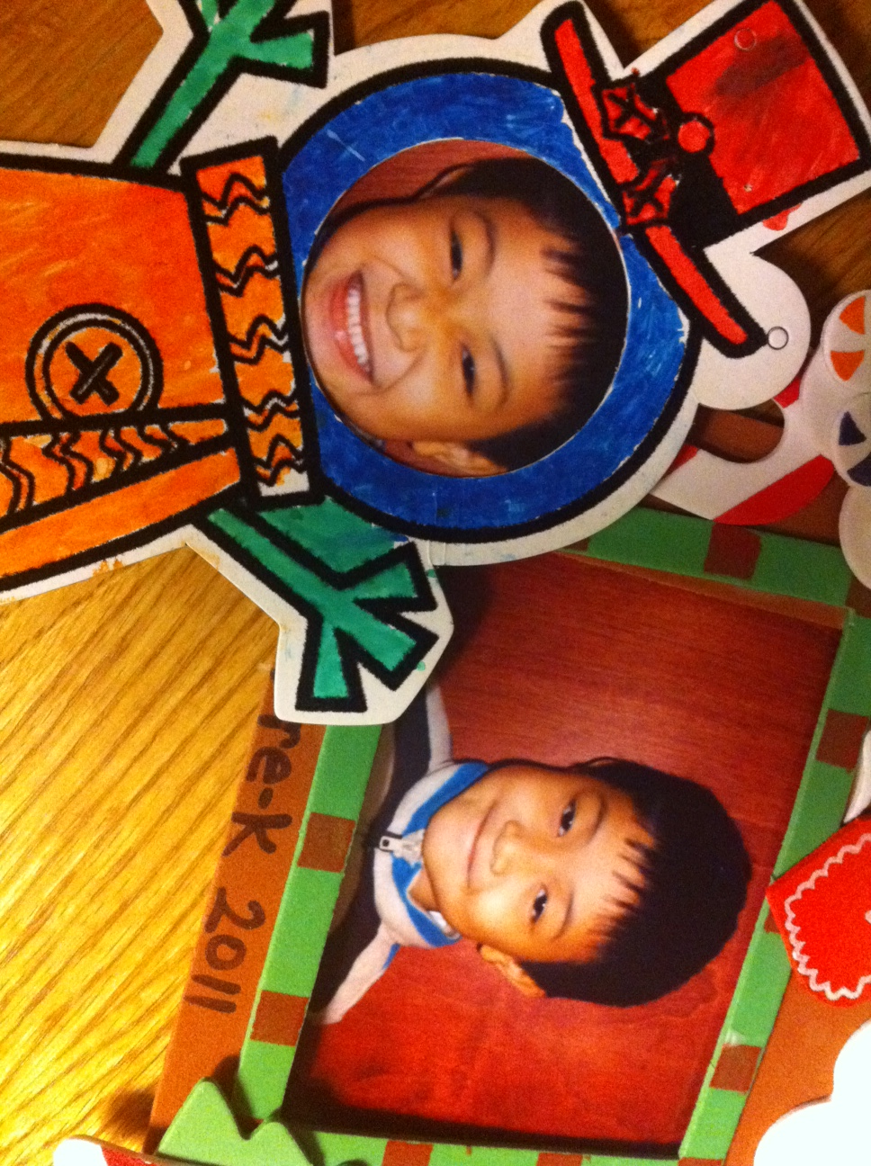
Interviews
“I continue to see his strange smiling face when he is cued to smile to the cameras.”
re-define
Notes:
Concerning facial expressions
- Difficulty expressing emotions
Kids need to both express emotions and recognize them in themselves
They don’t necessarily automatically show what they’re feeling; if they’re sad, they don’t necessarily make a sad face.
This also relates to identification of self and transferring to others

Slide 8
Statement of Need
5-12 year old children with mild to moderate autism
need to develop empathy and emotion expression
because failing to do so may lead to delayed social development and social isolation.
re-define
Notes:
Wanted to help kids learn empathy through recognition of emotions in themselves and in others.

Slide 9
Design Concept
Core Concept
Teaching and practicing emotions through facial & gestural recognition and expression using the Microsoft Kinect.
Uniqueness
Goes beyond recognition
Dynamic data
Collaboration with another
refine
Notes:
Kinect activity to help teach kids with autism empathy through emotions and facial expressions
Goes beyond recognition by having the child practice and interact – become familiar with the emotion more personally
Dynamic , user-generated data that is personal to the therapist vs. other solutions that rely on a large but static set of information
Thus, our solution is not a replacement for existing solutions, but more like a supplement that more actively engages the child
Flexibility for co-adaptation; therapist can use the data for any purpose
Interaction of the activity meant to facilitate social interaction, conversation and collaboration – many iPad apps are single player focused
Key design space dimensions: Social skills/etiquette, awareness and reading emotions
Lots of room when defining a “good emotion” capabilities of the Kinect too

Slide 10
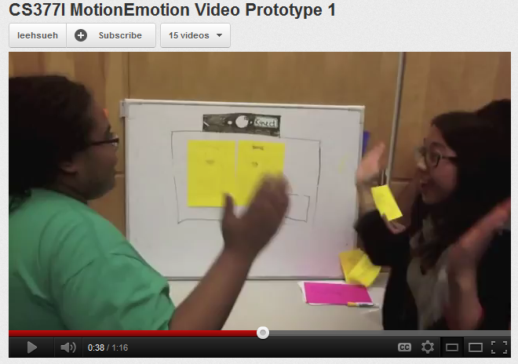
Initial Video Prototype
http://www.youtube.com/watch?v=QC4-Bfd2wZk
refine
Notes:
Design Scenario that we built:
Date / Time: Wednesday, 3:00PM Setting: Group therapy session after school Summary: The session is focused on training Janie on reading and expressing emotions Personas: Janie and Cathy (sisters, 10 and 11 respectively), Behavior therapist Dave [Pulled from user scenario] Dave has been using a tablet app to help Janie learn how to read emotions by providing digital flash cards with sample facial expressions. The app presents a card along with multiple choices that Janie can choose from. Janie has shown improvement in terms of choosing the right answers in the app, and breezes through a series of tests during the first 10 minutes of the session.
In the next part of the session, Dave wants to teach Janie how to express emotions. Although Janie can use the app to express her emotions, she still needs to learn how to express them physically.
In the next part of the session, Dave wants to teach Janie how to express emotions. Although Janie can use the app to express her emotions, she still needs to learn how to express them physically. He turns on the Kinect console. Eager that the video game console is on, tech savvy Janie and Cathy both run over to see what is going on. Inside the Kinect console is the game MotionEmotion (Name may change...). The game appears on the screen and has a friendly colorful prompt asking for the players to wave to start and join the game. Janie and Cathy both wave, Cathy a little bit more enthusiastically. Cathy selects the Emotion Matching Bear game for her sister. The game then asks them to each choose a character by standing opposite the character on the screen. Cathy and Janie negotiate who is going to be which character. Janie wants to be the baby bear and stands opposite the baby bear that is on the screen. Cathy then chooses to be the mama bear. The game asks them to clap once when their characters are chosen. Janie claps loudly and the game starts.

Slide 11
Feedback / Results
Emphasis on realism*
Focus on empathy – emotion in context*
Collaboration
Camera as a reward
Variety of stories
Flexibility
refine
Notes:
WALKTHROUGH RESULTS
Emphasis on realism – needs to be extremely salient to user so real faces instead of bears
Focus on empathy – emotion in context – Can’t be just straightforward mimicking; need to relate to situations they understand and put the emotions into context so they understand how to transfer it / See their face mimic the model face rather than just see the model face so they can monitor how well they match / Need to involve them more
Minimum level of cognitive functioning
Collaboration – Nice that another child or a therapist can be involved / both hands must be on the object
Scaffolding (prompts & voice) – Maybe have additional prompts for children who are on the more moderate than mild end; voice and text prompts must be salient and clear / Need to point out who Anna is
Animations as a reward – Kids love animations so having it just as the reward is fun for them – or at least letting them take a picture of themselves
Variety of stories – Kids will get bored just from one story ; maybe have videos that the kids like themselves so Shaun the Sheep
Involving the user –
Flexibility – coadaptation – so we didn’t showcase this in our video prototype but we are planning on building this in more – so allowing the therapists to add their own videos / dynamic data – being able to observe over time (monitoring and not just training)

Slide 12
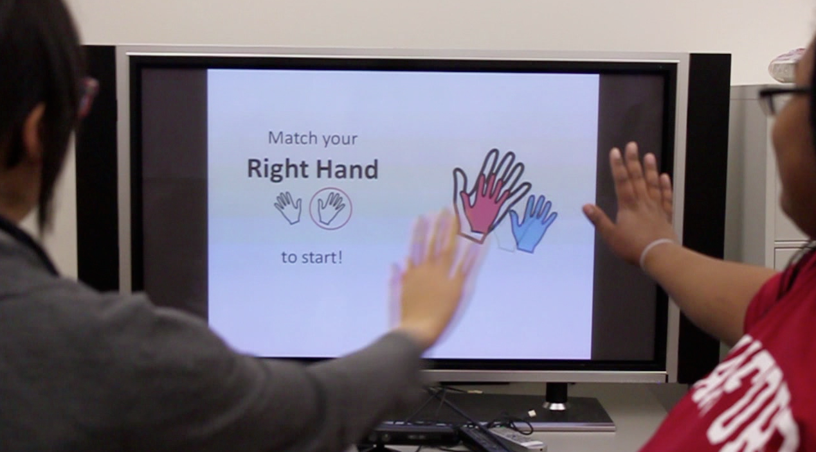
Final Video Prototype
http://www.youtube.com/watch?v=SdbgAEY3zh0
refine
Notes:
kineXpressions
The product that we are designing is a game that teaches children with autism to learn facial expressions. Unlike other applications on the market, the children will have to express the proper emotions to proceed through the game emotions. They will also be able to see themselves in real time matching the facial expressions and thus, be able to change it in real time. Furthermore, the game will scaffold the child to eventually learn the expressions for corresponding social contexts and not just the emotions themselves.

Slide 13
Next steps
Participatory Design Workshop
Assistance from Wendy
1 day in the d.School with therapists and parents
Relationship & Issue maps, Critical incident interviews, User Scenarios, Cultural probes
Build and test
Partnership with Microsoft Kinect development team & Developmental Pathways
Submitted idea to Microsoft Kinect Challenge
Obtaining IRB for project
status

Slide 14
Thank you! Questions?
Thank you to Developmental Pathways & ALLSINC for providing us the opportunity to user test!
Anna Ly (akly@stanford.edu), Hain-Lee Hseuh (leehseuh@stanford.edu), Andrea Miller (ammile9@stanford.edu)
Notes:
Looking forward with our curriculum, we are continuing to work with the Monterey Bay Aquarium to share the curriculum with teachers at their Teacher Institute this summer and hope that it will be implemented in schools next year.

