Slide 1
Conceptual Understanding of the Internet
Hain-Lee Hsueh
EDUC 328X

Slide 2
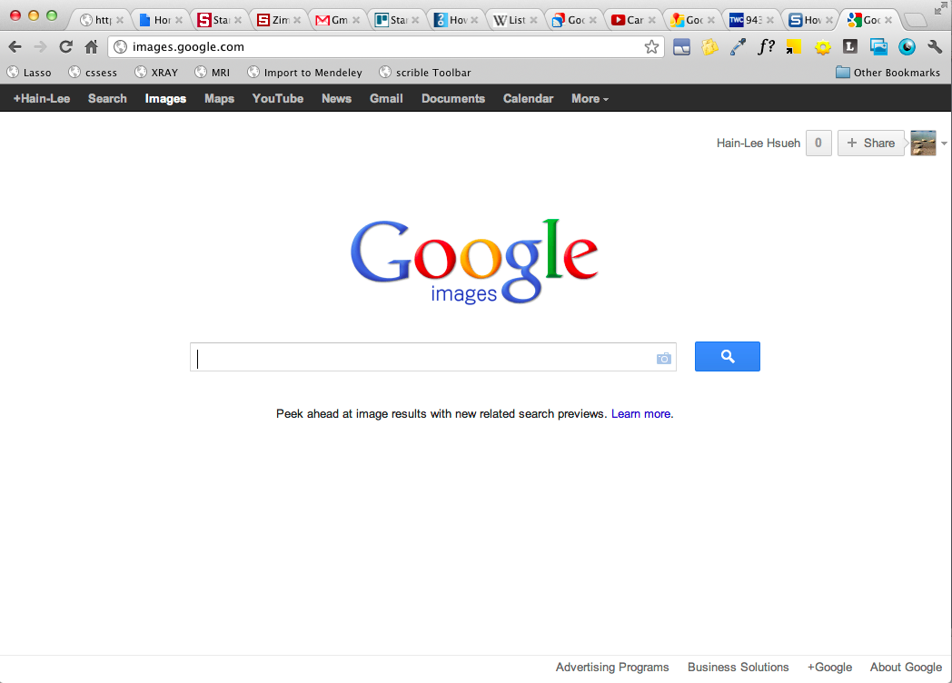
First: How does data travel on the Internet?
Internet

Slide 3
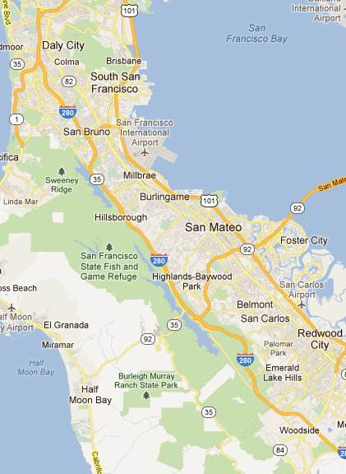
US Postal System
South SF
Each office manages a local “network of places”
How does a letter get from Stanford to South SF?
USPS is a network of “place” networks
Stanford

Slide 4
The Internet
Place = a computer
Post office = router
A router manages its local network of computers
The Internet is a…
network of computer networks
Why is it called the
“Inter - net?”
Notes:
Internet = INTER-connected NET-works

Slide 5
What happens when I “go to a website?”

Slide 6
Consider a large lecture…
This is Bob
Alice
Bob wants her #
Digits please
My #
Seat A3
Seat H12
Creeper with the seating chart
Notes:
You decide to pass a note, asking for her #. You know her name, but not exactly where she sits.

Slide 7
Accessing a Website
Client
request
Browser
f
Domain Name
facebook.com
Server
response
69.171.229.11
IP address
DNS
Notes:
Lets say you want to go on facebook.

Slide 8
Can you map the objects/entities between the lecture hall and the Internet?
Alice
Domain Name
Request
Digits please
Response
My #
Client
Part of the Internet
Server
Seat A3
Seat H12
IP address
DNS
Notes:
Have students recall on piece of paper

Slide 9
Sometimes things don’t work out
What might cause delays?
What might cause these errors?
Error 404: Not Found
Error 403: Forbidden
Error 503: Service Unavailable
“Oops! Google Chrome could not find …”
FYI:
Error 4xx means issue with client
Error 5xx means issue with server

Slide 10
What could go wrong?

