Slide 1
Tennis Racquets
Contrasting Cases
Hain-Lee Hsueh

Slide 2
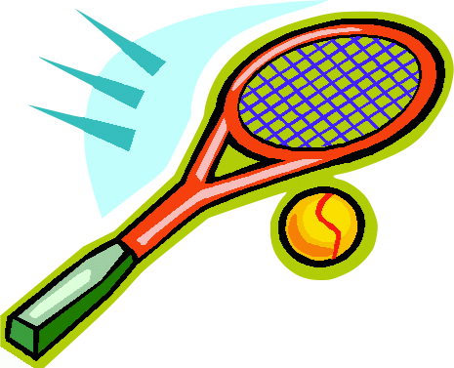
This is a tennis racquet

Slide 3
Some Dimensions
Head Size (sq. in.)
Midsize: 80-93
Midplus: 95-98
Oversize: 102-140
Weight Distribution
Head-heavy (HH): < 0
Balanced: ~0
Head-light (HL): > 0
Other Dimensions
Stiffness
String Pattern
open (sparse)
closed (dense)

Slide 4
Rough Power Relationships
Head Size | Weight Distribution
Stiffness | String Pattern
Power
Power
Head Size (sq. in.)
HH
Weight Distribution
HL
80
140
Power
Power
45
Stiffness
80
16x18 (open)
String Pattern
18x20 (closed)
In general, there is a trade-off between power and control.

Slide 5
2-D Gradient
Head Size
140 sq. in.
More Power
Less Power
90 sq. in.
very HH
Weight Distribution
very HL

Slide 6
Contrasting Cases
Which racquet is more powerful?

Slide 7
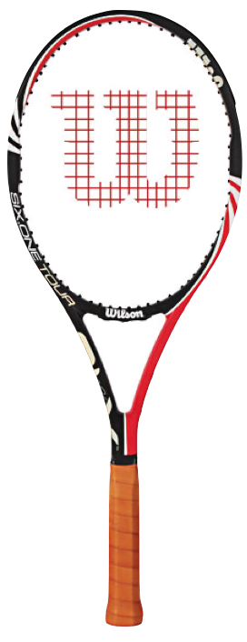
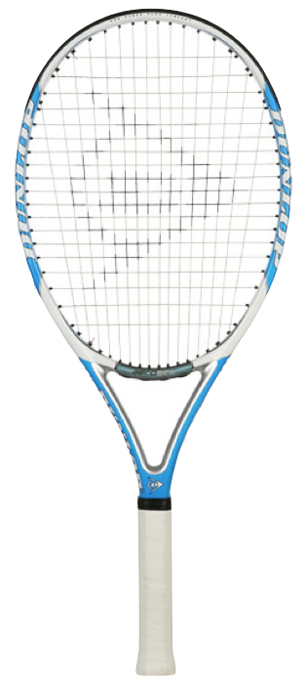
Head Size | 90 sq. in.
Weight Distribution | +9
Stiffness | 65
String Pattern | 16x19
Head Size | 118 sq. in.
Weight Distribution | -7
Stiffness | 69
String Pattern | 16x19

Slide 8
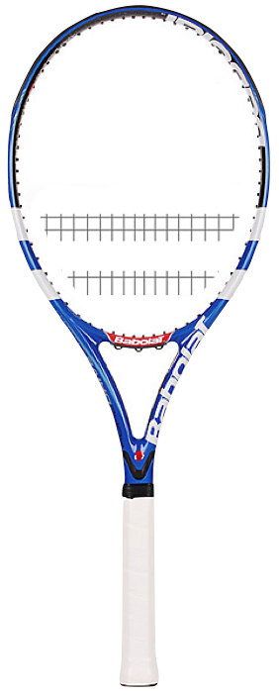

Head Size | 118 sq. in.
Weight Distribution | -7
Stiffness | 69
String Pattern | 16x19
Head Size | 100 sq. in.
Weight Distribution | +6
Stiffness | 70
String Pattern | 16x19

Slide 9
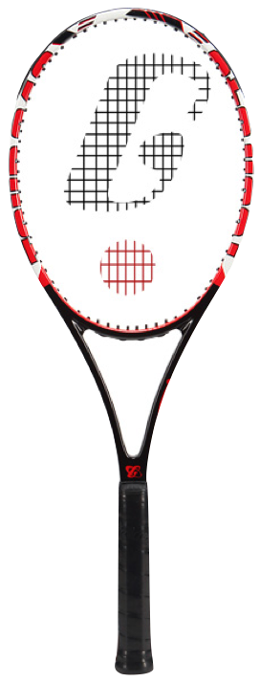
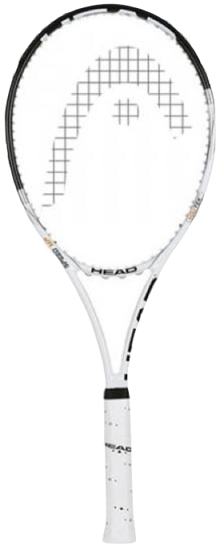
Head Size | 93 sq. in.
Weight Distribution | +7
Stiffness | 65
String Pattern | 18x20
Head Size | 100 sq. in.
Weight Distribution | +7
Stiffness | 65
String Pattern | 18x20

Slide 10
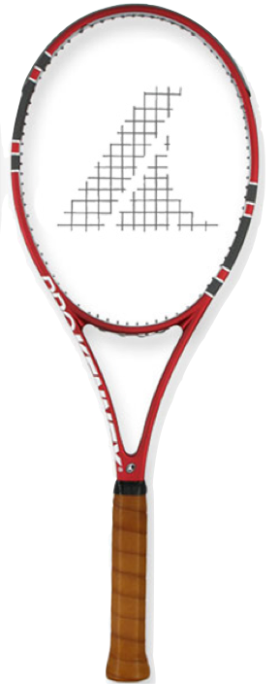
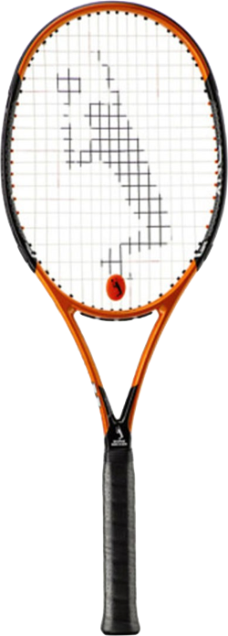
Head Size | 93 sq. in.
Weight Distribution | +8
Stiffness | 60
String Pattern | 18x20
Head Size | 93 sq. in.
Weight Distribution | +8
Stiffness | 60
String Pattern | 16x19

