Slide 1
Emotionary!
Learning and Applying Emotions
Assistive Technology
ENGR 110 | 210
Anna Ly | Hain-Lee Hsueh
Emotionary!
Assistive Technology
ENGR 110 / 210
Final Presentation

Slide 2
Emotionary!
Emotionary! is an iPad application that teaches children with autism about empathy and emotions through video scenarios and facial expressions.
background

Slide 3
Background
Problem
Children with autism or similar mental disorders have difficulty with social interactions as manifested by the following:
Use of nonverbal behaviors (ex. facial expressions)
Lack of social or emotional reciprocity
Lack of empathy
User Population
1 in 110 American children are on the autism spectrum
background
Notes:
Both of us have personal and emotional ties to the autism space. Together, we wanted to explore how we could design educational tools for children with autism spectrum disorders.

Slide 4
Empathy - Key Takeaways
Making facial expressions is extremely difficult for the children
They cannot grasp social cues (ex. proximity)
In-person communication is a problem: don’t answer or freeze up
empathy
Notes:
Usually overexaggerate or underexaggerate so it is unnatural or unexpressive
Applications are angular and look robotic
Sandra: “One kid once came up really close to me (*stands up against another staff member to illustrate) and said, “It’s nice to meet you!” and I had to back away to let him know that he was standing too close.”
"Communication is a major problem...when I ask him a question, he often doesn't answer it and just says whatever happens to be on his mind at the moment."
Although they may know exactly what to do, communication in person especially to strangers is extremely hard
Kids sometimes get attached to negative feedback

Slide 5
Statement of Need
5-10 year old children with autism need to recognize and express both emotions and social nuances because failing to do so may lead to social isolation as well as delayed cognitive and social development.
define
Notes:
we talked to various types of therapists (occupational, physical, and speech-language), and a common area that all of them work on is participation in social contexts.
a large part of behaving in an appropriate manner is understanding how others around them feel. one reason for this is because they cannot read emotions from people's facial expressions. even if these kids can recognize emotions, they may not know how to express them themselves (they do not necessarily automatically show how they feel on their face like typically developing peers do), which contributes to lack of reciprocity in social interactions. this in turn leads to the kids appearing as awkward or weird in social contexts. a large part of therapy is to help these children act in a way that is more natural.

Slide 6
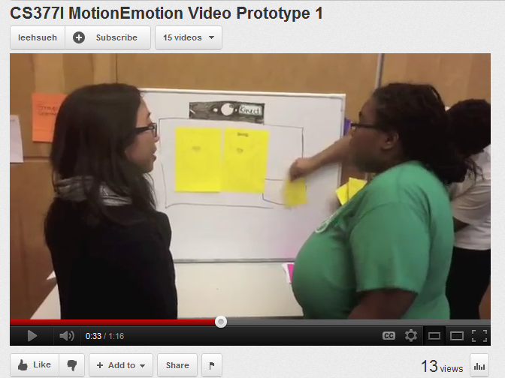
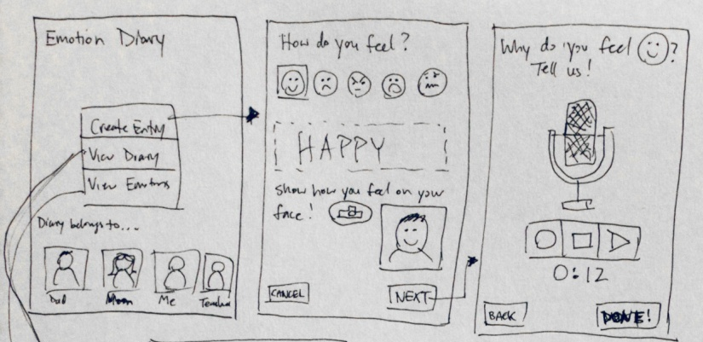
Ideation: Design Concepts
KinExpressions!
Emotion Diary:
ideation
Notes:
Facilitated Group Story Creation
A screen displays various objects to kickstart brainstorming and facilitate turn-taking. (video)
Music Generation with Blocks
Blocks that generate a sequence of sounds based on how they are positioned relative to each other. (video)
Color-changing Tiles
Interactive blocks or tiles that can change color depending on what tiles are connected to it.
Interactive Social Story Quest
Navigate through a virtual quest by performing appropriate social interactions with characters in the game.

Slide 7
Selected Design: Emotionary!
Core Concept
Empathizing with characters and expressing emotions with facilitators (therapists, parents) using the iPad.
Activity Procedure
The child
Watches a video
Identifies the emotion
Expresses the emotion with his/her face
Photos are saved and cataloged
refine
Notes:
What happened to kinexpressions?
Soon after midterm presentation we realized it was too ambitious given time and technical constraints
If there’s time and people have questions, they can ask more about it at the end
We realized we were getting bogged down with technical implementation; lose sight of the idea/concept development
We were already considering prototyping the concept as a mobile app anyways, so we decided to pursue that as a deliverable
Emotionary
Goal: help kids develop empathy through emotions
Design activity meant to be guided/facilitated by the therapist or parent
Child watches a video illustrating some kind of situation – they need to pay attention to one character (the character to empathize with)
After the video is done, the child is asked how the character feels
After the emotion is successfully identified, the child needs to express the emotion using his/her face
His/her picture is taken and saved and cataloged

Slide 8
Emotionary!
Key Benefits and Advantages
Goes beyond identification
Dynamic data
refine
Notes:
Has elements from existing solution: video situations, concept of a repository of data for each emotion, leveraging iPad
Goes one step beyond identification
Existing solutions focus on identifying emotions from pictures or video
Our app has that component, and goes one step further by having the child by practice expressing the emotions.
Dynamic data
Existing solutions are very interactive but depend on a fixed static set of information
Using the iPad our app can give users opportunity to generate data, creating a dynamic collection of information
This leads to a more personalized experience.
The data is personalized; the child can learn not just from others, but from himself and from people he/she is familiar with
Potential for co-adaptation; can imagine therapists or parents using this localized data to facilitate other kinds of activities with the child; personalized data can translate to more meaningful information

Slide 9
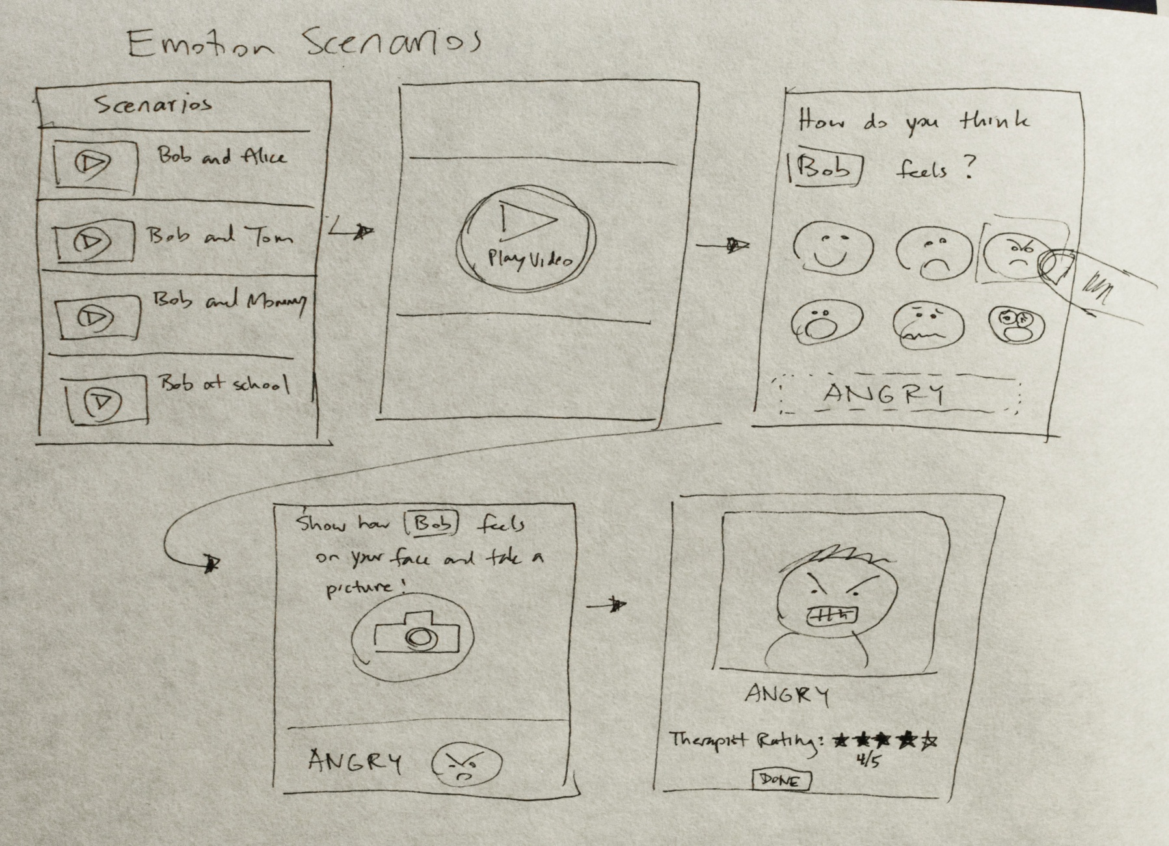
refine
Notes:
Rough storyboard that we used to pitch our ideas to a couple therapists. The response was positive and gave other advice/suggestions and considerations.

Slide 10
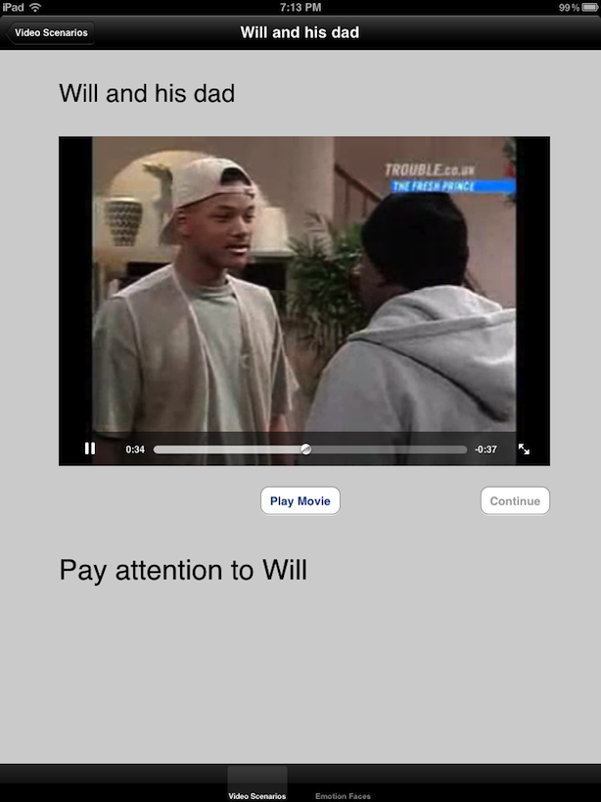
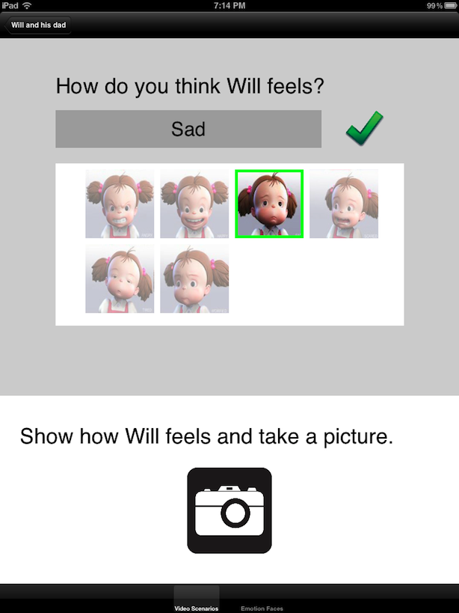
refine
Notes:
These are screenshots of the prototype in early but partially functional stage of development. I actually performed a short user test with one child when the app was in this form.

Slide 11
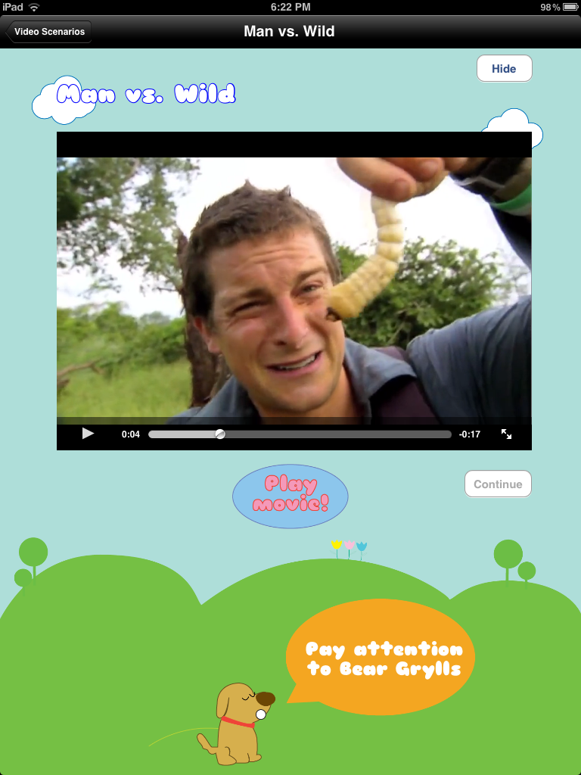
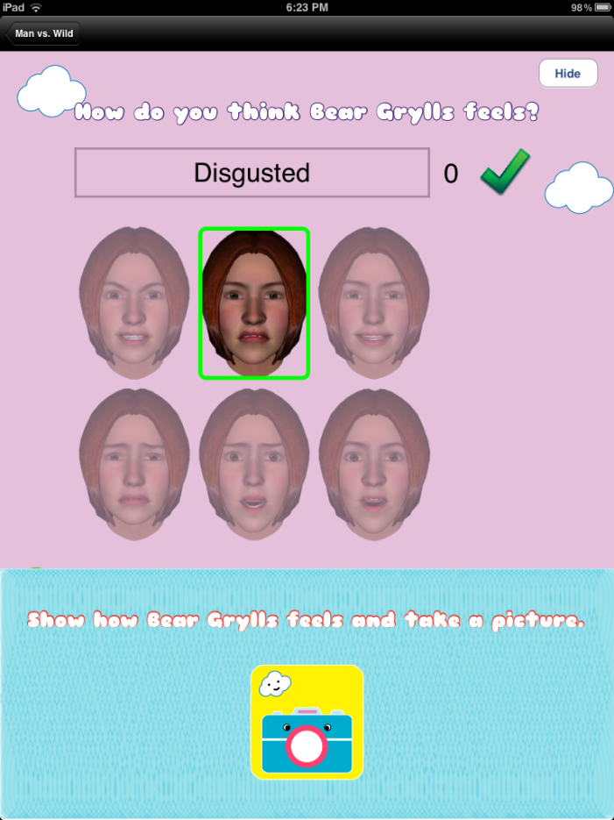
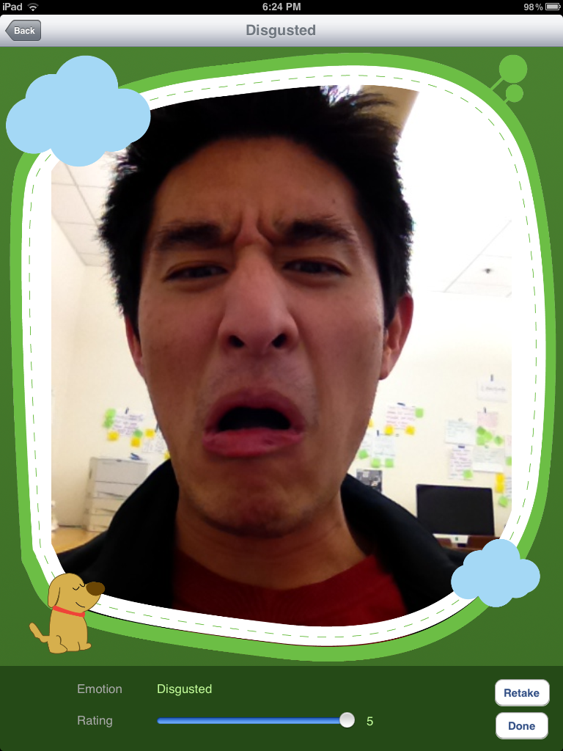
refine
Notes:
This is the app with kid-friendly illustrations; performed most user tests when the app was in this form

Slide 12
Demo!
demo

Slide 13
User Testing
[images removed]
Arbor Bay School in San Carlos
user testing
Notes:
We were able to get users to install the app on their own devices.
These are photos of the app being demonstrated in a class at the Arbor Bay school, which serves kids with language delays.

Slide 14
User Testing
[images removed]
Developmental Pathways for Kids
user testing
Notes:
We were able to get users to install the app on their own devices.
These are photos of the app being demonstrated in a class at the Arbor Bay school, which serves kids with language delays.

Slide 15
Future Work
Challenges
Making it fun!
Assessment of learning
Increased personalization
Activities that leverage collected data
status
Notes:
First challenge: how can we make the app more fun for kids? Compared to games, our app doesn’t seem exciting. The most fun part is taking a picture.
Second challenge: how can we tell whether it’s effective? How can we tell learning is happening?

Slide 16
Thank You!
Notes:
Increased personalization: this is our key benefit so we want to further develop it
Allow users to add their own videos
Categorization by child
Activities that use the data we are collecting (ex. studying two faces at the same time, build communication system)
Extension to the Kinect: for both facial and gestural movement

