Slide 1

My agent
workbench
Making things with AI.
Keeping enough evidence to trust them.
John Lee
AI & Ales · Jamestown Frontier Society
October 15, 2026 · Billsburg Brewery
Notes:
20 seconds
I'm John. I work on research software at Dartmouth's Center for Open Neuroscience. I use coding agents to build software, explore ideas, and prepare talks. Here are a few things I've made, connected by one question: what would let another person understand an agent's work and trust it?
Sources:
https://leej3.github.io/software-engineer-reborn/

Slide 2
The tools around my agent
Codex
A working partner in my projects, files and terminal
Skills + Markdown
Reusable instructions and decisions that survive a chat
Git + worktrees
Separate experiments, inspect changes, recover a state
Pixi + DataLad
Recover environments and connect data to the work
My skill workshop
Worktree tools
Execution records: duct
Notes:
35 seconds
Codex works with my actual project files and terminal. Skills are reusable instructions, while Markdown keeps the goal and decisions visible. Git records changes, and worktrees keep separate experiments from mixing together. Pixi describes the software environment, and DataLad connects data and code with their history. When I need execution records, duct captures what a command did. These tools give the agent something concrete to act on, and give me something concrete to check. My skill workshop and worktree utilities are linked here.
Sources:
https://github.com/leej3/software-engineer-reborn/tree/main/talk-concepts/06-the-ai-era-development-environment.md
https://github.com/leej3/skills-workshop
https://github.com/leej3/stamped-ai-research/tree/codex/stamped-poster-study

Slide 3
Keyhatch
Selective credential access for agents
Approve selected credentials once.
Allow repeated retrieval within a limited window.
Native macOS app + local command-line client
Expiry stops future retrieval. It cannot recall a disclosed secret.
Project + source
Design and limits
Experimental build
Notes:
35 seconds
Keyhatch tackles a very practical interruption: an agent needs a credential to do useful work. I'm building a native Mac app where I approve selected credentials once, then allow repeated retrieval during a limited window. Apple Passwords remains the source of truth, with selective import into Keyhatch. A local command-line client connects the agent to the broker. The important tradeoff is that a recipient can keep a disclosed secret. Expiry stops future retrieval; it cannot take that secret back. It's an experimental project with public source. Production signing and release validation remain unfinished.
Sources:
https://github.com/leej3/keyhatch
https://github.com/leej3/keyhatch/blob/main/SECURITY.md
https://github.com/leej3/keyhatch/blob/main/docs/DISTRIBUTION.md

Slide 4
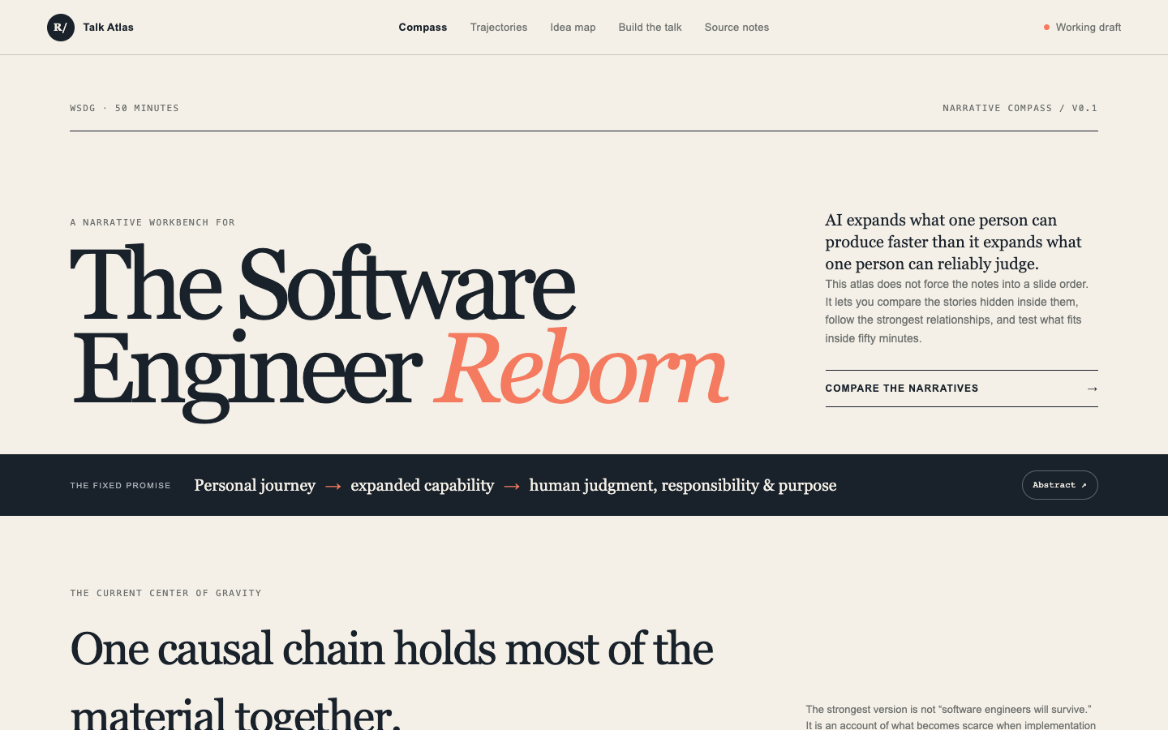
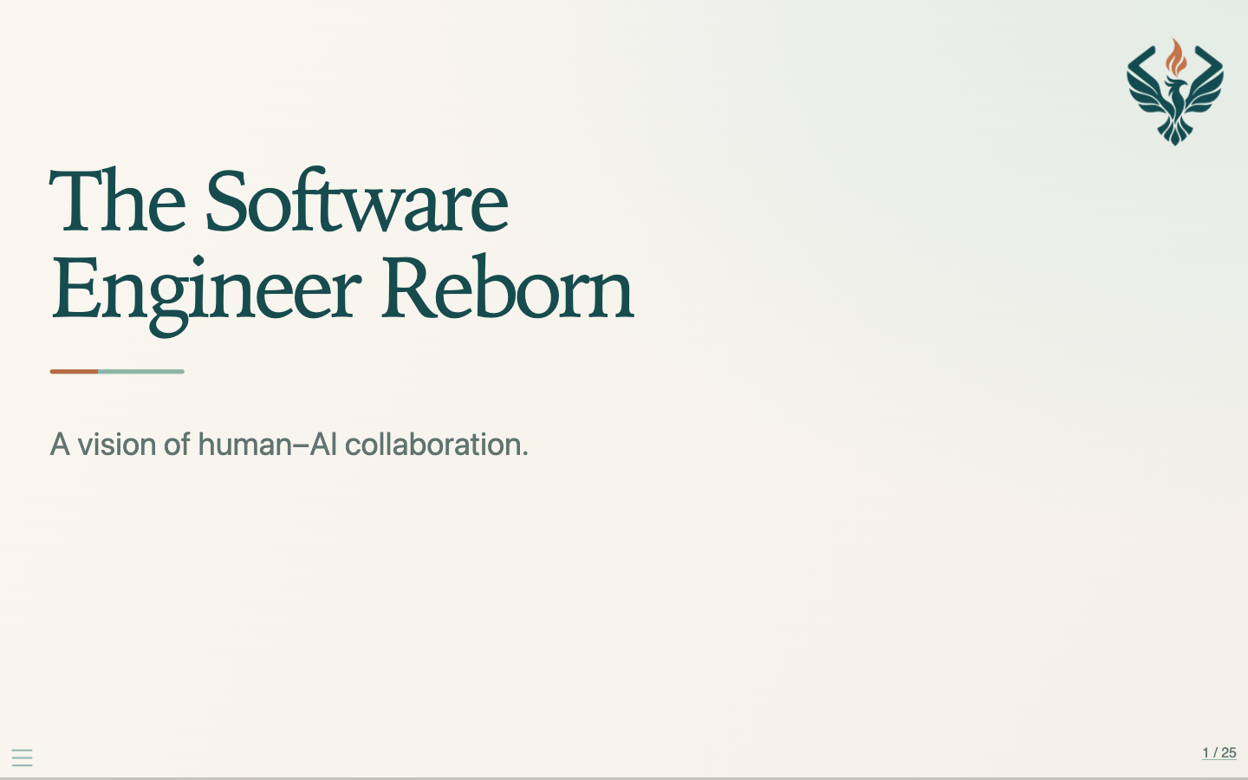
The Software Engineer Reborn
I used an interactive preparation space to work through the ideas.
Explore the preparation
Open the presentation
Notes:
40 seconds
This is The Software Engineer Reborn, a talk for the Williamsburg software community. On the left is the preparation: a Talk Atlas for comparing narratives and following source notes. On the right is the presentation. Making a tool to think with became part of making the talk. The question was about my own role. As the machine produces more implementation, I spend more attention on defining the problem, selecting evidence, and deciding which work I can stand behind. Both the preparation and the finished slides are public.
Sources:
https://software-engineer-reborn-atlas.johnlee3728739.chatgpt.site/
https://leej3.github.io/software-engineer-reborn/
https://github.com/leej3/software-engineer-reborn/tree/main/talk-concepts

Slide 5
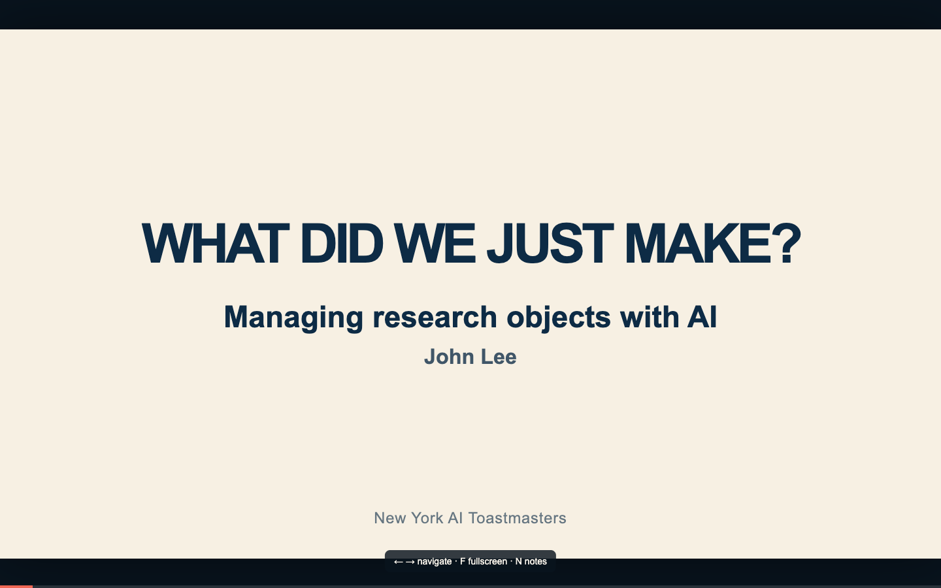
What did we just make?
A research object includes
the result and what it takes
to inspect or rerun it.
STAMPED asks about the package:
its history, its parts, its environment,
and how someone else can use it.
Research objects with AI: the talk
STAMPED principles
Notes:
40 seconds
The next talk asks, 'What did we just make?' A figure or report is only the visible result. The useful object also includes the inputs, code, decisions, and environment needed to inspect or rerun it. Our team's STAMPED principles give us a vocabulary: self-contained, tracked, actionable, modular, portable, ephemeral, and distributable. In plain terms: can I get the pieces, see their history, run the procedure, and recover a useful state elsewhere? This matters beyond science. An AI-generated website or spreadsheet also needs enough context for the next person.
Sources:
https://research-object-with-ai.pages.dev/
https://github.com/leej3/research-object-with-ai
https://stamped-principles.org/

Slide 6
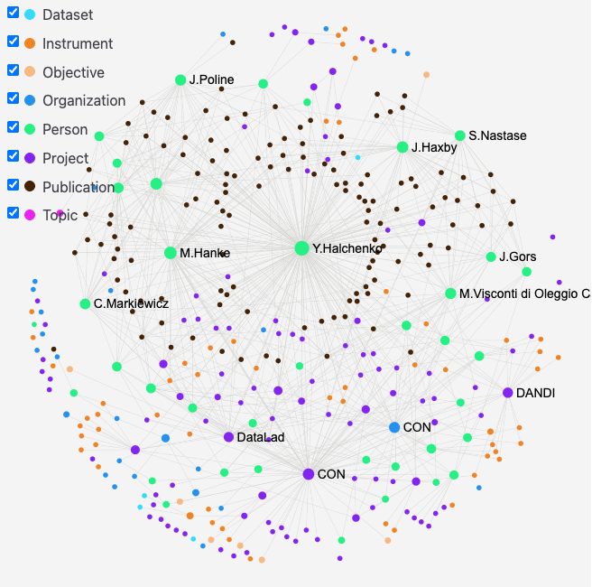
Orinoco Lite
Connected research information
People, projects and outputs
share explicit relationships.
An editor proposes changes.
GitHub review preserves the history.
The records feed a website and graph.
Project + source
Explore the graph
Poster
Notes:
50 seconds
Orinoco Lite is software I've been working on with agents. Research groups have information about people, projects, publications, and software scattered across many places. Here those become structured records with explicit relationships. The website and this graph are different views of those records. An editor proposes changes through GitHub, preserving a visible review history. It builds on upstream ORINOCO with a lighter Git-backed deployment. What interests me is shared context: people can browse it, software can validate it, and agents can work with a clearer description of what the group knows. This screenshot is saved, so the example works without Wi-Fi.
Sources:
https://github.com/ORINOCO-Lite/orinoco-lite-dev
https://dev.centerforopenneuroscience.org/explore/
https://doi.org/10.5281/zenodo.22834595

Slide 7
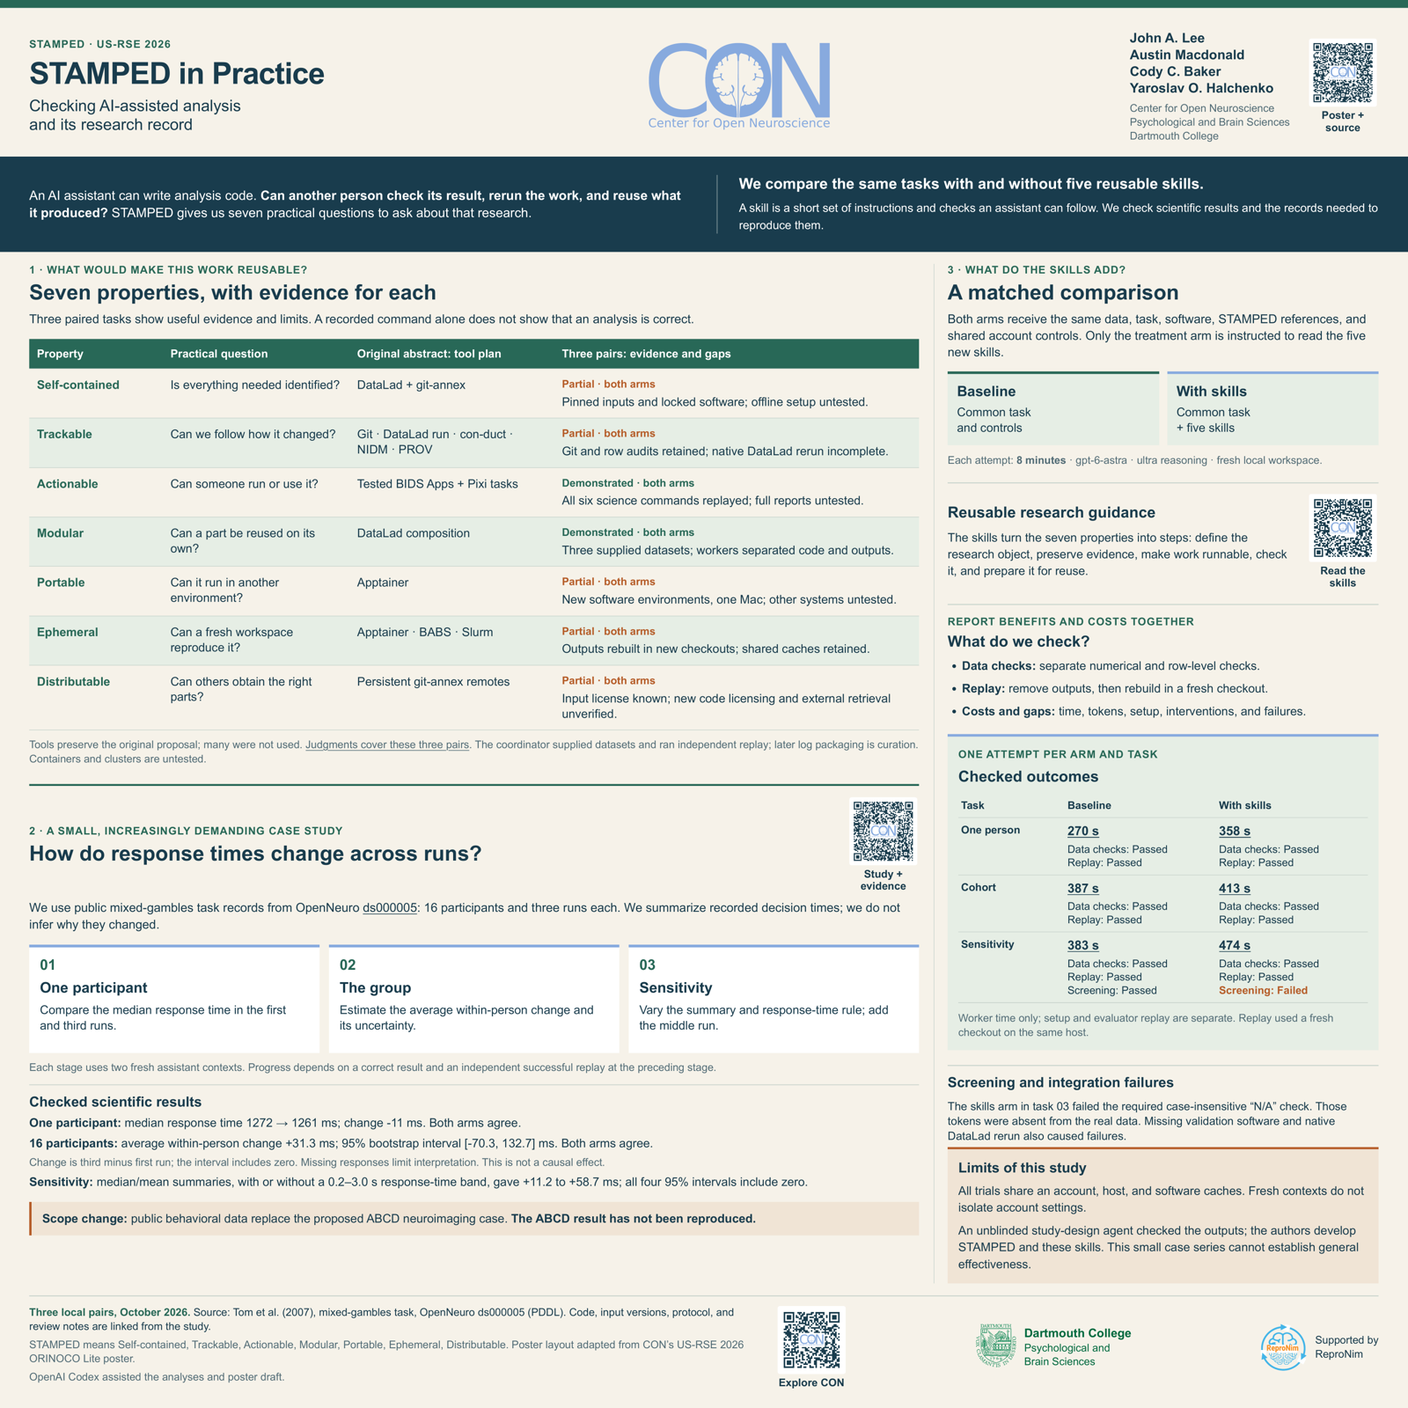
STAMPED in Practice
Skills that improve through
scientific work
Study record on Zenodo
Next: run, assess, improve, repeat
Compare four assistance conditions.
Test quality, effort and consistency.
Research workshop in development.
Transfer remains to be tested.
Poster PR #35
Study on Zenodo
Next repository
Notes:
55 seconds
The Zenodo record describes the original STAMPED in Practice proposal. The current poster PR captures the later public-data pilot, with working analyses and concrete failures to learn from. The next repository develops a repeated improvement process. Independent agents tackle the same scientific question under four kinds of assistance: baseline, general skill discovery, reproducibility-focused discovery, and explicit STAMPED skills. Independent judges assess scientific quality separately from how well the research object supports inspection and reuse. We then improve the skills and try again, keeping assessment fixed within a formal comparison. NARPS preparation pilots are already exposing useful problems. The hypothesis is that detailed STAMPED guidance improves performance and reduces inconsistent outcomes. The goal is transfer: a researcher brings their own data and hypothesis, and an independent agent can use these skills to do rigorous, convenient research. That improvement remains to be tested.
Sources:
https://github.com/con/talks/pull/35
https://zenodo.org/records/22833916
https://github.com/leej3/stamped-ai-research-next
https://github.com/leej3/stamped-ai-research-next/pull/3

Slide 8
What would
convince you?
What evidence do you need before you trust
something an agent made?
I’m exploring how to make that evidence easier to keep and inspect.
leej3.github.io/ai-and-ales-2026
All links, downloads and editable source
Notes:
25 seconds
That's the thread through my work: agents let me make more things, and I want the result to carry enough evidence for someone else to inspect it. I'm still figuring out how much context is useful and when keeping it becomes more work than it saves. I'd love to hear what evidence you look for before trusting something an agent made. All the projects and this deck's editable source are linked here.
Sources:
https://github.com/leej3/ai-and-ales-2026

