Slide 1
WHAT DID WE
JUST MAKE?
Research objects with AI
John A. Lee · New York AI Toastmasters
Notes:
I want to begin with a question I increasingly ask after a productive session with AI: what did we just make?
[Sources]
- /Users/johnlee/Documents/toastmasters/research-object-with-ai/docs/talk-concept.md
- https://www.youtube.com/watch?v=RrpajcAgR1E
[/Sources]

Slide 2
I had a
productive day.
Notes:
Perhaps you know this feeling. You ask AI for a little help, and by lunchtime you have a report, a plan, a prototype, and several excellent new directions.
[Sources]
- /Users/johnlee/Documents/toastmasters/research-object-with-ai/docs/talk-concept.md
[/Sources]

Slide 3
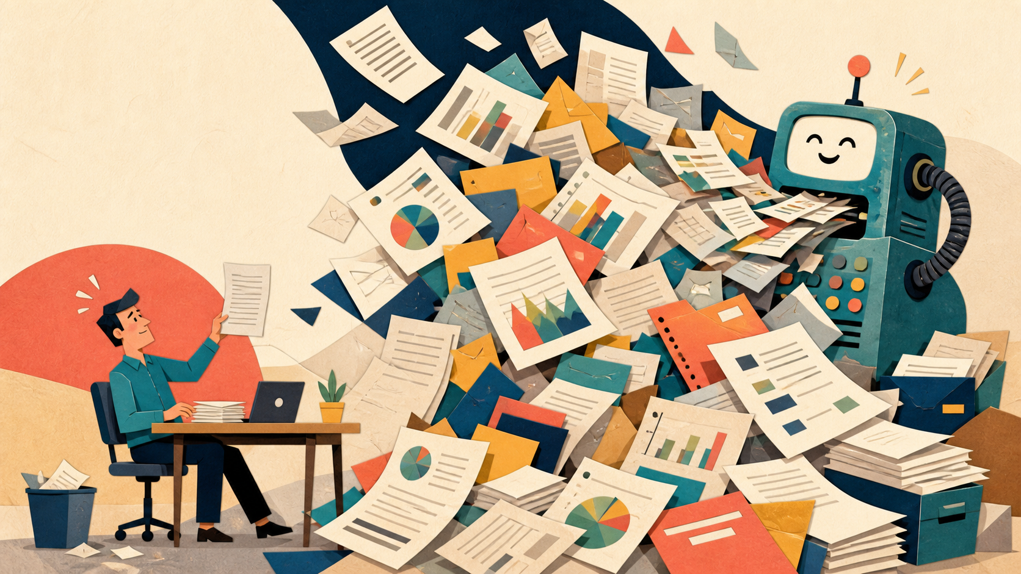
Very productive.
Notes:
Extremely productive. The machine is cheerful. The documents are polished. The pile is now taller than I am.
[Sources]
- OpenAI image generation; project prompts recorded in .build/slides/source-notes.txt
- /Users/johnlee/Documents/ChatGPT/wsdg-ai-collaboration/talk-concepts/07-the-finite-human-and-the-tireless-producer.md
[/Sources]

Slide 4
The next morning…
Notes:
Then comes the next morning. The coffee is fresh. My memory of yesterday's branching conversation is not.

Slide 5
What did we decide?
Notes:
What did we actually decide?

Slide 6
Which version
is real?
Notes:
Which version is real?

Slide 7
FINAL
FINAL-2
FINAL-real
final
USE-THIS
v7
Notes:
You know this archive. FINAL, FINAL-2, final-real, use-this, version seven. AI did not invent version confusion; it can simply produce candidates much faster.
[Sources]
- /Users/johnlee/Documents/toastmasters/research-object-with-ai/docs/talk-concept.md
[/Sources]

Slide 8
Where is the
useful bit?
Notes:
Where, in forty screens of fluent conversation, is the useful bit?

Slide 9
Could anyone else
continue?
Notes:
Could a colleague continue this work without a guided tour of my browser history?

Slide 10
NEW CHAT
How can I help you today?
It has forgotten yesterday with impressive confidence.
Notes:
And a new session greets me with perfect innocence: how can I help you today? The chat feels like a collaborator, but its continuity is a product feature—not a durable project record.
[Sources]
- /Users/johnlee/Documents/ChatGPT/wsdg-ai-collaboration/talk-concepts/07-the-finite-human-and-the-tireless-producer.md
[/Sources]

Slide 11
Ah.
Notes:
Ah.

Slide 12
AI can produce faster than I can…
understand
judge
remember
Notes:
AI can produce faster than I can understand, judge, or remember. That is the basic asymmetry: a finite human collaborating with an effectively tireless producer.
[Sources]
- /Users/johnlee/Documents/ChatGPT/wsdg-ai-collaboration/talk-concepts/07-the-finite-human-and-the-tireless-producer.md
[/Sources]

Slide 13
This feels new.
Notes:
This emotional experience feels new.

Slide 14
It isn't.
Notes:
But the organizational problem is not new at all.

Slide 15
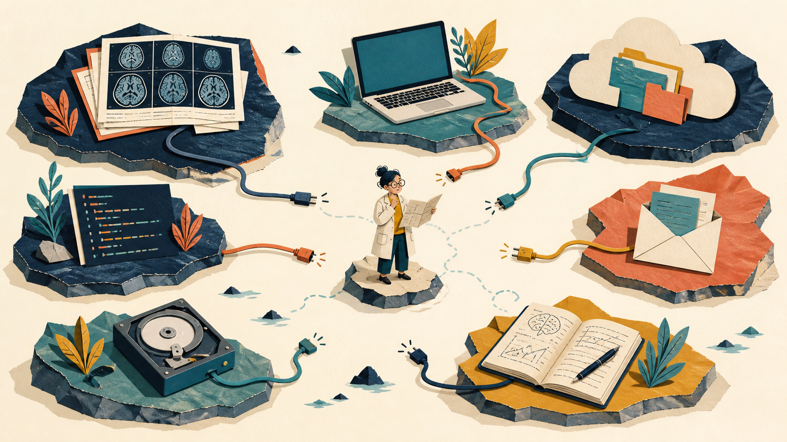
Science has seen this movie.
Notes:
Researchers have long worked across islands: data on a server, code in a repository, methods in a notebook, a key setting in somebody's head, and cables that almost connect the whole thing.
[Sources]
- OpenAI image generation; project prompts recorded in .build/slides/source-notes.txt
- https://stamped-principles.github.io/stamped-paper/
[/Sources]

Slide 16
Data: here.
Notes:
The data may be here, perhaps on a shared drive or controlled-access archive.

Slide 17
Code: there.
Notes:
The code is there, perhaps in a repository that points to a different version of the data.

Slide 18
Methods:
somewhere.
Notes:
The methods are somewhere: a paper, a wiki, or a lab notebook under a coffee cup.

Slide 19
Key setting:
in somebody's head.
Notes:
And the setting that makes it all work may live only in one person's head.

Slide 20
The paper is only
the visible tip.
Below it: data · code · metadata · environment · decisions
Notes:
A paper is the visible tip. Under it sits the data, code, metadata, environment, and decisions that produced the result.
[Sources]
- https://stamped-principles.github.io/stamped-paper/
[/Sources]

Slide 21
RESEARCH
OBJECT
A name for the whole digital body of work
Notes:
We use a name for that whole digital body of work: a research object.
[Sources]
- https://stamped-principles.github.io/stamped-paper/
[/Sources]

Slide 22
A research object
data + code + metadata
that together represent the research as a complete unit
Formal enough to be precise. Simple enough to picture as a suitcase.
Notes:
The technical term is a research object: a collection of data, code, and metadata that together represent the research as a complete unit. I am giving you the formal definition, but I do not expect you to memorize it. Picture a suitcase containing everything needed to understand the trip.
[Sources]
- https://stamped-principles.github.io/stamped-paper/
[/Sources]

Slide 23
We've spent decades
on this.
Notes:
Scientific communities have spent decades developing ways to make these objects understandable, reproducible, and reusable.
[Sources]
- https://stamped-principles.github.io/stamped-paper/
[/Sources]

Slide 24
folders
repositories
versioning
standards
workflows
Notes:
Over decades, communities developed folders and conventions, repositories, version control, standards, and executable workflows. Different approaches emphasized different parts of the problem.
[Sources]
- https://stamped-principles.github.io/stamped-paper/
- https://www.go-fair.org/fair-principles/
[/Sources]

Slide 25
FAIR
Findable · Accessible · Interoperable · Reusable
Notes:
FAIR asks that research objects be Findable, Accessible, Interoperable, and Reusable. STAMPED will complement that perspective rather than replace it.
[Sources]
- https://www.go-fair.org/fair-principles/
- https://stamped-principles.github.io/stamped-paper/
[/Sources]

Slide 26
Different routes.
Notes:
These efforts take different routes and operate at different layers.

Slide 27
Same hope:
Notes:
But they share a hope.

Slide 28
UNDERSTAND IT.
RERUN IT.
BUILD ON IT.
Notes:
Understand it. Rerun it. Build on it.
[Sources]
- https://stamped-principles.github.io/stamped-paper/
[/Sources]

Slide 29

This is my team.
Notes:
This is where my team enters the story: the Center for Open Neuroscience. We have been working on the older version of this problem—community infrastructure for open and reproducible research—since long before today's AI boom.
[Sources]
- https://centerforopenneuroscience.org/
- CON logo: https://centerforopenneuroscience.org/theme/img/logos/logo_blue_big_with_margins.png
[/Sources]

Slide 30
Open software, platforms, data, and methods
for neuroscience—and beyond
Notes:
CON provides open software frameworks, platforms, data, and methodologies for neuroscience and beyond.
[Sources]
- https://centerforopenneuroscience.org/
[/Sources]

Slide 31
OPEN
REUSE
SHARE
TEST
SIMPLIFY
COMMUNITY
Notes:
CON's homepage names open source, reuse and integration, dissemination, quality assurance, convenience, and community. In verbs: open, reuse, share, test, simplify, and build community.
[Sources]
- https://centerforopenneuroscience.org/
[/Sources]

Slide 32
Open only matters
if people can use it.
Notes:
Openness is not merely putting files online. It becomes valuable when a community can obtain, understand, trust, and reuse what has been shared.
[Sources]
- https://centerforopenneuroscience.org/
[/Sources]

Slide 33
“Reproducible bogus
results are useless!”
— Center for Open Neuroscience
Notes:
And CON puts an important brake on the celebration: reproducible bogus results are useless. Reproducibility makes work inspectable; it does not make a weak method correct.
[Sources]
- https://centerforopenneuroscience.org/
[/Sources]

Slide 34
Then AI arrived.
Notes:
Then AI arrived—not into an empty field, but into this ongoing community project.

Slide 35
BUILD
FASTER
Notes:
For a small team, AI can lower the cost of building tools, documentation, integrations, and tests.

Slide 36
DOCUMENT
INTEGRATE
TEST
SHARE
AI helps a small team…
Notes:
AI helps a small team document, integrate, test, and share tools faster. That is a genuine opportunity for community infrastructure—as long as speed remains connected to judgment and maintenance.
[Sources]
- /Users/johnlee/Documents/toastmasters/research-object-with-ai/docs/talk-concept.md
- /Users/johnlee/Documents/ChatGPT/wsdg-ai-collaboration/talk-concepts/05-human-collaboration-and-community.md
[/Sources]

Slide 37
Also…
Notes:
Also…

Slide 38
manufacture
confusion faster
Notes:
AI can manufacture confusion faster too: more artifacts, more branches, more hidden assumptions, and more output than colleagues can evaluate.
[Sources]
- /Users/johnlee/Documents/ChatGPT/wsdg-ai-collaboration/talk-concepts/05-human-collaboration-and-community.md
[/Sources]

Slide 39
The machine
keeps expanding.
Notes:
The machine keeps expanding the work. It does not become tired, bored, or emotionally saturated.
[Sources]
- /Users/johnlee/Documents/ChatGPT/wsdg-ai-collaboration/talk-concepts/07-the-finite-human-and-the-tireless-producer.md
[/Sources]

Slide 40
The human
is still finite.
Notes:
The human is still finite. We must decide what matters, notice drift, and periodically recover enough understanding to choose the next coherent step.
[Sources]
- /Users/johnlee/Documents/ChatGPT/wsdg-ai-collaboration/talk-concepts/07-the-finite-human-and-the-tireless-producer.md
[/Sources]

Slide 41
NOT MORE OUTPUT
Notes:
The answer cannot simply be more output.

Slide 42
BETTER OBJECTS
Notes:
We need better objects: durable homes for intent, evidence, history, and instructions.

Slide 43
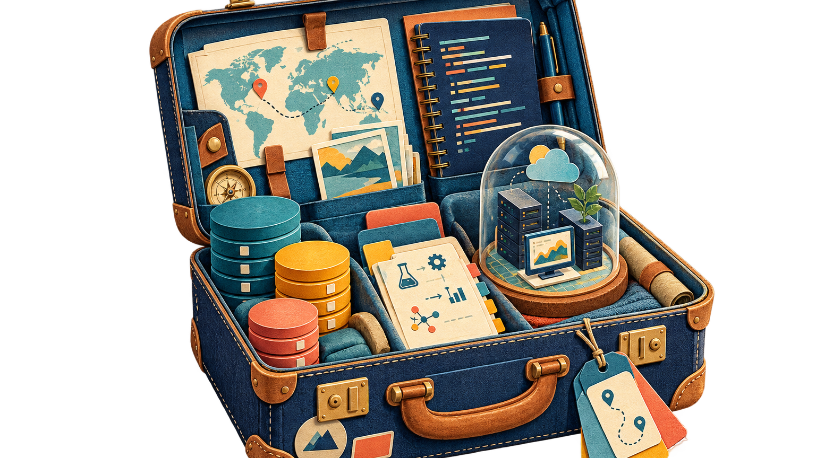
A durable home. A visible trail. A usable handoff.
Notes:
A good research object gives work a durable home, a visible trail, and a usable handoff. Think of it as packing the project so the next traveler can make sense of it.
[Sources]
- OpenAI image generation; project prompts recorded in .build/slides/source-notes.txt
- https://stamped-principles.github.io/stamped-paper/
[/Sources]

Slide 44
Seven spectra. One shared vocabulary.
Notes:
We call this vocabulary STAMPED. These are seven spectra, not a pass-fail certification. A project can improve incrementally from where it is today.
[Sources]
- https://stamped-principles.github.io/stamped-paper/
- STAMPED wordmark: https://github.com/stamped-principles/stamped-branding
[/Sources]

Slide 45
S
SELF-CONTAINMENT
No scavenger hunt.
Can I retrieve everything essential from one place?
A research object is a complete retrieval unit; it can be obtained and understood in its intended scope without needing to reference external resources.
Notes:
Self-containment asks whether everything essential is reachable from one boundary. That does not require physically copying private or enormous data into one folder; explicit, retrievable references can count. The key is no undocumented scavenger hunt.
[Sources]
- https://stamped-principles.github.io/stamped-paper/
[/Sources]

Slide 46
T
TRACKING
Leave footprints.
Can I trace what became what?
The state and provenance of all components is recorded.
Notes:
Tracking asks whether we can trace what became what: versions, contributors, inputs, outputs, and consequential changes. With AI, the model, prompt, decisions, and resulting changes become part of that record—but saving every transcript is not automatically useful provenance.
[Sources]
- https://stamped-principles.github.io/stamped-paper/
[/Sources]

Slide 47
A
ACTIONABILITY
Recipe, not ingredients.
Can a person—or a machine—make it happen again?
A research object contains machine-actionable information to carry out procedures to obtain or reproduce content.
Notes:
Actionability asks for a recipe, not merely a pile of ingredients. Can a person—or increasingly an AI agent—follow the instructions and make the important result happen again?
[Sources]
- https://stamped-principles.github.io/stamped-paper/
[/Sources]

Slide 48
M
MODULARITY
Pieces, not pudding.
Can I replace one part without unraveling the rest?
All modules are independent and composable.
Notes:
Modularity means pieces, not pudding. A dataset, method, environment, or analysis step should have a boundary clear enough that it can be understood, updated, or exchanged without unraveling everything else.
[Sources]
- https://stamped-principles.github.io/stamped-paper/
[/Sources]

Slide 49
P
PORTABILITY
Survive the trip.
Does it still work after it moves?
A research object can move to different environments while retaining its STAMPED properties.
Notes:
Portability asks whether the project survives the trip—from my laptop to yours, from one cloud to another, or from today's system to tomorrow's. Hidden assumptions about the original machine are baggage we forgot to declare.
[Sources]
- https://stamped-principles.github.io/stamped-paper/
[/Sources]

Slide 50
E
EPHEMERALITY
No ghosts in the machine.
Can it work from a clean start—without yesterday's leftovers?
Procedural execution is performed within a throwaway environment.
Notes:
Ephemerality has the least everyday name and perhaps the best test: can it work from a clean start, without yesterday's leftovers? The execution environment is disposable; the specification and evidence are durable. A clean room exposes the ghosts hiding in a lovingly accumulated laptop.
[Sources]
- https://stamped-principles.github.io/stamped-paper/
[/Sources]

Slide 51
D
DISTRIBUTABILITY
Same package, new hands.
Can someone else obtain the same state I had?
All modules and procedures are shareable externally in a persistent state.
Notes:
Distributability asks whether somebody else can obtain the same state I had. It does not mean every object must be public: healthcare data can remain controlled. It means the permitted recipient can obtain a persistent, well-identified state rather than an approximation.
[Sources]
- https://stamped-principles.github.io/stamped-paper/
[/Sources]

Slide 52
a study
a report
a spreadsheet
a slide deck
a plan
Research object—or simply durable digital work.
Notes:
STAMPED began with research objects, but the questions travel well. A study, a report, a spreadsheet, a slide deck, a plan—any digital object meant to outlive its current session can benefit.
[Sources]
- /Users/johnlee/Documents/toastmasters/research-object-with-ai/docs/talk-concept.md
[/Sources]

Slide 53
The next collaborator
may be AI.
Notes:
The next collaborator may be an AI system. A well-organized project gives it a boundary, a history, instructions, and evidence instead of asking it to reconstruct the world from a chat.

Slide 54
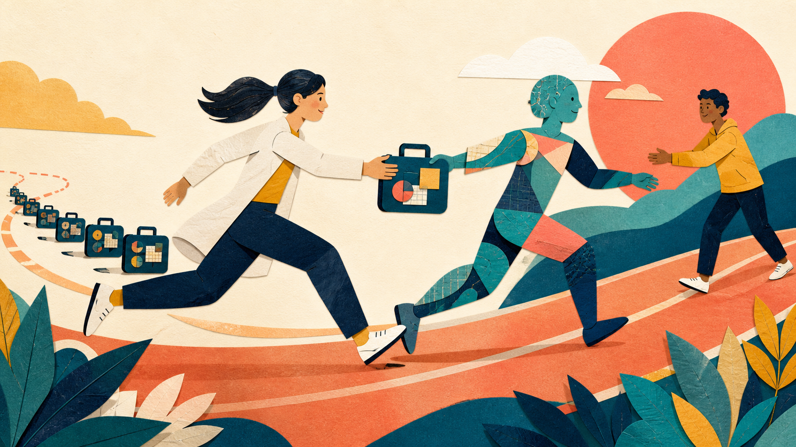
Make the handoff work.
Notes:
The goal is not to make the AI the owner of the work. It is to make the handoff work among people, machines, and communities while responsibility remains visible.
[Sources]
- OpenAI image generation; project prompts recorded in .build/slides/source-notes.txt
- /Users/johnlee/Documents/ChatGPT/wsdg-ai-collaboration/talk-concepts/05-human-collaboration-and-community.md
- https://stamped-principles.github.io/stamped-paper/
[/Sources]

Slide 55
The next collaborator
may be you.
Notes:
And the next collaborator may simply be you, three months from now, wondering what on earth you and the machine were thinking.

Slide 56
BUILD THE MEMORY
INTO THE WORK.
STAMPED
stamped-principles.org
Notes:
AI did not create the problem, and STAMPED does not solve scientific judgment. But if we build the memory into the work, we give future people and future machines a much better chance of understanding, rerunning, improving, and sharing what we made.
[Sources]
- https://stamped-principles.org/
- https://stamped-principles.github.io/stamped-paper/
[/Sources]

