Slide 1
Predicting the best neighborhood in Chicago, United States - to start an Indian Restaurant
Leeja Bijoy
July 2019

Slide 2
Introduction – Requirement & Background
A client, a successful restaurant chain in India is looking to expand operation into United States. They want to begin with Chicago as it has a large Indian community. They want to create a high-end restaurant that serves all Indian cuisines like Punjabi, Bengali, Rajashtani, Andhra, Tamil, Kerala, Maharashtrian, Goan etc. Their target is not only Indians but all Asians who would love Indian cuisine. The client requires a deeper insight into the demographics of Chicago so that they can decide on where to establish their first 'Royal Indian' restaurant that would provide a wide variety of Indian cuisine and the ambience of the restaurant would represent variety of Indian cultural attributes.

Slide 3
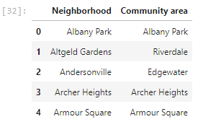
Data Acquisition
This project will rely on public data from Wikipedia and Foursquare. In this project, data is taken from the wikipedia link https://en.wikipedia.org/wiki/List_of_neighborhoods_in_Chicago . There are 246 community areas ( neighborhoods) in Chicago as per the above link.

Slide 4
Data Acquisition & Cleaning
We are interested only the Neighborhood. Hence the ‘Community Area’ column is dropped
In obtaining the location data of the locations, the Geocoder package is used with the arcgis_geocoder to obtain the latitude and longitude of the needed locations
These will help to create a new dataframe that will be used subsequently for the Chicago area. This data frame has the latitudes and longitudes for neighborhood from the Chicago neighbor hood . Both the dataframes are merged together to get a new dataframe

Slide 5
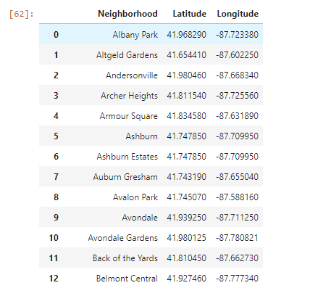
Merged Data Frame with Location Information

Slide 6
Data Acquisition – Foursquare API
The Foursquare API will be used to obtain the Chicago Area venues for the geographical location data. These will be used to explore the neighborhoods of Chicago accordingly
The venues within the neighborhoods Chicago like the area’s restaurants and proximity to amenities would be correlated
Accessibility and ease of supplies would be considered as it relates to venues
The data from the both the datasets will be explored by considering the venues within different neighborhood of Chicago. These areas' restaurants would be checked in terms of the types of restaurants within a certain mile radius

Slide 7
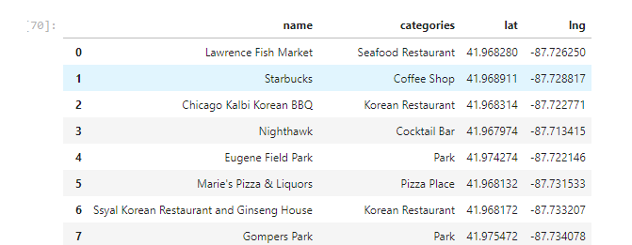
Methodology – Data Exploration
An initial exploration of a single neighborhood within the Chicago area is done to examine the Foursquare workability
'Albany Park' neighborhood is chosen here
The result is then cleaned up from json to a structured pandas dataframe

Slide 8
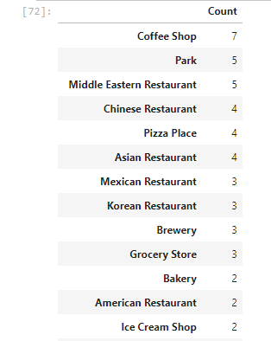
Data Exploration – Grouping by Category
Data is then grouped to find the unique categories
There are 59 categories in total

Slide 9
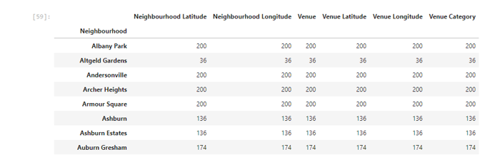
Data Exploration – Exploring multiple neighborhoods
Then multiple neighborhoods are explored
The number of venues returned for each neighborhoods is then explored as follows

Slide 10
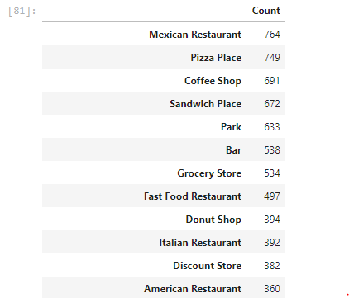
Data Exploration – Unique Categories
Data is checked for how many unique categories can be returned for the venues

Slide 11
Clustering Data
The neighbourhoods in Chicago will be clustered based on the processed data obtained above
Using the geopy library, the latitude and longitude values of Chicago is obtained
The folium library is then used to obtain the coordinates
The Chciago neighbourhoods are then superimposed on top as shown below using the folium library
Markers are added to the map

Slide 12
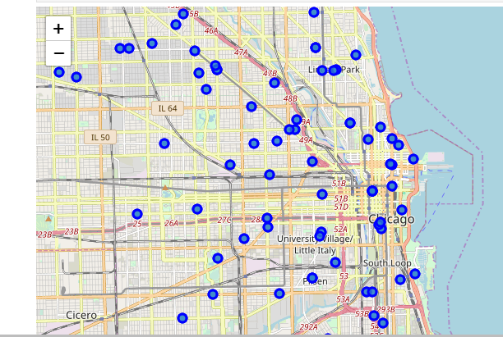
Clustering Data

Slide 13
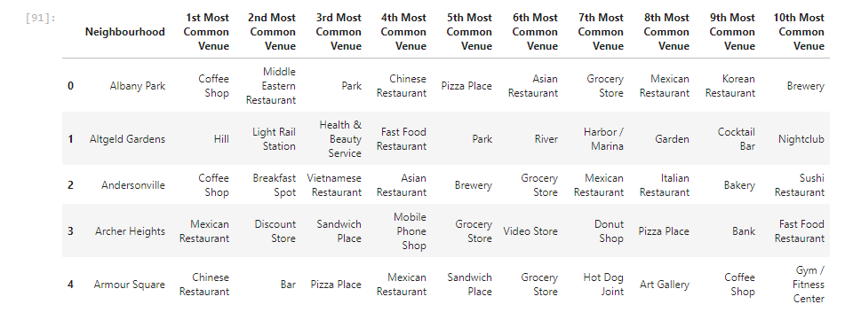
Clustering Data
One-hot encoding is done and then grouping of each Neighbourhoods with 10 common venues is done.

Slide 14
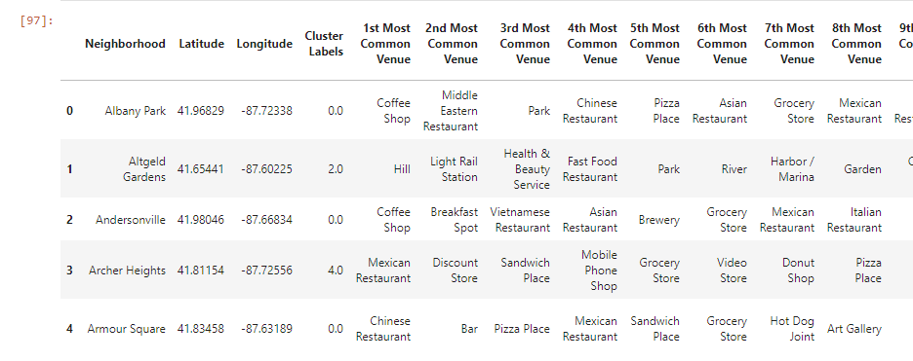
Clustering Data
Created clusters of the neighborhood using the k-means to cluster the neighborhood into 5 clusters

Slide 15
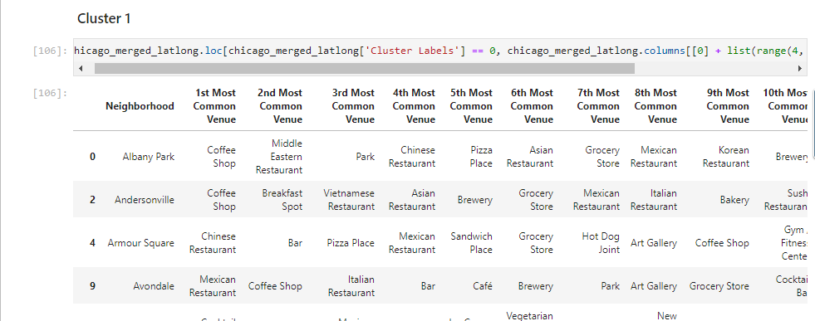
Clustering Data
Each clusters are now examined for most popular venues

Slide 16
Result
On analyzing 5 clusters it can be observed that:
Fast food restaurants, Pizza places and Coffee Shops are popular in the Chciago neighborhoods
If we consider restaurants, Mexican resataurants are very popular in Cluster 5
Chrysler Village, West Ridge, West Rogers Park, South East Ravenswood and Eden Green already have popular Indian restaurants
Cluster 1 has more Asian restaurants
Cluster 5 has lots of popular Mexican restaurants

Slide 17
Conclusion
Clusters 3 and 4 are the most feasible options for starting 'Royal Indian' restaurants
They don't have restaurants that serve any kind of Asian cuisines. So including other Asian cuisines like Thai, Japanese, Arab along with Indian menu is also a good option
Neighborhoods like Auburn Gresham, Beverly View, East Beverly, and Oakland in Cluster 3 doesn't have restaurants as 1st most common venue and also has convenience stores, grocery stores, discount stores and farmer's markets in the vicinity. So they can be considered as good options to start Indian restaurants

Slide 18
Conclusion contd.
Cluster 4 has more of hotels and gyms as the most common venues. So it looks more like a business location rather than a location where people would love to hang out and dine out
Considering this, Cluster 3 seems to be the best cluster for the client to explore options of starting an Indian restaurant

