Slide 1
Working on UC Davis Bioinformatics Core Administrated Computing Systems

Slide 2
Assumptions
What are the prerequisites? … The hands on portion of the workshop will be on the command-line. If you are not familiar with the command line you can still attend, listen and learn. But we will not have time to train participants on how to use the command-line during the workshop.
What do I need to bring? … You will need to bring your own laptop to use, it will need to be able to run Chrome or Firefox, have a recent version of Java installed, and an application that will allow you to ssh into a server (e.g. Putty, or iTerm). Assembly computation will be done on the remote server. We can help with setup early on in the workshop. If your department does not allow you to install software on the laptop you’ll be bringing, please contact us ahead of time.

Slide 3
Outline
Structure
The module system, when to request software, when to install software yourself.
Slurm scheduler, submitting to the cluster

Slide 4
Interacting with a Cluster
Lab/Workshop Share
User Home
Directories
Slurm
Scheduler
HPC14
Cabernet
Login node/server

Slide 5
Workshop details
Each person has a test user account, even if you have an account on our systems for this workshop, the test accounts are associated with the cluster allocation and your users are not.
Login node
Login to cabernet.genomecenter.ucdavis.edu
User space / shared workshop space
User space is @ 25Gb
Share space /share/workshop @ 2Tb, please create a folder under here to work in. Data associated with the workshop can also be found here.
Cluster allocation for the course
Use --reservation=workshop in submissions

Slide 6
Module system
For Software

Slide 7
Modules
The Environment Modules package provides for the dynamic modification of a user's environment via module files.
Each module file contains the information needed to configure the shell for an application. Once the Modules package is initialized, the environment can be modified on a per-module basis using the module command which interprets module files. Typically module files instruct the module command to alter or set shell environment variables such as PATH, MANPATH, etc. module files may be shared by many users on a system and users may have their own collection to supplement or replace the shared module files.
Modules are useful in managing different versions of applications. Modules can also be bundled into meta-modules that will load an entire suite of different applications, or ensure dependencies are loaded.

Slide 8
Modules
Users can manage their environment (software available on the path) via modules.
Users benefit from a familiar applications environment across UC Davis Bioinformatics Core systems (on and off-campus).
Requests for software from any user becomes available to all users.
Efficient system administration pooling software install/testing efforts from different projects/machines.
Additional information https://en.wikipedia.org/wiki/Environment_Modules_(software)

Slide 9
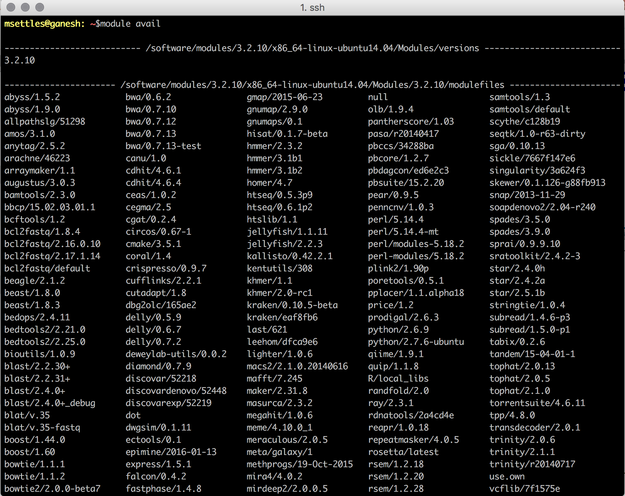

Slide 10
Module basics
module avail, show, load, list, unload
$ module avail
shows the currently available module to the system
format is application/version, if version is omitted default is used (most recent)
$ module show beast/1.8.3
shows information, such as what-is, other modules loaded and path information
$ module load beast/1.8.3
load the module beast version 1.8.3
$ module list
show currently loaded modules
$ module unload beast
unload the module beast

Slide 11
Module Example
$ which beast
$ module list
$ module avail
$ module show beast/1.8.3
$ module load beast/1.8.3
$ module list
$ which beast
# We can now use beast
$module unload beast
Use list, avail, show, load and unload to use the application beast

Slide 12
Modules are great for
Modules are great for keeping track of what software and specifically what version of the software is being used in an analysis.
You can keep track by
Doing an analysis from a bash script, loading the modules at the beginning of a script.
Copy/paste recording all commands to a file (ex. analysis.txt) to save the commands for review later
Use history at the end of an analysis and save all commands including module load commands
Note of caution: There are some applications available as a part of the system (ex. samtools) we are working to identify and remove these.

Slide 13
Slurm scheduler

Slide 14
SLURM
Simple Linux Utility for Resource Management
Manages compute resources
Schedules jobs using those resources
Original developed at Lawrence Livermore National Labs
Open Source
Supports plugins extending or enhancing functionality
Increasingly being used at academic research computing centers and national labs
Berkeley
UCSD Super Computer

Slide 15
Slurm Commands
sinfo, squeue, sacct, srun, sbatch, scancel
sinfo reports the state of partitions and nodes managed by Slurm. It has a wide variety of filtering, sorting, and formatting options.
squeue reports the state of jobs or job steps. It has a wide variety of filtering, sorting, and formatting options. By default, it reports the running jobs in priority order and then the pending jobs in priority order.
sacct is used to report job or job step accounting information about active or completed jobs.
srun is used to submit a job for execution or initiate job steps in real time. srun has a wide variety of options to specify resource requirements. A job can contain multiple job steps executing sequentially or in parallel on independent or shared resources within the job's node allocation.
sbatch is used to submit a job script for later execution. The script may contain one or more srun commands to launch parallel tasks.
scancel is used to cancel a pending or running job or job step. It can also be used to send an arbitrary signal to all processes associated with a running job or job step.

Slide 16
Slurm Commands - SINFO
sinfo reports the state of partitions and nodes managed by Slurm. It has a wide variety of filtering, sorting, and formatting options.
sinfo --summarize
Nodes are computers/servers (multiple cpu with shared memory)
Partitions are logical groups of nodes (possibly overlapping)
gc64, gc128, gc256, gc512
Partition gc is the collection of gc64, gc128 and gc256 and is the default queue

Slide 17
Slurm Commands – SQUEUE
squeue reports the state of jobs or job steps. It has a wide variety of filtering, sorting, and formatting options. By default, it reports the running jobs in priority order and then the pending jobs in priority order.
Use squeue to view jobs currently queued and running
--user=username
--states=[running or pending]
--long # long format
--start # sometimes gives approximate start time
scontrol show job <jobid> # shows details about a job

Slide 18
Slurm Commands -SBATCH
sbatch is used to submit a job script for later execution [non-interactive].
Login to cluster
Create a job script
I use a .slurm extension so that I know it’s a slurm job script
Submit the script to the cluster using sbatch
sbatch –reservation=workshop script.slurm
Slurm will respond with a jobid:
Submitted batch job 311533

Slide 19
Example Job script
#!/bin/bash
#SBATCH --partition=gc # partition to submit to
#SBATCH --job-name=“myjob” # Job name
#SBATCH --nodes=1 # single node, anything more than 1 will not run
#SBATCH --ntasks=1 # equivalent to cpus, stick to around 20 max on gc64, or gc128 nodes
#SBATCH --mem=1000 # in MB, memory pool all cores, default is 2GB per cpu
#SBATCH --time=0-01:30:00 # expected time of completion in hours, minutes, seconds, default 1-day
#SBATCH --output=my_output.out # STDOUT
#SBATCH --error=my_output.err # STDERR
#SBATCH --mail-user=you@gmail.com, does not work yet
#SBATCH --mail-type=ALL , does not work yet
# This will be run once for a single process
/bin/hostname
start=`date +%s`
module load blat/v.35-fastq
echo “HELLO”
end=`date +%s`
runtime=$((end-start))
echo $runtime

Slide 20
Slurm Commands – SCANCEL
scancel is used to cancel a pending or running job or job step. It can also be used to send an arbitrary signal to all processes associated with a running job or job step.
To delete a job
scancel <jobid>
Jobs not running yet (queued) are deleted, jobs running will be killed
To delete many jobs
scancel <jobid1> <jobid2> <jobid3> …
Delete all jobs by a user
scancel –u <username>
Delete all jobs by user that are pendin
scancel -t PENDING -u <username>

Slide 21
Slurm Command – srun and helper scripts
srun is used to submit a job for execution or initiate job steps in real time [non-interactive]. srun has a wide variety of options to specify resource requirements. A job can contain multiple job steps executing sequentially or in parallel on independent or shared resources within the job's node allocation.

Slide 22
An interactive session (preferred way)
slurmlogin
srun -N 1 -n 1 --pty /bin/bash
slurmlogin-wholenode
srun -N1 --exclusive --pty /bin/bash
Slurmlogin-gc512
srun -p gc512 --mem 500000 -N1 --exclusive --pty /bin/bash
If using ‘screen’, ‘screen’ on Cabernet, then srun, then when done exit/close the screen.

Slide 23
Dos and Don’ts
Do use your home directory (but remember you only have 25Gb)
Do use the /share/workshop as space to work in, BUT create a directory to work under.
Do submit jobs to the cluster (-N 1, --partition=gc), use the --reservation=workshop jobs will run quicker.
Do use srun -N 1 -n 1 --pty /bin/bash for interactive sessions
Don’t do anything on the login node, but submit jobs, basic commands, and screen.

Slide 24
Get to know the cluster
Login and create any space you want under the workshop share
Get to know sinfo and squeue
Submit a toy test job
#!/bin/bash
#SBATCH --job-name=test
#SBATCH --output=res.txt
#SBATCH --ntasks=1
#SBATCH --time=10:00
#SBATCH --mem-per-cpu=100
hostname
sleep 300
Show your test job in squeue and scontrol
Start up an interactive session

