Slide 1
Project 3 -Data Visualization Track
Jim piper, Lee Julia, Lu Ann, Walgama Jay
MLB Players from 1876-2015 Birthplaces

Slide 2
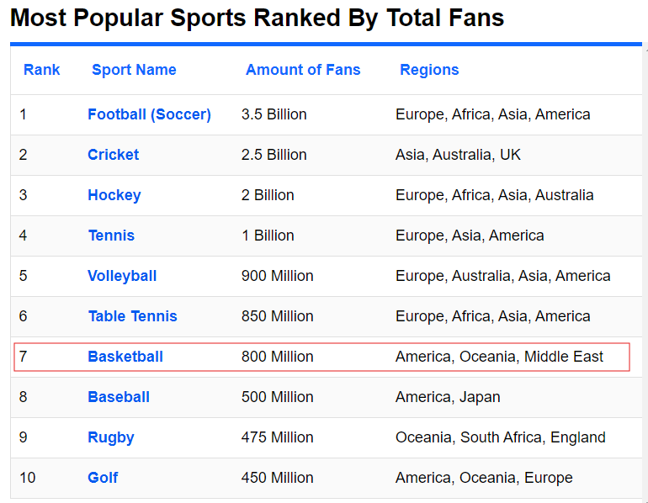
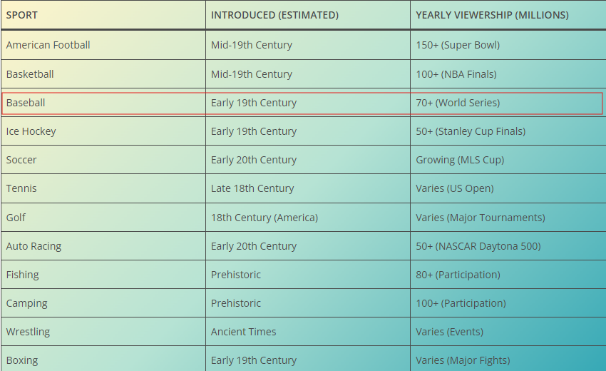
https://www.worldatlas.com/articles/what-are-the-most-popular-sports-in-the-world.html
https://bestdiplomats.org/most-popular-sports-in-usa/

