Slide 1

Project 3 -Data Visualization Track
Jim Pieper, Lee Julia, Lu Ann, Walgama Jay
MLB Players from 1876-2015 Birthplaces and Birth Year

Slide 2
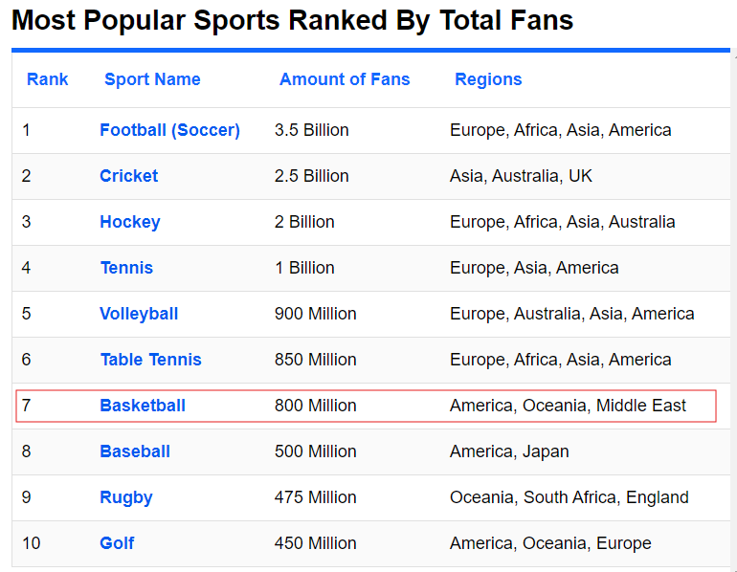
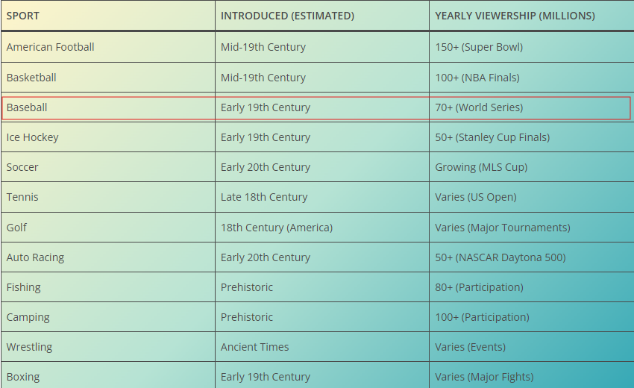
https://www.worldatlas.com/articles/what-are-the-most-popular-sports-in-the-world.html
https://bestdiplomats.org/most-popular-sports-in-usa/

Slide 3


The difference between Hall of fame and All-Star
Baseball
Hall of Fame
All-Star
The MLB All-Star Game is an annual exhibition game that showcases the league's top players from the American League (AL) and the National League (NL).
All-Star players are selected based on their performance during the first half of the MLB season. Fans, players, and managers vote for the players they believe are most deserving of an All-Star spot.
Being selected as an All-Star is a recognition of a player's outstanding performance in a particular season.
Unlike the Hall of Fame, which honors a player's entire career, an All-Star selection is specific to one season and does not have the same historical significance as a Hall of Fame induction.
The Baseball Hall of Fame, located in Cooperstown, New York, honors players, managers, umpires, and executives who have made significant contributions to the sport.
Induction into the Hall of Fame is based on a player's overall career performance, including factors such as skill, sportsmanship, character, and contributions to the game.
Players become eligible for Hall of Fame consideration after they have been retired from Major League Baseball (MLB) for at least five years. A selection committee then votes on eligible candidates.

Slide 4
Tools
Project Path
Data Visualization Track
Tools
Programing Language : JavaScript
Web Elements : HTML
Code IDE : Microsoft VS Code
Data Cleaning : Jupyter Notebook
Data Storage : MongoDB, Excel , CSV
Documentation : Microsoft Word
Project Collaboration : Git and GitHub

Slide 5
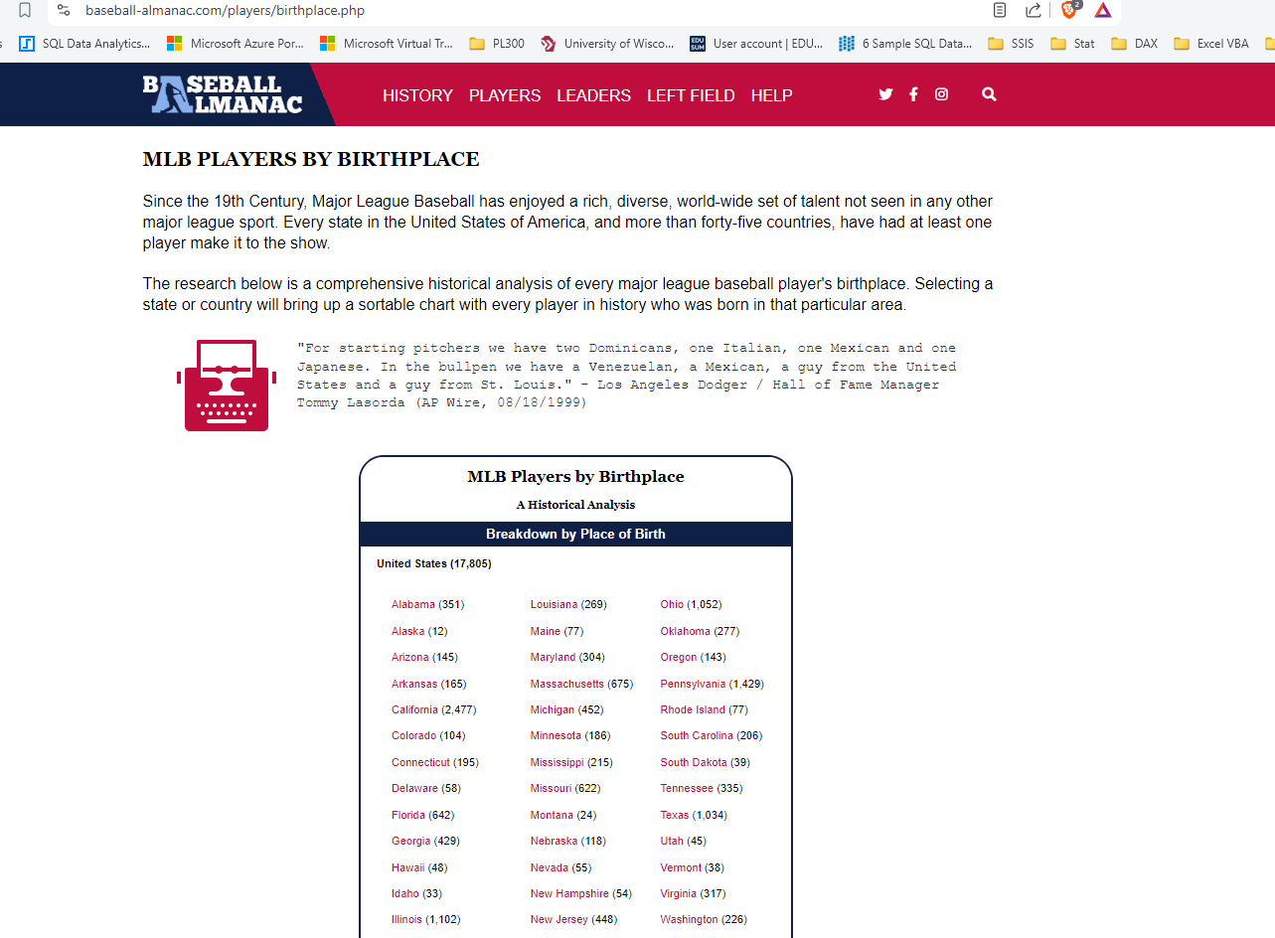
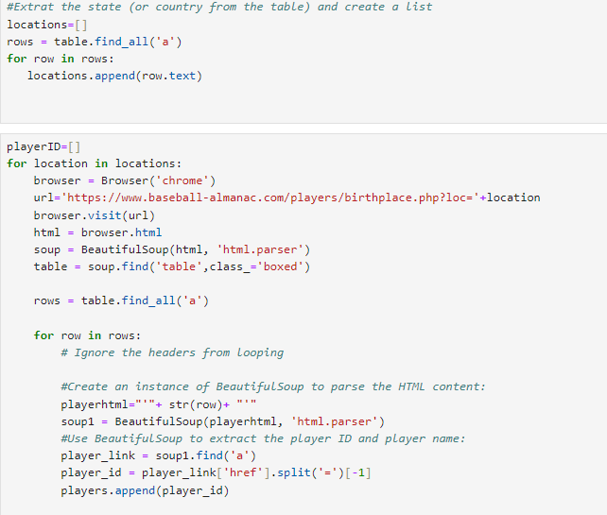
Challenges
Finding a Data source
Web scraping : https://www.baseball-almanac.com/players/birthplace.php
Problem Faced
Web scraping is a time consume process and not suitable for scraping a large data set.
Solution
https://www.kaggle.com/datasets/open-source-sports/baseball-databank
Solution

Slide 6
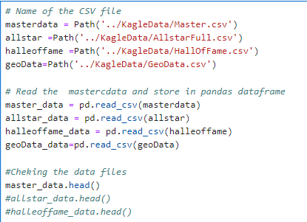
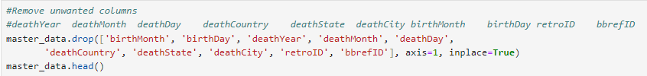
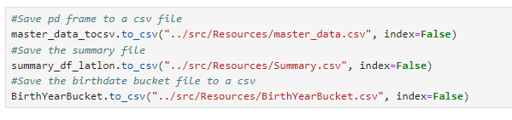
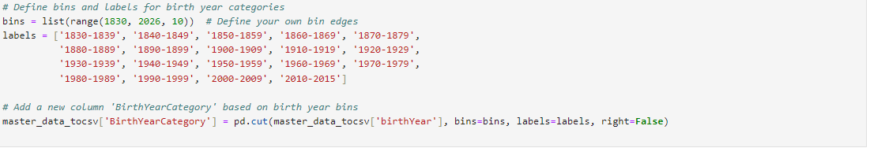
Data Cleaning Process

Slide 7
External Libraries Used
d3.csv("./Resources/Summary.csv").then(function(data) {
<!-- D3 library -->
<script src="https://d3js.org/d3.v7.min.js"></script>
Data Binding
<!-- Leaflet CSS -->
<link rel="stylesheet" href="https://unpkg.com/leaflet@1.9.4/dist/leaflet.css"
integrity="sha256-p4NxAoJBhIIN+hmNHrzRCf9tD/miZyoHS5obTRR9BMY="
crossorigin="" />
<!-- Leaflet JavaScript code -->
<script src="https://unpkg.com/leaflet@1.9.4/dist/leaflet.js"
integrity="sha256-20nQCchB9co0qIjJZRGuk2/Z9VM+kNiyxNV1lvTlZBo="
crossorigin=""></script>
<!-- leaflet-choropleth JavaScript -->
<script type="text/javascript" src="static/js/choropleth.js"></script>
Map Visuals
Graph Visuals
<script src="https://cdn.plot.ly/plotly-latest.min.js"></script>
<!-- Link to Bootstrap CSS -->
<link href="https://cdn.jsdelivr.net/npm/bootstrap@5.3.2/dist/css/bootstrap.min.css" rel="stylesheet">
<link href="https://stackpath.bootstrapcdn.com/bootstrap/4.5.2/css/bootstrap.min.css" rel="stylesheet">
HTML formatting

Slide 8

Conclusion
Summarize the visuals
World Density– not many players internationally join the American MLB.
States Density – Base on the visual we can tell that California has produce the most MLB players.
MLB players birth years – Most players born from 1960’s into late 1980’s contributed to the MLB.

Slide 9
Q & A
Web Project Repository : https://github.com/leeju09/Project-3-Baseball-

