Slide 1


Data Science Term Project
PREDICT
STROKE
201635820 신민오
201635831 이민수
201635840 이정명

Slide 2

Objective
-Brief description
Data
- Curation
- Inspection
- Preprocesssing
- Analysis
- Evaluation
Role

Slide 3
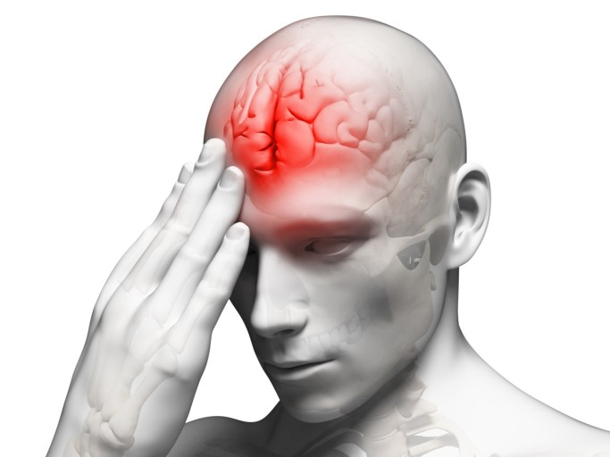
Objective
- Brief description
Among the mortality rates by cause in Korea, stroke is second only to cancer, and it is 70.3 per 100,000 population. This accounts for 13.9% of all deaths.
We try to identify the cause and prevent stroke through data analysis.

Slide 4
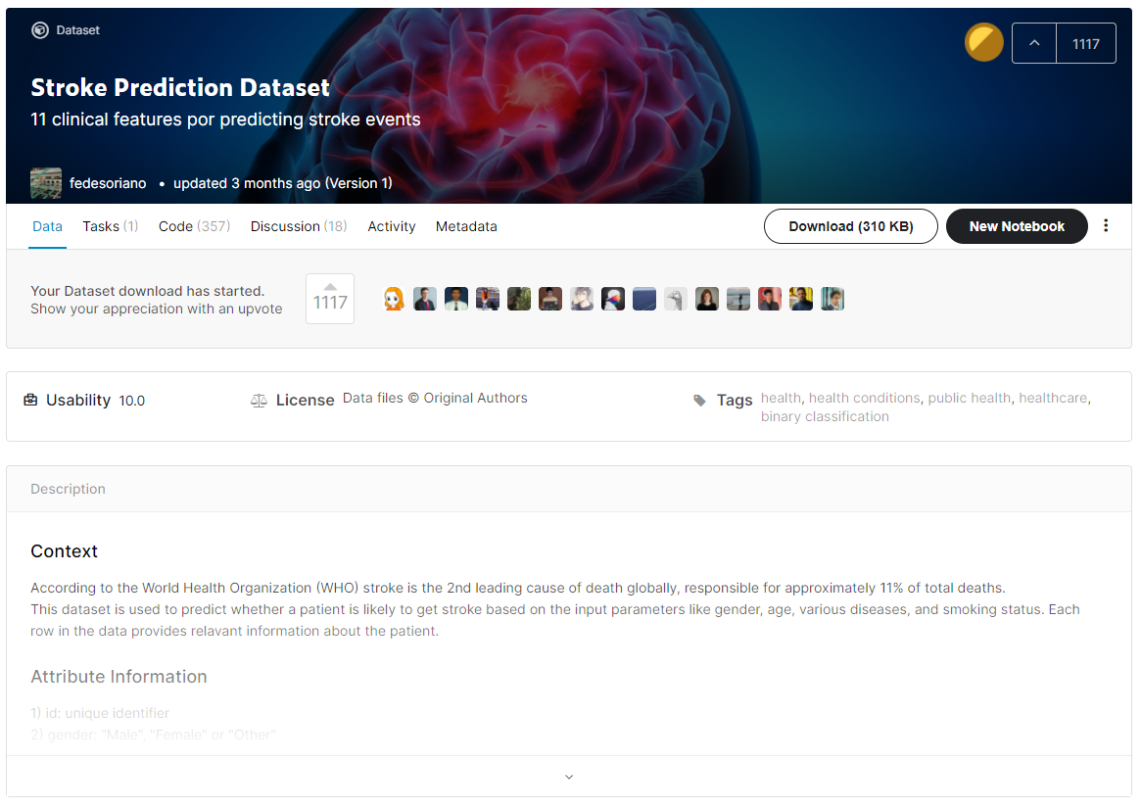
Data
- Curation
Source of data citation
https://www.kaggle.com/fedesoriano/stroke-prediction-dataset

Slide 5
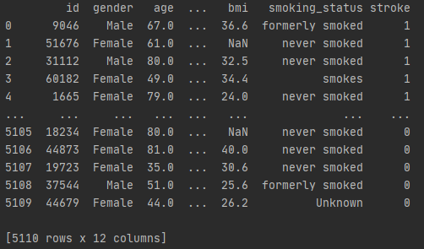
Data
- Inspection
Size
Data format
Size – 5110 rows
Size – 12 columns
Category – 5 pieces
Category

Slide 6
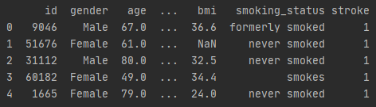
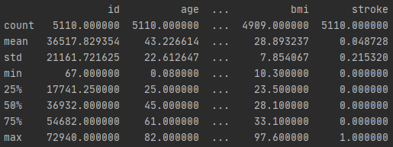
Data
- Inspection
Data.head()
Data.describe()

Slide 7
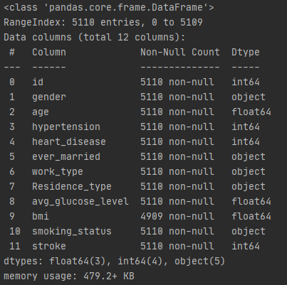
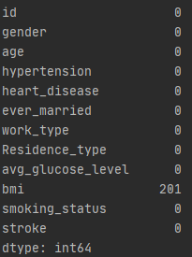
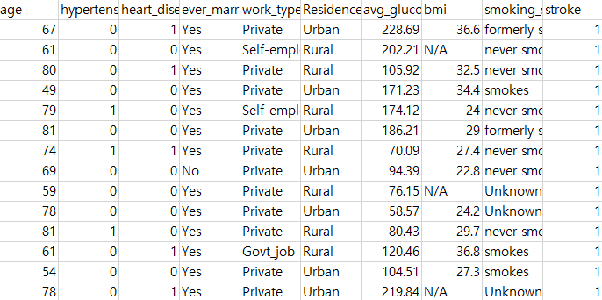
Data
- Inspection
Data.info()
Data.isNull()

Slide 8
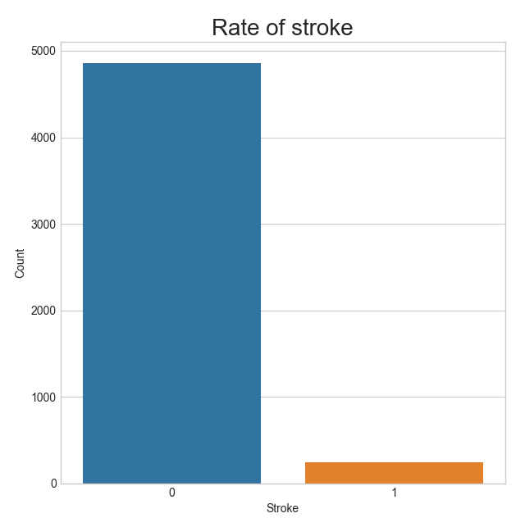
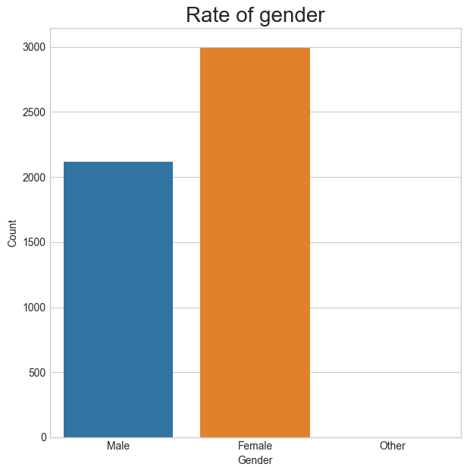
Data
- Inspection
Rate of stroke
Rate of gender

Slide 9
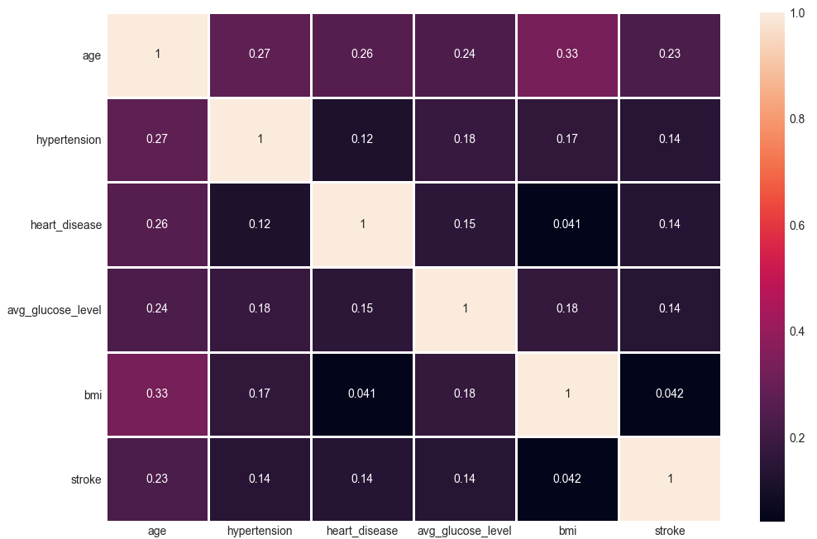
Data
- Inspection
Notes:
Heatmap을 통해 데이터간의 상관관계를 나타내보았습니다.

Slide 10
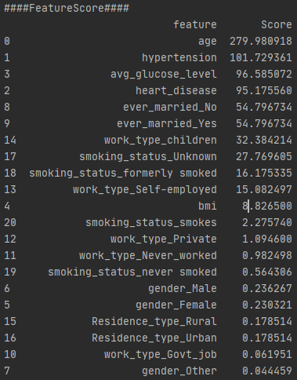
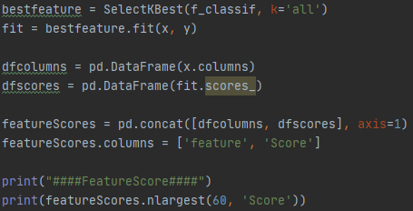
Data
- Inspection
Notes:
featureScore metho를 이용해 stroke 발병률에 영향을 미치는 feature를 순위로 나타내었습니다.

Slide 11
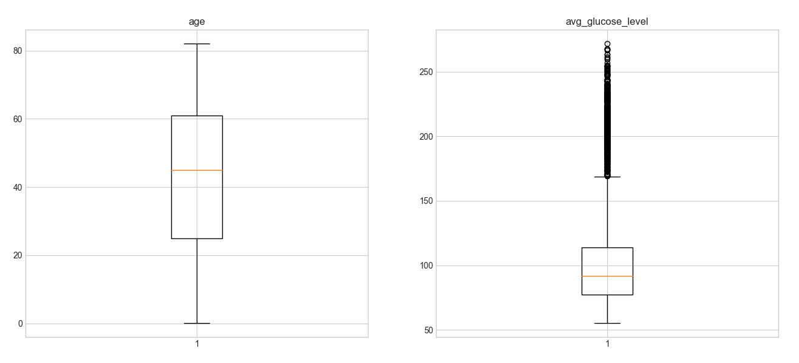
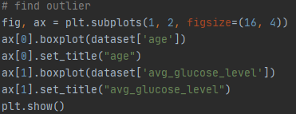
Data
- Inspection
Find Outlier

Slide 12


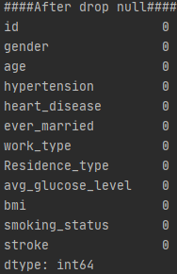
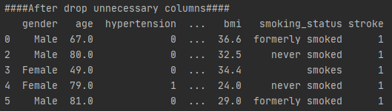
Data
- Preprocessing
Drop null data
Drop unnecessary column(ID)

Slide 13
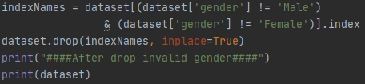
Data
- Preprocessing
Drop wrong value(gender)
Only one value of gender was in error.
Rows : 4909 -> 4908

Slide 14
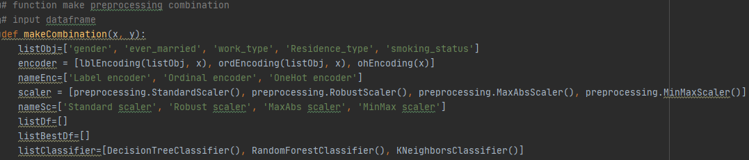
Data
- Data Analysis
Our team's function
-> A function that compares the accuracy to find the optimal encoding and scaling
3 Encoder
4 Scaler
Standard scaler
Robust scaler
MaxAbs scaler
MinMax scaler
12 Types
Label encoder
Ordinal encoder
OneHot encoder

Slide 15
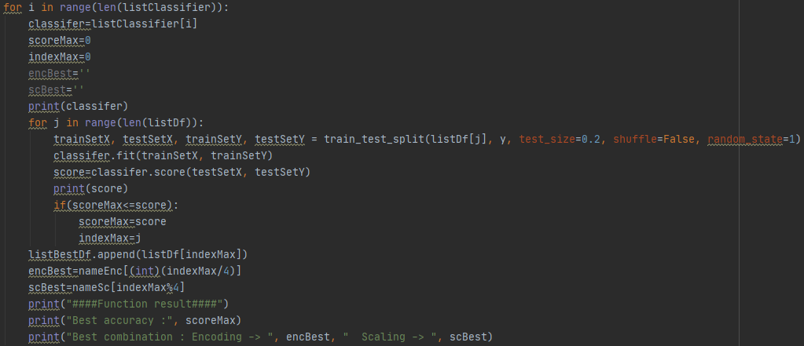

Data
- Data Analysis
Our team's function
-> A function that compares the accuracy to find the optimal encoding and scaling

Slide 16
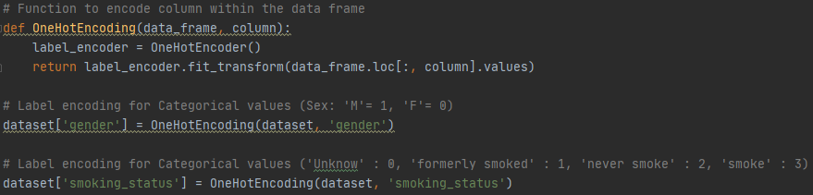
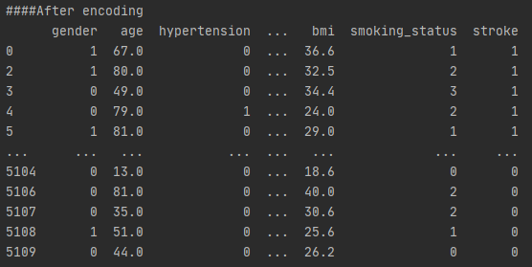
Data
- Preprocessing
Encoding(Label encoder)

Slide 17
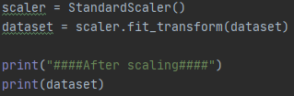
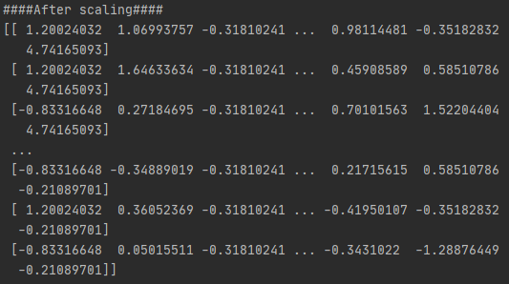
Data
- Preprocessing
Scaling(Standard scaling)

Slide 18
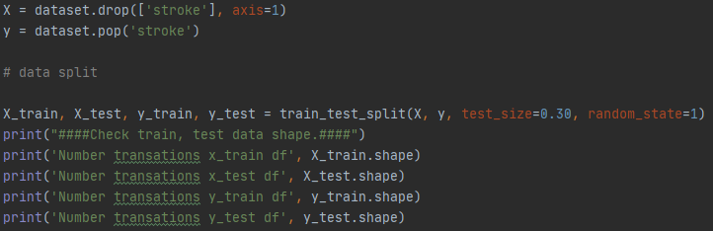
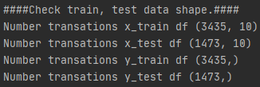
Data
- Data Analysis
Data split

Slide 19
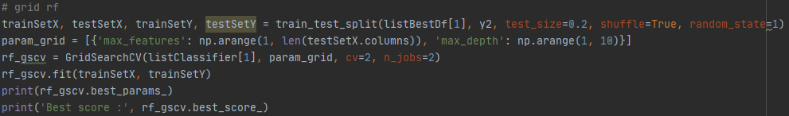
Data
- Data Analysis
Decision Tree
Accuracy

Slide 20
Data
- Data Analysis
Random Forest
Accuracy

Slide 21
Data
- Data Analysis
KNN
Accuracy

Slide 22
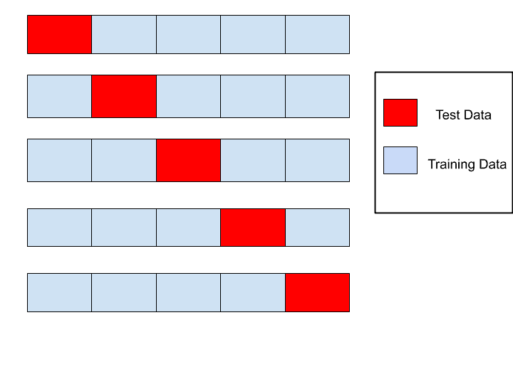
Data
- Evaluation
K-fold cross validation
Decision Tree
Random Forest
KNN

Slide 23
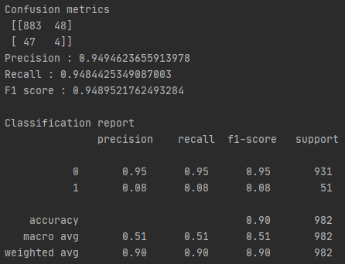
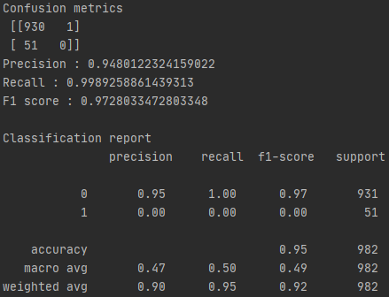
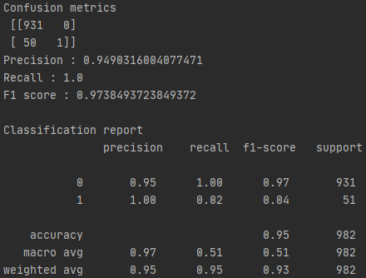
Data
- Evaluation
Confusion Matrix & Report
Decision Tree
Random Forest
KNN

Slide 24



Role
Curation
Inspection
Preprocesssing
Analysis
Evaluation
We are going to work on it all together.

Slide 25
3조
Thank You

