Slide 1


Data Science Term Project
PREDICT
STROKE
201635820 신민오
201635831 이민수
201635840 이정명

Slide 2

Objective
-Brief description
Data
-Size
-Data format
-Category
Algorithm
Role

Slide 3

Objective
Among the mortality rates by cause in Korea, stroke is second only to cancer, and it is 70.3 per 100,000 population. This accounts for 13.9% of all deaths.
We try to identify the cause and prevent stroke through data analysis.

Slide 4
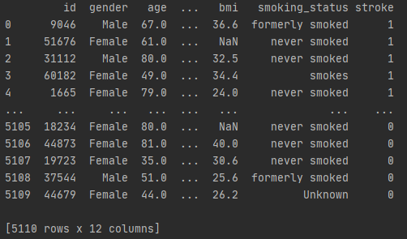
Data
Size
Data format
Size – 5110 rows
Size – 12 columns
Category – 5 pieces
Category

Slide 5
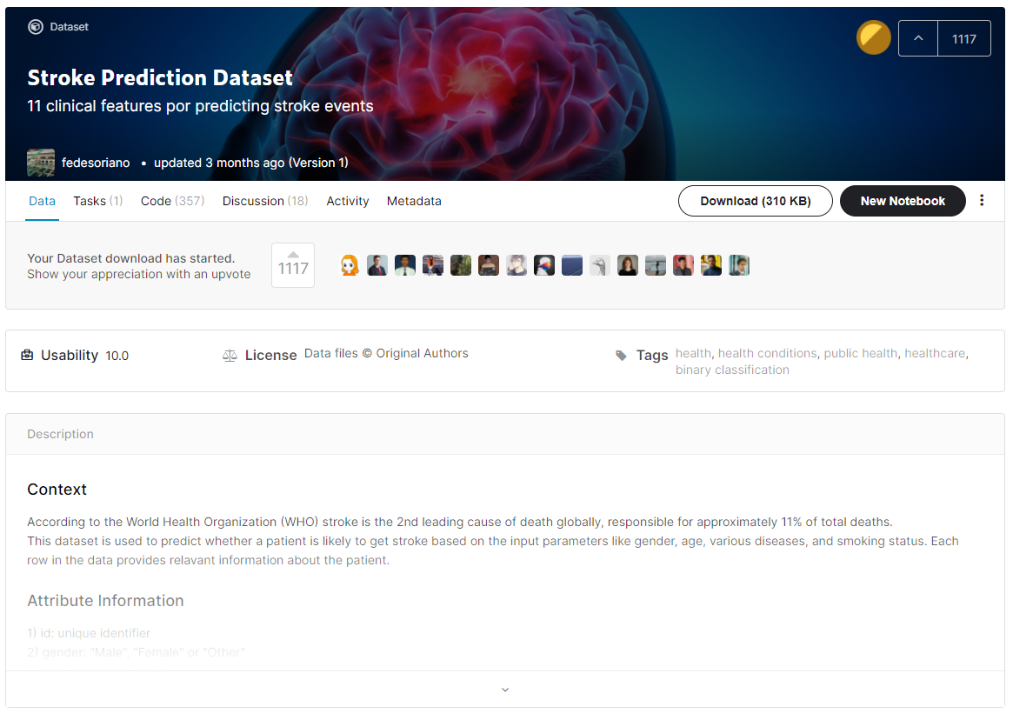
Data
Source of data citation
https://www.kaggle.com/fedesoriano/stroke-prediction-dataset

Slide 6
Algorithm
1. Linear Regression
Analyze the effect between variables
2. Logistic Regression
Prediction of probability (Estimate of stroke incidence)
3. Decision Trees
Determining which factors (ex BMI, smoke) are the most likely to cause stroke
4. K-Nearest Neighbor
Determining the distribution of glucosamine levels in normal and stroke patients

Slide 7



Role
Data preprocessing
Data regression
Algorithm
We are going to work on it all together.

Slide 8
3조
Thank You

