Slide 1
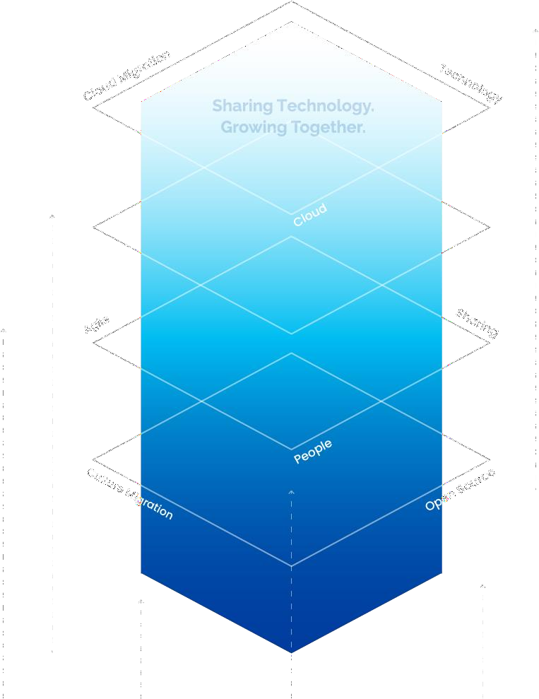





Slide 2



I
사내 On-premise LLM의 필요성
II
On-premise LLM 솔루션
III
제품의 차별성

Slide 3

업무 프로세스를 완전히 혁신하는 LLM LLM을 활용한 Usercases
On-premise LLM, 왜 필요한가

Slide 4
Chapter 2. 오픈소스 컨설팅의 On-premise LLM 솔루션
MAAL (Multilingual Adaptive Augmentation Language-model) MAAL 기반 On-premise 패키지
챗봇
Chatplay
LLM Task UI

Slide 5
차별성 1 – 독보적인 기술력
차별성 2 – 획기적인 가격 경쟁력 차별성 3 – 맞춤형 서비스로 확장 지원
차별성 4 – 원활한 고객 지원

Slide 6





Slide 7





Trustworthy Analytics with Generative AI: Four Use Cases for ChatGPT / GPT-4
Dr. Georg Wittenburg ▪ Inspirient
General Online Research Conference 2023 (GOR 23) Kassel, 21 September 2023

Slide 8
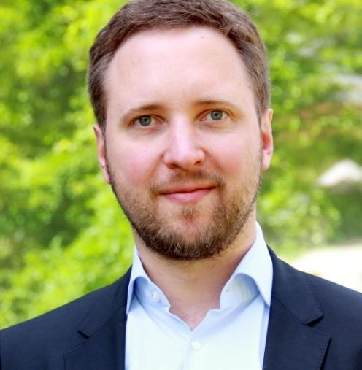


Copyright © 2023 by Inspirient GmbH. All rights reserved.
Dr. Georg Wittenburg
Co-founder and CEO at Inspirient

Slide 9

Thank you for your time today
Copyright © 2023 by Inspirient GmbH. All rights reserved.
Dr. Georg Wittenburg
georg.wittenburg@inspirient.com

Slide 10

RAG 세미나
Knowledge Intelligence Lab. Hanbat National University
자연어처리의 정보검색 기법과 최신 RAG 모델
2024.05.01
Cheoneum Park
Assistant Professor
Dept. of Computer Engineering Hanbat National University, Korea

Slide 11




연사 소개
Knowledge Intelligence Lab. Hanbat National University
박천음
Senior Researcher (HMG, `20~`23)
Manager (SKT, `23~`24)
Assistant Professor (HBNU, `24~)
Interested in:
Natural Language Processing
Question Answering
LLM and RAG
Multimodal Learning
Explainable AI

Slide 12
Outline
Knowledge Intelligence Lab. Hanbat National University
Retrievals
Sparse Retrieval
Benchmark Datasets
Dense Retrieval
Negative Sampling
Single Vector Retriever
Multi Vector Retriever
Generative Retrieval
Embeddings and Ranking
Large-scale Embeddings
Ranking Approach
Retrieval Augmented Generation
Basic RAG
RAG with Large Language Model
Advanced RAG
Modular RAG
The Future
Multimodal RAG

Slide 13
Chapter 1
Knowledge Intelligence Lab. Hanbat National University
Retrievals
Sparse Retrieval
Benchmark Datasets
Dense Retrieval
Negative Sampling
Single Vector Retriever
Multi Vector Retriever
Generative Retrieval

Slide 14
Chapter 2
Knowledge Intelligence Lab. Hanbat National University
Retrievals
Sparse Retrieval
Benchmark Datasets
Dense Retrieval
Negative Sampling
Single Vector Retriever
Multi Vector Retriever
Generative Retrieval
Embeddings and Ranking
Large-scale Embeddings
Ranking Approach

Slide 15
Chapter 3
Knowledge Intelligence Lab. Hanbat National University
Retrievals
Sparse Retrieval
Benchmark Datasets
Dense Retrieval
Negative Sampling
Single Vector Retriever
Multi Vector Retriever
Generative Retrieval
Embeddings and Ranking
Large-scale Embeddings
Ranking Approach
Retrieval Augmented Generation
Basic RAG
RAG with Large Language Model
Advanced RAG
Modular RAG
Multimodal RAG

Slide 16
감사합니다
Knowledge Intelligence Lab. Hanbat National University
Cheoneum Park
parkce@hanbat.ac.kr https://sites.google.com/view/ki-lab

Slide 17


1. Agados 기능과 특징
Agados UI , Flow Design & Visibility Technologies
Functions & Features Revision: 2014.11.23
Template Revision:20131025 v2.0

Slide 18
Biz. Application을 위한 Architecture

Slide 19
Biz. Application을 위한 디자이너/재조정기
‘아가도스’는 귀사의 SW Application내에서 Configure Tool의 역할 수행

Slide 20
정보처리 Application에 가시성(Visibilities) 부여하기
‘아가도스’는 귀사의 Application에게 다양한 가시성 제공 기능을 부여합니다.

Slide 21
Agados-based Application 를 위한 Benefit
‘아가도스’는 귀사의 Application에게 선진 고도화된 제품화 가능성을 제공합니다.

Slide 22



Pivotal HAWQ 소개
Seungdon Choi Field Engineer Pivotal Korea

Slide 23

Agenda
Overview
Architecture
Machine Learning using HAWQ
Roadmap
Appendix: HAWQ vs Hive

Slide 24




E m p o w e r i n g p e o p l e w i t h d a t a

Slide 25













INDEX

Slide 26






















[1] About Statista

Slide 27


Slide 28









Jamcracker 소개 시작
OSC ASIA GROUP LIMITED
Cloud Management Platform & Cloud Service Brokerage
CLOUD SERVICES BROKERAGE
MICROSOFT CSP ENABLEMENT
CLOUD GOVERNANCE
HYBRID CLOUD MANAGEMENT
@ OSC Korea & OSC Asia Group jerry@osckorea.com jerry@oscasia.net +82 10 9196 1416

Slide 29
Large Language Model Mata AI -LLaMA 2
LLaMa 2
LLMs
The Next Level of AI Generation
© Rk Rahul

Slide 30
Thanks!
LLaMa 2

