Slide 1

Going Deeper: Why Depth Works in CNNs
How three networks (AlexNet, VGG, ResNet) made it possible
Application No. [MT21021] · Junhyeong Lee
DGIST Artificial Intelligence Major · M.S. Admission Interview · October 21, 2026
1/5
Notes:
Good afternoon. I’m Junhyeong Lee. Today I’ll explain one concept: depth in CNNs — why deeper networks work better, and how AlexNet, VGG, and ResNet made it possible.

Slide 2
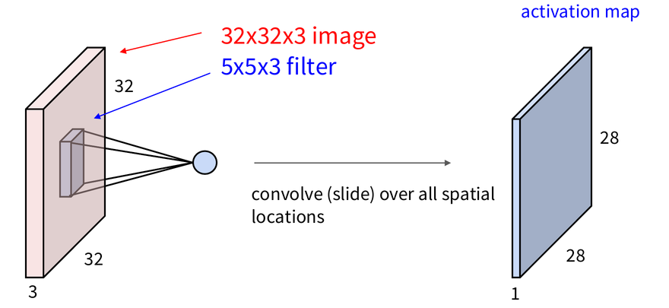
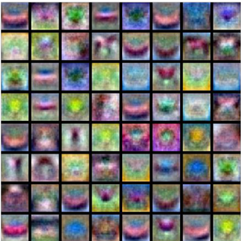
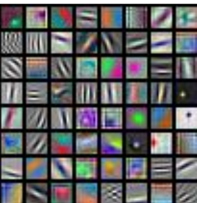
The core idea: convolution = a sliding dot product
A filter slides over the image: one dot product per position
Why not a fully-connected layer?
wᵀx + b
  224×224×3 image → 150k inputs → 150M weights for 1,000 units
  Every pixel connects to every unit → position is ignored
large where the patch looks like the filter
FC learns:
blurry whole-image templates
Conv learns: local edges & colors
Why does convolution fit images?
① Local connectivity
② Weight sharing
③ Stacking
④ Learned
Each unit sees only a small patch → position is kept
Same filter everywhere
→ few weights, found anywhere
Edges → parts → objects
Filter values are weights,
trained by backpropagation
Deeper layers see more of the image and build richer features. → how deep can we go?
2/5
Notes:
First, convolution. A small filter slides over the image and takes a dot product at each position. The output is large where the patch looks like the filter.
Why not a fully-connected layer? It needs millions of weights, and it ignores position — it only learns blurry whole-image templates. Convolution learns small local edges and colors instead.
So why does convolution fit images? Four reasons. Each unit sees only a small patch. The same filter is shared everywhere. Stacking turns edges into parts and objects. And the filters are learned by backpropagation.
Deeper layers see more of the image. So, how deep can we go?

Slide 3
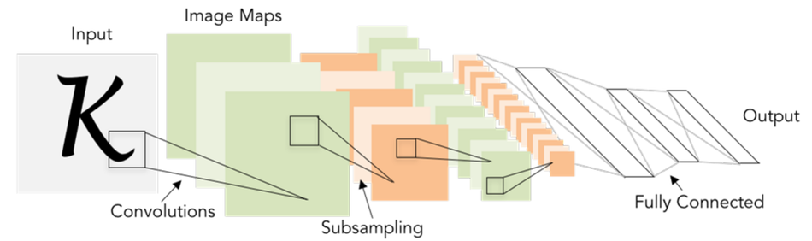
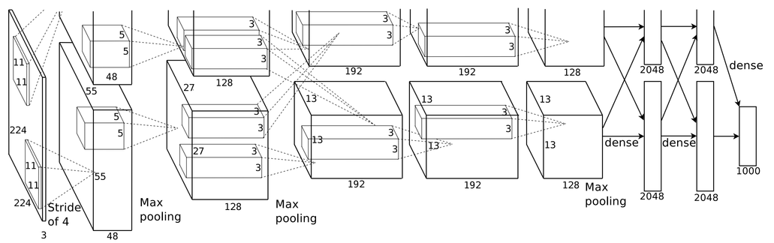
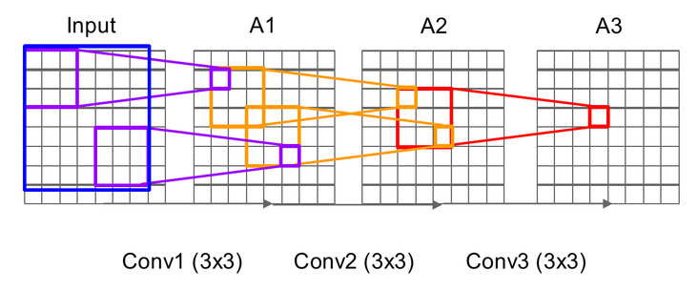
Going deeper: LeNet → AlexNet → VGG
LeNet-5
1998
5 learnable layers · MNIST digits
  conv + pooling + FC
  Too little data and compute to go deeper
LeCun et al., 1998
AlexNet
VGG
2012
2014
8 layers · 60M params · ImageNet top-5 error 25.8% → 16.4%
16–19 layers · top-5 error 7.3%
  GPUs + 1.2M images, ReLU, dropout, augmentation
  5 conv + 3 FC, split over two GPUs
  Only 3×3 filters: three 3×3 = one 7×7 receptive field, 27C² vs 49C² weights (C = channels), more non-linearity
  Same simple block, repeated → just go deeper
Krizhevsky et al., 2012
AlexNet made depth trainable. VGG made depth simple. Lesson: deeper is better — if you can train it
3/5
Notes:
LeNet already had this design in 1998, but there was not enough data or compute.
AlexNet in 2012 made depth trainable — with GPUs, ImageNet, ReLU, and dropout. The error fell to about 16 percent.
VGG in 2014 made depth simple. Three 3 by 3 layers see the same area as one 7 by 7, with fewer weights. So VGG just repeats the same block — 19 layers, 7.3 percent.
The lesson: deeper is better — if the network can be trained.

Slide 4
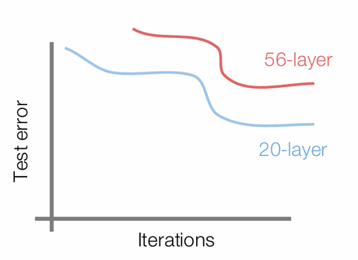
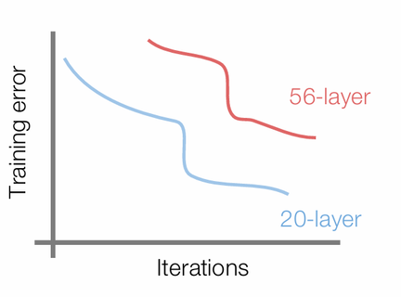
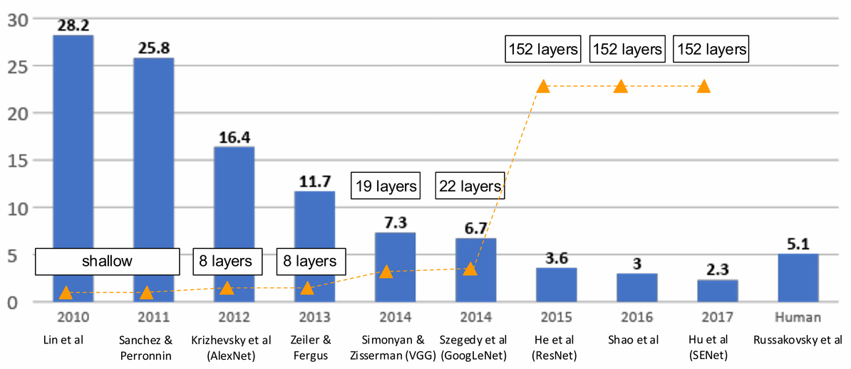
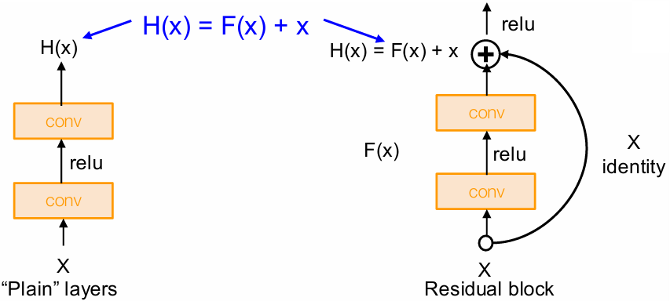
Deeper isn't free: the degradation problem and ResNet
Problem: 56 plain layers do worse than 20
Result: 152 layers, error below human level
ImageNet top-5 error (%)
  Even training error is worse
→ not overfitting. Deeper models are harder to optimize.
Solution: the residual block
 | ResNet | VGG | Human | AlexNet
Layers | 152 | 19 | - | 8
Top-5 error | 3.6% | 7.3% | 5.1% | 16.4%
He et al., 2016
  Layers learn only F(x) = H(x) − x → F = 0 gives identity
  Gradient flows straight through the skip path
What made depth possible was the skip connection, not just more layers.
4/5
Notes:
But deeper is not free. A 56-layer network was worse than a 20-layer one. And even the training error is worse — so it’s not overfitting. It’s an optimization problem.
ResNet’s solution is the residual block. We add the input x to the output, so the layers only learn the difference, F of x. If F is zero, we just get x back — so learning identity becomes easy, and extra layers don’t hurt. Gradients also flow straight through the skip path.
With this, ResNet trained 152 layers and reached 3.6 percent error — below human level.

Slide 5
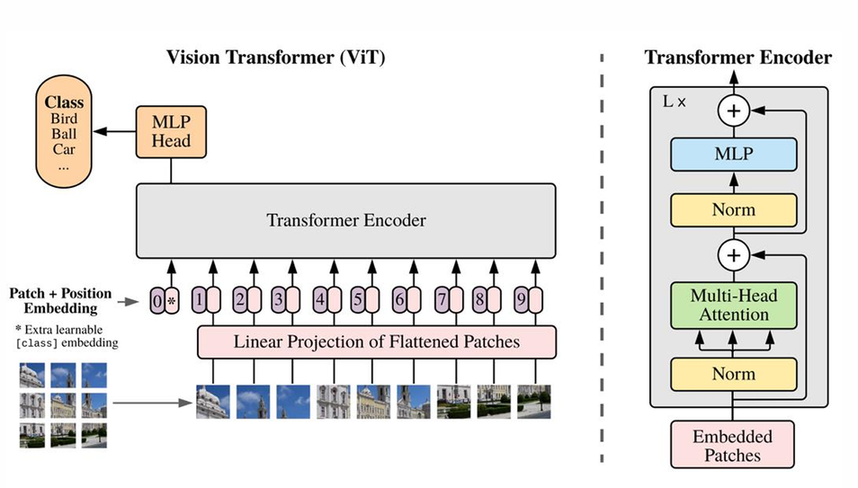
Summary: what three networks taught us about depth
AlexNet · 2012
VGG · 2014
ResNet · 2015
made depth TRAINABLE
made depth SIMPLE
made depth OPTIMIZABLE
GPUs, 1.2M images, ReLU, dropout
→ 8 layers, 16.4% error
Only 3×3 filters: three 3×3 = one 7×7, fewer weights, more non-linearity
→ 19 layers, 7.3%
Skip connection: learn F(x) = H(x) − x, identity is easy to learn
→ 152 layers, 3.6%
Depth is what makes deep learning powerful — residual connections are what made deeper networks trainable.
Beyond CNNs
  Transformers (2017) and Vision Transformers (2020) keep the residual path for exactly the same reason: it makes deep stacks trainable.
  ConvNeXt (2022): a modern CNN with residual blocks still matches Transformers
Dosovitskiy et al., 2021
5/5
Figures adapted from Stanford CS231n (Lectures 5–6) and the original papers.
Notes:
To summarize: AlexNet made depth trainable, VGG made it simple, and ResNet made it optimizable.
And Transformers use the same idea — these plus signs are the same skip connections we saw in ResNet.
Depth is what makes deep learning powerful, and residual connections are what made deeper networks trainable. Thank you.

