Slide 1
Optimizing Transportation Costs using the Simplex Method
Presented by Rebecca Menasci and Junil Lee

Slide 2

Introduction to Logistics and Transportation Costs
Logistics is a critical component of any business, and transportation costs can significantly impact a company's bottom line. Minimizing these costs is essential for maintaining profitability and competitiveness.
Outline:
Introduction to Linear Programming and Simplex Method
Overview of the Transportation Simplex Method
Detailed Example and Solution
Implementation in Python
Comparison and Conclusion

Slide 3
What is Linear Programming?
Linear Programming (LP) is a mathematical method for determining a way to achieve the best outcome in a given mathematical model whose requirements are represented by linear relationships.
Used in various fields such as economics, business, engineering, and military applications.
The Transportation Simplex Method is an optimization algorithm specifically adapted from the Simplex Method
Used to solve Transportation and Transportation Cost problems efficiently
Focuses on finding the optimal transportation plan that minimizes total transportation costs

Slide 4
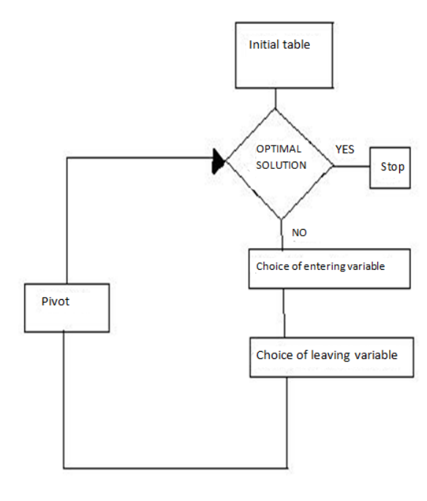
The Simplex Method Overview
The Simplex Method is an iterative algorithm designed to solve LP problems efficiently by moving along the edges of the feasible region to find the optimal solution.
Key Steps
Formulate the LP problem.
Convert the LP problem into standard form.
Set up the initial Simplex tableau.
Perform pivot operations to iterate towards optimality.
Check for optimality and repeat steps if necessary.
Extract and interpret the solution.

Slide 5
What is the Transportation Simplex Method?
Definition: An optimal variant of the Simplex Method specifically designed for solving transportation problems, which aim to minimize transportation costs.
Objective: To determine the most cost-effective way to transport goods from suppliers to consumers while satisfying supply and demand constraints. Key Differences:
Initial Feasibility using the Northwest Corner Rule.
Modified calculations for the transportation problem structure.

Slide 6

Steps in the Transportation Simplex Method
1
Check for balancing
2
Initial solution using Northwest Corner Rule
3
Calculate opportunity costs, identify entering variable.
Determine the loop, adjust allocations.
Recalculate Dual Variables and Opportunity Costs
4
5

Slide 7
Applying the Simplex Method to a Real-World Transportation Problem
1
Data Collection
Gather detailed information
2
Model Development
Formulate the transportation problem
3
Optimization
Apply the Simplex Method
Description: Involves finding the least cost way to transport goods from a set of suppliers to a set of consumers. Components: Supply, Demand and Cost Matrix

Slide 8
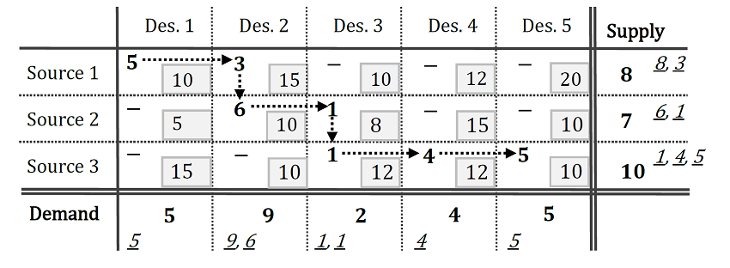
The Northwest Corner Method
A heuristic for finding an initial feasible solution in transportation problems.
Used as a starting point for optimization methods.
Step 1: Start with the top-left cell (the North-West corner cell) of the transportation matrix. Assign it the minimum value of supply or demand, i.e., min(supply, demand).
Step 2: Subtract the minimum value from the corresponding row and column's supply and demand. This can result in three possible scenarios:
If the supply is zero, cross out that row and move down to the next cell.
If the demand is zero, cross out that column and move right to the next cell.
If both supply and demand are zero, cross out both the row and column and move diagonally to the next cell.
Step 3: Repeat these steps until all supply and demand values are zero.

Slide 9
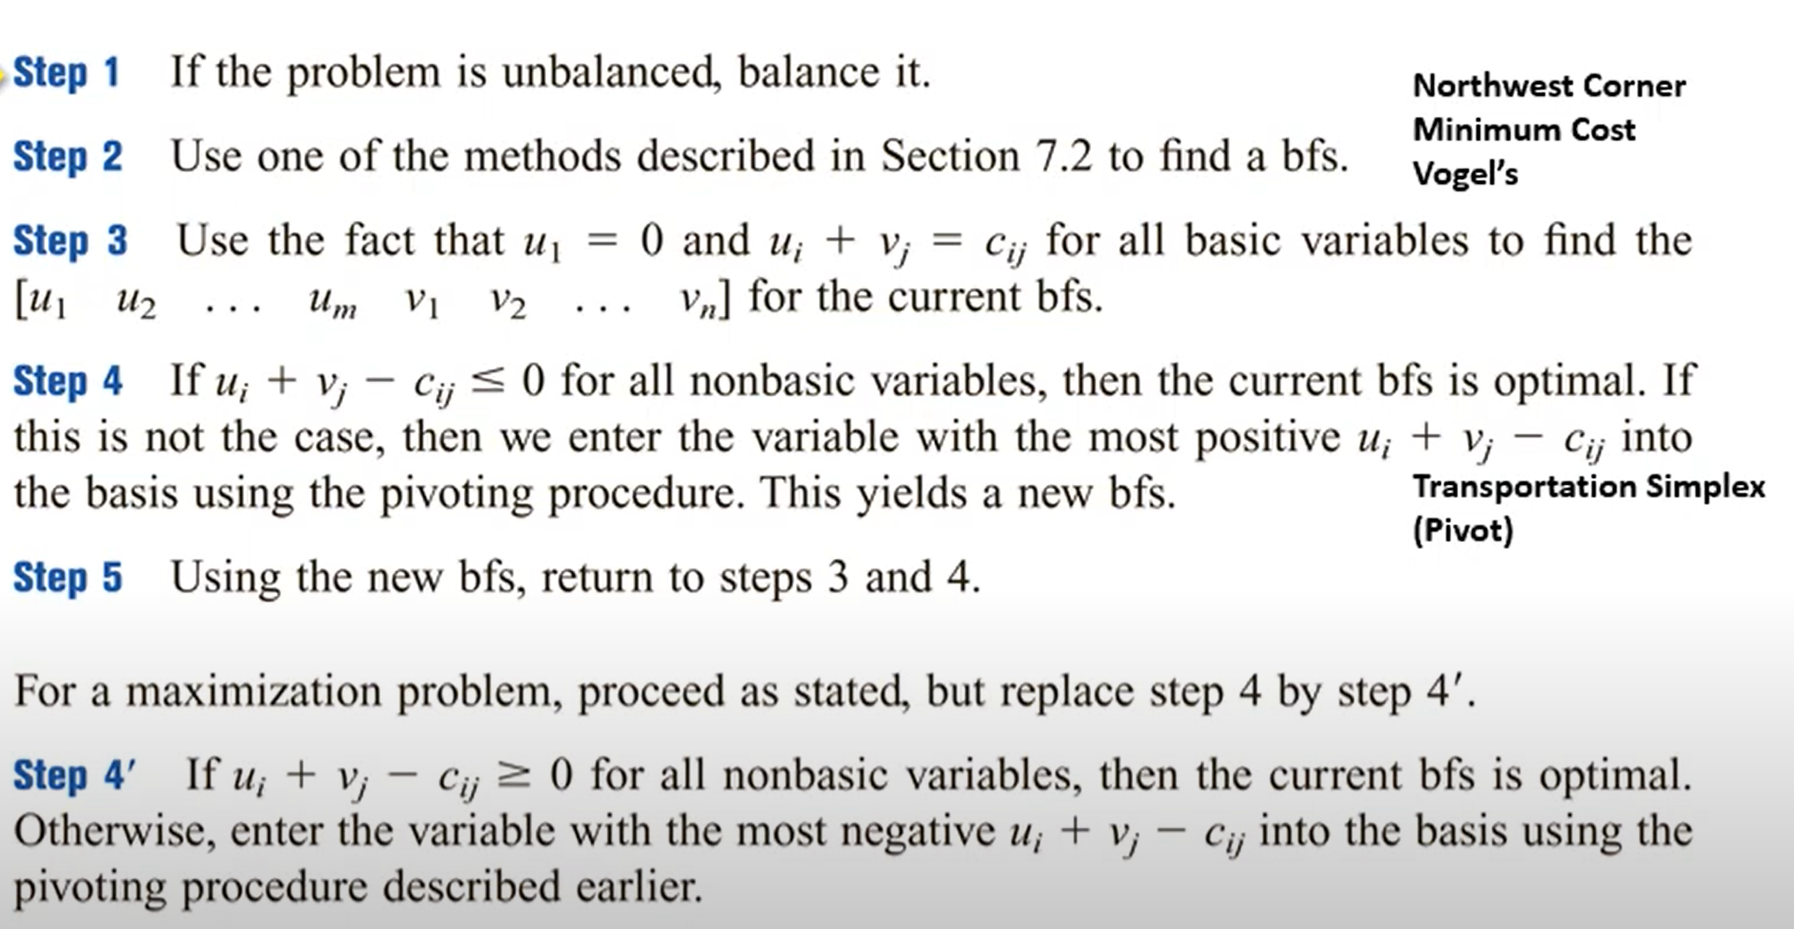
Example Problem Setup
from | City 1 | City 2 | City 3 | City 4 | SUPPLY
Plant 1 | $8 | $6 | $10 | $9 | 35
Plant 2 | $9 | $12 | $13 | $7 | 50
Plant 3 | $14 | $9 | $16 | $5 | 50
DEMAND | 45 | 20 | 30 | 30

Slide 10
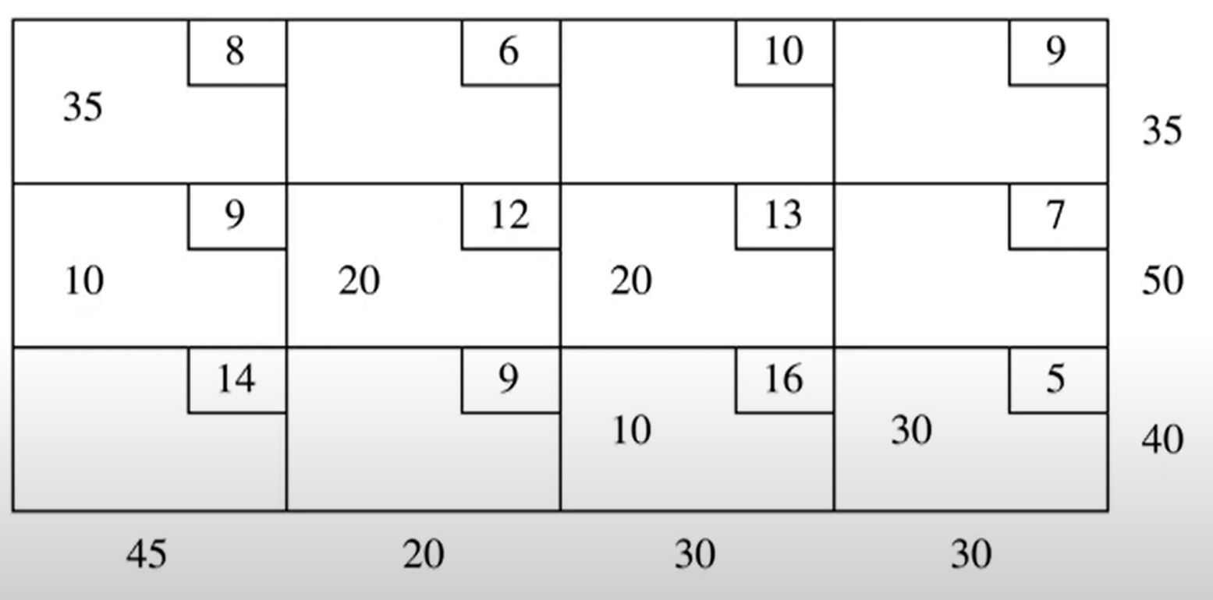
Step 2: Northwest corner rule
Step-by-Step:
Allocate 35 units to (0,0) (Supply: 35, Demand: 45)
Remaining Supply: [0, 50, 40], Remaining Demand: [10, 20, 30, 30]
Move to (1,0), Allocate 10 units (Supply: 50, Demand: 10)
Remaining Supply: [0, 40, 40], Remaining Demand: [0, 20, 30, 30]
Continue until all supplies and demands are met.
Initial Cost Calculation: 35⋅8+10⋅9+20⋅12+20⋅13+10⋅16+30⋅5=$1180

Slide 11
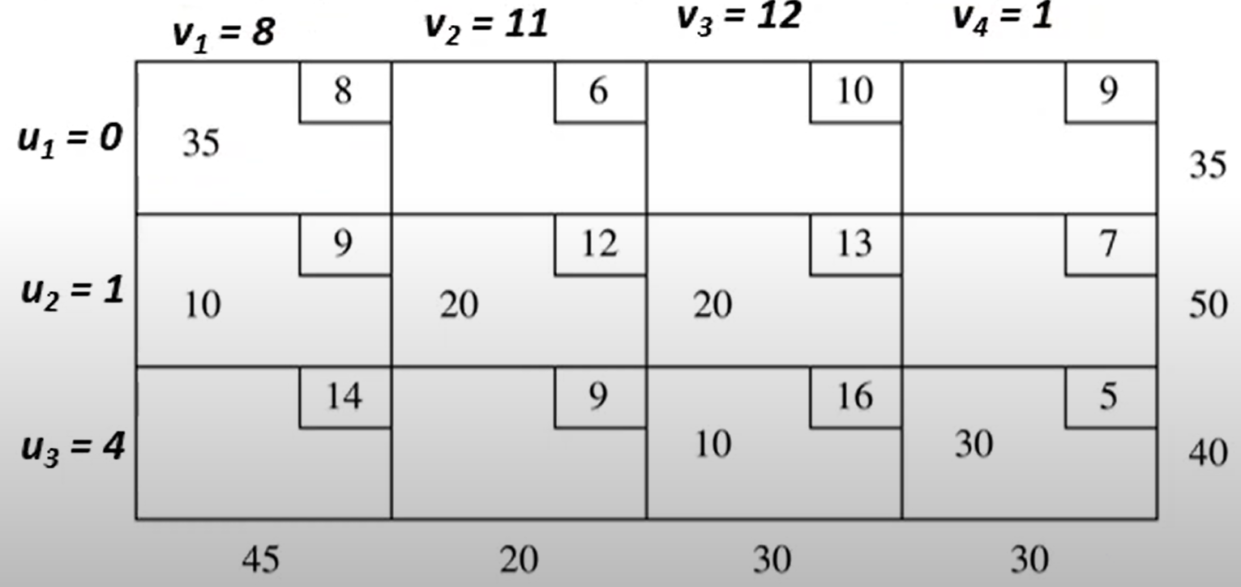
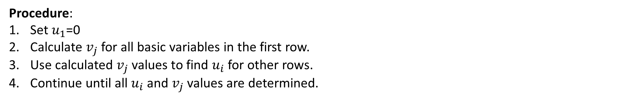
Step 3: Basic Variables
Procedure:
Set $u_{1}$=0
Calculate $v_{j}$ for all basic variables in the first row.
Use calculated $v_{j}$​ values to find $u_{i}$ for other rows.
Continue until all $u_{i}$ and $v_{j}$ values are determined.

Slide 12
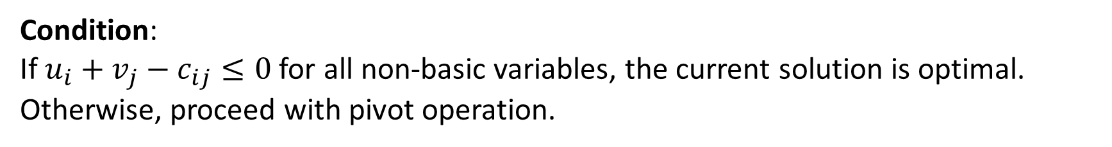


Step 4: Non basic Variables
Condition:
If $u_{i}+v_{j}−c_{ij}≤0$ for all non-basic variables, the current solution is optimal. Otherwise, proceed with pivot operation.
Calculate opportunity cost for non-basic variables.
Identify the variable with the most positive opportunity cost.
$${\overline{c_{ij}}=u}_{i}+v_{j}−c_{ij}$$
$\overline{c_{12}}=0+11−6=5$
$\overline{c_{14}}=0+1−9=−8$
$\overline{c_{31}}=4+8−14=−2$
$\overline{c_{13}}=0+12−10=2$
$\overline{c_{24}}=1+1−7=−5$
$\overline{c_{32}}=4+11−9=6$

Slide 13
Pivot: Transportation Simplex
Step 1: Select an unused cell with the most positive reduced cost as incoming.
Step 2: Find the loop involving the entering variable and some of the basic variable
Step 3: Counting only cells in the loop, label those found in step 2 that are even number of cells away from the entering variable as even and the other ones as odd.
Step 4: Find the odd cell whose variable assumes the smallest value , call this value as α. To perform the pivot, decrease the value of each odd cell by the value α and increase the value of each even cell by α. The values of variables not in the loop remain unchanged

Slide 14
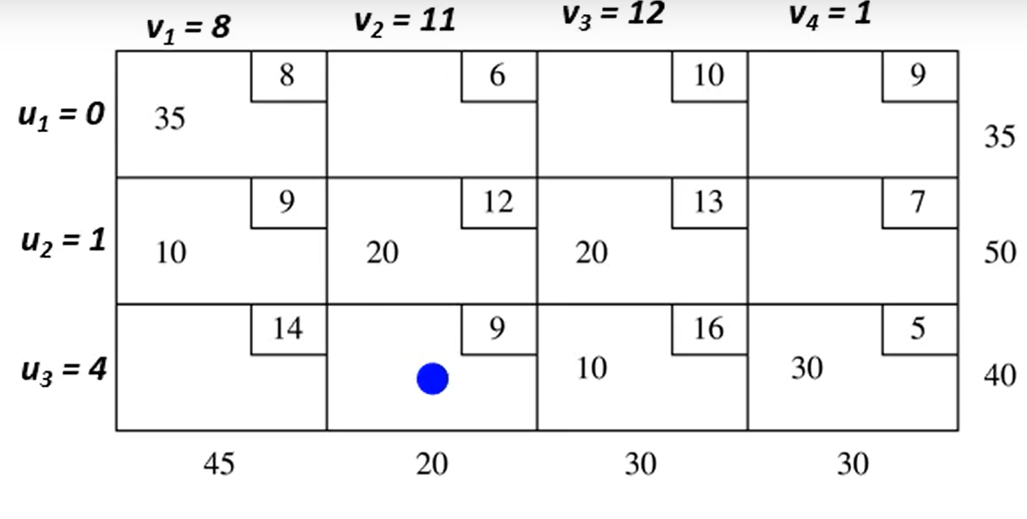
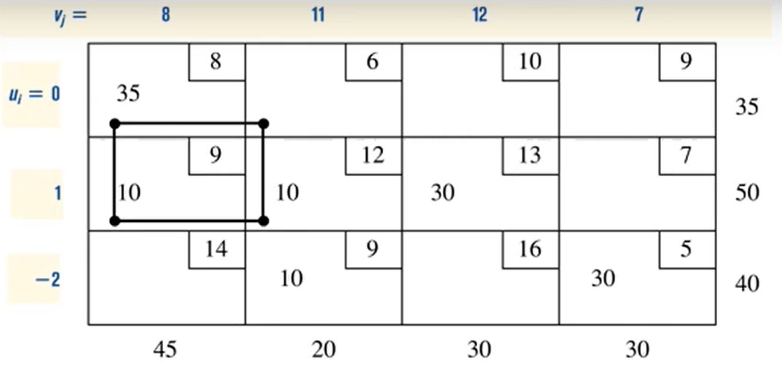
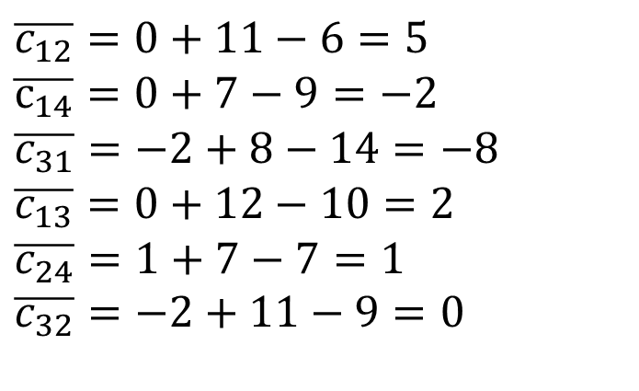

α=min(20,10)=10
-10
+10
+10
-10
α=min(35,10)=10
Update the $u_{i}$and $v_{j}$
-10
+10
$\overline{c_{12}}=0+11−6=5$
$\overline{c_{14}}=0+7−9=−2$
$\overline{c_{31}}=−2+8−14=−8$
$\overline{c_{13}}=0+12−10=2$
$\overline{c_{24}}=1+7−7=1$
$\overline{c_{32}}=−2+11−9=0$
+10
-10

Slide 15
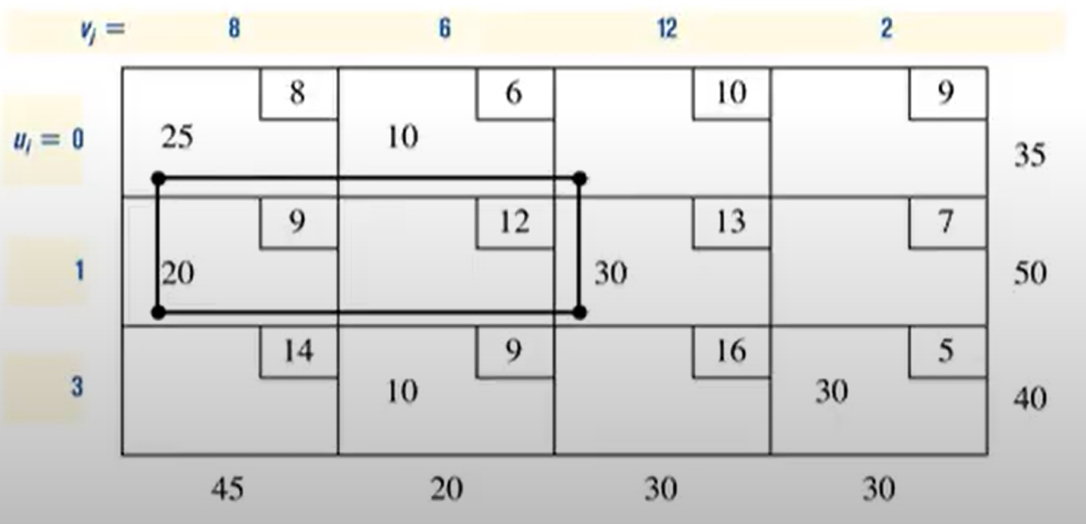
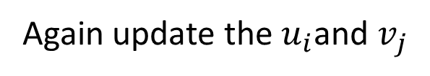
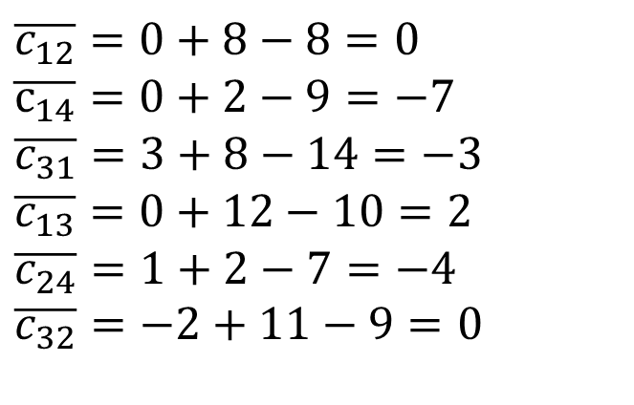
Again update the $u_{i}$and $v_{j}$
-25
+25
$\overline{c_{12}}=0+8−8=0$
$\overline{c_{14}}=0+2−9=−7$
$\overline{c_{31}}=3+8−14=−3$
$\overline{c_{13}}=0+12−10=2$
$\overline{c_{24}}=1+2−7=−4$
$\overline{c_{32}}=−2+11−9=0$
+25
-25
α=min(30,25,20)=25

Slide 16
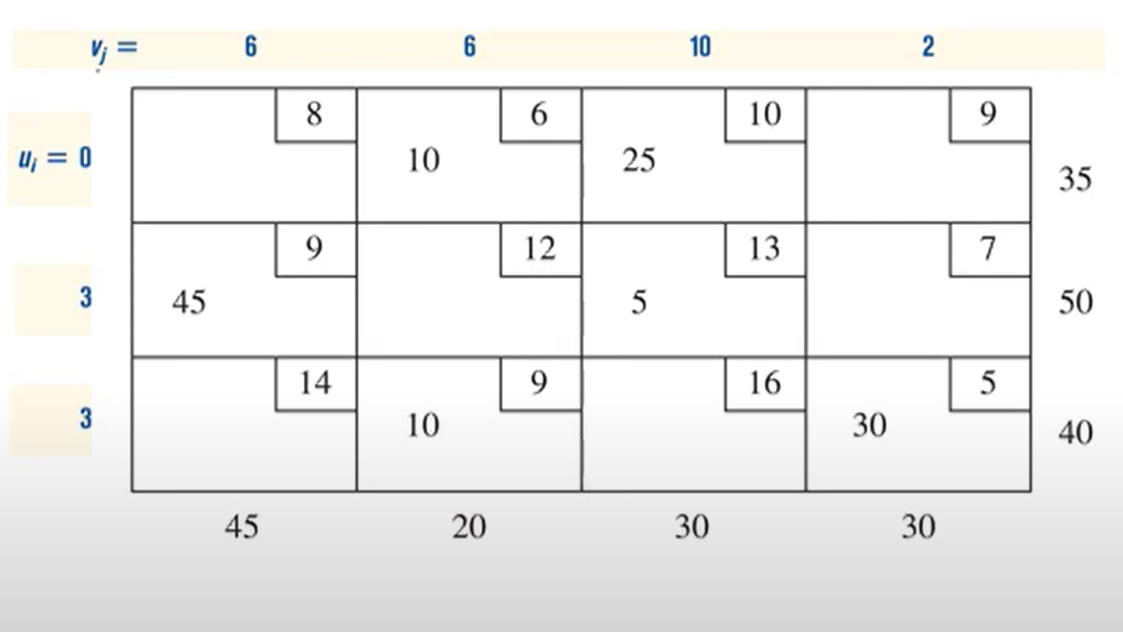
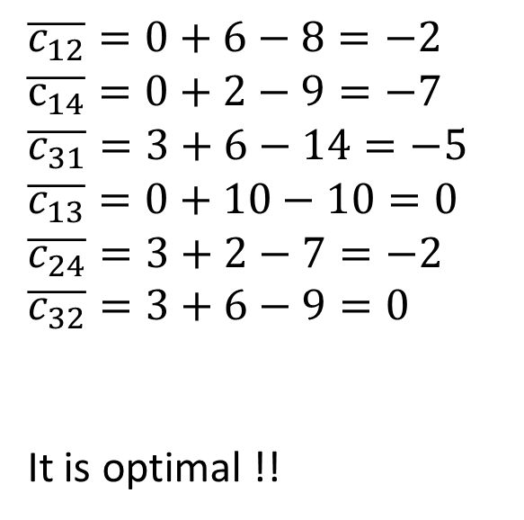
Optimal Solution
$\overline{c_{12}}=0+6−8=−2$
$\overline{c_{14}}=0+2−9=−7$
$\overline{c_{31}}=3+6−14=−5$
$\overline{c_{13}}=0+10−10=0$
$\overline{c_{24}}=3+2−7=−2$
$\overline{c_{32}}=3+6−9=0$
It is optimal !!
$totalCost=6(10)$+10(25)+45(9)+5(13)+10(9)+30(5)=$1020

Slide 17
Comparison and Relevance to the Simplex Method
Northwest Corner provides an initial feasible solution.
Simplex Method refines this to find the optimal solution.
Standard Simplex Method:
General LP problems.
Operates on tableau form.
Moves from one vertex of the feasible region to another.
Transportation Simplex Method:
Specialized for transportation problems.
Operates on a cost matrix.
Moves along basic feasible solutions with cost adjustments.
Relevance:
Both methods aim to find the optimal solution.
Transportation Simplex is an adaptation of the Simplex Method, tailored for specific constraints and structures in transportation problems.
Utilizes initial feasible solutions and iteratively improves them, similar to the Simplex Method.

Slide 18
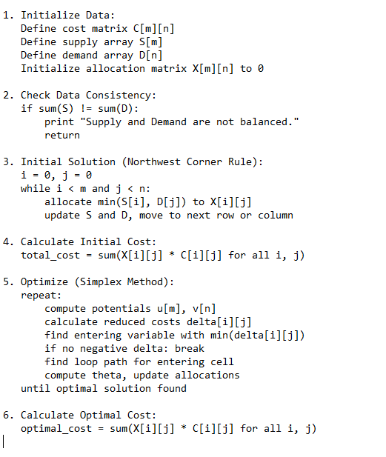
Pseudo Code
Transportation Cost Optimization

Slide 19
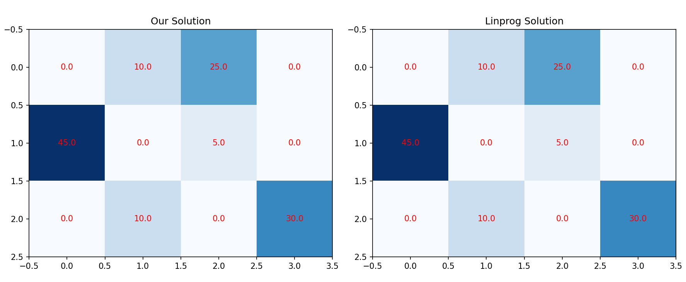
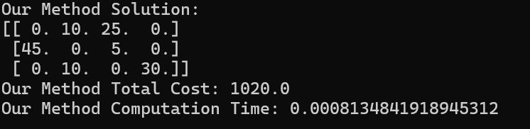
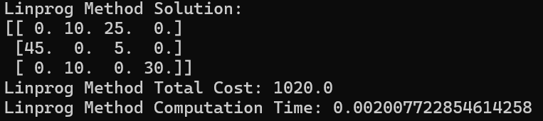
Our Implementation compared to Linprog Method

Slide 20
Conclusion
The Simplex Method is a powerful tool for optimizing transportation costs in logistics. By applying this mathematical algorithm, companies can achieve significant financial and operational benefits, leading to improved profitability and a stronger competitive position in the market.
Cost Savings
Reduced transportation expenses
Improved Efficiency
Enhanced delivery times and customer satisfaction
Competitive Advantage
Ability to offer more competitive pricing and services
Github link: https://github.com/leejunillee/num_optimization_final

