Slide 1
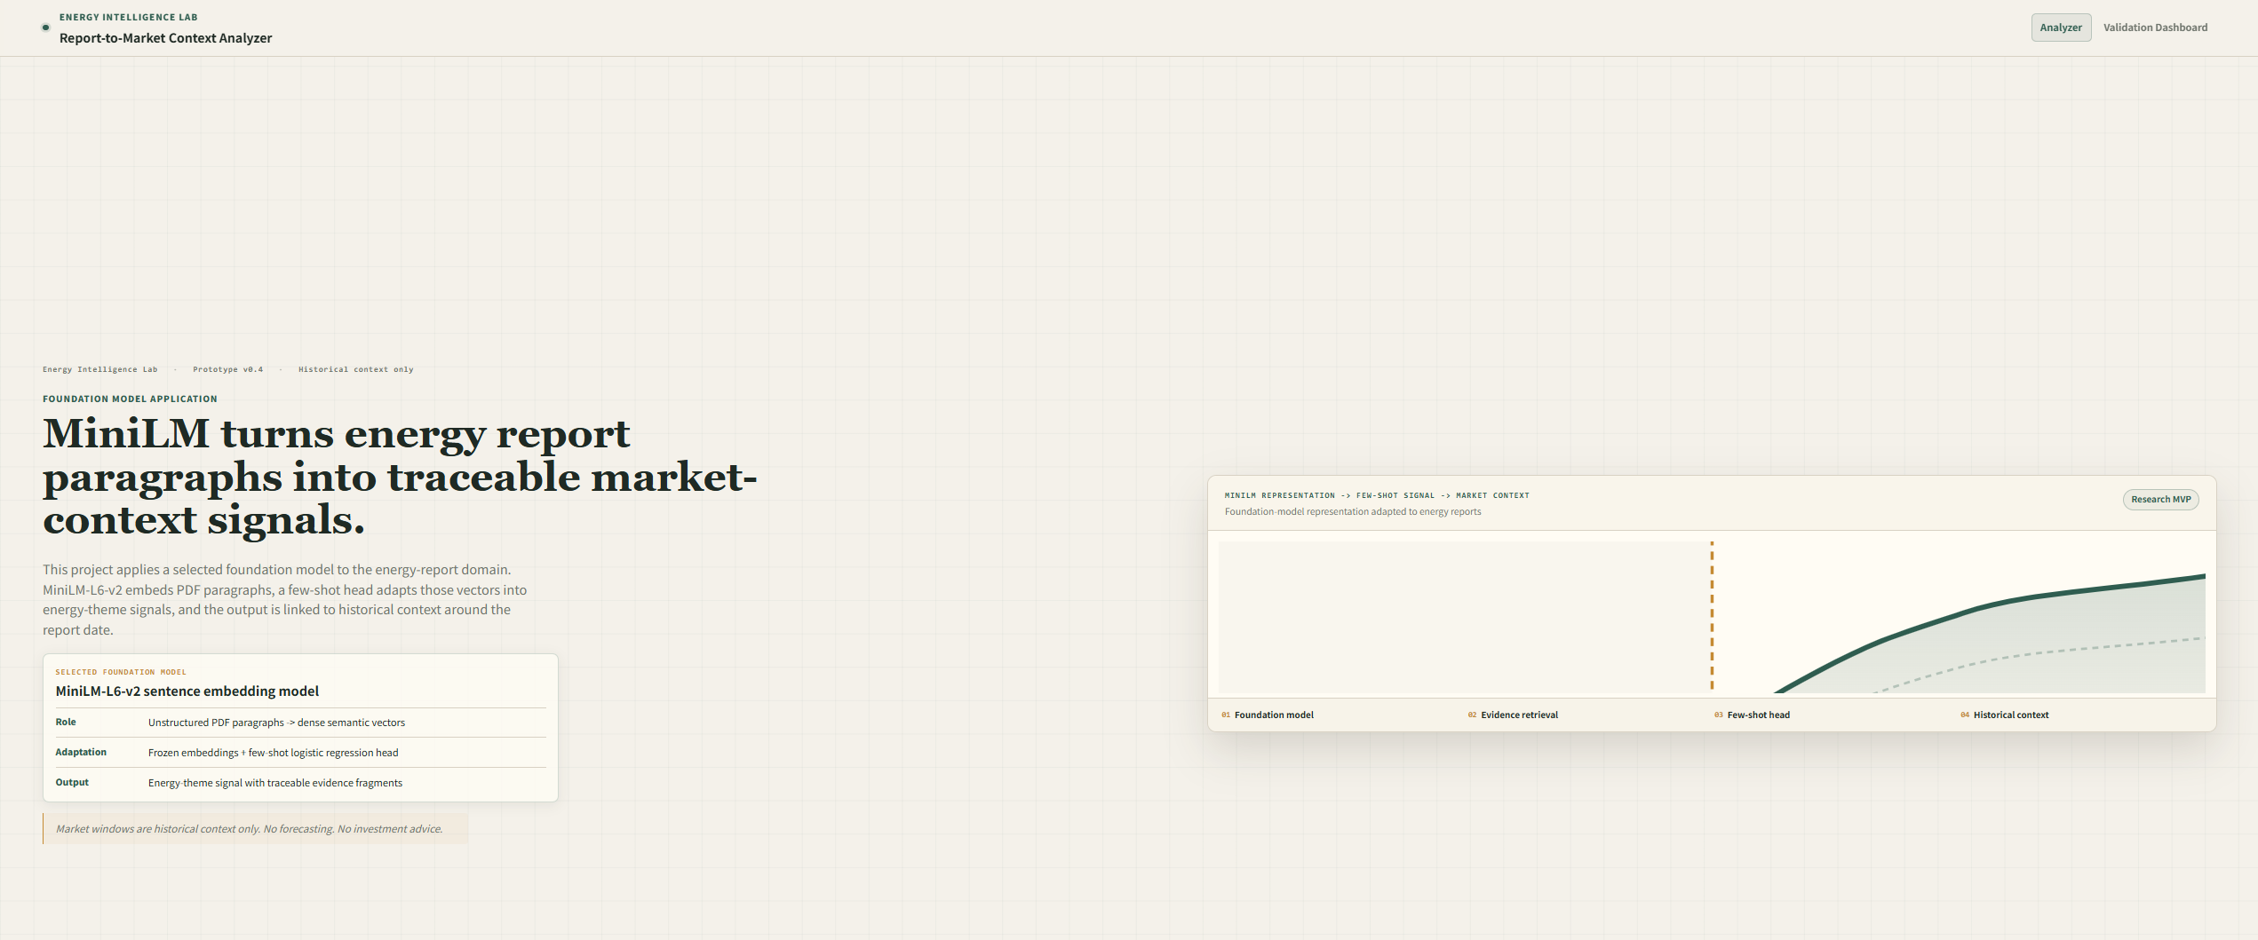
Deep Learning Project
에너지 PDF 보고서 기반
Theme Signal Analyzer
MiniLM-L6-v2 frozen encoder + supervised logistic linear probe
Evidence-grounded topic salience and historical context MVP
Interactive Web MVP
이준서 · 2026.06
No forecasting · No investment advice · Historical context only

Slide 2
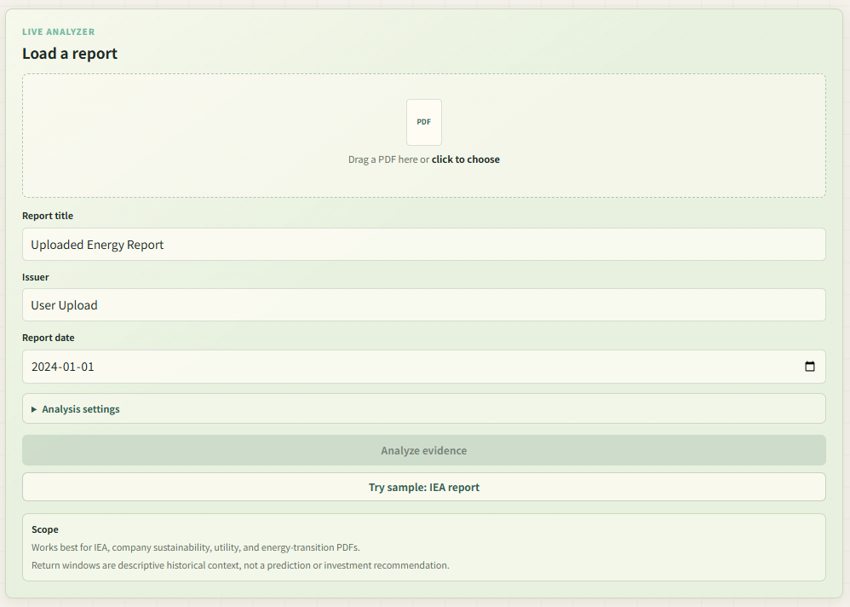
문제 정의: 긴 PDF를 근거 추적 가능한 신호로 바꾸기
보고서 전체 요약이 아니라 문단 단위 근거와 테마 점수를 함께 남기는 것이 목표입니다.
PDF 보고서의 어려움
• 에너지 전환 보고서는 수십~수백 페이지의 비정형 PDF로 제공됨
• 전체 요약만으로는 어떤 문단이 판단 근거인지 확인하기 어려움
• 여러 보고서의 주제 방향을 일관된 기준으로 비교하기 어려움
프로젝트 목표
PDF paragraphs are converted into MiniLM-L6-v2 384-d semantic vectors.
Theme score = topic salience in retrieved evidence, not bullish/bearish market direction.
The market window is attached only as historical context, not as model input or forecast.
범위: 미래 예측이 아니라, 보고서 날짜 주변의 historical context를 탐색적으로 연결합니다.
웹 입력 패널: PDF, 제목, 발행기관, 보고서 날짜
Problem definition
03

Slide 3
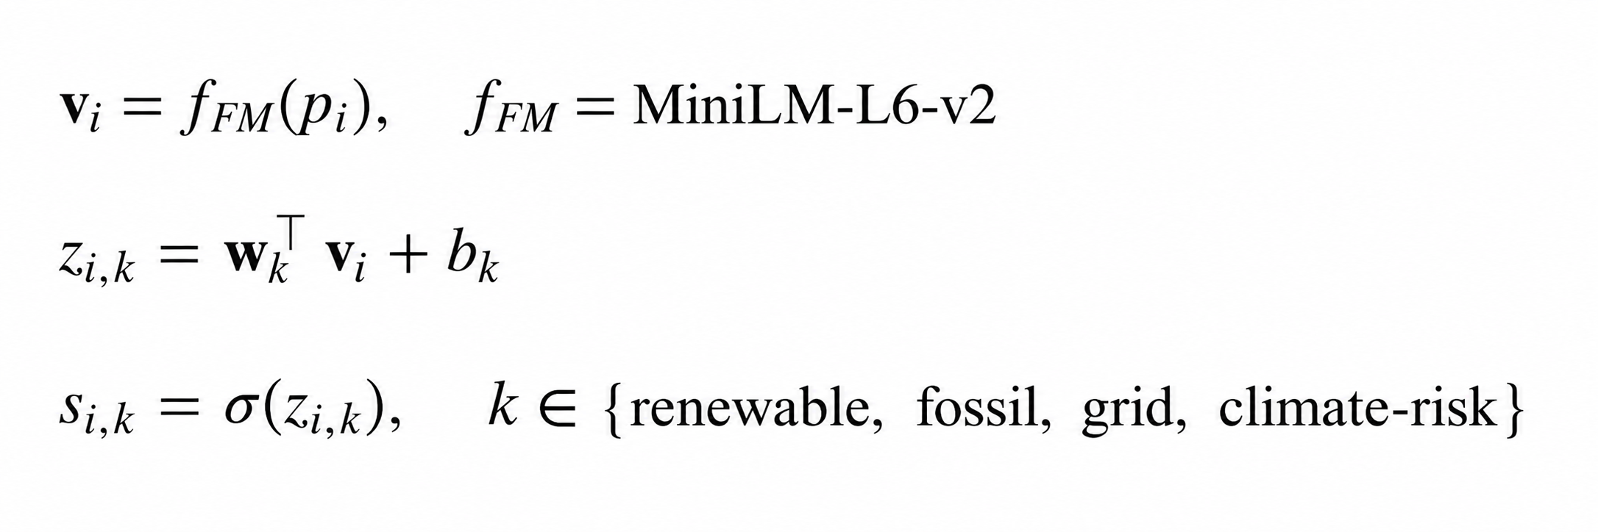
1. 알고리즘 개요
Frozen MiniLM-L6-v2 embeddings are reused as foundation representations. Only four small logistic heads are trained from curated examples.
PDF
report
Text
PyMuPDF
Chunks
paragraphs
Retrieval
TF-IDF + MiniLM
MiniLM
384-d vector
Heads x4
linear probe
Scores
4 themes
Context
date join
수식
Why four binary heads?
Energy reports can discuss renewable, fossil, grid, and climate themes together. Independent heads estimate p(theme | paragraph), while a softmax would force one exclusive class.
Aggregation
For each theme, the top 30% evidence probabilities are averaged and min-max scaled across themes.
Scores are relative topic-salience scores, not calibrated probabilities.
Algorithm overview
04

Slide 4
2. 전체 알고리즘 파이프라인과 모델별 입출력
Role separation: MiniLM supplies frozen paragraph embeddings; logistic heads learn theme salience; OOD/mixed rules decide review status; market data is joined only after scoring.
단계 | 사용 방법 / 모델 | 입력 | 출력 | 상태
1 | PyMuPDF | PDF file | page text | library
2 | Paragraph chunking | page text | paragraph chunks | rule
3 | TF-IDF + MiniLM retrieval | chunks + theme queries | top evidence fragments | hybrid
4 | all-MiniLM-L6-v2 | evidence paragraph | 384-d semantic vector | frozen
5 | Logistic Regression head ×4 | 384-d vector | theme probability scores | few-shot
6 | Signal decoder / OOD guard | 4 scores + relevance | asset hint / mixed / OOD | rule
7 | Historical context join | report date + CSV | pre/post market windows | analysis
Gemini scope
Theme scores come from MiniLM embeddings + logistic heads. Gemini only summarizes evidence fragments into a short explanation and does not classify the report.
Pipeline I/O
05

Slide 5
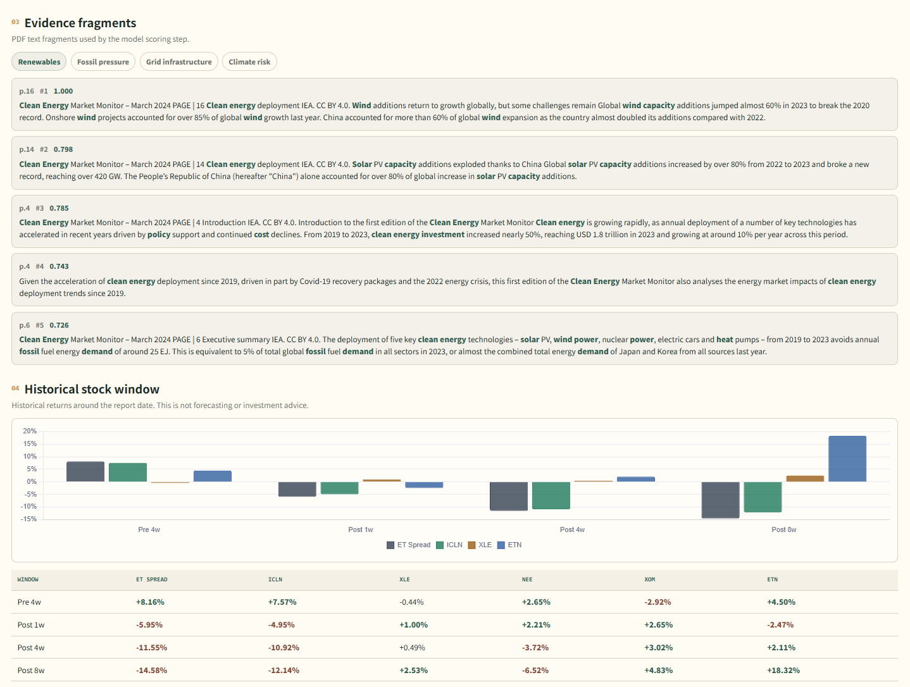
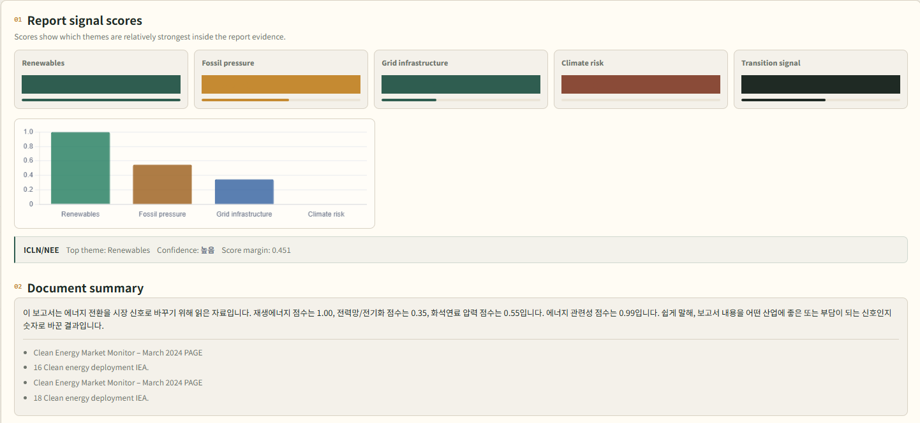
3. 알고리즘 입력 및 최종 결과
웹 화면을 기준으로 입력값이 어떤 산출물로 바뀌는지 확인할 수 있습니다.
Input
Output payload includes top theme, theme score vector, separation margin, OOD flag, mixed-report flag, evidence paragraphs, and theme-linked sector context.
입력: PDF, 보고서 제목, 발행기관, 보고서 날짜
Decision rules
Mixed if top-two margin <= 0.10 and second score >= 0.80. OOD if energy relevance < 0.35; low relevance if < 0.55. Scores are uncalibrated review signals.
Input and output
06

Slide 6
최종 결과: 근거 문단과 과거 시장 맥락을 함께 제시
점수만 보여주지 않고 evidence fragment와 historical window를 함께 제공합니다.
Evidence fragments: page/chunk ID와 판단 근거 문단을 함께 제시
해석 방식
Evidence fragments는 모델이 왜 해당 theme score를 높게 판단했는지 확인하기 위한 근거이며, historical window는 모델 예측에 사용되지 않고 사후적으로 연결한 과거 맥락입니다.
Historical stock window: 보고서 날짜 주변 과거 수익률 확인
Evidence and historical context
07

Slide 7
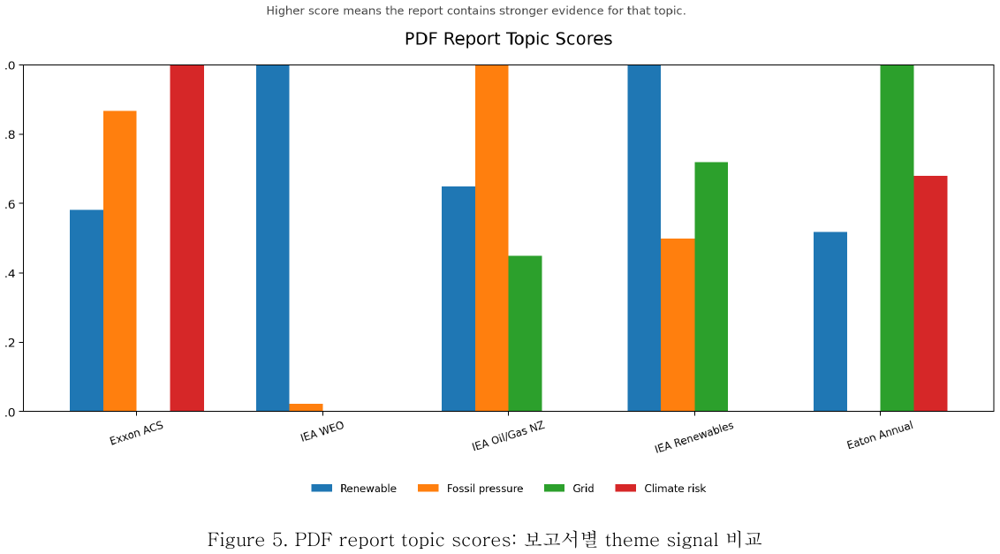
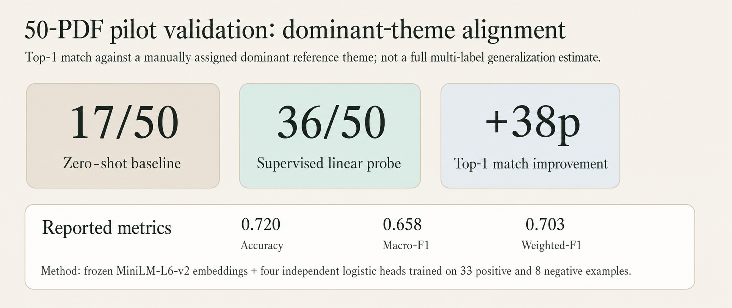
Pilot dominant-theme alignment evaluation
50 public-PDF pilot evaluation; measures dominant-theme top-1 alignment, not full multi-label generalization.
17/50
36/50
+38p
0.720
0.658
0.703
Zero-shot baseline
Linear probe
match improvement
Accuracy
Macro-F1
Weighted-F1
Zero-shot vs supervised linear probe validation table
Interpretation: evaluated 50 public PDFs from the validation catalog. Metric is top-1 match between the human reference dominant theme and the model top theme. Zero-shot 17/50 -> supervised linear probe 36/50, showing adaptation direction but not a generalization claim.
Evaluation
08

Slide 8
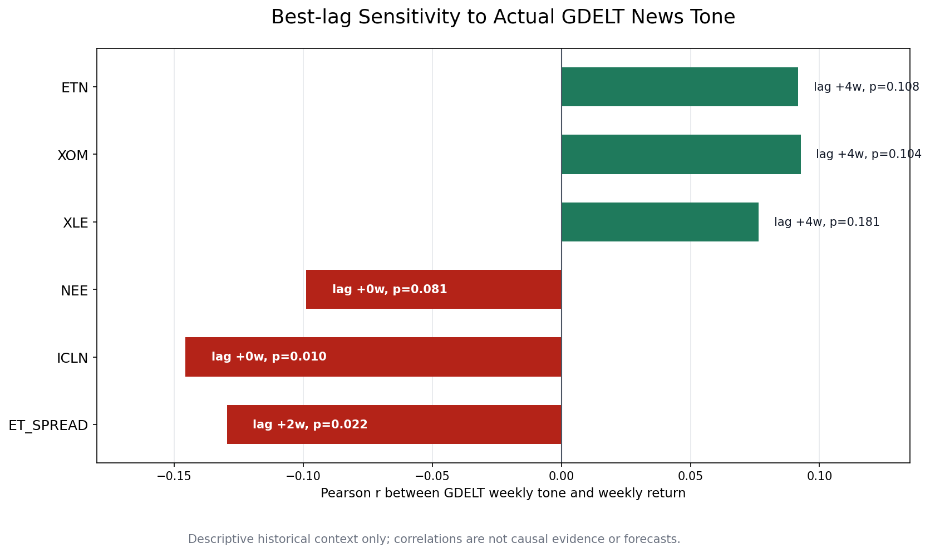
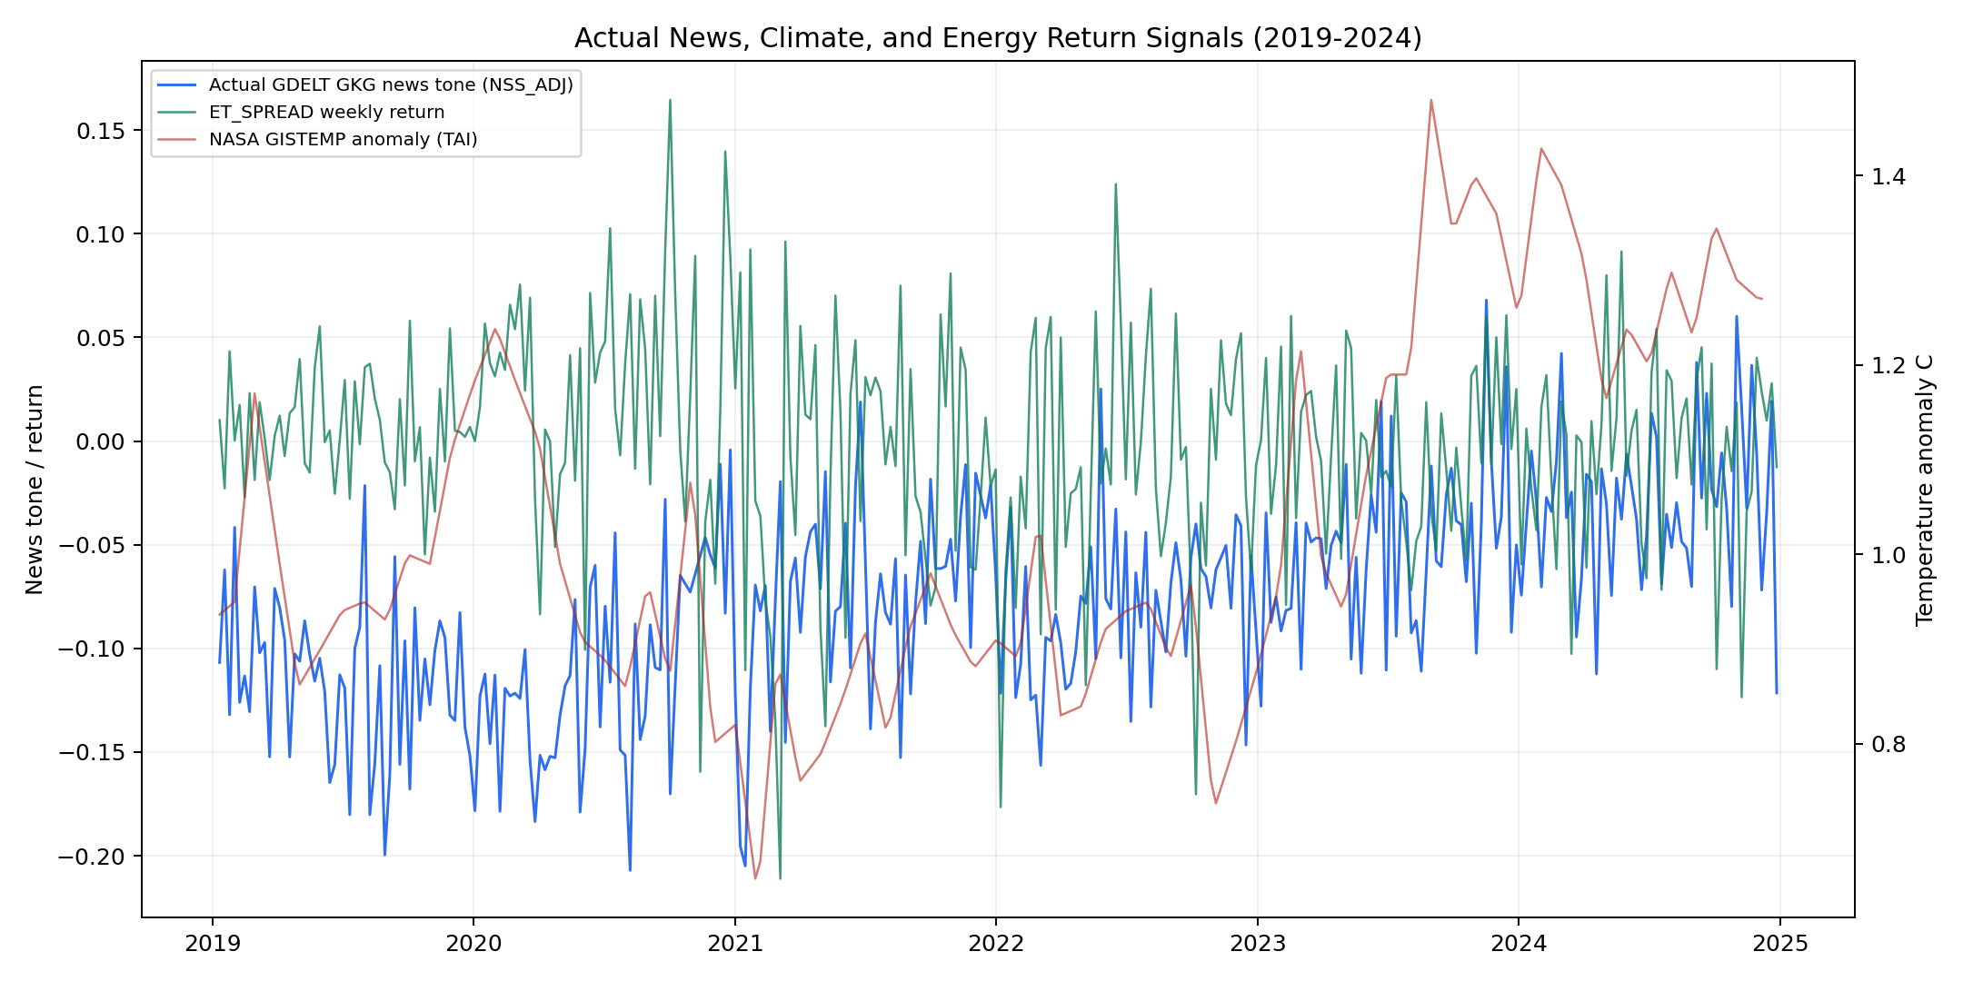
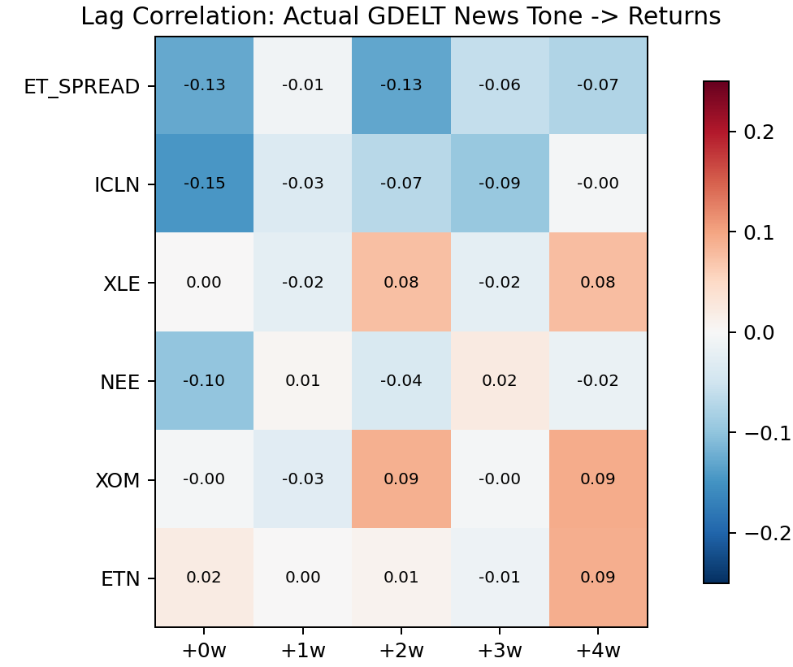
뉴스 tone과 시장 window는 탐색적 맥락 분석으로 사용
After theme scoring, the app joins news and historical stock-return windows to make the context auditable. This bridge is downstream context, not an input feature for classification.
Time series: climate anomaly, news tone, market indicators
Lag heatmap: news tone → market returns
Exploratory lag correlation across predefined windows
Market context scope
News snippets and stock windows help reviewers compare report timing with public market context.
They do not convert the theme score into a forecast or investment recommendation.
p-value와 correlation은 통제변수와 실험 설계가 제한된 탐색 분석으로만 해석합니다.
Historical context analysis
09

Slide 9
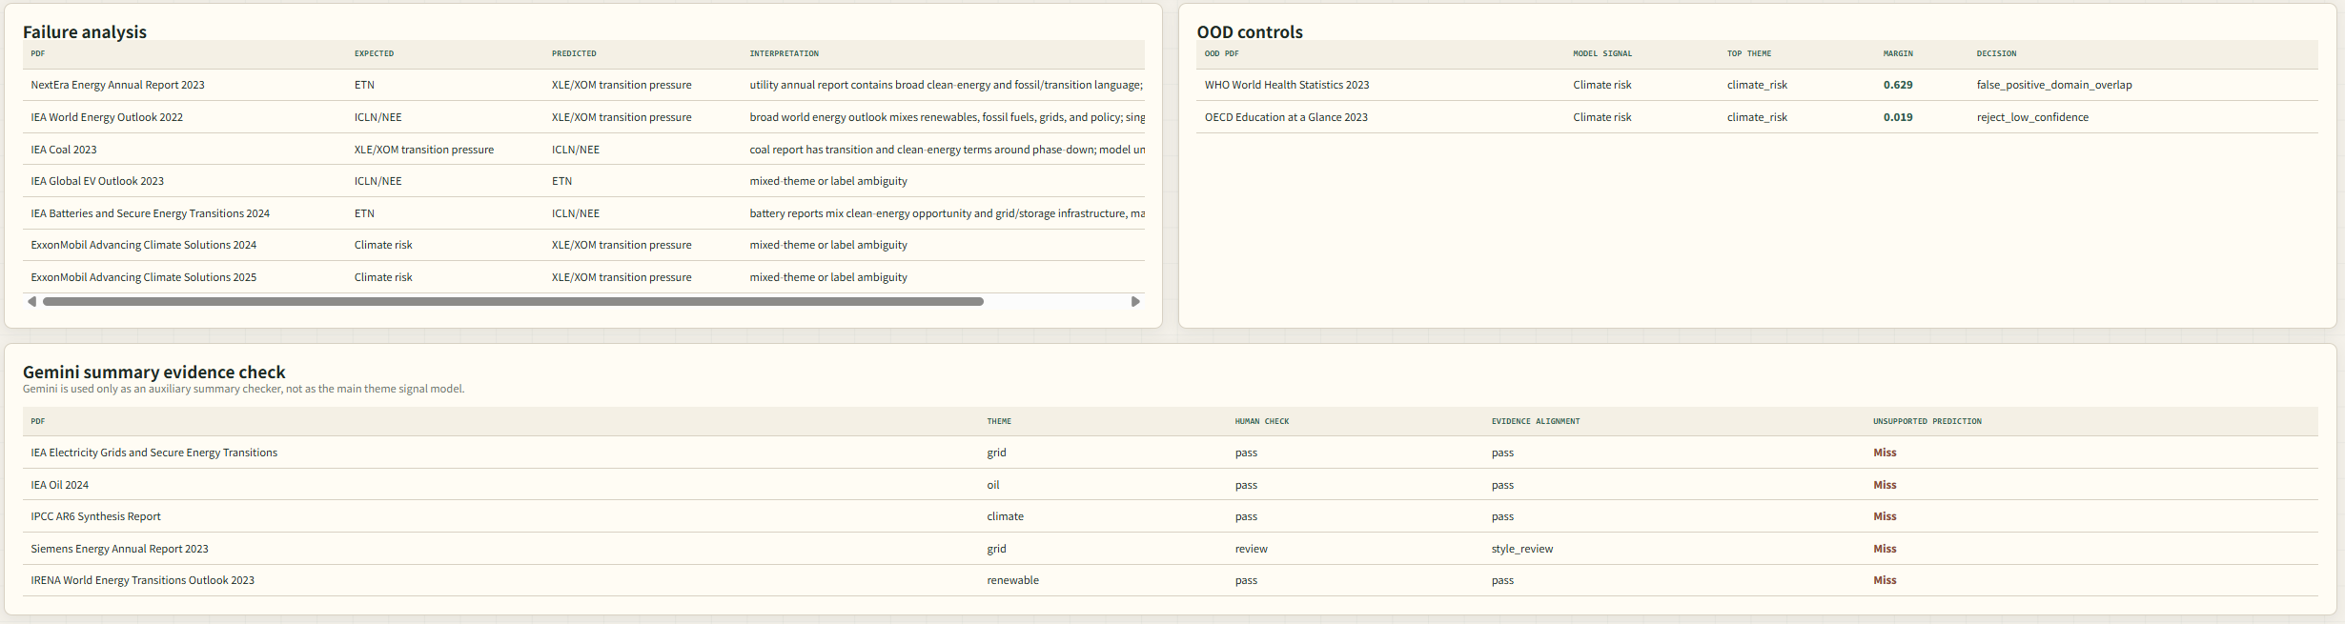
실패 분석과 향후 개선
실제 사례를 공개하고, mixed-signal PDF와 OOD 한계를 개선 과제로 정리했습니다.
Failure analysis / OOD controls
대표 실패 원인
향후 개선
• WEO, 배터리, EV 보고서처럼 여러 테마가 동시에 등장
• Exxon ACS 문서처럼 climate risk와 fossil transition pressure가 겹침
• WHO 보건 문서처럼 climate-health 표현이 OOD false-positive를 유발
• PDF 수 100개 이상으로 확장하고, 기관/연도/theme 별로 균형있게 수집
• 문단 단위 multi-label ground truth를 구축하여 mixed-signal PDF를 하나의 정답이 아닌 복수 theme 문제로 평가
• energy-domain OOD reject classifier 추가
• 더 체계적인 event study 설계
This project implements an evidence-grounded PDF analysis pipeline: frozen MiniLM embeddings retrieve relevant paragraphs; independent logistic heads estimate topic salience; rule-based OOD and mixed checks prevent overclaiming; Gemini summarizes only the retrieved evidence; and historical market data is attached as context. The 50-PDF pilot shows improved dominant-theme alignment, but the result should be presented as few-sample adaptation evidence, not a full generalization benchmark or investment signal.
Limitations and conclusion
10

Slide 10
구현 세부사항 및 평가 범위
Use this slide to answer where learning happens, what the foundation model does, and what the pilot numbers mean.
주제 점수 (Theme score)
Topic salience in retrieved evidence. It is not bullish/bearish direction and not an investment signal.
모델 구조(Model structure)
Foundation model: frozen MiniLM-L6-v2 paragraph embeddings. Learned part: four logistic regression heads.
학습 데이터(Training data)
Curated few-sample set: 33 positive theme examples and 8 negative examples. Only the heads are fitted.
검색 및 점수화
(Retrieval and scoring)
Theme-conditioned TF-IDF + MiniLM retrieval. For each theme, top 30% evidence probabilities are averaged.
평가 범위(Evaluation scope)
50 public PDFs. Reported accuracy/F1 are dominant-theme top-1 alignment metrics, not full multi-label generalization.
검토 기준(Review rules)
Mixed: margin <= 0.10 and second score >= 0.80. OOD: energy relevance < 0.35; low relevance < 0.55.
Implementation details
10

