Slide 1
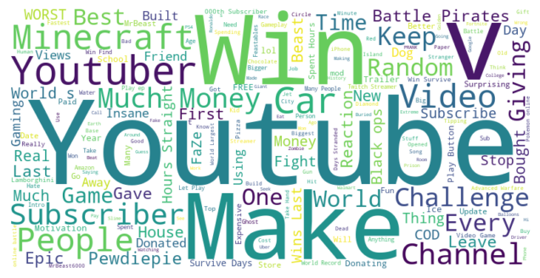
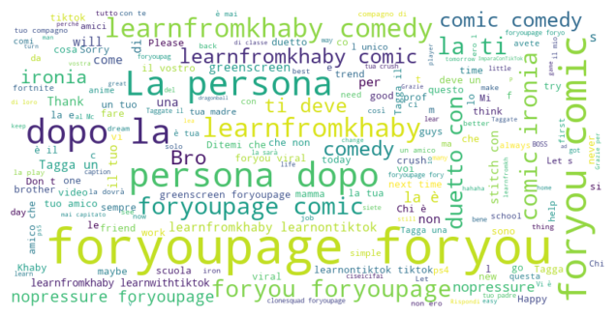
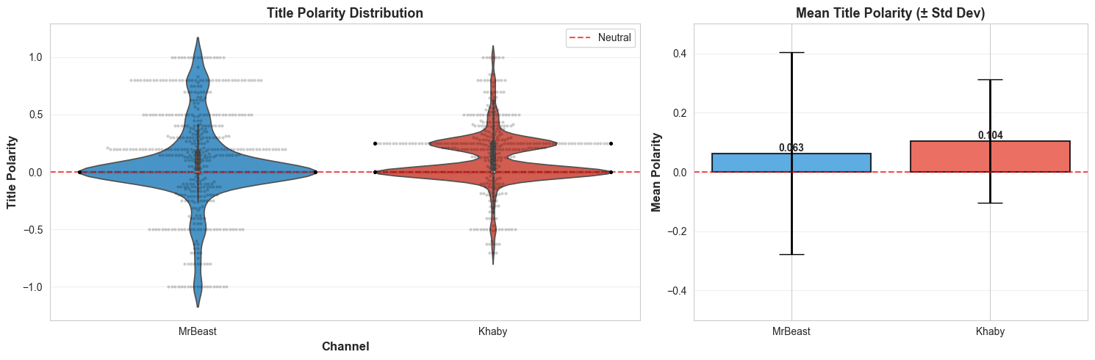
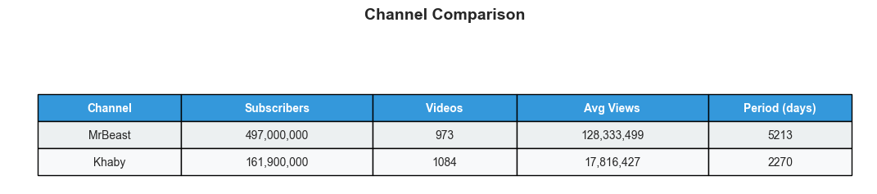
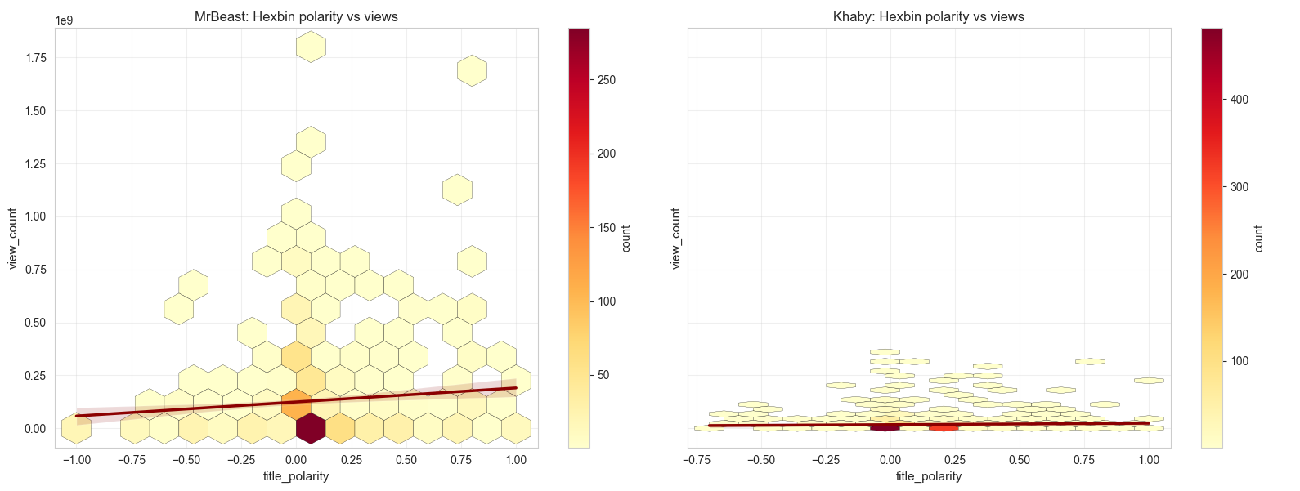
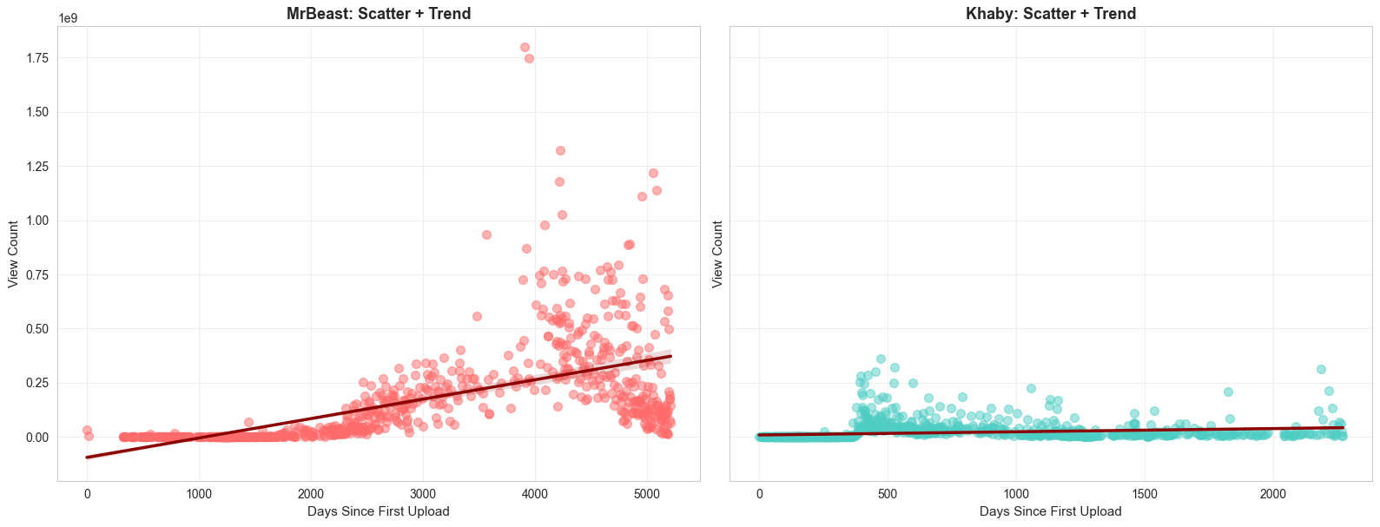
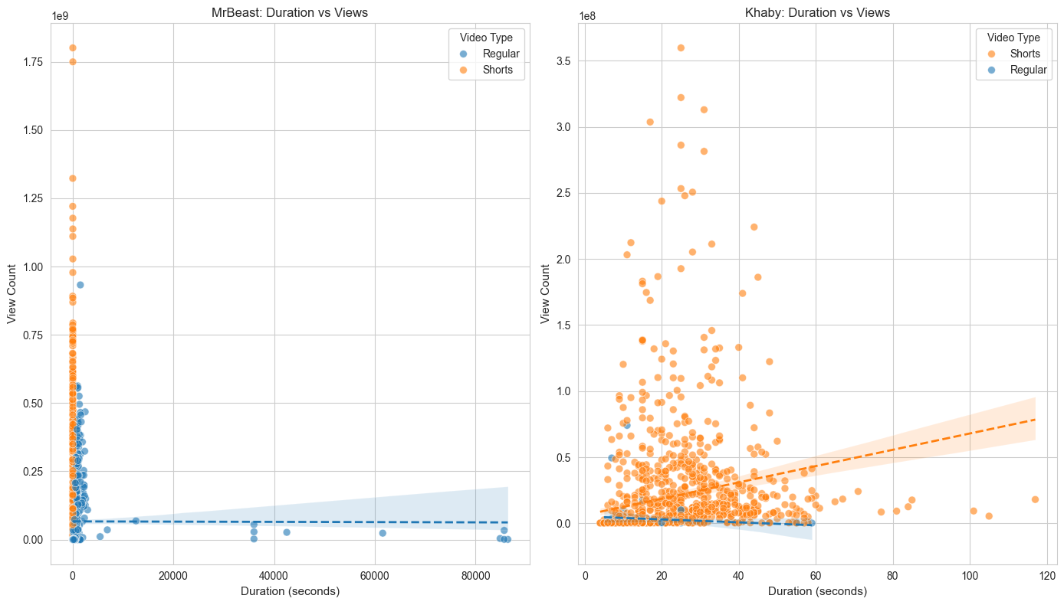
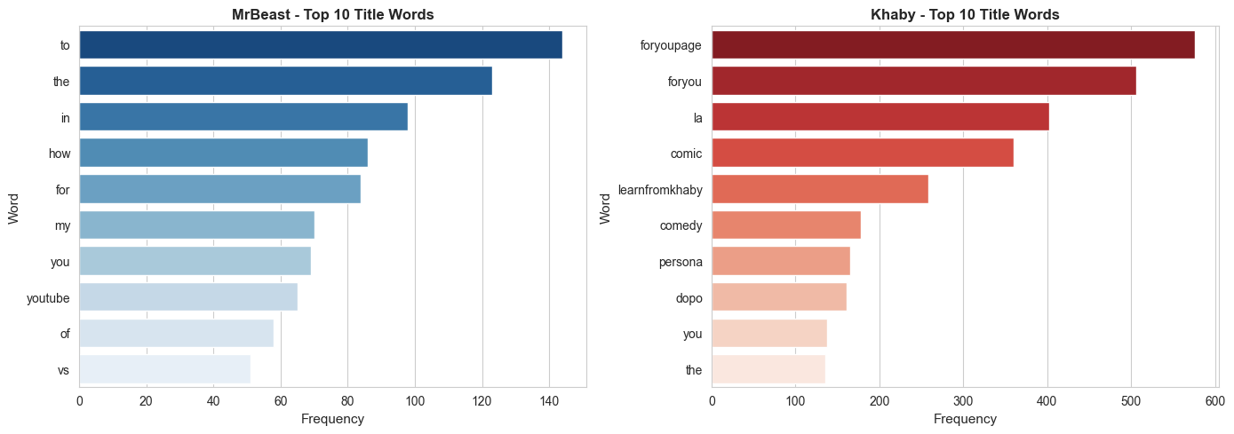
Analysis of Factors Affecting Video Views
<A Comparative Study of MrBeast and Khaby Lame>
Subject
Basic Computing
Department
College of Liberal Studies
Professor
Akihiko Yamada
Name
이준수
Background and Need for the Study
Analysis 2 - Word Cloud
YouTube: repeated dominant keywords → clearer title strategy.
TikTok: more diverse vocabulary → weaker dependence on titles.
Suggests stronger influence of recommendation algorithms on TikTok.
YouTube and TikTok differ in recommendation and viewing mechanisms.
YouTube users actively choose videos using titles and thumbnails.
TikTok users mainly consume videos through algorithmic feeds.
This study compares MrBeast and Khaby Lame to identify platform-specific factors affecting views.
Project Workflow
Research Question
How does platform structure influence view-driving factors?
Data Collection
MrBeast (YouTube)
Khaby Lame (TikTok)
Analysis
Upload frequency
Title keywords
Sentiment of keywords
Video format(short-form vs long-form)
Interpretation
Compare view-driving factors across platforms
Analysis 3: Title Sentiment
Positive titles were more common than negative titles on both platforms.
YouTube: positive titles showed slightly higher views.
TikTok: sentiment had little effect on views.
Consistent with the keyword-analysis results.
Results of the Project
Channel Comparison
MrBeast and Khaby Lame are the largest creators on their platforms.
Absolute views are platform-dependent.
Focus: factors affecting views rather than view counts themselves.
Analysis 1: Upload Frequency
YouTube: Higher upload frequency → higher views.
Strong channel-growth effect from subscriber-based exposure.
TikTok: Weaker relationship between uploads and views.
Individual video performance matters more than channel size.
Analysis 4: Video Format
Shorts generally received more views than regular videos.
Video length showed little correlation with views within Shorts.
Format mattered more than duration.
Algorithmic recommendation likely drives performance.
Analysis 2: Title Keywords
MrBeast: reward, challenge, scale-oriented keywords.
Khaby Lame: hashtags or comedy-related keywords.
YouTube titles communicate content value.
TikTok titles play a smaller role in attracting viewers.
Expected Outcomes of the Project
Implications
Platform structure affects content strategy.
YouTube rewards title optimization and consistent uploads.
TikTok relies more on algorithm-driven discovery.
Creators should adapt strategies to each platform.
Limitation
Only one representative channel was analyzed per platform.
Results may not generalize to all creators.

